Slide 1


Save our Boardwalk
VOTE Wilderness for the kykNET Kwela Town of the Year 2025

Slide 2
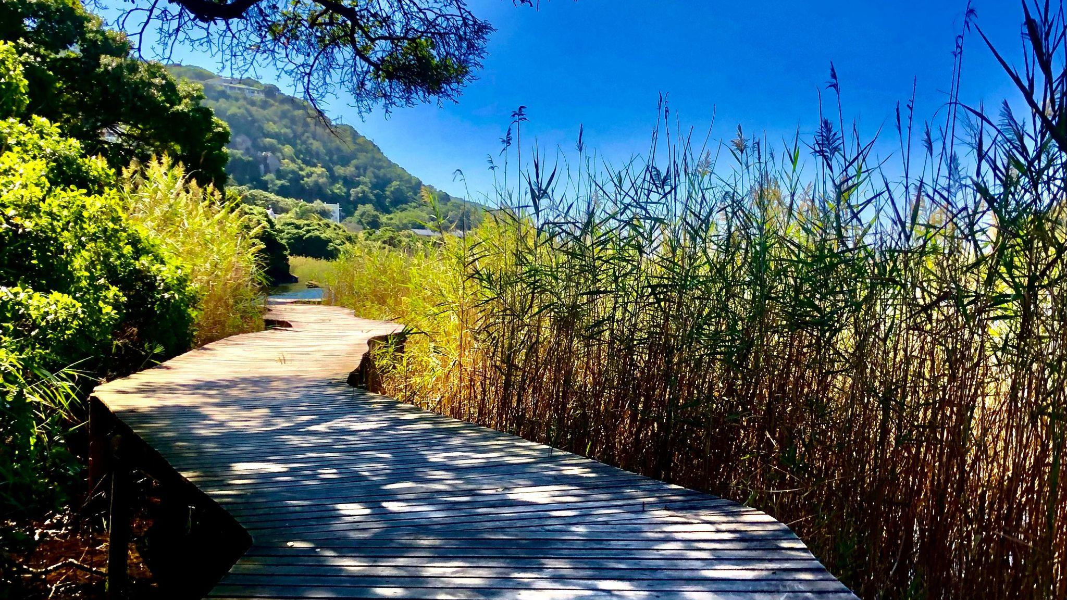

VOTE Wilderness for Town of the Year 2025

Slide 3
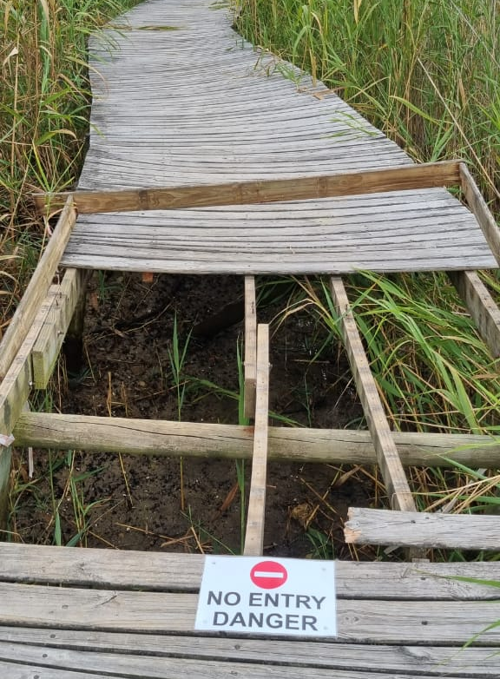
Background
After years of bad weather and lack of maintenance our beloved boardwalk has been left in a state of disrepair and is currently closed to the public
SANParks have put out tenders for its repair, however they do not currently possess the budget to undertake this project
It is up to us, as a community, to save our boardwalk

Slide 4
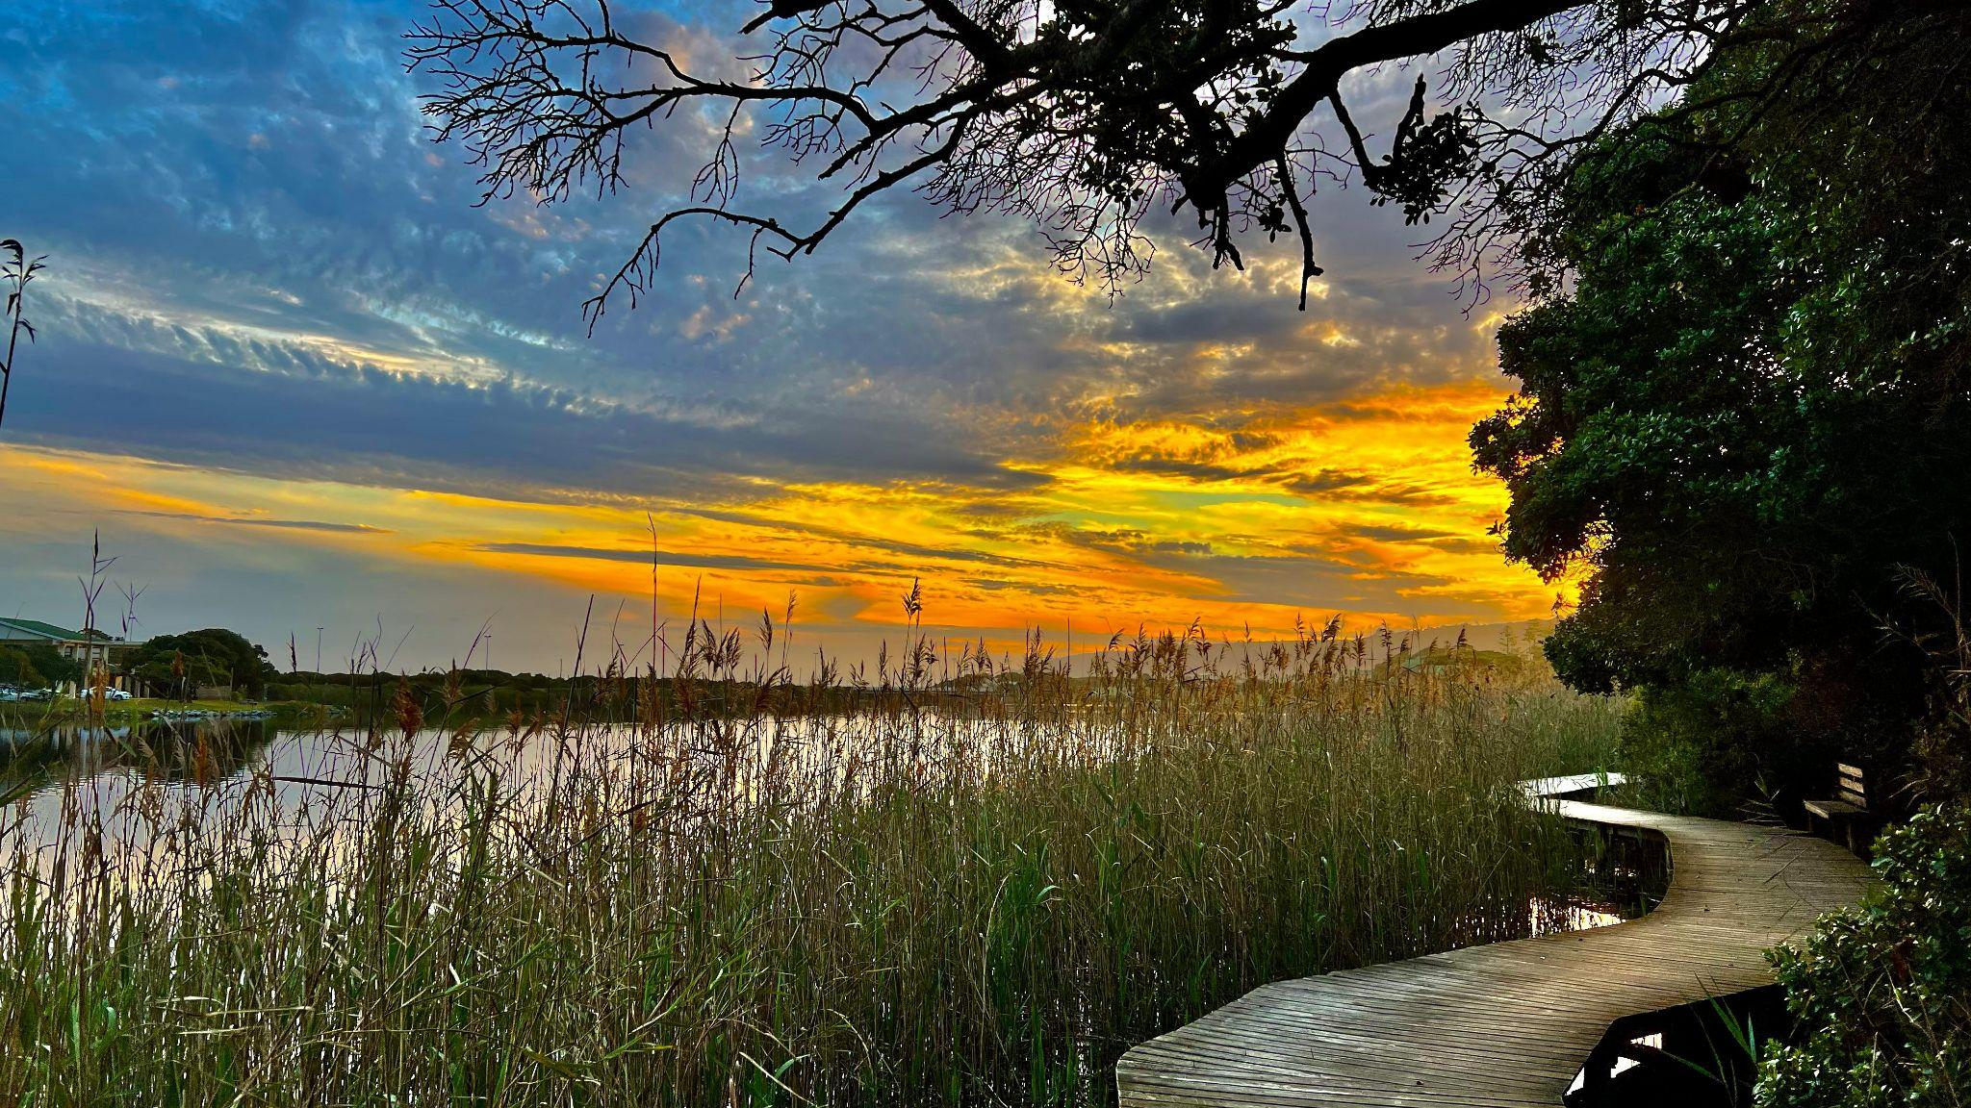
VOTE Wilderness for Town of the Year 2025

Slide 5
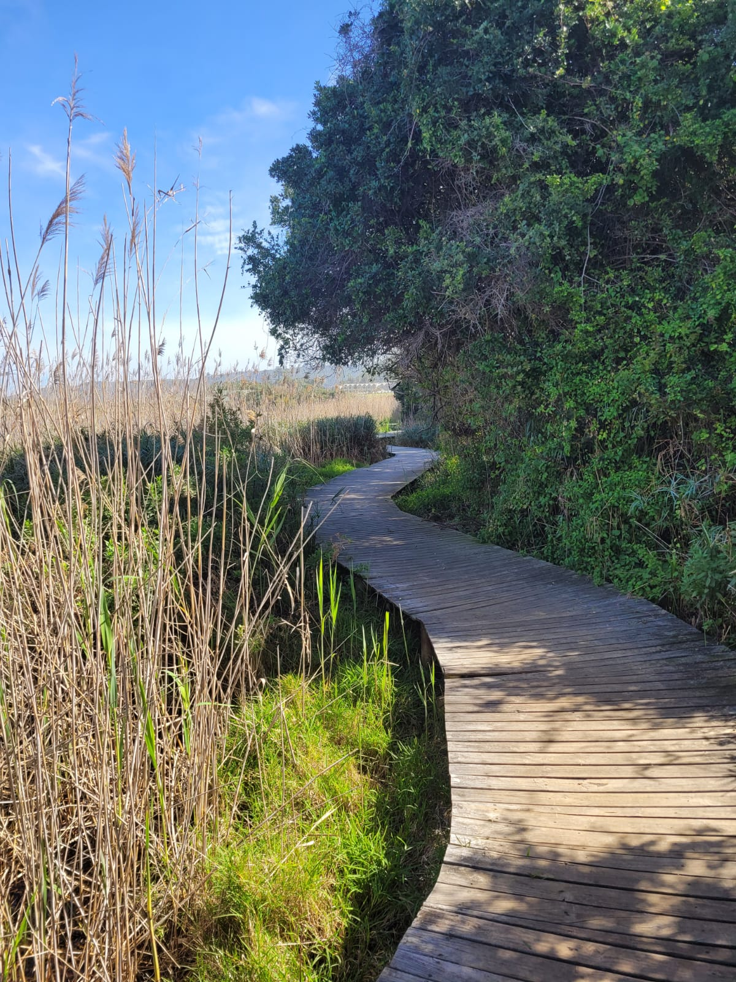
kykNET Kwela’s Town of the Year 2025
Who qualifies?
Any town in South Africa or Namibia can be nominated, provided it has:
Less than 500 000 inhabitants
Not been a regional winner in the last two years
Not won in the last 6 years

Slide 6
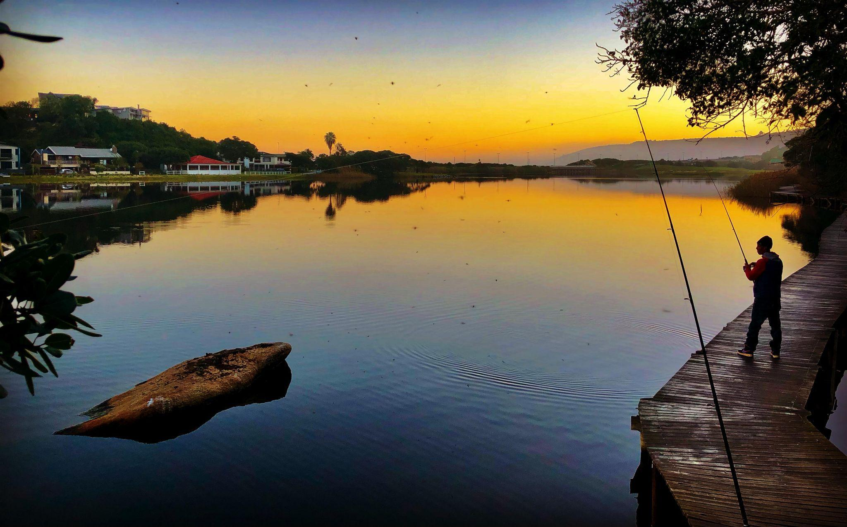
VOTE Wilderness for Town of the Year 2025

Slide 7
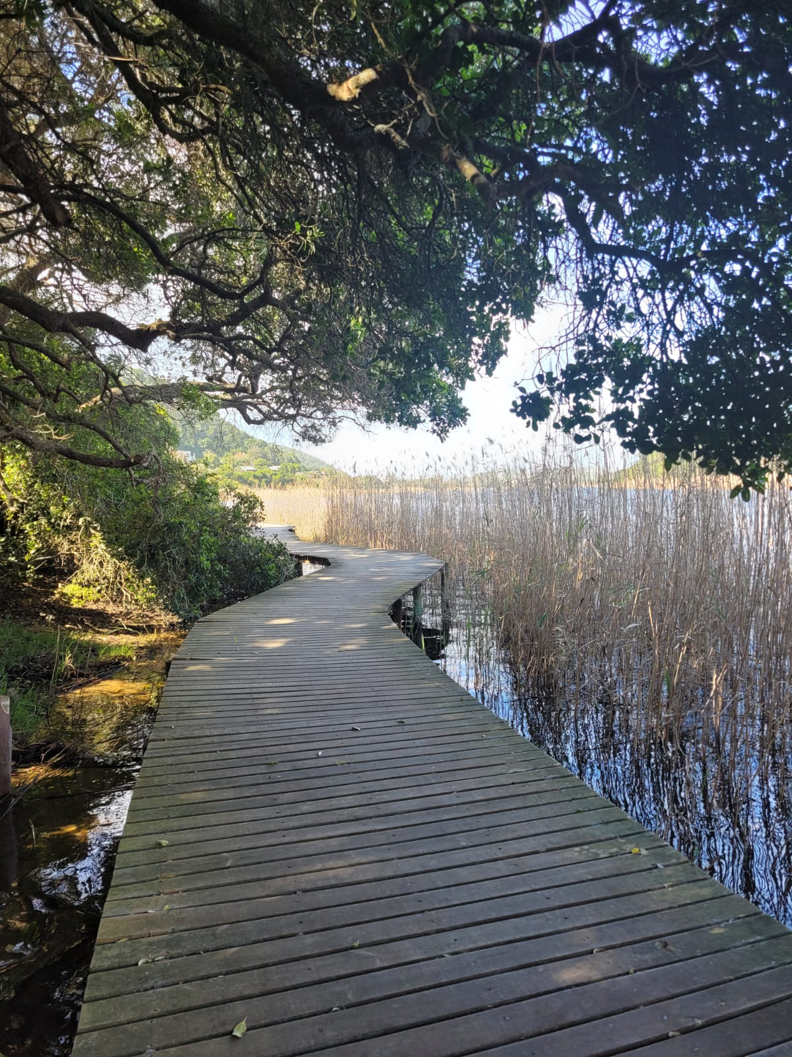
Winner:
Town of the Year
The winner of Town of the Year 2025 will receive:
R1 million in marketing value from kykNET
Homebrew Films will make a 45 second commercial about the town
Lottoland is also donating a R1 million cash prize for the winning town
kykNET will host a night of festivities for the winning town

Slide 8
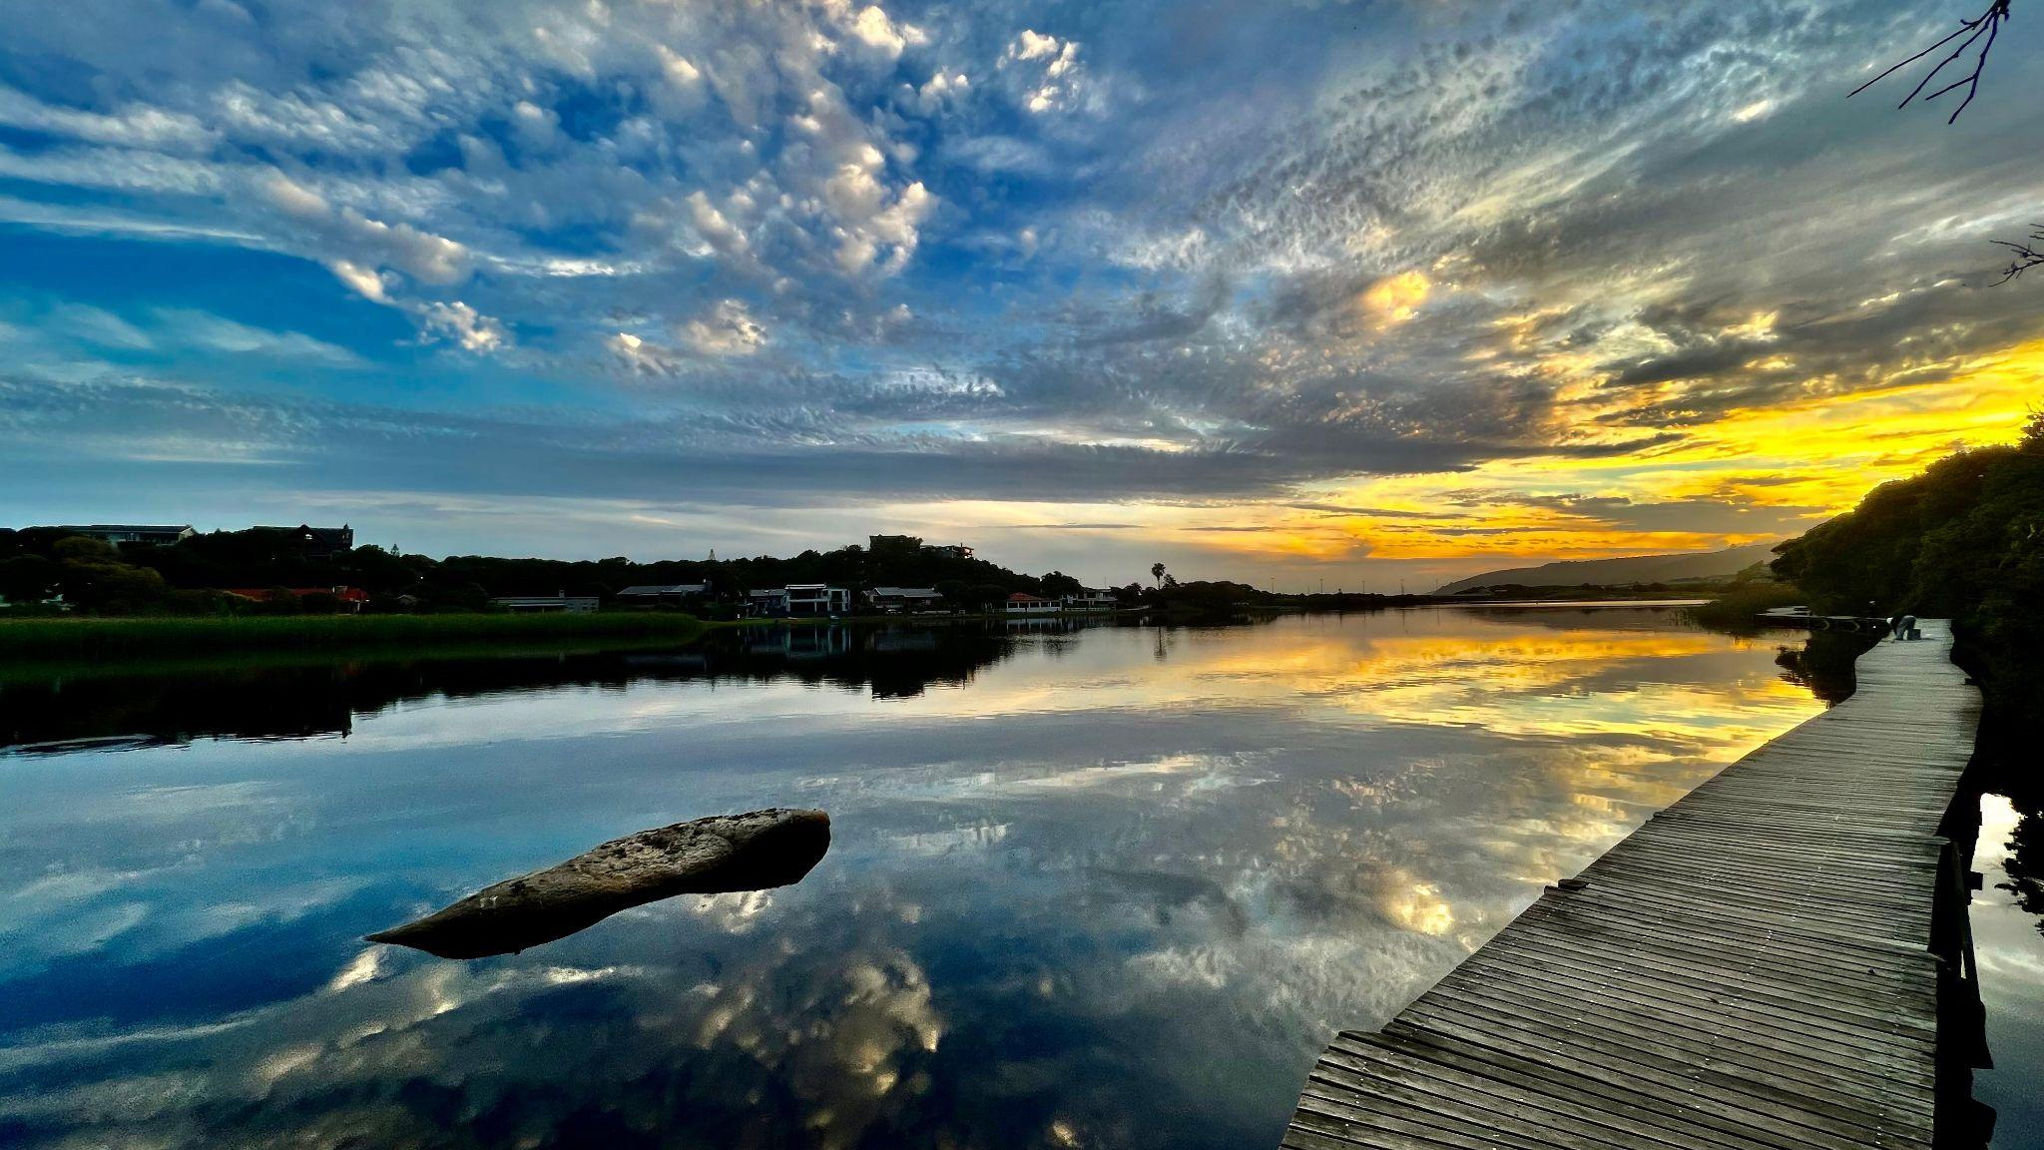
VOTE Wilderness for Town of the Year 2025

Slide 9
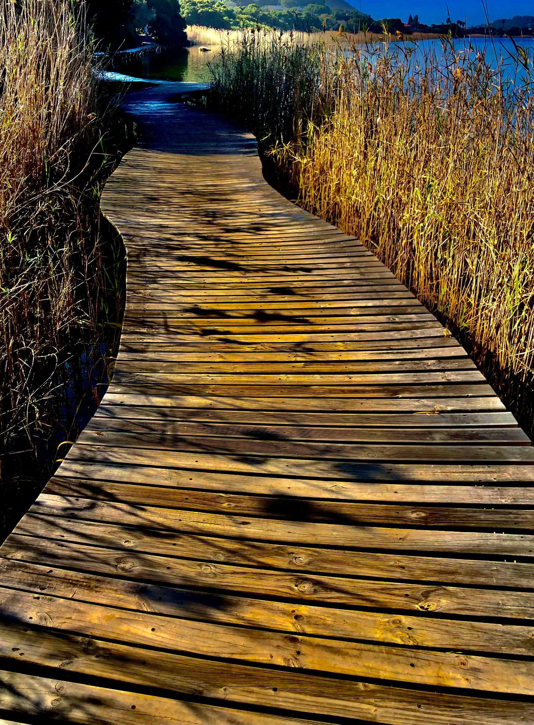
Process:
Nomination Round
Voting opens on Sunday, 2 March at 19:00 and closes on Friday, 14 March at 12:00 noon
Nominate your favourite town from any region (provinces and Namibia) by SMSing the town name to 33157 (SMS costs R1.50)
You can nominate as many towns as you like (only one town name per SMS, and as many SMSes as you like in this nomination round)

Slide 10
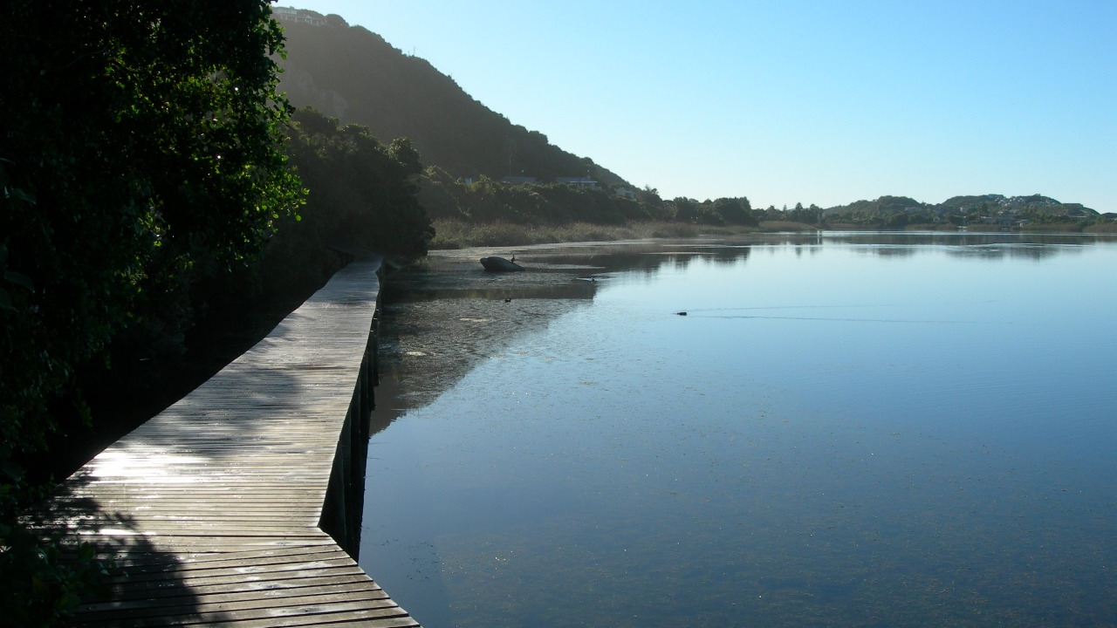
VOTE Wilderness for Town of the Year 2025

Slide 11
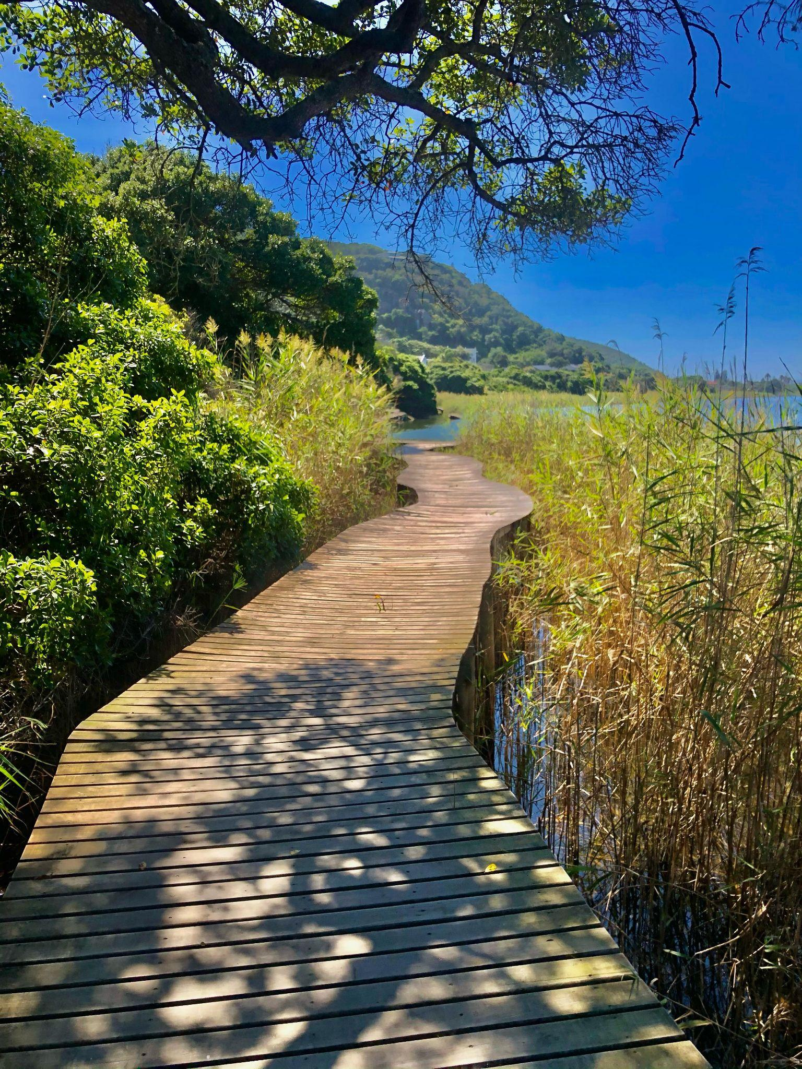
Process:
Semi-finals
The three towns from each region with the most nominations will advance to the semi-final round
Voting for the semi-finals will commence 6 to 8 weeks after the nomination round
This round only allows 30 text messages per number
The town with the most votes in each region will progress to the final round

Slide 12
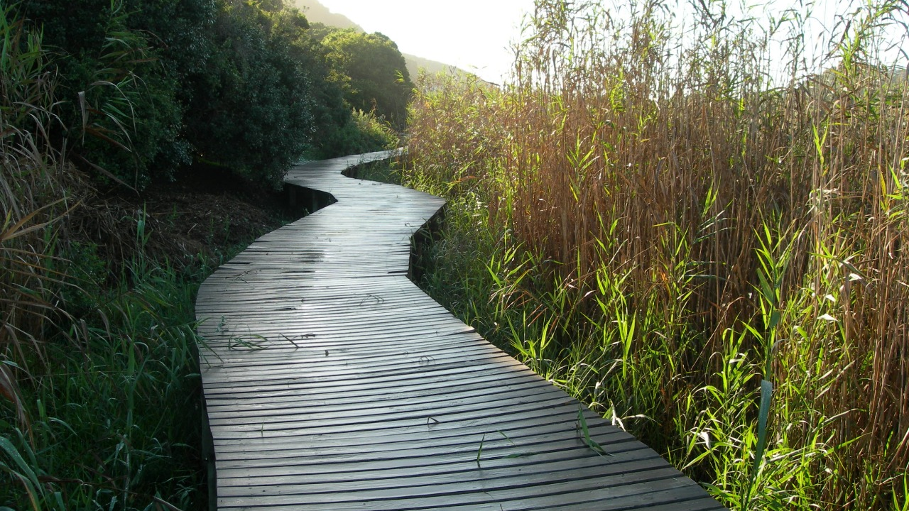
VOTE Wilderness for Town of the Year 2025

Slide 13
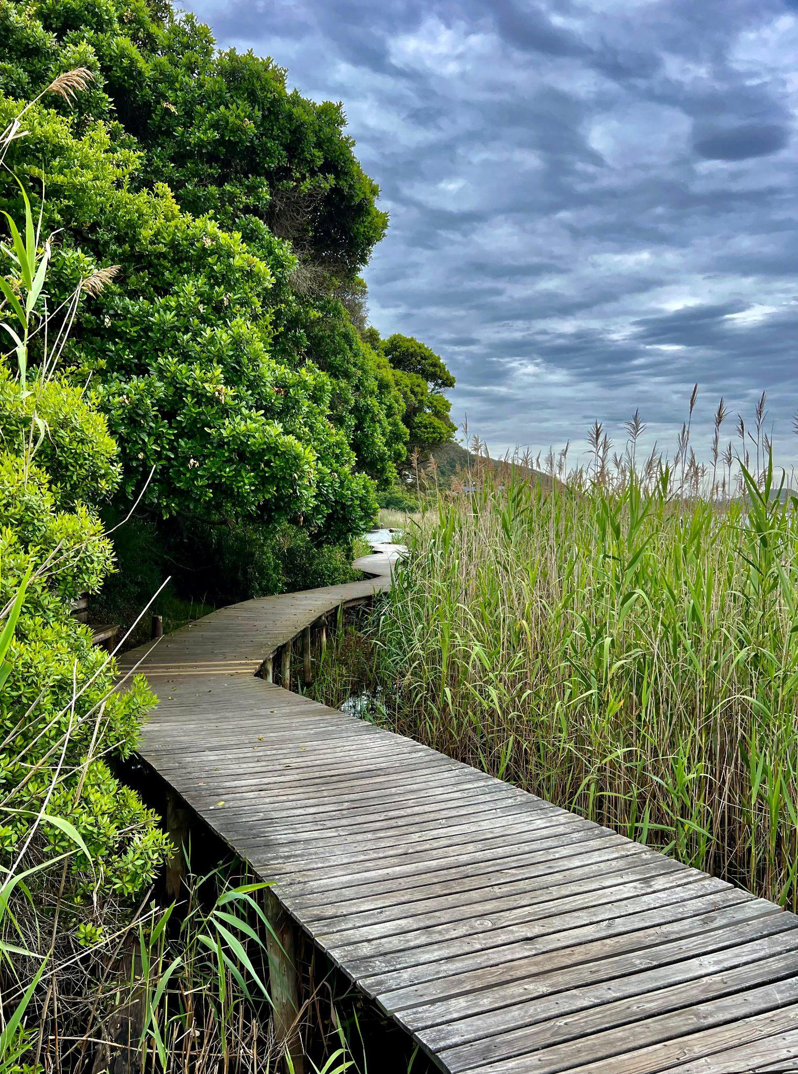
Process:
Finals
All nine regional winners will then be featured on Kwela
Once all regional winners have been featured, the public will have the opportunity to vote for their favourite town
Voting will be for a week during mid-July
This round only allows 30 text messages per number

Slide 14
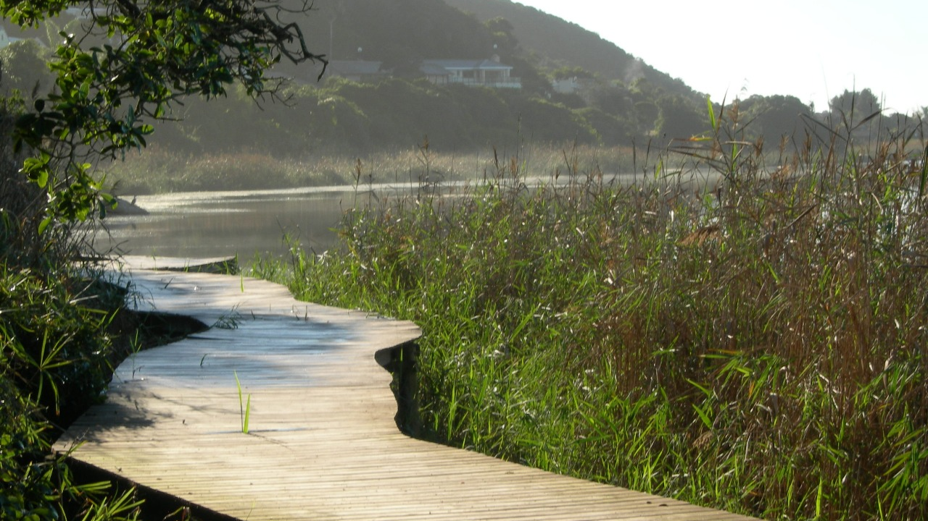
VOTE Wilderness for Town of the Year 2025

Slide 15
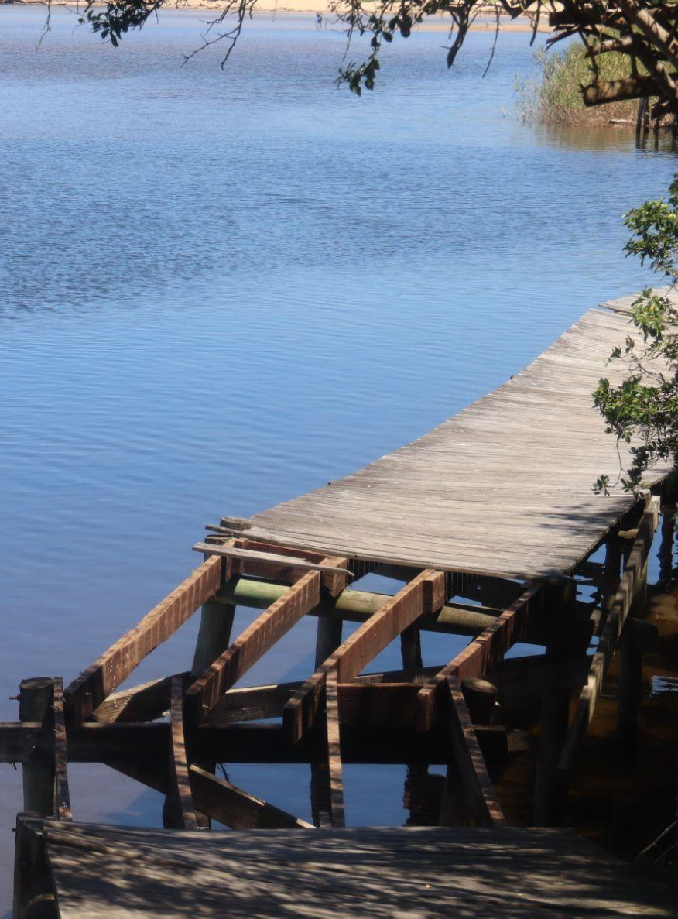
LET’S WIN AND SAVE OUR BOARDWALK!
Any Questions?

