Slide 1
Executive roadmap update
Date of presentation
Click here to quickly build visual roadmaps for different audiences in Aha!

Slide 2
What we will cover today
Vision
Market analysis
Product goals
Initiatives update
Portfolio roadmap
Customer feedback
Metrics overview
Q&A
Confidential
Notes:
Use this slide to expectations for your audience with a presentation agenda.

Slide 3
Our vision
Add your company's product vision statement here.
Confidential
Notes:
Remind everyone of your product vision — this clearly states the direction for where your product is headed.

Slide 4
Updated SWOT Analysis
Strengths | Weaknesses
Your advantages | Areas for improvement
Opportunities | Threats
Situations to apply your advantages | Where you are at risk
Confidential
Notes:
Now set the big picture context — summarize the latest market conditions since the last time you met. You can use this SWOT analysis template to show the market landscape and relevance to your strategy.

Slide 5
Product goals
Goal | Success metric
Confidential
Notes:
Share progress on product goals, as well as any new goals. Include success metrics so your audience understands how you will measure results.

Slide 6
Initiatives update
Time frame
Time frame
Time frame
Initiative 1
Initiative 2
Initiative 3
Initiative 1
Initiative 2
Initiative 3
Initiative 1
Initiative 2
Initiative 3
Confidential
Notes:
Communicate your high-level efforts or initiatives — you might also discuss your product direction, investment areas, and release timelines across products.

Slide 7
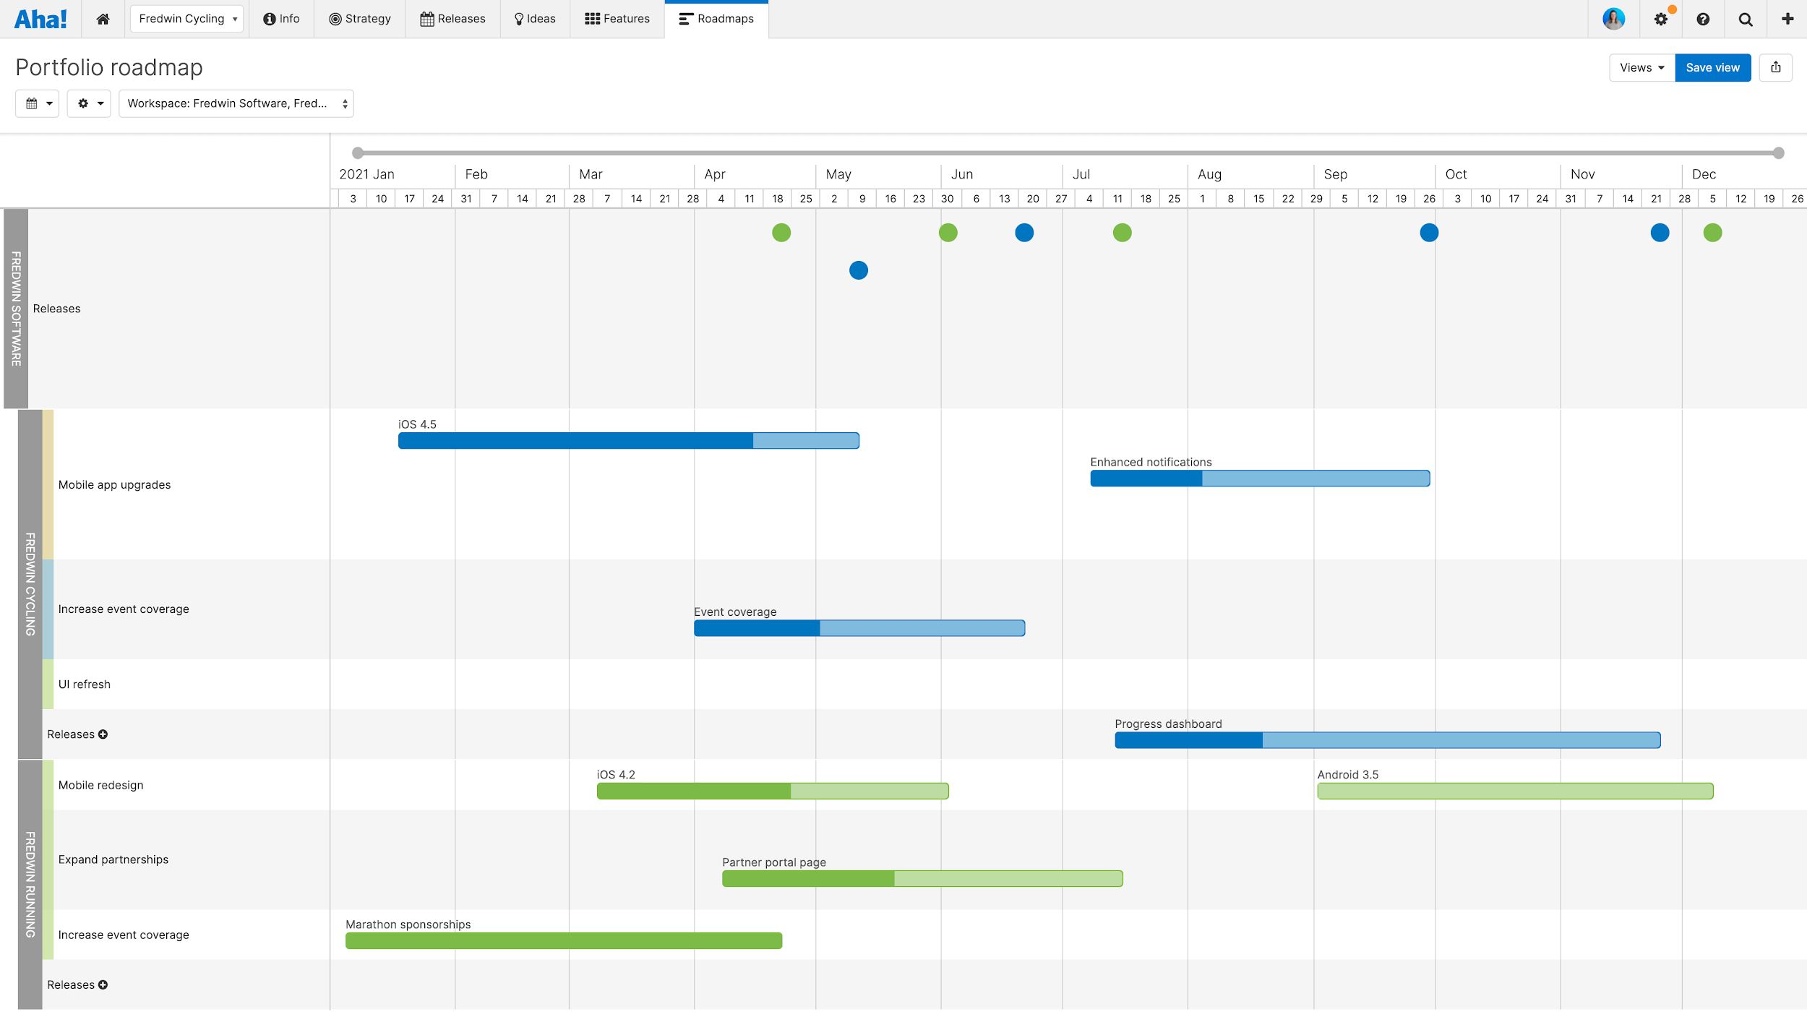
Portfolio roadmap
Confidential
Notes:
Give timelines for the major releases you have coming up and show how the strategy is connected to work. Here your executive audience might want to see a portfolio or strategy roadmap, for example.

Slide 8
Customer feedback
Most popular ideas:
Confidential
Notes:
Share the latest customer feedback and discuss how you plan to incorporate the best ideas into your product roadmap.

Slide 9
Metrics overview
Engagement metrics
Product financials
Users/Active users
Confidential
Notes:
Present metrics to show the team's impact on the product’s success.

Slide 10
Q&A
Notes:
Be sure to allot time for questions, answers, and comments.

