Slide 1
Engineering roadmap update
Date of presentation
Click here to quickly build visual roadmaps for different audiences in Aha!

Slide 2
What we will cover today
User personas
Product goals
Initiatives update
Features roadmap
Customer feedback
Metrics overview
Q&A
Confidential
Notes:
Use this slide to expectations for your audience with a presentation agenda.

Slide 3
Updated user persona
User persona
 | Product knowledge | Education | Experience
Likes Dislikes Trusts information from Influence Description Goals Challenges Responsibilities Skills
Confidential
Notes:
Now set the big picture context. You could use a persona profile to explain the “why” behind product decisions.

Slide 4
Product goals
Goal | Success metric
Confidential
Notes:
Share progress on product goals, as well as any new goals. Include success metrics so your audience understands how you will measure your results.

Slide 5
Product initiatives
Time frame
Time frame
Time frame
Initiative 1
Initiative 2
Initiative 3
Initiative 1
Initiative 2
Initiative 3
Initiative 1
Initiative 2
Initiative 3
Confidential
Notes:
Communicate your high-level efforts or initiatives — you might also discuss your product direction, investment areas, and release timelines across products.

Slide 6
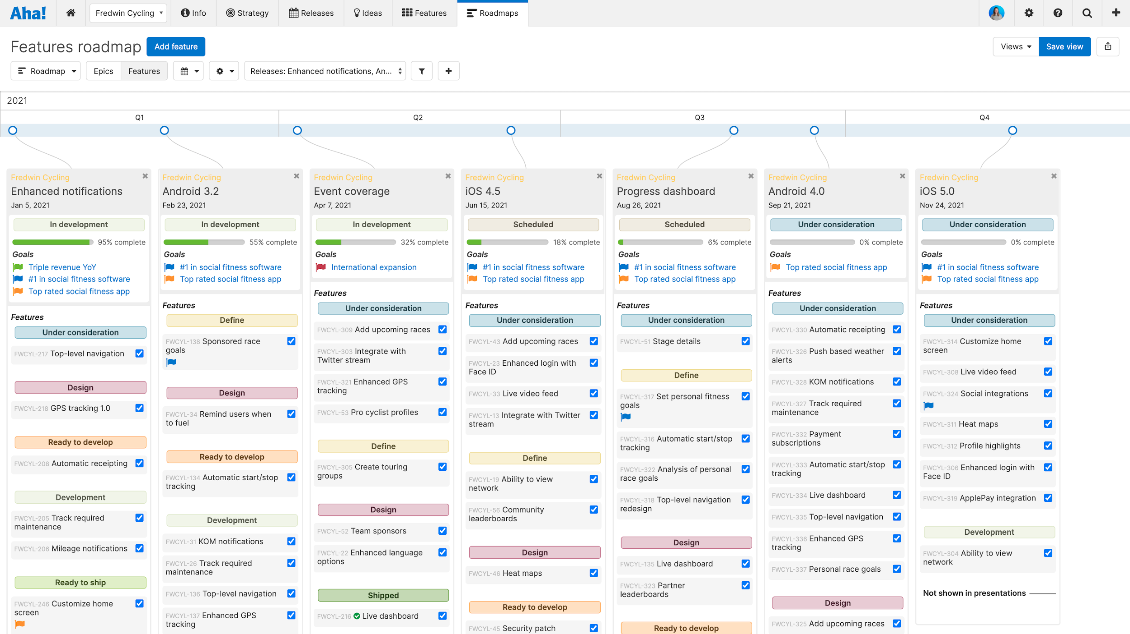
Features roadmap
Confidential
Notes:
Give timelines for the major releases you have coming up and show how the strategy is connected to work. Here your engineering audience might want to see a roadmap with goals and initiatives mapped to planned features.

Slide 7
Customer feedback
Most popular ideas:
Confidential
Notes:
Share the latest customer feedback and discuss how you plan to incorporate the best ideas into your product roadmap.

Slide 8
Metrics overview
Engagement metrics
Product financials
Users/Active users
Confidential
Notes:
Present metrics to show the team's impact on the product’s success.

Slide 9
Q&A
Notes:
Be sure to allot time for questions, answers, and comments.

