Slide 1
Gambling & Finance
Exploring cashless and other payment methods

Slide 2
Cashless & Payment Methods
Key Objective: understanding what types of payments are typically used and preferred for land-based gambling, and the motivations for different payment types
Exec Summary
Cash is viewed as the best way to maintain control over gambling spend
High importance is placed on the need for a budget when gambling, but using cashless methods often leads to exceeding these limits
Cash remains the most preferred method for gambling in land-based premises
However, those more at risk of harm from gambling are less likely to use it
As society becomes more cashless, this potentially puts an even greater proportion of gamblers at risk
Providing an app to give players and gambling companies access to spending data could help ensure those most at risk have greater support in controlling their spend
Points for further consideration
While the UK is shifting towards cashless payments, it’s important that land-based venues continue to allow cash payments to help gamblers keep control of their spending.
Could education around the benefits of paying via cash to assist with monitoring spend and budgeting, and help to protect gamblers from over-spending (particularly younger adults)?
There is openness to app-payment that allows the player to control their spend and gambling companies to step in if needed.
This could be particularly beneficial if it’s able to help gamblers monitor and control their spend, as it could help reach higher risk gamblers who prefer cashless.
To protect gamblers, this should be in addition to, not instead of, the option to pay via cash.

Slide 3
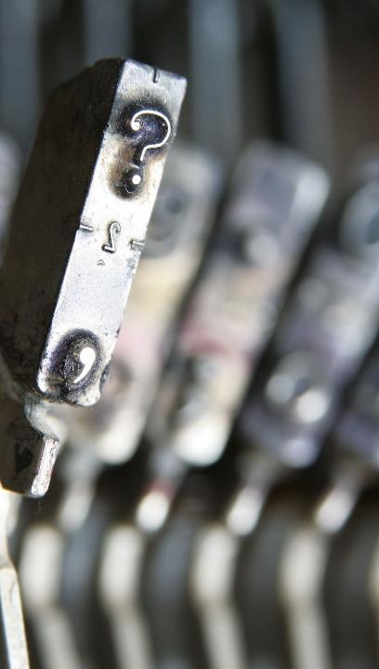
Consumer Voice | Summary of sample
615 respondents completed a 20 minute online survey
METHODOLOGY
A 20min online survey
Survey focused on:
Payment methods for those who take part in land-based gambling
Financial harms experienced through gambling (your own or someone else’s)
SAMPLE
N=615 gamblers across the UK (defined as anyone taking part in a gambling activity, excluding people who had only played on lotteries*, in the last 12 months)
Nat rep gambler quotas applied on age, gender and region to ensure a representative spread
Behaviour based sub-groups were allowed to fall out naturally. We spoke to:
N=314 land-based gamblers
N=117 gamblers who have experienced financial harms. Of which there were:
105 from their own gambling
59 from someone else’s gambling
*National Lottery draws or other lotteries

Slide 4
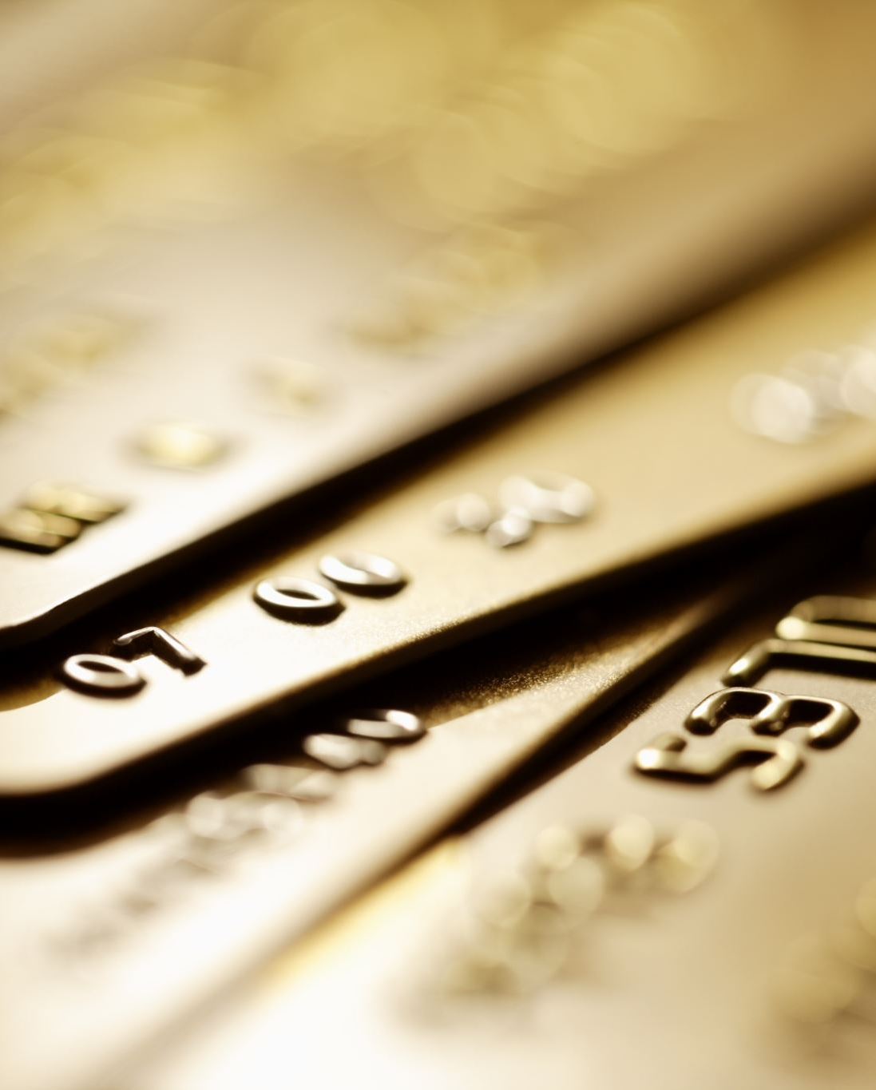
Cashless & Payment Methods Summary of Key Findings
Cash is viewed as the best way to maintain control over gambling spend
High importance is placed on the need for a budget when gambling, but using cashless methods often leads to exceeding these limits
Cash remains the most preferred method for gambling in land-based premises
However, those more at risk of harm from gambling are less likely to use it
As society becomes more cashless, this potentially puts an even greater proportion of gamblers at risk
Providing an app to give players and gambling companies access to spending data could help ensure those most at risk have greater support in controlling their spend

Slide 5
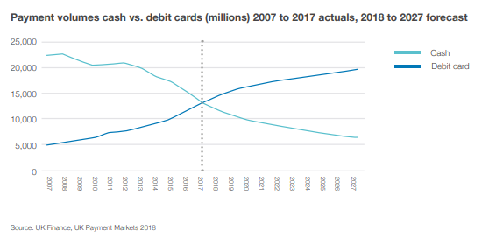
While cash use is declining, and predicted to continue doing so, for many it remains a key way of keeping control of their spend
The UK population use cash because:
34% like to have a choice when paying for things
20% feel more in control of their money when they use cash
16% find it easier to manage their household budget using cash
6% want to protect their privacy (i.e. don’t leave an online record of my spending)
5% don’t trust the internet with their money
3% state they don’t trust banks to control the way they pay
3% like to keep their guilty pleasures hidden from their partner
Source – Access To Cash Review:
https://www.accesstocash.org.uk/media/1159/interim-report-final-web.pdf

Slide 6
Cash payments help gamblers feel in control of their gambling as it enables them to keep track and set limits
Perceptions of payment methods
In control of spending
Not in control of spending
M4. Thinking about the different ways you can pay when you ACTIVITY, what form of payment best fits each of the descriptions below?
Base: Land-based gamblers (314)
Notes:
M4

Slide 7
Even those who prefer to use cashless payments admit it’s easier to lose control when using this method
Perceptions of payment methods by payment method preference
Prefer cash
Prefer cashless
M4. Thinking about the different ways you can pay when you ACTIVITY, what form of payment best fits each of the descriptions below?
Base: Land-based gamblers – prefer cash (178), prefer cashless (133)
Notes:
M4

Slide 8
There is strong belief in the importance of keeping to a budget, but gamblers feel they are less likely to stick to it when using cashless
Impact on spend vs. intention by payment method
“Because a card is not physical money, you can disassociate with the money element of what you're doing”
Quote – quantitative respondent
This is not just a perception people have but is also backed up by research into spending patterns. Cashless payments lack the ‘flinch’ moment that is typically experienced when we part with our money and can therefore lead to greater spend*
Lower among ages 18-34 and moderate/problem gamblers
Those who consider it very important to stick to a budget are more likely to think cashless methods will increase spend
M8. How important is it to you that you only spend on gambling the amount that you had budgeted to spend? M5. Imagine that before you ACTIVITY you plan to not spend more than a certain amount, how much do you think you would end up spending if you paid using METHOD?
Base: Land-based gamblers (314)
*Source: www.bbc.com/future/article/20191204-does-e-money-make-you-spend-more
Notes:
M5

Slide 9
Cash is the most prominent payment method for land-based gambling, affording the greater control needed vs. general spend
Payment methods typically used (multi answer)
“If you use card you can lose a lot of money. No control on spending.”
Quote – quantitative respondent
The exceptions are betting on events and FOBTs which skew more to cashless transactions (and problem gamblers)
M1. What form(s) of payment do you typically use for the following activities?
Base: Land-based gamblers - general spending activities (314), Place bets on events (58), FOBTs (68), Casinos (75), Bingo (114), Place bets on sports (169), Fruit/slot machines (147)
Note: certain gambling activities (e.g. FOBTs) are well set up for cashless payments, where as others (e.g. slot machines) are generally cash only products
Notes:
M1

Slide 10
When given a choice, there’s a slight preference for cash, although some prefer different methods for different activities
Preference for using cash for gambling activities
prefer to pay with cash
prefer to pay with cashless
48%
37%
More preferred in fruit/slot machines, bets on sports games or races, and casinos.
13%
More preferred in FOBTs, bets on events, and bingo.
prefer different payment for different activities
Note: preference doesn’t account for feasibility – respondents had the option to say they preferred an option even if it isn’t possible at the venue/for the type of gambling
62%
51%
M2. What form of payment would you prefer to use for the following activities? (answered across all land-based gambling activities qualify for)
Base: Land-based gamblers (314)
Notes:
M1 / M2

Slide 11
Cashless is preferred for its security, speed, ease, record of payments and limiting contact in a post-covid world
Cash is preferred for the control it provides over both spend and privacy, but is also linked to a cash only legacy in some establishments
Contactless with my phone is the easiest and most convenient way to pay. I don't have to take money out in advance and can spend as much as I would like to when I'm there.
Doesn’t tempt me to go over what I’d brought in with me which I could do with card payment
It’s gambling and I like to know exactly how much I’m spending. If I just stick with cash I can’t use any more than I currently have.
It’s just quicker and easier, especially when places are busy. It also minimises contact.
Its easier to be aware of money you are spending if its physically in my hand
With COVID-19 I’m unsure as to how many people actually wash their hands and money is dirty to start with, so less handling of money
I think it helps to regulate, realise and limit what you are actually spending
Most machines previously have only accepted cash and that is what I am used to
Because I find it way easier compared to other forms of payment, and I can check all my payments at instant online
I don't trust betting establishments having access to my bank card details.
It is safer not to carry too much cash
Quotes from quantitative respondents
M3. You said you would prefer to use [METHOD] when you [ACTIVITY]. Why is this?
(Quotes from quantitative respondents)

Slide 12
Unsurprisingly, preference for cashless skews to younger gamblers, and those more at risk from gambling
Preference for cashless for gambling activities
68%
54%
Who is it that’s most likely to prefer cashless?
32%
18-34 | 35-54 | 55+
63%
68%
40%
41%
Very important to keep to budget | Less important to keep to budget
Non-problem / low risk gamblers | Moderate / problem gamblers
A similar pattern is seen for buying drinks at a bar, but not other categories of general spend
M2. What form of payment would you prefer to use for the following activities? (anyone who selects cash at one or more land-based gambling activity)
Base: Land-based gamblers (314), 18-34 (87), 35-54 (121), 55+ (106), Non-problem / low risk gambler (202), Moderate / problem gambler (112), Very important to keep to budget (173), Less important to keep to budget (141)
Notes:
Those who prefer cashless are also more likely to experience gambling harms, but this is driven by the fact that they’re more likely to be moderate/Problem gamblers, rather than being identifiably driven by the payment type itself

Slide 13
A system which records information from cashless transactions could be an effective way to help at risk gamblers
Cashless payments may make it easier for players to lose track of their gambling spend. Introducing an app which can facilitate cashless payments could mitigate this issue, if the app would allow operators to track gambling activity (time/money spent) and step in when needed, while also enabling the player to keep track of their own gambling*.
Interest in cashless and information sharing
I would be happy to pay for gambling through a cashless payment method…
18-34yr olds are more likely to be happy using a cashless payment method, and for gambling companies to access the information
However, given the high overlap between age and problem gambling we can’t say which of these two factors is driving this preference
But concerns around privacy and access to data will need to be taken into consideration
*Questions were asked to understand consumer attitudes towards using an app to facilitate cashless payments for gambling and operators having access to their gambling history data.
M9. Which of the following statements best describes your attitudes towards using cashless payments to fund gambling
Base: Land-based gamblers (314), Non-problem/low risk (202), Moderate /problem (112)
Notes:
M9

Slide 14
Concerns centre around retaining privacy and control over spend; some mentions of increased marketing and lack of relevancy
Invasion of privacy
There are some mentions of security, but the overriding concern is simply that this is private information and they want it to remain private
Controlling spend is easier with cash
Would need to emphasis benefit for the gambler in being able to set limits in order to encourage uptake
Concern it will lead to more marketing
Because then they would be able to send me targeted adverts based on my transactions
I believe that using cash is the only safe way to monitor my own gambling spending in person.
I think my gambling is my own business, not theirs
I dislike giving more personal data to betting firms.
You could easily get carried away and spend too much because it is so easy
I prefer to use cash, that way I know what I've spent.
‘Me vs. Them’ attitude to problem gambling – it doesn’t feel relevant
Privacy. The firms do not need to know what I have in the bank.
I gamble for fun, and don’t have a problem with spending more than I intend, or can afford. Therefore the method I use to pay is not important. Just a matter of convenience
I feel I am losing a little too much privacy than I require to if I am revealing my gambling habits to gambling companies
It is incredibly difficult for me to stay in budget while gambling. I’d prefer cash
M10. You said [ANSWER TO M9]. Please tell us why. (happy to use cashless but not for gambling companies to access the data OR not happy to use a cashless app)

Slide 15
Cashless & Payment Methods Key Points for Consideration
While the UK is shifting towards cashless payments, it’s important that land-based gambling venues continue to allow cash payments to help gamblers keep control of their spending.
Could education around monitoring spend and budgeting help to protect gamblers from over-spending (particularly younger adults)?
There is openness to app-based payment methods that allow the player to control their spend and gambling companies to step in if needed.
This could be particularly beneficial if it’s able to help gamblers monitor and control their spend, as it could help reach higher risk gamblers who prefer cashless.
To protect gamblers, this should be in addition to, not instead of, the option to pay via cash.

Slide 16
Contact details
Chloe.Deschryver@2cv.com
Abigail.Plank@2cv.com
Barnaby.Purvis@2cv.com
Jack.Wilson@2cv.com
Nicola.Catchpole@2cv.com
Chelle.Watson@2cv.com
Terms & Conditions

