Slide 1
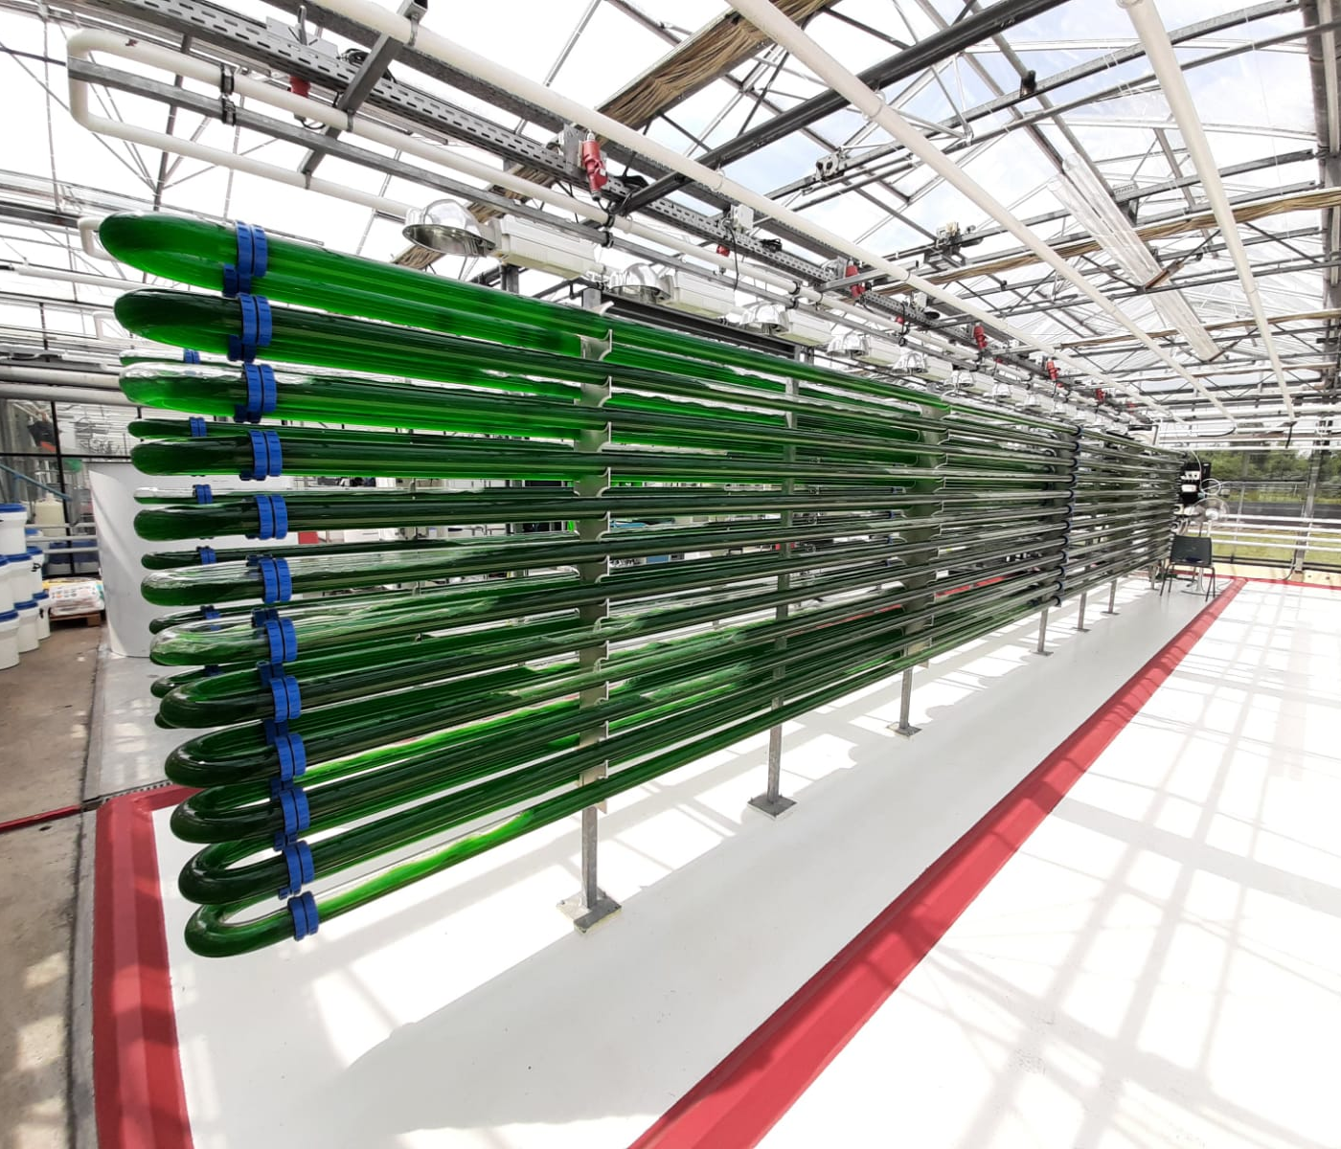

Mixotrophy improves microalgae productivity at pilot scale without aeration
Scaling up mixotrophic cultivation of Galdieria sulphuraria
Autotrophic processes are limited by high costs
Oxygen-balanced mixotrophy improves productivity while reducing aeration costs
G. sulphuraria contains 60% protein content and prevents contamination
Approach and results
Scale-down simulation of large-scale fluctuations
In silico simulation and design of substrate feeding
Scale-up in a pilot tubular photobioreactor
↓
Avg productivity = 0.7 g·L⁻¹·day⁻¹
Max productivity ≈ 1.2 g·L⁻¹·day⁻¹
Yield on substrate ≈ 80%
Pedro Moñino Fernández / Wageningen University & Research (Wageningen, the Netherlands)

