Slide 1
2015 CEF Transport Calls
Action Proposals Preparation
Mid-Term Review Workshop
©
December, 1st 2015

Slide 2
Welcome and introduction
©
Paola Di Giovanni – FPA Coordination Manager

Slide 3
Agenda
10:00 – 10:10: Welcome and Introduction
10:10 – 10:35: Implementation projects received:
key figures and overall feedback
10:35 – 11:00: Next steps
        Clustering & PMO support
        Cost effectiveness of projects received
        Roadmap
11:00 – 11:30: Administrative documents Part A, Part B, Part C and Part D:
how to read the Guidelines
11:30 – 12:00: Live online Q & A
12:00 – 13:00: Submit your additional questions

Slide 4
Implementation projects received: key figures and overall feedback
©
Nicolas Warinsko – Deputy Managing Director and
Director Technical and Operations

Slide 5




Candidate Implementation Projects
Key figures
12%
35 from Military
Stakeholders
297
Projects
88%
262 from Civil
Stakeholders
Overall budget
Eligibility for funding
€ 2.5 bln*
8%
25 eligible for Cohesion Fund
89%
7 submissions as mixed envelope
88%
2%
*The overall budget only refers to 216 projects which provided information on the budget

Slide 6
Candidate Implementation Projects
Distribution per stakeholder category
ANSPs
99
Airport Operators
69
Airspace Users
37
Military
authorities
35
Network
Manager
24
Industry
Providers
17
EUROCONTROL
11
MET Services
Providers
5

Slide 7
Candidate Implementation Projects
Distribution per AF
1%
18%
6%
AF1
54
27%
AF2
79
AF3
46
AF4
23
AF1
25%
AF2
AF5
73
AF3
AF6
18
AF4
15%
AF5
8%
No AF identified
4
AF6
AFX
AF1
AF2
AF3
AF4
AF5
AF6
No AF

Slide 8
Candidate Implementation Projects
Main SDM feedbacks (1/2)
Overall context
  General call significantly overbooked → highly selective
  Cohesion call under booked
Relevance to PCP (what, where) and DP (family, gap)
  If not relevant, request to submit under category “other projects”
  If tasks not relevant detected into an IP mostly relevant, request to delete non relevant tasks

Slide 9
Candidate Implementation Projects
Main SDM feedbacks (2/2)
Timing (when)
  If IP to start beyond mid-2017, advise to postpone submission to next call to limit unnecessary competition between IP not on same timescale
  If long lasting IP, advise to ease potential split by EC to protect the “must be awarded” part of the IP
Request evidences of committed partners for IP aiming at implementing common services
Encourage de-fragmentation when complementary/similar IPs detected

Slide 10
Next steps
©
Nicolas Warinsko – Deputy Managing Director and
Director Technical and Operations
Michel Gorog – Head of Performance and Financial Systems

Slide 11
Clustering (1/2)
From 300 projects to 3 Action Proposals
Close to 300 projects to cluster in a limited number of proposals
SDM elaborated a first scenario to be further revised on the basis of the information to be provided with the 2nd IP templates draft: in particular economics
Project’s end date will be the main driver to cluster:
  2 Action Proposals under General Call
    Action proposal #1 - All IPs completed by 31/12/2018 (indicative)
    Action proposal #2 - Other IPs
  1 Action Proposal under Cohesion Call

Slide 12
Clustering (2/2)
For each proposal
SDM is the action coordinator
No action leader
Projects clustered per AF
Reduced number of activities with SDM as activity leader

Slide 13
Implementation level’s PMO (1/2)
A new approach
PMO in implementation level is required
  By SDM to relay, disseminate and support synchronisation, coordination, performance assessment and cost benefit analysis;
  By Implementation Partners to ease them managing the complexity of the FPA environment whilst complying with SDM’s/INEA’s requests for monitoring and reporting;
  To promote project management’s best practices
Envisaged approach for PMO in the proposals to 2015 CEF Transports Calls
  No evidence of any PMO service provider willing to join as a partner;
  SDM to describe PMO activities when preparing proposals as part of FPA coordination;
  SDM to subcontract PMO activities as a result from an open call.

Slide 14
Implementation level’s PMO (2/2)
Consequences
A sub contracted PMO shall be 100% funded, requiring to adjust the coordination fee within reasonable limit;
SDM strongly expects that :
  Wider scope and financial envelope for SGAs 2015 compared to 2014;
  Competition through an open call;
  Experience drawn from SGA 2014;
  Stronger SDM and robust STAR; and
  Improved FPA coordination/PMO integration under SDM;
  should allow for PMO provision at minimum impact on FPA coordination fee.
Updated coordination fee to be agreed with implementing partners when revising the ICA/terms and conditions for the purpose of SGA(s) 2015

Slide 15
Cost effectiveness analysis
Purpose
Support PCP implementation as per CIR (EU) N°716/2014 and its supporting PCP CBA
Ensuring that projects are in line with the overall economic envelope
The expected outcome is a high performing ATM infrastructure that will enable the safe, efficient and environmentally friendly operation and development of air transport

Slide 16
Cost effectiveness analysis
SDM’s methodology
PCP relevant
Implementation Projects
CIR (EU) N°716/2014 and
Its supporting CBA
Declared costs
SDM analysis
Supported by NM
AF1
AF2
AF3
AF4
AF5
AF6
Expected R.O.I per
ATM
functionality
Performance contribution
expected per Gap
Gap coverage
Increased profitability
Expected profitability
Lower profitability

Slide 17
Next steps
©
Nicolas Warinsko – Deputy Managing Director and Director Technical and Operations

Slide 18
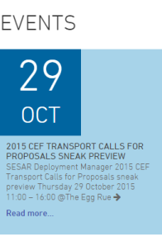
Technical Roadmap – 29th of October to 22th of December (1/2)
16/11
1
07/12
5
17/12
9
Provision of 1st draft IP template proposals
Uploading of 2nd draft of IP template proposals updated on the basis of SDM comments
TO BE RECEIVED BY COB (6 PM CET)
Deadline for uploading the comments to the Technical Part v1.0, the Budget v1.0 and for providing the IP template final
IPPs
2016
26/11
2
6
23/12
10
11/12
Elaboration and uploading of the Technical Part v2.0 and Budget v2.0 (budget elaboration starting on December 7th)
Clustering of the IPs on the basis of the IP templates received
Uploading of the Technical Part v1.0 and Budget v1.0
29/10
27/11
4
Launch of the Appl. Form part D elaboration (Technical Part)
SDM
2015
CEF Call Publication
5/11
27/11
3
Elaboration and provision of
technical comments
on the 1st drafts of IP template proposals
10/12
7
14/12
8
INEA
INFO day (webstreaming)
30/11
SDM
INFO day (webstreaming)
01/12
Start of the elaboration of the Cost Effectiveness Analysis
Elaboration and uploading of the
IP template analysis final results
Deadline has been revised
Notes:
Following the CEF Tranport Call publication the SDM Guidelines for call responses elaboration will be distributed (including the relevant templates)
Launch of the IP templates elaboration and the provision of the 1° draft by 13/11 - the updated IP template is available on SDM website
To highlight the fact the the elaboration of the proposals starts from the Call publication, the buget elaboration will starts after the 2° draft of IP templates receipt
To stress the importance to fill in the IP templates properly (in terms of corretness and completeness of the information) for the successful proposals elaboration
To stress the fact that budget proposals will be represented for each project throught overall costs per year (no references to single costs, etc.)

Slide 19
Technical Roadmap – 22th of December to 16th of February (2/2)
11/01
11
19/01
14
21/01
17
10/02
18
Deadline for uploading the comments to the Technical Part v2.0 and to the Budget v2.0
Approvals to the Technical Part v3.0 and Budget v3.0 by IPPs
IPPs (where possible one per State) to send/provide its MS with the documentation to be approved
IPPs/MS to provide with the originals/scanned copy of the Application form A2.3
IPPs
2015
20/01
16/02
20
16
Proposals submission (part A, B, C and D)
SDM to send an alert to all MS involved about the finalization of the documents to be approved by MS
23/12
10
13/01
12
15/01
13
Elaboration and uploading of the Technical Part v2.0 and Budget v2.0
Finalization of the Cost Effectiveness Analysis
Elaboration and uploading of the integrated Tech. Part v3.0 and Budget for IPPs approval v3.0
SDM
15
10/02
19
20/01
TENtec Uploading Finalization
Preparation and distribution of the Batch of the documentation for the MS submission (batch will include: Abstract of the Technical Part, Admin. Part, Overall Budget, IP templates related to the each Member State)
Deadline has been revised
Notes:
OPEN POINT: Who’s going to submit the proposals (impact on the proposals finalization and packaging)
To stress the fact that iteraction process aims at verifying the correctness and completness of the information included in all proposal parts ( IPPs are responsible for the information reported in the 4 Application Forms )
SDM will ask to all IPPs to approve the Application Forms before their finalization (before MS endorsement) and submission

Slide 20
Administrative Roadmap – 29th of October to 16th of February
25/11
3
Beginning of provisioning of Overall, Administrative, Financial and Technical POC
09/12
4
20/01
11
Appointing of the organization (s) who will be responsible for the MS approval within the State
Request for
MS endorsement
IPPs
2
5
10/02
12
25/11
09/12
15/01
10
Beginning of provision/checking of scanned copies of Administrative/Legal documents
Target date for the provision of scanned copies of Administrative/Legal documents
Target date for the provision of originals of Administrative/Legal documents
MS endorsement
25/11
09/12
6
16/12
7
16/02
13
1
Beginning of the Administrative and Legal part of the proposal(s)
(Appl. Form A, B and C) elaboration
SDM feedback on the Administrative and Legal Documents scanned
Provision of Guidelines on Proposal(s) Elaboration
Proposals submission (part A, B, C and D)
SDM
16/12
8
15/01
9
29/10
SDM uploading to TENtec website Administrative and Legal Documents scanned
Appl. Form A, B and C Finalization including the uploading to TENtec website for Member State Approval
Notes:
OPEN POINTS - Who’s going to submit the proposal(s) the information impacts on where the originals have to be sent by each IPP
Each IPP has to sent the scanned copies as well as originals (on request of SDM during the proposals elaboration phases).

Slide 21
Administrative documents - Part A, Part B, Part C and Part D
How to read the Guidelines
©
Paola Di Giovanni – FPA Coordination Manager

Slide 22
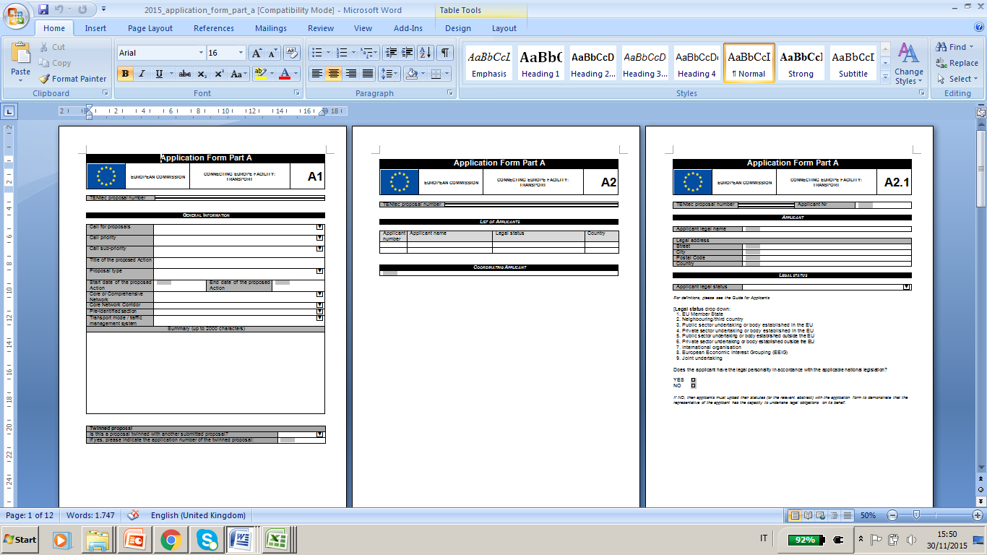
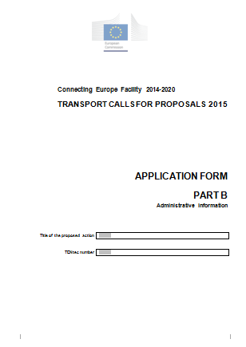
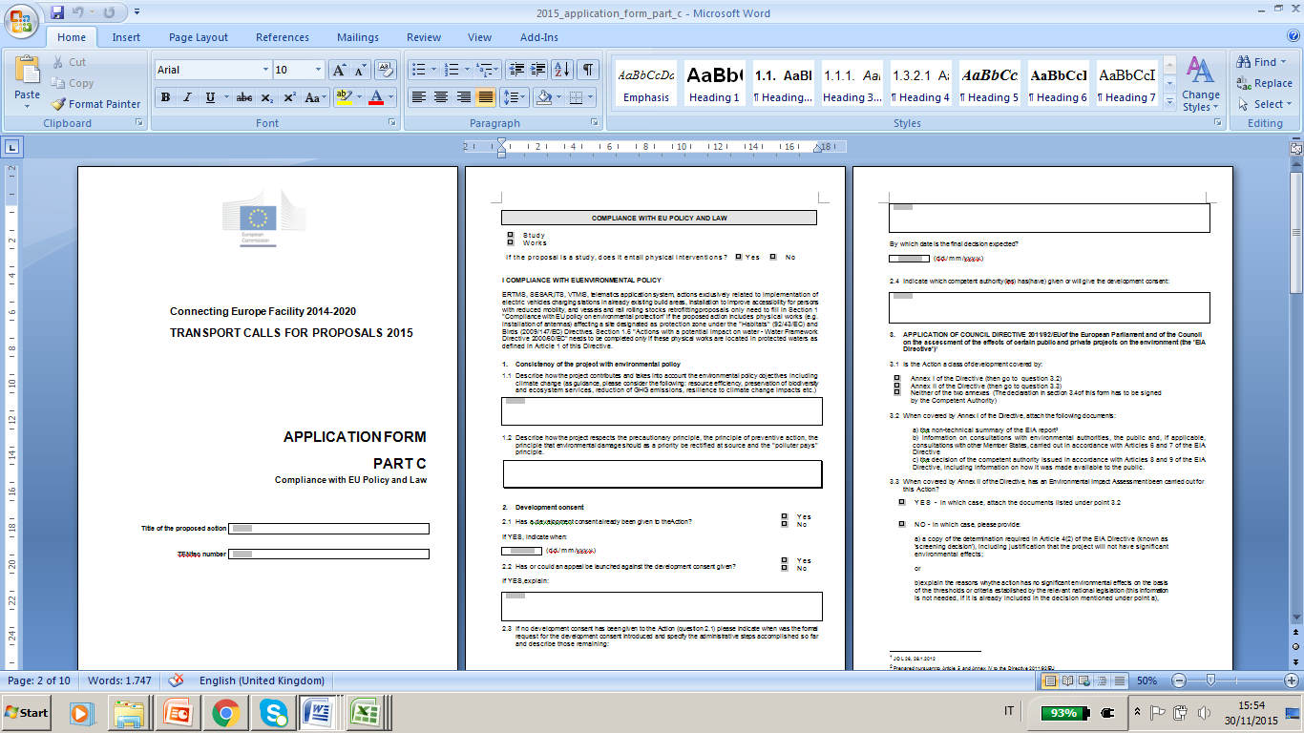
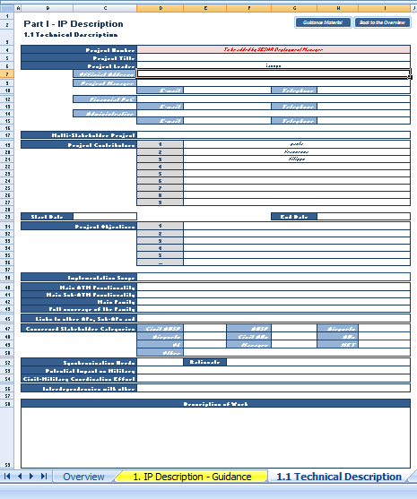
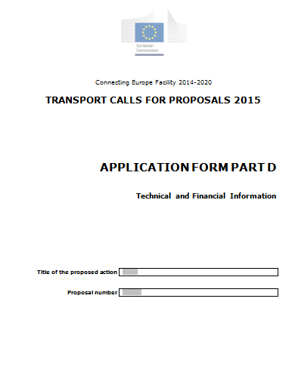
CEF Proposals Response
Documentation to be submitted
According to the EC/INEA process for proposal elaboration, the proposal(s) consists of four forms:
PART A
Main characteristics of the proposal and budget of the Action
PART B
Administrative Information on Applicants
PART C
Compliance with Union Policy and Law
PART D
Technical Information
22
Notes:
To be noted that the forms are only for illustrative purpose (Call 2014) the new templates will be available after the Call publication

Slide 23
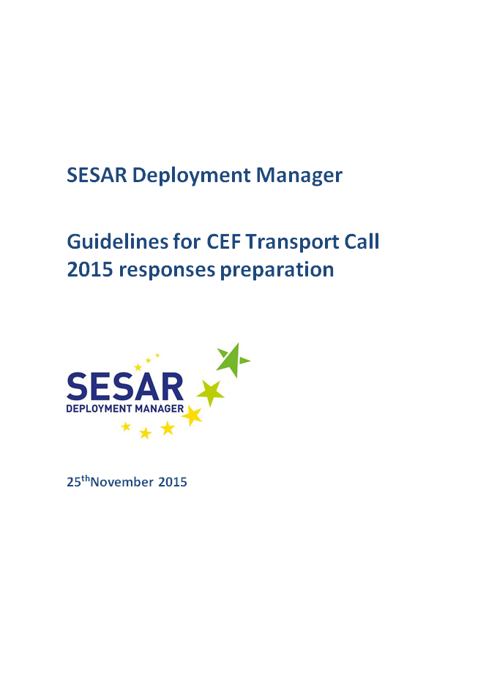
SDM supporting document
for application process
SDM Guidelines for CEF Transport Call 2015 responses preparation
SDM to support IPPs during “response preparation phase” published on 25th of November the SDM Guidelines describing the support to be put in place to assist the IPPs interest in participating to the CEF Transport Calls 2015.
Introduction (the objectives and structure of the paper)
SESAR Deployment Manager’s context and role
2015 CEF TRANSPORT MULTI-ANNUAL CALL– Funding Objective -3
Preparing the Application:
  4.1. Part A
  4.2. Part B
  4.3. Part C
  4.4. Part D
Proposals Submission Procedure
Supporting tools
European Commission Evaluation and Selection Process
Next Steps: SGA finalization and Execution Phase
List of Actions
Annexes

Slide 24
SDM supporting document
for application process
Proposal response Templates – Part A
The section starts with the box indicating the scope of the Part A and HOW the information will be used: Part A will be uploaded by SDM on the basis of the information submitted by all applicants
  For each of the form it is indicated TYPE of information to be collected and WHO has to fill in the form
  Form to be filled in by Implementing Partners are those highlighted in red within the SDM Guidelines, A2.1,A2.2 A2.3, A2.4 (in case of affiliate entity) and A5
First choice in the form A2.1
  Member State
  Neighbouring country / Third country
  Public sector undertaking or body established in the EU
  Private undertaking or body established in the EU
  Public sector undertaking or body established outside the EU
  Private sector undertaking or body established outside the EU
  International organisation
  European Economic Interest Grouping (EEIG)
  Joint undertaking
Documents vary according to the categories each applicant belongs to
Notes:
Member State endorsement: the proposal (technical abstract, budget and Part A) has to be endorse by respective MS (before the proposal(s) submission)
Submission – paper and electronic throught the TENtec website)

Slide 25
SDM supporting document
for application process
Proposal response Templates – Part B
PART B complement information on each of the applicants identified in part A
Each applicant shall fill in all the form highlighted in red within the SDM Guidelines for 2015 CEF Transport Calls responses preparation:
1 – Legal Entity Form (private or public entity)
  Supporting documents listed according to the type of legal entity and form selected
2 – Grounds for exclusion
  Each applicant shall fill in and sign the declaration in ANNEX B-I and in case of affiliate entity Annex B-II
3 – Financial Identification
  Each applicant shall fill in and sign
4 - Requirements on financial and operational capacity
  Only for applicants that are in the following categories:
  4 Private undertaking or body established in the EU
  5. Public sector undertaking or body established outside the EU
  6. Private sector undertaking or body established outside the EU
  9. Joint Undertaking
5 - Requirements for applicants that are neighbouring / third countries or entities established in neighbouring / third countries ():
  Specified Implementing Partners are required to include the agreement of a EU member state, together with Annex B-III and Annex B-IV
Notes:
Member State endorsement: the proposal (technical abstract, budget and Part A) has to be endorse by respective MS (before the proposal(s) submission)
Submission – paper and electronic throught the TENtec website)

Slide 26
SDM supporting document
for application process
Proposal response Templates – Part C
Application Form C aims at providing information regarding the compliance of the proposed proposal(s) with EU policies and law
Form C finalization will performed by SDM according to the contributions provided by Implementing Partners for their projects
All Implementing Partners have to provide SDM with a full Part C, with regard to the candidate implementation project/s which fall/s under their responsibility
Chapter I – Compliance with Union law on environmental protection: this section indicates if the proposal is for studies or works
Section 1 – Consistency of the project with environmental policy: a description must be inserted here to show how the action/proposal takes into account the environmental policy objectives
Section 2: development consent Explain whether development consent has already been given to this proposed Action
Section 3 – Application of Directive 2011/92/EU on Environmental Impact Assessment: the documents specified in the application form must be provided to ensure that the environmental implications of the decision are taken into due account
Section4 – Application of the Strategic Environmental Assessment Directive 2001/42/EC: if the proposed action results from a plan falling within the scope of the SEA Directive
Section 5 – Impact of the Action on Natura 2000 sites: following the text of Council Directive 92/43/EEC (21 May 1992)
Section 6 – Actions with a potential impact on water – Water Framework Directive 2000/60/EC: if relevant for the proposed action/proposal, information on any new modification to the physical characteristics of a surface water body have to provided
…,etc,
Notes:
Member State endorsement: the proposal (technical abstract, budget and Part A) has to be endorse by respective MS (before the proposal(s) submission)
Submission – paper and electronic throught the TENtec website)

Slide 27
SDM supporting document
for application process
Proposal response Templates – Part D
Application Form Part D requests information on the global project and the proposed Action, to set the basis for the evaluation of the proposal
SDM will elaborate and finalize the Part D through the iterative process (where SDM uploads the updated version of Part D and IPPs uploads the comments to the ad hoc Repository) according to the contributions provided by Implementing Partners through the collection of the IP templates
Section 1 - General description of the Global project including needs, objectives and financial information -
Section 2 – Description of the proposed Action
Section 3 – Relevance: Contribution of the proposed Action to the TEN-T/CEF policy objectives and Union dimension
Section 4 – Maturity of the Action
Section 5 – Impact of the proposed Action
Section 6 – Quality of the proposed Action
Section 7 – Annexes
Notes:
Member State endorsement: the proposal (technical abstract, budget and Part A) has to be endorse by respective MS (before the proposal(s) submission)
Submission – paper and electronic throught the TENtec website)

Slide 28
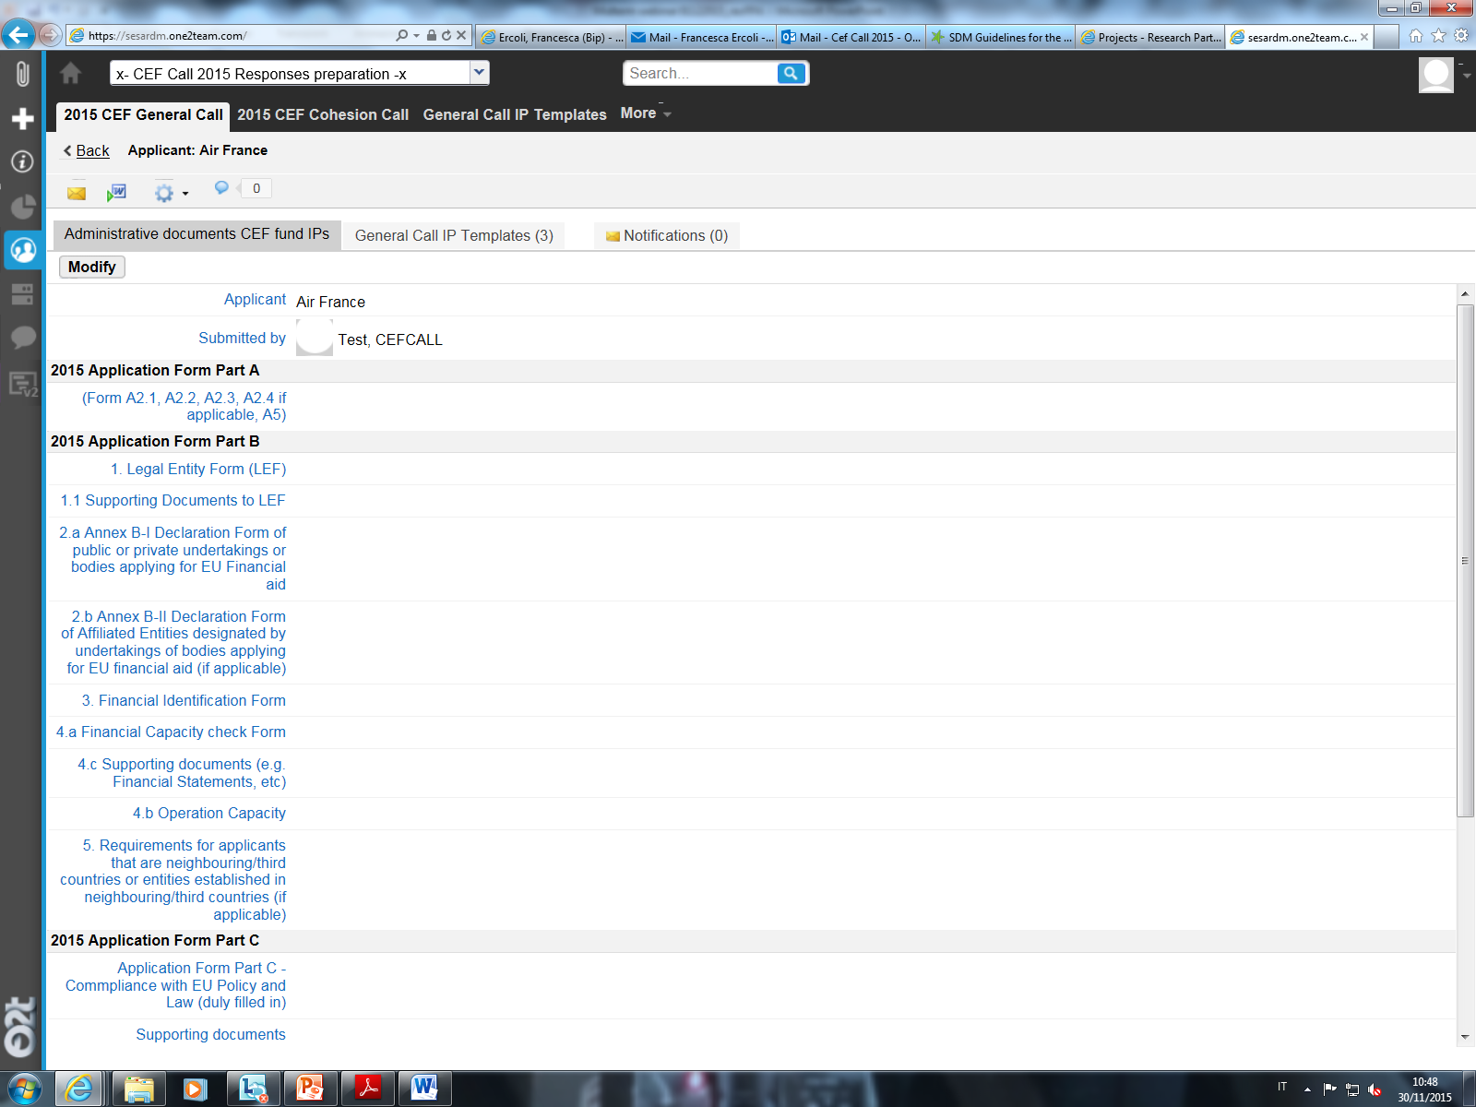
Repository to support 2015 CEF Transport Call responses preparation
To ensure that each Implementing Partner will get all the documents and for reasons of Partner confidentiality, SDM has created a specific repository.
Repository will be structured in two main sessions:
    Public – including general Call documents, Guidelines, Roadmap and FAQ subfolders
    Restricted – access only for Implementing Partners involved in the responses preparation phase where all proposals parts (e.g. Part A, B, C, D, IP templates, etc.) will be uploaded
The Repository will be launched on 3th December
28

Slide 29
Closing remarks
Paola Di Giovanni – FPA Coordination Manager

