Slide 1
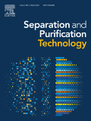
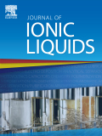
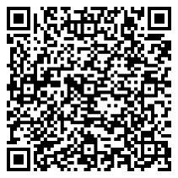
Supporting
publications
5th International Conference on Ionic Liquids in Separation and Purification Technology
5–8 February 2023 | Scottsdale, Arizona, USA
Abstract submission deadline: 2 September 2022
Early registration deadline: 4 November 2022
Conference chairs:
Jason Hallett, Imperial College London, United Kingdom
Mark B. Shiflett, The University of Kansas, USA

Slide 2
5th International Conference on Ionic Liquids in Separation and Purification Technology
5–8 February 2023 | Scottsdale, Arizona, USA
The aim of the 5th International Conference on Ionic Liquids in Separation and Purification Technology is to provide a forum for researchers in academia, national laboratories, and industry to share and discuss their latest results on the use of ionic liquids in separation applications. This meeting will build on the momentum from the previous ILSEPT meetings held in 2011, 2014, 2017, and 2019.
Conference topics:
Ionic Liquids as Advanced Materials
Applications of Ionic Liquids
Process Modeling and Fundamental Studies
Laboratory to Commercialization, “What is needed to drive
the use of ionic liquids for separation and purification”
Visit the site for full details.
Sponsorship & Exhibitions
Contact: Charlotte Alman
Tel: +44 (0)1865 843089
Email: c.alman@elsevier.com

