Slide 1
Secretariat of the Pacific Regional Environment Programme
Environmental Data
July 28, 2017

Slide 2
Outline of presentation
Mandate
Why ?
Methods of Environmental statistics development
SOE, SOE links to SDGs and MEAs, Regional Frameworks
Projects supporting the development of data and statistics
Database options
Regional (NMDI)
National (IRIS)

Slide 3
Mandate – 1993 SPREP Agreement
To promote co-operation in the Pacific region and provide assistance in order to protect and improve its environment and to ensure sustainable development for present and future generations
The Pacific environment, sustaining our livelihoods and natural heritage in harmony with our culture
Notes:
In this context sustainable development includes protecting communities and livelihoods and is not restricted to those that live off the extraction industries (fishing and mining), but rather MUST include – and fully protect the rights of – those that make a living by PROTECTING rare and endangered species and their habitats. It´s important that the term sustainable use, is extended to mean all truly sustainable uses, including non-extractive uses, which do provide quality earnings for communities, both in having higher aggregated value and ensuring a longer-term use of natural resources.

Slide 4
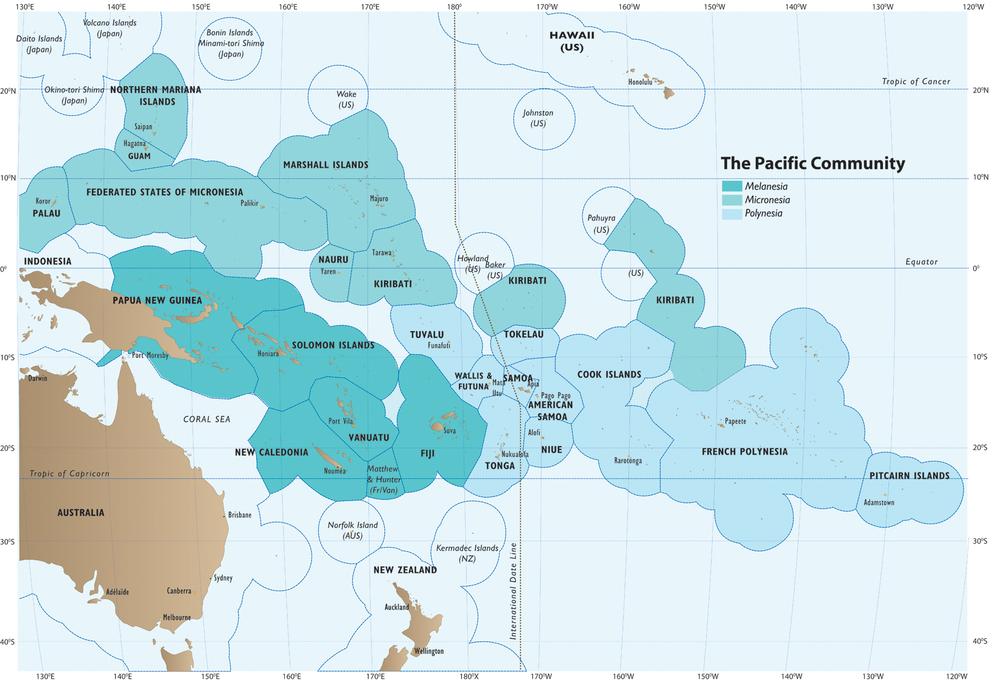
Notes:
The Pacific region – supported by CROP agencies including the Fourm, USP SPC and SPREP all of which Samoa is a member and – of which Samoa is the heart and centre – if you look at the brown bits you can see why Oceans are such a big deal

Slide 5
Data- Why
National Demand
International Reporting
Tracking Change
Stats for development
IMPACT!

Slide 6
List of activities
Inform
ACPMEAs
SOE, NEMS
GEONODE, SPREP GIS
PIPAP (BIOPAMA)
PACMAN (data demand)
PCCP
Pacific MET desk
PEIN- Pacific Environment Information network

Slide 7
SPREP Environmental Data
Basic data/stats on:
Protected areas, Biodiversity, MEAs, wildland waters, invasives, Migratory species, Mangroves
Marine pollution, hazardous waste and solid waste, chemical waste
MEA reporting, EIA, NEMS, Legal review, SOE
On going capacity building for monitoring and reporting of environmental statistics

Slide 8
SOE process
Between 30 – 40 environmental indicator/statistics developed for each PIC based on available env. data statistics
Fiji, Samoa
RMI, Cooks,
Niue

Slide 9
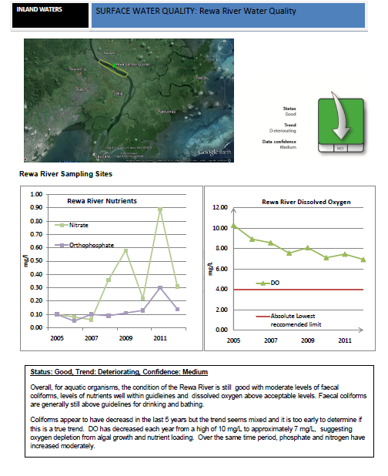
A Data Driven Approach Fiji surface water quality example
Links to SDG 15.1, CBD Aichi target 14 (biodiversity, sustainability) pair with Terrestrial PAs
SAMOA Pathway, FPR – livelihoods and environment sustainability
Raw data sourced from national authority
Condition is good- trend is negative
The NEMS (national environment managment strategy) will address this trend over the next 5 year planning period
Note there are 30-40 of these indicators for each PIC

Slide 10
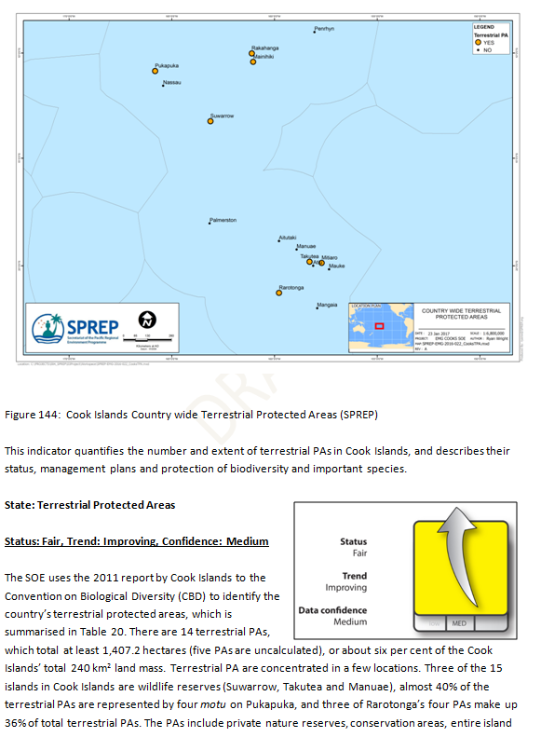
Protected areas
CBD 11,12
SDG 14.5 15.1,15.5
SAMOA Pathway, FPR – livelihoods and environment sustainability
Through the support of ACPMEA, EU and GEF ..

Slide 11
SOE indicators Themes Atmosphere and Climate Inland waters Land Marine Biodiversity Culture and Heritage Built Environment

Slide 12
Region wide GEF Capacity Building project (INFORM) on monitoring/reporting/data management
Support the develop national repositories of environmental data + regional hub
Accelerate monitoring/reporting/planning and implementation

Slide 13
Integrated waste management)

Slide 14
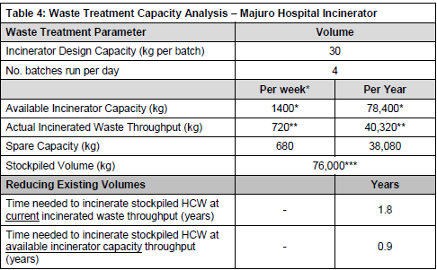
PACwaste
SDG link – 12.4, 12.5
Other data from JICA (Jprism) EDF11 etc

Slide 15
NMDI / Database

Slide 16
Challenges
Accessing data from countries, compiled
Identifying and populating relevant databases
Clear demand for the data, processing into useful information
Slow process to produce national SOEs

Slide 17
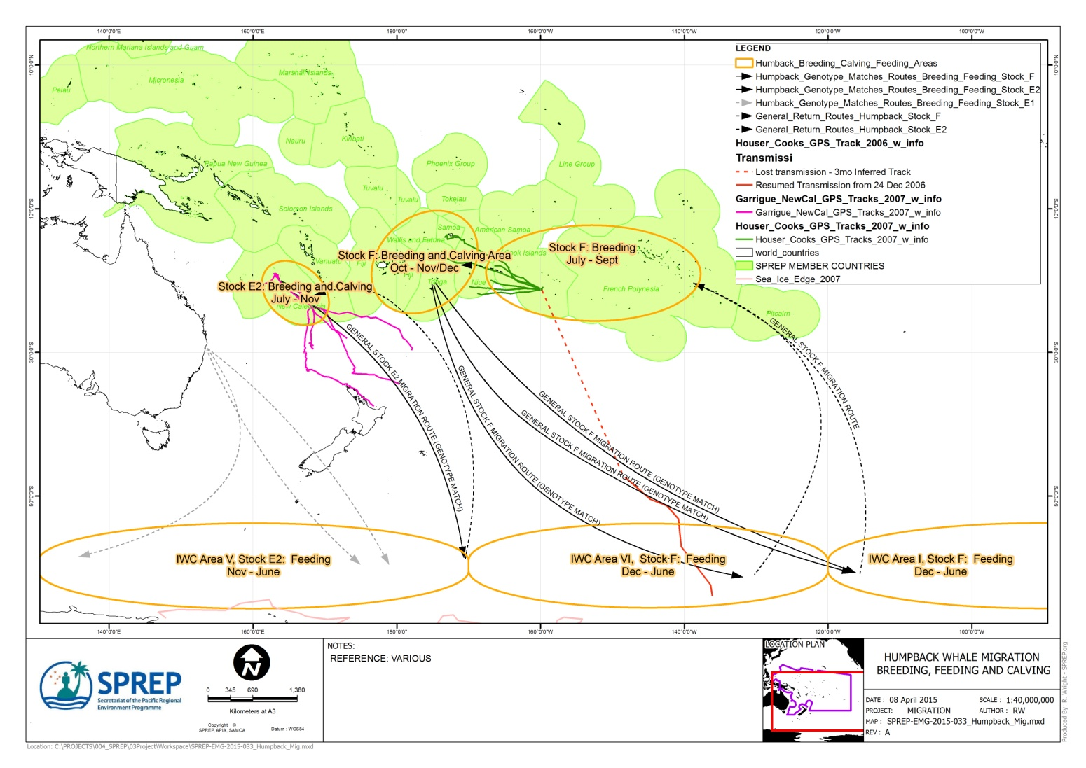
Thank you
Paula@sprep.org

