Slide 1

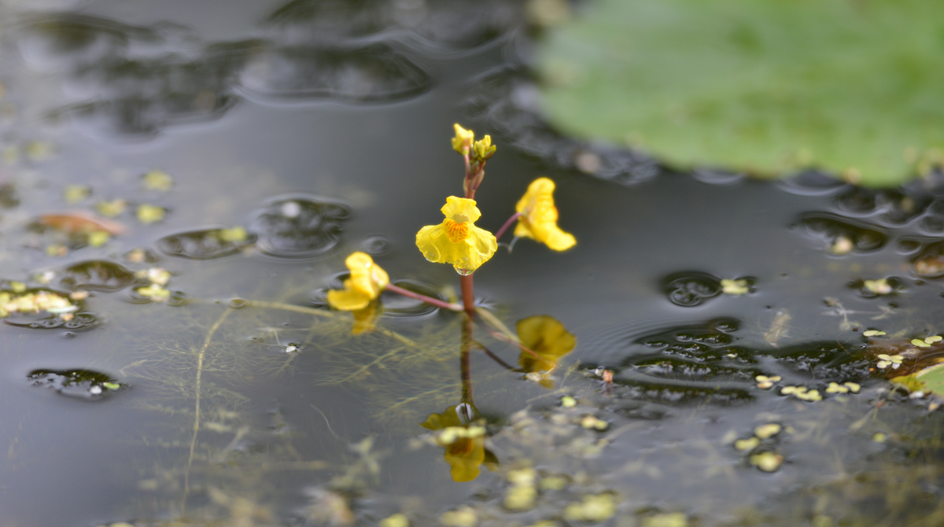
Overview
Greater bladderwort (Utricularia vulgaris), Internationale Gartenausstellung, Berlin, 6 Sept 2017.
Photo BY-SA 4.0 by W.-H. Kusber. From BoBO - Botanic Garden and Botanical Museum Berlin-Dahlem Observations https://www.gbif.org/occurrence/1668720265.
November 2017

Slide 2

BY THE NUMBERS
31 Oct 2017
Species occurrence records
Datasets
856,162,238
36,863
Country Participants
Organizational Participants
Publishers
54
36
1,119
Records downloaded per month (avg Jan-Oct 2017)
User sessions (Sept-Oct avg)
60.3 billion
123,730
Notes:
Useful to see GBIF in its different modalities:
A window on biodiversity
An informatics infrastructure focuseD on tools and standards in service to science and society
A global network on bioinformatics

Slide 3
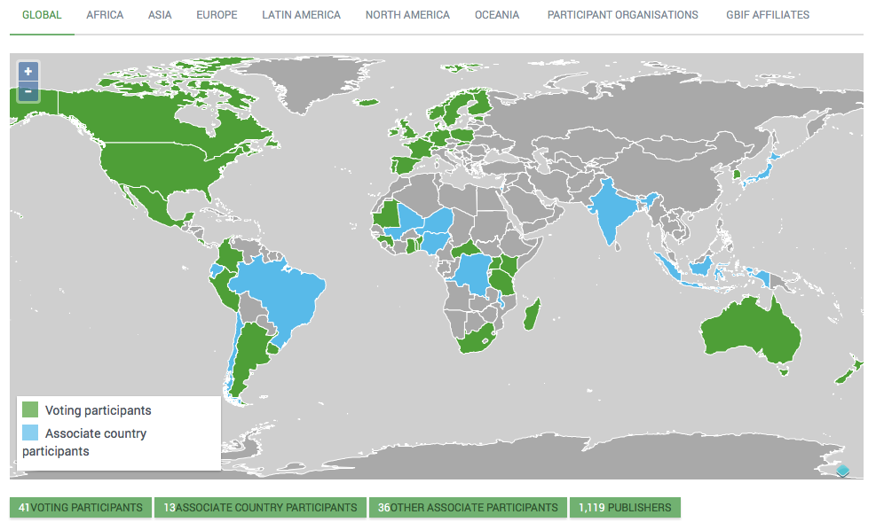
Current network
participation
https://www.gbif.org/the-gbif-network

Slide 4

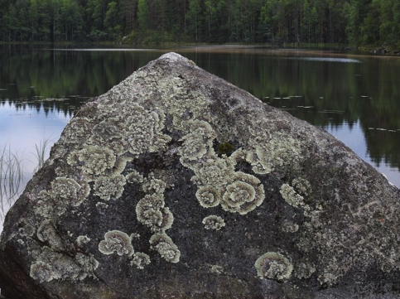

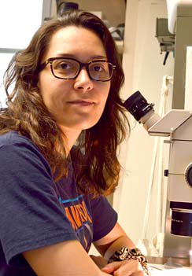
Latest news
communications
      Tanya Abrahamse elected chair of GBIF Governing Board
      South African scientist and executive tops slate of new and returning officers chosen at GB24 in Helsinki
      Read more
      Finland adds 22 million records, surpasses
      pre-licensing totals
      GB24 host becomes third-largest country publisher for 2017, returns to top ten all-time Read more
      Winners of the 2017 Young Researchers Awards
      Nora Escribano becomes Spain’s first winner of the annual prize while Itanna Oliveira Fernandes is the second consecutive recipient from Brazil
https://www.gbif.org/resource/search?contentType=news
Photo credits: (center) Concentric ring lichen (Arctoparmelia centrifuga), Kuhmoinen, Finland.
Photo by Kari Pihlaviita via iNaturalist research-grade observations, licensed under CC BY-NC 4.0.

Slide 5
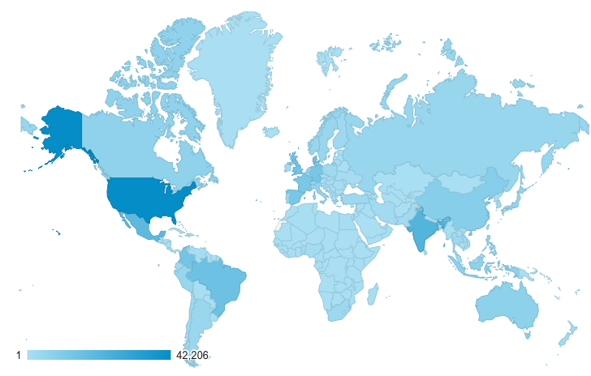
Web traffic to GBIF.org, 2017
Rank | Country/Territory | Sessions | % Total Sessions | 2016 rank | Pages / Session
1 | United States | 175,990 | 12.75% | 1 | 4.28
2 | India | 107,765 | 7.81% | 2 | 2.07
3 | Mexico | 60,834 | 4.41% | 8 | 7.34
4 | Brazil | 55,500 | 4.02% | 5 | 4.83
5 | United Kingdom | 54,569 | 3.95% | 7 | 6.09
6 | Germany | 51,830 | 3.76% | 4 | 4.93
7 | Spain | 50,844 | 3.68% | 6 | 5.29
8 | France | 44,411 | 3.22% | 3 | 4.27
9 | Colombia | 42,784 | 3.10% | 9 | 5.54
10 | Indonesia | 29,021 | 2.15% | 12 | 2.61
data access and use

Slide 6
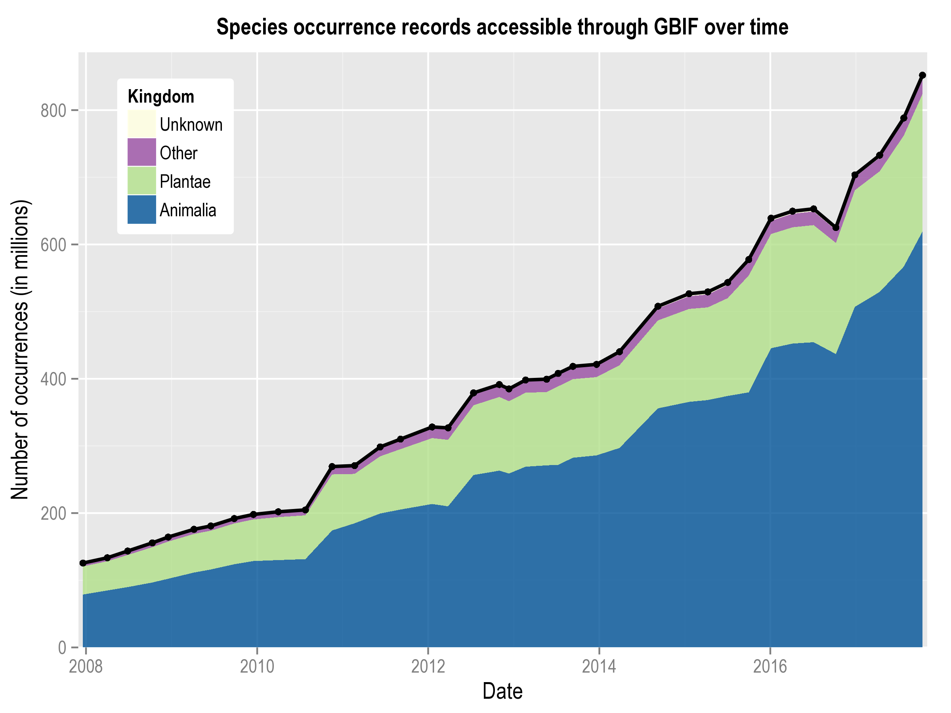
Data published through GBIF.org
data availability
www.gbif.org/analytics/global

Slide 7
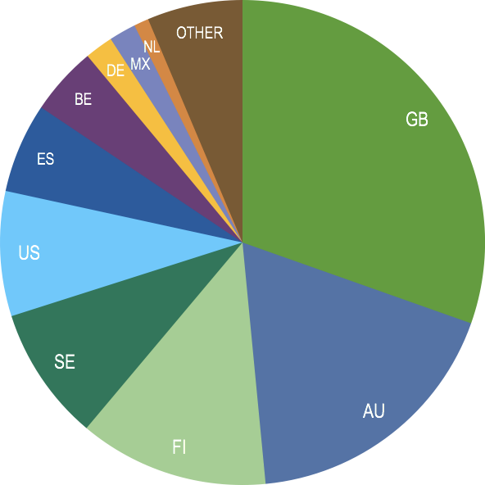
Occurrence records published during 2017 by country as of 31 Oct 2017
 | Country | New records | Aug-17 rank
1 | United Kingdom | 59,513,584 | 1
2 | Australia | 35,352,943 | 6
3 | Finland | 24,760,158 | n/a
4 | Sweden | 17,536,154 | 3
5 | United States | 16,298,025 | 2
6 | Spain | 11,719,497 | 4
7 | Belgium | 8,929,239 | 5
8 | Germany | 3,692,654 | 8
9 | Mexico | 3,511,026 | 7
10 | Netherlands | 1,934,323 | 12
data availability
http://www.gbif.org/country

Slide 8
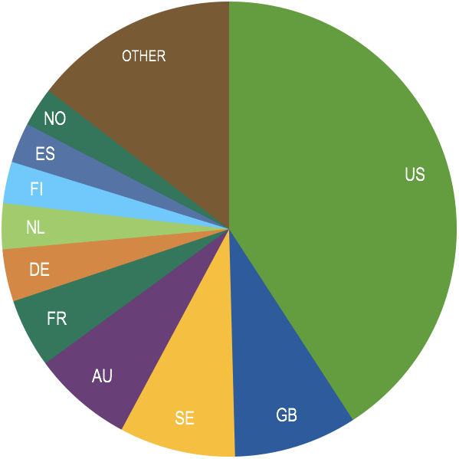
Total number of occurrence records published by country as of 31 Oct 2017
 | Country | Downloads | Aug-17 rank
1 | United States | 349,631,581 | 1
2 | United Kingdom | 74,864,904 | 2
3 | Sweden | 70,707,890 | 3
4 | Australia | 60,896,329 | 5
5 | France | 41,985,004 | 4
6 | Germany | 31,823,735 | 6
7 | Netherlands | 27,852,278 | 7
8 | Finland | 25,286,057 | 21
9 | Spain | 24,394,631 | 8
10 | Norway | 23,861,209 | 9
data availability
http://www.gbif.org/country

Slide 9
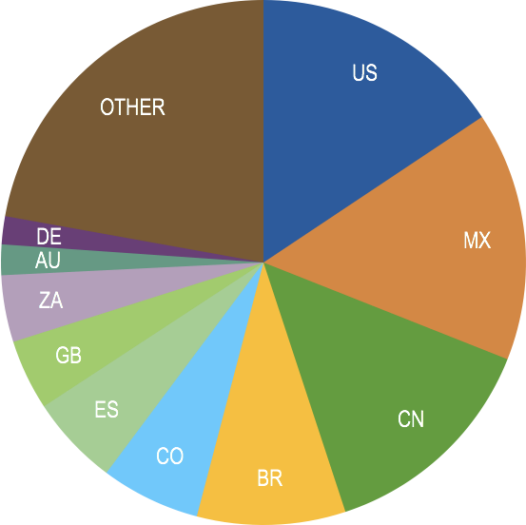
Data download requests by country, 2017 as of 31 Oct 2017
 | Country | Downloads | Aug-17 rank
1 | United States | 14,533 | 2
2 | Mexico | 14,273 | 3
3 | China | 12,940 | 1
4 | Brazil | 8,499 | 4
5 | Colombia | 5,684 | 5
6 | Spain | 5,163 | 6
7 | United Kingdom | 4,036 | 7
8 | South Africa | 3,819 | 8
9 | Australia | 1,748 | 10
10 | Germany | 1,603 | 9
data access and use

Slide 10
data access and use
Peer-reviewed publications using GBIF-mediated data
through 31 Oct 2017

Slide 11
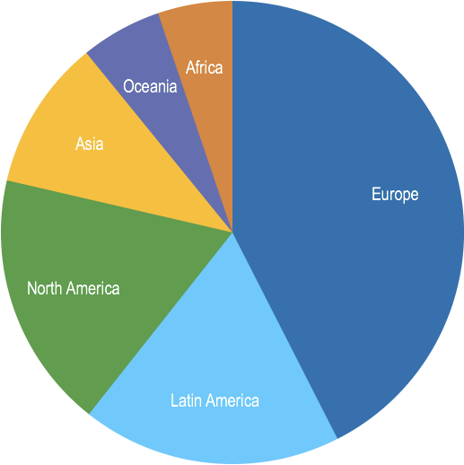
Peer-reviewed uses, by country and region, 2017
Total # of peer-reviewed papers by country
1 | United States | 158
2 | United Kingdom | 72
3 | Brazil | 64
4 | Germany | 63
5 | Spain | 54
6 | Australia | 50
6 | Mexico | 50
8 | China | 44
9 | Canada | 42
10 | France | 36
data access and use
Total # of papers by region
1 | Europe | 473
2 | Latin America | 202
3 | North America | 200
4 | Asia | 117
5 | Oceania | 63
6 | Africa | 58

Slide 12
Featured research
Sept 2017
1 / 2
 | Asch RG, Cheung WWL & Reygondeau G (2017) Future marine ecosystem drivers, biodiversity, and fisheries maximum catch potential in Pacific Island countries and territories under climate change. Marine Policy. https://doi.org/10.1016/j.marpol.2017.08.015 Author countries: United States, Canada
 | Beilschmidt C, Drönner J, Mattig M et al. (2017) VAT: A Scientific Toolbox for Interactive Geodata Exploration. Datenbank-Spektrum 17(3): 233-243. https://doi.org/10.1007/s13222-017-0266-5 Author country: Germany
 | Forti LR, Becker CG, Tacioli L et al. (2017) Perspectives on invasive amphibians in Brazil. PLoS ONE 12(9): e0184703. https://doi.org/10.1371/journal.pone.0184703 Author countries: Brazil, United States
 | Galindo-Rodriguez C & Roa-Fuentes LL (2017) Seed desiccation tolerance and dispersal in tropical dry forests in Colombia: Implications for ecological restoration. Forest Ecology and Management 404: 289-293. https://doi.org/10.1016/j.foreco.2017.08.042 Author country: Colombia
 | Magarey R, Newton L, Hong SC (2017) Comparison of four modeling tools for the prediction of potential distribution for non-indigenous weeds in the United States. Biological Invasions. https://doi.org/10.1007/s10530-017-1567-1 Author countries: United States, Canada, Germany
 | Müller FL, Raitt LM, Chimphango SB et al. (2017) Prioritisation of native legume species for further evaluation as potential forage crops in water-limited agricultural systems in South Africa. Environmental Monitoring and Assessment 189: 512. https://doi.org/10.1007/s10661-017-6230-x Author country: South Africa
data access and use
Invasive alien species
Impact of climate change
Species conservation and protected areas
Biodiversity and human health
Food, farming and biofuels
Ecosystem services
Advancing biodiversity science
Data management
Data papers
https://www.gbif.org/resource/search?contentType=literature

Slide 13
Featured research
Sept 2017
2 / 2
 | Rodríguez-Merino A, Fernández-Zamudio R & García-Murillo P (2017) An invasion risk map for non-native aquatic macrophytes of the Iberian Peninsula. Anales del Jardín Botánico de Madrid 74(1): e055. https://doi.org/10.3989/ajbm.2452 Author country: Spain
 | Semotiuk AJ, Colunga-García Marín P, Valenzuela Maldonado D & Ezcurra E (2017) Pillar of strength: Columnar cactus as a key factor in Yoreme heritage and wildland preservation. Ambio. https://doi.org/10.1007/s13280-017-0940-8 Author countries: United States, Mexico
 | Troia MJ & McManamay RA (2017) Completeness and coverage of open-access freshwater fish distribution data in the United States. Diversity and Distributions. https://doi.org/10.1111/ddi.12637 Author country: United States
 | Waeber PO, Gardner CJ, Lourenço WR & Wilmé L (2017) On specimen killing in the era of conservation crisis – A quantitative case for modernizing taxonomy and biodiversity inventories. PLoS ONE 2(9): e0183903. https://doi.org/10.1371/journal.pone.0183903 Author countries: Switzerland, United Kingdom, France, United States
 | Wan JZ, Wang CJ & Yu FH (2017) Wind effects on habitat distributions of wind-dispersed invasive plants across different biomes on a global scale: Assessment using six species. Ecological Informatics 42: 38-45. https://doi.org/10.1016/j.ecoinf.2017.09.002 Author country: China
data access and use
Invasive alien species
Impact of climate change
Species conservation and protected areas
Biodiversity and human health
Food, farming and biofuels
Ecosystem services
Advancing biodiversity science
Data management
Data papers
https://www.gbif.org/resource/search?contentType=literature

Slide 14
Featured research
Oct 2017
1 / 2
 | Dallas T, Decker RR & Hastings A (2017) Species are not most abundant in the centre of their geographic range or climatic niche. Ecology Letters. https://doi.org/10.1111/ele.12860 Author country: United States
 | Dyderski MK, Paź S, Frelich LE & Jagodziński AM (2017) How much does climate change threaten European forest tree species distributions? Global Change Biology. https://doi.org/10.1111/gcb.13925 Author countries: Poland, United States
 | Glon HE, Heumann BW, Carter JR, Bartek JM & Monfils AK (2017) The contribution of small collections to species distribution modelling: A case study from Fuireneae (Cyperaceae). Ecological Informatics 42: 67-78. https://doi.org/10.1016/j.ecoinf.2017.09.009 Author country: United States
 | Mayer K, Haeuser E, Dawson W et al. (2017) Naturalization of ornamental plant species in public green spaces and private gardens. Biological Invasions. https://doi.org/10.1007/s10530-017-1594-y Author countries: Germany, United Kingdom, Austria, South Africa, Czech Republic, China
 | Mounce R, Smith P & Brockington S (2017) Ex situ conservation of plant diversity in the world’s botanic gardens. Nature Plants 3: 795-802. https://doi.org/10.1038/s41477-017-0019-3 Author country: United Kingdom
 | Nicolson N & Tucker A (2017) Identifying Novel Features from Specimen Data for the Prediction of Valuable Collection Trips. Advances in Intelligent Data Analysis XVI, Lecture Notes in Computer Science 10584: 235-246. https://doi.org/10.1007/978-3-319-68765-0_20 Author country: United Kingdom
data access and use
Invasive alien species
Impact of climate change
Species conservation and protected areas
Biodiversity and human health
Food, farming and biofuels
Ecosystem services
Advancing biodiversity science
Data management
Data papers
https://www.gbif.org/resource/search?contentType=literature

Slide 15
Featured research
Oct 2017
2 / 2
 | Padayachee AL, Irlich UM, Faulkner KT et al. (2017) How do invasive species travel to and through urban environments? Biological Invasions. https://doi.org/10.1007/s10530-017-1596-9 Author countries: South Africa, Germany, France
 | Renteria JL, Rouget M & Visser V (2017) Rapid prioritization of alien plants for eradication based on climatic suitability and eradication feasibility. Austral Ecology. https://doi.org/10.1111/aec.12528 Author country: South Africa
 | Roll U, Feldman A, Novosolov M et al. (2017) The global distribution of tetrapods reveals a need for targeted reptile conservation. Nature Ecology & Evolution 1: 1677-1682. https://doi.org/10.1038/s41559-017-0332-2 Author countries: United Kingdom, Israel, United States, Colombia, Brazil, Malaysia, Cameroon, Belgium, Italy, Ecuador, Senegal, Germany, China
 | Sakalli A (2017) Simulation of potential distribution and migration of Alnus spp. under climate change . Applied Ecology and Environmental Research 15(4):1039-1070. http://www.aloki.hu/pdf/1504_10391070.pdf Author country: Turkey
 | van Treuren R, Hoekstra Roel & van Hintum TJL (2017) Inventory and prioritization for the conservation of crop wild relatives in The Netherlands under climate change. Biological Conservation 216: 123-139. https://doi.org/10.1016/j.biocon.2017.10.003 Author country: Netherlands
 | Vidan E, Roll U & Bauer A et al. (2017) The Eurasian hot nightlife: Environmental forces associated with nocturnality in lizards. Global Ecology and Biogeography 26(11): 1316-1325. https://doi.org/10.1111/geb.12643 Author countries: Israel, United Kingdom, United States, China, Italy, Germany
data access and use
Invasive alien species
Impact of climate change
Species conservation and protected areas
Biodiversity and human health
Food, farming and biofuels
Ecosystem services
Advancing biodiversity science
Data management
Data papers
https://www.gbif.org/resource/search?contentType=literature

