Slide 1
Mobilizing Data, Building Human Capacity and African Regional Engagement are key for better Biodiversity Policy and Management
Dr. Tanya Abrahamse and Ms. Fatima Parker-Allie
COP13 Side Event 6th December 2016

Slide 2
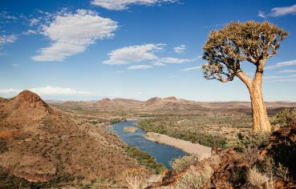
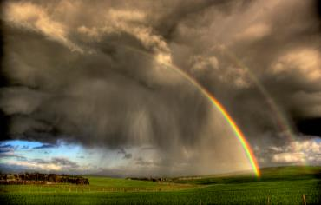
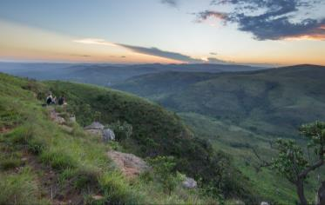
Introduction
Africa is one of the most megadiverse continents in the world.
African biodiversity plays a critical role in sustainable development, provides vital ecosystem services and is one of our greatest regional assets.
The benefits of biodiversity are crucial to key economic sectors (i.e. forestry, agriculture, fisheries, tourism, health and energy) and to providing solutions to sustainable development and poverty alleviation on the continent.
The management of our natural assets and the information related to this are crucial – key to mainstreaming and getting win-win-win solutions

Slide 3
Introduction
The wealth of data we generate, manage, coordinate, and manipulate must be accurate and openly accessible.
Ensuring improved availability, accuracy, reliability and fitness for use, is key to the efficient use of data and information for decision making. Ultimately, we cannot manage what we don’t measure.
Of the c. 0.5 billion species occurrence records that have been published through GBIF, less than ±4% are about African biodiversity, despite Africa having a considerable share of the world’s biodiversity
Aichi Targets of the Strategy of the CBD for 2011-2020
Goal C: Improve the status of biodiversity by safeguarding ecosystems, species and genetic diversity
Goal E: Enhance implementation through participatory planning, knowledge management & capacity building.
Target 19
By 2020, knowledge, the science base and technologies relating to biodiversity, its values, functioning, status and trends, and the consequences of its loss, are improved, widely shared and transferred, and applied.

Slide 4
DATA PUBLISHING ABOUT & FROM AFRICA

Slide 5
Which African Participants are Publishing Data?
South Africa publishes the majority of the data records from the region: 11,501,665
An additional 11 countries and 3 organization Participants from the region publish data
4 Countries publish species checklist data
A number of the institutions participating in BID will also contribute to the publication figures (not included here)

Slide 6
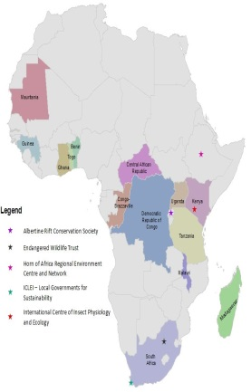
GBIF-Africa
Since 2009 GBIF enabled a series of regional engagement opportunities, to enhance collaborative action in the area of Biodiversity Information Management.
Through the regionalisation strategy Node Managers from approximately 16 countries and 5 organisations, have shown a continual increase in collaboration and capacity.
SANBI was asked to lead the GBIF African Co-ordinating Mechanism (ACM) by the African GBIF members in 2015
Through the ACM, the African Nodes strive to become the data-science interface for this mega-diverse continent, in support of the implementation of the Africa’s Science and Technology Consolidated Plan of Action, amongst other regional policy objectives.
Niger and Nigeria also became Participants post May 2016

Slide 7
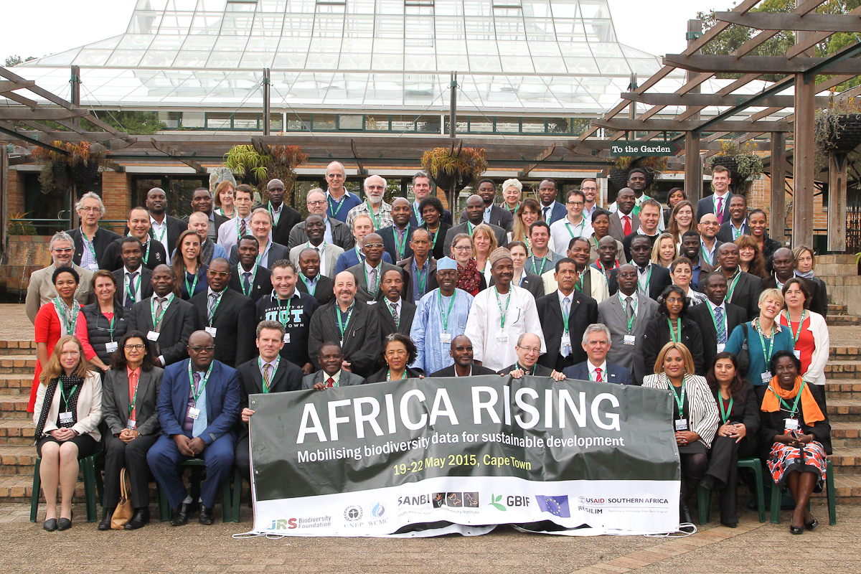
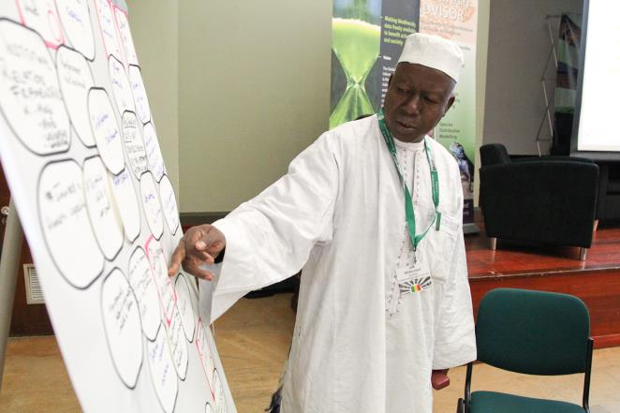
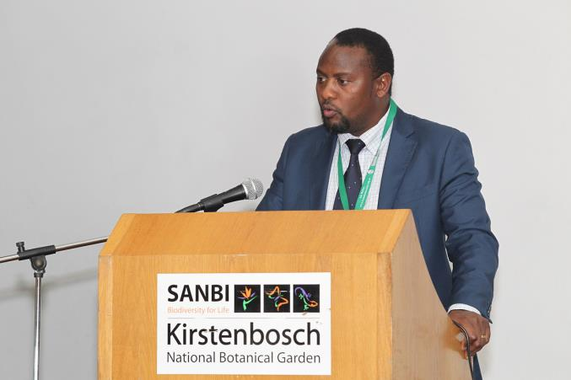
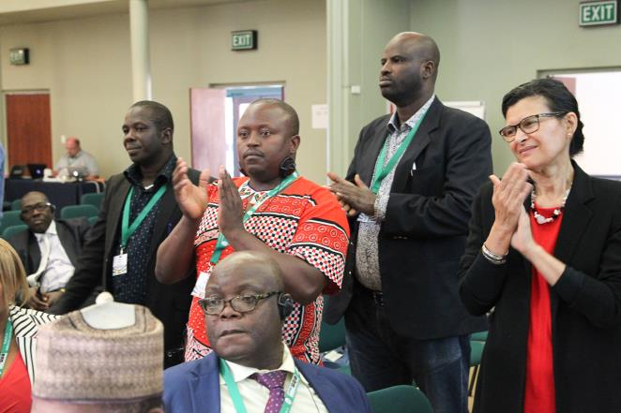
Objectives:
Raise awareness of biodiversity data for sustainable development
Showcase relevant tools, resources & learning networks
Compile regional plan of action & proclaim a declaration
Declaration
Developing a Plan of Action
Notes:
SANBI hosted the very successful Africa Rising Conference in 2015 (approx. 100 delegates from 21 countries), which was the culmination of the project “Mobilizing Africa’s Policy Relevant Data”. This project was developed to initiate the GBIF Africa - ACM with a key achievement of bringing a regional coordinator on board, to support the coordination activities of the GBIF Africa network.

Slide 8
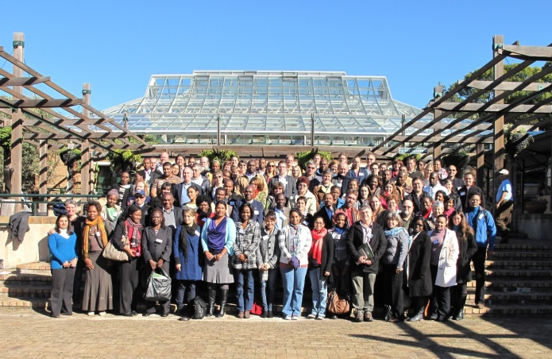
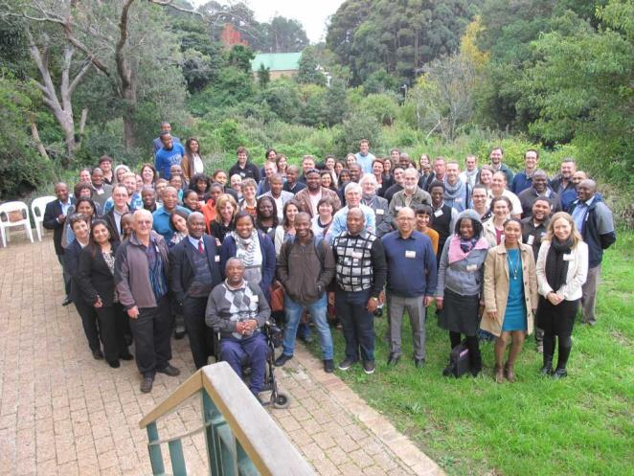
A new Initiative
Africa Biodiversity Challenge: Unlocking Data for Sustainable Development
Goal: To capacitate and incentivise three African countries to mobilise as much biodiversity data as possible in support of sustainable development
Implemented by SANBI in collaboration with UNEP-WCMC and GBIF
Several sub-goals:
Enhance the capacities of the 3 countries to manage and share biodiversity data by providing an intensive tailor‐made training programme.
Establish cohesive and productive national networks through organising Biodiversity Information Management Forums (BIMFs) and compiling ‘national data mobilisation road maps’.
Strengthen incentives for data publishing by way of a competition.
Increase the volume of data published by African institutions.
Increase the awareness of biodiversity benefits (and biodiversity data benefits) through a communications campaign.
End-users: scientists, civil servants and policy-makers.
SANBI has hosted the BIMF annually since 2007. As part of the ABC project this model will be emulated in 3 African countries to build
capacity in BIM
Notes:
Further funding has been awarded by the JRS ($ 250 000 over 2 years) with a key focus on data mobilization and capacity development in Biodiversity Information Management. This project has been initiated in Oct 2016

Slide 9
Improved human wellbeing,
service delivery , economy & job creation
Science based evidence for all levels
Harnessing biodiversity value and enjoyment
Investment in ecological infrastructure
Ecosystem-based adaptation to climate change
Streamlined environmental decision-making
WHAT WE INFLUENCE
SCIENCE INTO POLICY / ACTION:
information | planning | policy advice | models | tools
BUILDING BIODIVERSITY KNOWLEDGE:
assessments | status | trends | monitoring | modelling
GARDENS
windows on biodiversity
HUMAN CAPITAL DEVELOPMENT
WHAT WE DO
FOUNDATIONS OF BIODIVERSITY:
collections| taxonomy | inventory | maps | classification of ecosystems and species

Slide 10
Policy Context for the Regional Engagement Strategy
SDGs
MTSF
DEA Outcomes
SANBI Prog’s
NDP
International agreements
National
National Biodiversity Framework: all 6 Strategic Objectives for regional cooperation with
other Southern African countries.
Medium Term Strategic Framework (2014-2019):
DST’s Ten-Year Innovation Plan :
National Biodiversity Strategy and Action Plans
Institutional
SANBI's mandate comes from the NEMBA 2004. In the framework of this strategy, it is intended
to look at strengthening SA role in supporting SADC and other African countries in fulfilment of the
National Development Plan and international conventions including UNFCCC, UNCCD, CBD. SANBI’s
divisions supports a number of the conventions and international initiatives.
Data-Science Platforms (GEOBON)
Through the regional approach, intended to deliver data sets that contribute to the objectives
of GEOBON, which align with the Aichi Targets.
Science-Policy Platforms (IPBES)
IPBES: The platform includes capacity building and the generation of data and
knowledge among its four core functions, alongside the development of policy tools and
preparation of assessments to enhance the science-policy interface. Improving the availability of
data and information on biodiversity will strengthen the ability of developing countries to
contribute to and benefit from IPBES activities.
SDGs
CBD
Aichi targets
UNCD
UNFCCC
CITES
Progs
e.g. GBIF
IUCN
IPBES

Slide 11
Schematic of the Biodiversity Informatics Landscape for Biodiversity Evidence and Policy
National Government
Implemen-tation & Monitoring
policy
SDG’s CBD CMS CITES RAMSAR
Commitments
Science Policy Interface IPBES
IUCN UNEP-WCMC Future Earth
Taxonomic Research Ecological Research Conservation Research Agricultural Research Human Health Climate Change
Expert Assessments
science
Scientific Research
SANBI Lead ACM
GBIF-Africa Network
GBIF Nodes
ACC
BIOPAMA – IUCN
BHL Africa
Extended Networks – Africa Rising (Data-Science-Policy)
IPBES Regional
Assessment
BID Grantees
JRS
Catalogue of Life
Global Datasets
GBIF
BHL
EOL
IBOL
Biodiversity Information Management Directorate
FBIP
ISPOT
NBA
Specimens/observations/
Images
Taxonomy/
Species
Citizen
Science
Geospatial
data
Sequences/
barcodes
Research /Ecological /
Monitoring data
Literature
Records
Source data
Data
Notes:
As an institution, data is mobilized by SANBI as well it’s the network of partners. This includes the FBIP, the ISPOT initiative, SANBI-GBIF and others. The data generated and mobilized includes occurrence records (specimens and observation records), species data, molecular data, images, literature, geospatial data etc. These data sources are coordinated by the Biodiversity Information Management Planning Directorate, and contribute to global datasets and platforms such as the GBIF, EOL, BHL, IBOL and the Catalogue of Life.
In order to further contribute to these global datasets, SANBI also plays a role through coordinating a regional network of GBIF-Africa Nodes, also geared towards data mobilization and publishing efforts.
Here large amounts of data will be mobilised through the Biodiversity for Development (BID) Initiative, funded by the European Union. Data mobilised at national and regional levels, is then fed into scientific assessments, such as the IUCN redlisting efforts, initiatives such as Future Earth and will support and contribute to the objectives of the Global Earth Observation Biodiversity Observation Network (GEOBON), which is a Data-Science Platform.
All this data and knowledge generated will support the objectives of IPBES, and the conventions which national governments are committed towards. The platform includes capacity building and the generation of data and knowledge among its four core functions, alongside the development of policy tools and preparation of assessments to enhance the science-policy interface. Improving the availability of data and information on biodiversity will strengthen the ability of developing countries to contribute to and benefit from IPBES activities.

Slide 12
Conclusion
In a world that counts the United Nations describe data as the lifeblood of decision making and the raw material for accountability. Thus, good and accurate data is one the key building blocks for analysis
As huge volumes of data become available in this modern digital age, due to new and innovative technologies, we look towards mobilising “the data revolution” for sustainable development.
This will demand broad efforts to build capacity and increase human capital in the field of Biodiversity Information, especially on the African continent, to fully support a data revolution for sustainable development.
IEAG 2014. A world that counts. Mobilising the Data Revolution for Sustainable Development.
Report prepared by The United Nations Secretary-General’s Independent Expert Advisory Group
on a Data Revolution for Sustainable Development, at the request of Secretary General of the
United Nations, New York.

Slide 13
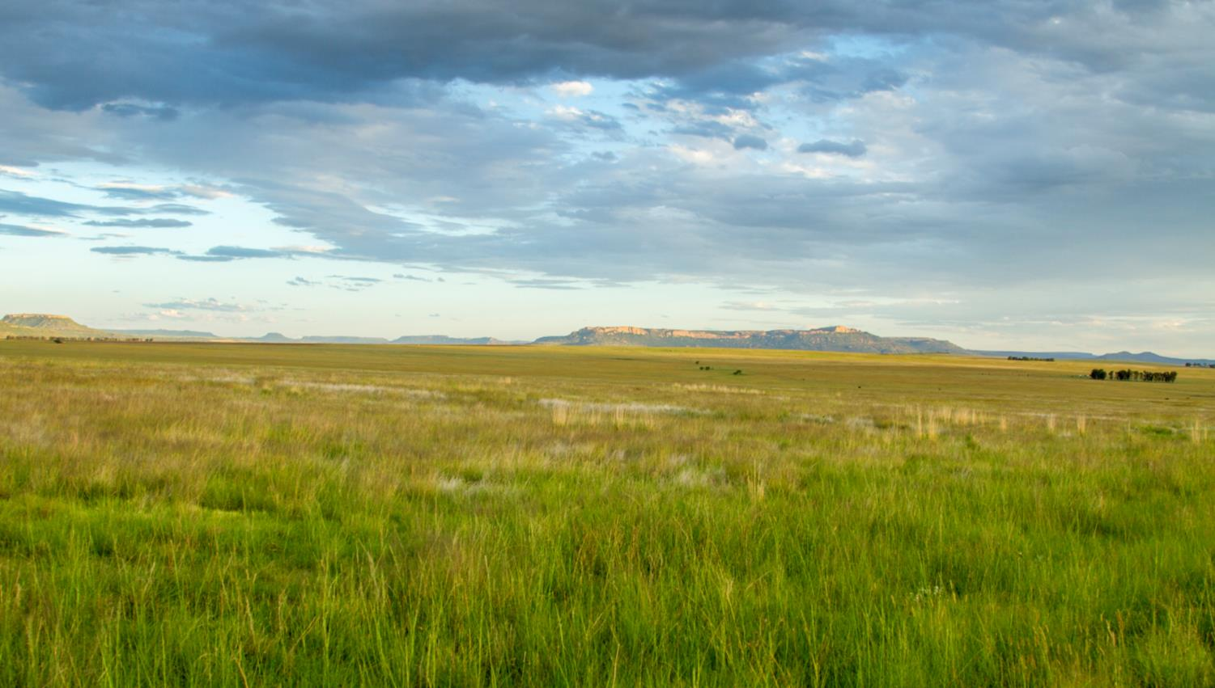
Thank You

