Slide 1
Introduction to GBIF and the BID programme
Tim Hirsch, Deputy Director, GBIF Secretariat
Regional engagement meeting, bid pacific, sprep headquarters, samoa, 27-28 july 2017

Slide 2

GBIF origins
1999: recommendation of Biodiversity Informatics Subgroup of OECD Megascience Forum
“An international mechanism is needed to make biodiversity data and information accessible worldwide”
2001: GBIF Memorandum of Understanding opened for signature
2003: Secretariat established in Copenhagen under country host agreement with Denmark
2004, 2008, 2012: MoU renewed, last version NOT time limited

Slide 3

Memorandum of understanding (mou)
Three forms of participation:
Voting country – financial contribution to core funds
Associate country – time limited to 5 years
Associate organization/economy

Slide 4
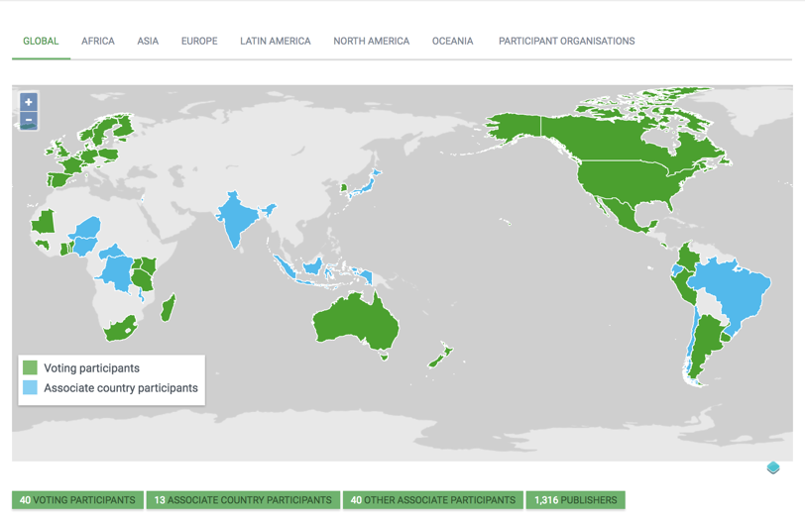
Current national participants
participation
Participation is through ‘nodes’ coordinating data mobilization from national institutions/networks
Collaboration at regional and global level
https://demo.gbif.org/the-gbif-network

Slide 5
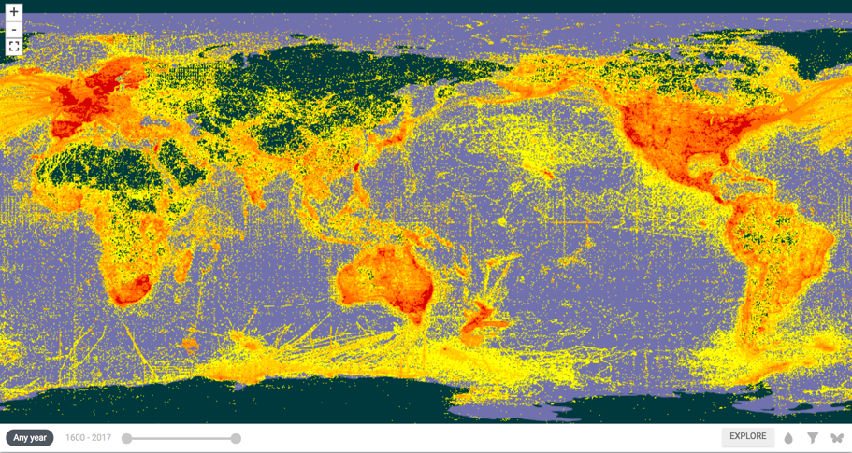
DATA DISTRIBUTION
Each dot represents evidence of species occurrence with standardized information on e.g.: What? Where? When? Collected/observed by whom? What evidence?
www.gbif.org/occurrence

Slide 6
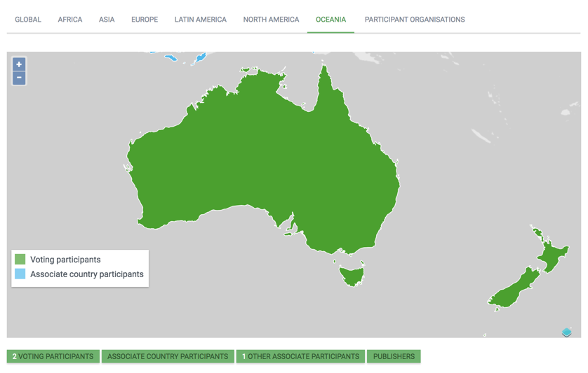
Participation in oceania
https://demo.gbif.org/the-gbif-network/oceania

Slide 7
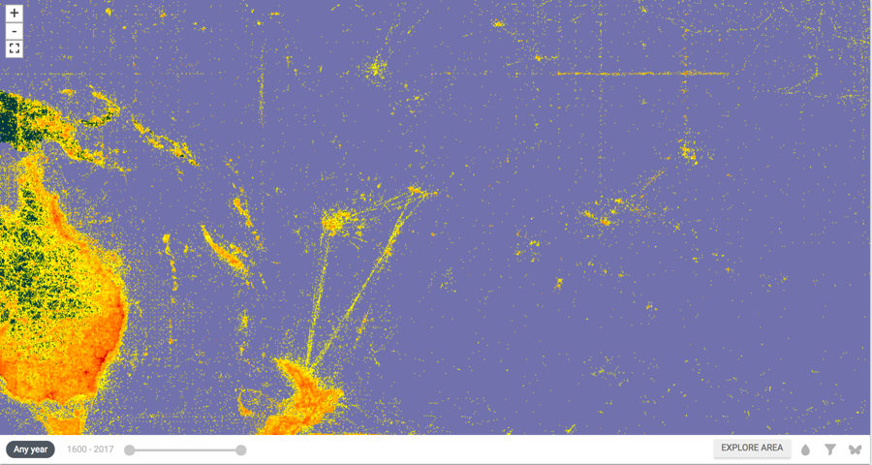
Data distribution in the pacific

Slide 8

BY THE NUMBERS
July 2017
Species occurrence records
Datasets
788,930,523
35,449
Country Participants
Organizational Participants
Publishers
53
40
993
Records downloaded per month (avg 2017)
Unique users per month (Apr 2017)
35.7 billion
106,438
Notes:
Useful to see GBIF in its different modalities:
A window on biodiversity
An informatics infrastructure focuseD on tools and standards in service to science and society
A global network on bioinformatics

Slide 9
data access and use
Peer-reviewed publications using GBIF-mediated data

Slide 10

data access and use
Peer-reviewed publications using GBIF-mediated data
https://demo.gbif.org/science-review

Slide 11
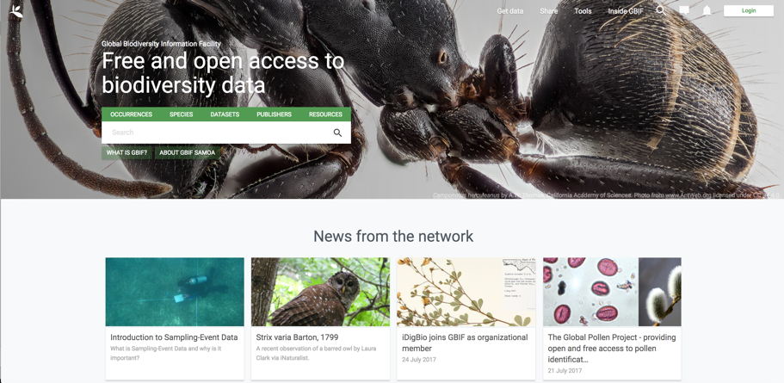
New gbif.org platform!
https://demo.gbif.org

Slide 12
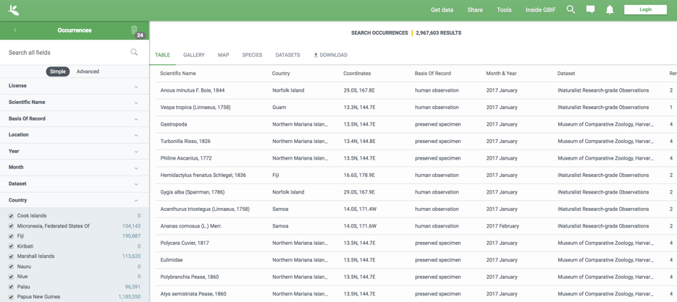
Species Occurrence records in pacific islands

Slide 13
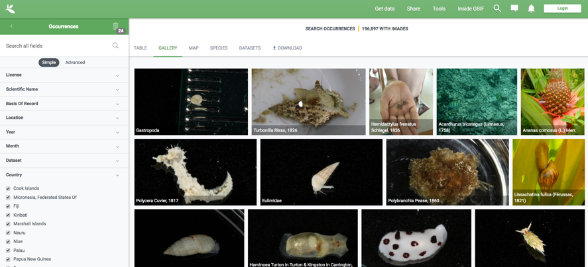
Species Occurrence records in pacific islands

Slide 14
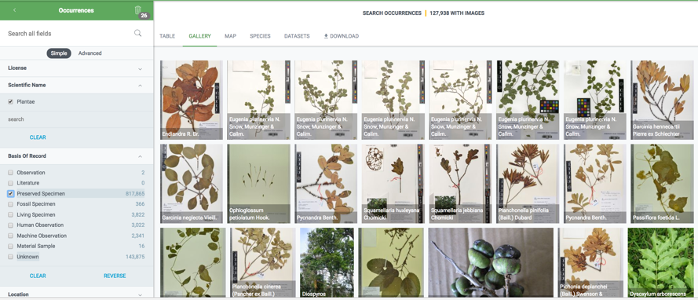
Species Occurrence records in PACIFIC ISLANDS

Slide 15
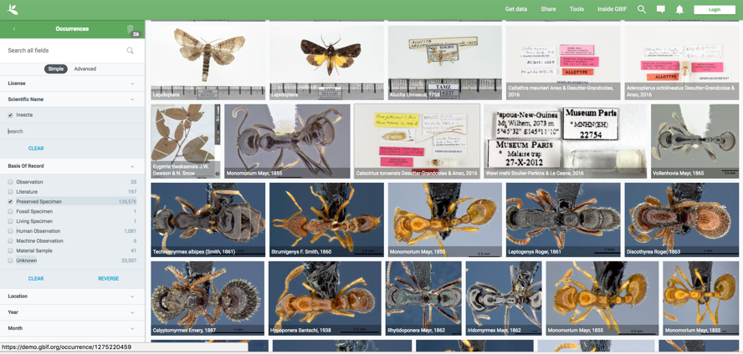
Species Occurrence records in PACIFIC ISLANDS

Slide 16

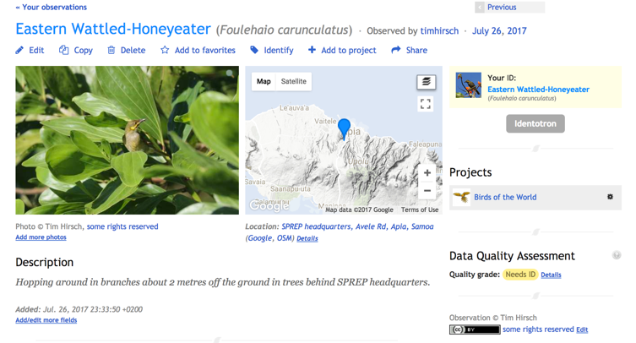
Citizen science records in gbif

Slide 17
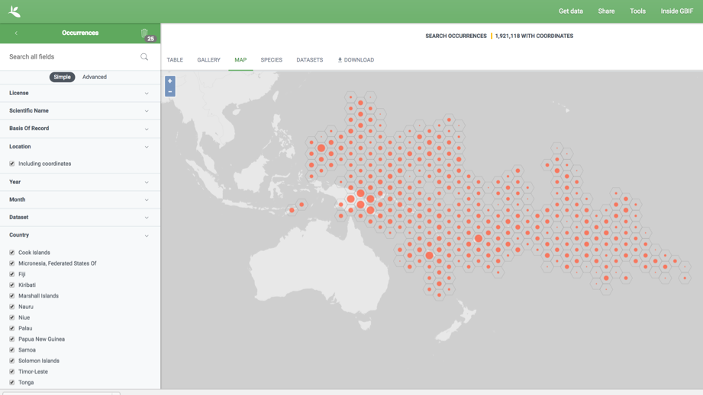
Species Occurrence records in PACIFIC ISLANDS

Slide 18
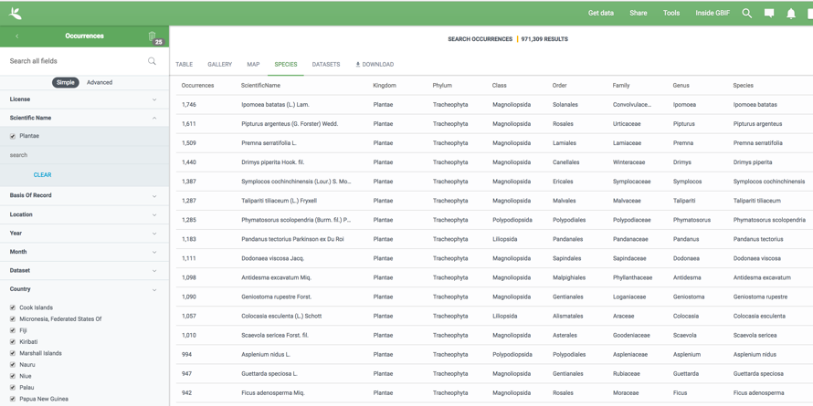
Species Occurrence records in PACIFIC ISLANDS

Slide 19
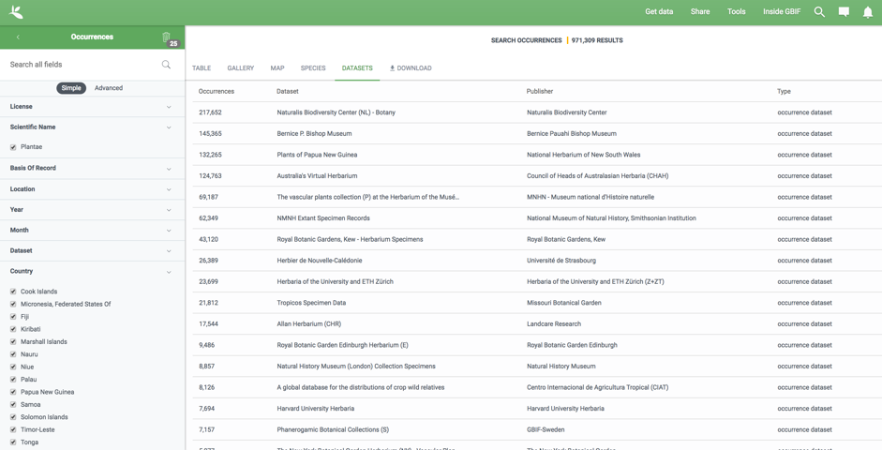
Species Occurrence records in PACIFIC ISLANDS

Slide 20
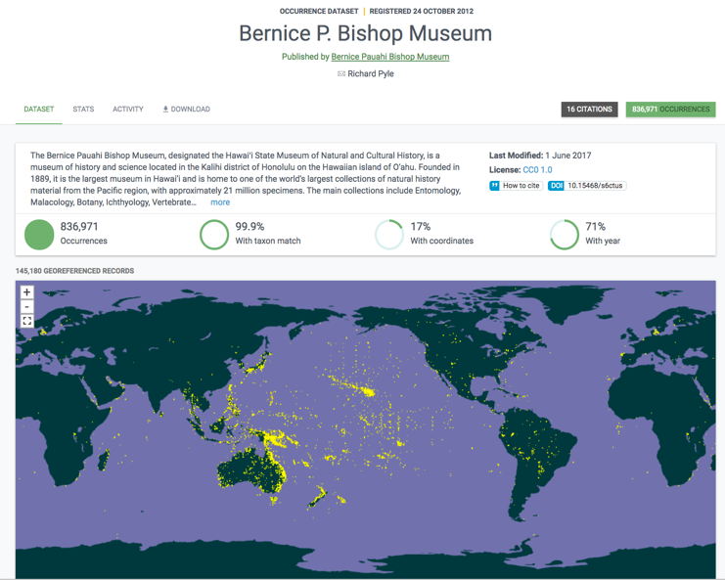
Dataset pages and citations

Slide 21
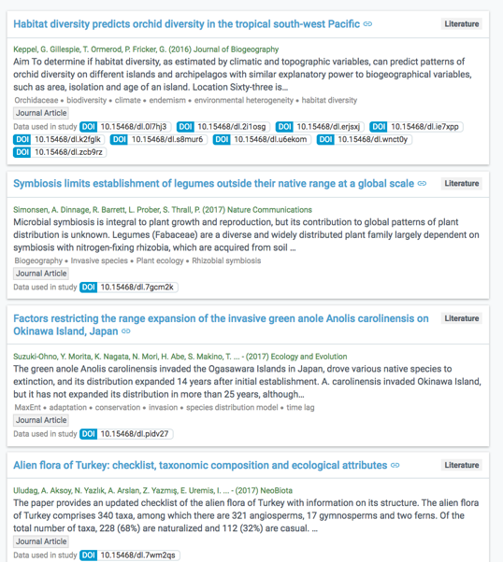
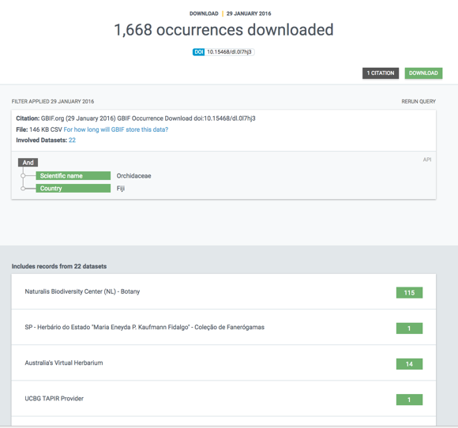
Dataset pages and citations

Slide 22
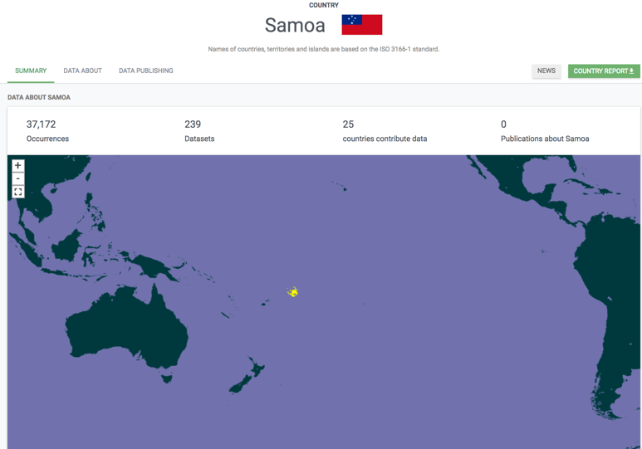
COUNTRY PAGES AND REPORTS

Slide 23
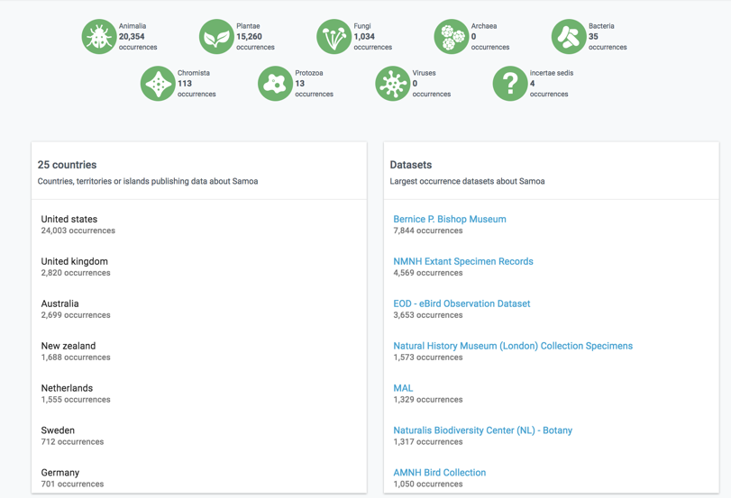
COUNTRY PAGES AND REPORTS

Slide 24
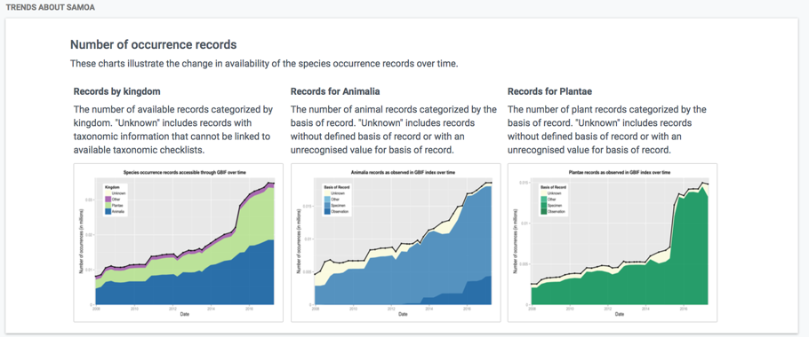
COUNTRY PAGES AND REPORTS

Slide 25

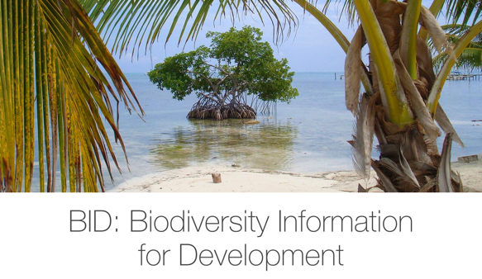

The bid programme
Four-year programme, 2015-2018
Funded by EuropAid (EU DEVCO), managed by GBIF
Aims to increase biodiversity information available in Africa, Caribbean, Pacific
Supports capacity enhancement, mobilization of data, strengthening networks
Focus on data to support policy needs (invasives, protected areas, threatened species)
www.gbif.org/bid, http://bid.gbif.org/

Slide 26
Bid programme timetable
Three project periods
First Africa call – 23 projects running (2016-2018)
Parallel calls in Caribbean and Pacific – 8 projects running in Caribbean, 5 in Pacific (2017-2018)
Second Africa call – 384 concept notes received! 42 projects invited to submit full proposals, selection August 2017
http://www.gbif.org/newsroom/news/idb-2015

Slide 27
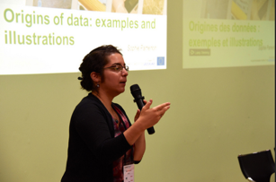
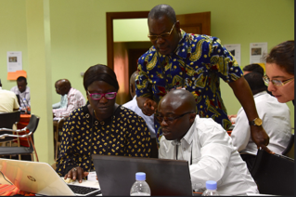
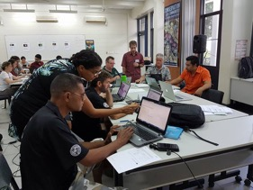
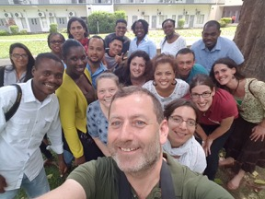
Building community of practice
Capacity workshops for project teams: Rwanda (Aug 2016), Trinidad (June 2017), Samoa (July 2017)
Strong voluntary training/mentoring effort from GBIF community experts
Continuing mentoring and helpdesk support through project implementation
www.gbif.org/bid

Slide 28
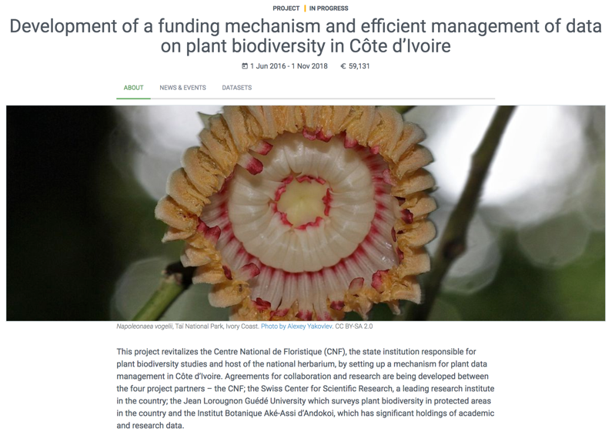
Project datasets
https://demo.gbif.org/dataset/6638025e-8f15-45e7-9fc4-2afe55b20d1e

Slide 29
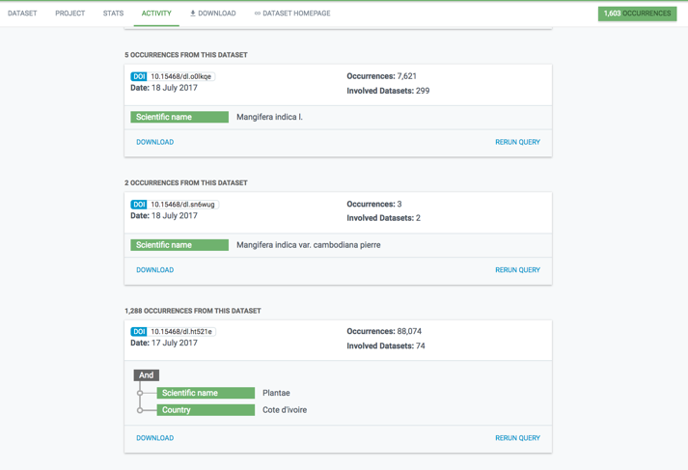
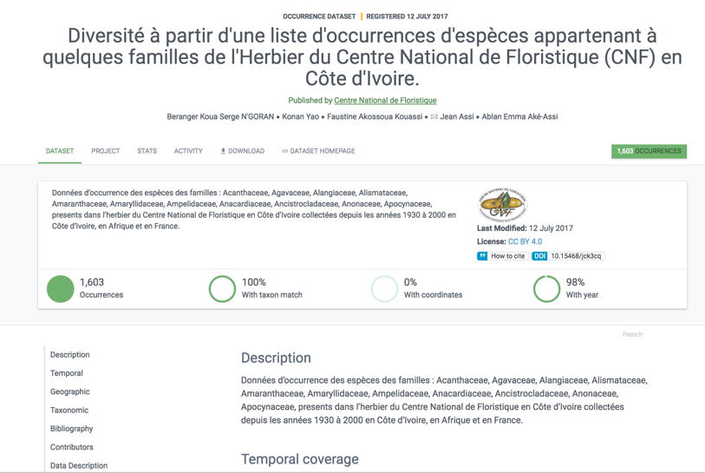
Project datasets already in use!
https://demo.gbif.org/dataset/6638025e-8f15-45e7-9fc4-2afe55b20d1e

Slide 30
Fa’afetai lava!
thirsch@gbif.org

