Slide 1
CBD COP13 Presentation
INTRODUCING the Connect project –
“mainstreaming biodiversity information in three African countries to deliver global lessons”
Hilary ALLISON
Notes:
Start of a journey
Brief title full title

Slide 2
INTRODUCING the Connect project – mainstreaming biodiversity information in three African countries to deliver global lessons
The context and the challenge we face
The Connect project
The problem – barriers
The impact
The approach
Notes:
Road map of the talk

Slide 3





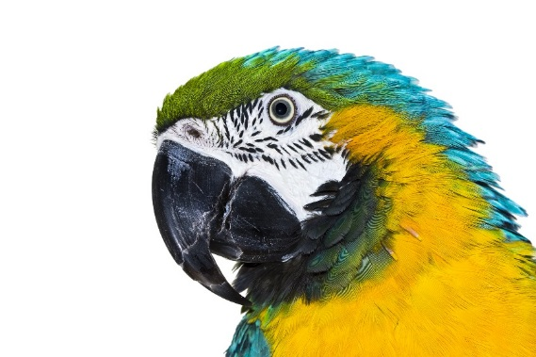
CONTEXT
Notes:
Lets begin with some context
A number of initiatives and organisations collate and enhance open access to data and tools and increase scientific robustness of b/d data
BIP - data sharing, collaboration and networking to mobilise evidence to track the Aichi Targets.
GBIF for species occurrence data, sharing and capacity building
GEO BON for b/d observations, data management, analysis and reporting and coordination of BONs
UNEP LIVE An UN system-wide open platform of environmental information
designed for global, regional and national data sharing and
assessment

Slide 4
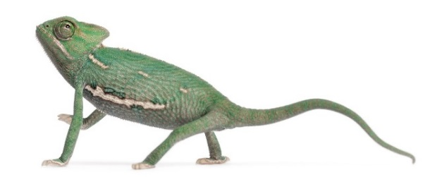
Data for decisions: Challenges
Decision makers need:
  Scientifically credible, legitimate and relevant information.
  Effective methods to interpret this scientific information in order to make informed decisions
Scientific community needs:
  To better understand decision makers’ needs to provide them with useable information.
Notes:
Collective challenge - transform this effort into tangible impact on the ground?
2 sides of the coin:
Decision-makers need robust science relevant to their circumstances.
Scientists want a deep understanding by users of their data. Key theme emerging from the Science Forum – need to understand what decision makers want and get closer to them

Slide 5
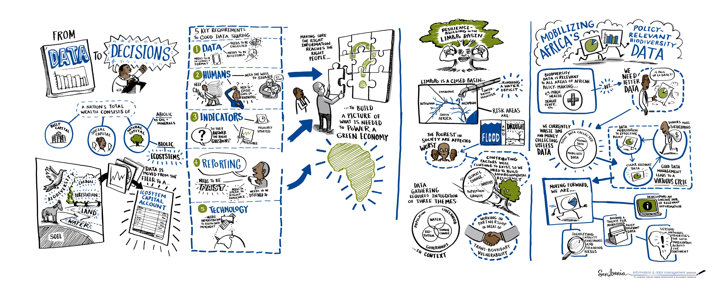
Biodiversity information in national decision making
Notes:
But
It is not simply about providing more or better data
It’s about targeting those decisions that directly impact on the sustainability of natural capital and finding the entry points for b/d info.
It’s about making existing data available through strengthening sharing platforms and databases
It’s about understanding the decision making context. The constraints put on decision makers and the frameworks they work within in their day to day work.
These issues are THE BACKBONE OF THE CONNECT PROJECT

Slide 6



CONNECT: Mainstreaming biodiversity information into the heart of government decision making
Funder
Global Environment Facility
Global Trust Fund, Biodiversity Focal area
Implementing Agency
UN Environment
Overall project supervision to ensure consistency with GEF and UNEP policies and procedures
Executing Agency
UNEP-WCMC
Responsible for overall execution of the project and ensuring that financial and technical reporting requirements are met
Notes:
THE CONNECT PROJECT We are at start of a journey – project just launched in October
The project is being designed as a global project
GEF $5m over four years. Multiple partners inc. national govs.
Designed to achieve a balance of “deep” interventions in a small number of related countries, with “broad” engagement and showcasing at global level

Slide 7
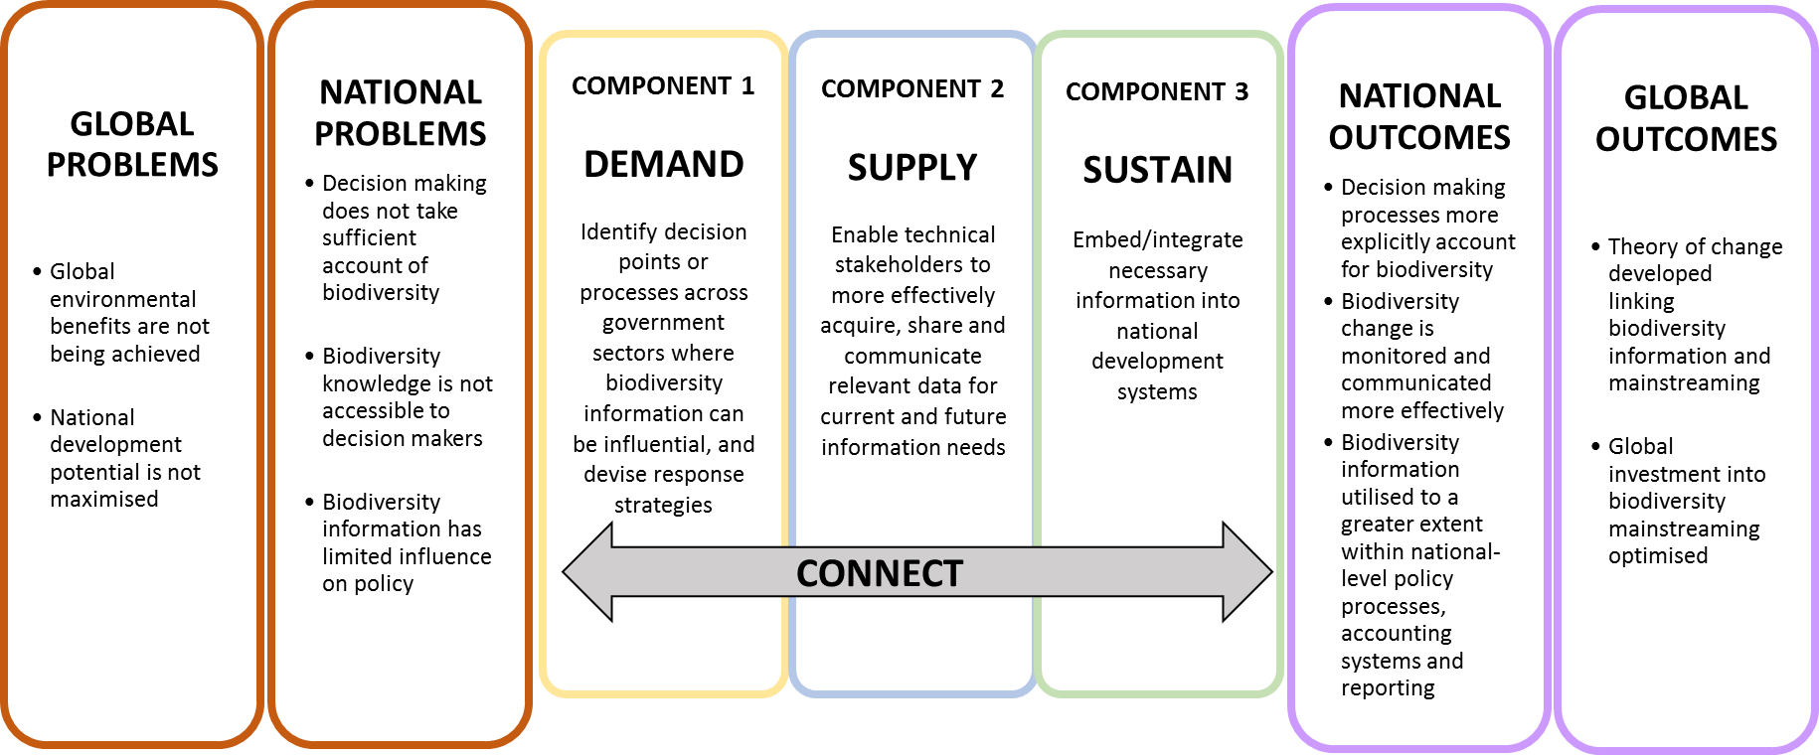
CONNECT: Mainstreaming biodiversity information into the heart of government decision making
Notes:
High level theory of change –
The ultimate goal is to help achieve sus. Dev. by bringing b/d to the heart of government d/m using actionable b/d info
SWITCH behaviour change as well as biodiversity information

Slide 8



Country partners
Uganda
Ghana
Mozambique
INTERNATIONAL PARTNERS
IIED, Birdlife International, GBIF, SCBD, GEO-BON, JRC
Notes:
We are very pleased to be working with three highly motivated countries
And a range of international partners and data providers

Slide 9
The Problem
GLOBAL PROBLEMS
Global environmental benefits are not being achieved
National development potential is not maximised
NATIONAL PROBLEMS
Decision making does not take sufficient account of biodiversity
Biodiversity knowledge is not accessible to decision makers
Biodiversity information has limited influence on policy
BARRIERS
Availability of data
Usability and quality of data
Willingness to collect and use data
Capacity
Notes:
Let’s look together at the high level problems (say them)
COP 12 workshop - 42 participants from 20 African countries - discussed the barriers to using b/d info in decision making in their country

Slide 10
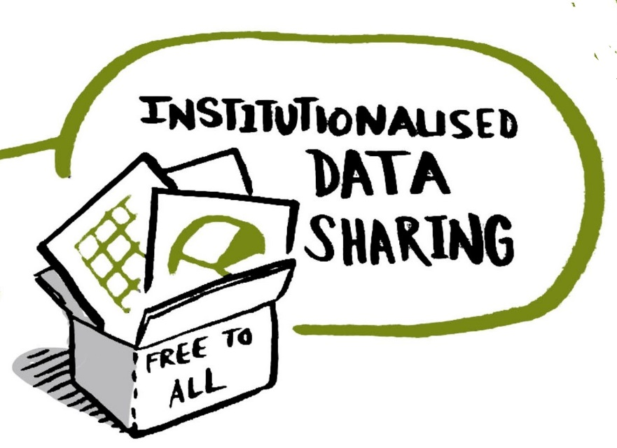

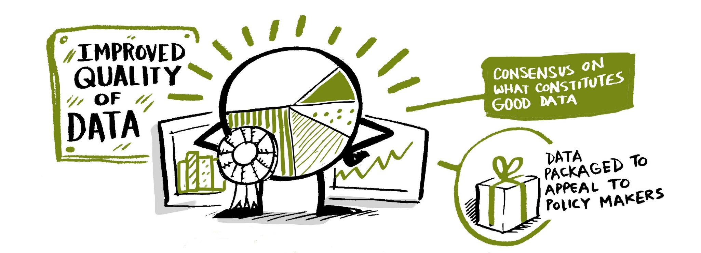
1. Data availability???
2. Usability and quality of data???
Notes:
Barriers identified
Availability of data Poorly targeted info initiatives / Limited understanding of what b/d data are required – one government stated it finds integration of data challenging due to poor institutional connections - underlying political tensions.
2. Usability and quality of data Data do not exist, in incompatible formats, or otherwise inaccessible. / PERCEIVED QUALITY In one country they have scientific info on land use impacts on b/d, but this is not used in d/m – due to info being collected by academic institutions, with little interaction with potential data users in d/m

Slide 11
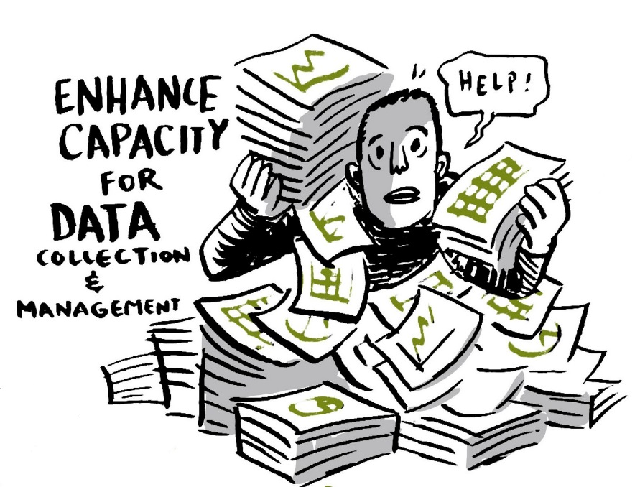
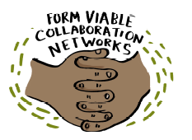
3. Willingness to share
4. Capacity
Notes:
Barriers
WILLINGNESS Government ministries have competing priorities / Insufficient political will. In one NBSAP it was noted that public managers were disregarding b/d info due to political interests / lack of inter-ministerial collaboration
CAPACITY high turnover of government staff / Inefficient systems for sharing experiences, lessons, good practices, tools etc.

Slide 12
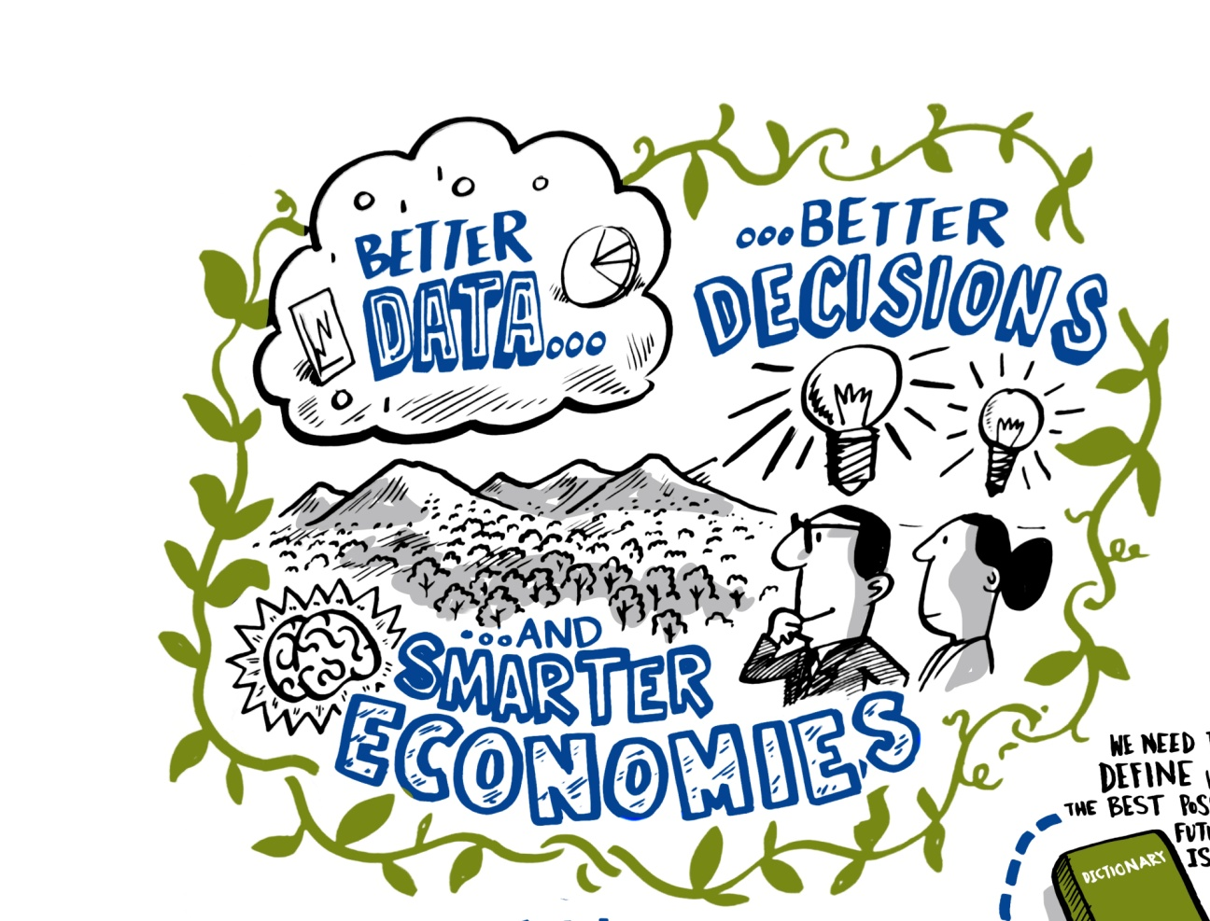
The Impact
NATIONAL OUTCOMES
  Decision making processes more explicitly account for biodiversity
  Biodiversity change is monitored and communicated more effectively
  Biodiversity information utilised to a greater extent within national-level policy processes, accounting systems and reporting
GLOBAL OUTCOMES
  Proof of concepts developed linking biodiversity information and mainstreaming
  Global investment into biodiversity mainstreaming optimised
Notes:
What is the impact and the outcomes we seek?
Improved GLOBAL understanding of, and capacity to use and generate b/d info to influence development outcomes.
Revision and development of project theory of change through practice and applied research.
Leading to peer reviewed literature on these subjects which can be used by global initiatives

Slide 13
The Approach
Notes:
Connect focuses on in depth development of proofs of concept with a small number of pilots to:
DEMAND - understand the in-country demands for, and barriers to using, biodiversity info within gov decision making including clarifying the format, timing and packaging required - at this stage we don’t know for certain whether we will focus on a particular sector with respect to biodiversity mainstreaming or on a more generic approach such as natural capital accounts
SUPPLY - Mobilise and repackage existing b/d data and information to meet a number of the demands; and
SUSTAIN - strengthen connections between gov d/m and data providers in order to sustainably provide policy-relevant, spatially explicit information to meet ongoing national needs.
Explore these three components in a bit more detail

Slide 14
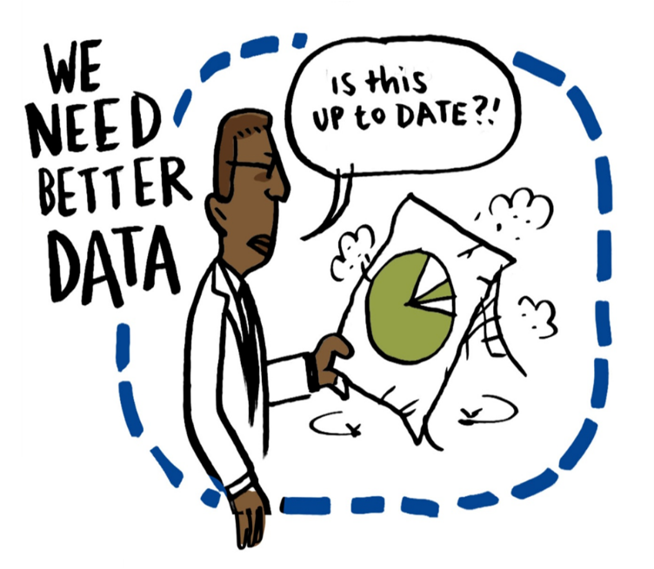
Component 1: demand
Decision points or processes across government sectors are identified where biodiversity information can be influential, and response strategies devised.
Assess the national situation
Political Economy Analysis
Raise awareness and build partnerships
User groups established
Find suitable entry points for biodiversity information
Develop an action plan
OECD-DAC definition: “political economy analysis is concerned with the interaction of political and economic processes in a society; including the distribution of power and wealth between groups and individuals, and the processes that create, sustain and transform these relationships over time”.
Notes:
Key activities of this component include
carrying out preliminary situation assessments with user groups;
better understanding the governmental, institutional and political contexts – political economy analysis ;
assessing and strengthening mainstreaming capacities;
enhancing co-ordination mechanisms for sustained mainstreaming;
and raising awareness and building partnerships.
PEA – help recognise and understand the current political and economic processes in order to strategically position project interventions.

Slide 15
Component 2: Supply
Technical stakeholders are more easily able to acquire and share relevant data, and use this to communicate effectively, for current and future information needs
Strengthen the capacity of data providers to respond to demand
  Respond to barriers
Assess current biodiversity information landscape
  Information on where relevant data housed and by whom
Rapid data mobilisation exercise
  Source and repackage existing biodiversity information
Capacity building to ensure technical stakeholders are more easily able to acquire and share relevant data and global data providers can respond to national needs

Slide 16

Component 3: Sustain
Policy frameworks, including accounting and reporting systems across a range of sectors are incorporating biodiversity decisions
Embed biodiversity information into national decision making frameworks
  e.g. MOUs between data providers and end-users
  Cross-ministerial forums and partnerships
Dissemination of project outputs at the regional and global scale
Notes:
Mainstreaming is a long-term process, and the project timeframe allows us only to measures steps towards a long-term behaviour change.
Activities such as establishing Memorandums of Understanding (MoUs) between data providers and end users, establishing cross-ministerial forums, and targeted, bespoke capacity building activities for both data providers and end users.
Replicating successful project interventions, along with applying the lessons learned iteratively through the project, will allow for future mainstreaming interventions on a national, regional or global scale to be more strategically designed. This will in turn allow for a greater chance of these projects being successful and global environmental benefits being achieved.
As biodiversity information is integrated into decision making across government sectors, end users will be able to implement policy or commitments more effectively and data providers will be provided with up-to-date information on the context in which their data are used.

Slide 17
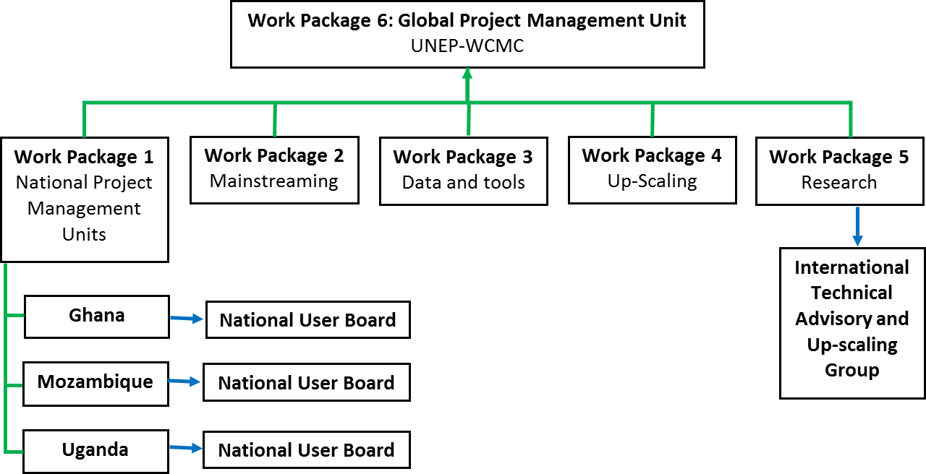
Project structure

Slide 18
CONNECT: Mainstreaming biodiversity information into the heart of government decision making
Notes:
Together these make up the high level theory of change.
Starting a journey…………..

Slide 19

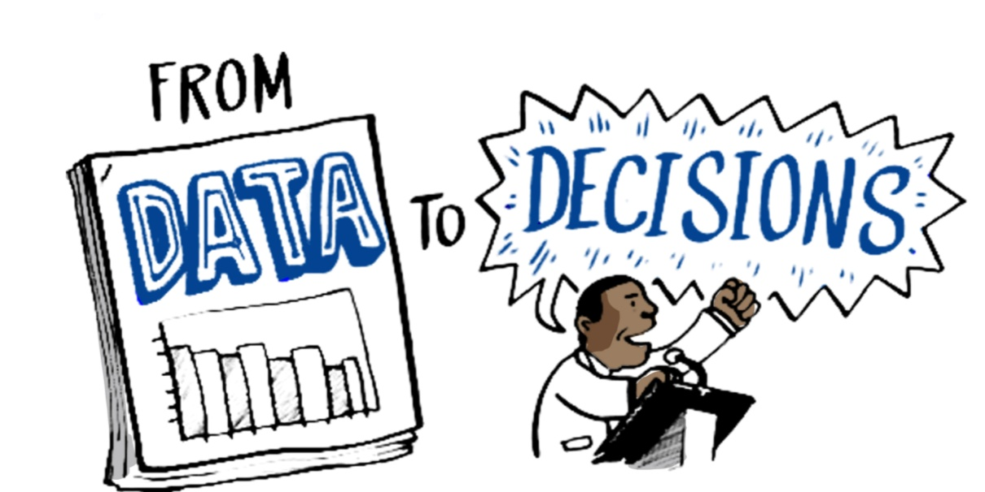
How to make BIODIVERSITY data more influential?
Thank you
Notes:
Leave you thinking about on how data can have a bigger impact in the world... GBIF and others can use the outputs of the Connect project to deeply understand end user needs.
Ultimately this understanding of the national context better improves the Credibility Relevance and Legitimacy of your information
Thank you

