Slide 1
Capacity building and data mobilization for conservation and decision making in the South Pacific BID-PA2016-0002-REG
Kelly Thomas Brown
School of Marine Studies, Faculty of Science, Technology and Environment, The University of the South Pacific,
Laucala Campus, Suva, Fiji.
kelly.brown@usp.ac.fj

Slide 2
BID-PA2016-0002-REG:
Government of the Solomon Islands.
Ministry of Environment, Climate Change, Disaster Management &
Meteorology
Environment & Conservation Division
School of Marine Studies
Fisheries, Aquaculture & Marine Ecosystems Division

Slide 3
Non-ACP consortium partner:
Project collaborator:
www.vertnet.org

Slide 4
Why come together to undertake this type of Project?

Slide 5
Source: http://www.lib.utexas.edu/maps/islands_oceans_poles/oceania_95.jpg

Slide 6
Source: http://www.lib.utexas.edu/maps/islands_oceans_poles/oceania_95.jpg

Slide 7
Source: http://www.lib.utexas.edu/maps/islands_oceans_poles/oceania_95.jpg

Slide 8
Source: http://www.lib.utexas.edu/maps/islands_oceans_poles/oceania_95.jpg

Slide 9
Source: http://www.lib.utexas.edu/maps/islands_oceans_poles/oceania_95.jpg

Slide 10
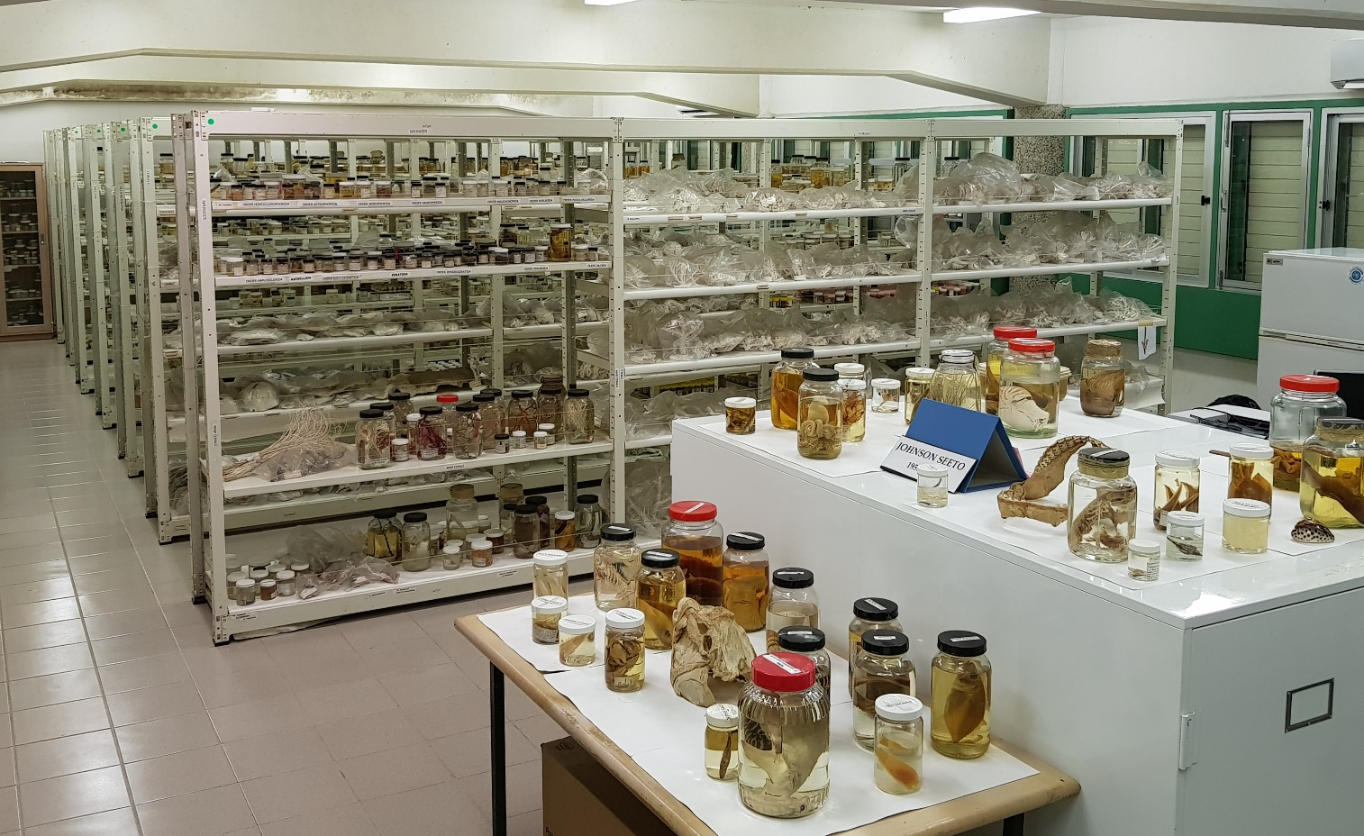
The Marine Collection at the School of Marine Studies (USP)

Slide 11
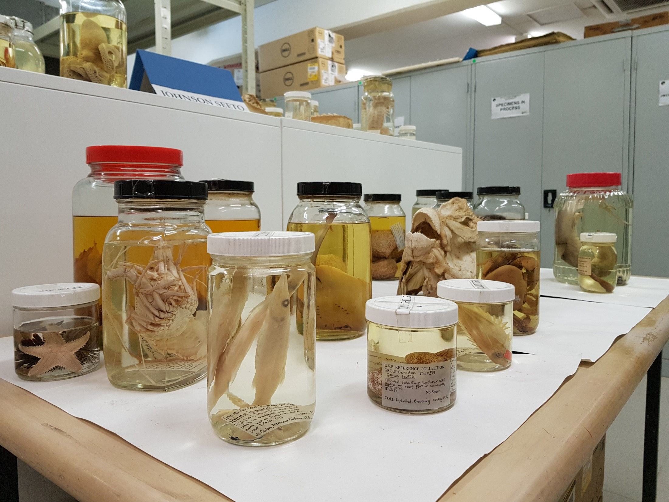

Slide 12
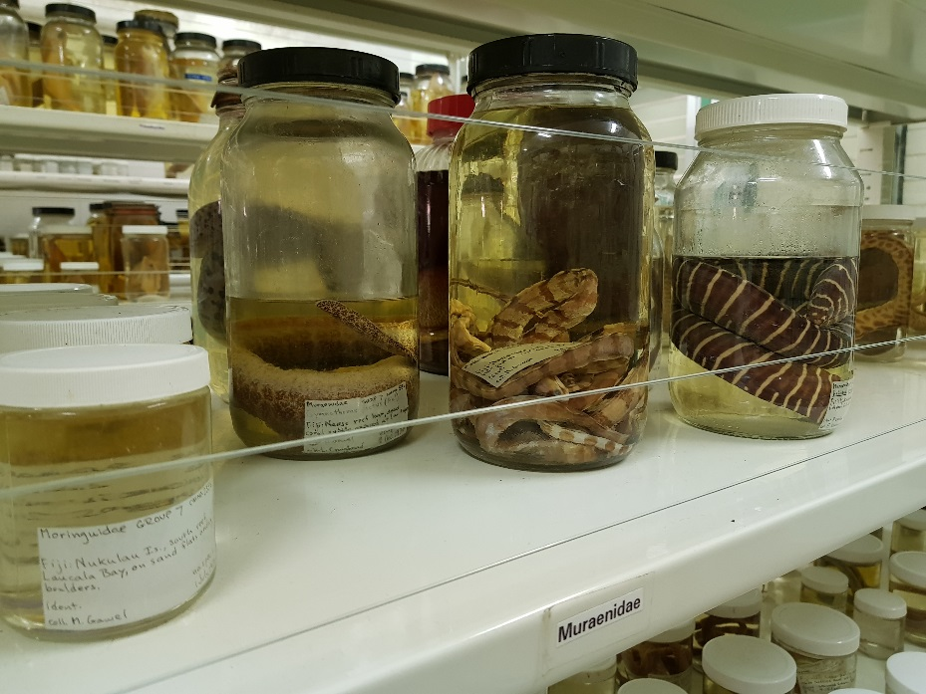
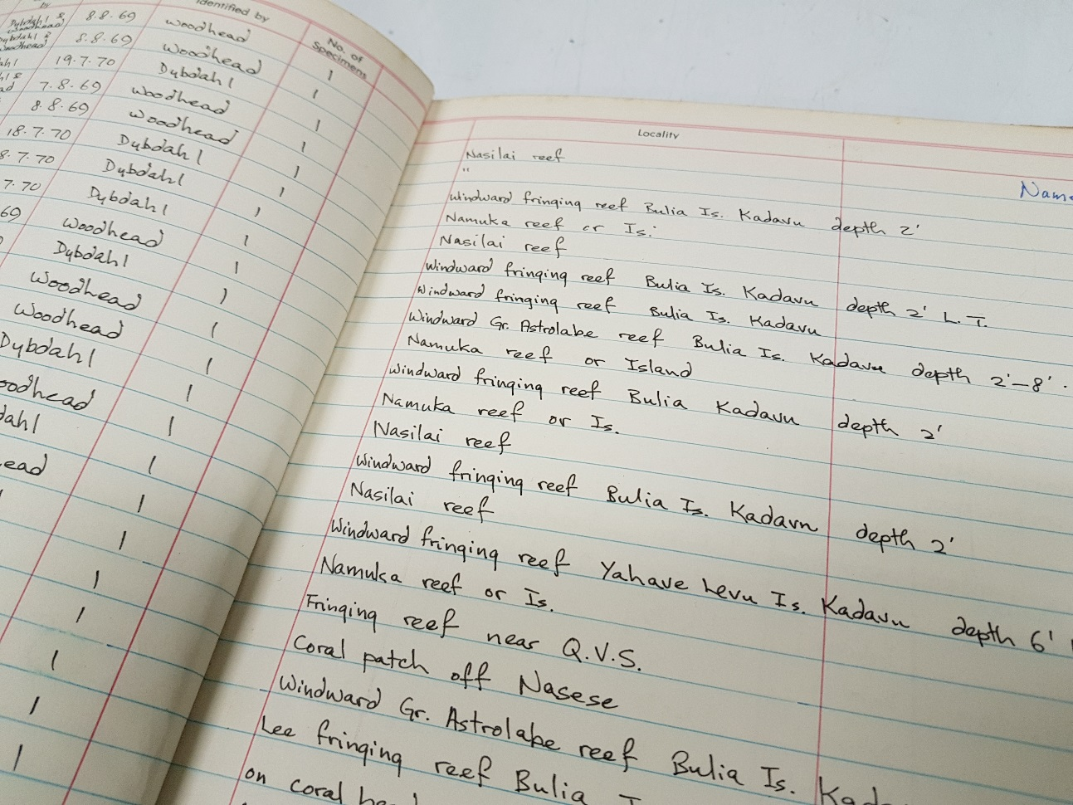

Slide 13
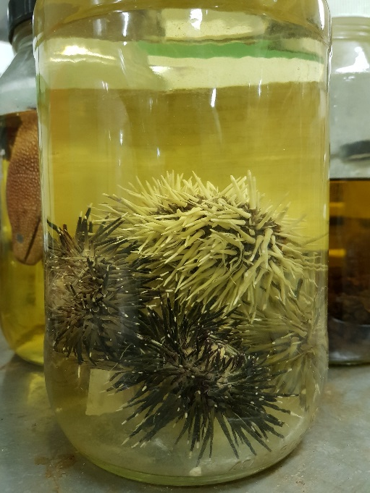
Project goals:
motivate the collection and standardisation
of georeferenced biodiversity data across the
region,
train a cadre of data generators and decision makers in how to collect, manage, digitise and publish biodiversity data, and
lay the foundation for a collaborative network of biodiversity researchers and resource managers who can identify overlapping interests and regional needs to develop new initiatives.

Slide 14
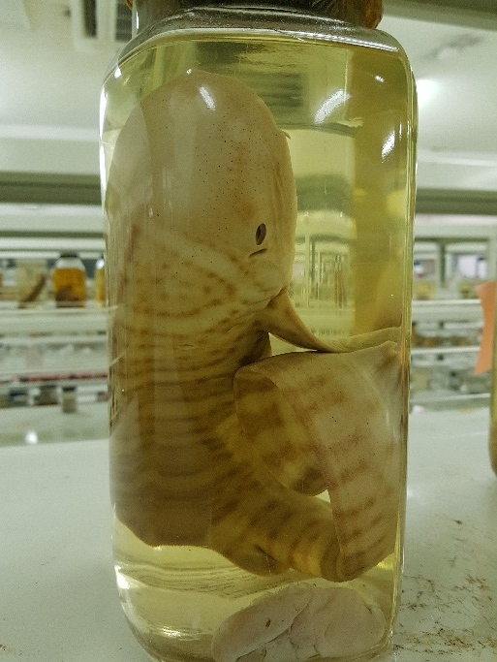
Project activity:
Conduct a 5 day training workshop in Suva, Fiji
(July 2018).
Collection managers, academic researchers and conservationists (Fiji, New Caledonia, the Solomon Islands & Vanuatu).
Instruction and hands-on exercise on how to mobilise and digitise data (CSUMB & VertNet).
Publish marine biodiversity datasets to GBIF.

Slide 15
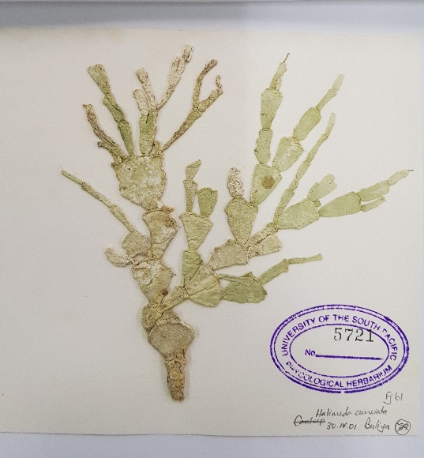
Workshop objective #1
Network building – collaborative network of biodiversity researchers.
USP as the hub for biodiversity data in the region.
Enroll partners in Diversity of the Indo-Pacific Network (DIPnet; diversityindopacific.net).
Training in use of biodiversity data in
public repositories: GBIF, DIPnet and
VertNet.

Slide 16
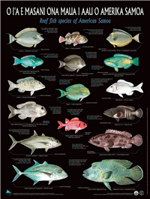
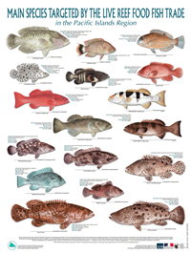
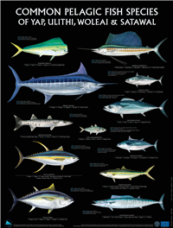
Workshop objective #2
Training (digitisation, quality control)
Publishing
- occurence data (mainly USP) and,
- checklist data for the participating countries
Checklist images from www.spc.int

Slide 17
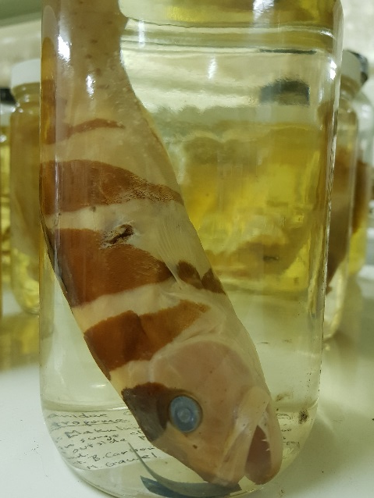
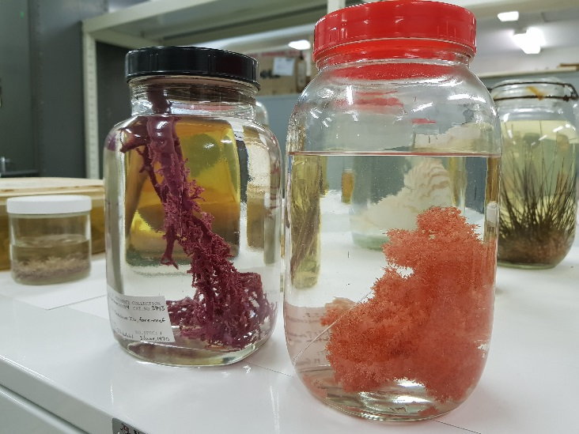
Workshop objective #3
Training on how to use biodiversity data as a management tool.
Training using software R and Biodiversity Data Visualization.

Slide 18
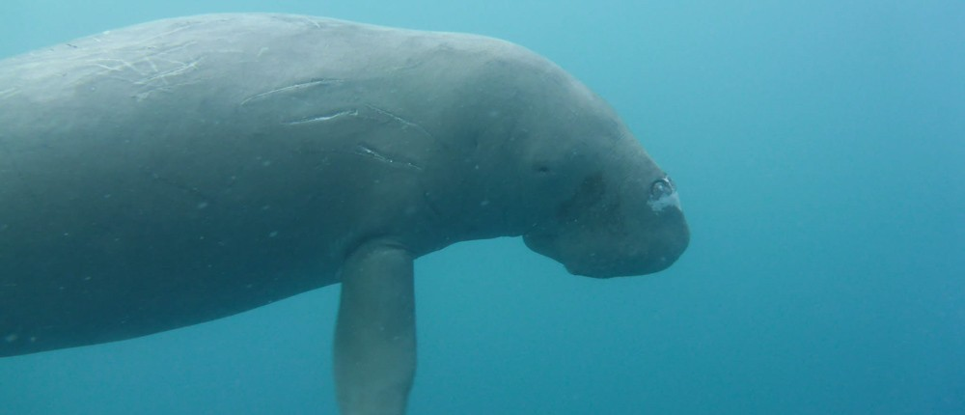
Lessons from the Pacific BID Workshop with regards to our Project:
We are now in a better position to plan for and prepare our institutional data for GBIF publishing ahead of the Project Workshop (2018).
Incorporate into future research/collection reporting.
We now have 3 potential ‘helpers’ for our Project Workshop.
Source: Christina Shaw. VESS.

Slide 19
Teaching and mentor team, thank you so much for the instruction and guidance (and patience)!
Vinaka vakalevu! Tanggio! Tangkiu tumas!

