Slide 1

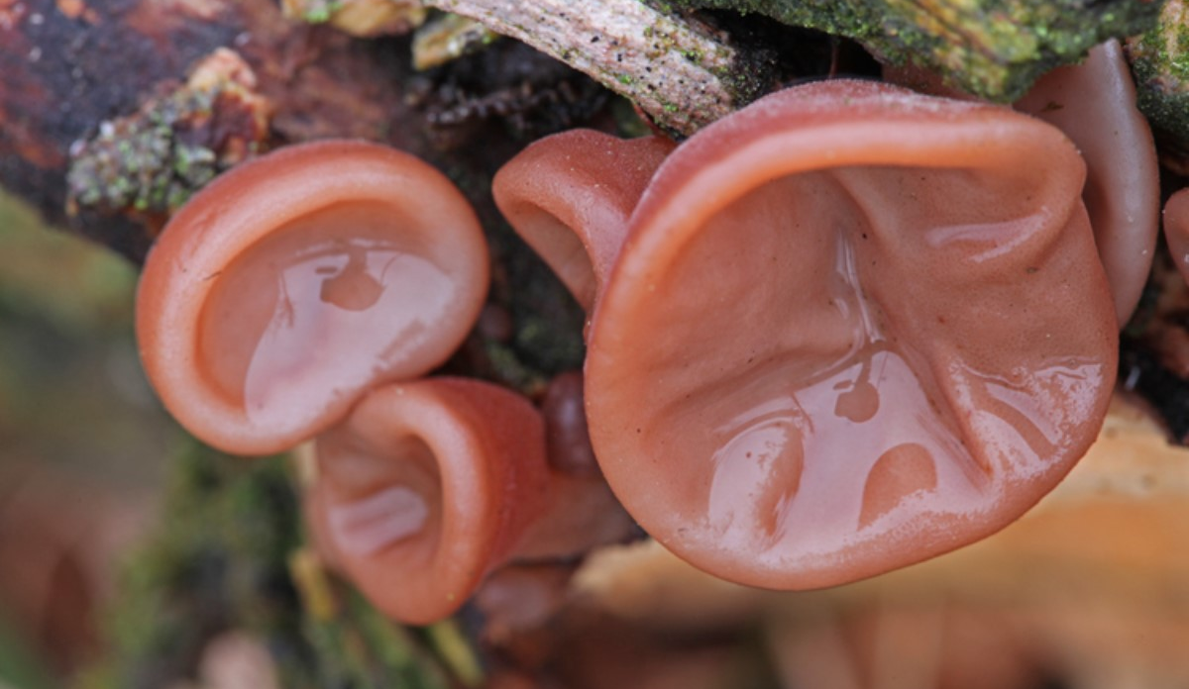
Overview
Photo: Jelly ear fungus (Auricularia auricula-judae), 10 Jan 2017, from Danish Mycological Society fungal records database
https://demo.gbif.org/occurrence/1424728142
January 2017

Slide 2

BY THE NUMBERS
1 Jan 2017
species occurrence records
datasets
702,911,384
30,712
publishers
Country Participants
Organizational Participants
862
54
39

Slide 3
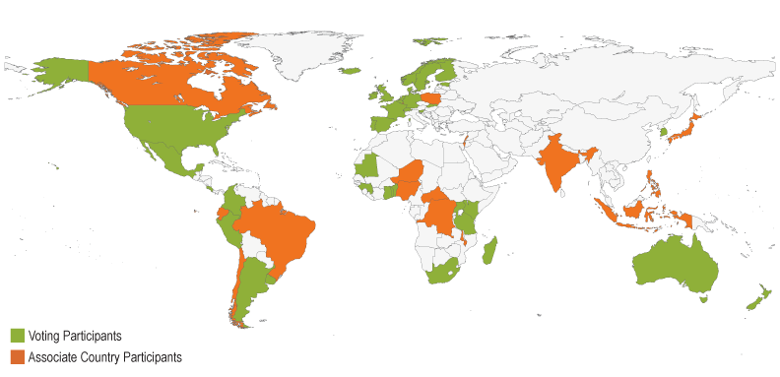
Current national participants
participation
http://www.gbif.org/participation/participant-list

Slide 4
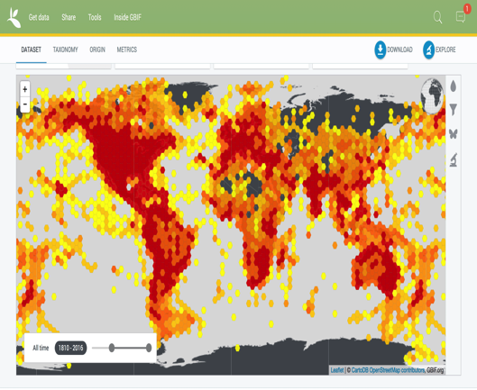
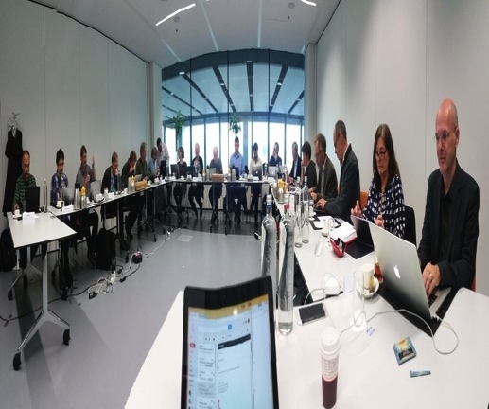
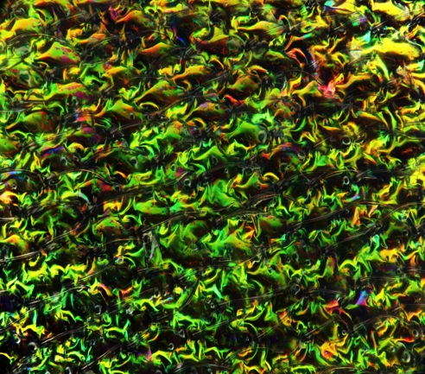
Latest news
communications
      63.8 million new observations increase eBird total to 275 million records
      Annual dataset refresh grows by 30 per cent, with biggest gains in Asia and Europe
      Read more
      'Names in November' workshop targets single shared species list
        Partnership with taxonomic community aims for a single, sustainable information service for species names
        Read more
      Experts outline strategy for improving alien species information
        Task group recommends actions for reducing the impacts of invasive species on biodiversity
        Read more
http://www.gbif.org/newsroom/summary
Photo credits: (center) courtesy of Peter Schalk.
(right) Abdomen of emerald ash borer (Argils planipennis) at 50x magnification by Macroscopic Solutions via Flickr. Photo licensed under CC BY-NC 2.0.

Slide 5
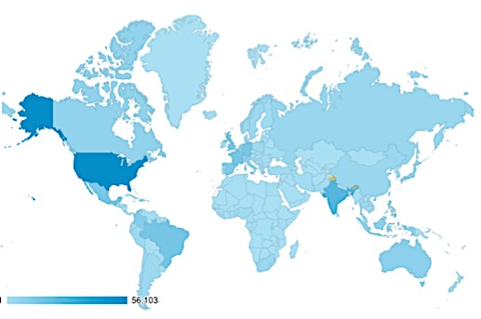
Web traffic to GBIF.org, 2016
Rank | Country/Territory | Sessions | % Total Sessions | Previous rank | Pages / Session
1 | United States | 222,580 | 14.31% | 1 | 4.51
2 | India | 100,826 | 6.40% | 2 | 2.60
3 | France | 68,372 | 4.34% | 5 | 3.69
4 | Germany | 67,198 | 4.27% | 3 | 4.60
5 | Brazil | 62,625 | 3.98% | 7 | 5.75
6 | Spain | 62,621 | 3.98% | 4 | 5.70
7 | United Kingdom | 61,547 | 3.91% | 6 | 5.38
8 | Mexico | 57,044 | 3.62% | 8 | 8.30
9 | Colombia | 43,256 | 2.75% | 9 | 5.70
10 | Italy | 37,722 | 2.40% | 10 | 4.44
data access and use

Slide 6
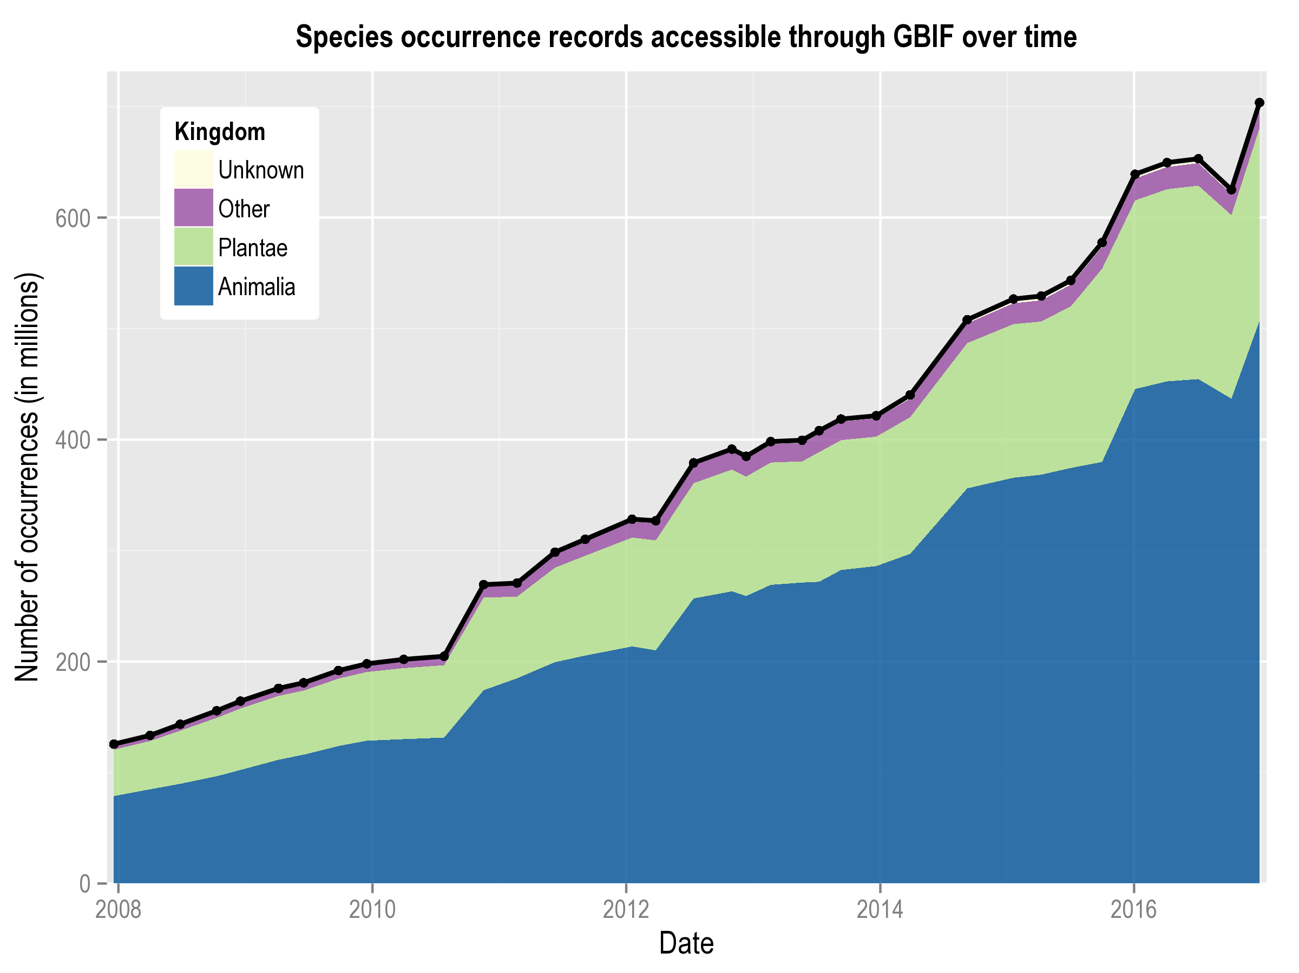
Data published through GBIF.org
data availability
www.gbif.org/analytics/global

Slide 7
Occurrence records published during 2016 by country
1 | United States | 83,774,897
2 | Germany | 15,837,819
3 | United Kingdom | 15,217,220
4 | Netherlands | 13,098,430
5 | South Africa | 9,630,896
6 | Norway | 4,519,715
7 | Colombia | 4,122,621
8 | Denmark | 4,048,381
9 | Spain | 3,175,906
10 | Belgium | 2,366,452
data availability
http://www.gbif.org/country

Slide 8
Total number of occurrence records published by country as of 31 Dec 2016
1 | United States | 269,908,182
2 | Sweden | 53,791,605
3 | France | 39,900,258
4 | Australia | 37,232,140
5 | Germany | 27,003,112
6 | Netherlands | 25,709,366
7 | United Kingdom | 22,986,875
8 | South Africa | 20,441,422
9 | Spain | 14,474,227
10 | Belgium | 11,360,898
data availability
http://www.gbif.org/country

Slide 9
Data download requests by country, 2016
1 | United States | 14,700
2 | Mexico | 14,053
3 | Brazil | 7,437
4 | Spain | 6,443
5 | Colombia | 5,431
6 | United Kingdom | 5,195
7 | South Africa | 3,492
8 | India | 3,480
9 | China | 3,046
10 | Italy | 2,389
data access and use

Slide 10
data access and use
Peer-reviewed publications using GBIF-mediated data

Slide 11
Peer-reviewed uses, by country and region, 2016
2016
Total # of papers by country
1 | United States | 148
2 | United Kingdom | 61
3 | Germany | 51
4 | Brazil | 50
5 | Australia | 48
6 | China | 41
6 | Mexico | 41
8 | France | 39
9 | Spain | 31
10 | Canada | 25
10 | South Africa | 25
data access and use
Total # of papers by region
1 | Europe | 351
2 | North America | 173
3 | Latin America | 134
4 | Asia | 94
5 | Africa | 58
6 | Oceania | 54

Slide 12
Featured research
December 2016
1/2
 | Canavan S, Richardson DM, Visser V, Le Roux JJ, Vorontsova MS & Wilson JRU (2016) The global distribution of bamboos: assessing correlates of introduction and invasion. AOB Plants. doi:10.1093/aobpla/plw078 Author countries: South Africa, United Kingdom.
 | Cramer MD & Verboom GA (2016) Measures of biologically relevant environmental heterogeneity improve prediction of regional plant species richness. Journal of Biogeography. doi:10.1111/jbi.1291 Author country: South Africa
 | Dauby G, Zaiss R, Blach-Overgaard A et al. (2016) RAINBIO: a mega-database of tropical African vascular plants distributions. PhytoKeys 74: 1-18. doi:10.3897/phytokeys.74.9723 Author countries: France, Portugal, Denmark, Netherlands, Belgium, United Kingdom, United States, Germany
 | Horvitz N, Wang R, Wan FH & Nathan R (2016) Pervasive human-mediated large-scale invasion: analysis of spread patterns and their underlying mechanisms in 17 of China's worst invasive plants. Journal of Ecology 105: 85-94. doi:10.1111/1365-2745.12692 Author countries: China, Israel
 | Ivanova NV & Shashkov MP (2016) Biodiversity Databases in Russia: Towards a National Portal. Arctic Science doi:10.1139/AS-2016-0050 Author country: Russian Federation
 | Liu HM, Zhang SZ, Wan T et al. (2016) Exploring the pteridophyte flora of the Eastern Afromontane biodiversity hotspot. Journal of Systematics and Evolution 54: 691-705. doi:10.1111/jse.12232 Author countries: China, Kenya, United Kingdom, Germany
data access and use
Invasive alien species
Impact of climate change
Species conservation and protected areas
Biodiversity and human health
Food, farming and biofuels
Ecosystem services
Advancing biodiversity science
Data management
Data papers

Slide 13
Featured research
December 2016
2/2
 | Lundgren MR & Christin PA (2016) Despite phylogenetic effects, C3–C4 lineages bridge the ecological gap to C4 photosynthesis. Journal of Experimental Botany doi:10.1093/jxb/erw451 Author country: United Kingdom
 | Pertierra LR, Aragón P, Shaw JD, Bergstrom DM, Terauds A & Olalla-Tárraga MÁ (2016) Global thermal niche models of two European grasses show high invasion risks in Antarctica. Global Change Biology doi:10.1111/gcb.13596 Author countries: Spain, Australia
 | Schleuning M, Fründ J, Schweiger O et al. (2016) Ecological networks are more sensitive to plant than to animal extinction under climate change. Nature Communications 7 doi:10.1038/ncomms13965 Author countries: Germany, Canada, Poland, Switzerland, New Zealand, United Kingdom, Belgium, Serbia, Australia
 | Sikes DS, Trumbo ST & Peck SB (2016) Cryptic diversity in the New World burying beetle fauna: Nicrophorus hebes Kirby; new status as a resurrected name (Coleoptera: Silphidae: Nicrophorinae). Arthropod Systematics & Phylogeny 74(3): 299-309. http://bit.ly/2ijxmqD Author countries: United States, Canada
 | Spolberg SØ & Chou YY (2016) Conservation of Indigenous Vegetables from a Hotspot in Tropical Asia: What Did We Learn from Vavilov? Frontiers in Plant Science. doi:10.3389/fpls.2016.01982 Author country: Taiwan
 | Wyse SV & Dickie JB (2016) Predicting the global incidence of seed desiccation sensitivity. Journal of Ecology. doi:10.1111/1365-2745.12725 Author country: United Kingdom
data access and use
Invasive alien species
Impact of climate change
Species conservation and protected areas
Biodiversity and human health
Food, farming and biofuels
Ecosystem services
Advancing biodiversity science
Data management
Data papers

Slide 14
Featured research
November 2016
1/2
 | Boavida J, Assis J, Silva I & Serrão EA (2016) Overlooked habitat of a vulnerable gorgonian revealed in the Mediterranean and Eastern Atlantic by ecological niche modelling. Scientific Reports 6: 36460. doi:10.1038/srep36460 Author country: Portugal
 | Calderón L, Campagna L, Wilke T et al. (2016) Genomic evidence of demographic fluctuations and lack of genetic structure across flyways in a long distance migrant, the European turtle dove. BMC Evolutionary Biology 16:237. doi:10.1186/s12862-016-0817-7 Author countries: Germany, United_States; France, United Kingdom, Spain, Bulgaria, Greece, Malta, Italy.
 | Chandler M, See L, Copas K et al. (2016) Contribution of citizen science towards international biodiversity monitoring. Biological Conservation. doi:10.1016/j.biocon.2016.09.004 Author countries: United States, Austria, Denmark, Spain, Australia.
 | Curtis CA & Bradley BA (2016) Plant Distribution Data Show Broader Climatic Limits than Expert-Based Climatic Tolerance Estimates. PLoS ONE 11(11): : e0166407. doi:10.1371/journal.pone.0166407 Author country: United States. Advancing Biodiversity Sciences
 | Dupin J, Matzke NJ, Särkinen T et al. (2016) Bayesian estimation of the global biogeographical history of the Solanaceae. Journal of Biogeography doi:10.1111/jbi.12898 Author countries: United States, Australia, United Kingdom.
 | Gómez-Ruiz EP & Lacher TE (2016) Modelling the potential geographic distribution of an endangered pollination corridor in Mexico and the United States. Diversity and Distributions. doi:10.1111/ddi.12499 Author countries: Mexico, United States.
data access and use
Invasive alien species
Impact of climate change
Species conservation and protected areas
Biodiversity and human health
Food, farming and biofuels
Ecosystem services
Advancing biodiversity science
Data management
Data papers

Slide 15
Featured research
November 2016
2/2
 | Harris RMB, Kriticos DJ, Remenyi T & Bindoff N (2016) Unusual suspects in the usual places: a phylo-climatic framework to identify potential future invasive species. Biological Invasions. doi:10.1007/s10530-016-1334-8 Author country: Australia.
 | Marshall CAM, Wieringa JJ & Hawthorne WD (2016) Bioquality Hotspots in the Tropical African Flora. Current Biology 26(23): 3214-3219. doi:10.1016/j.cub.2016.09.045 Author countries: United Kingdom, Netherlands.
 | Munson SM & Long AL (2016) Climate drives shifts in grass reproductive phenology across the western USA. New Phytologist. doi:10.1111/nph.14327 Author country: United States. Impact of climate change
 | Rivera D, Verde A, Obón C et al. (2016) Is there nothing new under the sun? The influence of herbals and pharmacopoeias on ethnobotanical traditions in Albacete (Spain). Journal of Ethnopharmacology. doi:10.1016/j.jep.2016.11.040 Author countries: Spain, Italy. Biodiversity and human health
 | Vall-llosera M, Woolnough AP, Anderson D & Cassey P (2016) Improved surveillance for early detection of a potential invasive species: the alien Rose-ringed parakeet Psittacula krameri in Australia. Biological Invasions. doi:10.1007/s10530-016-1332-x Author countries: Australia, New Zealand. Invasive Alien Species
 | Zizka A, Steege HT, Pessoa MDCR & Antonelli A (2016) Finding needles in the haystack: Where to look for rare species in the American tropics. Ecography. doi:10.1111/ecog.02192 Author countries: Sweden, Netherlands, Brazil. Advancing Biodiversity Sciences
data access and use
Invasive alien species
Impact of climate change
Species conservation and protected areas
Biodiversity and human health
Food, farming and biofuels
Ecosystem services
Advancing biodiversity science
Data management
Data papers

