Slide 1

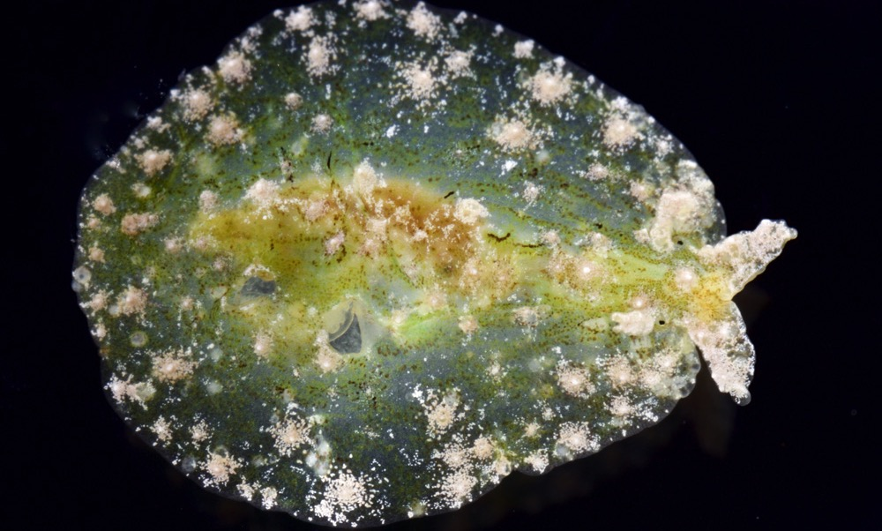
Overview
Turtlegrass seahare sea slug (Phyllaplysia engeli), collected off the coast of Panama, 17 Mar 2017.
Photo CC BY-NC-SA Vanessa Knutson. Museum of Comparative Zoology, Harvard University. demo.gbif.org/occurrence/1449837207
May 2017

Slide 2

BY THE NUMBERS
1 Feb 2017
Species occurrence records
Datasets
736,355,309
35,232
Country Participants
Organizational Participants
Publishers
54
39
891
Records downloaded per month (avg 2017)
Unique users per month (Apr 2017)
35.7 billion
106,438
Notes:
Useful to see GBIF in its different modalities:
A window on biodiversity
An informatics infrastructure focuseD on tools and standards in service to science and society
A global network on bioinformatics

Slide 3
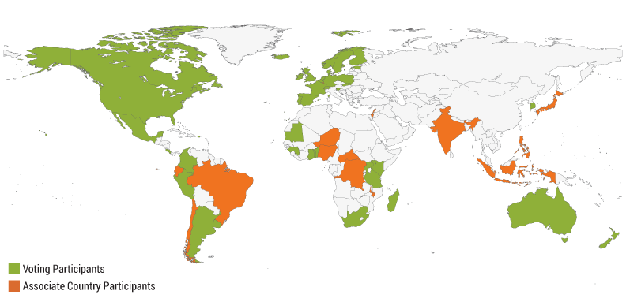
Current national participants
participation
http://www.gbif.org/participation/participant-list

Slide 4
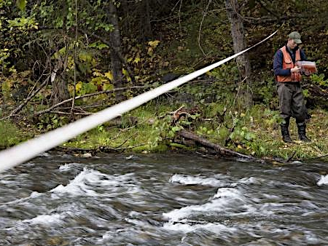
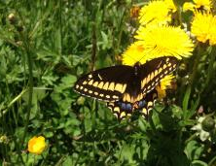
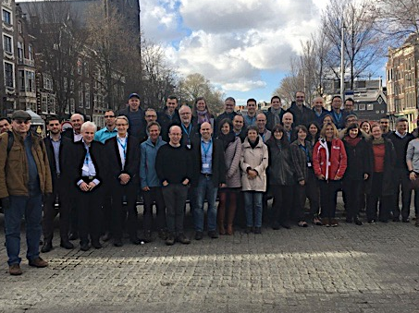
Latest news
communications
      Call for nominations opens for 2017 Young Researchers Awards
      Nominations due 15 July for 2017 programme focused on publication of sampling-event datasets
      Read more
      Canada resumes full participation in GBIF
      One of GBIF’s founding national delegations restores status and becomes 40th Voting Participant
      Read more
      GLOBIS-B workshop on developing an ‘EBV’ class for species traits
      Experts gathered to discuss creation of consistent ecological metrics for phenological and physiological traits and behaviours
      Read more (from GLOBIS-B)
http://www.gbif.org/newsroom/summary
Photo credits: (left) Surveying in Cooper Creek, Chugach National Forest, Alaska. Photo by USDA Forest Service Alaska Region, licensed under CC BY 2.0.
(centre) Short-tailed swallowtail (Papilio brevicauda). Photo by Jody Allair licensed under CC BY-NC 4.0. (right) Courtesy of GLOBIS-B.

Slide 5
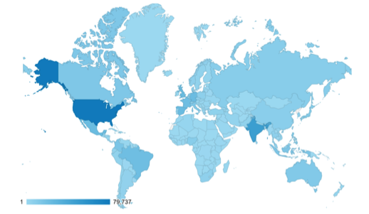
Web traffic to GBIF.org, 2017
Rank | Country/Territory | Sessions | % Total Sessions | 2016 rank | Pages / Session
1 | United States | 82,191 | 13.75% | 1 | 4.52
2 | India | 47,968 | 8.03% | 2 | 1.97
3 | Spain | 23,781 | 3.98% | 6 | 6.07
4 | United Kingdom | 23.637 | 3.95% | 5 | 7.01
5 | Mexico | 23,247 | 3.89% | 7 | 8.36
6 | Germany | 23,082 | 3.86% | 3 | 5.47
7 | Brazil | 21,043 | 3.52% | 8 | 5.05
8 | France | 20,750 | 3.47% | 4 | 3.43
9 | Colombia | 15,316 | 2.56% | 13 | 6.47
10 | Indonesia | 14,277 | 2.39% | 12 | 2.75
data access and use

Slide 6
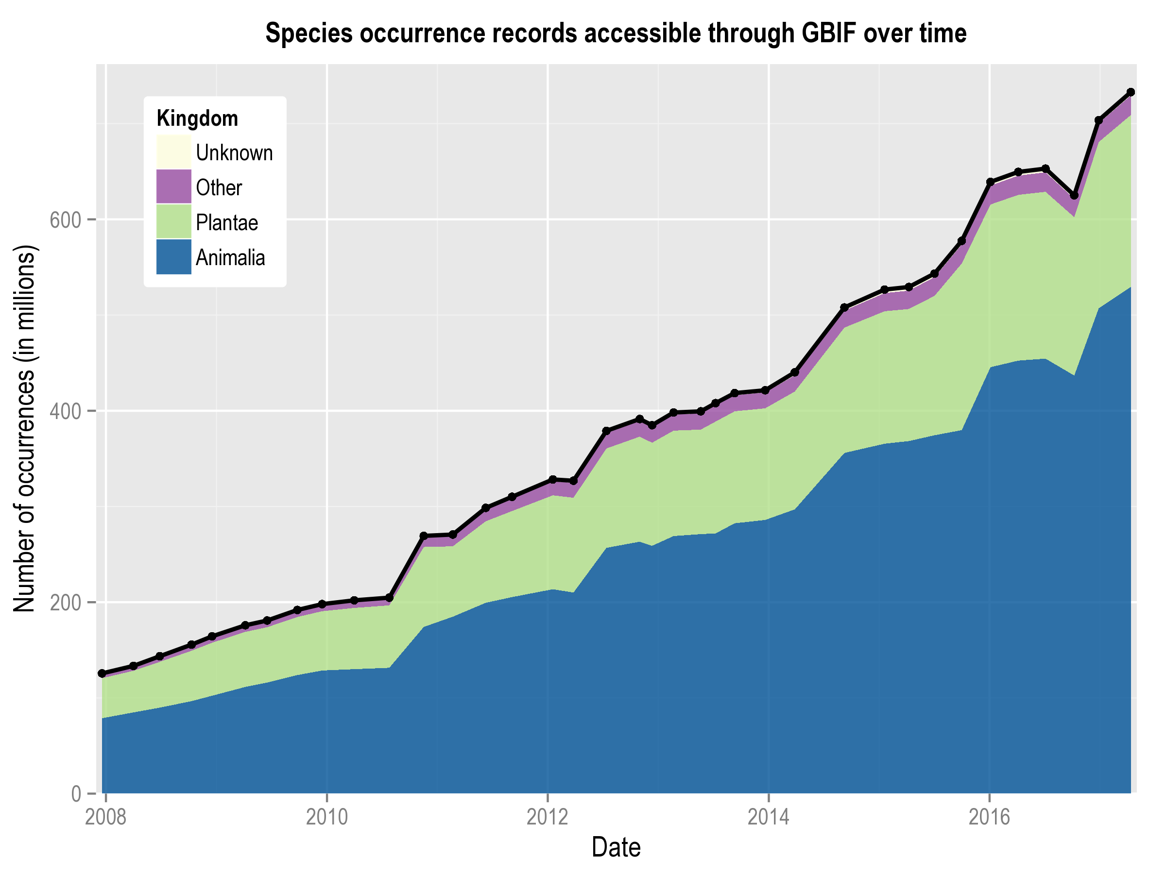
Data published through GBIF.org
data availability
www.gbif.org/analytics/global

Slide 7
Occurrence records published during 2017 by country
 | Country | New records | Feb-17 rank
1 | Sweden | 11,346,533 | 1
2 | Spain | 8,969,548 | 19
3 | Belgium | 7,541,222 | 9
4 | Mexico | 3,516,388 | 2
5 | United States | 3,220,424 | 5
6 | Australia | 2,597,168 | 16
7 | Germany | 1,870,213 | 17
8 | Norway | 1,630,498 | 3
9 | New Zealand | 1,499,975 | 6
10 | Canada | 723,367 | 7
data availability
http://www.gbif.org/country

Slide 8
Total number of occurrence records published by country as of 30 Apr 2017
1 | United States | 339,979,449
2 | Sweden | 65,190,071
3 | France | 40,519,027
4 | Australia | 31,451,021
5 | Germany | 30,325,909
6 | United Kingdom | 29,406,999
7 | Netherlands | 26,545,089
8 | Norway | 24,232,504
9 | Spain | 23,277,447
10 | South Africa | 21,218,378
data availability
http://www.gbif.org/country

Slide 9
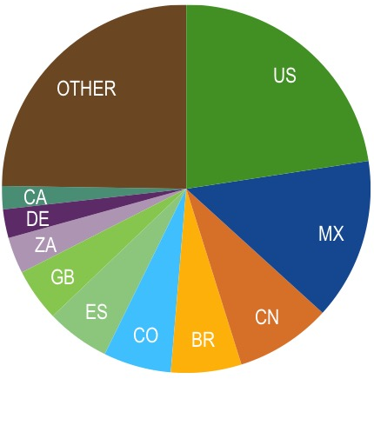
Data download requests by country, 2017
 | Country | Downloads | Feb-17 rank
1 | United States | 7,576 | 1
2 | Mexico | 4,756 | 2
3 | China | 2,818 | 5
4 | Brazil | 2,074 | 4
5 | Colombia | 1,994 | 9
6 | Spain | 1,873 | 6
7 | United Kingdom | 1,556 | 3
8 | South Africa | 1,071 | 7
9 | Germany | 844 | 8
10 | Canada | 683 | 12
data access and use

Slide 10
data access and use
Peer-reviewed publications using GBIF-mediated data

Slide 11
Peer-reviewed uses, by country and region, 2017
Total # of peer-reviewed papers by country
1 | United States | 61
2 | Brazil | 24
3 | Australia | 21
4 | Spain | 19
4 | United Kingdom | 19
6 | Germany | 17
7 | Mexico | 16
8 | China | 15
9 | Switzerland | 14
10 | India | 13
data access and use
Total # of papers by region
1 | Europe | 154
2 | Latin America | 76
3 | North America | 69
4 | Asia | 43
5 | Oceania | 25
6 | Africa | 12

Slide 12
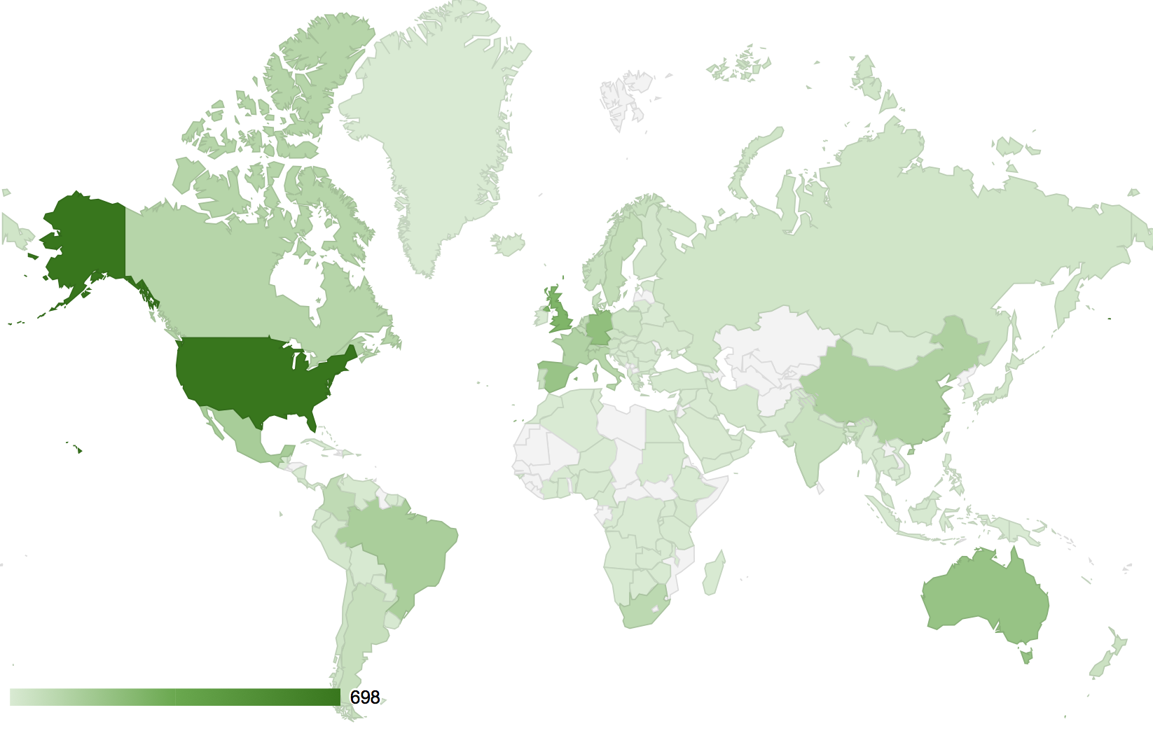
data access and use
Geography of GBIF-enabled research
2008-present
In this map, darker shades indicate a higher number of peer-reviewed papers citing use of GBIF as a data source, authored by researchers from institutions in the country shown.
To view an interactive version of this map, including the up to date number for each country, visit http://buff.ly/2nY4hY7

Slide 13
Featured research
March 2017
1/3
 | Aguilar GD, Waqa-Sakiti H & Winder L (2017) Using predicted locations and an ensemble approach to address sparse data sets forspecies distribution modelling: Long-horned beetles (Cerambycidae) of the Fiji islands. Unitec ePress. unitec.ac.nz/GisForConservation/index.php/report Author country: New Zealand
 | Avendaño JE, Arbeláez-Cortés E & Cadena CD (2017) On the importance of geographic and taxonomic sampling in phylogeography: A reevaluation of diversification and species limits in a Neotropical thrush (Aves, Turdidae). Molecular Phylogenetics and Evolution 111: 87-97. doi:10.1016/j.ympev.2017.03.020 Author country: Colombia
 | Chadin I, Dalke I, Zakhozhiy I et al. (2017) Distribution of the invasive plant species Heracleum sosnowskyi Manden. in the Komi Republic (Russia). PhytoKeys 77: 71-80. doi:10.3897/phytokeys.77.11186 Author country: Russian Federation
 | Chen YN (2017) An analysis of characteristics and structures embedded in data papers: a preliminary study. Libellarium 9(2): 145-156. doi:10.15291/libellarium.v9i2.266 Author country: Taiwan.
 | Curti RN, Sajama J & Ortega-Baes P (2017) Setting conservation priorities for Argentina's pseudocereal crop wild relatives. Biological Conservation 209: 349-355. doi:10.1016/j.biocon.2017.03.008 Author country: Argentina
 | Doherty KD, Butterfield BJ & Wood TE (2017) Matching seed to site by climate similarity: Techniques to prioritize plant materials development and use in restoration. Ecological Applications 27(3): 1010-1023. doi:10.1002/eap.1505 Author country: United States
data access and use
Invasive alien species
Impact of climate change
Species conservation and protected areas
Biodiversity and human health
Food, farming and biofuels
Ecosystem services
Advancing biodiversity science
Data management
Data papers
https://demo.gbif.org/cms/search?type=data_use

Slide 14
Featured research
March 2017
2/3
 | ElQadi MM, Dorin A, Dyer A, Burd M & Bukovac Z (2017) Mapping species distributions with social media geo-tagged images: Case studies of bees and flowering plants in Australia. Ecological Informatics 39: 23-31. doi:10.1016/j.ecoinf.2017.02.006 Author country: Australia
 | Hughes AC (2017) Mapping priorities for conservation in Southeast Asia. Biological Conservation 209: 395-405. doi:10.1016/j.biocon.2017.03.007 Author country: China
 | Longbottom J, Browne AJ, Pigott DM et al. (2017) Mapping the spatial distribution of the Japanese encephalitis vector, Culex tritaeniorhynchus Giles, 1901 (Diptera: Culicidae) within areas of Japanese encephalitis risk. Parasites & Vectors 10: 148. doi:10.1186/s13071-017-2086-8 Author countries: United Kingdom, United States, Australia
 | Marnewick K, Page-Nicholson S, Roxburgh L & Somers M (2017) Tracking data from nine free-roaming Cheetahs (Acinonyx jubatus) collared in the Thabazimbi area, Limpopo Province, South Africa. Biodiversity Data Journal 5: e11323. doi:10.3897/bdj.5.e11323 Author country: South Africa
 | Nimbs MJ, Willan RC, Smith SDA (2017) Is Port Stephens, eastern Australia, a global hotspot for biodiversity of Aplysiidae (Gastropoda: Heterobranchia)? Molluscan Research 37(1): 45-65. doi:10.1080/13235818.2016.1207280 Author country: Australia
 | Rasmussen K, Thyrring J, Muscarella R & Borchsenius F (2017) Climate-change-induced range shifts of three allergenic ragweeds (Ambrosia L.) in Europe and their potential impact on human health. PeerJ 5: e3104. doi:10.7717/peerj.3104 Author country: Denmark
data access and use
Invasive alien species
Impact of climate change
Species conservation and protected areas
Biodiversity and human health
Food, farming and biofuels
Ecosystem services
Advancing biodiversity science
Data management
Data papers
https://demo.gbif.org/cms/search?type=data_use

Slide 15
Featured research
March 2017
3/3
 | Rubio de Casas R, Willis CG, Pearse WD, Baskin CC, Baskin JM & Cavender-Bares J (2017) Global biogeography of seed dormancy is determined by seasonality and seed size: a case study in the legumes. New Phytologist. doi:10.1111/nph.14498 Author countries: Spain, United States & Canada
 | Sosef MSM, Dauby G, Blach-Overgaard A et al. (2017) Exploring the floristic diversity of tropical Africa. BMC Biology 15: 15. doi:10.1186/s12915-017-0356-8 Author countries: Belgium, Denmark, France, United Kingdom, Portugal, Netherlands, Cameroon, United States, Czech Republic, Germany
 | Stone OML, Guy AJ (2017) Predicting Optimal Release Sites for Rehabilitated Monkeys: a Vervet Monkey (Chlorocebus aethiops) Case Study. International Journal of Primatology. doi:10.1007/s10764-017-9956-y Author country: Australia
 | Ward PS & Branstetter MG (2017) The acacia ants revisited: convergent evolution and biogeographic context in an iconic ant/plant mutualism. Proceedings of the Royal Society B 284(1850): 20162569. doi:10.1098/rspb.2016.2569 Author country: United States
 | Yessoufou K, Daru BH, Tafirei R, Elansary HO & Rampedi I (2017) Integrating biogeography, threat and evolutionary data to explore extinction crisis in the taxonomic group of cycads. Ecology and Evolution 7(8): 2735-2746. doi:10.1002/ece3.2660 Author countries: South Africa, United States, Egypt
 | Zuquim G, Tuomisto H & Prado J (2017) A free-access online key to identify Amazonian ferns. PhytoKeys 78: 1-15. doi:10.3897/phytokeys.78.11370 Author countries: Brazil, Finland
data access and use
Invasive alien species
Impact of climate change
Species conservation and protected areas
Biodiversity and human health
Food, farming and biofuels
Ecosystem services
Advancing biodiversity science
Data management
Data papers
https://demo.gbif.org/cms/search?type=data_use

Slide 16
Featured research
April 2017
1/2
 | Del Olmo-Ruiz M, García-Sandoval R, Alcántara-Ayala O, Véliz M & Luna-Vega I (2017) Current knowledge of fungi from Neotropical montane cloud forests: distributional patterns and composition. Biodiversity and Conservation. doi:10.1007/s10531-017-1337-5 Author countries: Mexico, Guatemala
 | Faulkner KT, Robertson MP, Rouget M & Wilson JRU (2017) Prioritising surveillance for alien organisms transported as stowaways on ships travelling to South Africa. PLoS ONE 12(4): e0173340. doi:10.1371/journal.pone.0173340 Author countries: South Africa, France
 | Grossenbacher DL, Brandvain Y, Auld JR et al. (2017) Self-compatibility is over-represented on islands. New Phytologist. doi:10.1111/nph.14534 Author countries: United States, Australia, France, Switzerland, South Africa, Greece, Spain, Canada
 | Gutiérrez-Valencia J, Chomicki G & Renner SS (2017) Recurrent breakdowns of mutualisms with ants in the neotropical ant-plant genus Cecropia (Urticaceae). Molecular Phylogenetics and Evolution 111: 196-205. doi:10.1016/j.ympev.2017.04.009 Author country: Denmark
 | Hoekman D, LeVan KE, Ball GE et al. (2017) Design for ground beetle abundance and diversity sampling within the National Ecological Observatory Network. Ecosphere 8(4): e01744. doi:10.1002/ecs2.1744 Author countries: United States, Canada, Finland
 | Ibarra-Cerdeña CN, Valiente-Banuet L, Sánchez-Cordero V, Stephens CR & Ramsey JM (2017) Trypanosoma cruzi reservoir—triatomine vector co-occurrence networks reveal meta-community effects by synanthropic mammals on geographic dispersal. PeerJ 5: e3152. doi:10.7717/peerj.3152 Author country: Mexico
 | Kałucka IL, Jagodziński AM & Nowiński M (2016) Biodiversity of ectomycorrhizal fungi in surface mine spoil restoration stands in Poland – first time recorded, rare, and red-listed species. Acta Mycologica 51(2): 1080. doi:10.5586/am.1080 Author country: Poland
data access and use
Invasive alien species
Impact of climate change
Species conservation and protected areas
Biodiversity and human health
Food, farming and biofuels
Ecosystem services
Advancing biodiversity science
Data management
Data papers
https://demo.gbif.org/cms/search?type=data_use

Slide 17
Featured research
April 2017
2/2
 | Liao CC & Chen CH (2017) Investigation of floristic similarities between Taiwan and terrestrial ecoregions in Asia using GBIF data. Botanical Studies 58: 15. doi:10.1186/s40529-017-0171-0 Author country: Taiwan
 | Liedtke HC, Müller H, Hafner J et al. (2017) Terrestrial reproduction as an adaptation to steep terrain in African toads. Proceedings of the Royal Society B 284: 20162598. doi:10.1098/rspb.2016.2598 Author countries: Switzerland Spain, Germany, United Kingdom & Czech Republic
 | Mair L, Harrison PJ, Räty M, Bärring L, Strandberg G & Snäll T (2017) Forest management could counteract distribution retractions forced by climate change. Ecological Applications. doi:10.1002/eap.1541 Author country: Sweden
 | Merow C, Bois ST, Allen JM, Xie Y & Silander JA (2017) Climate change both facilitates and inhibits invasive plant ranges in New England. Proceedings of the National Academy of Sciences 114(16): E3276–E3284 doi:10.1073/pnas.1609633114 Author country: United States
 | Simonsen AK, Dinnage R, Barrett LG, Prober SM & Thrall PH (2017) Symbiosis limits establishment of legumes outside their native range at a global scale. Nature Communications 8: 14790. doi:10.1038/ncomms14790 Author country: Australia
 | Visser V, Wilson JRU, Canavan K et al. (2017) Grasses as invasive plants in South Africa revisited: Patterns, pathways and management. Bothalia 47(2). doi:10.4102/abc.v47i2.2169 Author country: South Africa
 | Weatherdon LV, Appeltans W, Bowles-Newark N et al. (2017) Blueprints of Effective Biodiversity and Conservation Knowledge Products That Support Marine Policy. Frontiers in Marine Science 4: 96. doi:10.3389/fmars.2017.00096 Author countries: United Kingdom, Belgium, Switzerland, Philippines, Australia, Germany, Denmark
data access and use
Invasive alien species
Impact of climate change
Species conservation and protected areas
Biodiversity and human health
Food, farming and biofuels
Ecosystem services
Advancing biodiversity science
Data management
Data papers
https://demo.gbif.org/cms/search?type=data_use

