Slide 1
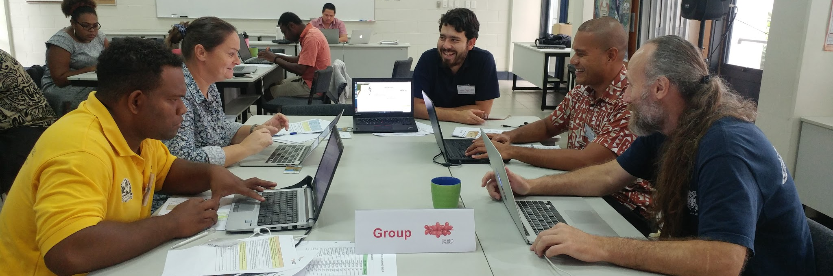
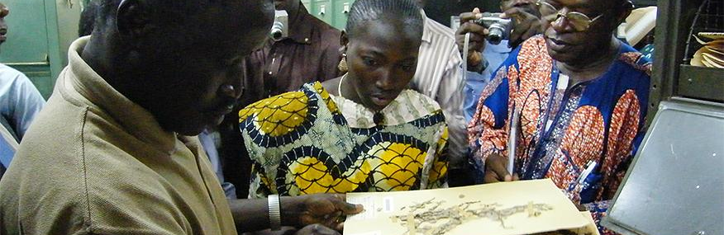
Skills and Capacity in the Pacific
Laura Russell and David Bloom
27 July 2017
THE BID PROGRAMME IS FUNDED BY THE EUROPEAN UNION

Slide 2
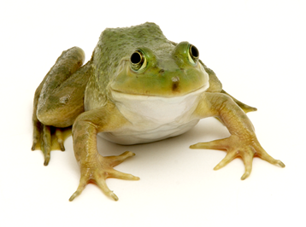
WORKSHOP SUMMARY
Introductions to
Biodiversity data mobilization planning
Biodiversity data digitization
Biodiversity data curation, formatting and transformation
Biodiversity data publishing
Skills and capacity
Notes:
Image from Adrian Gtz, obtained via http://www.freeimages.com/photo/frog-2-1247908.

Slide 3
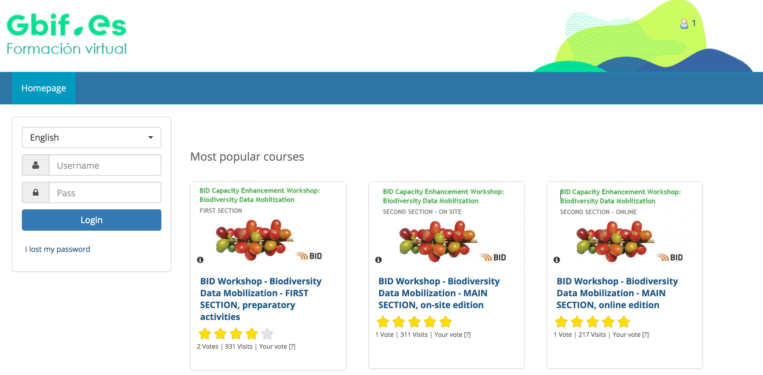
BLENDED LEARNING
Skills and capacity
eLearning platform
elearning.gbif.es

Slide 4
CERTIFICATION
2 personal capacity badges
BASIC biodiversity data mobilization badge
ADVANCED biodiversity data mobilization badge
Skills and capacity

Slide 5
PARTICIPANTS
PA2016-0002-REG
Kelly Brown
Trevor Maheda
Christina Shaw
PA2016-0005-REG
David Moverley
Bradley Myer
Tony O'Keeffe
Viliami Hakaumotu
Francois Tron
Ainsof Soo
Tavita Su’a
PA2016-0008-NAC
Penniel Lamei
PA2016-0009-SMA
Siteri Tikoca
PA2016-0001-NAC
Rolenas Tavue Baereleo

Slide 6
BID MENTORS
David Bloom, Katia Cezón, Daniel Amariles, Anne-Sophie Archambeau

Slide 7
BID TRAINERS/MENTORS
Support
Sharon Grant, Sophie Pamerlon, John Wieczorek

Slide 8
BID CAPACITY ENHANCEMENT APPROACH
Goal:
Enhanced capacity for effective mobilization and use of biodiversity information through a strengthened community of practice supporting the implementation of funded projects
Roles:
-BID Grantees
-BID Mentors
-BID Trainers
Community of practice

Slide 9
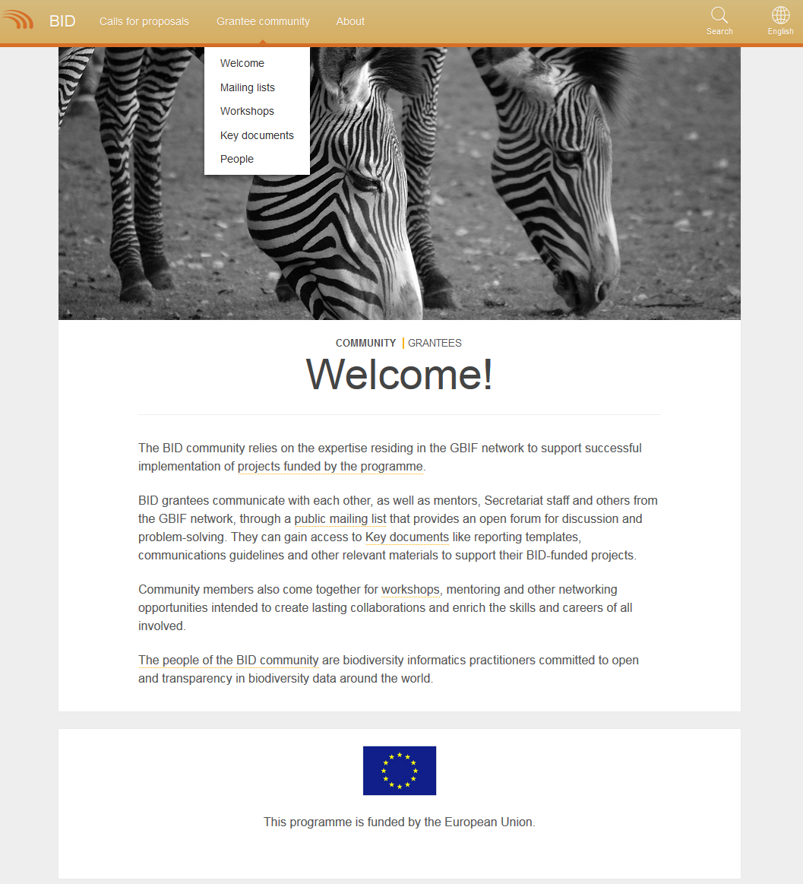
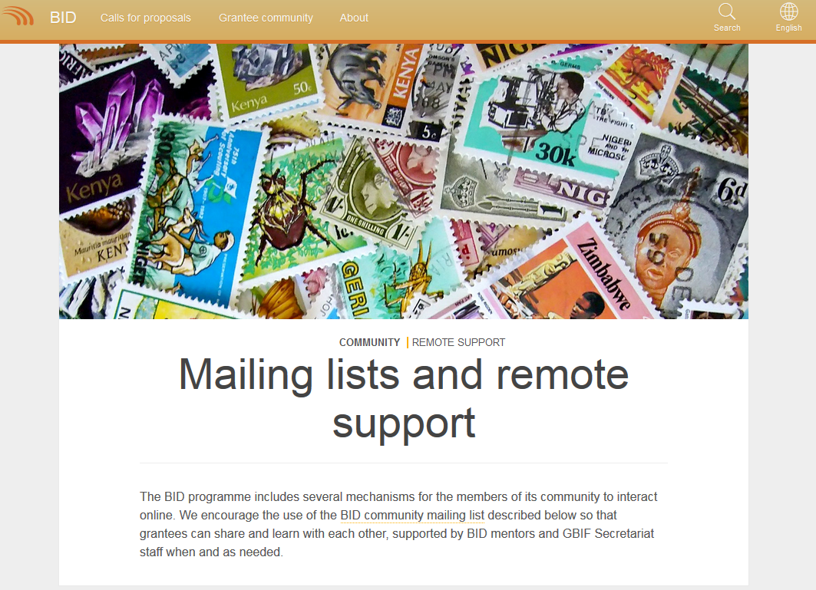
BID.GBIF.ORG
Community of practice

Slide 10
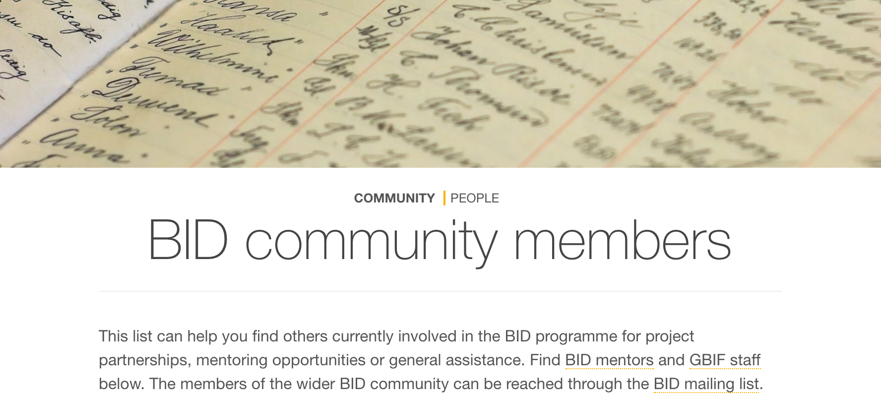

Slide 11
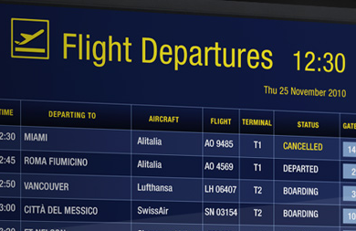
BID VOLUNTEER MENTORS
Remote (online) assistance:
Support for data management and publishing issues
Checking the quality of published datasets
Feedback on plans, agendas or resources
Reviewing draft narrative reports
Community of practice
On-site mentoring visits:
Hands-on training involving the project team
Attending national meetings and engaging with key stakeholders
Acting as trainers

Slide 12
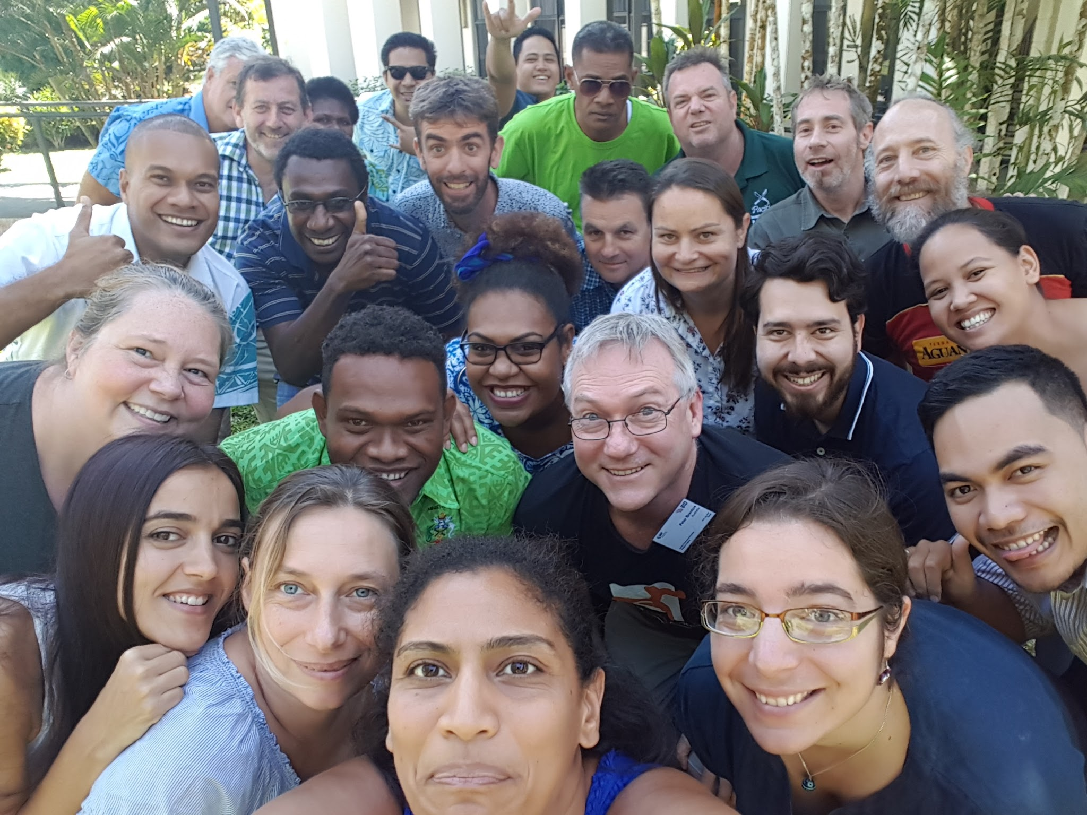

Slide 13
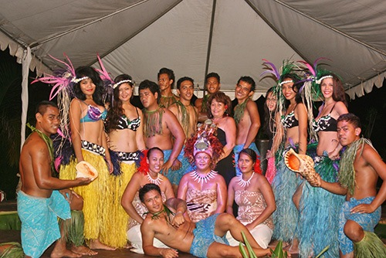
SOCIAL EVENING
Le Manumea Hotel
+685 27755
Cross Island Road
Buffet - 19:30
Show - 20:15

