Slide 1
BID-PA2016-0009: Mobilizing Fiji’s macro-moth collection and data to enhance knowledge and encourage protection of Fiji’s unique Biodiversity.
Presenter: Siteri Tikoca
Email:stikoca@naturefiji.org
Website:NatureFiji.org

Slide 2
WHO?
NatureFiji-MareqetiViti (NFMV)
- local membership based NGO
- local scientists
-conservation and biodiversity
- Local and International partners - Collaboration
South Pacific Regional Herbarium (SPRH)
- holds a big collection of plant specimens with smaller collections of other fauna including insects especially beetles, moths and butterflies.
- activities in this project ensures that all physical specimens are properly managed and all available

Slide 3
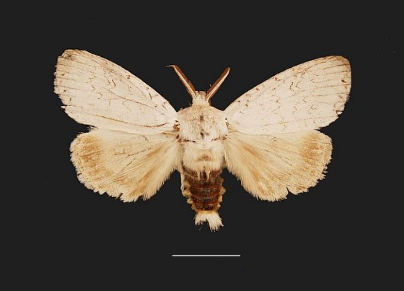
WHAT & WHY ?
BID Small grant project : €5,000
(Curating & mobilizing available macro-moth data)
The IUCN RedList of endangered and threatened species is considered incomeplete for Fiji - insufficient data for Fiji’s invertebrates.
This project will be the first step towards the mobilization of Fiji’s invertebrate data from books to softcopy and making it available for all resource and data users that may need to use it in the future.
Within Fiji’s NBSAP output (2012 – 2020) – establishing database for biodiversity data to increase access to such valuable data

Slide 4
Data Sources:
At present we have three available data sets that we aim to mobilise.
MSc thesis data and specimens (2000+)
Data collected by Gadern Robinson’s thesis (1975) who has since died
John Clayton's moth data collected from a number of Islands in Fiji.

Slide 5
HOW?

Slide 6
Goal 1: Increase available biodiversity data, within and beyond the grant period
Deliverables:
Design a database is compatible with the GBIF requirements and format.
Verifying/updating identification and curating all moth collections (MSc collection) held at the South Pacific Regional Herbarium
Extracting, updating taxonomy and mobilising data from Gadern Robinson's PHd thesis on the macro-moth species of the Fiji Islands and Rotuma (1975)
Extracting, updating taxonomy and mobilising all data from Clayton's moth collections

Slide 7
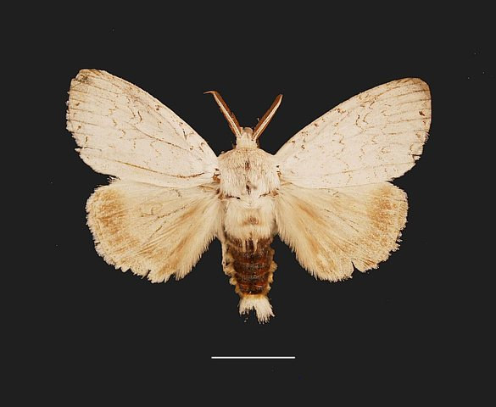
GOAL 2: Apply biodiversity data in response to conservation priorities
Incorporate moth data into National Biodiversity Strategic Action Plan
The National Biodiversity Strategic Action Plan is the main guiding document by which Fiji has and will be implementing conservations and priorities concerning its unique biodiversity.
Its in line with NBSAP actions for species management where they recommend the establishment of a database for biodiversity data in order to increase access to such valuable data (NBSAP – (2011-2020))

Slide 8
WHERE & WHEN?
Where: SOUTH PACIFIC REGIONAL HERBARIUM – USP (SUVA, FIJI)
When: 31st May 2017 – 30th April 2018
Activity | 1 | 2 | 3 | 4 | 5 | 6 | 7 | 8 | 9 | 10 | 11 | 12 | Notes
Mid-term evaluation & reporting |  |  |  |  |  | X
Database design | X | X
Curation of physical specimens |  |  | X | X | X
Mobilizing Gaden’s collection data |  |  |  |  |  | X | X | X
Mobilising Clayton’s collection data. |  |  |  |  |  |  |  |  | X | X | X

Slide 9
Vinaka

