Slide 1
Mobilizing Collections
Digitization Infrastructure in the US
Greg Riccardi
GB23 Brasilia

Slide 2
ADBC: Advancing Digitization of Biodiversity Collections
US National Science Foundation
  Plans to spend $10 million over 10 years
The goal is to digitize and aggregate
  1 billion biological and paleontological records over the 10-year life of the project.
iDigBio project is the HUB of ADBC
  U of Florida, Florida State U
Digitization projects
  Chosen by NSF peer review
  18 Thematic Collections Networks

Slide 3
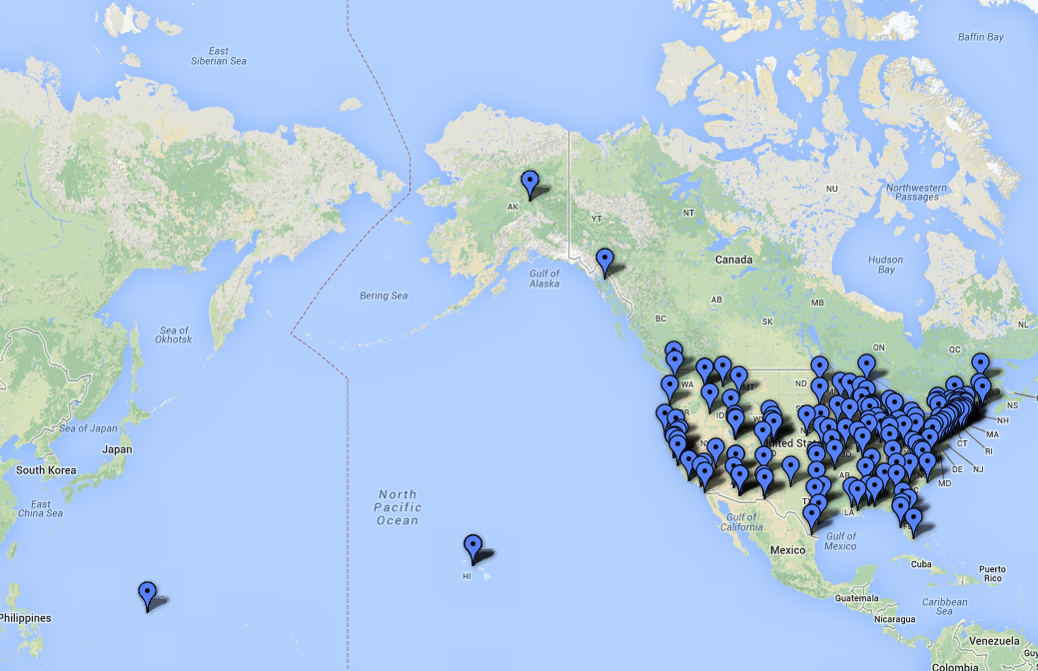
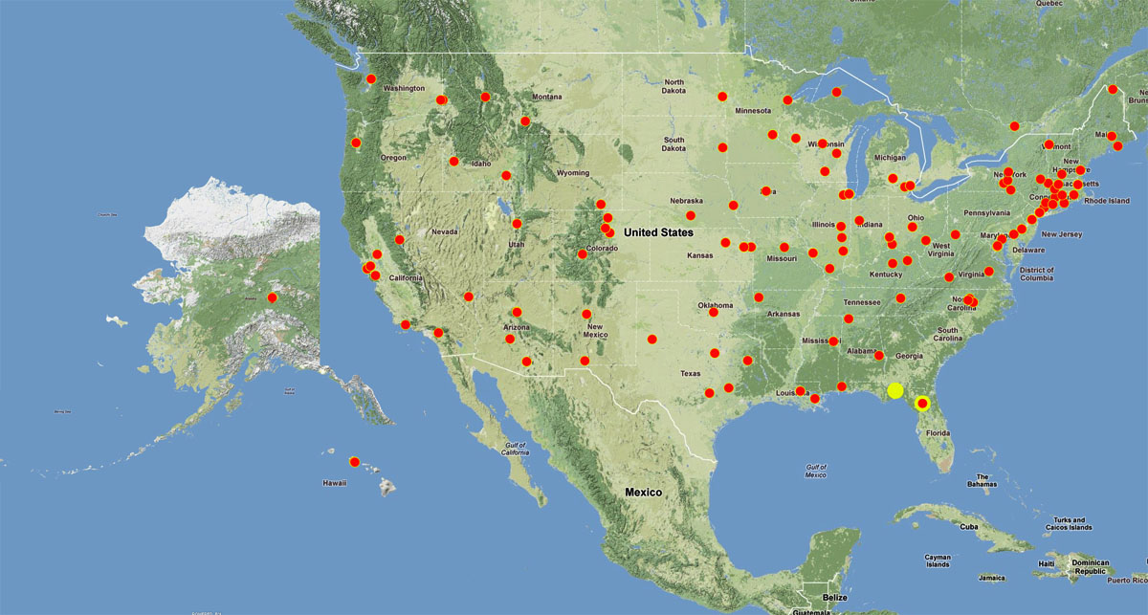
Advancing Digitization of Biodiversity Collections (ADBC)
Developing networks, enhancing communication, facilitating collaboration
To date: 17 TCNs, 152 unique institutions, ~276 projects, 50 states and Guam

Slide 4
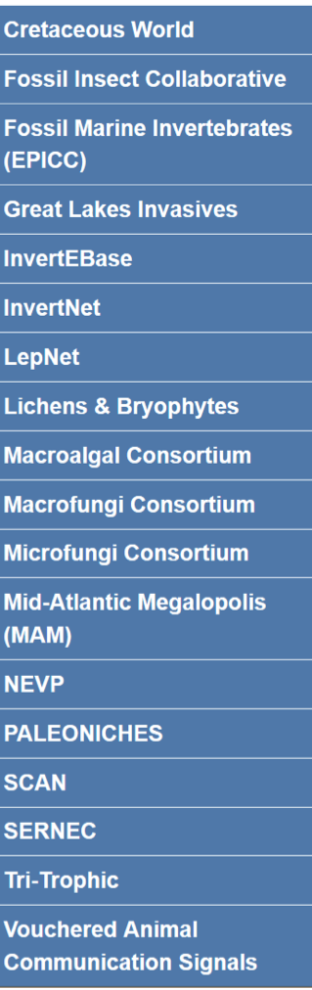
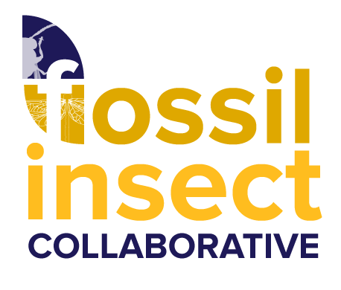
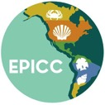
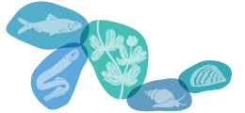


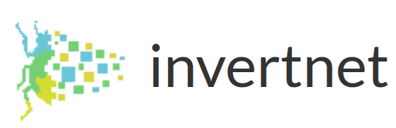


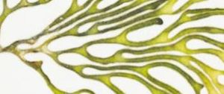


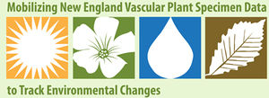


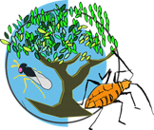


Thematic Collections Networks (TCNs)
TCN: network of institutions strategically digitizing information for a particular research theme, such as impacts of climate change or biota of a region.
The Cretaceous World
The Mid-Atlantic Megalopolis
Notes:
#epicctcn nine natural history museums, united to digitize the Cenozoic invertebrate fossils of the eastern Pacific.
#GLI One of the greatest threats to the health of North America's Great Lakes is invasion by exotic species, several of which already have had catastrophic impacts on property values, the fisheries, shipping, and tourism industries, and continue to threaten the survival of native species and wetland ecosystems. This bi-national thematic collections network of >20 institutions from eight states and Canada will digitize 1.73 million historical specimens representing 2,550 species of exotic fish, clams, snails, mussels, algae, plants, and their look-alikes documented to occur in the Great Lakes Basin.
How many collections are there in Thematic Collection Networks?
More than 271 institutions across 15 tcns + 15 pens, with more than 475 total distinct collections (and new TCNs coming soon).
From everyone (awardees, subawards, volunteers, …) a current total of 786 record sets
Data coming not only from the USA, but also Brazil Norway Sweden South Africa Denmark France New Zealand. What about your collections?
Have other collaborators or contacts been involved? (as of April 2015)
Institutions collaborating in TCNs and PENs (271): https://www.idigbio.org/content/collaborating-institutions
Current iDigBio publishing over 786 datasets: https://www.idigbio.org/portal/publishers
Datasets in the process of being ingested by iDigBio: https://www.idigbio.org/wiki/index.php/Data_Ingestion_Report
InvertNet: An Integrative Platform for Research on Environmental Change, Species Discovery and Identification
Plants, Herbivores, and Parasitoids: A Model System for the Study of Tri-Trophic Associations
North American Lichens and Bryophytes: Sensitive Indicators of Environmental Quality and Change
Digitizing Fossils to Enable New Syntheses in Biogeography - Creating a PALEONICHES-TCN
The Macrofungi Collection Consortium: Unlocking a Biodiversity Resource for Understanding Biotic Interactions, Nutrient Cycling and Human Affairs
Mobilizing New England Vascular Plant Specimen Data to Track Environmental Change
Southwest Collections of Arthropods Network (SCAN): A Model for Collections Digitization to Promote Taxonomic and Ecological Research
iDigPaleo: Fossil Insect Collaborative: A Deep-Time Approach to Studying Diversification and Response to Environmental Change
Developing a Centralized Digital Archive of Vouchered Animal Communication Signals
The Macroalgal Herbarium Consortium: Accessing 150 Years of Specimen Data to Understand Changes in the Marine/Aquatic Environment
Collaborative: Documenting the Occurrence through Space & Time of Aquatic Non-indigenous Fish, Mollusks, Algae, & Plants Threatening North America's Great Lakes
Collaborative Research: The Key to the Cabinets: Building and Sustaining a Research Database for a Global Biodiversity Hotspot (plants)
InvertEBase: reaching back to see the future: species-rich invertebrate faunas document causes and consequences of biodiversity shifts
The Microfungi Collections Consortium: A Networked Approach to Digitizing Small Fungi with Large Impacts on the Function and Health of Ecosystems​ (MiCC)
Documenting Fossil Marine Invertebrate Communities of the Eastern Pacific - Faunal Responses to Environmental Change over the last 66 million years​ (PCMIF)

Slide 5
NIBA Strategic Plan 2010
Vision Statement: NIBA will
  Develop an inclusive, vibrant, partnership of U.S. biological collections
  Document the nation’s biodiversity resources
  Create a dynamic electronic resource
  Serve the country’s needs in answering critical questions about the environment, human health, biosecurity, commerce, and the biological sciences

Slide 6
NIBA Goals 2010
Digitization of specimens will enable
  Benefits to collections
  Benefits to science and policy
Particular benefits to science and policy
  climate change, species invasions, natural disasters, the spread of disease vectors and agricultural pests and pollinators, and other environmental issues.

Slide 7
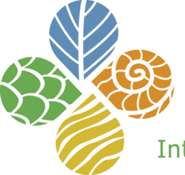
What does iDigBio do?
Enable digitization of biodiversity collections data
  Develop efficient & effective standards & workflows
  Workforce education & training
Provide portal access to biodiversity data
in a cloud computing environment
  Respond to cyberinfrastructure needs
  Enable access & discoverability
Facilitate use of biodiversity data to
address key environmental and
economic challenges
  Researchers, educators, general public,
  policy-makers, …
Plan for long-term sustainability of the
national digitization network & effort
  Expand participation: partners, data sources, public, …
  Proliferate and broaden uses of biodiversity data
Cyber-
infrastructure
Serving the Research Community
Administration
Digitization
Education & Outreach

Slide 8
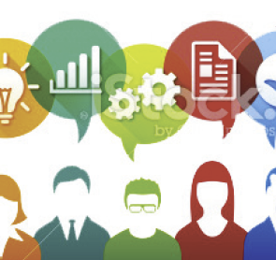
iDigBio Success: Workshop Principles
Community-driven process
Each workshop
  Created in response to need
  Organized by interested parties
  Attended by diverse group
Geographical distribution of sites
Demographic distribution
Notes:
The illustration suggests a community of people with different expertise and interests exchanging information

Slide 9
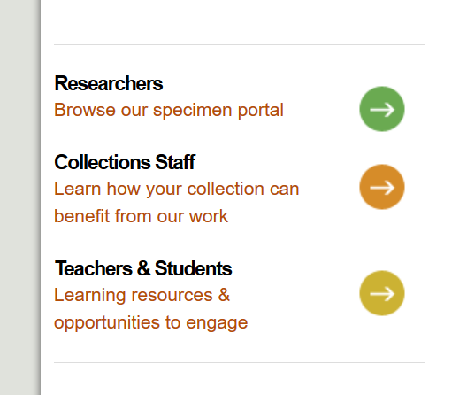
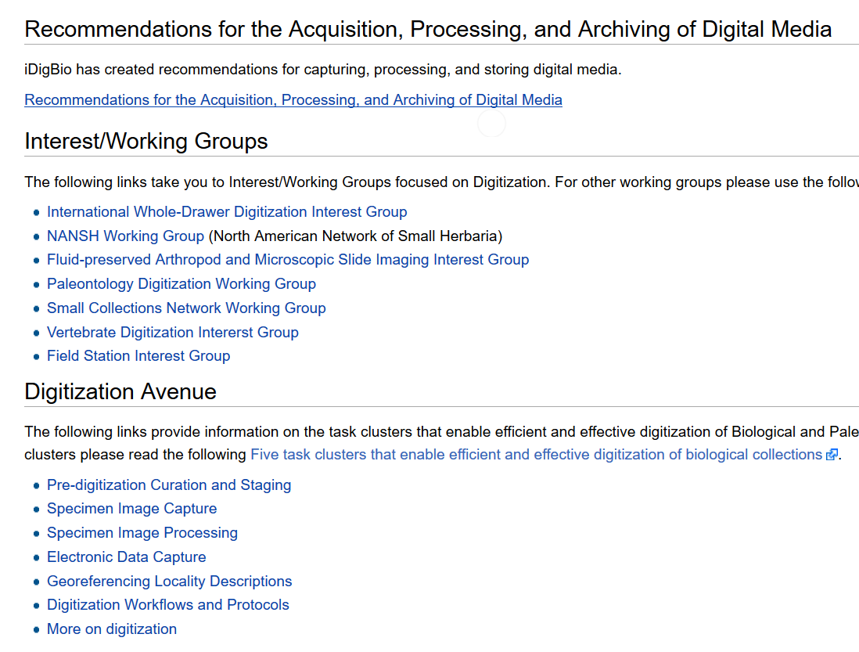
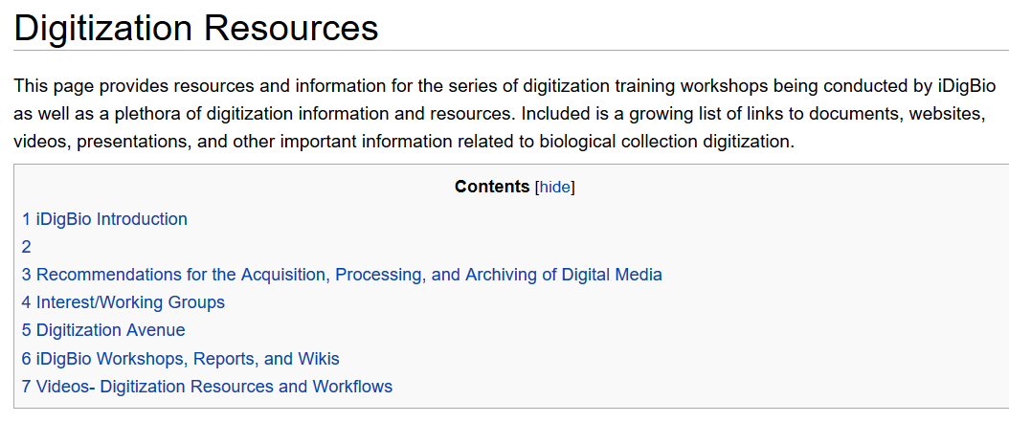
Resources for mobilization

Slide 10
Where dies iDigBio go from here?
Limited time program (10 years)
How to sustain activities?
  Digitization projects?
  Support for digitization improvements?
How to sustain data infrastructure?
  Data persistence?
  Data quality?
  Data portal?
How to sustain commitment
  Governmental?
  Community?

Slide 11
iDigBio, GBIF and International Partners
Data sharing
  iDigBio sharing with GBIF and ALA, more to come
Digitization techniques and training
  SiBBr workshop in November 2014
  Data Carpentry workshops in Kenya, Phillipines, Costa Rica
Technology sharing
  Taxonomic names services
We are encouraged by our funders to collaborate
  Issues are global, effort needs to be global

