Slide 1


Overview
Bullfinch (Pyrrhula pyrrhula), Estonia, 17 Feb 2017. Photo CC BY Madis Karu. PlutoF platform observations.
demo.gbif.org/occurrence/1438561625
March 2017

Slide 2

BY THE NUMBERS
1 Feb 2017
Species occurrence records
Datasets
715,170,991
31,780
Country Participants
Organizational Participants
Publishers
54
39
880
Records downloaded per month
Unique users per month (Feb 2017)
26.7 billion
105,729
Notes:
Useful to see GBIF in its different modalities:
A window on biodiversity
An informatics infrastructure focuseD on tools and standards in service to science and society
A global network on bioinformatics

Slide 3
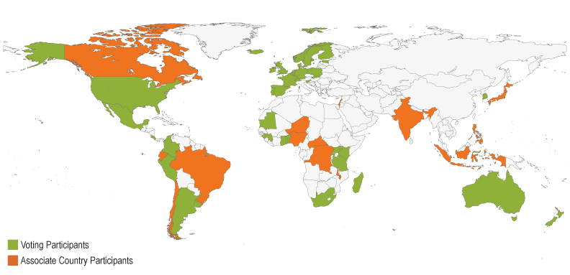
Current national participants
participation
http://www.gbif.org/participation/participant-list

Slide 4
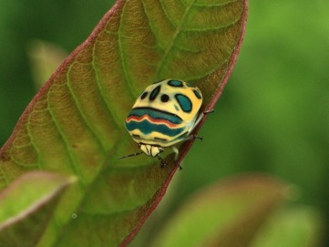
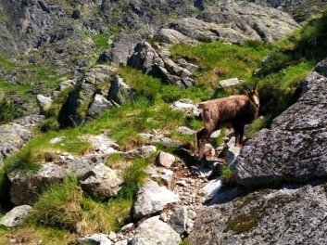
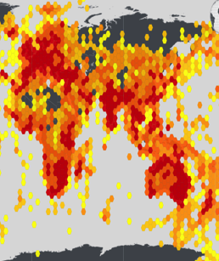
Latest news
communications
      Final BID call for proposals seeks projects from sub-Saharan Africa
      First stage of two-stage selection process under the EU-funded data mobilization programme in
      • English
      • Français
      • Portugûes
      Poland elevates commitment, becomes GBIF Voting Participant
        Long-time Associate Participant is 39th full national member and 19th among European countries
        Read more
      63.8 million new records increase eBird total to 275 million
      Annual dataset refresh grows by 30 per cent, with biggest gains in Asia and Europe
      Read more
http://www.gbif.org/newsroom/summary
Photo credits: (left) Picasso bug (Sphaerocoris annulus). Used by permission © 2013 Jeremy Roberts.
(centre) Tatra Chamois, Kozica tatrzańska in Polish (Rupicapra rupicapra tatrica), Tatra mountains, Poland.

Slide 5
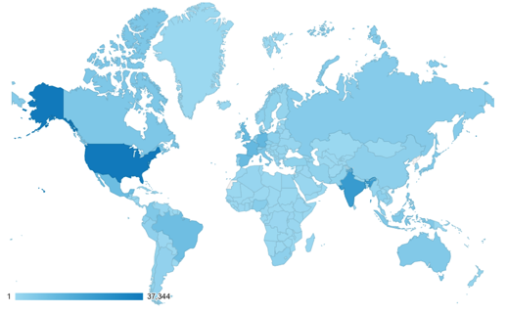
Web traffic to GBIF.org, 2017
Rank | Country/Territory | Sessions | % Total Sessions | 2016 rank | Pages / Session
1 | United States | 38,201 | 13.35% | 1 | 4.71
2 | India | 23,095 | 8.07% | 2 | 2.03
3 | Germany | 12,483 | 4.36% | 4 | 5.85
4 | France | 12,080 | 4.27% | 3 | 3.18
5 | United Kingdom | 11,395 | 3.98% | 7 | 7.80
6 | Spain | 11,031 | 3.98% | 6 | 5.37
7 | Mexico | 10,292 | 3.91% | 8 | 8.13
8 | Brazil | 9,658 | 3.62% | 5 | 4.96
9 | Italy | 6,750 | 2.75% | 10 | 3.99
10 | Canada | 6,455 | 2.40% | 13 | 4.66
data access and use

Slide 6
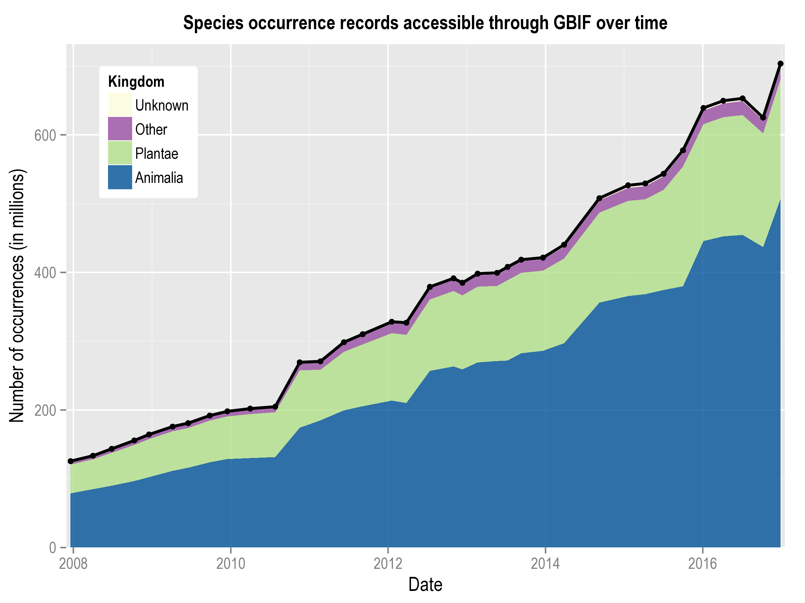
Data published through GBIF.org
data availability
www.gbif.org/analytics/global

Slide 7
Occurrence records published during 2017 by country
 | Country | New records | 2016 rank
1 | Sweden | 7,357,480 | 26
2 | Mexico | 3,061,571 | 14
3 | Norway | 1,575,075 | 6
4 | Brazil | 1,050,962 | 15
5 | United States | 883,444 | 1
6 | New Zealand | 702,182 | 13
7 | Canada | 688,413 | 19
8 | United Kingdom | 631,112 | 4
9 | Belgium | 578,138 | 10
10 | France | 366,898 | 17
data availability
http://www.gbif.org/country

Slide 8
Total number of occurrence records published by country as of 28 Feb 2017
1 | United States | 333,498,481
2 | Sweden | 61,000,794
3 | France | 40,281,742
4 | Australia | 36,435,662
5 | United Kingdom | 29,635,764
6 | Germany | 28,477,939
7 | Netherlands | 26,075,010
8 | Norway | 24,187,647
9 | South Africa | 21,043,210
10 | Spain | 14,321,775
data availability
http://www.gbif.org/country

Slide 9
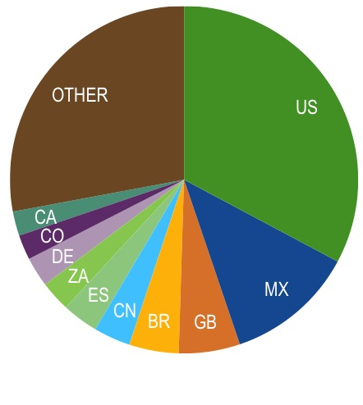
Data download requests by country, 2017
 | Country | Downloads | 2016 rank
1 | United States | 5,384 | 1
2 | Mexico | 1,970 | 2
3 | United Kingdom | 932 | 6
4 | Brazil | 756 | 3
5 | China | 561 | 9
6 | Spain | 551 | 4
7 | South Africa | 464 | 7
8 | Germany | 455 | 11
9 | Colombia | 381 | 5
10 | Italy | 372 | 12
data access and use
2017
Notes:
5384 1970 932 756 561 551 464 455 381 372

Slide 10
data access and use
Peer-reviewed publications using GBIF-mediated data

Slide 11
Peer-reviewed uses, by country and region, 2017
2017
Total # of papers by country
1 | United States | 28
2 | United Kingdom | 19
3 | Germany | 15
4 | Spain | 14
5 | Brazil | 13
6 | Mexico | 10
6 | Switzerland | 10
8 | Australia | 9
8 | France | 9
10 | Norway | 8
data access and use
Total # of papers by region
1 | Europe | 119
2 | North America | 33
3 | Latin America | 32
4 | Asia | 18
5 | Oceania | 10
6 | Africa | 5

Slide 12
Featured research
January 2017
 | De Pooter D, Appeltans W, Bailly N et al. (2017) Toward a new data standard for combined marine biological and environmental datasets - expanding OBIS beyond species occurrences. Biodiversity Data Journal 5 doi:10.3897/BDJ.5.e10989 Author countries: Belgium, Greece, United States, Italy, Argentina, New Zealand, United Kingdom, Australia, Mexico, Kenya, Venezuela
 | Hosoya T, Uzuhashi S, Hosaka K & Kudo S (2017) An assessment of fungi endemic to Japan. Japanese Journal of Mycology 57: 77-84. doi:10.18962/jjom.57.2_77 Author country: Japan.
 | Liu D, Wang R, Gordon DR, Sun X, Chen L & Wang Y (2017) Predicting Plant Invasions Following China's Water Diversion Project. Environmental Science & Technology doi:10.1021/acs.est.6b05577 Author countries: China, United States
 | Odonne G, Houël E, Bourdy G & Stien D (2017) Healing leishmaniasis in Amazonia: review of ethnomedicinal concepts and pharmaco-chemical analysis of traditional treatments to inspire modern phytotherapies. Journal of Ethnopharmacology doi:10.1016/j.jep.2017.01.048 Author country: France
 | Padilla O, Rosas P, Moreno W & Toulkeridis T (2017) Modeling of the ecological niches of the anopheles spp in Ecuador by the use of geo-informatic tools. Spatial and Spatio-temporal Epidemiology 21:1-11. doi:10.1016/j.sste.2016.12.001 Author country: Ecuador
 | Pellegrini AFA, Anderegg WRL, Paine CET et al. (2016) Convergence of bark investment according to fire and climate structures ecosystem vulnerability to future change. Ecology Letters doi:10.1111/ele.12725 Author countries: United States, United Kingdom, Norway, Brazil
 | Rengifo-Correa L, Stephens CR, Morrone JJ, Téllez-Rendón-JL & González-Salazar (2016) Understanding transmissibility patterns of Chagas disease through complex vector–host networks. Parasitology: 1-13. doi:10.1017/S0031182016002468 Author country: Mexico
data access and use
Invasive alien species
Impact of climate change
Species conservation and protected areas
Biodiversity and human health
Food, farming and biofuels
Ecosystem services
Advancing biodiversity science
Data management
Data papers
https://demo.gbif.org/cms/search?type=data_use

Slide 13
Featured research
February 2017
1/2
 | Andrew C, Heegaard E, Kirk PM et al. (2017) Big data integration: Pan-European fungal species observations' assembly for addressing contemporary questions in ecology and global change biology. Fungal Biology Reviews doi:10.1016/j.fbr.2017.01.001 Author countries: Norway, United Kingdom, Denmark, Switzerland, Czech Republic, Austria, Netherlands, Germany, United States.
 | Antonelli A, Hettling H, Condamine FL (2016) Toward a Self-Updating Platform for Estimating Rates of Speciation and Migration, Ages, and Relationships of Taxa. Systematic Biology. doi:10.1093/sysbio/syw066 Author countries: Sweden, Netherlands, France, United States, Switzerland.
 | Carew ME, Metzeling L, St Clair R, Hoffmann AA (2016) Detecting invertebrate species in archived collections using next-generation sequencing. Molecular Ecology Resources. doi:10.1111/1755-0998.12644 Author country: Australia.
 | Figuerola B, Barnes DKA, Brickle P, Brewin PE (2017) Bryozoan diversity around the Falkland and South Georgia Islands: Overcoming Antarctic barriers. Marine Environmental Research doi:10.1016/j.marenvres.2017.02.005 Author countries: Spain, United Kingdom, Falkland Islands (Malvinas).
 | González-Salazar C, Stephens CR & Sánchez-Cordero V (2017) Predicting the Potential Role of Non-human Hosts in Zika Virus Maintenance. EcoHealth. doi:10.1007/s10393-017-1206-4 Author country: Mexico.
 | Martin CA & Harvey WJ (2017) The Global Pollen Project: A New Tool for Pollen Identification and the Dissemination of Physical Reference Collections. Methods in Ecology and Evolution. doi:10.1111/2041-210X.12752 Author country: United Kingdom.
data access and use
Invasive alien species
Impact of climate change
Species conservation and protected areas
Biodiversity and human health
Food, farming and biofuels
Ecosystem services
Advancing biodiversity science
Data management
Data papers
https://demo.gbif.org/cms/search?type=data_use

Slide 14
Featured research
February 2017
2/2
 | Odonne G, Houël E, Bourdy G, Stien D (2017) Treating leishmaniasis in Amazonia: A review of ethnomedicinal concepts and pharmaco-chemical analysis of traditional treatments to inspire modern phytotherapies. Journal of Ethnopharmacology doi:10.1016/j.jep.2017.01.048 Author country: France.
 | Pausas JG & Ribeiro E (2017) Fire and plant diversity at the global scale. Global Ecology & Biogeography. uv.es/jgpausas/papers/Pausas-2017-GEB_fire-diversity.pdf Author countries: Spain, Netherlands.
 | Prieto-Benítez S, Yela JL, Giménez-Benavides L (2017) Ten years of progress in the study of Hadena-Caryophyllaceae nursery pollination. A review in light of new Mediterranean data. Flora. doi:10.1016/j.flora.2017.02.004 Author countries: Spain, United States.
 | Skeels A & Cardillo M (2017) Environmental niche conservatism explains the accumulation of species richness in Mediterranean-hotspot plant genera. Evolution doi:10.1111/evo.13179 Author country: Australia.
 | Taylor NG, Kell SP, Holubec V, Parra-Quijano M, Chobot K & Maxted N (2017) A systematic conservation strategy for crop wild relatives in the Czech Republic. Diversity and Distributions doi:10.1111/ddi.12539 Author countries: United Kingdom, Czech Republic, Italy.
 | Zohner CM, Benito BM, Fridley JD, Svenning JC, Renner SS (2017) Spring predictability explains different leaf-out strategies in the woody floras of North America, Europe and East Asia. Ecology Letters. doi:10.1111/ele.12746 Author countries: Denmark, Norway, United States.
data access and use
Invasive alien species
Impact of climate change
Species conservation and protected areas
Biodiversity and human health
Food, farming and biofuels
Ecosystem services
Advancing biodiversity science
Data management
Data papers
https://demo.gbif.org/cms/search?type=data_use

