Slide 1
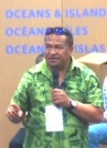
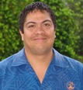
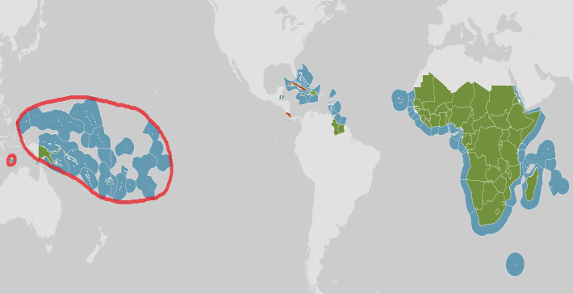
BIOPAMA Phase 2 Better Information and Capacity for Protected and Managed Areas
15 countries + o/s territories are ok too

Slide 2
its all about protected and managed areas

Slide 3
Main aims
Collating and presenting better information about protected areas and managed areas
Building capacity to use and monitor that information to strengthen governance, management and policy making

Slide 4
BIOPAMA Phase 2
IUCN Oceania and SPREP are the regional implementing partners for a 6 year program 2017-2023
Due to commence NOW
SPREP operates a regional information portal for protected areas
IUCN implements a grants program for specific actions that help improve baseline information inventories and build capacity to use information for more effective protected areas

Slide 5
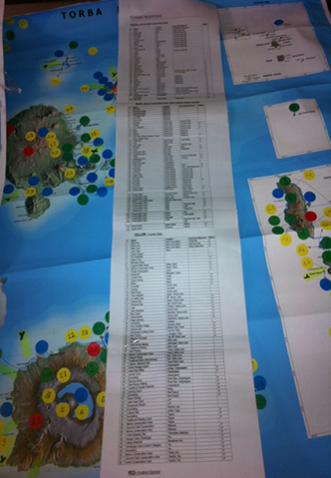
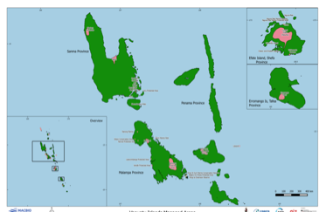
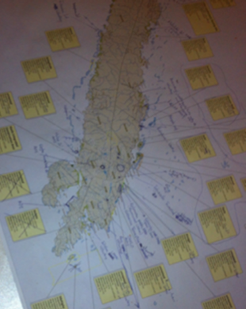

Slide 6
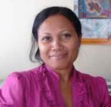
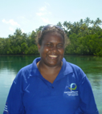
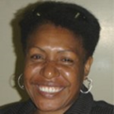
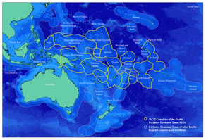
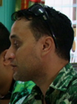
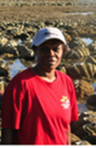
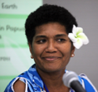
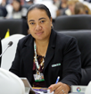
What countries say they want
a secure, safe, trustworthy place to store and view information
• global and regional is nice, but want to see their own local info
‘restricted access only’ to authorised people
• fast / clickable / interactive / pictorial
• produce summaries, graphic statistics and reports
• support with obtaining site coordinates - seeing and making maps
• accessible for users to let them update
• available without always requiring strong internet connection
• links in with national ideas and intentions for improving information

Slide 7
What types of information ?
‘Hard’ | ‘Soft’
Location and extent of areas registered, reserved, governed and managed for their special marine, coastal, land/landscape, forest, cultural, plant or animal, or food/water resources Maps and written descriptions, inventories and other metrics Baseline physical biological/environmental situation Terrestrial, coastal and marine areas scientifically identified as important for biodiversity , ie; KBA’s, EBSA’s, IBAs, AZE’s Ecosystem types Species and habitat (+ invasive species) Ecological connections | Management issues, pressures, threats Governance arrangements Assessments of management effectiveness Relevant reports, plans, strategies, roadmaps, case studies, solutions, ideas, and practical experience stories Capacity development options and recognition opportunities Sources of funding, expertise and other support Information sharing forums and peer networks

Slide 8
BIOPAMA Phase 2 activities …
improve baseline information inventories, including maps,
Providing a secure, on-line portal (Pacific Islands Protected Areas Portal, PIPAP) that national services, partners and stakeholders can freely use to store, view and interpret information
Regular contact with country counterparts to review protected area records, check information needs, identifying challenges faced and gaps,
Technical demonstrations and hands on capacity building to give stakeholders’ specialised skills in data gathering and acquisition, data management, creating spatial products and monitoring
information is shared
Working with national, regional and international partners to obtain the best and most relevant open source information available

Slide 9
http://ibis.fos.auckland.ac.nz/

Slide 10
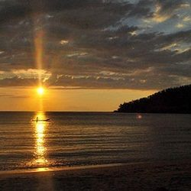
Any Q&A’s

