Slide 1

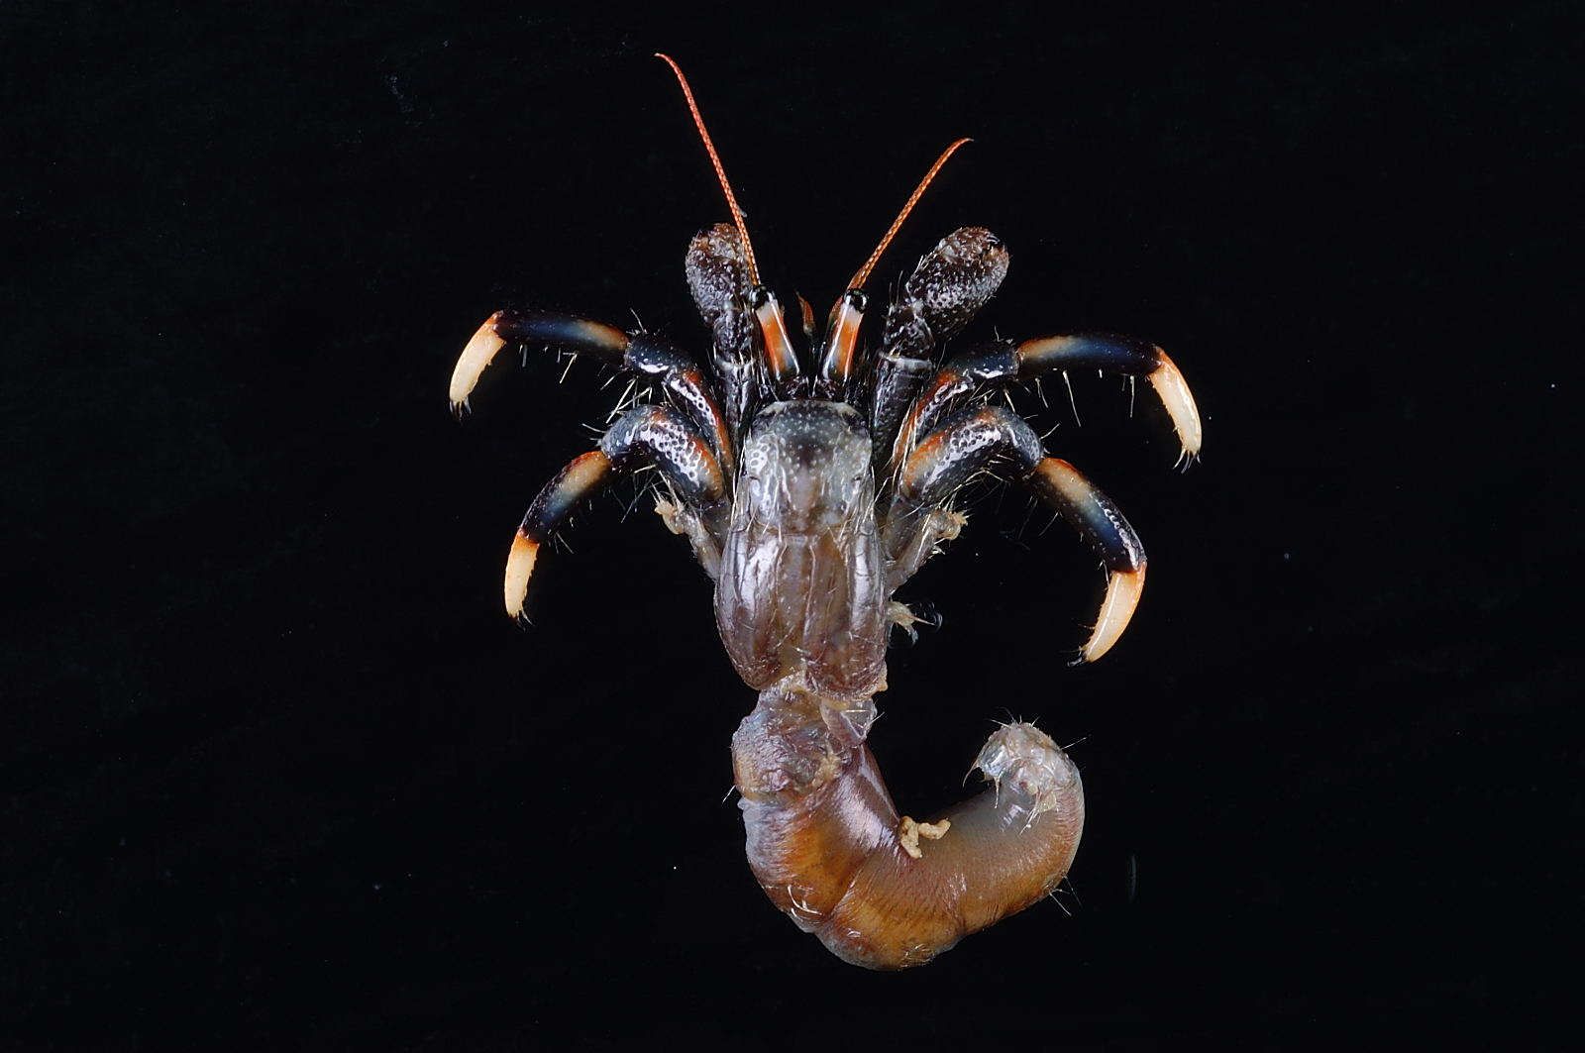
Overview
Hermit crab (Clibanarius merguiensis), collected at West Baldwin Cove, mouth of Nasouli River, Vanuatu, 11 Sept 2006.
Photo BY-NC-ND 4.0 MNHN: Cléva R & Chan TY, 2013. From Crustaceans collection of the Muséum national d'Histoire naturelle (MNHN), Paris https://www.gbif.org/occurrence/440010042
May 2018

Slide 2

BY THE NUMBERS
1 May 2018
Species occurrence records
Datasets
976,620,725
38,829
Country Participants
Organizational Participants
Publishers
55
36
1,176
Average records downloaded per month (2018)
Avg monthly user sessions (2018)
121.6 billion
167,833
Notes:
Useful to see GBIF in its different modalities:
A window on biodiversity
An informatics infrastructure focuseD on tools and standards in service to science and society
A global network on bioinformatics

Slide 3
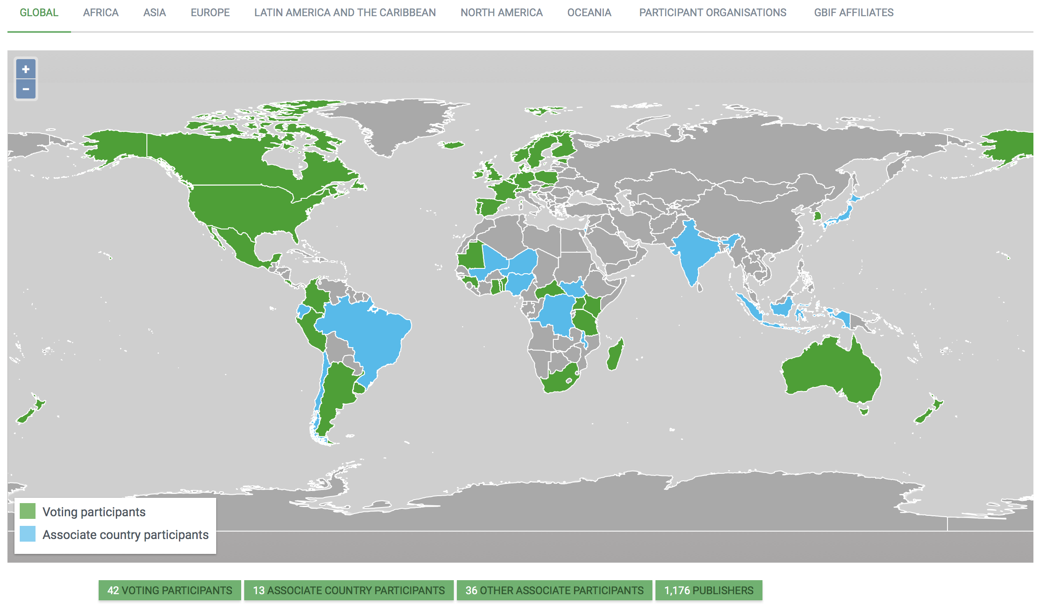
Current network
participation
https://www.gbif.org/the-gbif-network

Slide 4
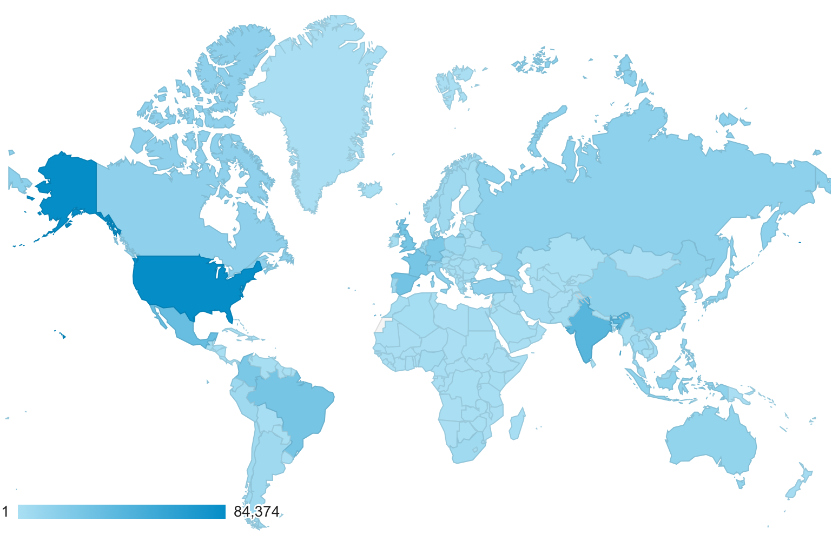
GBIF.org Web traffic
2018 to date
Rank | Country/Territory | Sessions | % Total Sessions | 2017 rank | Pages / Session
1 | United States | 84,374 | 12.57% | 1 | 3.07
2 | India | 41,822 | 6.24% | 2 | 3.33
3 | Mexico | 34,084 | 5.08% | 3 | 3.88
4 | Spain | 28,460 | 4.24% | 6 | 3.53
5 | United Kingdom | 26,978 | 4.02% | 5 | 4.35
6 | Brazil | 26,736 | 3.98% | 4 | 3.81
7 | France | 25,940 | 3.86% | 8 | 3.12
8 | Colombia | 24,406 | 3.64% | 9 | 3.18
9 | Germany | 23,459 | 3.49% | 7 | 3.56
10 | China | 14,744 | 2.20% | 15 | 5.90
data access and use

Slide 5
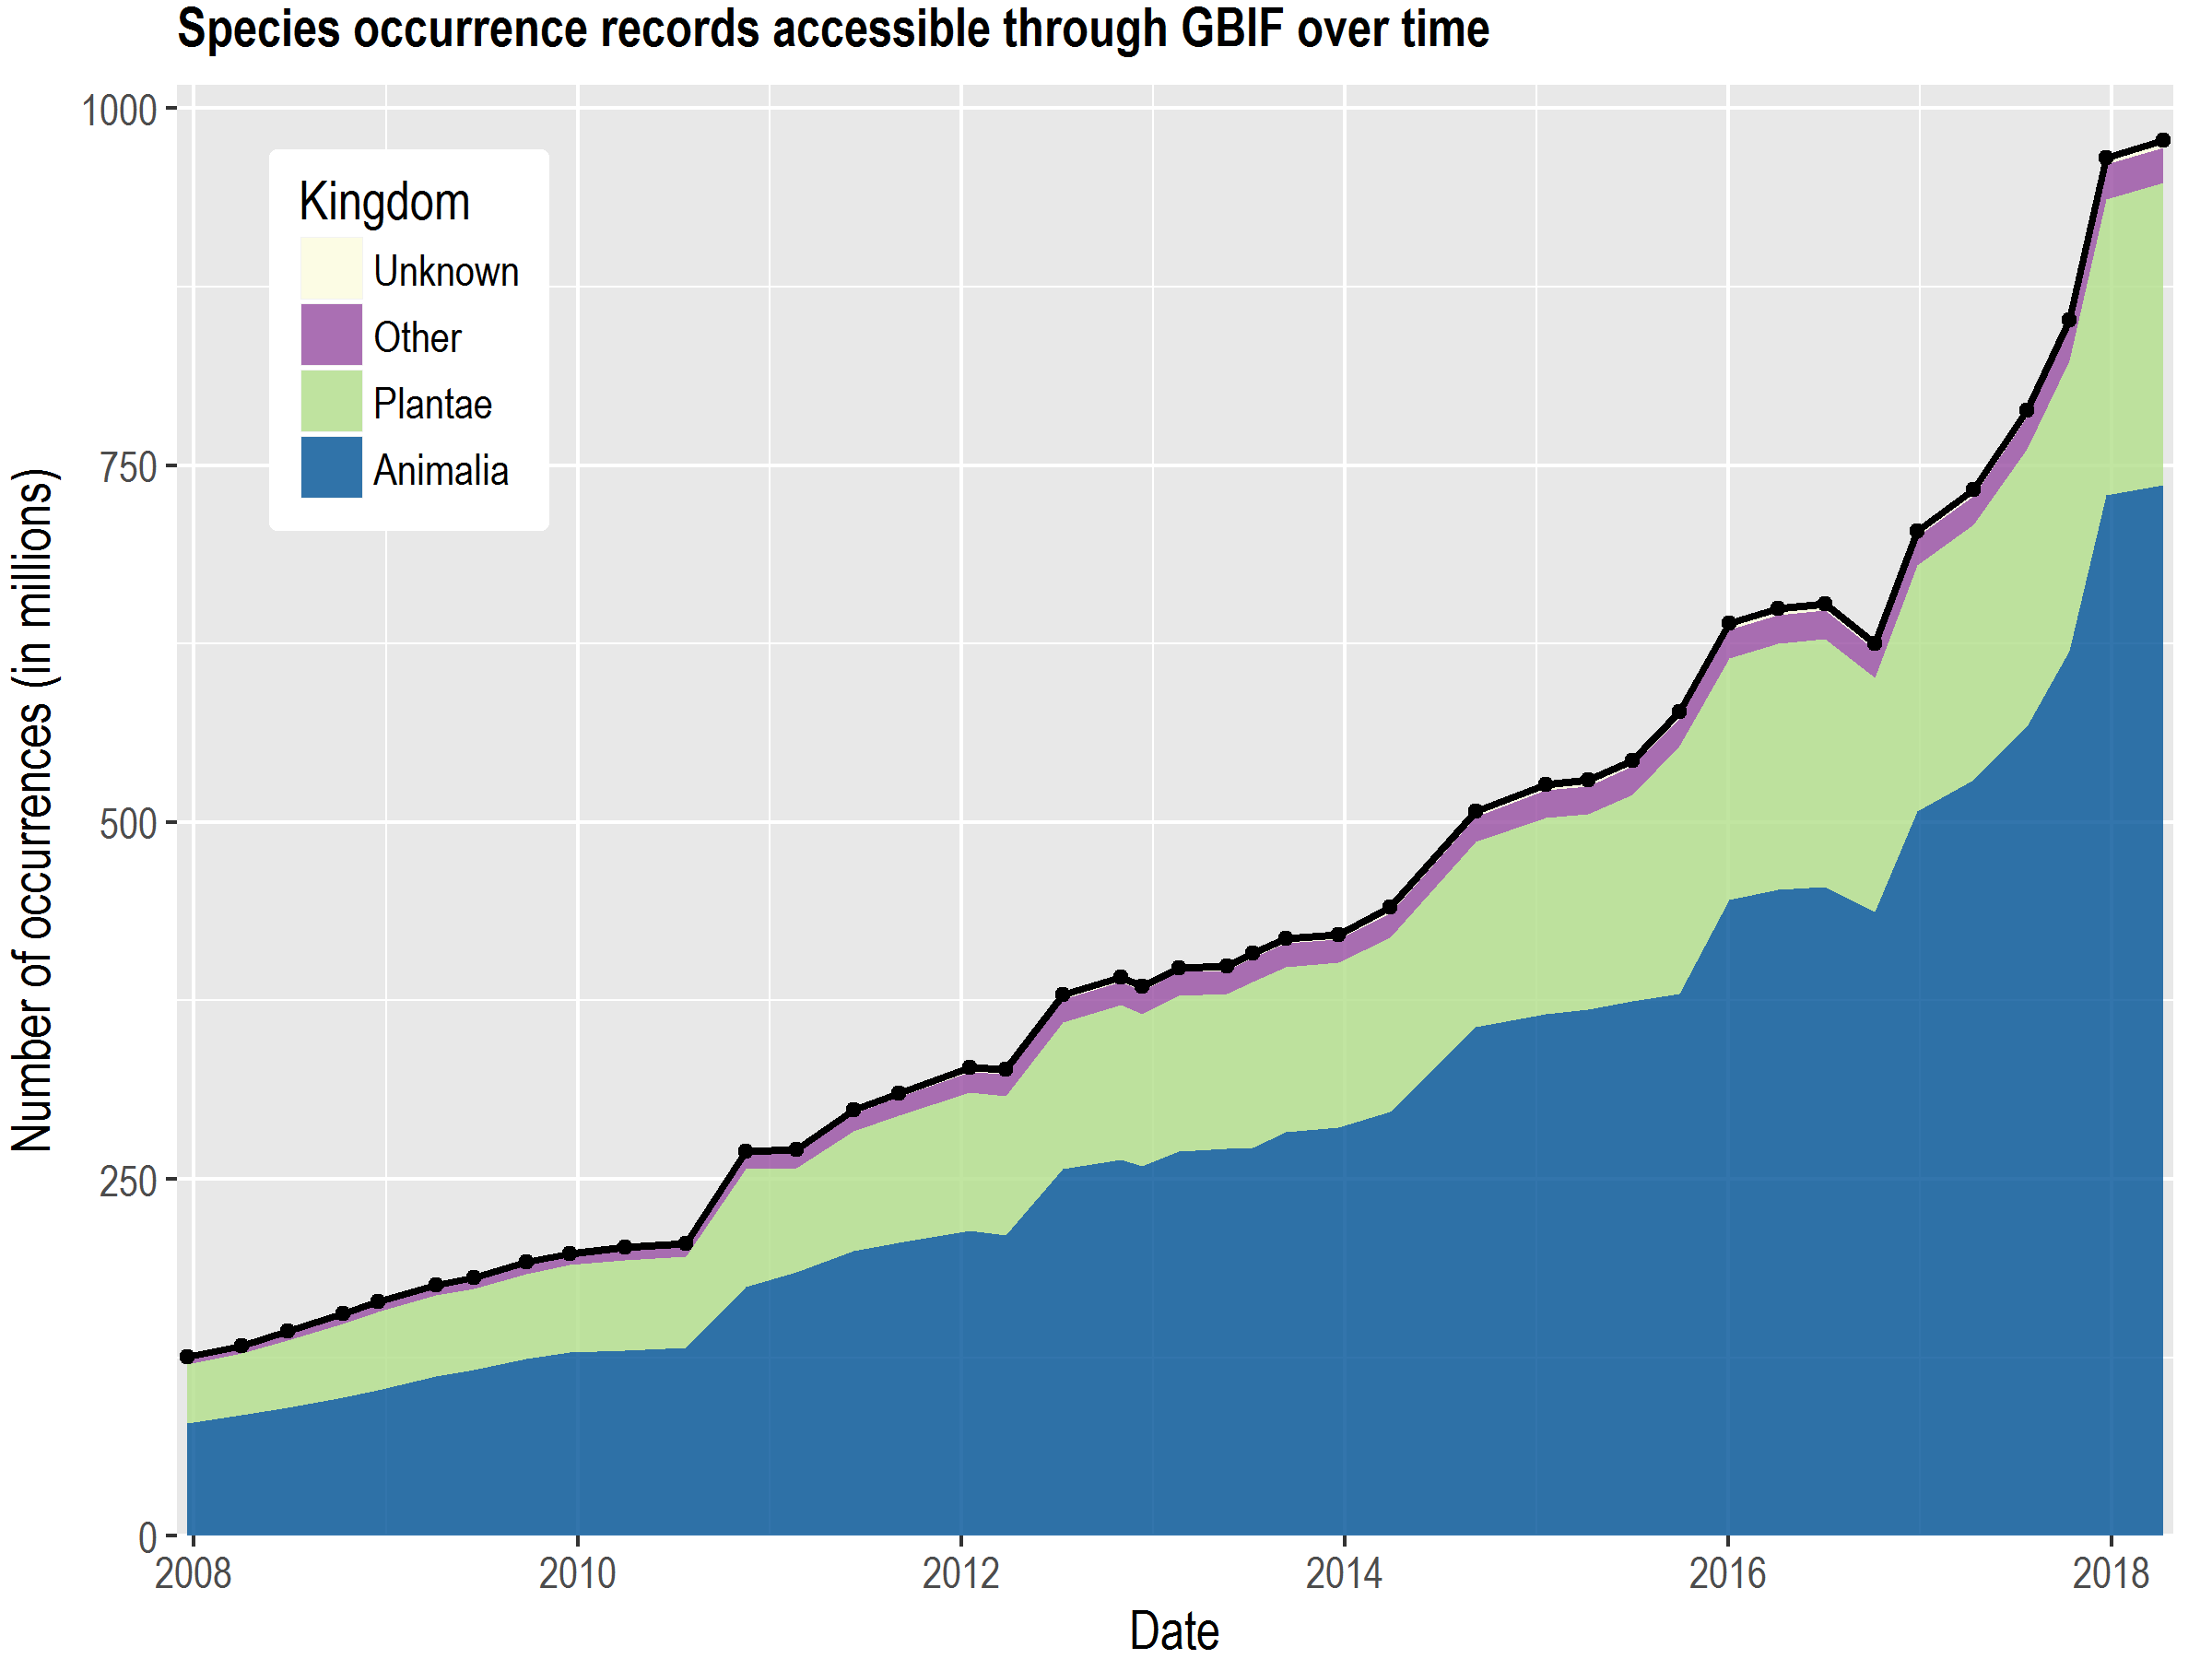
Data published through GBIF.org
data availability
www.gbif.org/analytics/global

Slide 6
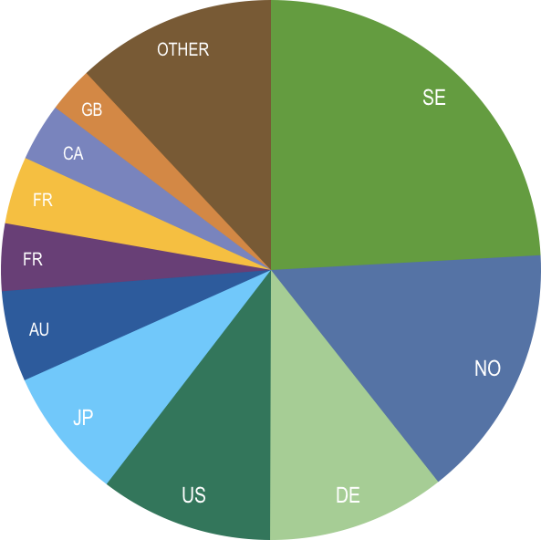
Occurrence records published during 2018, by country
 | Country | New records | 02/17 rank
1 | Sweden | 6,883,824 | 2
2 | Norway | 4,346,838 | 1
3 | Germany | 3,050,654 | 5
4 | United States | 2,958,353 | 4
5 | Japan | 2,248,474 | 20
6 | Australia | 1,552,291 | 3
7 | France | 1,150,838 | 8
8 | South Korea | 996,976 | 6
9 | Canada | 989,749 | 7
10 | United Kingdom | 781,165 | 9
data availability
http://www.gbif.org/country

Slide 7
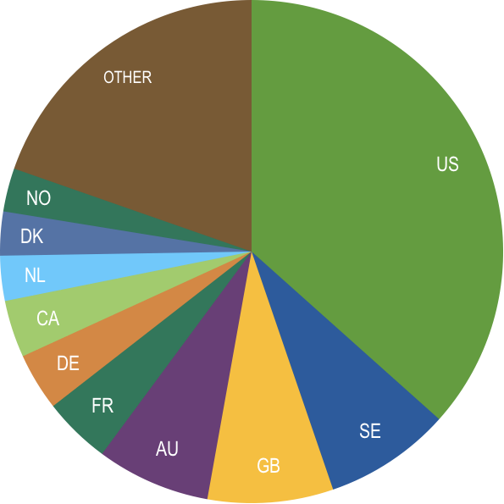
Total number of occurrence records published by country as of 30 Apr 2018
 | Country | Occurrences | Aug-17 rank
1 | United States | 357,485,201 | 1
2 | Sweden | 79,946,767 | 2
3 | United Kingdom | 78,875,224 | 3
4 | Australia | 71,428,234 | 4
5 | France | 42,364,098 | 5
6 | Germany | 36,104,134 | 7
7 | Canada | 35,908,690 | 6
8 | Netherlands | 28,240,700 | 8
9 | Denmark | 27,566,241 | 9
10 | Norway | 27,248,781 | 10
data availability
http://www.gbif.org/country

Slide 8
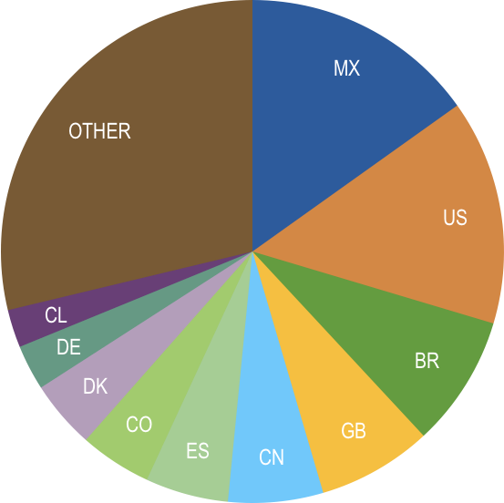
Data download requests by country, 2018
 | Country | Downloads | 02/17 rank
1 | Mexico | 6,652 | 1
2 | United States | 6,362 | 2
3 | Brazil | 3,719 | 4
4 | United Kingdom | 3,238 | 3
5 | China | 2,684 | 5
6 | Spain | 2,345 | 8
7 | Colombia | 2,030 | 8
8 | Denmark | 1,923 | 13
9 | Germany | 1,280 | 6
10 | Chile | 1,072 | 7
data access and use

Slide 9
data access and use
Peer-reviewed publications using GBIF-mediated data
through 30 Apr 2018

Slide 10
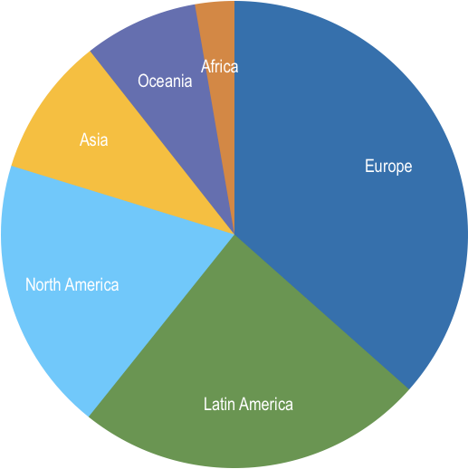
Peer-reviewed uses, by country and region
2018 to date
Total # of peer-reviewed papers by country
1 | United States | 57
2 | Brazil | 28
3 | Mexico | 27
4 | Australia | 26
5 | United Kingdom | 23
6 | China | 22
6 | Spain | 22
8 | Canada | 17
9 | Germany | 14
10 | France | 13
data access and use
Total # of papers by region
1 | Europe & Central Asia | 148
2 | Latin America & the Caribbean | 98
3 | North America | 77
4 | Asia | 39
5 | Oceania | 32
6 | Africa | 11

Slide 11
Featured research
Mar 2018
1 / 3
 | Alvez-Valles CM, Balslev H, Garcia-Villacorta R, Carvalho FA & Menini Neto L (2018) Palm species richness, latitudinal gradients, sampling effort, and deforestation in the Amazon region. Acta Botanica Brasilica. doi:10.1590/0102-33062017abb0400 Author countries: Brazil, Denmark, Peru
 | Bemmels JB, Wright SJ, Garwood NC, Queenborough SA, Valencia R & Dick CW (2018) Filter-dispersal assembly of lowland Neotropical rainforests across the Andes. Ecography. https://doi.org/10.1111/ecog.03473 Author countries: United States, Panama, Ecuador
 | Botella C, Joly A, Bonnet P, Monestiez P & Munoz F (2018) Species distribution modeling based on the automated identification of citizen observations. Applications in Plant Sciences 6(2): e1029. https://doi.org/10.1002/aps3.1029. Author country: France
 | Englert Duursma D, Gallagher RV, Price JJ & Griffith SC (2018) Variation in avian egg shape and nest structure is explained by climatic conditions. Scientific Reports 8: 4141. doi:10.1038/s41598-018-22436-0 Author countries: Australia, United States
 | Faurby S & Araújo MB (2018) Anthropogenic range contractions bias species climate change forecasts. Nature Climate Change 8: 252–256. https://doi.org/10.1038/s41558-018-0089-x Author countries: Sweden, Spain, Portugal, Denmark
 | van ‘t Klooster CIEA, Haabo V, Ruysschaert S, Vossen T & van Andel TR (2018) Herbal bathing: an analysis of variation in plant use among Saramaccan and Aucan Maroons in Suriname. Journal of Ethnobiology and Ethnomedicine 14: 20. doi:10.1186/s13002-018-0216-9 Author countries: Netherlands, Suriname
data access and use
Invasive alien species
Impact of climate change
Species conservation and protected areas
Biodiversity and human health
Food, farming and biofuels
Ecosystem services
Advancing biodiversity science
Data management
Data papers
https://www.gbif.org/resource/search?contentType=literature

Slide 12
Featured research
Mar 2018
2 / 3
 | Mageski MM, Varela S & Roper JJ (2018) Consequences of dispersal limitation and habitat fragmentation for the Brazilian heart‐tongued frogs (Phyllodytes spp.). Austral Ecology. doi:10.1111/aec.12591 Author countries: Brazil, Germany
 | Rattis L, Dobrovolski R, Talebi M & Loyola R (2018) Geographic range-scale assessment of species conservation status: A framework linking species and landscape features. Perspectives in Ecology and Conservation. doi:10.1016/j.pecon.2018.01.001 Author countries: Brazil, United States
 | Reichgelt T, West CK & Greenwood DR (2018) The relation between global palm distribution and climate. Scientific Reports 4721. doi:10.1038/s41598-018-23147-2 Author countries: United States, Canada
 | Schirpke U, Meisch C & Tappeiner U (2018) Symbolic species as a cultural ecosystem service in the European Alps: insights and open issues. Landscape Ecology 33(5): 711–730. doi:10.1007/s10980-018-0628-x Author countries: Austria, Italy
 | Shabani F, Shafapour Tehrany M, Solhjouy-fard S & Kumar L (2018) A comparative modeling study on non-climatic and climatic risk assessment on Asian Tiger Mosquito (Aedes albopictus). PeerJ 6: e4474. doi:10.7717/peerj.4474 Author countries: Australia Human_health
 | Stevenson PR, Aldana AM, Cárdenas S & Negret PJ (2018) Flooding and soil composition determine beta diversity of lowland forests in Northern South America. Biotropica. doi:10.1111/btp.12541 Author countries: Colombia, Australia
data access and use
Invasive alien species
Impact of climate change
Species conservation and protected areas
Biodiversity and human health
Food, farming and biofuels
Ecosystem services
Advancing biodiversity science
Data management
Data papers
https://www.gbif.org/resource/search?contentType=literature

Slide 13
Featured research
Mar 2018
3 / 3
 | Tedersoo L, Laanisto L, Rahimlou S, Toussaint A, Hallikma T & Pärtel M (2018) Global database of plants with root-symbiotic nitrogen fixation: NodDB. Journal of Vegetation Science. doi:10.1111/jvs.12627 Author country: Estonia
 | Walsh MG & Webb C (2018) Hydrological features and the ecological niches of mammalian hosts delineate elevated risk for Ross River virus epidemics in anthropogenic landscapes in Australia. Parasites & Vectors 11: 192. doi:10.1186/s13071-018-2776-x Author country: Australia
 | Younis S, Weiland C, Hoehndorf R et al. (2018) Taxon and trait recognition from digitized herbarium specimens using deep convolutional neural networks. Botany Letters. doi:10.1080/23818107.2018.1446357 Author countries: Germany, Saudi Arabia
 | van Zonneveld M, Larranaga N, Blonder B, Coradin L, Hormaza JI & Hunter D (2018) Human diets drive range expansion of megafauna-dispersed fruit species. Proceedings of the National Academy of Sciences 115(13): 3326-3331. doi:10.1073/pnas.1718045115 Author countries: Costa Rica, Taiwan, Spain, United Kingdom, United States, Brazil, Australia
data access and use
Invasive alien species
Impact of climate change
Species conservation and protected areas
Biodiversity and human health
Food, farming and biofuels
Ecosystem services
Advancing biodiversity science
Data management
Data papers
https://www.gbif.org/resource/search?contentType=literature

Slide 14
Featured research
Apr 2018
1 / 2
 | Callcutt K, Croft S & Smith GC (2018) Predicting population trends using citizen science data: do subsampling methods produce reliable estimates for mammals? European Journal of Wildlife Research 64: 28. https://doi.org/10.1007/s10344-018-1189-7 Author country: United Kingdom
 | Ceccarelli FS, Mongiardino Koch N, Soto EM, Barone ML, Arnedo MA & Ramírez MJ (2018) The grass was greener: Repeated evolution of specialized morphologies and habitat shifts in ghost spiders following grassland expansion in South America. Systematic Biology syy028. https://doi.org/10.1093/sysbio/syy028 Author countries: Argentina, Mexico, United States, Spain
 | Escribano N, Galicia D & Ariño AH (2018) The tragedy of the biodiversity data commons: a data impediment creeping nigher. Database. https://doi.org/10.1093/database/bay033 Author country: Spain
 | Lobo JM, Hortal J, Yela JL et al. (2018) KnowBR: An application to map the geographical variation of survey effort and identify well-surveyed areas from biodiversity databases. Ecological Indicators 91: 241-248. https://doi.org/10.1016/j.ecolind.2018.03.077 Author country: Spain
 | Mesibov R (2018) An audit of some processing effects in aggregated occurrence records. ZooKeys 751: 129-146. https://doi.org/10.3897/zookeys.751.24791 Author country: Australia
 | Petersen KB & Burd M (2018) The adaptive value of heterospory: evidence from Selaginella. Evolution. https://doi.org/10.1111/evo.13484 Author country: Australia
data access and use
Invasive alien species
Impact of climate change
Species conservation and protected areas
Biodiversity and human health
Food, farming and biofuels
Ecosystem services
Advancing biodiversity science
Data management
Data papers
https://www.gbif.org/resource/search?contentType=literature

Slide 15
Featured research
Apr 2018
2 / 2
 | Schley RJ, de la Estrella M, Alejandro Pérez-Escobar O et al. (2018) Is Amazonia a ‘museum’ for Neotropical trees? The evolution of the Brownea clade (Detarioideae, Leguminosae). Molecular Phylogenetics and Evolution 126: 279-292. doi:10.1016/j.ympev.2018.04.029 Author countries: United Kingdom, Canada
 | Slodowicz D, Descombes P, Kikodze D, Broennimann O & Müller-Schärer H (2018) Areas of high conservation value at risk by plant invaders in Georgia under climate change. Ecology and Evolution. doi:10.1002/ece3.4005 Author countries: Switzerland, Georgia
 | Solberg SØ & Yndgaard F (2018) Trait Patterns and Genetic Resources of Dill (Anethum graveolens L.). Geneconserve 17(66): 1-17. http://bit.ly/2FH85md Author countries: Norway, Sweden
 | Yañez-Arenas C, Díaz-Gamboa, Luis, Patrón-Rivero C, López-Reyes K & Chiappa-Carrara X (2018) Estimating geographic patterns of ophidism risk in Ecuador. Neotropical Biodiversity 4(1): 55-61. doi:10.1080/23766808.2018.1454762 Author country: Mexico
 | Yap TA, Koo MS, Ambrose RF & Vredenburg VT (2018) Introduced bullfrog facilitates pathogen invasion in the western United States. PLoS ONE 13(4): e0188384. doi:10.1371/journal.pone.0188384 Author country: United States
 | You J, Qin X, Ranjitkar S et al. (2018) Response to climate change of montane herbaceous plants in the genus Rhodiola predicted by ecological niche modelling. Scientific Reports 5879. doi:10.1038/s41598-018-24360-9 Author countries: China, Canada
 | Zhang X & Vincent ACJ (2018) Predicting distributions, habitat preferences and associated conservation implications for a genus of rare fishes, seahorses (Hippocampus spp.). Diversity and Distributions. doi:10.1111/ddi.12741 Author country: Canada
data access and use
Invasive alien species
Impact of climate change
Species conservation and protected areas
Biodiversity and human health
Food, farming and biofuels
Ecosystem services
Advancing biodiversity science
Data management
Data papers
https://www.gbif.org/resource/search?contentType=literature

