Slide 1
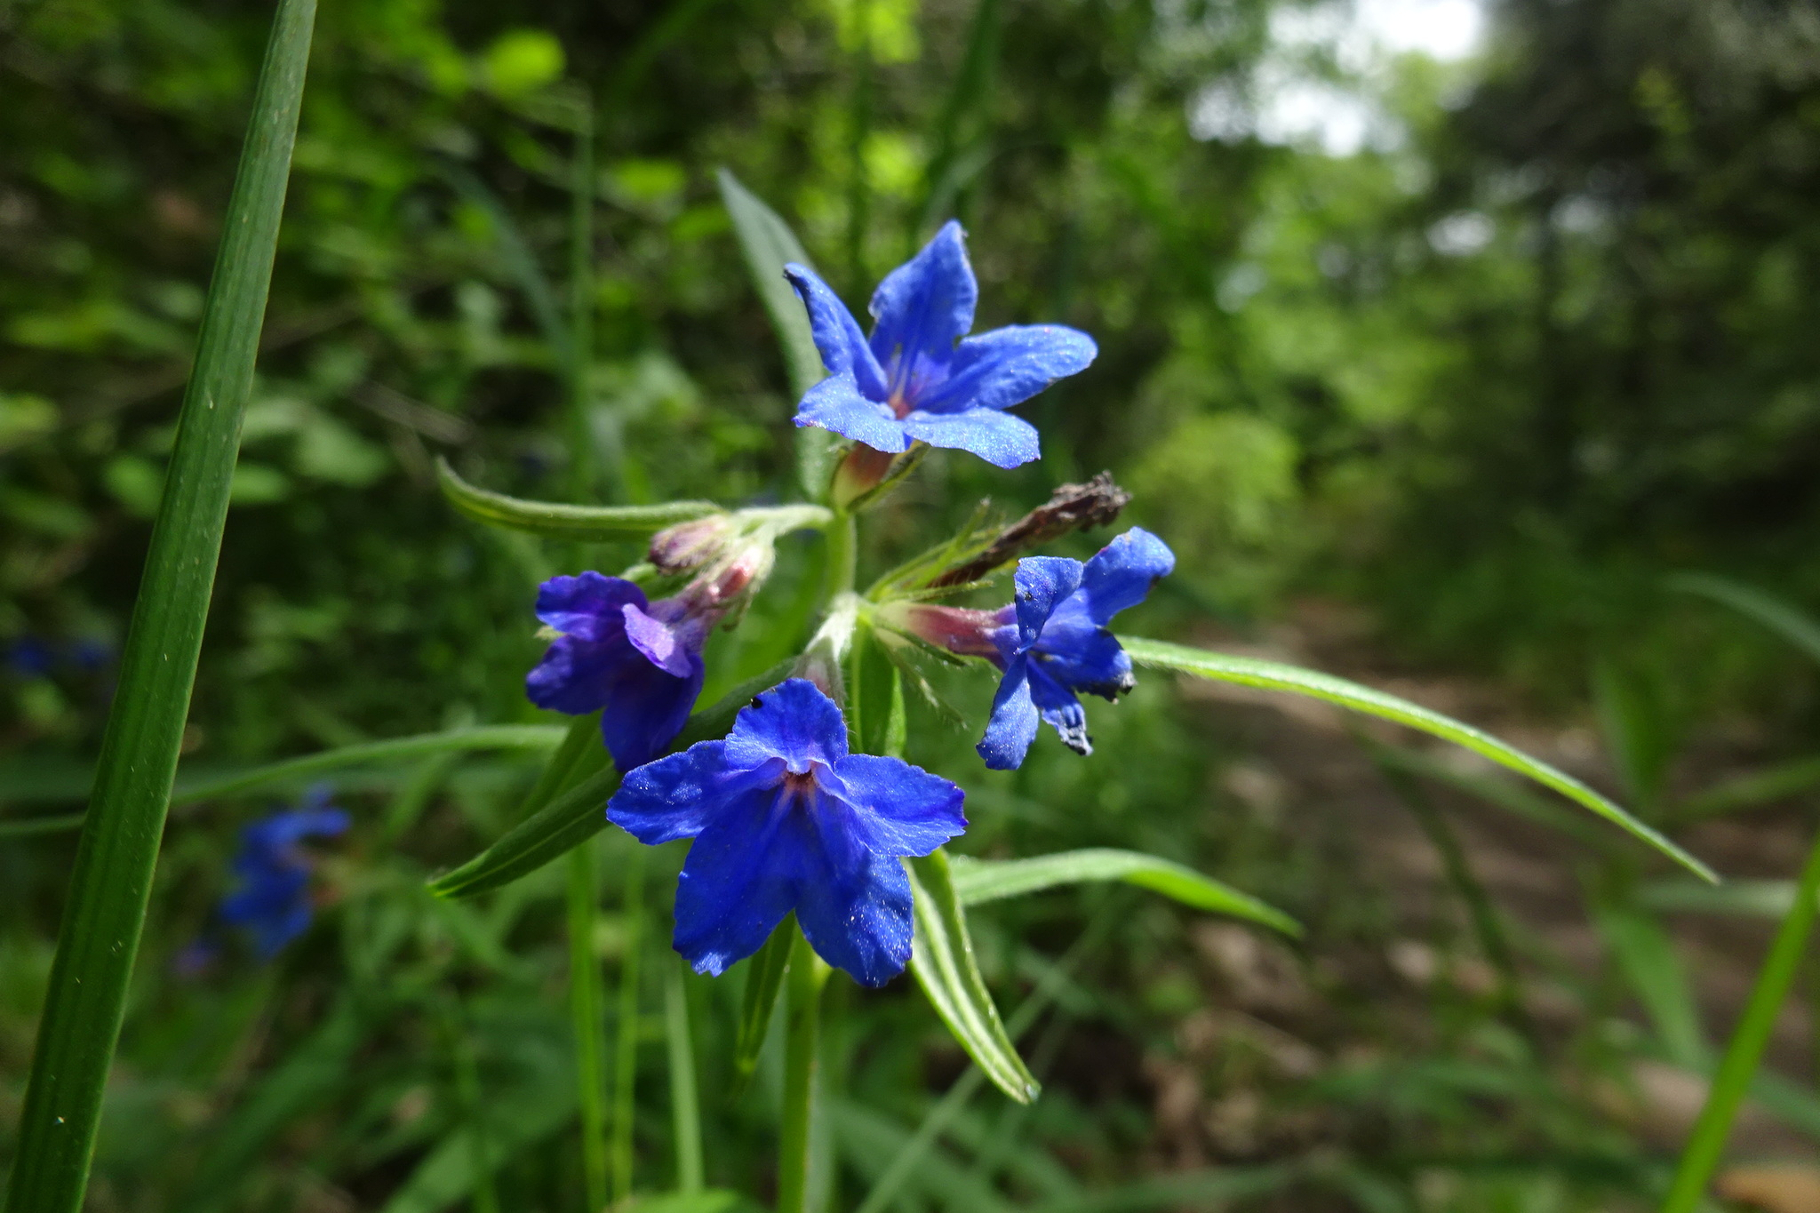
Overview
Purple gromwell (Lithospermum purpurocaeruleum), Romaguets, Catalonia, Spain, 15 May 2018. Photo ressotaelspeus BY-NC 3.0 via Natusfera Citizen Science Observation Dataset https://www.gbif.org/occurrence/1845054322
November 2018

Slide 2
BY THE NUMBERS 1 November 2018
Species occurrence records
Datasets
1,031,907,051
41,499
Country Participants
Organizational Participants
Publishers
59
38
1,297
Average records downloaded per month (2018)
Avg monthly user sessions (2018)
89.3 billion
155,009
Notes:
Useful to see GBIF in its different modalities:
A window on biodiversity
An informatics infrastructure focuseD on tools and standards in service to science and society
A global network on bioinformatics

Slide 3
Current network
participation
https://www.gbif.org/the-gbif-network

Slide 4
GBIF.org Web traffic 2018 to date
Rank | Country/Territory | Sessions | % Total Sessions | 2017 rank | Pages / Session
1 | United States | 188,431 | 12.16% | 1 | 2.70
2 | Mexico | 96,414 | 6.22% | 3 | 3.24
3 | India | 94,253 | 6.08% | 2 | 3.09
4 | Colombia | 71,952 | 4.64% | 4 | 2.89
5 | Brazil | 68,374 | 4.41% | 6 | 3.78
6 | Spain | 60,942 | 3.93% | 9 | 3.28
7 | France | 56,146 | 3.62% | 8 | 2.74
8 | United Kingdom | 56,129 | 3.62% | 5 | 3.61
9 | Germany | 50,130 | 3.23% | 7 | 3.10
10 | China | 38, 714 | 2.50% | 15 | 4.57
data access and use

Slide 5
Data published through GBIF.org
data availability
www.gbif.org/analytics/global

Slide 6
Occurrence records published during 2018, by country as of 31 Oct 2018
 | Country | New records | 5/18 rank
1 | France | 23,382,891 | 9
2 | Germany | 13,519,494 | 4
3 | United States | 12,683,465 | 2
4 | South Africa | 10,673,178 | 12
5 | Sweden | 9,253,615 | 1
6 | United Kingdom | 6,455,901 | 11
7 | Norway | 5,642,697 | 3
8 | Australia | 4,217,580 | 8
9 | Mexico | 4,025,780 | 62
10 | Canada | 2,901,851 | 5
data availability
http://www.gbif.org/country

Slide 7
Total number of occurrence records published by country as of 31 Oct 2018
 | Country | Occurrences | 4/18 rank
1 | United States | 351,241,153 | 1
2 | Sweden | 81,854,130 | 2
3 | United Kingdom | 79,837,930 | 3
4 | Australia | 74,871,062 | 4
5 | France | 64,624,201 | 5
6 | Germany | 46,040,998 | 7
7 | Canada | 42,704,405 | 6
8 | Netherlands | 28,670,467 | 8
9 | Norway | 28,532,243 | 10
10 | Denmark | 27,920,029 | 9
data availability
http://www.gbif.org/country

Slide 8
Data download requests by country, 2018
 | Country | Downloads | 05/18 rank
1 | United States | 20,454 | 1
2 | Mexico | 19,555 | 2
3 | Brazil | 12,331 | 3
4 | Israel | 10,131 | 63
5 | Colombia | 6,374 | 6
6 | Germany | 6,240 | 8
7 | China | 6,223 | 4
8 | United Kingdom | 5,258 | 5
9 | Spain | 4,224 | 7
10 | Chile | 3,165 | 9
data access and use

Slide 9
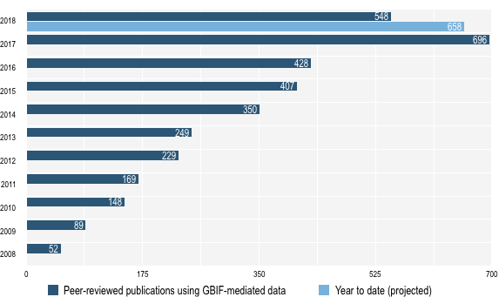
data access and use
Peer-reviewed publications using GBIF-mediated data through 31 August 2018

Slide 10
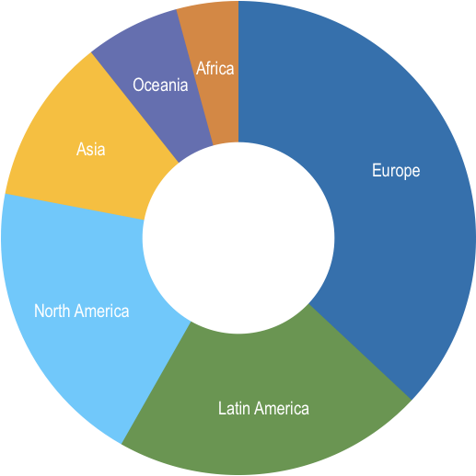
Peer-reviewed uses, by country and region 2018 to date
Total # of peer-reviewed papers by country
1 | United States | 166
2 | Brazil | 68
3 | Mexico | 62
4 | United Kingdom | 54
5 | China | 53
6 | Australia | 51
7 | Spain | 50
8 | Germany | 41
9 | Canada | 39
10 | France | 38
data access and use
Total # of papers by region
1 | Europe & Central Asia | 385
2 | Latin America & the Caribbean | 221
3 | North America | 206
4 | Asia | 118
5 | Oceania | 67
6 | Africa | 44

Slide 11
Featured research September 2018 1 / 2
 | Bieńkowski AO & Orlova-Bienkowskaja MJ (2018) Alien leaf beetles (Coleoptera, Chrysomelidae) of European Russia and some general tendencies of leaf beetle invasions. PLoS ONE 13(9): e0203561. doi:10.1371/journal.pone.0203561 Author country: Russian Federation
 | Botella C, Joly A, Bonnet P, Monestiez P & Munoz F (2018) A Deep Learning Approach to Species Distribution Modelling. Multimedia Tools and Applications for Environmental & Biodiversity Informatics. doi:10.1007/978-3-319-76445-0_10 Author country: France
 | Cano J, Rodríguez A, Simpson H, Tabah EN, Gómez JF & Pullan RL (2018) Modelling the spatial distribution of aquatic insects (Order Hemiptera) potentially involved in the transmission of Mycobacterium ulcerans in Africa. Parasites & Vectors 11: 501. doi:10.1186/s13071-018-3066-3 Author countries: United Kingdom, Spain, Cameroon
 | Garroutte M, Huettmann F, Webb CO & Ickert-Bond SM (2018) Biogeographic and anthropogenic correlates of Aleutian Islands plant diversity: A machine-learning approach. Journal of Systematics and Evolution 56: 476-497. doi:10.1111/jse.12456 Author country: United States
 | Herrera JP, Borgerson C, Tongasoa L et al. (2018) Estimating the population size of lemurs based on their mutualistic food trees. Journal of Biogeography. doi:10.1111/jbi.13409 Author countries: United States, Madagascar, Canada
 | Mhaisen FT, Ali AH & Khamees NR (2018) Marine Fish Parasitology of Iraq: A Review and Checklists. Biological and Applied Environmental Research 2(2): 231-297. http://bit.ly/2JA9oHe Author countries: Sweden, Iraq
 | Meineke EK, Classen AT, Sanders NJ & Davies TJ (2018) Herbarium specimens reveal increasing herbivory over the past century. Journal of Ecology. doi:10.1111/1365-2745.13057 Author countries: United States, Canada
data access and use
Invasive alien species
Impact of climate change
Species conservation and protected areas
Biodiversity and human health
Food, farming and biofuels
Ecosystem services
Advancing biodiversity science
Data management
Data papers
https://www.gbif.org/resource/search?contentType=literature

Slide 12
Featured research September 2018 2 / 2
 | Monteiro LM, Brum FT, Pressey RL et al. (2018) Evaluating the impact of future actions in minimizing vegetation loss from land conversion in the Brazilian Cerrado under climate change. Biodiversity and Conservation. doi:10.1007/s10531-018-1627-6 Author countries: Brazil, Australia
 | Nicolson N, Paton A, Phillips S & Tucker A (2018) Specimens as research objects: reconciliation across distributed repositories to enable metadata propagation. arXiv 1809.07725 arXiv.org/1809.07725 Author country: United Kingdom
 | Orton MG, May JA, Ly W, Lee DJ & Adamowicz SJ (2018) Is molecular evolution faster in the tropics? Heredity. doi:10.1038/s41437-018-0141-7 Author country: Canada
 | Pelayo-Villamil P, Guisande C, Manjarrés-Hernández A et al. (2018) Completeness of national freshwater fish species inventories around the world. Biodiversity and Conservation. doi:10.1007/s10531-018-1630-y Author countries; Colombia, Spain
 | Salinas-Rodríguez MM, Sajama MJ, Gutiérrez-Ortega JS, Ortega-Baes P & Estrada-Castillón AE (2018) Identification of endemic vascular plant species hotspots and the effectiveness of the protected areas for their conservation in Sierra Madre Oriental, Mexico. Journal for Nature Conservation 46: 6-27. doi:10.1016/j.jnc.2018.08.012 Author countries: Mexico, Argentina, Japan
 | Townhill BL, Tinker J, Jones M et al. (2018) Harmful algal blooms and climate change: exploring future distribution changes. ICES Journal of Marine Science fsy113. doi:10.1093/icesjms/fsy113 Author countries: United Kingdom, Canada
data access and use
Invasive alien species
Impact of climate change
Species conservation and protected areas
Biodiversity and human health
Food, farming and biofuels
Ecosystem services
Advancing biodiversity science
Data management
Data papers
https://www.gbif.org/resource/search?contentType=literature

Slide 13
Featured research October 2018 1 / 2
 | Andrade BO, Marchesi E, Burkart S et al. (2018) Vascular plant species richness and distribution in the Río de la Plata grasslands. Botanical Journal of the Linnean Society. https://doi.org/10.1093/botlinnean/boy063 Author countries: Brazil, Uruguay, Argentina
 | Ansong M, Pergl J, Essl F et al. (2018) Naturalized and invasive alien flora of Ghana. Biological Invasions. https://doi.org/10.1007/s10530-018-1860-7 Author countries: Ghana, Czechia, Austria, Germany, China, Australia, South Africa
 | van Erp M, Wevers M & Huurdeman H (2018) Constructing a Recipe Web from Historical Newspapers. Lecture Notes in Computer Science,The Semantic Web – ISWC 2018. https://doi.org/10.1007/978-3-030-00671-6_13 Author country: Netherlands
 | Helliwell EE, Faber-Hammond J, Lopez ZC et al. (2018) Rapid establishment of a flowering cline in Medicago polymorpha after invasion of North America. Molecular Ecology. https://doi.org/10.1111/mec.14898 Author country: United States
 | Larcombe MJ, Jordan GJ, Bryant D & Higgins SI (2018) The dimensionality of niche space allows bounded and unbounded processes to jointly influence diversification. Nature Communications 9: 4258. https://doi.org/10.1038/s41467-018-06732-x Author countries: New Zealand, Australia, Germany
 | Mancini F, Coghill GM & Lusseau D (2018) Quantifying wildlife watchers’ preferences to investigate the overlap between recreational and conservation value of natural areas. Journal of Applied Ecology. https://doi.org/10.1111/1365-2664.13274 Author country: United Kingdom
data access and use
Invasive alien species
Impact of climate change
Species conservation and protected areas
Biodiversity and human health
Food, farming and biofuels
Ecosystem services
Advancing biodiversity science
Data management
Data papers
https://www.gbif.org/resource/search?contentType=literature

Slide 14
Featured research October 2018 2 / 2
 | Miller EC, Hayashi KT, Song D & Wiens JJ (2018) Explaining the ocean's richest biodiversity hotspot and global patterns of fish diversity. Proceedings of the Royal Society B: Biological Sciences. https://doi.org/10.1098/rspb.2018.1314 Author countries: United States, China
 | Neves IQ, Da Luz Mathias M, Bastos-Silveira C (2018) The terrestrial mammals of Mozambique: Integrating dispersed biodiversity data. Bothalia. https://doi.org/10.4102/abc.v48i1.2330 Author country: Portugal
 | Pradheep K, Singh M, Sultan SM, Singh K, Parimalan R & Ahlawat SP (2018) Diversity in wild relatives of wheat: an expedition collection from cold-arid Indian Himalayas. Genetic Resources and Crop Evolution. https://doi.org/10.1007/s10722-018-0706-6 Author country: India Agriculture
 | Pfeffer DA, Lucas TCD, May D et al. (2018) malariaAtlas: an R interface to global malariometric data hosted by the Malaria Atlas Project. Malaria Journal. https://doi.org/10.1186/s12936-018-2500-5 Author countries: United Kingdom, United States
 | Pocock MJO, Chandler M, Bonney R et al. (2018) A Vision for Global Biodiversity Monitoring With Citizen Science. https://doi.org/10.1016/bs.aecr.2018.06.003 Author countries: United Kingdom, United States, Denmark, Brazil, Chile, Kenya, New Zealand, Madagascar
 | Thapa A, Wu R, Hu Y et al. (2018) Predicting the potential distribution of the endangered red panda across its entire range using MaxEnt modeling. Ecology and Evolution. https://doi.org/10.1002/ece3.4526 Author country: China
 | Wan JZ, Wang CJ & Yu FH (2019) Large-scale environmental niche variation between clonal and non-clonal plant species: Roles of clonal growth organs and ecoregions. Science of The Total Environment. https://doi.org/10.1016/j.scitotenv.2018.10.280 Author country: China
data access and use
Invasive alien species
Impact of climate change
Species conservation and protected areas
Biodiversity and human health
Food, farming and biofuels
Ecosystem services
Advancing biodiversity science
Data management
Data papers

