Slide 1

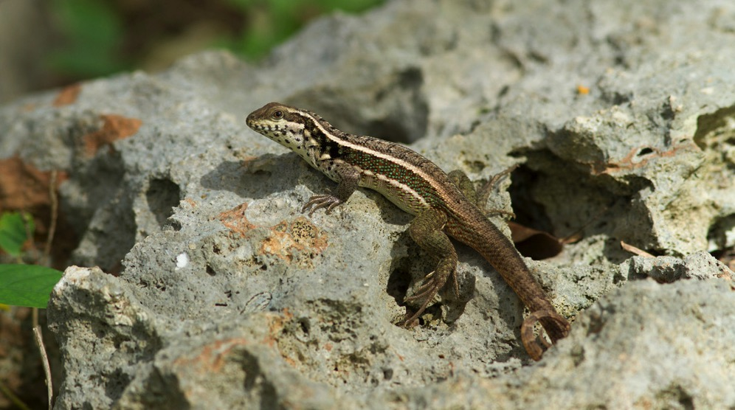
Overview
Santo Domingo curlytail lizard (Leiocephalus lunatus subsp. lunatus), Distrito Nacional, Dominican Republic, 31 Jan 2018.
Photo BY-NC-SA 3.0 by Justin. From Museum of Comparative Zoology, Harvard University https://www.gbif.org/occurrence/1807806467
March 2018

Slide 2

BY THE NUMBERS
5 Mar 2018
Species occurrence records
Datasets
978,039,760
38,269
Country Participants
Organizational Participants
Publishers
54
36
1,154
Average records downloaded per month (2018)
Avg monthly user sessions (2018)
127.6 billion
162,258
Notes:
Useful to see GBIF in its different modalities:
A window on biodiversity
An informatics infrastructure focuseD on tools and standards in service to science and society
A global network on bioinformatics

Slide 3
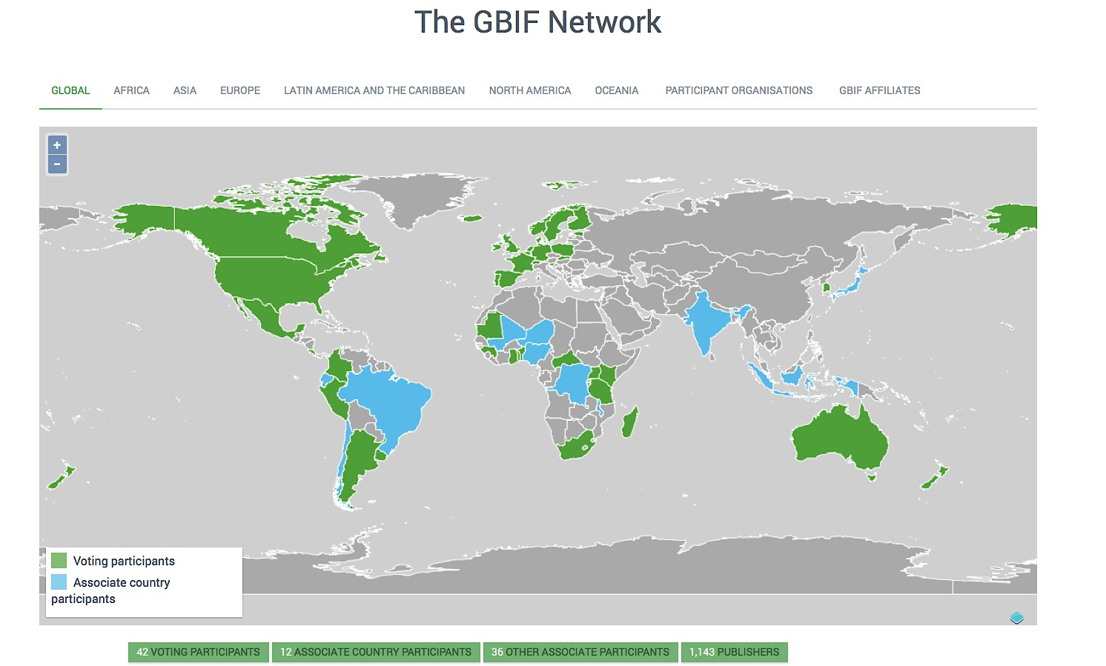
Current network
participation
https://www.gbif.org/the-gbif-network

Slide 4
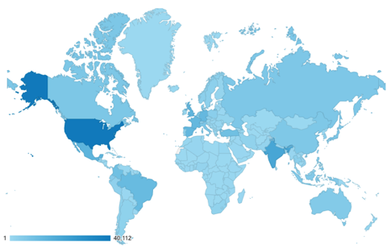
GBIF.org Web traffic
2018 to date
Rank | Country/Territory | Sessions | % Total Sessions | 2017 rank | Pages / Session
1 | United States | 40,112 | 12.36% | 1 | 3.50
2 | India | 20,306 | 6.26% | 2 | 3.70
3 | Mexico | 14,783 | 4.56% | 3 | 4.50
4 | United Kingdom | 14,052 | 4.33% | 5 | 5.18
5 | Spain | 13,021 | 4.01% | 6 | 3.61
6 | France | 12,899 | 3.97% | 8 | 3.51
7 | Germany | 12,686 | 3.91% | 7 | 3.60
8 | Brazil | 11,818 | 3.64% | 4 | 4.20
9 | Turkey | 9,991 | 3.08% | 22 | 1.68
10 | Colombia | 9,926 | 3.06% | 9 | 3.49
data access and use

Slide 5
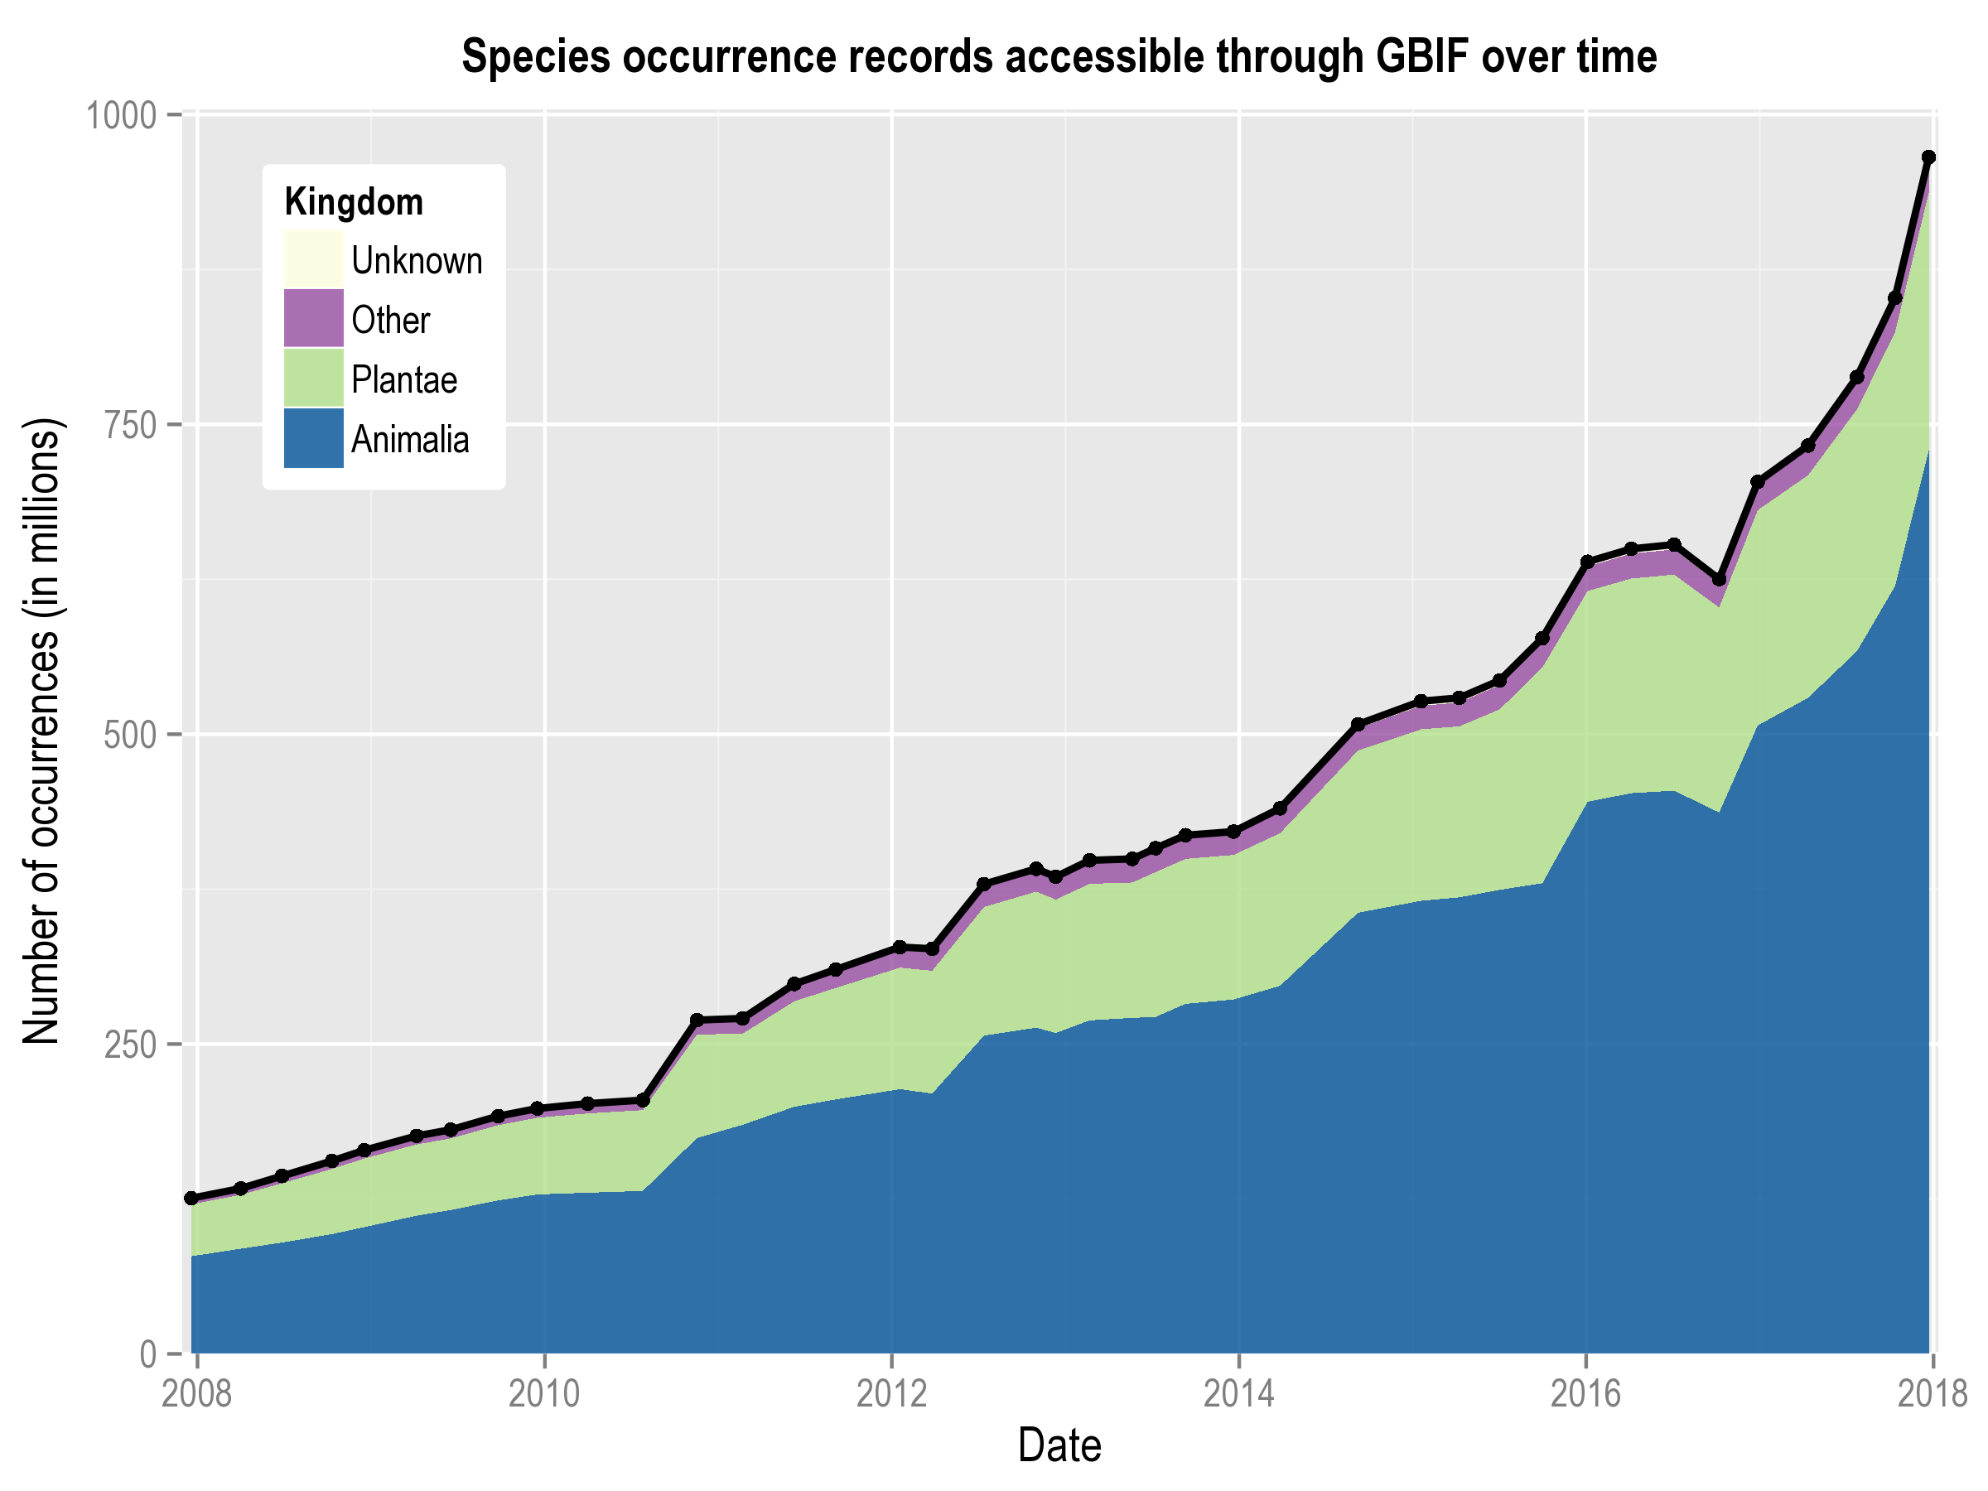
Data published through GBIF.org
data availability
www.gbif.org/analytics/global

Slide 6
Occurrence records published during 2018, by country
 | Country | New records | 2017 rank
1 | Norway | 4,299,805 | 25
2 | Sweden | 1,927,678 | 5
3 | Australia | 1,520,506 | 3
4 | United States | 1,485,101 | 1
5 | Germany | 1,010,181 | 10
6 | South Korea | 999,976 | –
7 | Canada | 935,435 | 8
8 | France | 818,998 | 27
9 | United Kingdom | 696,975 | 2
10 | Netherlands | 459,265 | 20
data availability
http://www.gbif.org/country

Slide 7
Total number of occurrence records published by country as of 28 Feb 2018
 | Country | Occurrences | Aug-17 rank
1 | United States | 344,515,277 | 1
2 | United Kingdom | 79,123,502 | 2
3 | Sweden | 74,536,614 | 3
4 | Australia | 72,533,205 | 4
5 | France | 43,409,213 | 5
6 | Canada | 41,990,213 | 6
7 | Germany | 34,910,636 | 7
8 | Netherlands | 28,187,988 | 8
9 | Denmark | 27,568,798 | 9
10 | Norway | 27,222,807 | 11
data availability
http://www.gbif.org/country

Slide 8
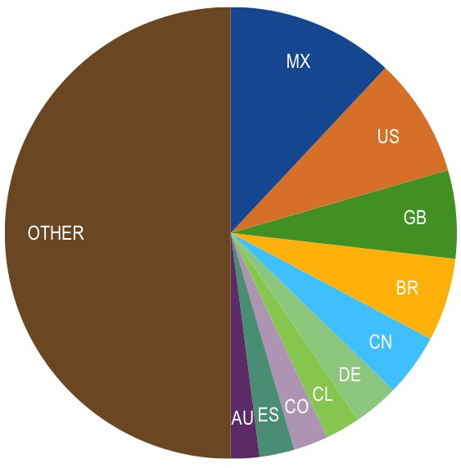
Data download requests by country, 2018
 | Country | Downloads | 2017 rank
1 | Mexico | 3,542 | 2
2 | United States | 2,526 | 1
3 | United Kingdom | 1,867 | 7
4 | Brazil | 1,753 | 4
5 | China | 1,326 | 3
6 | Germany | 957 | 10
7 | Chile | 738 | 14
8 | Colombia | 737 | 5
8 | Spain | 737 | 6
10 | Australia | 602 | 9
data access and use

Slide 9
data access and use
Peer-reviewed publications using GBIF-mediated data
through 28 Feb 2018

Slide 10
Peer-reviewed uses, by country and region
2018 to date
Total # of peer-reviewed papers by country
1 | United States | 26
2 | Brazil | 14
2 | China | 14
2 | Mexico | 14
5 | United Kingdom | 12
6 | Spain | 10
7 | Australia | 9
8 | France | 7
9 | Canada | 5
9 | Colombia | 5
9 | Denmark | 5
9 | Germany | 5
data access and use
Total # of papers by region
1 | Europe & Central Asia | 63
2 | Latin America & the Caribbean | 51
3 | North America | 32
4 | Asia | 22
5 | Oceania | 12
6 | Africa | 8

Slide 11
Featured research
Jan 2018
1 / 2
 | Costa WF, Ribeiro M, Saraiva AM, Imperatriz-Fonseca VL & Giannini TC (2018) Bat diversity in Carajás National Forest (Eastern Amazon) and potential impacts on ecosystem services under climate change. Biological Conservation 218: 200-210. https://doi.org/10.1016/j.biocon.2017.12.034 Author country: Brazil
 | Grímsson F, Grimm GW, Potts AJ, Zetter R & Renner SS (2017) A Winteraceae pollen tetrad from the early Paleocene of western Greenland, and the fossil record of Winteraceae in Laurasia and Gondwana. Journal of Biogeography 45(3): 567-581. https://doi.org/10.1111/jbi.13154 Author countries: Austria, France, South Africa, Germany
 | Pelletier TA & Carstens BC (2018) Geographical range size and latitude predict population genetic structure in a global survey. Biology Letters 14: 20170566. https://doi.org/10.1098/rsbl.2017.0566 Author country: United States
 | Pinilla-Buitrago GE, Escalante T, Gutiérrez-Velázquez A, Reyes-Castillo P & Rojas-Soto OR (2018) Areas of endemism persist through time: A palaeoclimatic analysis in the Mexican Transition Zone. Journal of Biogeography. https://doi.org/10.1111/jbi.13172 Author country: Mexico
 | Rubio Teso ML, Torres Lamas E, Parra-Quijano M, de la Rosa L, Fajardo J & Iriondo JM (2018) National inventory and prioritization of crop wild relatives in Spain. Genetic Resources and Crop Evolution. https://doi.org/10.1007/s10722-018-0610-0 Author countries: Spain, Colombia
data access and use
Invasive alien species
Impact of climate change
Species conservation and protected areas
Biodiversity and human health
Food, farming and biofuels
Ecosystem services
Advancing biodiversity science
Data management
Data papers
https://www.gbif.org/resource/search?contentType=literature

Slide 12
Featured research
Jan 2018
2 / 2
 | Serra-Diaz JM, Enquist BJ, Maitner B, Merow C & Svenning JC (2018) Big data of tree species distributions: how big and how good? Forest Ecosystems 4: 30. https://doi.org/10.1186/s40663-017-0120-0 Author countries: Denmark, United States. Species_distributions
 | Šímová I, Violle C, Svenning JC et al. (2018) Spatial patterns and climate relationships of major plant traits in the New World differ between woody and herbaceous species. Journal of Biogeography. https://doi.org/10.1111/jbi.13171 Author countries: Czechia, France, Denmark, Germany, United States, New Zealand, United Kingdom, Netherlands, Chile, Austria
 | Toledo RM, Santos RF, Baeten L, Perring MP & Verheyen K (2018) Soil properties and neighboring forest cover affect aboveground biomass and functional composition during tropical forest restoration. Applied Vegetation Science. https://doi.org/10.1111/avsc.12363 Author countries: Brazil, Belgium, Australia
 | Watcharamongkol T, Christin PA & Osborne CP (2018) C4 photosynthesis evolved in warm climates but promoted migration to cooler ones. Ecology Letters 21(3): 376-383. https://doi.org/10.1111/ele.12905 Author country: United Kingdom
 | Yonow T, Kriticos, DJ, Kirichenko N & Ota N (2018) Considering biology when inferring range-limiting stress mechanisms for agricultural pests: a case study of the beet armyworm. Journal of Pest Science 91(2): 523-538. https://doi.org/10.1007/s10340-017-0938-9 Author countries: United States, Australia, Russian Federation
data access and use
Invasive alien species
Impact of climate change
Species conservation and protected areas
Biodiversity and human health
Food, farming and biofuels
Ecosystem services
Advancing biodiversity science
Data management
Data papers
https://www.gbif.org/resource/search?contentType=literature

Slide 13
Featured research
Feb 2018
1 / 2
 | Hayes MA & Piaggio AJ (2018) Assessing the potential impacts of a changing climate on the distribution of a rabies virus vector. PLoS ONE 13(2): e0192887. https://doi.org/10.1371/journal.pone.0192887 Author country: United States
 | Mori E, Zozzoli R & Menchetti M (2018) Global distribution and status of introduced Siberian chipmunks Eutamias sibiricus. Mammal Review 48(2):139-152. https://doi.org/10.1111/mam.12117 Author country: Italy
 | Ribeiro BR, Sales LP & Loyola R (2018) Strategies for mammal conservation under climate change in the Amazon. Biodiversity and Conservation. https://doi.org/10.1007/s10531-018-1518-x Author country: Brazil
 | Rolland J, Silvestro D, Schluter D, Guisan A, Broennimann O & Salamin N (2018) The impact of endothermy on the climatic niche evolution and the distribution of vertebrate diversity. Nature Ecology & Evolution 2: 459-464. https://doi.org/10.1038/s41559-017-0451-9 Author countries: Switzerland, Canada, Sweden
 | Taverna A, Lagger C, Maggioni T, Reyna P, Lovrich G & Tatián M (2018) Ascidian distribution provides new insights to help define the biogeographic provinces in the South American Region. Polar Biology. https://doi.org/10.1007/s00300-018-2272-y Author country: Argentina
data access and use
Invasive alien species
Impact of climate change
Species conservation and protected areas
Biodiversity and human health
Food, farming and biofuels
Ecosystem services
Advancing biodiversity science
Data management
Data papers
https://www.gbif.org/resource/search?contentType=literature

Slide 14
Featured research
Feb 2018
2 / 2
 | Vetaas OR, Grytnes JA, Bhatta KP & Hawkins BA (2018) An intercontinental comparison of niche conservatism along a temperature gradient. Journal of Biogeography. https://doi.org/10.1111/jbi.13185 Author countries: Norway, United States
 | Vlam M, de Groot GA, Boom A et al. (2018) Developing forensic tools for an African timber: Regional origin is revealed by genetic characteristics, but not by isotopic signature. Biological Conservation 220: 262-271. https://doi.org/10.1016/j.biocon.2018.01.031 Author countries: Netherlands, Cameroon
 | Wells K, Gibson DI, Clark NJ, Ribas A, Morand S & McCallum HI (2018) Global spread of helminth parasites at the human-domestic animal-wildlife interface. Global Change Biology. https://doi.org/10.1111/gcb.14064 Author countries: Australia, United Kingdom, Spain, Thailand
 | von Wettberg EJB, Chang PL, Başdemir Fatma et al. (2018) Ecology and genomics of an important crop wild relative as a prelude to agricultural innovation. Nature Communications 9: 649. https://doi.org/10.1038/s41467-018-02867-z Author countries: United States, Turkey, Ethiopia, Russian Federation, Pakistan, Canada, India, Australia Ecology
data access and use
Invasive alien species
Impact of climate change
Species conservation and protected areas
Biodiversity and human health
Food, farming and biofuels
Ecosystem services
Advancing biodiversity science
Data management
Data papers
https://www.gbif.org/resource/search?contentType=literature

