Slide 1
BY THE NUMBERS | 31 March 2021
1,667,617,812
57,432
Datasets
Species occurrence records
1,659
5,658
Peer-review papers
using data
61
39
Country Participants
Organizational Participants
85.6 billion
Data-publishing institutions
Avg records downloaded per month (2021)
Notes:
Frequently used slide, redone
Please copy and paste these to your slides and never make any changes to them directly in the toolkit.
Useful to see GBIF in its different modalities:
A window on biodiversity
An informatics infrastructure focuseD on tools and standards in service to science and society
A global network on bioinformatics

Slide 2
Species occurrence records with MultiMedia evidence Year-to-date, 31 March 2021
74.3 million records with taxonomically identified images
37.8 million specimens
33.6 million human observations
1.4 million material samples
1.3 million fossil specimens
708,377 audio files
2,771 videos
https://www.gbif.org/occurrence/gallery

Slide 3
Data From the GBIF Network 31 March 2021

Slide 4
GBIF Participant countries 31 March 2021
Voting Participants
Associate Participants
Notes:
This map is fully editable. This map is a grouped element of all the countries in the world. All the countries are named correctly and can be accessed and selected via the Selection Pane.
There are ways you can edit and make changes to the map. But please remember to always make a copy of the map on your slide and never make changes to the toolkit version.
Please take a look at the next few slides to find out different ways of editing this map

Slide 5
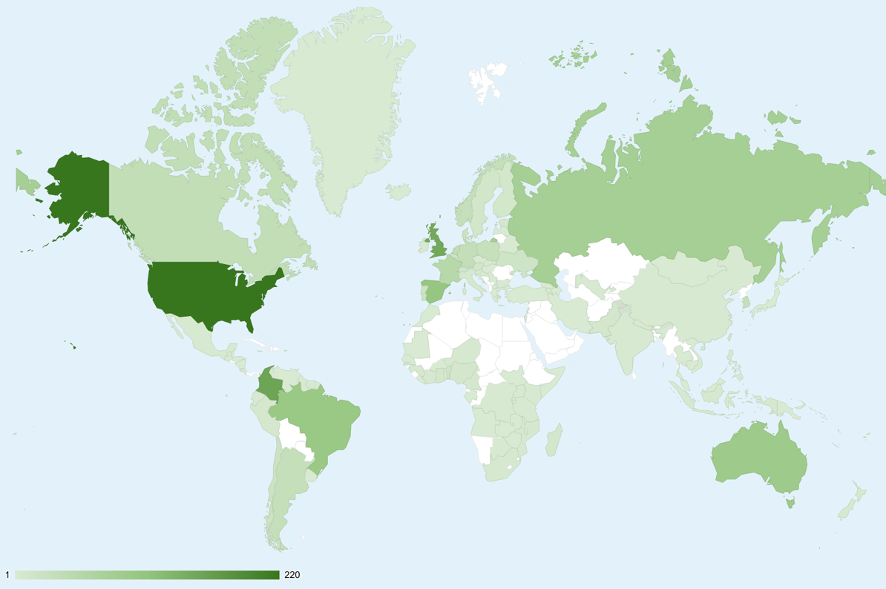
GBIF Network of Data publishing institutions Year-to-date, 8 April 2021
124
countries with institutions sharing data through GBIF
Top 10 countries: number of data publishers
1 | United States | 220
2 | Colombia | 155
3 | United Kingdom | 148
4 | Spain | 106
5 | Brazil | 100
6 | Australia | 93
7 | Russian Federation | 80
8 | France | 54
9 | Canada | 37
9 | Netherlands | 37

Slide 6
Peer-reviewed Research uses by author country Year-to-date, 31 March 2021
Brunei Darussalam
Hong Kong
Macao
Singapore
Tonga
Bermuda
Cape Verde
Falkland Islands (Malvinas)
Trinidad and Tobago
> 100
50-100
20-49
10-19
1-10
> 100 | 50-100 | 20-49 | 10-19 | < 9
https://www.gbif.org/resource/search?contentType=literature&literatureType=journal&relevance=GBIF_USED&peerReview=true
Notes:
This map is fully editable. This map is a grouped element of all the countries in the world. All the countries are named correctly and can be accessed and selected via the Selection Pane.
There are ways you can edit and make changes to the map. But please remember to always make a copy of the map on your slide and never make changes to the toolkit version.
Please take a look at the next few slides to find out different ways of editing this map

Slide 7
GBIF.org traffic by country Year-to-date, 31 March 2021
Rank | Country/Territory | Visitors | Sessions | Effective visits* | % Effective visits | 2020 rank | Pages / session
1 | United States | 56,004 | 99,681 | 49,870 | 9.81% | 1 | 6.01
2 | Mexico | 36,623 | 62,305 | 26,000 | 5.11% | 2 | 4.49
3 | Brazil | 31,925 | 59,058 | 30,320 | 5.96% | 5 | 6.00
4 | Colombia | 26,807 | 53,154 | 23,616 | 4.64% | 3 | 4.95
5 | Spain | 24,796 | 51,290 | 26,686 | 5.25% | 4 | 6.87
6 | France | 22,007 | 42,656 | 20,901 | 4.11% | 6 | 6.02
7 | United Kingdom | 18,491 | 37,000 | 19,388 | 3.81% | 7 | 6.56
8 | India | 18,141 | 36,949 | 17,543 | 3.45% | 9 | 5.65
9 | Germany | 18,122 | 35,819 | 19,883 | 3.91% | 8 | 7.30
10 | Italy | 12,590 | 22,695 | 10,240 | 2.01% | 10 | 5.53
 | TOTAL | 510,632 | 1,018,890 | 50,426 | 100.00% |  | 6.07

Slide 8
Occurrences published by Country Year-to-date, 31 March 2021
Year-to-date |  |  |  | 2021 | 2020 total | 2020 rank
1 | United States |  | 4,567,125 |  | 104,951,678 | 1
2 | Canada |  | 3,277,930 |  | 13,595,190 | 5
3 | United Kingdom |  | 2,740,086 |  | 19,375,254 | 2
4 | Sweden |  | 1,922,162 |  | 10,821,710 | 8
5 | Denmark |  | 1,462,478 |  | 11,362,884 | 7
6 | Portugal |  | 1,319,248 |  | 1,606,684 | 20
7 | Norway |  | 1,228,708 |  | 9,028,709 | 10
8 | Belgium |  | 1,087,022 |  | 675,027 | 33
9 | Estonia |  | 962,845 |  | 998,509 | 28
10 | Switzerland |  | 688,430 |  | 9,942,319 | 9
 | ALL OTHERS |  | 6,083,683 |  | 49,885,694
TOTAL |  |  | 25,339,976 |  | 268,831,632
Notes:
This is a live doughnut pie chart representing different theme colours and how they work, placed next to one another.
You do not have to use the same exact chart, you can simply create your own by clicking on:
Insert tap on the ribbon > Click on Chart > chose a chart of your choice (in this example I chose, Doughnut) > add in your data in the automatically opened Excel sheet and see your chart changing and adopting to the new information you have entered in the data sheet.

Slide 9
Data download requests Year-to-date, 31 March 2021
Year-to-date |  |  | 2021 |  | 2020 total | 2020 rank
1 | United States |  |  | 18,736 | 29,392 | 1
2 | China |  |  | 12,248 | 26,785 | 2
3 | Mexico |  |  | 5,919 | 24,123 | 3
4 | Brazil |  |  | 5,713 | 16,274 | 4
5 | United Kingdom |  |  | 3,974 | 9,610 | 7
6 | Colombia |  |  | 3,159 | 13,501 | 5
7 | Spain |  |  | 3,084 | 8,981 | 8
8 | France |  |  | 2,109 | 10,030 | 6
9 | Ecuador |  |  | 1,874 | 7,339 | 12
10 | Canada |  |  | 1,550 | 6,214 | 11
 | ALL OTHERS |  |  | 17,308 | 66,837

Slide 10
Peer-reviewed publications using GBIF-mediated data 31 March 2021
1,204
Notes:
The next 3 slides are showcasing PPT standard or Live charts.
To create a chart simply click on the Insert tap on the ribbon > Click on Chart > chose a chart of your choice (in this example I chose, Bar) > add in your data in the automatically opened Excel sheet and see your chart changing and adopting to the new information you have entered in the data sheet.

Slide 11
Data Use in peer-reviewed journals Year-to-date, 31 March 2021
Peer-reviewed uses by country
Year-to-date |  |  |  | 2021 total | 2020 total | 2020 rank
1 | United States |  | 82 |  | 268 | 1
2 | China |  | 56 |  | 168 | 2
3 | Mexico |  | 36 |  | 93 | 5
4 | Brazil |  | 33 |  | 123 | 3
5 | United Kingdom |  | 28 |  | 109 | 4
6 | Germany |  | 27 |  | 85 | 6
7 | Spain |  | 23 |  | 77 | 7
8 | France |  | 20 |  | 53 | 10
9 | Canada |  | 16 |  | 64 | 8
9 | Colombia |  | 16 |  | 40 | 11
Notes:
This is a live doughnut pie chart representing different theme colours and how they work, placed next to one another.
You do not have to use the same exact chart, you can simply create your own by clicking on:
Insert tap on the ribbon > Click on Chart > chose a chart of your choice (in this example I chose, Doughnut) > add in your data in the automatically opened Excel sheet and see your chart changing and adopting to the new information you have entered in the data sheet.

