Slide 1

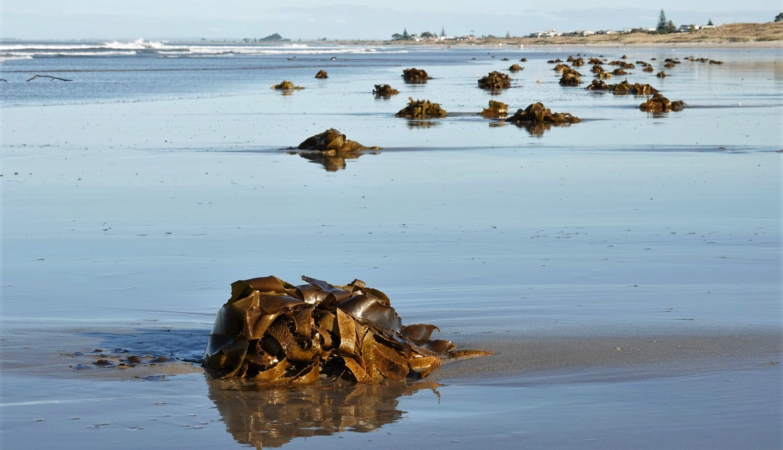
Overview
Common kelp (Ecklonia radiata), Omanu Beach, New Zealand. Photo 2019 jacqui-nz via
iNaturalist Research-grade observations (www.gbif.org/occurrence/1990603467) licensed under CC BY-NC 4.0
January 2020

Slide 2

BY THE NUMBERS
1 January 2020
Species occurrence records
Datasets
1,375,355,798
49,992
Country Participants
Organizational Participants
Publishers
59
38
1,556
Average records served per month (2019)
Avg monthly user sessions (2019)
39.8 billion
214,876
Notes:
The numbers for species occurrence records, datasets and publishers all can (and should) be updated ahead of use in presentation: find them on the home page, https://www.gbif.org.

Slide 3
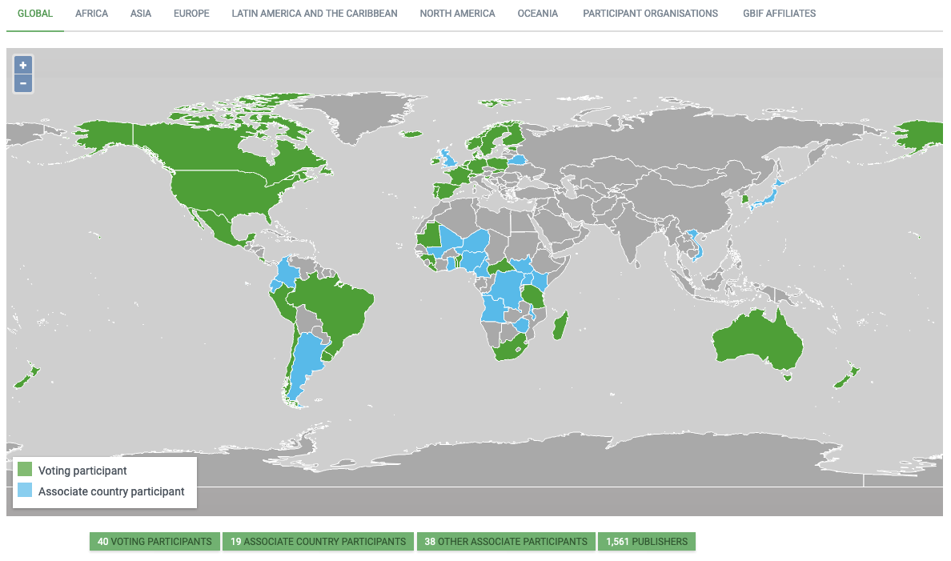
GBIF Participant network
1 January 2020
https://www.gbif.org/the-gbif-network

Slide 4
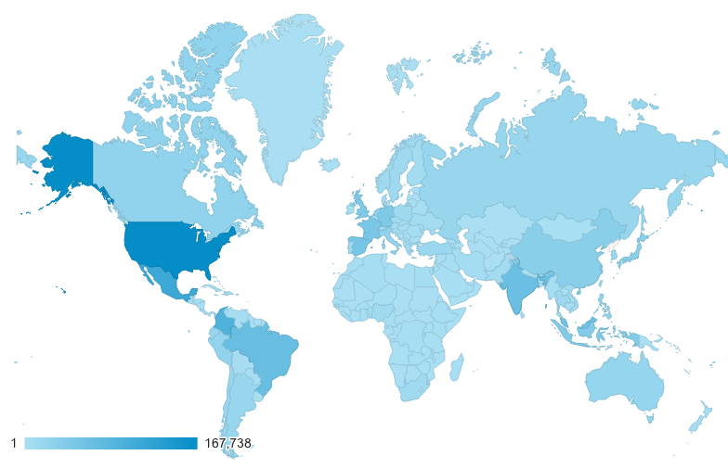
GBIF.org Web traffic
Annual totals 2019
Rank | Country/Territory | Sessions | % total sessions | 9/19 rank | Pages / session
1 | United States | 266,369 | 10.33% | 1 | 4.27
2 | Mexico | 179,698 | 6.97% | 2 | 4.24
3 | Colombia | 154,936 | 6.01% | 3 | 3.64
4 | India | 133,274 | 5.17% | 4 | 6.91
5 | Brazil | 116,913 | 4.53% | 5 | 4.97
6 | Spain | 100,341 | 3.89% | 6 | 5.13
7 | France | 89,448 | 3.47% | 7 | 4.73
8 | Germany | 79,963 | 3.10% | 9 | 4.83
9 | United Kingdom | 79,259 | 3.07% | 8 | 5.48
10 | Indonesia | 77,909 | 3.02% | 11 | 4.53

Slide 5
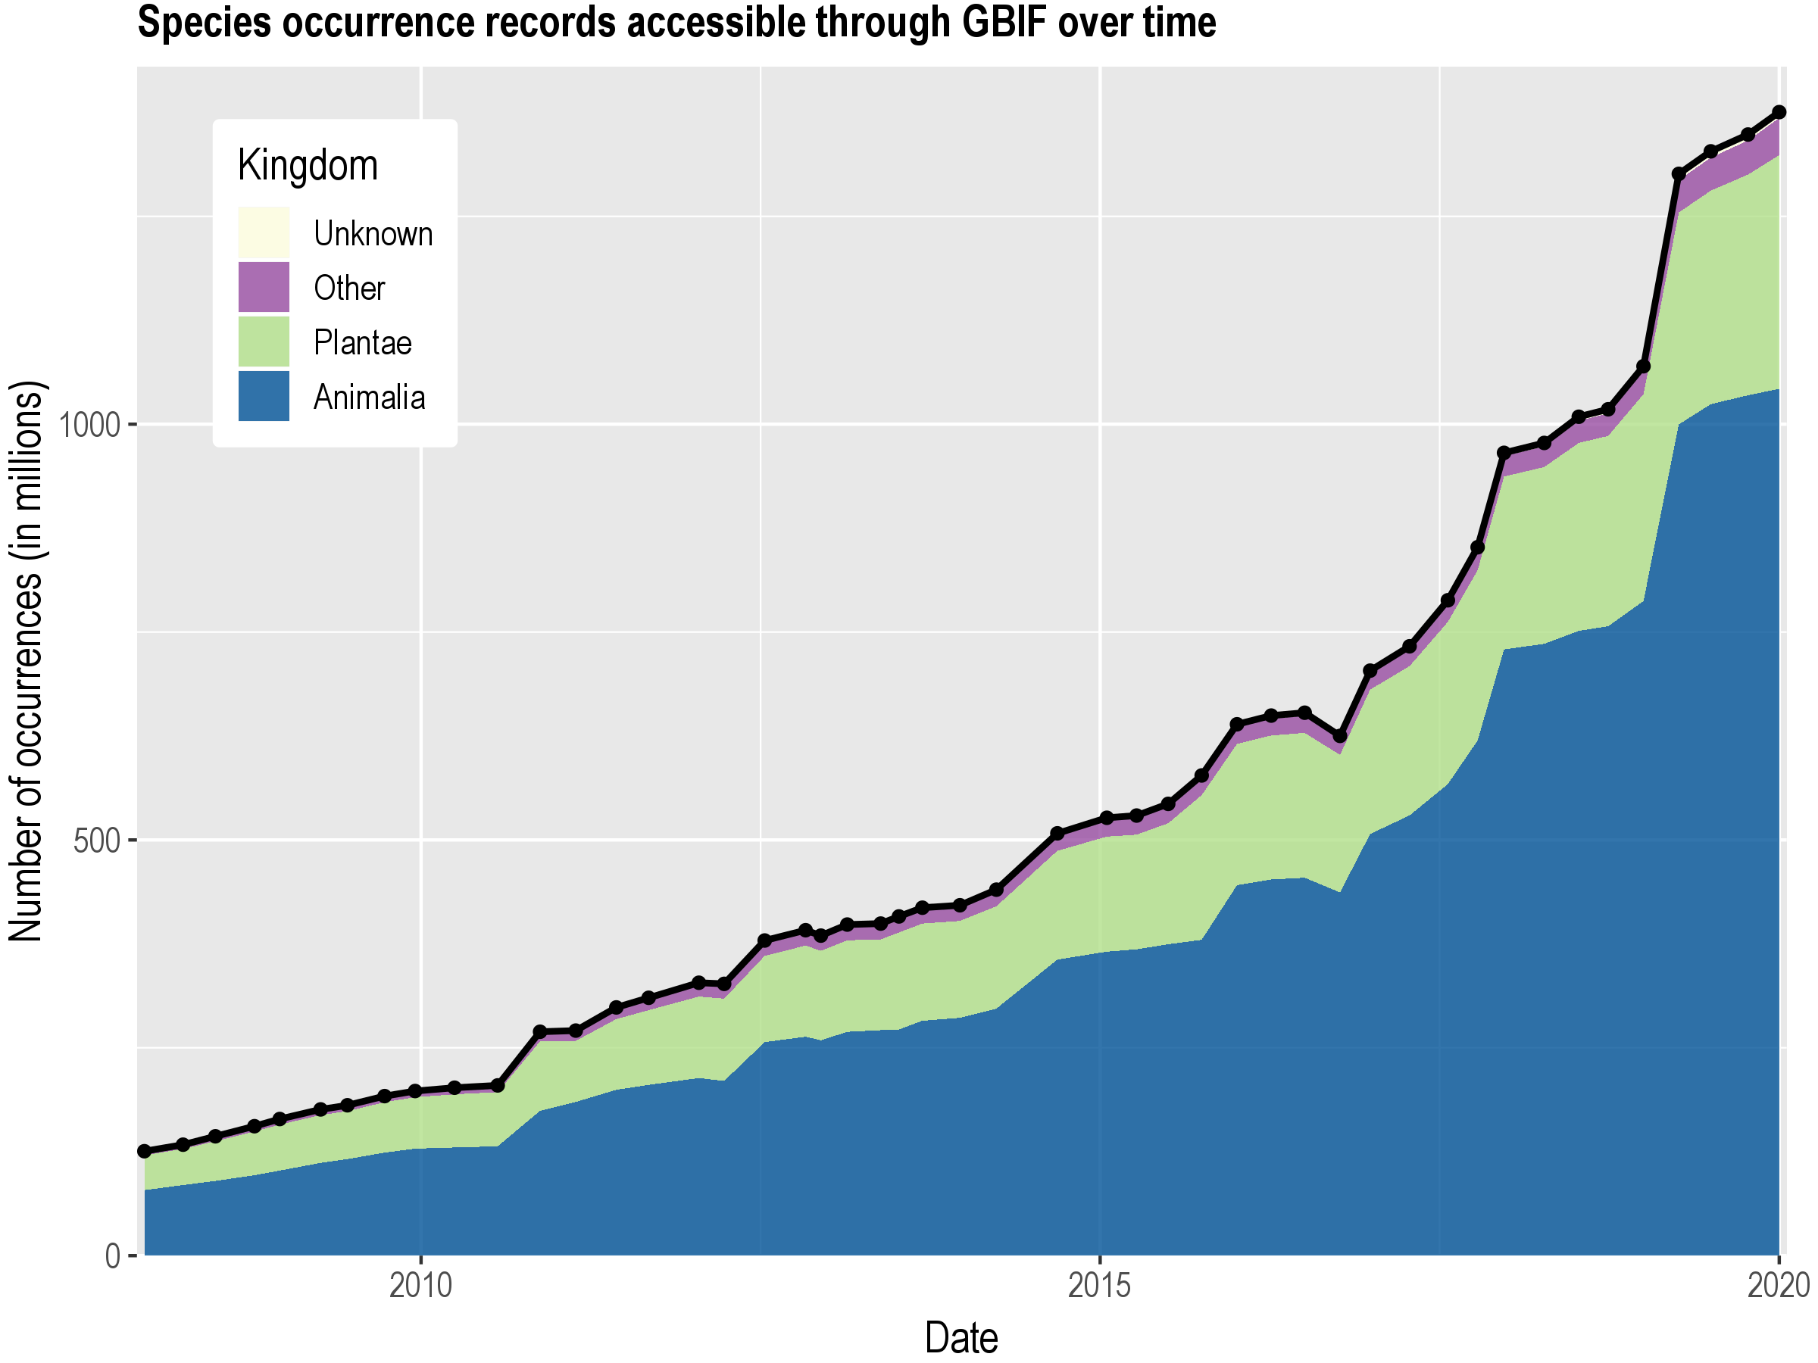
Data published through GBIF.org
www.gbif.org/analytics/global

Slide 6
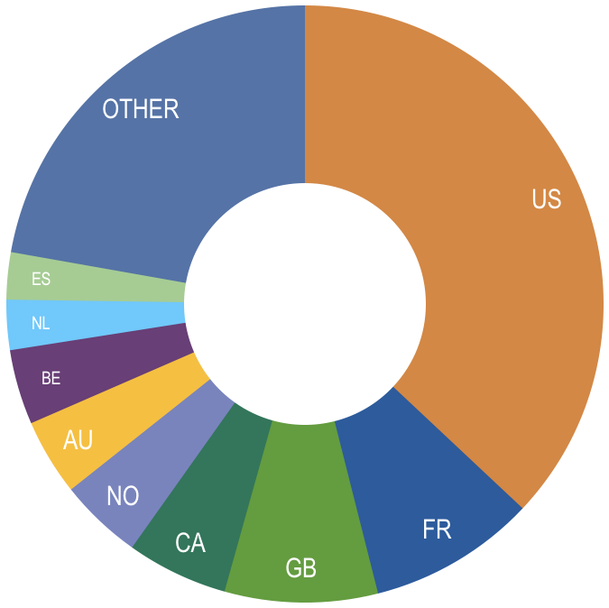
Occurrence records published during 2019, by country
Annual totals
 | Country | New records | 2018 rank
1 | United States | 155,149,296 | 5
2 | France | 37,998,824 | 2
3 | United Kingdom | 34,750,951 | 4
4 | Canada | 22,996,608 | 12
5 | Norway | 18,864,164 | 8
6 | Australia | 17,351,784 | 9
7 | Belgium | 17,012,039 | 14
8 | South Africa | 15,312,272 | 6
9 | Netherlands | 11,371,762 | 1
10 | Spain | 10,705,938 | 16
http://www.gbif.org/country

Slide 7
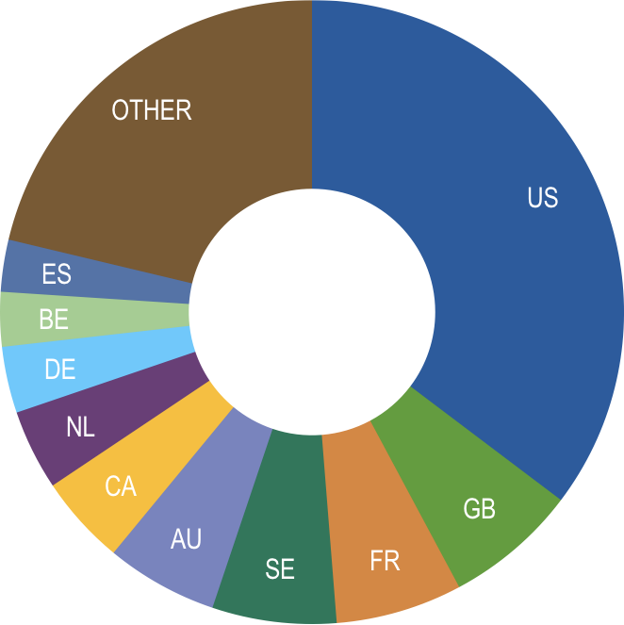
Total number of occurrence records published by country
Annual totals 2019
 | Country | Occurrences | 2018 rank
1 | United States | 492,314,389 | 1
2 | United Kingdom | 96,000,707 | 2
3 | France | 91,562,482 | 5
4 | Sweden | 89,773,061 | 3
5 | Australia | 80,956,959 | 4
6 | Canada | 64,730,196 | 8
7 | Netherlands | 58,055,965 | 6
8 | Germany | 47,945,430 | 7
9 | Belgium | 39,394,880 | 11
10 | Spain | 37,584,508 | 13
http://www.gbif.org/country

Slide 8
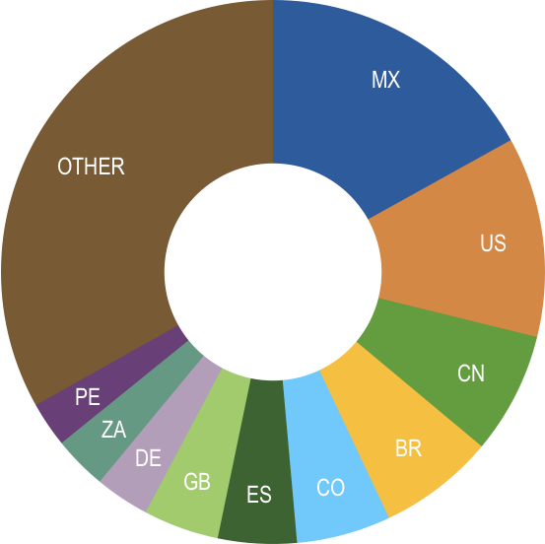
Data download requests by country
Annual totals 2019
 | Country | Downloads | 2018 rank
1 | Mexico | 26,749 | 2
2 | United States | 18,798 | 1
3 | China | 11,420 | 7
4 | Brazil | 10,903 | 3
5 | Colombia | 8,852 | 5
6 | Spain | 7,384 | 9
7 | United Kingdom | 7,097 | 8
8 | Germany | 5,112 | 6
9 | South Africa | 5,022 | 11
10 | Peru | 4,229 | 19

Slide 9
Peer-reviewed publications using GBIF-mediated data
Annual totals 2019
Notes:
Add peer-reviewed article uses URL

Slide 10
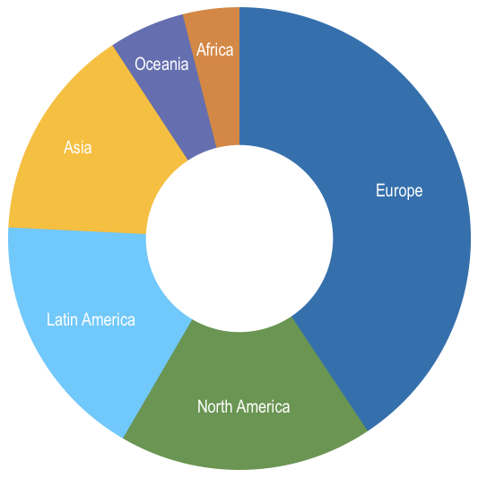
Uses in peer-reviewed journals, by country and region
Annual totals 2019
Total # of peer-reviewed papers by country |  |  | 2018 rank
1 | United States | 218 | 1
2 | China | 117 | 5
3 | Brazil | 94 | 2
4 | United Kingdom | 90 | 4
5 | Mexico | 68 | 3
6 | Germany | 64 | 8
7 | Australia | 56 | 7
8 | Spain | 55 | 6
9 | France | 49 | 10
10 | Canada | 43 | 9
Total # of papers by region
1 | Europe & Central Asia | 597
2 | North America | 261
3 | Latin America & the Caribbean | 255
4 | Asia | 220
5 | Oceania | 78
6 | Africa | 58

