Slide 1

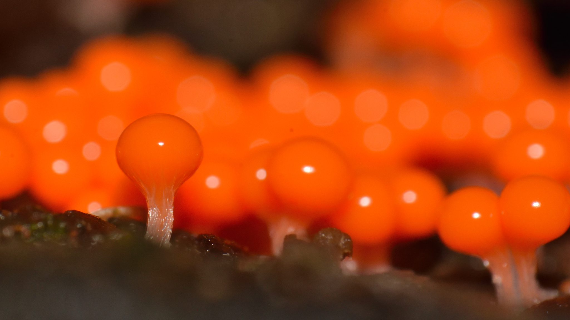
Overview
Trichia decipiens, Tangancícuaro, Michoacán, México, 4 December 2018.
Photo Ricardo Arredondo Torres CC BY-NC 4.0 via iNaturalist research-grade observations https://www.gbif.org/occurrence/1949998045
January 2019

Slide 2

BY THE NUMBERS
31 December 2018
Species occurrence records
Datasets
1,069,725,852
41,962
Country Participants
Organizational Participants
Publishers
59
38
1,328
Average records downloaded per month (2018)
Avg monthly user sessions (2018)
79.8 billion
154,498
Notes:
Useful to see GBIF in its different modalities:
A window on biodiversity
An informatics infrastructure focuseD on tools and standards in service to science and society
A global network on bioinformatics

Slide 3
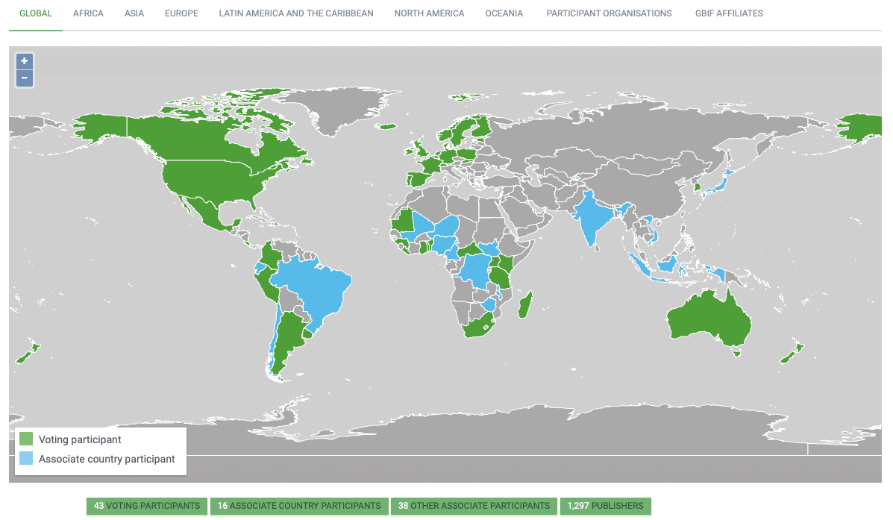
Current network
participation
https://www.gbif.org/the-gbif-network

Slide 4
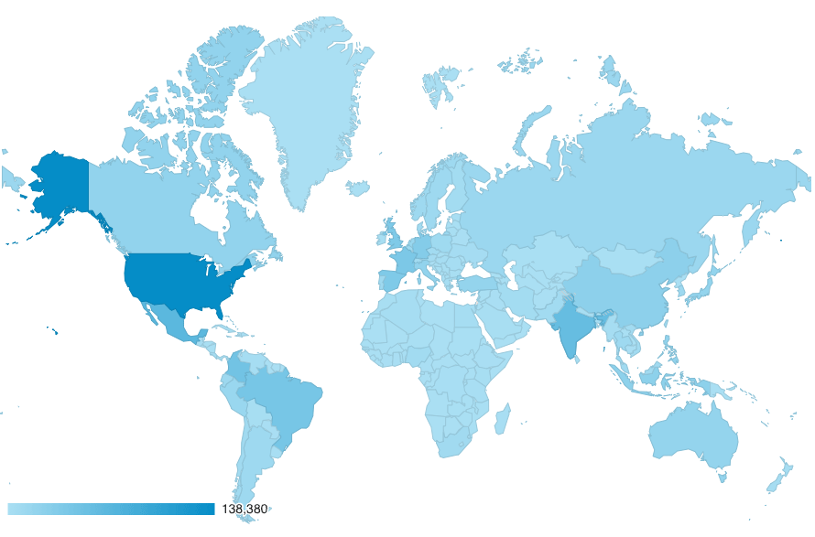
GBIF.org Web traffic
2018 Totals
Rank | Country/Territory | Sessions | % Total Sessions | 2017 rank | Pages / Session
1 | United States | 222,860 | 12.02% | 1 | 2.65
2 | Mexico | 118,302 | 6.38% | 3 | 3.11
3 | India | 110,825 | 5.98% | 2 | 3.04
4 | Colombia | 84,490 | 4.56% | 4 | 2.80
5 | Brazil | 80,583 | 4.35% | 6 | 3.74
6 | Spain | 73,829 | 3.98% | 9 | 3.26
7 | France | 67,359 | 3.63% | 8 | 2.67
8 | United Kingdom | 66,932 | 3.61% | 5 | 3.48
9 | Germany | 59,535 | 3.21% | 7 | 3.08
10 | China | 48,010 | 2.59% | 15 | 4.32
data access and use

Slide 5
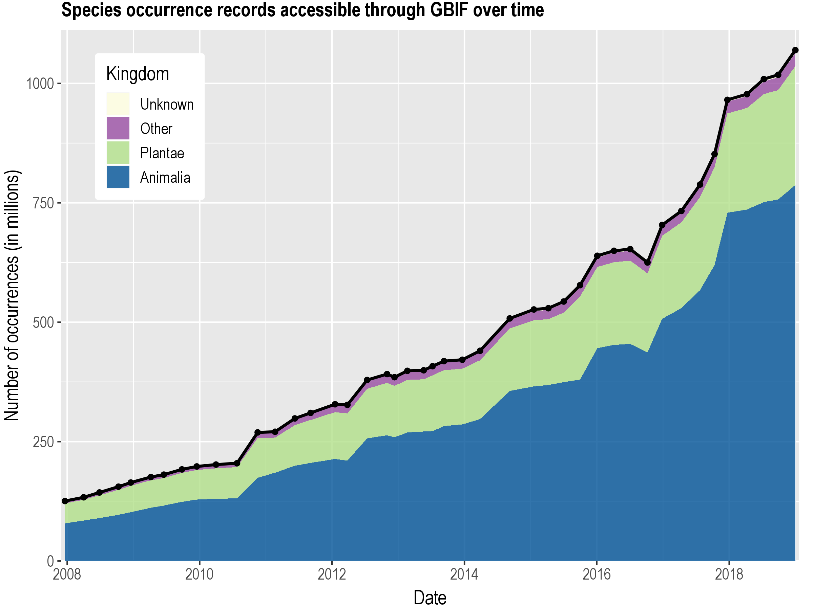
Data published through GBIF.org
data availability
www.gbif.org/analytics/global

Slide 6
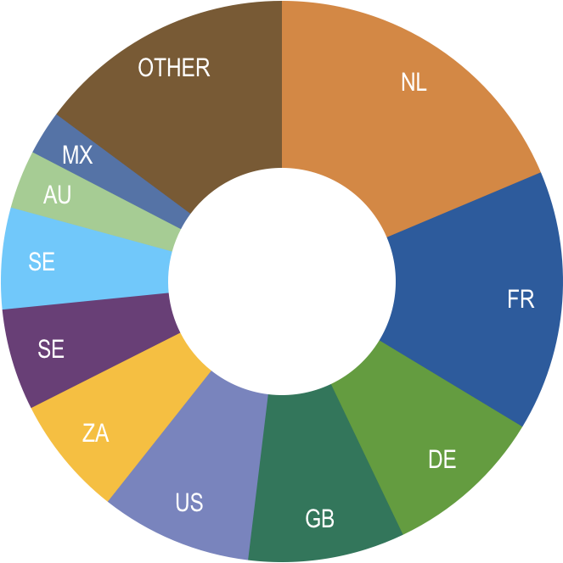
Occurrence records published during 2018, by country
 | Country | New records | 10/18 rank
1 | Netherlands | 29,531,297 | 14
2 | France | 23,784,903 | 1
3 | Germany | 14,675,581 | 2
4 | United Kingdom | 14,284,814 | 6
5 | United States | 13,811,002 | 3
6 | South Africa | 10,950,300 | 4
7 | Sweden | 9,262,582 | 5
8 | Norway | 6,251,581 | 7
9 | Australia | 5,345,044 | 8
10 | Mexico | 4,025,780 | 9
data availability
http://www.gbif.org/country

Slide 7
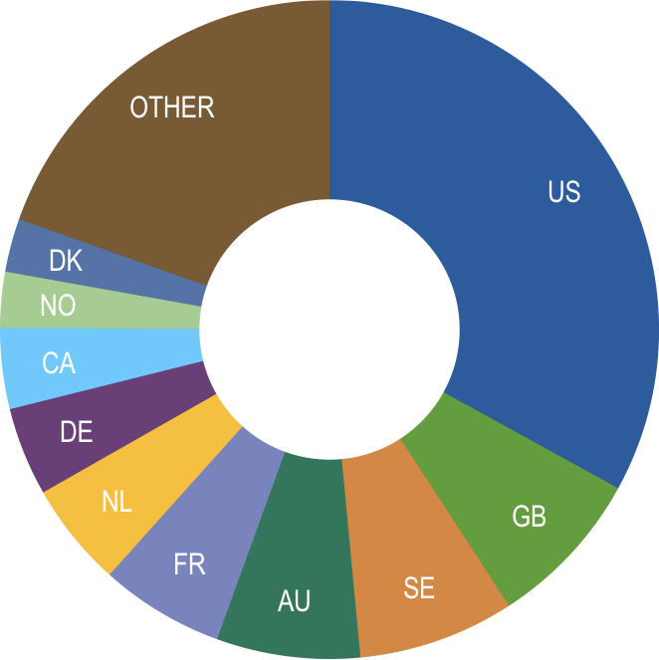
Total number of occurrence records published by country
31 Dec 2018
 | Country | Occurrences | 4/18 rank
1 | United States | 352,100,560 | 1
2 | United Kingdom | 83,530,234 | 3
3 | Sweden | 81,863,095 | 2
4 | Australia | 75,144,489 | 4
5 | France | 65,025,972 | 5
6 | Netherlands | 54,719,920 | 8
7 | Germany | 46,343,030 | 6
8 | Canada | 42,392,979 | 7
9 | Norway | 29,137,586 | 9
10 | Denmark | 27,925,477 | 10
data availability
http://www.gbif.org/country

Slide 8
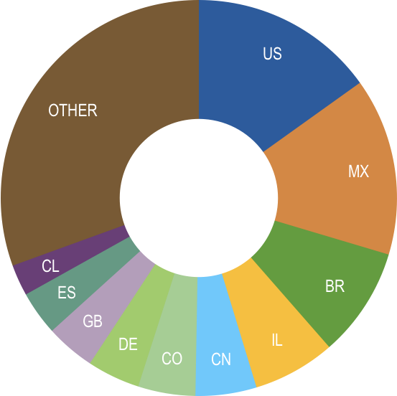
Data download requests by country, 2018
 | Country | Downloads | 05/18 rank
1 | United States | 20,454 | 1
2 | Mexico | 19,555 | 2
3 | Brazil | 12,331 | 3
4 | Israel | 10,131 | 63
5 | Colombia | 6,374 | 6
6 | Germany | 6,240 | 8
7 | China | 6,223 | 4
8 | United Kingdom | 5,258 | 5
9 | Spain | 4,224 | 7
10 | Chile | 3,165 | 9
data access and use

Slide 9
data access and use
Peer-reviewed publications using GBIF-mediated data
31 December 2018

Slide 10
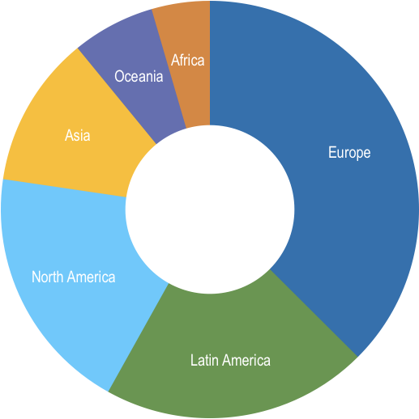
Peer-reviewed uses, by country and region
2018 Totals
Total # of peer-reviewed papers by country |  |  | 2017 rank
1 | United States | 205 | 1
2 | Brazil | 83 | 3
3 | Mexico | 73 | 7
4 | China | 72 | 8
4 | United Kingdom | 72 | 2
6 | Spain | 65 | 5
7 | Australia | 59 | 6
8 | Germany | 53 | 3
9 | Canada | 47 | 9
10 | France | 44 | 10
data access and use
Total # of papers by region
1 | Europe & Central Asia | 491
2 | Latin America & the Caribbean | 270
3 | North America | 252
4 | Asia | 154
5 | Oceania | 84
6 | Africa | 59

Slide 11
Featured research
November 2018
1 / 3
 | Alaniz AJ, Carvajal MA, Bacigalupo A & Cattan PE (2018) Global spatial assessment of Aedes aegypti and Culex quinquefasciatus: a scenario of Zika virus exposure. Epidemiology and Infection 147: e52. doi:10.1017/S0950268818003102 Author country: Chile
 | Bartomeus I, Stavert JR, Ward D & Aguado O (2018) Historical collections as a tool for assessing the global pollination crisis. Philosophical Transactions of the Royal Society B: Biological Sciences 374(1763): 20170389. doi:10.1098/rstb.2017.0389 Author countries: Spain, New Zealand
 | Byrne L, Chapleau F & Aris-Brosou S (2018) How the Central American Seaway and an Ancient Northern Passage Affected Flatfish Diversification. Molecular Biology and Evolution 35 (8): 1982–1989. doi:10.1093/molbev/msy104 Author country: Canada
 | Crespo-Mendes N, Laurent A, Bruun HH & Hauschild MZ (2018) Relationships between plant species richness and soil pH at the level of biome and ecoregion in Brazil. Ecological Indicators 98: 266-275. doi/10.1016/j.ecolind.2018.11.004 Author country: Denmark
 | Crespo-Mendes N, Laurent A & Hauschild MZ (2018) Effect factors of terrestrial acidification in Brazil for use in Life Cycle Impact Assessment. The International Journal of Life Cycle Assessment. doi:10.1007/s11367-018-1560-7 Author country: Denmark
 | Fadrique B, Báez S, Duque, Á et al. (2018) Widespread but heterogeneous responses of Andean forests to climate change. Nature 564: 207–212. doi:10.1038/s41586-018-0715-9 Author countries: United States, Ecuador, Colombia, Argentina, Peru, United Kingdom, Netherlands, Germany
 | Hewitt TL, Wood CL & Foighil DÓ (2018) Ecological correlates and phylogenetic signal of host use in North American unionid mussels. International Journal for Parasitology 49(1): 71-81. doi:10.1016/j.ijpara.2018.09.006 Author country: United States
data access and use
Invasive alien species
Impact of climate change
Species conservation and protected areas
Biodiversity and human health
Food, farming and biofuels
Ecosystem services
Advancing biodiversity science
Data management
Data papers

Slide 12
Featured research
November 2018
2 / 3
 | Kharouba HM, Lewthwaite JMM, Guralnick R, Kerr JT & Vellend M (2018) Using insect natural history collections to study global change impacts: challenges and opportunities. Philosophical Transactions of the Royal Society B: Biological Sciences 374(1763): 20170405. doi:10.1098/rstb.2017.0405 Author countries: Canada, United States
 | Khoury CK, Amariles D, Soto JS et al. (2018) Comprehensiveness of conservation of useful wild plants: An operational indicator for biodiversity and sustainable development targets. Ecological Indicators 98: 420-429. doi:10.1016/j.ecolind.2018.11.016 Author countries: Colombia, United States, Ireland, Germany, Peru
 | Menegotto A & Rangel TF (2018) Mapping knowledge gaps in marine diversity reveals a latitudinal gradient of missing species richness. Nature Communications 9: 4713. doi:10.1038/s41467-018-07217-7 Author country: Brazil
 | de Menezes AA, da Silva Cáceres ME, Bastos CJP & Lücking R (2018) The latitudinal diversity gradient of epiphytic lichens in the Brazilian Atlantic Forest: does Rapoport's rule apply? The Bryologist 121(4): 480-498. doi:10.1639/0007-2745-121.4.480 Author country: Brazil, Germany
 | Nic Lughadha E, Walker BE, Canteiro C et al. (2018) The use and misuse of herbarium specimens in evaluating plant extinction risks. Philosophical Transactions of the Royal Society B: Biological Sciences 374(1763): 20170402. doi:10.1098/rstb.2017.0402 Author country: United Kingdom
 | Perez TM, Valverde-Barrantes O, Bravo C et al. (2018) Botanic gardens are an untapped resource for studying the functional ecology of tropical plants. Philosophical Transactions of the Royal Society B: Biological Sciences 374(1763): 20170390. doi:10.1098/rstb.2017.0390 Author country: USA
 | Smith JR, Letten AD, Ke PJ et al. (2018) A global test of ecoregions. Nature Ecology & Evolution 2: 1889-1896. doi:10.1038/s41559-018-0709-x Author countries: United States, New Zealand, Canada, Switzerland
data access and use
Invasive alien species
Impact of climate change
Species conservation and protected areas
Biodiversity and human health
Food, farming and biofuels
Ecosystem services
Advancing biodiversity science
Data management
Data papers

Slide 13
Featured research
November 2018
3 / 3
 | Strand J, Soares-Filho B, Costa MH et al. (2018) Spatially explicit valuation of the Brazilian Amazon Forest’s Ecosystem Services. Nature Sustainability 1: 657-664. doi:10.1038/s41893-018-0175-0 Author countries: United States, Brazil, Netherlands
 | Strona G & Bradshaw CJA (2018) Co-extinctions annihilate planetary life during extreme environmental change. Scientific Reports 8: 16724. doi:10.1038/s41598-018-35068-1 Author countries: Italy, Australia
 | Suchan T, Talavera G, Sáez L, Ronikier M & Vila R (2018) Pollen metabarcoding as a tool for tracking long-distance insect migrations. Molecular Ecology Resources 19(1): 149-162. doi:10.1111/1755-0998.12948 Author country: Poland, Spain
 | West AM, Jarnevich CS, Young NE & Fuller PL (2018) Evaluating Potential Distribution of High-Risk Aquatic Invasive Species in the Water Garden and Aquarium Trade at a Global Scale Based on Current Established Populations. Risk Analysis. doi:10.1111/risa.13230 Author country: United States
 | Wyse SV, Dickie JB & Willis KJ (2018) Seed banking not an option for many threatened plants. Nature Plants 4: 848-850. doi:10.1038/s41477-018-0298-3 Author countries: New Zealand, United Kingdom
 | Zacarias D & Loyola R (2018) Climate change impacts on the distribution of venomous snakes and snakebite risk in Mozambique. Climatic Change 152(1): 195-207. doi:10.1007/s10584-018-2338-4 Author country: Brazil, Portugal, Mozambique
 | Zarrillo S, Gaikwad N, Lanaud C et al. (2018) The use and domestication of Theobroma cacao during the mid-Holocene in the upper Amazon. Nature Ecology & Evolution 2: 1879-1888. doi:10.1038/s41559-018-0697-x Author country: Canada, United States, France, Ecuador
data access and use
Invasive alien species
Impact of climate change
Species conservation and protected areas
Biodiversity and human health
Food, farming and biofuels
Ecosystem services
Advancing biodiversity science
Data management
Data papers
https://www.gbif.org/resource/search?contentType=literature

Slide 14
Featured research
December 2018
1 / 3
 | Botella C, Joly A, Bonnet P, Monestiez P & Munoz F (2018) A Deep Learning Approach to Species Distribution Modelling, in Multimedia Tools and Applications for Environmental & Biodiversity Informatics 169-199. doi:10.1007/978-3-319-76445-0_10 Author country: France
 | Estrada-Peña A, Adkin A, Bertolini S et al. (2018) Evaluating a mixed abiotic-biotic model for the distribution and host contact rates of an arthropod vector of pathogens: an example with Ixodes ricinus (Ixodidae). Microbial Risk Analysis. doi:10.1016/j.mran.2018.12.001 Author countries: Spain, United Kingdom, Italy, France, Switzerland
 | Goyder DJ, Barker N, Bester SP, Frisby A, Janks M & Gonçalves FMP (2018) The Cuito catchment of the Okavango system: a vascular plant checklist for the Angolan headwaters. PhytoKeys 113: 1-31. doi:10.3897/phytokeys.113.30439 Author countries: United Kingdom, Angola, South Africa, Germany
 | Guerra C, Baquero RA, Gutiérrez-Arellano D & Nicola GG (2018) Is the nature 2000 network effective to prevent the biological invasions? Global Ecology and Conservation 16: e00497. doi:10.1016/j.gecco.2018.e00497 Author countries: Spain, Mexico
 | Hanson JO, Fuller RA & Rhodes JR (2018) Conventional methods for enhancing connectivity in conservation planning do not always maintain gene flow. Journal of Applied Ecology. doi:10.1111/1365-2664.13315 Author country: Australia
 | Hardisty AR, Belbin L, Hobern D et al. (2018) Research infrastructure challenges in preparing essential biodiversity variables data products for alien invasive species. Environmental Research Letters 14: 025005. doi:10.1088/1748-9326/aaf5db Author countries: United Kingdom, Australia, Denmark, Netherlands
data access and use
Invasive alien species
Impact of climate change
Species conservation and protected areas
Biodiversity and human health
Food, farming and biofuels
Ecosystem services
Advancing biodiversity science
Data management
Data papers
https://www.gbif.org/resource/search?contentType=literature

Slide 15
Featured research
December 2018
2 / 3
 | Joka FR, Van Gils H, Huang LY & Wang XL (2019) High probability areas for ASF infection in China along the Russian and Korean borders. Transboundary and Emerging Diseases. doi:10.1111/tbed.13094 Author countries: China, South Africa
 | Khoury CK, Amariles D, Soto JS et al. (2018) Data for the calculation of an indicator of the comprehensiveness of conservation of useful wild plants. Data in Brief 22: 90-97. doi:10.1016/j.dib.2018.11.125 Author countries: Colombia, United States, Germany, Peru
 | Pelletier TA, Carstens BC, Tank DC, Sullivan J & Espíndola A (2018) Predicting plant conservation priorities on a global scale. Proceedings of the National Academy of Sciences 115(51): 13027-13032. doi:10.1073/pnas.1804098115 Author country: United States
 | Peterson AT, Asase A, Canhos D, de Souza S & Wieczorek J (2018) Data Leakage and Loss in Biodiversity Informatics. Biodiversity Data Journal 6: 326826. doi:10.3897/bdj.6.e26826 Author countries: United States, Ghana, Brazil
 | Prudic K, Oliver J, Brown B & Long E (2018) Comparisons of Citizen Science Data-Gathering Approaches to Evaluate Urban Butterfly Diversity. Insects 9(4): 186. doi:10.3390/insects9040186 Author country: United States
data access and use
Invasive alien species
Impact of climate change
Species conservation and protected areas
Biodiversity and human health
Food, farming and biofuels
Ecosystem services
Advancing biodiversity science
Data management
Data papers
https://www.gbif.org/resource/search?contentType=literature

Slide 16
Featured research
December 2018
3 / 3
 | Rathore P, Roy A & Karnatak H (2018) Assessing the vulnerability of Oak (Quercus) forest ecosystems under projected climate and land use land cover changes in Western Himalaya. Biodiversity and Conservation. doi:10.1007/s10531-018-1679-7 Author country: India
 | Riede K (2018) Acoustic profiling of Orthoptera: present state and future needs. Journal of Orthoptera Research 27(2): 203-215. doi:10.3897/jor.27.23700 Author country: Germany
 | Skeels A & Cardillo M (2018) Reconstructing the Geography of Speciation from Contemporary Biodiversity Data. The American Naturalist 193(2): 240-255. doi:10.1086/701125 Author country: Australia
 | Vilches-Blázquez LM & Saavedra J (2018) A framework for connecting two interoperability universes: OGC Web Feature Services and Linked Data. Transactions in GIS 23(1): 22-47. doi:10.1111/tgis.12496 Author countries: Colombia, Spain
data access and use
Invasive alien species
Impact of climate change
Species conservation and protected areas
Biodiversity and human health
Food, farming and biofuels
Ecosystem services
Advancing biodiversity science
Data management
Data papers
https://www.gbif.org/resource/search?contentType=literature

