Slide 1

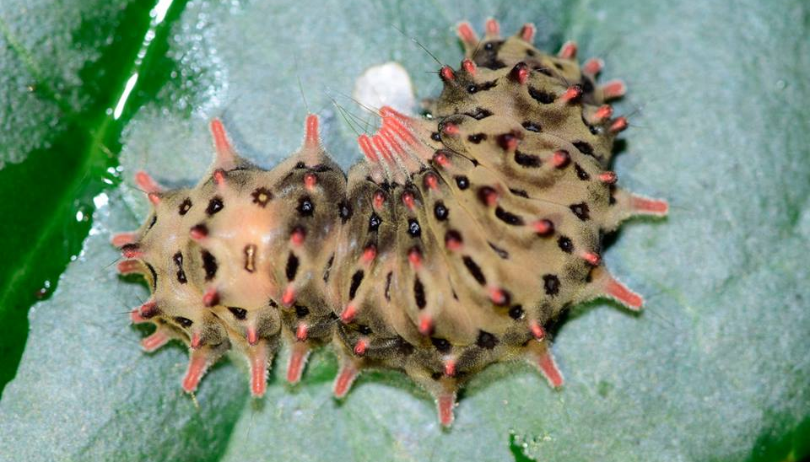
Overview
Histia flabellicornis subsp. ultima larva, Wooden Gate Park, Wenshan District, Taipei, Taiwan, 6 January 2019.
Photo by TwMoth215089 via Taiwan Moth Occurrence Data Collected From Social Network https://www.gbif.org/occurrence/1981438452
March 2019

Slide 2

BY THE NUMBERS
1 March 2018
Species occurrence records
Datasets
1,083,206,502
21,396
Country Participants
Organizational Participants
Publishers
58
38
1,358
Average records downloaded per month (Jan-Feb 2019)
Avg monthly user sessions (Jan-Feb 2019)
36.9 billion
154,586
Notes:
Useful to see GBIF in its different modalities:
A window on biodiversity
An informatics infrastructure focuseD on tools and standards in service to science and society
A global network on bioinformatics

Slide 3
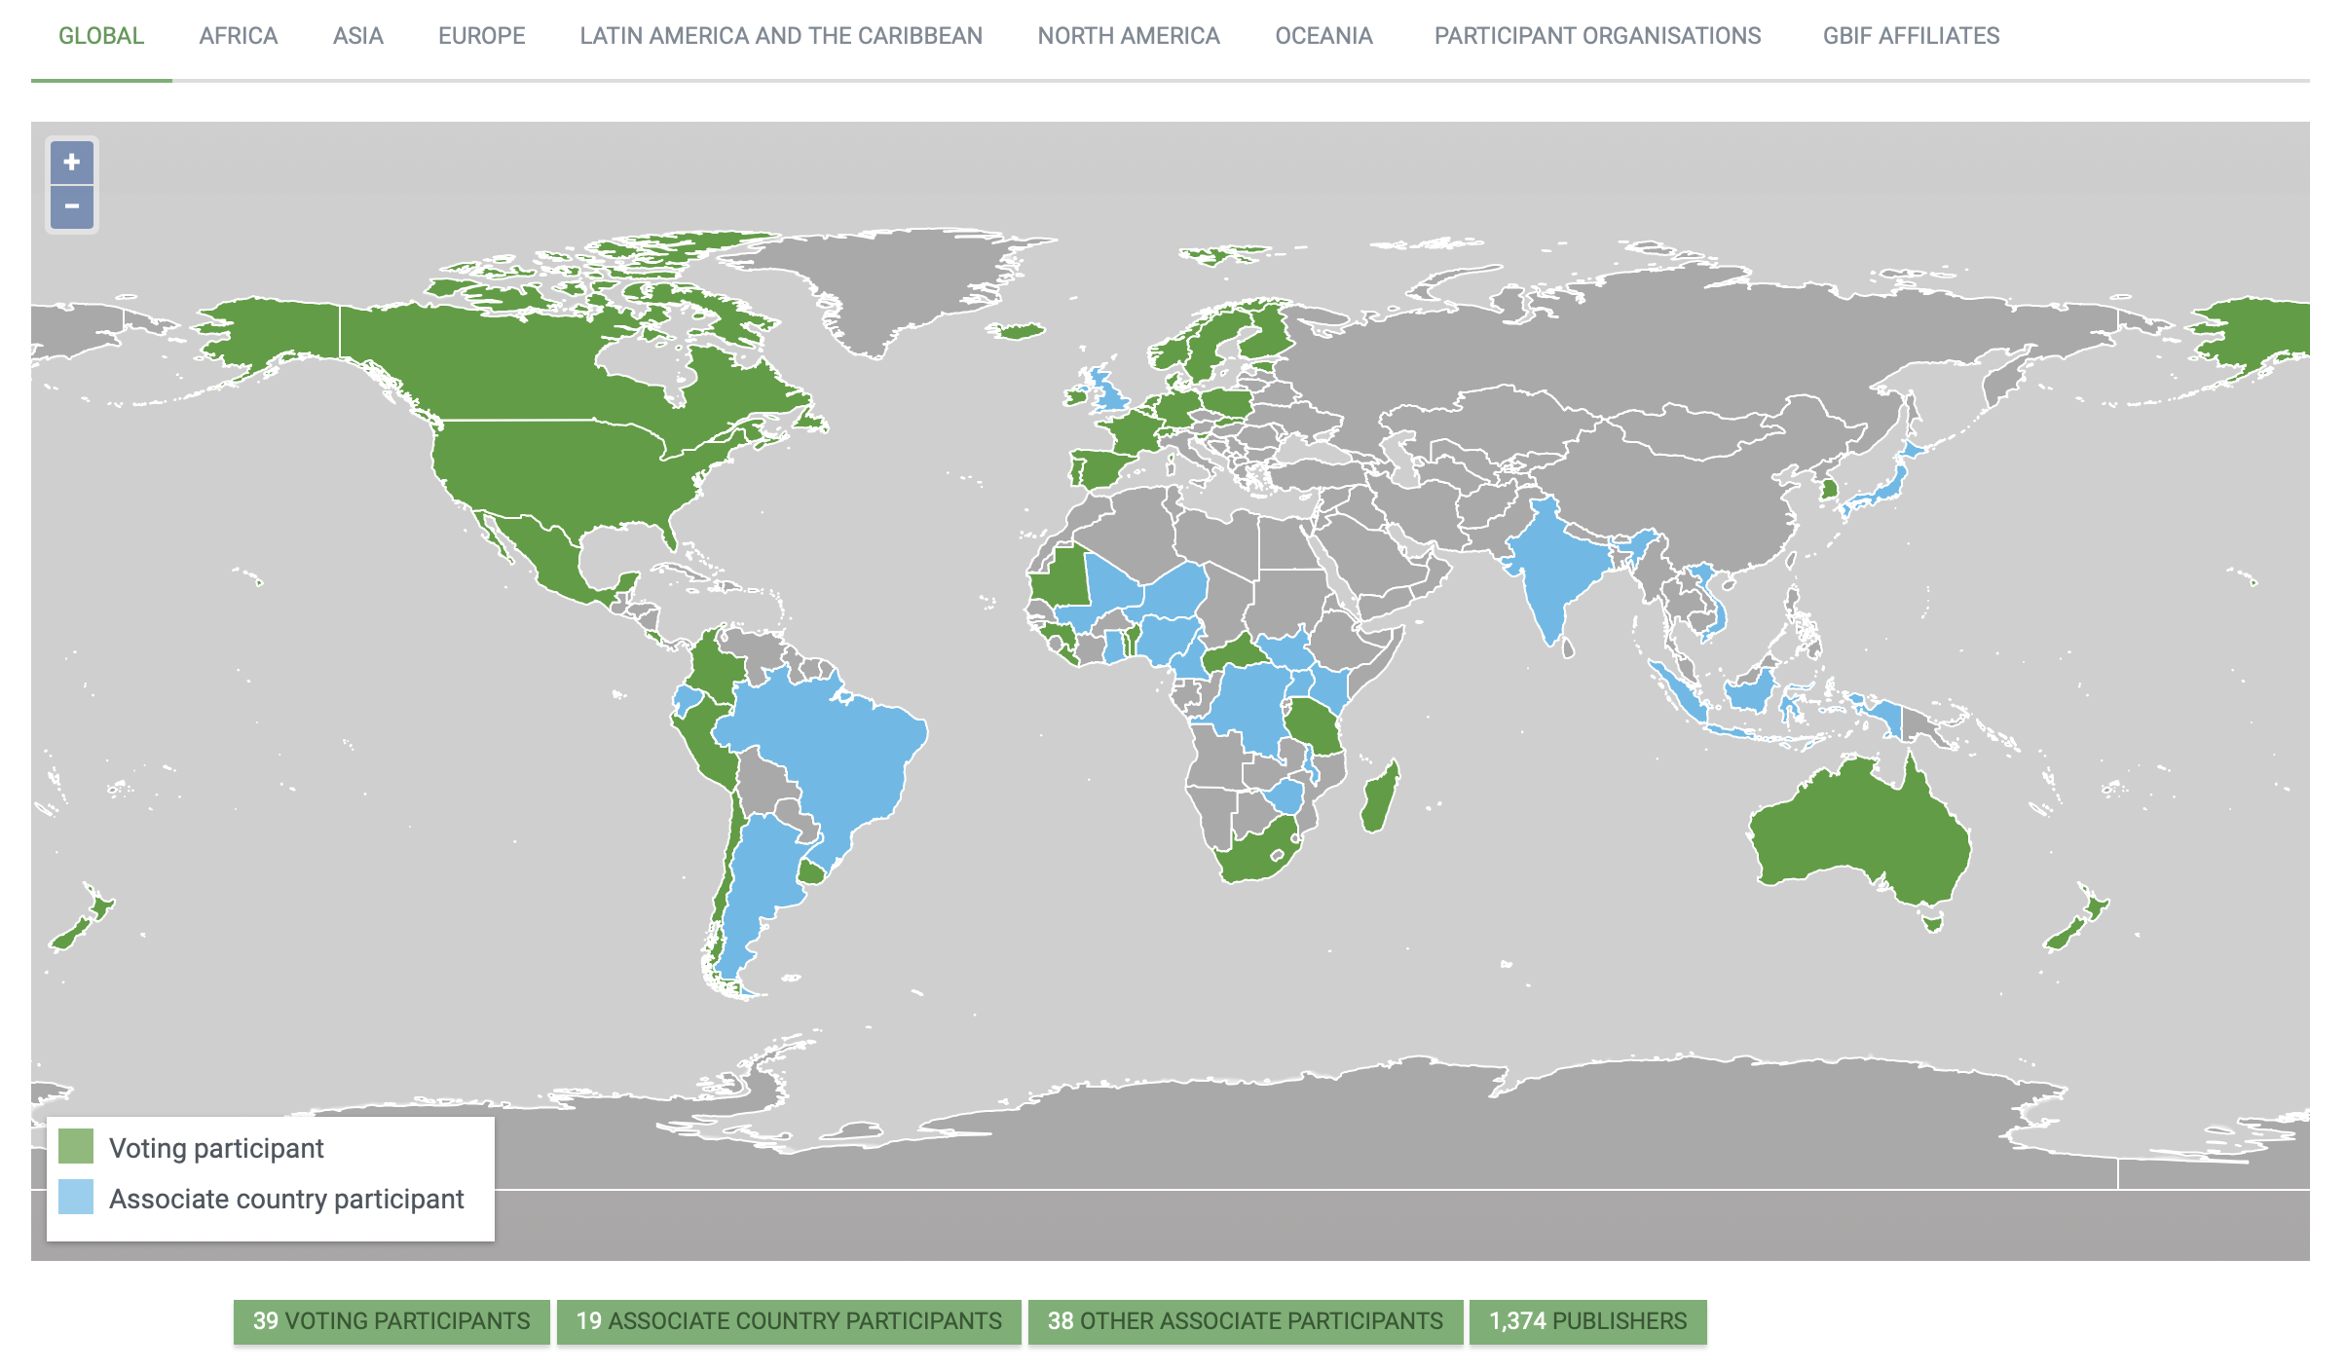
Current network
participation
https://www.gbif.org/the-gbif-network

Slide 4
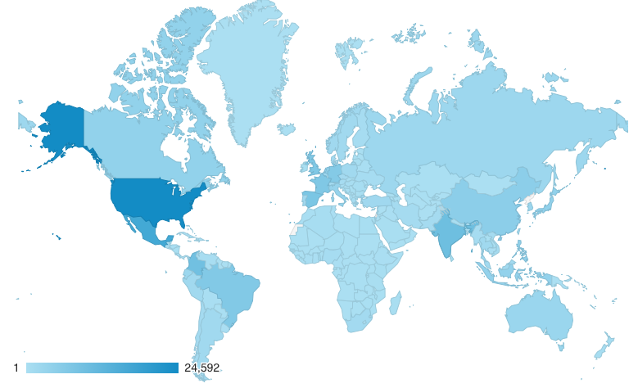
GBIF.org Web traffic year-to-date 2019
Rank | Country/Territory | Sessions | % Total Sessions | 2018 rank | Pages / Session
1 | United States | 24,592 | 13.65% | 1 | 2.54
2 | Mexico | 15,924 | 8.84% | 2 | 2.75
3 | India | 9,296 | 5.16% | 3 | 3.26
4 | Colombia | 8,861 | 4.92% | 4 | 2.60
5 | Spain | 7,259 | 4.03% | 6 | 3.20
6 | France | 6,592 | 3.66% | 7 | 2.77
7 | United Kingdom | 6,577 | 3.65% | 8 | 3.18
8 | Brazil | 6,326 | 3.51% | 5 | 3.24
9 | Germany | 6,026 | 3.35% | 9 | 3.38
10 | China | 4,745 | 2.63% | 10 | 3.71
data access and use

Slide 5
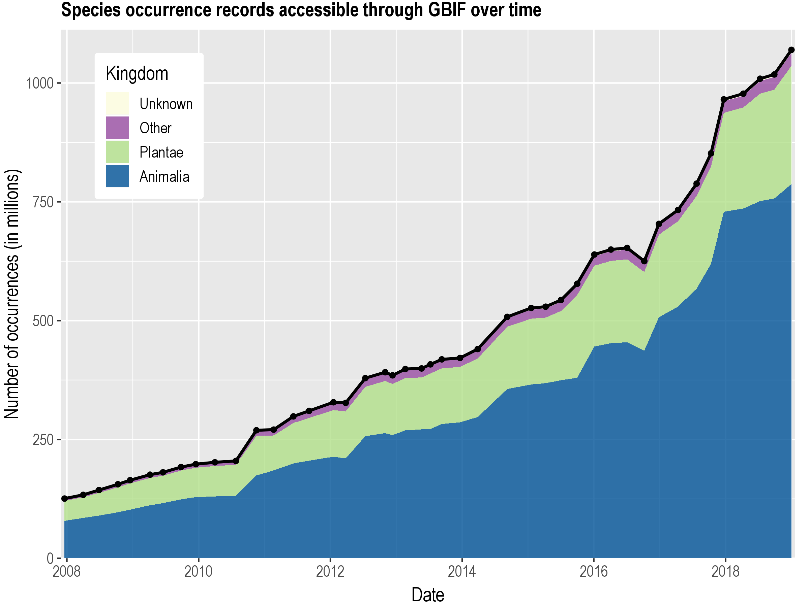
Data published through GBIF.org
data availability
www.gbif.org/analytics/global

Slide 6
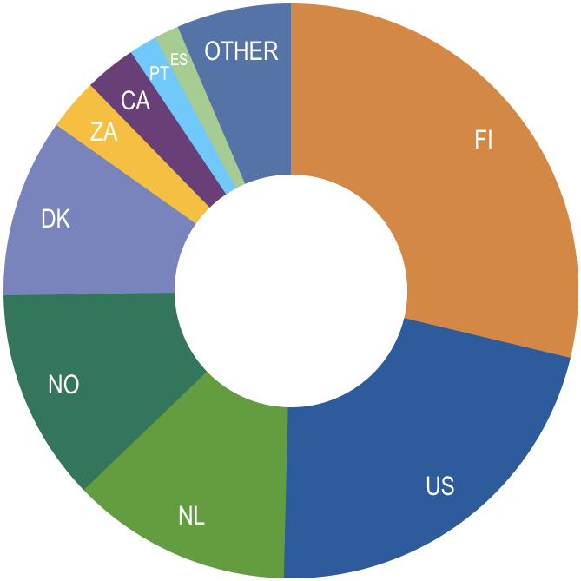
Occurrence records published during 2019, by country
28 Feb 2019
 | Country | New records | 2018 rank
1 | Finland | 6,153,680 | 20
2 | United States | 4,636,311 | 5
3 | Netherlands | 2,660,699 | 1
4 | Norway | 2,554,748 | 8
5 | Denmark | 2,150,940 | 22
6 | South Africa | 622,924 | 6
7 | Canada | 618,689 | 12
8 | Sweden | 509,184 | 7
9 | Portugal | 336,209 | 13
10 | Spain | 297,383 | 16
data availability
http://www.gbif.org/country

Slide 7
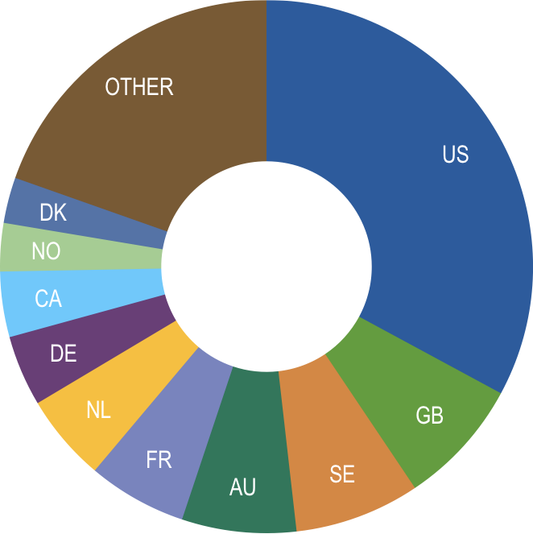
Total number of occurrence records published by country
28 Feb 2019
 | Country | Occurrences | 2018 rank
1 | United States | 356,132,096 | 1
2 | United Kingdom | 83,483,848 | 3
3 | Sweden | 82,367,144 | 2
4 | Australia | 75,147,260 | 4
5 | France | 65,072,532 | 5
6 | Netherlands | 57,380,619 | 8
7 | Germany | 46,484,330 | 6
8 | Canada | 42,974,349 | 7
9 | Norway | 31,690,344 | 9
10 | Denmark | 30,037,523 | 10
data availability
http://www.gbif.org/country

Slide 8
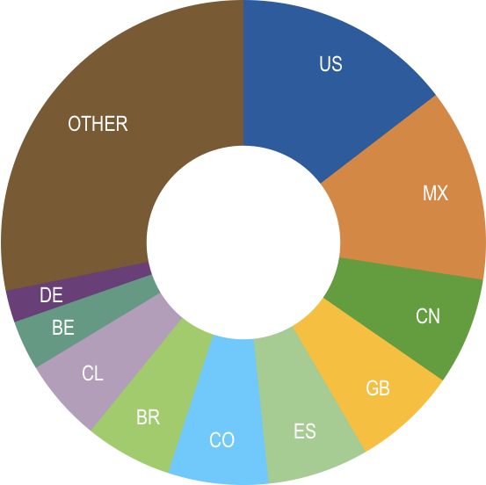
Data download requests by country, 2019
 | Country | Downloads | 2018 rank
1 | United States | 3,052 | 1
2 | Mexico | 2,694 | 2
3 | China | 1,501 | 5
4 | United Kingdom | 1,456 | 8
5 | Spain | 1,413 | 9
6 | Colombia | 1,400 | 6
7 | Brazil | 1,217 | 3
8 | Chile | 1,151 | 10
9 | Belgium | 696 | 18
10 | Germany | 444 | 7
data access and use

Slide 9
data access and use
Peer-reviewed publications using GBIF-mediated data
28 February 2019

Slide 10
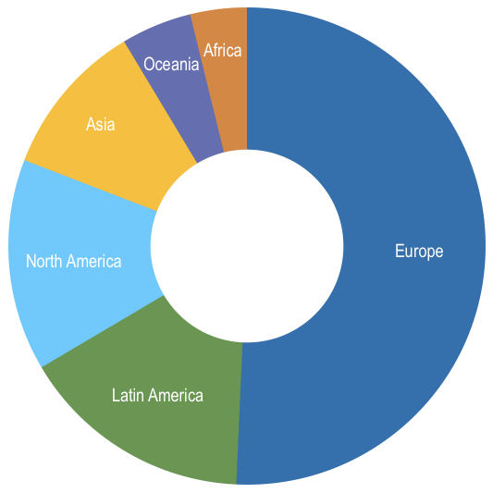
Peer-reviewed uses, by country and region
28 Feb 2019
Total # of peer-reviewed papers by country |  |  | 2018 rank
1 | United States | 23 | 1
2 | United Kingdom | 15 | 4
3 | Brazil | 13 | 2
4 | Germany | 12 | 8
4 | Spain | 12 | 6
6 | China | 9 | 4
7 | Australia | 7 | 7
7 | Canada | 7 | 9
9 | Finland | 6 | 29
9 | Italy | 6 | 13
9 | South Africa | 6 | 19
data access and use
Total # of papers by region
1 | Europe & Central Asia | 106
2 | Latin America & the Caribbean | 33
3 | North America | 30
4 | Asia | 22
5 | Oceania | 10
6 | Africa | 8

Slide 11
Featured research
January 2019
 | Beilschmidt C, Mattig M, Fober T & Seeger B (2019) An efficient aggregation and overlap removal algorithm for circle maps. GeoInformatica. doi:10.1007/s10707-019-00342-5 Author country: Germany
 | Jiang D, Wang Q, Ding F, Fu J & Hao M (2019) Potential marginal land resources of cassava worldwide: A data-driven analysis. Renewable and Sustainable Energy Reviews 104: 167-173. doi:10.1016/j.rser.2019.01.024 Author country: China
 | Liu X, Blackburn TM, Song T, Li X, Huang C & Li Y (2019) Risks of Biological Invasion on the Belt and Road. Current Biology 39(3): 499-505.e4. doi:10.1016/j.cub.2018.12.036 Author countries: China, United Kingdom, South Africa
 | Saleem G, Akhtar M, Ahmed N & Qureshi WS (2019) Automated analysis of visual leaf shape features for plant classification. Computers and Electronics in Agriculture 157: 270-280. doi:10.1016/j.compag.2018.12.038 Author countries: Pakistan, Australia
 | Shchepin ON, Schnittler M, Erastova DA et al. (2019) Community of dark-spored myxomycetes in ground litter and soil of taiga forest (Nizhne-Svirskiy Reserve, Russia) revealed by DNA metabarcoding. Fungal Ecology 39: 80-93. doi:10.1016/j.funeco.2018.11.006 Author countries: Russia, Germany, New Zealand
 | Zizka A, Silvestro D, Andermann T et al. (2019) CoordinateCleaner: standardized cleaning of occurrence records from biological collection databases. Methods in Ecology and Evolution. doi:10.1111/2041-210X.13152 Author countries: Sweden, Germany, Switzerland, Norway
data access and use
Invasive alien species
Impact of climate change
Species conservation and protected areas
Biodiversity and human health
Food, farming and biofuels
Ecosystem services
Advancing biodiversity science
Data management
Data papers
https://www.gbif.org/resource/search?contentType=literature

Slide 12
Featured research
February 2019
 | Daru BH, le Roux PC, Gopalraj J, Park DS, Holt BG & Greve M (2019) Spatial overlaps between the global protected areas network and terrestrial hotspots of evolutionary diversity. Global Ecology and Biogeography. doi:10.1111/geb.12888 Author countries: United States, South Africa, United Kingdom, Denmark
 | Guo W-Y, van Kleunen M, Pierce S et al. (2019) Domestic gardens play a dominant role in selecting alien species with adaptive strategies that facilitate naturalization. Global Ecology and Biogeography. doi:10.1111/geb.12882 Author countries: Czechia, Denmark, Germany, China, United Kingdom, Italy, Austria
 | Mittermeier JC, Roll U, Matthews TJ & Grenyer R (2019) A season for all things: Phenological imprints in Wikipedia usage and their relevance to conservation. PLOS Biology 17(3): e3000146. doi:10.1371/journal.pbio.3000146 Author countries: United Kingdom, Israel, Portugal
 | Piñar G, Poyntner C, Tafer H & Sterflinger K (2019) A time travel story: metagenomic analyses decipher the unknown geographical shift and the storage history of possibly smuggled antique marble statues. Annals of Microbiology. doi:10.1007/s13213-019-1446-3 Author country: Austria
 | Rice A, Šmarda P, Novosolov M et al. (2019) The global biogeography of polyploid plants. Nature Ecology & Evolution 3: 265-273. doi:10.1038/s41559-018-0787-9 Author countries: Israel, Czechia
data access and use
Invasive alien species
Impact of climate change
Species conservation and protected areas
Biodiversity and human health
Food, farming and biofuels
Ecosystem services
Advancing biodiversity science
Data management
Data papers
https://www.gbif.org/resource/search?contentType=literature

