Slide 1

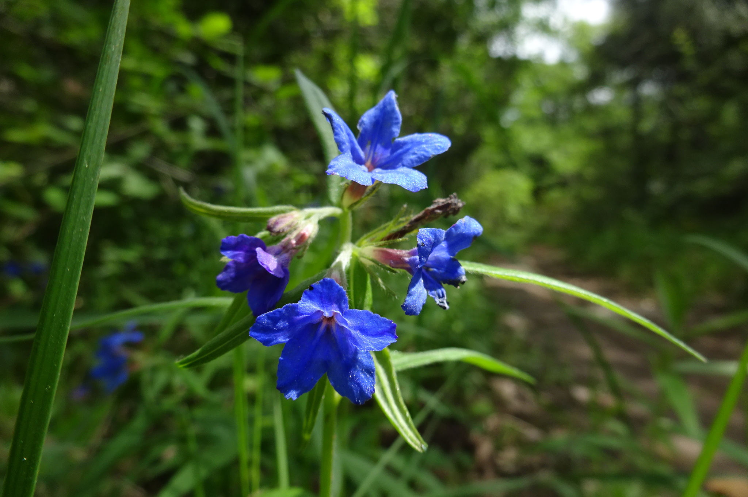
Overview
Purple gromwell (Lithospermum purpurocaeruleum), Romaguets, Catalonia, Spain, 15 May 2018.
Photo ressotaelspeus BY-NC 3.0 via Natusfera Citizen Science Observation Dataset https://www.gbif.org/occurrence/1845054322
September 2018

Slide 2

BY THE NUMBERS
1 September 2018
Species occurrence records
Datasets
1,017,404,292
40,668
Country Participants
Organizational Participants
Publishers
57
37
1,258
Average records downloaded per month (2018)
Avg monthly user sessions (2018)
116.8 billion
152,223
Notes:
Useful to see GBIF in its different modalities:
A window on biodiversity
An informatics infrastructure focuseD on tools and standards in service to science and society
A global network on bioinformatics

Slide 3
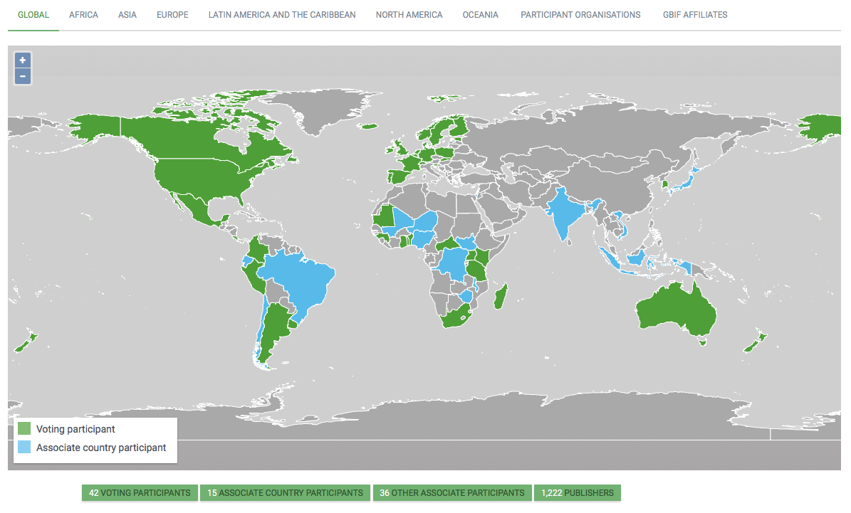
Current network
participation
https://www.gbif.org/the-gbif-network

Slide 4
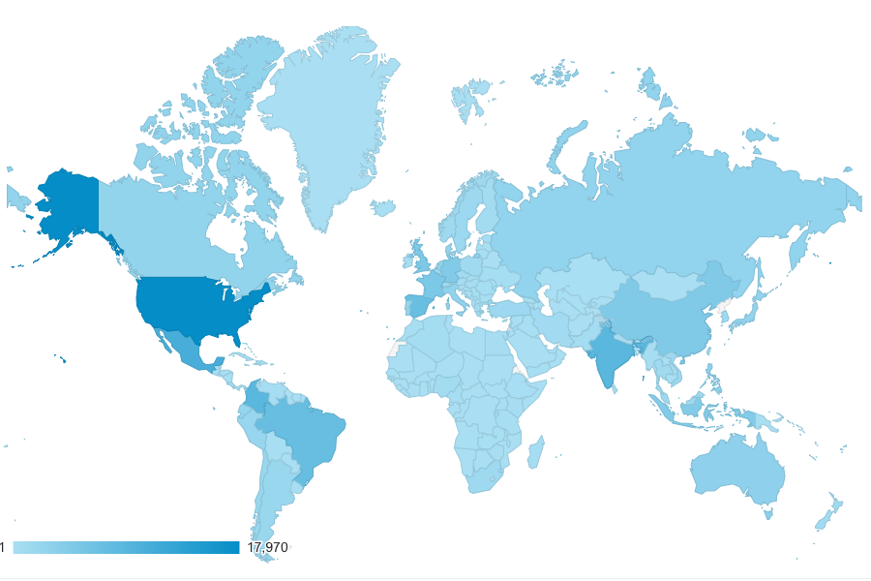
GBIF.org Web traffic
2018 to date
Rank | Country/Territory | Sessions | % Total Sessions | 2017 rank | Pages / Session
1 | United States | 147,833 | 12.14% | 1 | 2.77
2 | India | 75,884 | 6.23% | 2 | 3.20
3 | Mexico | 69,644 | 5.72% | 3 | 3.41
4 | Brazil | 53,738 | 4.41% | 6 | 3.79
5 | Colombia | 52,793 | 4.34% | 4 | 3.00
6 | Spain | 49,078 | 4.03% | 9 | 3.29
7 | United Kingdom | 45,426 | 3.73% | 5 | 3.80
8 | France | 44,680 | 3.67% | 8 | 2.82
9 | Germany | 40,863 | 3.36% | 7 | 3.17
10 | China | 31,167 | 2.56% | 15 | 4.78
data access and use

Slide 5
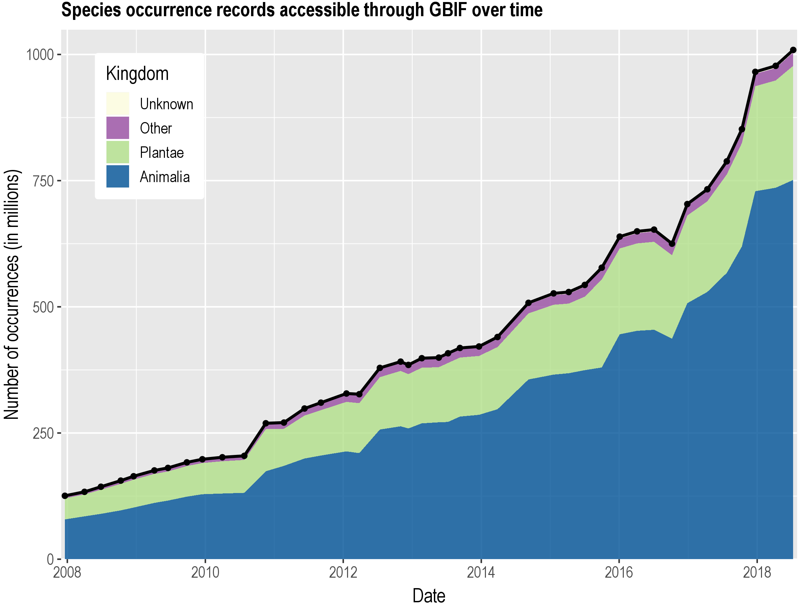
Data published through GBIF.org
data availability
www.gbif.org/analytics/global

Slide 6
data access and use
Peer-reviewed publications using GBIF-mediated data
through 31 August 2018

Slide 7
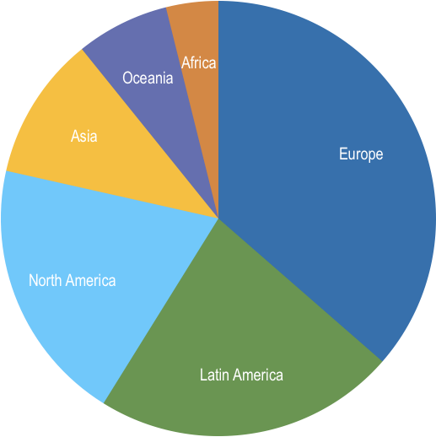
Peer-reviewed uses, by country and region
2018 to date
Total # of peer-reviewed papers by country
1 | United States | 130
2 | Brazil | 58
3 | Mexico | 55
3 | Australia | 44
5 | United Kingdom | 42
6 | Spain | 39
7 | China | 38
8 | Canada | 31
9 | Germany | 30
10 | France | 29
data access and use
Total # of papers by region
1 | Europe & Central Asia | 300
2 | Latin America & the Caribbean | 185
3 | North America | 162
4 | Asia | 88
5 | Oceania | 57
6 | Africa | 32

Slide 8
Featured research
July 2018
1 / 2
 | Calixto-Pérez E, Alarcón-Guerrero J, Ramos-Fernández G et al. (2018) Integrating expert knowledge and ecological niche models to estimate Mexican primates’ distribution. Primates 59(5): 451-467. https://doi.org/10.1007/s10329-018-0673-8 Author countries: Mexico, Spain
 | Castellanos-Morales G, Paredes-Torres LM, Gámez N et al. (2018) Historical biogeography and phylogeny of Cucurbita: insights from ancestral area reconstruction and niche evolution. Molecular Phylogenetics and Evolution 128: 38-54. https://doi.org/10.1016/j.ympev.2018.07.016 Author country: Mexico
 | Ceschin S, Abati S, Ellwood NTW & Zuccarello V (2018) Riding invasion waves: Spatial and temporal patterns of the invasive Lemna minuta from its arrival to its spread across Europe. Aquatic Botany150: 1-8. https://doi.org/10.1016/j.aquabot.2018.06.002 Author country: Italy
 | Dornelas M, Antão LH, Moyes F et al. (2018) BioTIME: A database of biodiversity time series for the Anthropocene. Global Ecology and Biogeography 27(7): 760-786. https://doi.org/10.1111/geb.12729 Author countries: Australia, Belgium, Brazil, Canada, Chile, Colombia, Denmark, Finland, France, Germany, Iceland, India, Indonesia, Ireland, Israel, Italy, Lithuania, Norway, Poland, Portugal, Russian Federation, Spain, Sweden, Switzerland, Taiwan, United States, Viet Nam
data access and use
Invasive alien species
Impact of climate change
Species conservation and protected areas
Biodiversity and human health
Food, farming and biofuels
Ecosystem services
Advancing biodiversity science
Data management
Data papers
https://www.gbif.org/resource/search?contentType=literature

Slide 9
Featured research
July 2018
2 / 2
 | Fitzpatrick MC & Ellison AM (2018) Estimating the exposure of carnivorous plants to rapid climatic change. Oxford Scholarship Online. https://doi.org/10.1093/oso/9780198779841.003.0028 Author country: United States
 | Hernández-Quiroz NS, Badano EI, Barragán-Torres F, Flores J & Pinedo-Álvarez C (2018) Habitat suitability models to make conservation decisions based on areas of high species richness and endemism. Biodiversity and Conservation 27(12): 3185–320. https://doi.org/10.1007/s10531-018-1596-9 Author country: Mexico
 | Longbottom J, Shearer FM, Devine M et al. (2018) Vulnerability to snakebite envenoming: a global mapping of hotspots. The Lancet 392(10148): 673-684. https://doi.org/10.1016/s0140-6736(18)31224-8 Author countries: United Kingdom, Switzerland, United States, Australia
 | Magona N, Richardson DM, Le Roux JJ, Kritzinger-Klopper S & Wilson JRU (2018) Even well-studied groups of alien species might be poorly inventoried: Australian Acacia species in South Africa as a case study. NeoBiota 39: 1-29. https://doi.org/10.3897/neobiota.39.23135 Author country: South Africa
 | Moreira TCL, Amato-Lourenço LF, da Silva GT et al. (2018) The Use of Tree Barks to Monitor Traffic Related Air Pollution: A Case Study in São Paulo–Brazil. Frontiers in Environmental Science 6: 72. https://doi.org/10.3389/fenvs.2018.00072 Author country: Brazil
data access and use
Invasive alien species
Impact of climate change
Species conservation and protected areas
Biodiversity and human health
Food, farming and biofuels
Ecosystem services
Advancing biodiversity science
Data management
Data papers
https://www.gbif.org/resource/search?contentType=literature

Slide 10
Featured research
Aug 2018
1 / 2
 | Aguilar-Rivera N, Serna-Lagunes R, Michel-Cuello C & Trujillo-Mata A (2019) Upgrading Comparative and Competitive Advantages for Ethanol Fuel Production From Agroindustrial Crops in Developing Countries: Mexico as a Case Study. Bioethanol Production from Food Crops 401-415. https://doi.org/10.1016/b978-0-12-813766-6.00020-5 Author country: Mexico
 | Bhattacharyya S, Dawson DA, Hipperson H & Ishtiaq F (2018) A diet rich in C3 plants reveals the sensitivity of an alpine mammal to climate change. Molecular Ecology. https://doi.org/10.1111/mec.14842 Author countries: India, United Kingdom
 | Falcão de Oliveira E, Galati EAB, Oliveira AGd, Rangel EF, Carvalho BMd (2018) Ecological niche modelling and predicted geographic distribution of Lutzomyia cruzi, vector of Leishmania infantum in South America. PLoS Neglected Tropical Diseases 12(7): e0006684. https://doi.org/10.1371/journal.pntd.0006684 Author country: Brazil
 | Groom QJ, Marsh CJ, Gavish Y & Kunin WE (2018) How to predict fine resolution occupancy from coarse occupancy data. Methods in Ecology and Evolution. https://doi.org/10.1111/2041-210X.13078 Author countries: Belgium, United Kingdom
 | Jayathilake DRM & Costello MJ (2018) A modelled global distribution of the seagrass biome. Biological Conservation 226: 120-126. https://doi.org/10.1016/j.biocon.2018.07.009 Author country: New Zealand
 | Joly A, Goëau H, Botella C et al. (2018) Overview of LifeCLEF 2018: A Large-Scale Evaluation of Species Identification and Recommendation Algorithms in the Era of AI. Lecture Notes in Computer Science 11018: 247-266. https://doi.org/10.1007/978-3-319-98932-7_24 Author countries: France, Netherlands, Switzerland
data access and use
Invasive alien species
Impact of climate change
Species conservation and protected areas
Biodiversity and human health
Food, farming and biofuels
Ecosystem services
Advancing biodiversity science
Data management
Data papers
https://www.gbif.org/resource/search?contentType=literature

Slide 11
Featured research
Aug 2018
2 / 2
 | Lortie CJ, Filazzola A, Kelsey R, Hart AK & Butterfield HS (2018) Better late than never: a synthesis of strategic land retirement and restoration in California. Ecosphere 9(8): e02367. https://doi.org/10.1002/ecs2.2367 Author countries: United States, Canada
 | Rodríguez-Merino A, García-Murillo P, Cirujano S & Fernández-Zamudio R (2018) Predicting the risk of aquatic plant invasions in Europe: How climatic factors and anthropogenic activity influence potential species distributions. Journal for Nature Conservation 45: 58-71. https://doi.org/10.1016/j.jnc.2018.08.007 Author country: Spain Invasives
 | Samy AM, Alkishe AA, Thomas S, Wang L & Zhang W (2018) Mapping the potential distributions of etiological agent, vectors, and reservoirs of Japanese Encephalitis in Asia and Australia. Acta Tropica 188: 108-117. https://doi.org/10.1016/j.actatropica.2018.08.014 Author countries: Egypt, United States, Libya, Germany, China
 | Syfert MM, Brummitt NA, Coomes DA, Bystriakova N & Smith MJ (2018) Inferring diversity patterns along an elevation gradient from stacked SDMs: A case study on Mesoamerican ferns. Global Ecology and Conservation. https://doi.org/10.1016/j.gecco.2018.e00433 Author country: United Kingdom
 | Taylor PJ, Neef G, Keith M, Weier S, Monadjem A & Parker DM (2018) Tapping into technology and the biodiversity informatics revolution: updated terrestrial mammal list of Angola, with new records from the Okavango Basin. ZooKeys 779: 51-88. https://doi.org/10.3897/zookeys.778.25964 Author countries: South Africa, Eswatini
data access and use
Invasive alien species
Impact of climate change
Species conservation and protected areas
Biodiversity and human health
Food, farming and biofuels
Ecosystem services
Advancing biodiversity science
Data management
Data papers

