Slide 1

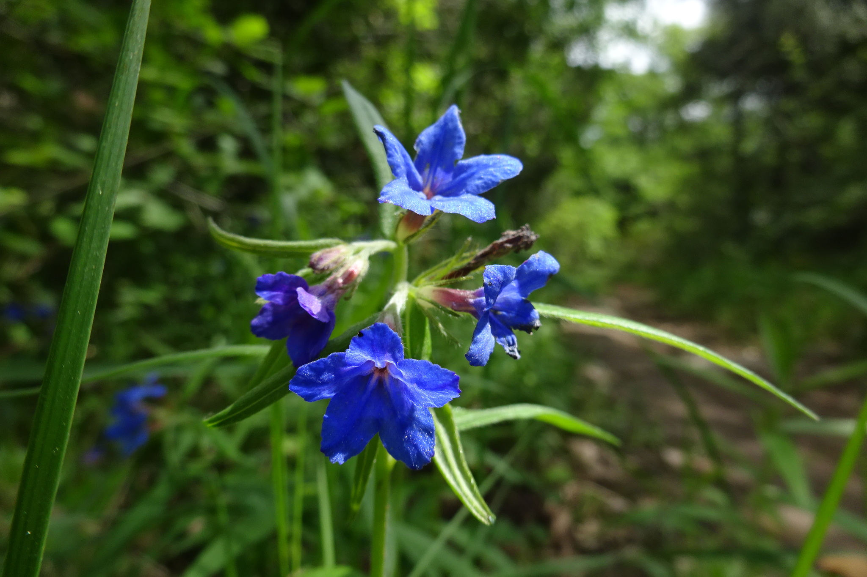
Overview
Purple gromwell (Lithospermum purpurocaeruleum), Romaguets, Catalonia, Spain, 15 May 2018.
Photo ressotaelspeus BY-NC 3.0 via Natusfera Citizen Science Observation Dataset https://www.gbif.org/occurrence/1845054322
July 2018

Slide 2

BY THE NUMBERS
7 July 2018
Species occurrence records
Datasets
1,008,977,612
39,715
Country Participants
Organizational Participants
Publishers
57
36
1,217
Average records downloaded per month (2018)
Avg monthly user sessions (2018)
134.3 billion
159,127
Notes:
Useful to see GBIF in its different modalities:
A window on biodiversity
An informatics infrastructure focuseD on tools and standards in service to science and society
A global network on bioinformatics

Slide 3
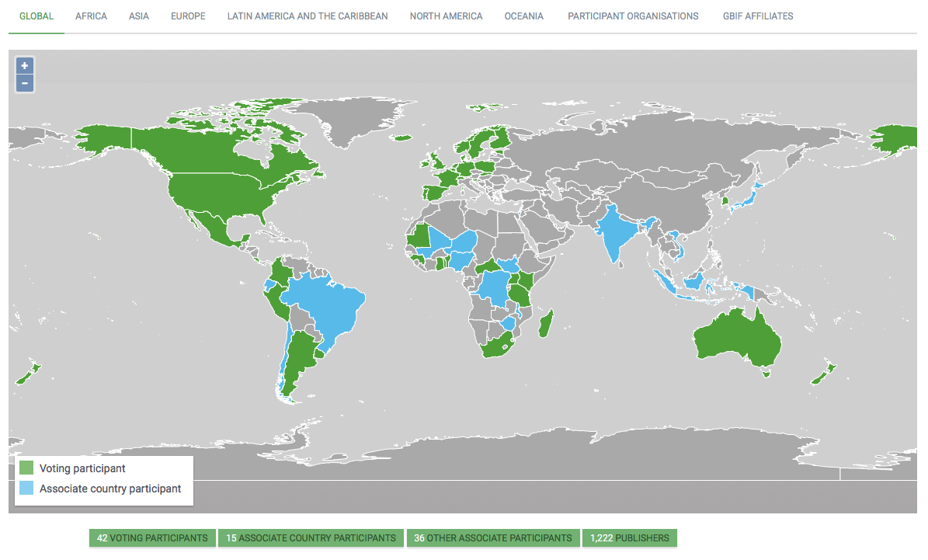
Current network
participation
https://www.gbif.org/the-gbif-network

Slide 4
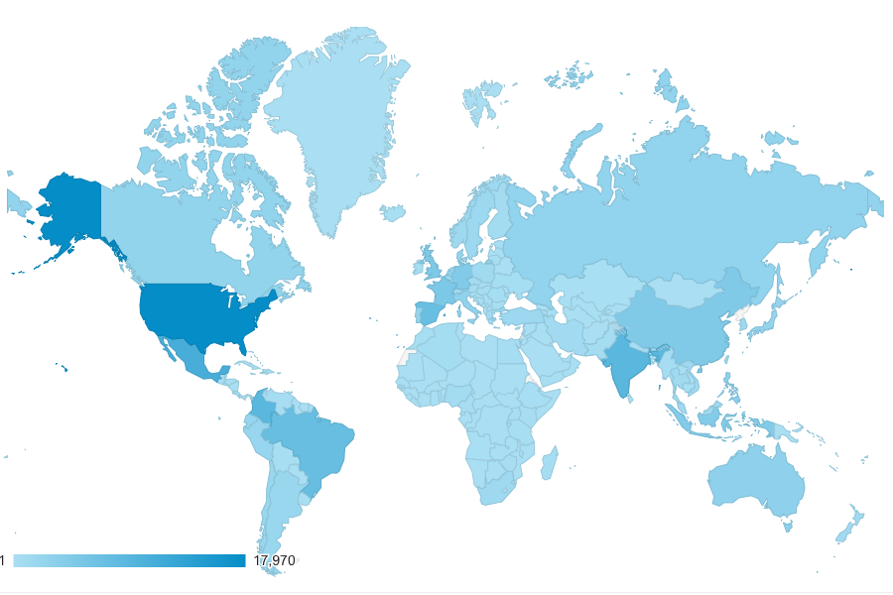
GBIF.org Web traffic
2018 to date
Rank | Country/Territory | Sessions | % Total Sessions | 2017 rank | Pages / Session
1 | United States | 116,763 | 12.23% | 1 | 2.87
2 | India | 57,960 | 6.07% | 2 | 3.17
3 | Mexico | 53,915 | 5.65% | 3 | 3.50
4 | Spain | 40,562 | 4.26% | 6 | 3.42
5 | Brazil | 40,504 | 4.24% | 4 | 3.88
6 | Colombia | 38,571 | 4.04% | 9 | 2.96
7 | United Kingdom | 36,031 | 3.77% | 5 | 4.05
8 | France | 35,382 | 3.71% | 8 | 2.85
9 | Germany | 32,481 | 3.40% | 7 | 3.27
10 | China | 23,991 | 2.51% | 15 | 4.90
data access and use

Slide 5
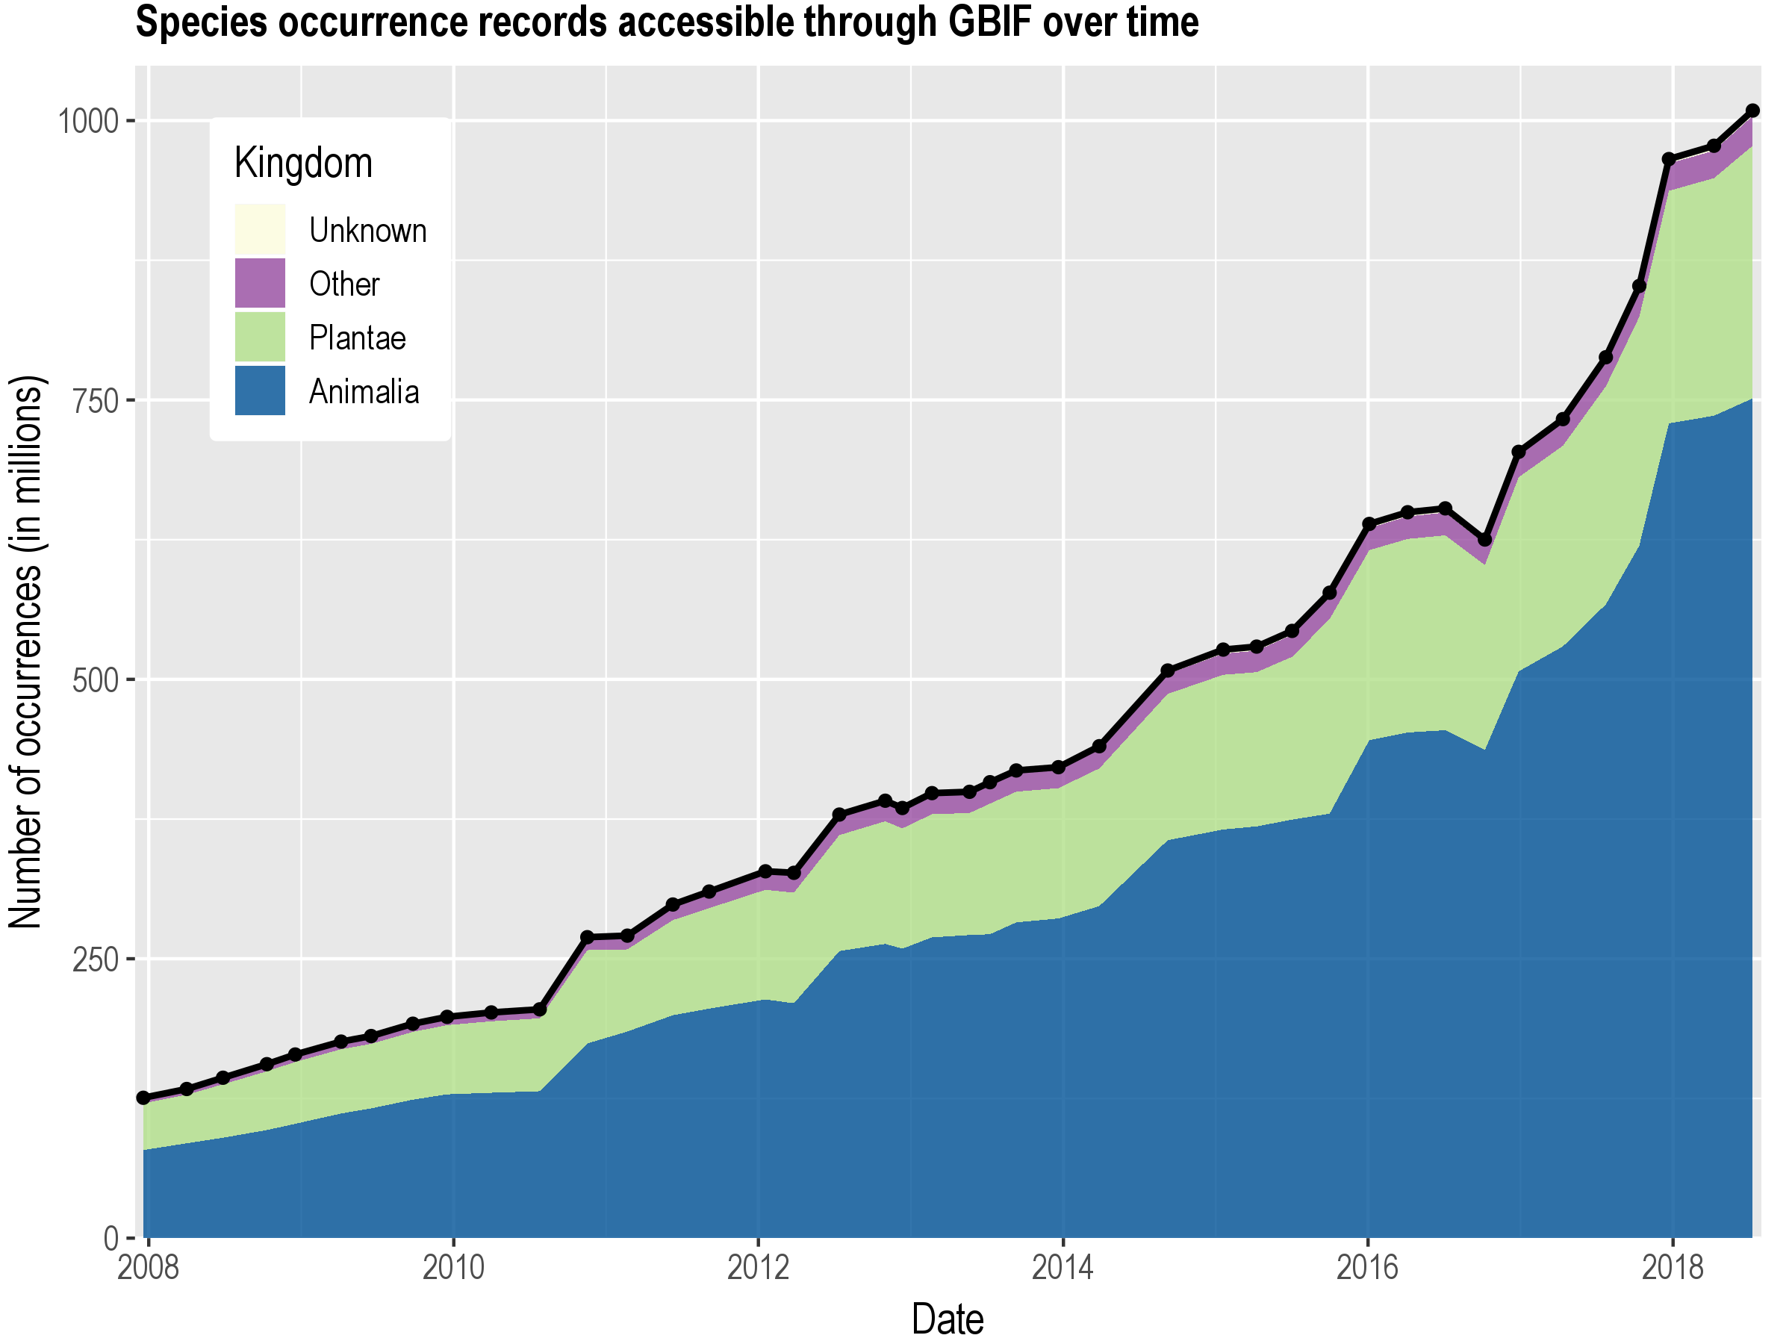
Data published through GBIF.org
data availability
www.gbif.org/analytics/global

Slide 6
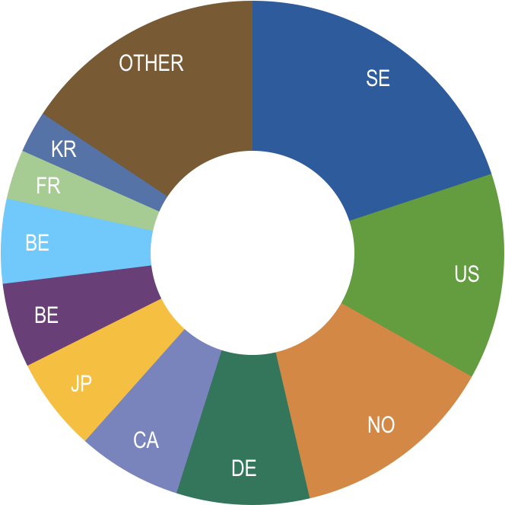
Occurrence records published during 2018, by country as of 31 May 2018
 | Country | New records | 4/18 rank
1 | Sweden | 7,431,114 | 1
2 | United States | 4,942,291 | 4
3 | Norway | 4,916,051 | 2
4 | Germany | 3,185,655 | 3
5 | Canada | 2,501,220 | 9
6 | Japan | 2,248,474 | 5
7 | Belgium | 2,022,611 | 14
8 | Australia | 1,578,147 | 6
9 | France | 1,186,336 | 7
10 | South Korea | 996,976 | 8
data availability
http://www.gbif.org/country

Slide 7
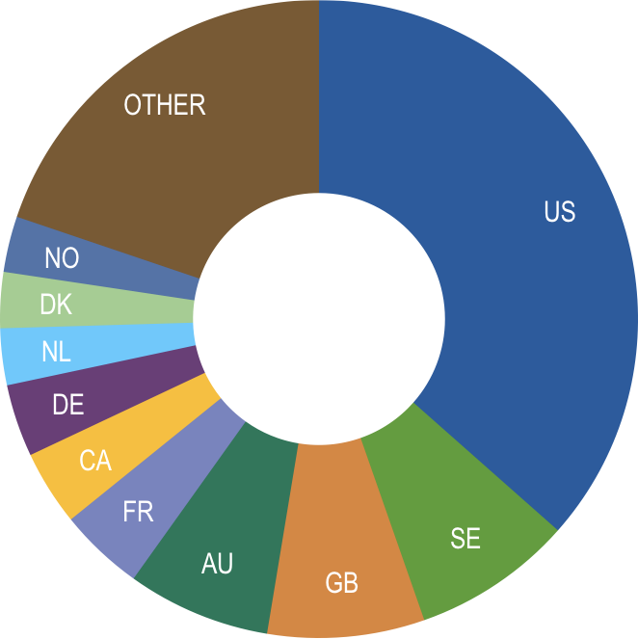
Total number of occurrence records published by country as of 31 May 2018
 | Country | Occurrences | 4/18 rank
1 | United States | 359,247,117 | 1
2 | Sweden | 79,864,885 | 2
3 | United Kingdom | 78,359,466 | 3
4 | Australia | 71,450,942 | 4
5 | France | 42,399,483 | 5
6 | Canada | 37,419,974 | 7
7 | Germany | 36,126,390 | 6
8 | Netherlands | 28,252,978 | 8
9 | Denmark | 27,853,090 | 9
10 | Norway | 27,804,087 | 10
data availability
http://www.gbif.org/country

Slide 8
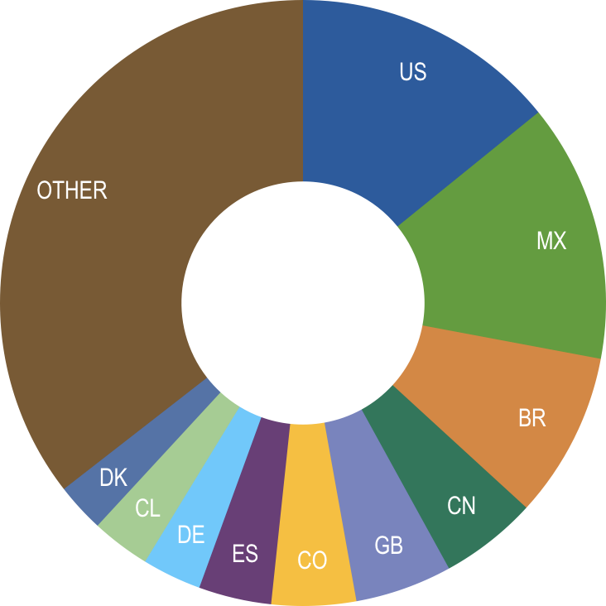
Data download requests by country, 2018
 | Country | Downloads | 04/18 rank
1 | United States | 10,772 | 2
2 | Mexico | 10,490 | 1
3 | Brazil | 6,733 | 3
4 | China | 3,947 | 5
5 | United Kingdom | 3,941 | 4
6 | Colombia | 3,429 | 7
7 | Spain | 2,952 | 6
8 | Germany | 2,406 | 9
9 | Chile | 2,386 | 10
10 | Denmark | 1,987 | 8
data access and use

Slide 9
data access and use
Peer-reviewed publications using GBIF-mediated data
through 30 June 2018

Slide 10
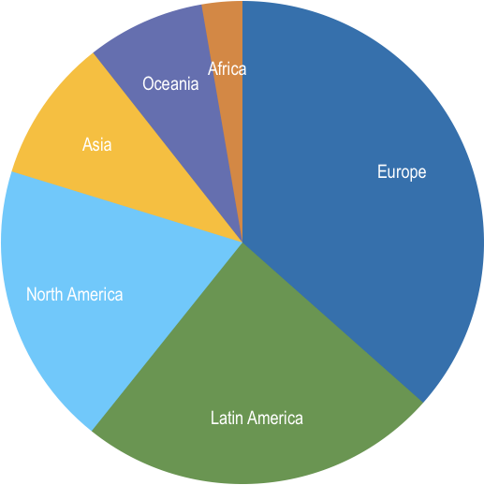
Peer-reviewed uses, by country and region
2018 to date
Total # of peer-reviewed papers by country
1 | United States | 89
2 | Brazil | 44
3 | Mexico | 35
3 | Australia | 35
5 | United Kingdom | 32
6 | China | 30
7 | Spain | 27
8 | Canada | 20
9 | France | 20
10 | Germany | 19
data access and use
Total # of papers by region
1 | Europe & Central Asia | 203
2 | Latin America & the Caribbean | 133
3 | North America | 112
4 | Asia | 58
5 | Oceania | 44
6 | Africa | 23

Slide 11
Featured research
May 2018
1 / 3
 | van Andel T, Scholman A & Beumer M (2018) Icones Plantarum Malabaricarum: early 18th century botanical drawings of medicinal plants from colonial Ceylon. Journal of Ethnopharmacology. https://doi.org/10.1016/j.jep.2018.04.033 Author country: Netherlands
 | Antonelli A, Zizka A, Carvalho FA et al. (2018) Amazonia is the primary source of Neotropical biodiversity. Proceedings of the National Academy of Sciences 115(23): 6034-6039. https://doi.org/10.1073/pnas.1713819115 Author countries: Sweden, United States, Brazil, Switzerland, France
 | Clarke AG, Lord JM, Hua X & Ohlemüller R (2018) Does current climate explain plant disjunctions? A test using the New Zealand alpine flora. Journal of Biogeography 45(7): 1490-1499. https://doi.org/10.1111/jbi.13222 Author country: New Zealand
 | Karst J, Burns C, Cale JA et al. (2018) Tree species with limited geographical ranges show extreme responses to ectomycorrhizas. Global Ecology and Biogeography. https://doi.org/10.1111/geb.12745 Author countries: Canada, United States
 | Lalis A, Mona S, Stoetzel E et al. (2018) Out of Africa: demographic and colonization history of the Algerian mouse (Mus spretus Lataste). Heredity. https://doi.org/10.1038/s41437-018-0089-7 Author countries: France, Algeria, Morocco
data access and use
Invasive alien species
Impact of climate change
Species conservation and protected areas
Biodiversity and human health
Food, farming and biofuels
Ecosystem services
Advancing biodiversity science
Data management
Data papers
https://www.gbif.org/resource/search?contentType=literature

Slide 12
Featured research
May 2018
2 / 3
 | Liu J, Milne RI, Möller M et al. (2018) Integrating a comprehensive DNA barcode reference library with a global map of yews (Taxus L.) for forensic identification. Molecular Ecology Resources. https://doi.org/10.1111/1755-0998.12903 Author countries: China, United Kingdom, Kenya, Taiwan
 | Lowenstein D, Andrews H, Rudolf E, Winman N & Marshall C (2018) Historical Records Of The Digger Wasps, Astata Latreille 1796 (Hymenoptera: Crabronidae: Astatinae), From The United States And Canada In The Oregon State Arthropod Collection. Catalog: Oregon State Arthropod Collection 2(1): 1–9. https://doi.org/10.5399/osu/cat_osac.2.1.4321 Author country: United States
 | Park DS, Ellison AM & Davis CC (2018) Mating system does not predict niche breadth. Global Ecology and Biogeography. https://doi.org/10.1111/geb.12740 Author country: United States
 | Segura S, Fresnedo J, Mathuriau C ,López J, Andrés J & Muratalla A (2018) The edible fruit species in Mexico. Genetic Resources and Crop Evolution 65(6): 1767–1793. https://doi.org/10.1007/s10722-018-0652-3 Author countries: Mexico, United States
 | Slavik K, Lemmen C, Zhang W, Kerimoglu O, Klingbeil K & Wirtz KW (2018) The large-scale impact of offshore wind farm structures on pelagic primary productivity in the southern North Sea. Hydrobiologia. https://doi.org/10.1007/s10750-018-3653-5 Author country: Germany, France
data access and use
Invasive alien species
Impact of climate change
Species conservation and protected areas
Biodiversity and human health
Food, farming and biofuels
Ecosystem services
Advancing biodiversity science
Data management
Data papers
https://www.gbif.org/resource/search?contentType=literature

Slide 13
Featured research
May 2018
3 / 3
 | Speed JDM, Bendiksby M, Finstad AG, Hassel K, Kolstad AL & Prestø T (2018) Contrasting spatial, temporal and environmental patterns in observation and specimen based species occurrence data. PLoS ONE 13(4): e0196417. https://doi.org/10.1371/journal.pone.0196417 Author country: Norway
 | Vandebroek I, Picking D, Aiken S et al. (2018) A Review of Coralilla (Antigonon leptopus): An Invasive and Popular Urban Bush Medicine in Jamaica. Economic Botany. https://doi.org/10.1007/s12231-018-9415-5 Author countries: United States, Jamaica
 | Warren R, Price J, Graham E, Forstenhaeusler N & VanDerWal J (2018) The projected effect on insects, vertebrates, and plants of limiting global warming to 1.5°C rather than 2°C. Science 360(6390): 791-795. https://doi.org/10.1126/science.aar3646 Author country: United Kingdom, Australia
 | Wittich HC, Seeland M, Wäldchen J, Rzanny M & Mäder P (2018) Recommending plant taxa for supporting on-site species identification. BMC Bioinformatics 19: 190. https://doi.org/10.1186/s12859-018-2201-7 Author country: Germany
 | Yoo KO, Crowl AA, Kim KA, Cheon KS & Cellinese N (2018) Origins of East Asian Campanuloideae (Campanulaceae) diversity. Molecular Phylogenetics and Evolution. https://doi.org/10.1016/j.ympev.2018.04.040 Author countries: Republic of Korea, United States
data access and use
Invasive alien species
Impact of climate change
Species conservation and protected areas
Biodiversity and human health
Food, farming and biofuels
Ecosystem services
Advancing biodiversity science
Data management
Data papers
https://www.gbif.org/resource/search?contentType=literature

Slide 14
Featured research
June 2018
1 / 2
 | Abotsi, Komla;Kokou, Kouami;Dubuisson, Jean-Yves;Rouhan, Germinal (2018) A first checklist of the Pteridophytes of Togo (West Africa). Biodiversity Data Journal 6: e24137. https://doi.org/10.3897/bdj.6.e24137 Author countries: Togo, France
 | Alves RJV, Lorscheitter ML, Rezende CM & Silva NG(2018) Airborne palynomorphs on Trindade Island, South Atlantic Ocean, Brazil. Brazilian Journal of Botany 41(2): 435–446. https://doi.org/10.1007/s40415-018-0460-1 Author country: Brazil
 | Arenas-Castro S, Gonçalves J, Alves P, Alcaraz-Segura D & Honrado JP (2018) Assessing the multi-scale predictive ability of ecosystem functional attributes for species distribution modelling. PLoS ONE 13(6): e0199292. https://doi.org/10.1371/journal.pone.0199292 Author countries: Portugal, Spain
 | Ballesteros-Mejia L, Lima JS & Collevatti RG (2018) Spatially-explicit analyses reveal the distribution of genetic diversity and plant conservation status in Cerrado biome. Biodiversity and Conservation. https://doi.org/10.1007/s10531-018-1588-9 Author country: Brazil
 | Collins C, Asouti E, Grove M, Kabukcu C, Bradley L & Chiverrell R (2018) Understanding resource choice at the transition from foraging to farming: An application of palaeodistribution modelling to the Neolithic of the Konya Plain, south-central Anatolia, Turkey. Journal of Archaeological Science 96: 57-72. https://doi.org/10.1016/j.jas.2018.02.003 Author country: United Kingdom
 | Deka M & Morshed N (2018) Mapping Disease Transmission Risk of Nipah Virus in South and Southeast Asia. Tropical Medicine and Infectious Disease 3(2): 57. https://doi.org/10.3390/tropicalmed3020057 Author country: United States
data access and use
Invasive alien species
Impact of climate change
Species conservation and protected areas
Biodiversity and human health
Food, farming and biofuels
Ecosystem services
Advancing biodiversity science
Data management
Data papers
https://www.gbif.org/resource/search?contentType=literature

Slide 15
Featured research
June 2018
2 / 2
 | Hendricks SA, Schweizer RM, Harrigan RJ et al. (2018) Natural re-colonization and admixture of wolves (Canis lupus) in the US Pacific Northwest: challenges for the protection and management of rare and endangered taxa. Heredity. https://doi.org/10.1038/s41437-018-0094-x Author countries: United States, Canada
 | Jarnevich CS, Young NE, Talbert M & Talbert C (2018) Forecasting an invasive species’ distribution with global distribution data, local data, and physiological information. Ecosphere 9(5): e02279. https://doi.org/10.1002/ecs2.2279 Author country: United States
 | Johnston MA, Aalbu R & Franz N (2018) An updated checklist of the Tenebrionidae sec. Bousquet et al. 2018 of the Algodones Dunes of California, with comments on checklist data practices. Biodiversity Data Journal 6: e24927. https://doi.org/10.3897/bdj.6.e24927 Author country: United States
 | Medeiros CM, Hernández-Lambraño RE, Ribeiro KAF & Sánchez Agudo JÁ (2018) Living on the edge: do central and marginal populations of plants differ in habitat suitability? Plant Ecology. https://doi.org/10.1007/s11258-018-0855-x Author country: Spain
 | Troudet J, Vignes-Lebbe R, Grandcolas P & Legendre F (2018) The increasing disconnection of primary biodiversity data from specimens: How does it happen and how to handle it? Systematic Biology syy044. https://doi.org/10.1093/sysbio/syy044 Author country: France
 | Yagui MMM, Maia LFMP, Oliveira J & Vivacqua AS (2018) Curation of Physical Objects in Botany: Architecture and Development of a Linked Open Data-Based Application. 2017 IEEE 15th Intl Conf on Dependable, Autonomic and Secure Computing, 15th Intl Conf on Pervasive Intelligence and Computing, 3rd Intl Conf on Big Data Intelligence and Computing and Cyber Science and Technology Congress(DASC/PiCom/DataCom/CyberSciTech). https://doi.org/10.1109/dasc-picom-datacom-cyberscitec.2017.149 Author country: Brazil
data access and use
Invasive alien species
Impact of climate change
Species conservation and protected areas
Biodiversity and human health
Food, farming and biofuels
Ecosystem services
Advancing biodiversity science
Data management
Data papers

