Slide 1
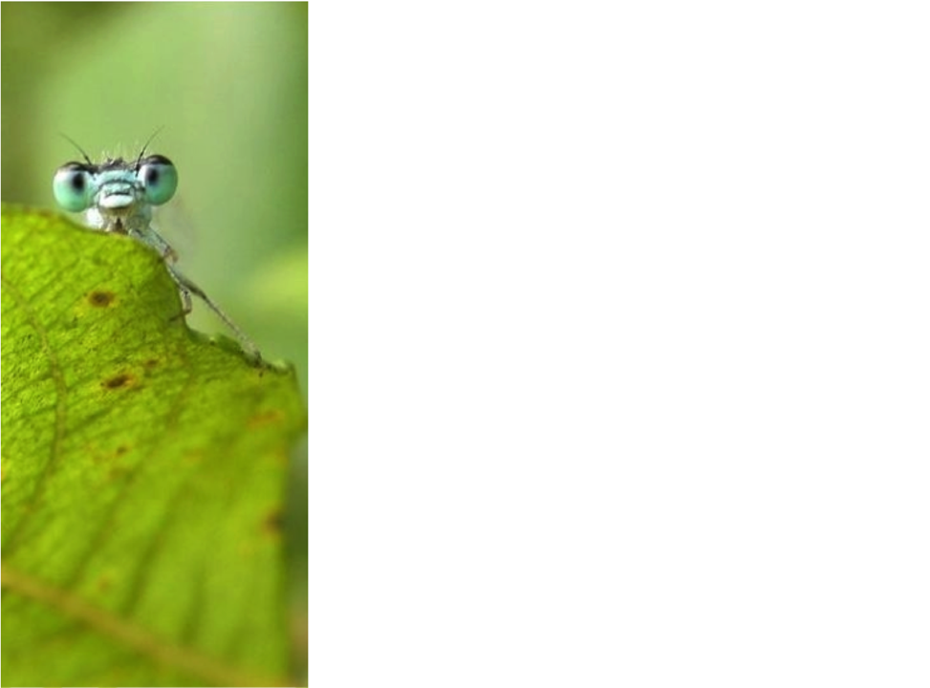


Living Atlases community
Regional Engagement Workshop, BID Pacific
July 28th, 2017
Anne-Sophie Archambeau
Node manager GBIF France
archambeau@gbif.fr
Marie-Elise Lecoq
Lead developer, GBIF France: melecoq@gbif.fr
Dave Martin
Systems Architect, ALA: david.martin@csiro.au

Slide 2

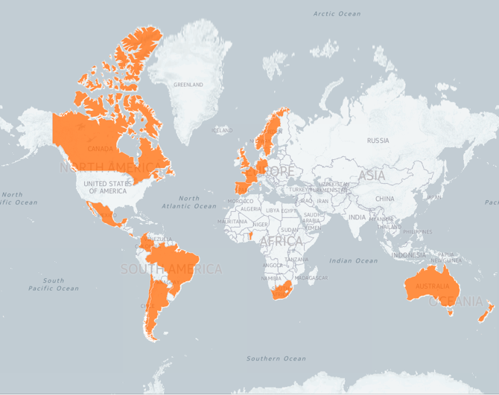
Countries involved
Community
Katia Cezon : https://katia.carto.com/viz/92d56bd0-a0e1-11e6-a7e6-0e3ebc282e83/public_map

Slide 3
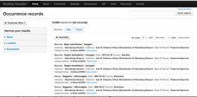
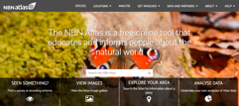
Data portals in production
Instituto Chico Mendes de Conservaçao de Biodiversidad
(Brazil)
Atlas de la Biodiversidad de Costa Rica - CRBio
Sistemas Nationales Datos Biológicos (Argentina)
GBIF Portugal
Community
NBN Atlas Scotland
Atlas of Living Australia
GBIF Spain
NBN Atlas
BioAtlas Sweden
GBIF France

Slide 4
Why a national portal?
Gives users more possibilities in terms of map visualization
Adds more specific fields in the search engine
Increases data quality using national tools (flags, national checklist, etc.)
Gives a visibility to data publishers in the national language
Community

Slide 5
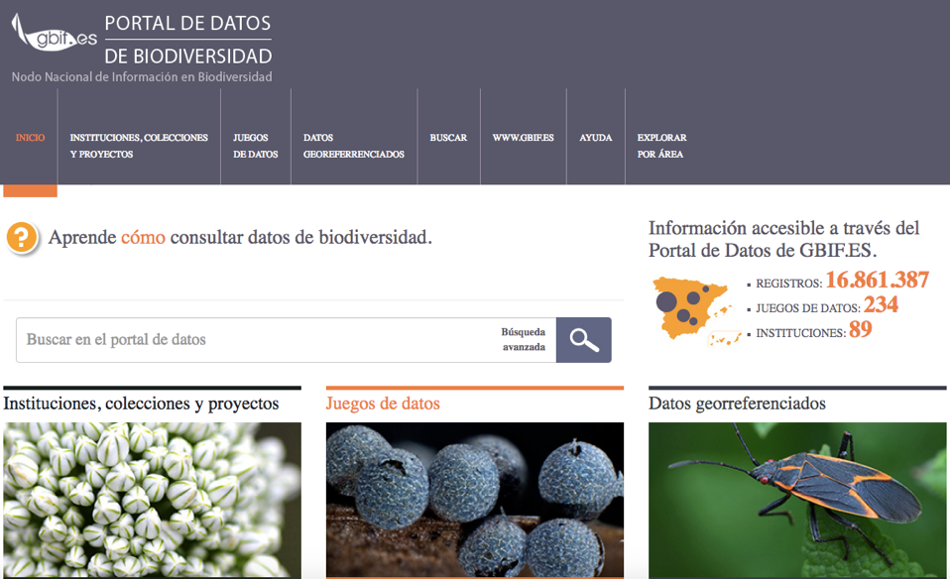
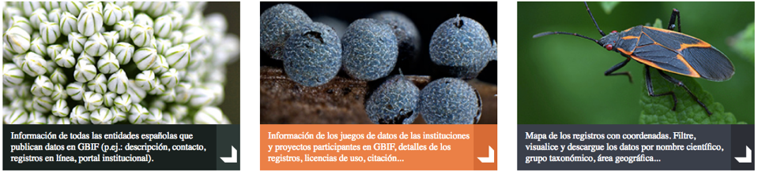
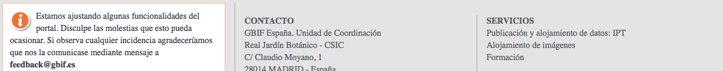
Notes:
Santiago Martinez de la Riva, first implementation in 2015

Slide 6

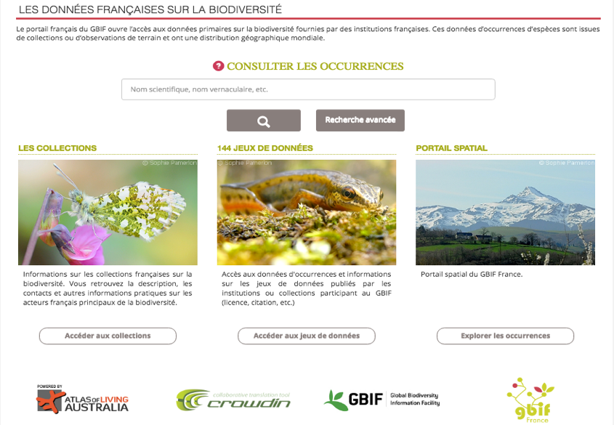
Notes:
TDWG 2013 : Discussion with Tim Robertson (GBIF) about the Atlas of Living Australia (ALA) platform
July 2014 : Workshop ALA in Canberra
28 May 2015 : ALF in production
10 June 2016 : Spatial portal in production

Slide 7
Why use Atlas of Living Australia modules?
Tools working in others countries (Autralia, Brazil, Portugal, Scotland, Spain)
Worldwide community around the project
Lasting solution from a technical point of view
Significant staff turnover especially in the IT team
Community
Notes:
Dev begun 5 years ago

Slide 8
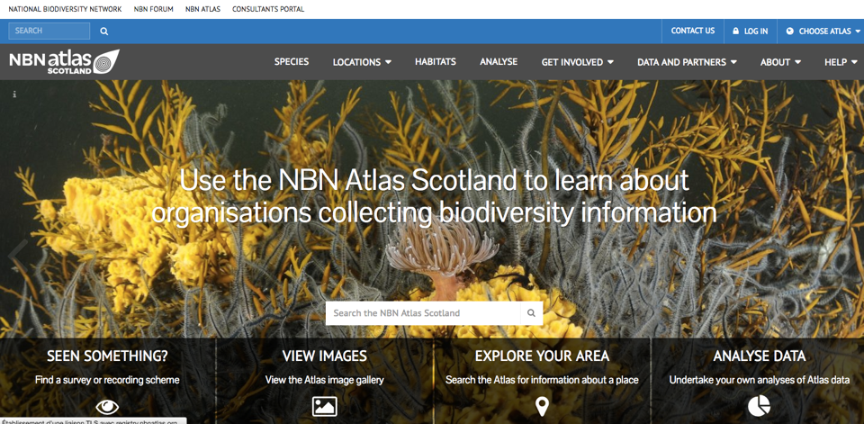
Example of the NBN Atlas
They begun by the NBN Atlas of Scotland…
Community

Slide 9
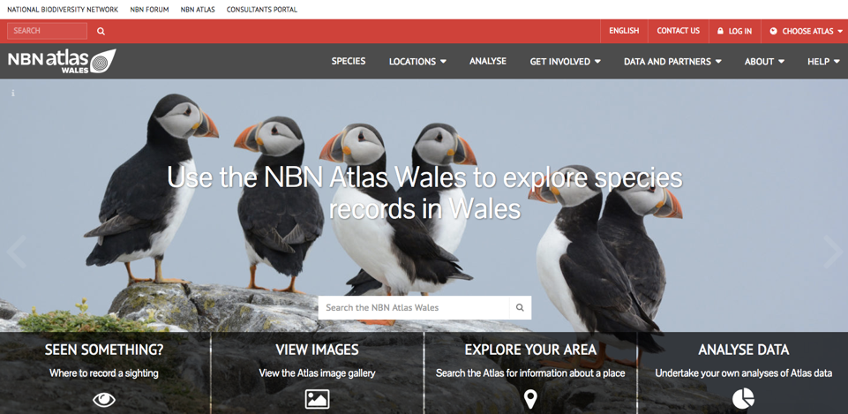
Example of the NBN Atlas
Then the NBN Atlas Wales….
Community

Slide 10
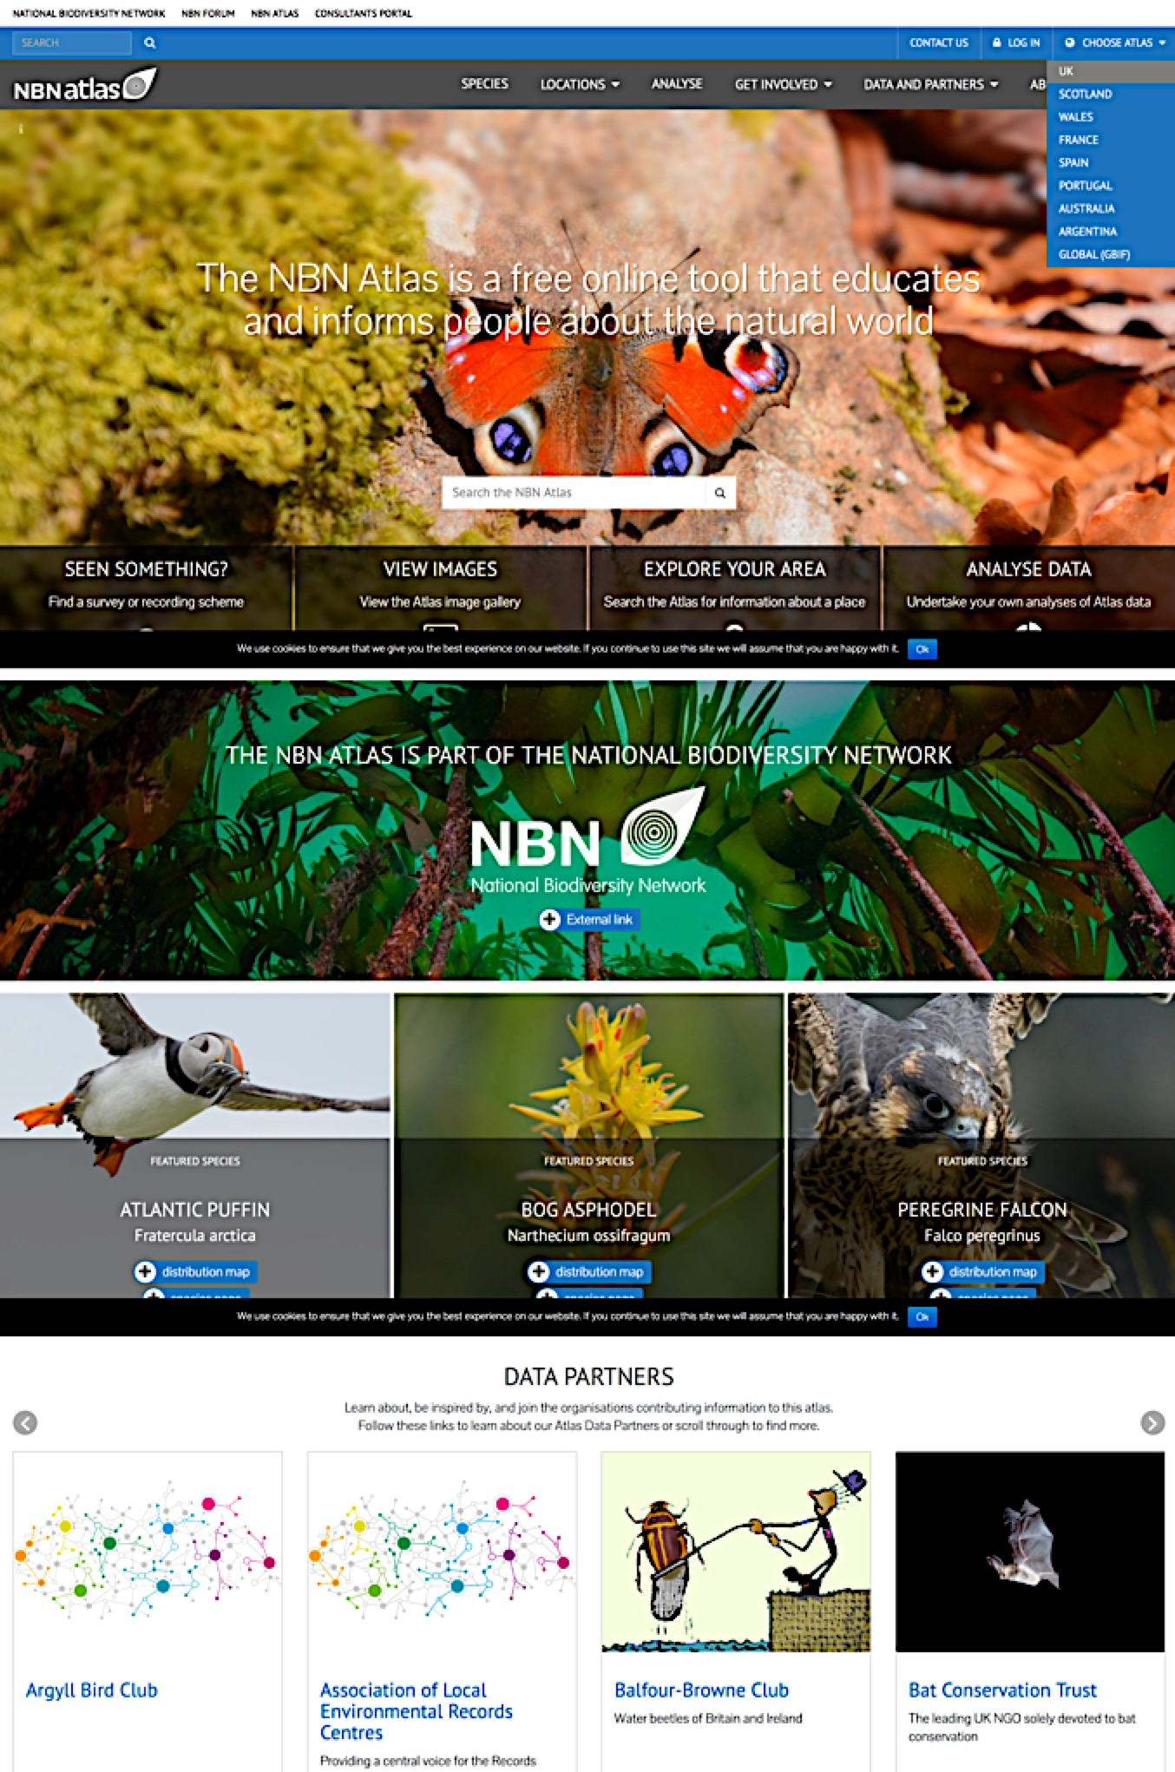
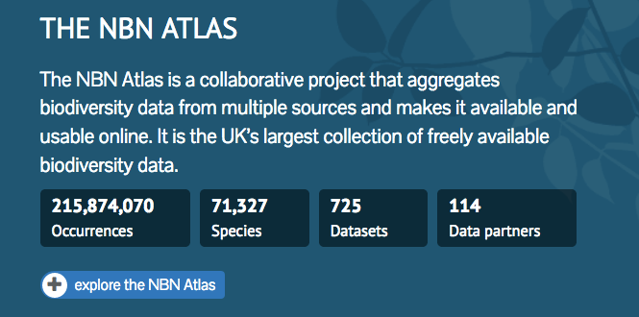
Example of the NBN Atlas
  And then the global NBN Atlas UK launched 1st April 2017
  More atlases to come for England, Northern Ireland, Isle of Man….
Community

Slide 11
Communication
Mailing List
ala.portal@lists.gbif.org
Registration: lists.gbif.org/mailman/listinfo/ala-info
HipChat Room (for developers)
Public access: https://www.hipchat.com/gx1ej3K6Q
Documentation
Official web page on the GBIF.org (demo)https://demo.gbif.org/programme/82953/living-atlases.
- ALA Key Technical Document http://www.gbif.org/project/2015-ala-internationalization
ALA GitHub folder https://github.com/atlasoflivingaustralia/documentation
Community

Slide 12
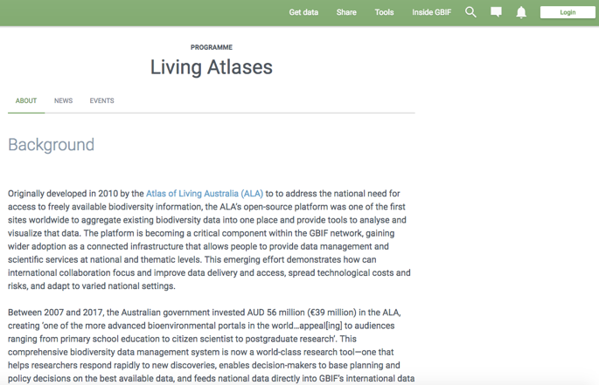
Creation of a webpage for the community : https://demo.gbif.org/programme/82953/living-atlases.
Community

Slide 13
2017 / 2018
CESP Project :
CESP Regional event between 13 nodes to organize the 1-week workshop in 2018 in Madrid (advanced level).
CESP Mentoring between Canadensys and GBIF France to help open the community to French-speaking countries.
CESP Mentoring between GBIF Benin and GBIF France to install the Beninese data portal based on ALA
TDWG 2017 :
A half-day Beginner workshop around Atlas of Living Australia tools
Collaboration
GBIF Argentina has begin to help to install ALA in Colombia.
GBIF Spain has begin to work on the installation of the ALA portal in GBIF Andorra.
Current projects
Notes:
.

Slide 14
Future…
More technical workshops (at least one per year) focused on different modules of the platform (Species list, Spatial, etc.) and for different levels (beginner and advanced)
More GBIF participants will launch their portals in production: Andorra, Canadensys, Germany, Luxembourg, Mexico, Sweden, etc.
Improvement of the communication between participants (project calls, helpdesk, bug report, etc.)
Future plan

Slide 15

discussion…
A main entrance for Pacific area?
Fiji
Samoa
PNG
Tonga
Vanuatu
Etc…
Regional ideas?
Back end
Atlas of Pacific region
Or other large institution in the region?

Slide 16
Thank you !
Questions ?
Conclusion

Slide 17
Projects and workshops
CESP Project (2012 – 2013)
Costa Rica and Atlas of Living Australia collaborated to install ALA tools for the Costa Rican node. Hosted the first workshop around ALA tools.
CoopBioPlat (2015 – 2016)
Pilot Coordination Action (PCA) project funded by ERANET-LAC between South American and European countries in order to create a cooperation between institutions around national biodiversity data portals based on Atlas of Living Australia (ALA) modules.
Encounter Bay (2015 – 2016)
CESP project between Belgium, France, Portugal and Spain in order to write the ALA Key Technical Document.
5 technical workshops around the world in 4 years (Costa Rica, Australia, France and Spain *2).
In the Past …
Notes:
Mentoring between ALA and Costa Rica
Goal for Encounter Bay : Reach an institutional agreement to cooperate on biodiversity data portals (national, based on ALA); and demonstrate technical cooperation and progress in developing national data portals.
Goal for CoopBioPlat: Reach an institutional agreement to cooperate on biodiversity data portals (national, based on ALA); and demonstrate technical cooperation and progress in developing national data portals.

Slide 18
Presentations (1)
GB22, Public Symposium (October 2015) :
“Atlas of Living Australia for nodes: A collaborative endeavor” (Paco Pando, 2015): presentation of the beginning of the community and the power of this kind of collaboration
TDWG 2015 & 2016 :
2 presentations and 1 poster talking about the GBIF France data portal as an example based on Atlas of Living Australia tools
“The community around Atlas of Living Australia’s platform” (ME Lecoq, M Carboni, F Cavière, R Figueira, S Martinez de la Riva and D Martin): poster describing the Living Atlases community.
In the Past …

Slide 19
Presentations (2)
GEOBON (July 2016)
“Atlas of Living France : GBIF France’s portal access to primary data about biodiversity provided by French institutions” (ME Lecoq): presentation about the community and show of an example of portal based on ALA modules.
For more information
https://github.com/AtlasOfLivingAustralia/documentation/wiki/Presentation-ala-project
In the Past …

Slide 20
Atlas of Living Australia

Slide 21











ALA – sharing biodiversity knowledge
>$50 million investment
A world-leading
collaborative e-infrastructure integral to growing
biodiversity knowledge
$8.2M NCRIS (2007-2011)
$30M SS EIF (2010-2012)
$2.8 M CRIS (2013-2015)
$5.7M NCRIS2013 (2013-2015)
$4.6M NCRIS 2015
>67 million records
>587 data sets
>477 spatial layers
>9 billion records downloaded
>3.5 thousand users/day
Partners – founding & beyond
founding partners and contributors primarily biological collections and museums
increased contribution & use by citizen science, government, industry
Data
specimens
occurrence
images, sounds
literature
sequences
more coming……
National Research infrastructure
NCRIS established in 2006
Currently within Education Dept
Related environmental infrastructures TERN (terrestrial ecological info/data capture) & IMOS (marine)
System
data capture & aggregation
data management
data discovery
data visualisation
data analysis & reporting
Open source & open access
ALA driving cultural shift regarding open access to data
ALA at forefront of accessibility to public sector information
Notes:
ALA is funded by the Australian government as part of its Research Infrastructure funding
Funding – NCRIS has funding for the next 10 years.
Used by government, industry and citizen science groups
ALA is interesting in bring together all types of biodiversity information to help support Australian research
Everything we do is open source

Slide 22
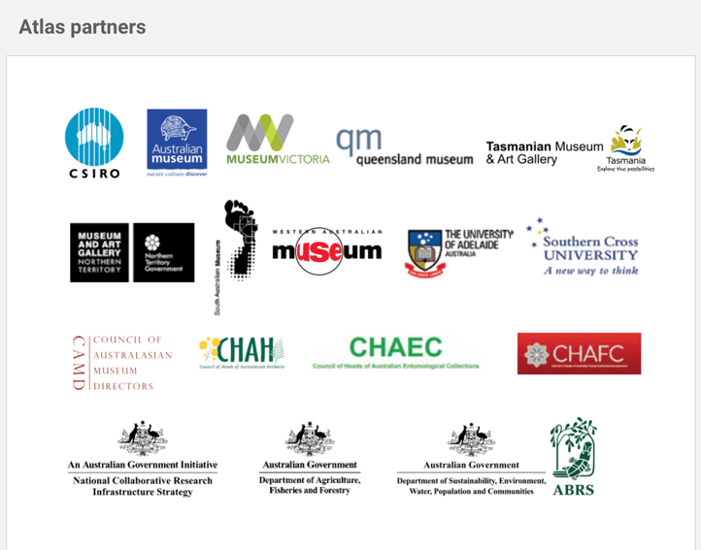
ALA Partners
Atlas of Living Australia
Notes:
ALA Partners – ALA exists because of collaborative funding proposals from the zoological collections and herbaria community.
These remain ALA’s key partners.

Slide 23
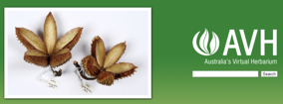
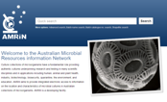
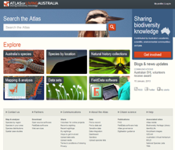
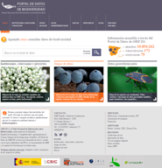
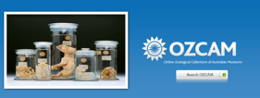
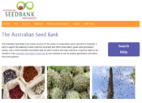
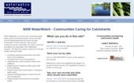


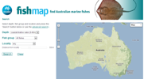
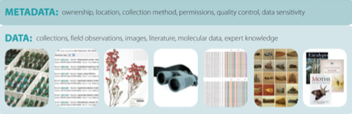

What is ALA? - an open infrastructure
Spain’s “ALA”
click on images to go through to site
One infrastructure - many systems
Web Services
Notes:
Open infrastructure – NCRIS
Open data – free and open access to biodiversity data
Open source – everything we do is either open source, or built on open source solutions. Everything we do is in an open repository in GitHub.
Our issue tracking is all open.
Open APIs – support an open API
Key message – a single infrastructure supporting multiple applications, thematic portals, portals for specific regions and portals tailored to specific communities (e.g. Herbaria, Seedbanks).

Slide 24
Living atlases community
Notes:
Mentoring between ALA and Costa Rica
Goal for Encounter Bay : Reach an institutional agreement to cooperate on biodiversity data portals (national, based on ALA); and demonstrate technical cooperation and progress in developing national data portals.

