Slide 1
towards a (post-2018) alliance for biodiversity knowledge
Kyle Copas GBIF Secretariat
BRIDGING AICHI TARGETS 5, 11 AND 15 WITH THE DIGITAL OBSERVATORY FOR PROTECTED AREAS DOPA AND THE WORLD ATLAS OF DESERTIFICATION (WAD)
COP14, SHARM EL SHEIKH—19 NOV 2018

Slide 2
BY THE NUMBERS 19 November 2018
Species occurrence records
Datasets
1,035,890,658
41,655
Country Participants
Organizational Participants
Publishers
59
38
1,308
Average records downloaded per day (2018)
Avg monthly user sessions (2018)
4.0 billion
155,009
Notes:
Useful to see GBIF in its different modalities:
A window on biodiversity
An informatics infrastructure focuseD on tools and standards in service to science and society
A global network on bioinformatics

Slide 3
Stable, mature data infrastructure…
GBIF.org surpassed 1 billion records in July
Institutions from 124 countries sharing open biodiversity data
Global aggregation point for other regional and thematic networks
Avg of nearly two peer-reviewed uses each day (and four total citations)
DataCite’s third-largest issuer of DOIs
Peer-reviewed publications using GBIF-mediated data through 31 October 2018
https://www.gbif.org/resource/search?contentType=literature&relevance=GBIF_USED&peerReview=true

Slide 4
…recognizing obstacles to growth
User outreach activities highlight confusion about the standards
Different communities have different needs
What our standards support limit the system’s scalability
Growing calls for access to managed infrastructure
Built over time, system architecture has most of the required pieces, but they are fragmented

Slide 5
CURRENT: Parallel Indexing
Sample Events
Process
Interpret
Index
Package
Incomplete coverage
≠
≠
≠
≠
Different GUIDs
Ocean Variables
Process
Interpret
Index
Package
Inconsistent flags
?
≠
≠
≠
≠
?
User
Measure-ments
Process
Interpret
Index
Package
?
≠
≠
≠
≠
?
National Variables
?
Process
Interpret
Index
Package
Different properties
≠
≠
≠
≠
Incompatible APIs
National Variables
Process
Interpret
Index
Package
Different formats

Slide 6
PROPOSAL: COLLABORATIVE INDEXING
Complete coverage
Standardised processing
Version History
Standardised formats
Sample Events
National Variables
Shared
GUIDs
Consistent attribution chain
Ocean Variables
User
Measure-ments
GUID Tools
Download Service
Process
Interpret
Index
Package
Paleo Variables
Annotation Services
Citation Tracking
Fish Specimen
Annotations as public linked open data
Herbarium Sheet
Typified Names
Sensitive Data Rules
Consistent
API
Extensible
properties
SQL, SPARQL, …

Slide 7
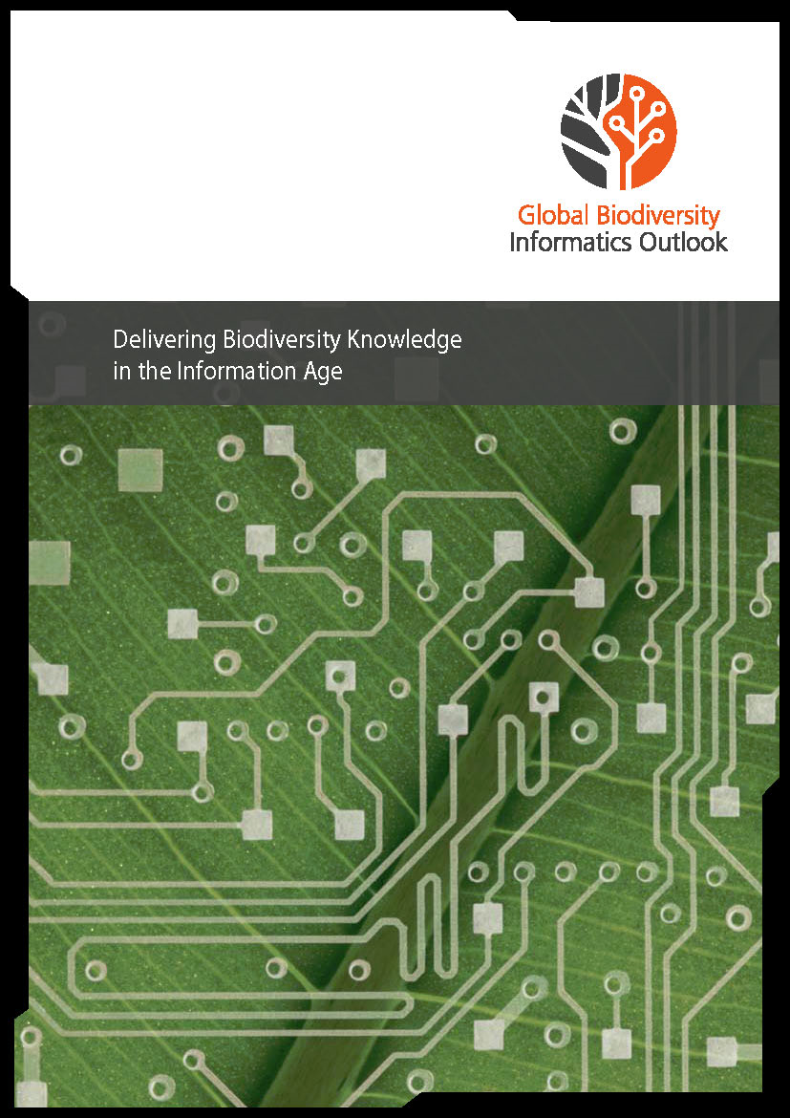
Global Biodiversity Informatics Outlook
2012 meeting in Copenhagen: GBIC: the Global Biodiversity Informatics Conference
Resulting report: Global Biodiversity Informatics Outlook: Delivering biodiversity knowledge in the Information Age (www.gbif.org/document/80859)
http://biodiversityinformatics.org/

Slide 8
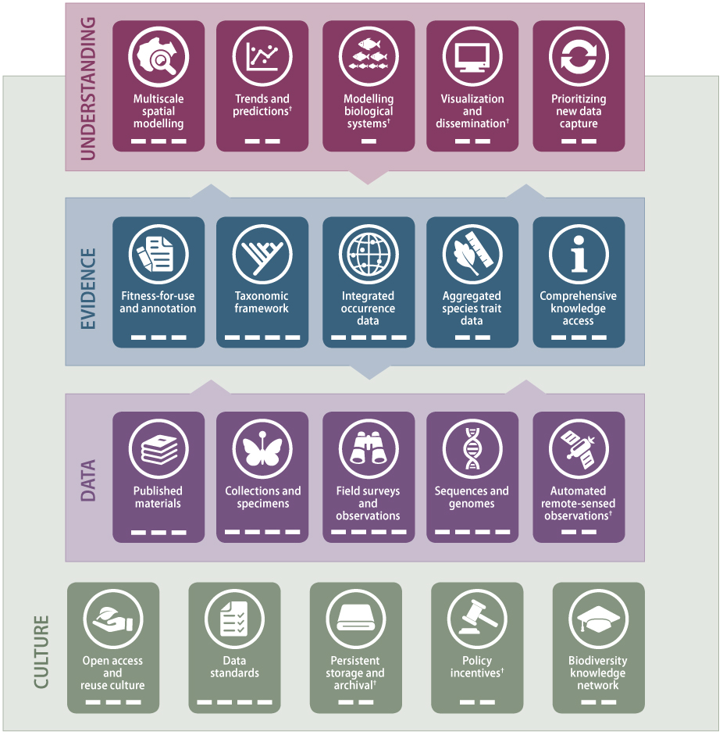
GBIO Framework
Report outlined an interconnected view of priority areas where the biodiversity informatics community needed to make progress
Framework cited steadily in research and policy
March 2017 meeting at Senckenberg reemphasized the ‘need to establish a shared mechanism for planning and delivering a linked and open global biodiversity data infrastructure’
http://biodiversityinformatics.org/
Notes:
Attendees representing global data infrastructures, national data centres and major research institutions agreed on the
Most recently, Basque Government using it to establish guidelines and criteria for selecting and monitoring projects receiving or requesting public funds

Slide 9
GBIC2: 2nd Global Biodiversity Informatics Conference
100+ experts returned to Copenhagen to discuss ‘Delivering a Roadmap for Biodiversity Knowledge in the Information Age’, July 2018
Attendees sought to explore a broad-based vision and model to increase collaboration between stakeholders from all regions and all scales
Workshop perspectives seek a more holistic, interoperable and globalized approach to biodiversity informatics
http://biodiversityinformatics.org/
Notes:
Attendees representing global data infrastructures, national data centres and major research institutions agreed on the
Most recently, Basque Government using it to establish guidelines and criteria for selecting and monitoring projects receiving or requesting public funds

Slide 10
toward a post-2018 alliance for biodiversity knowledge
Proposal from GBIC2
To establish a lightweight global alliance to transform our understanding of biodiversity by connecting all efforts to observe, measure and model the living planet.
Stakeholders in collaborative planning and implementation
Global-scale data infrastructures
National or regional projects and infrastructures
Major institutions that host significant data and services
Organizations that depend on these infrastructures
E.g. CBD, FAO, CMS, IPBES, GEO BON, IUCN, WWF, CETAF, ICZN …
Communities and individuals with an interest in biodiversity
http://biodiversityinformatics.org/

Slide 11
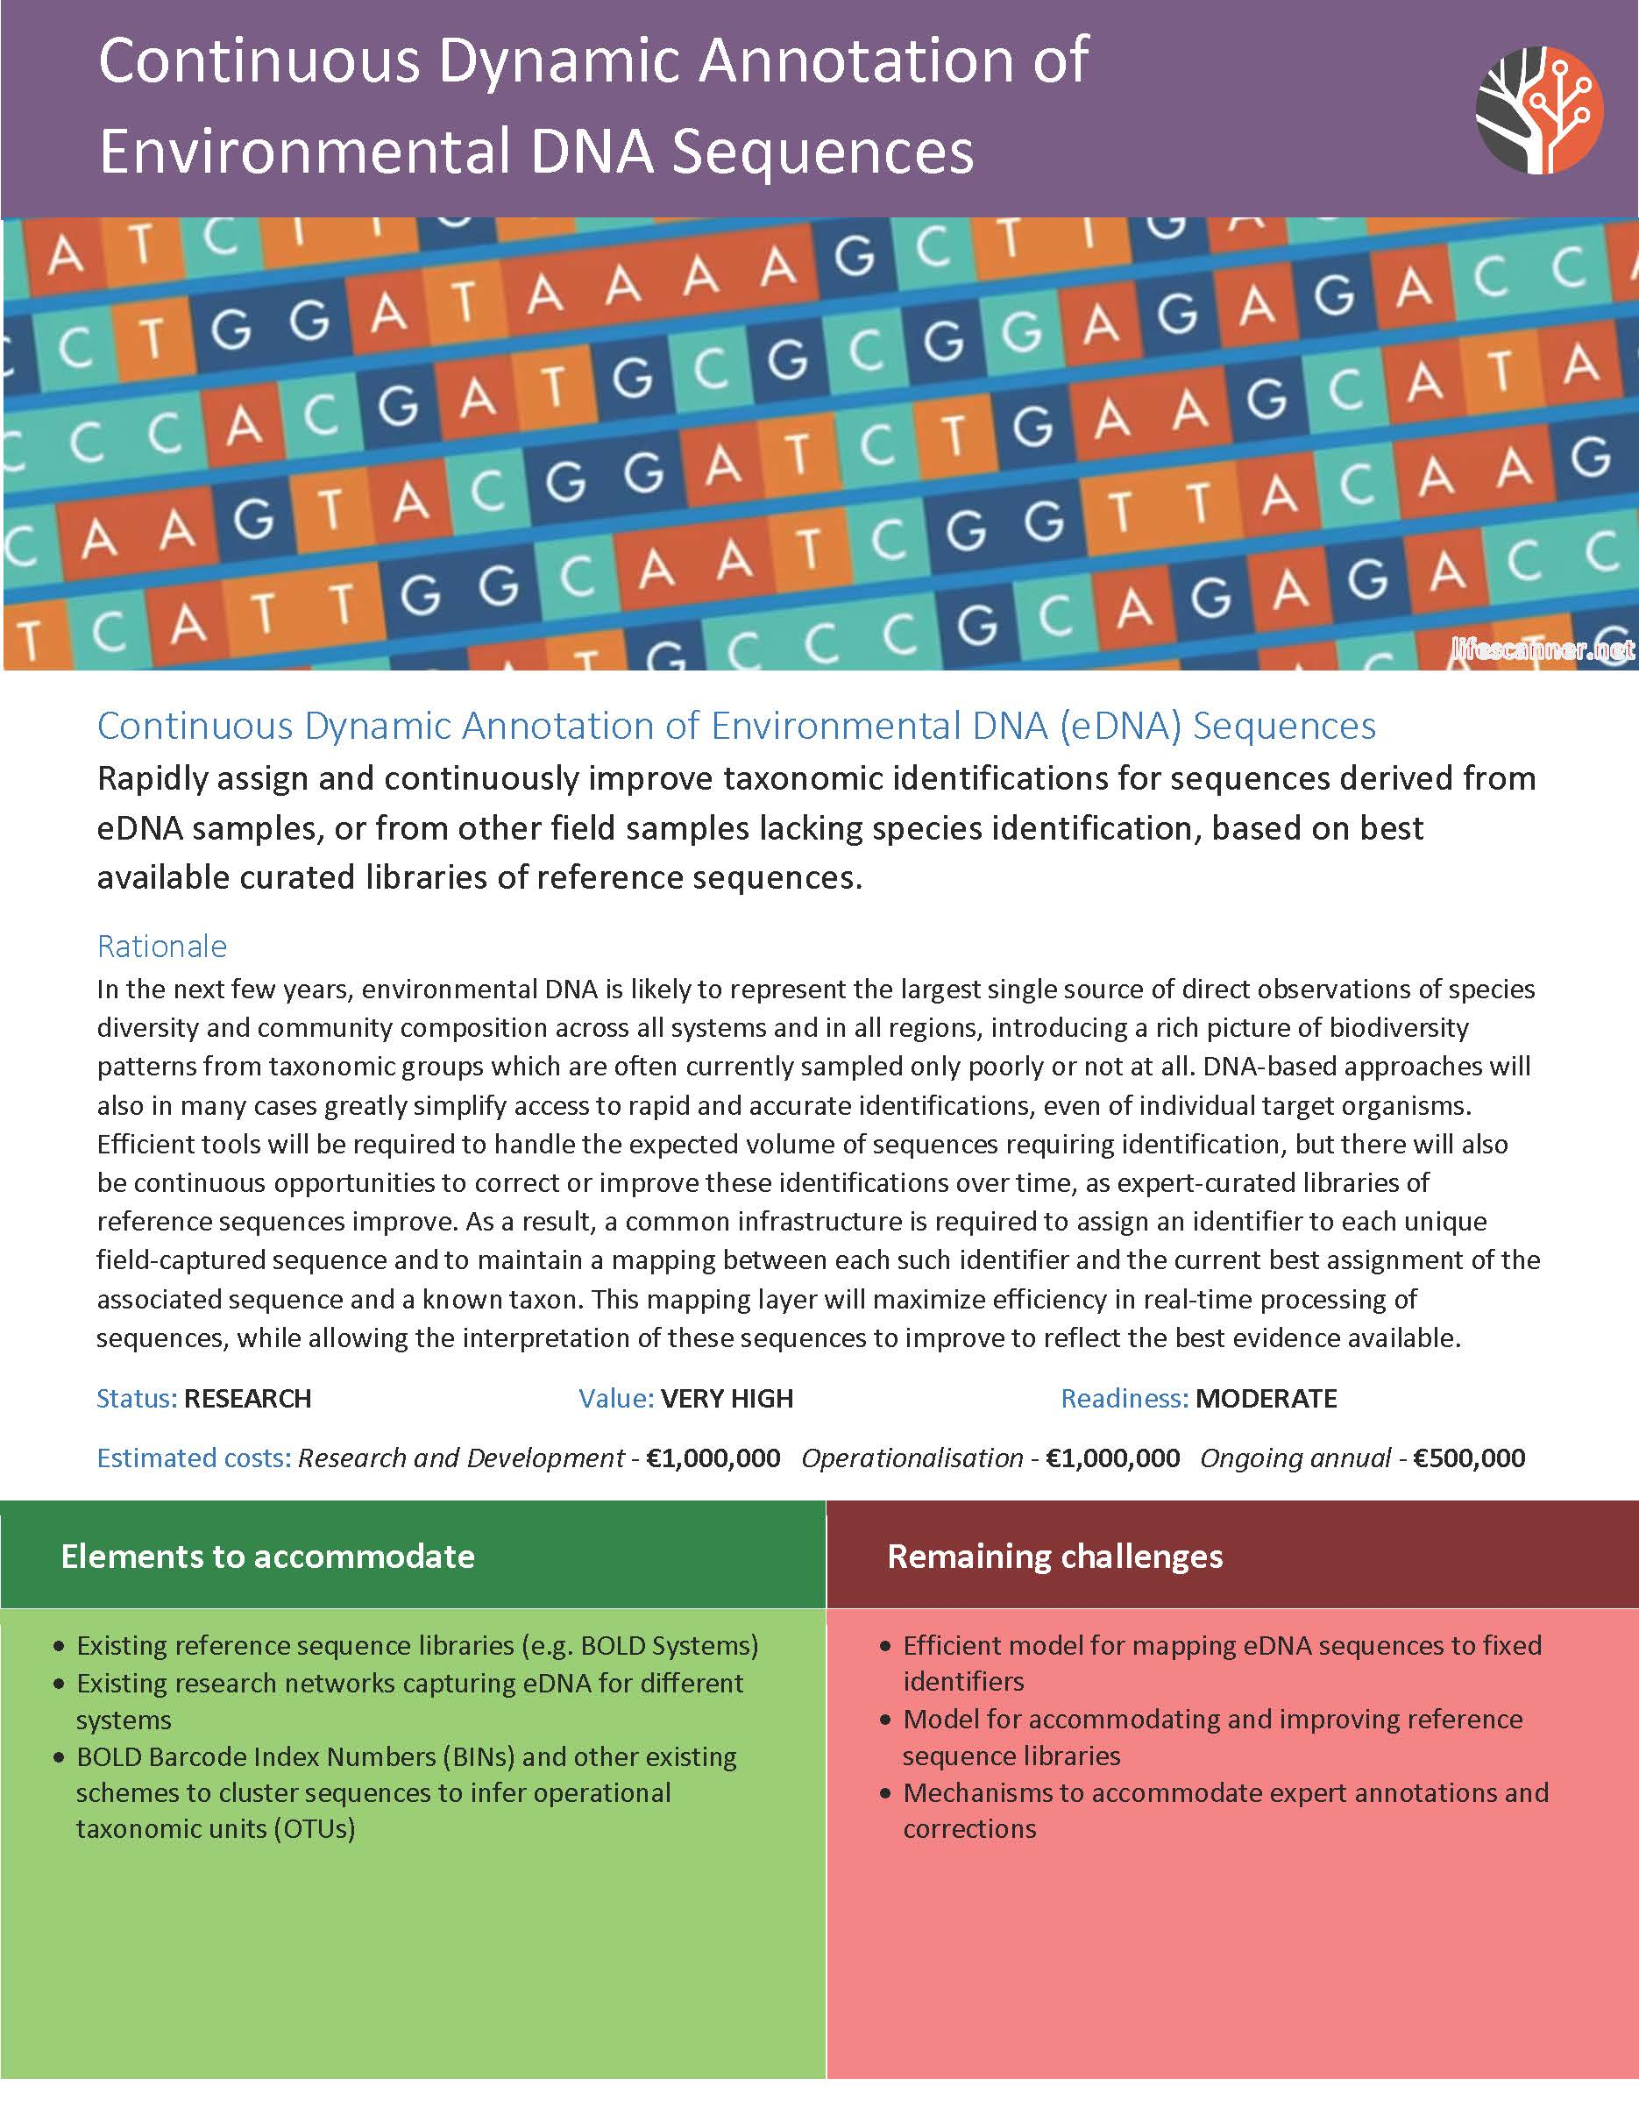
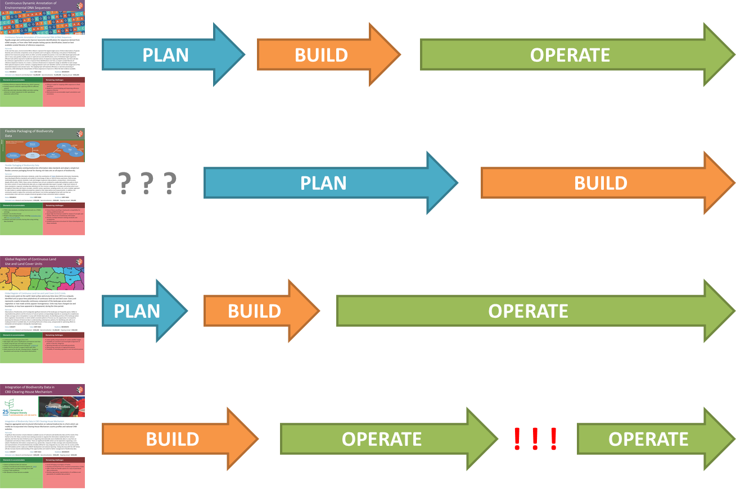
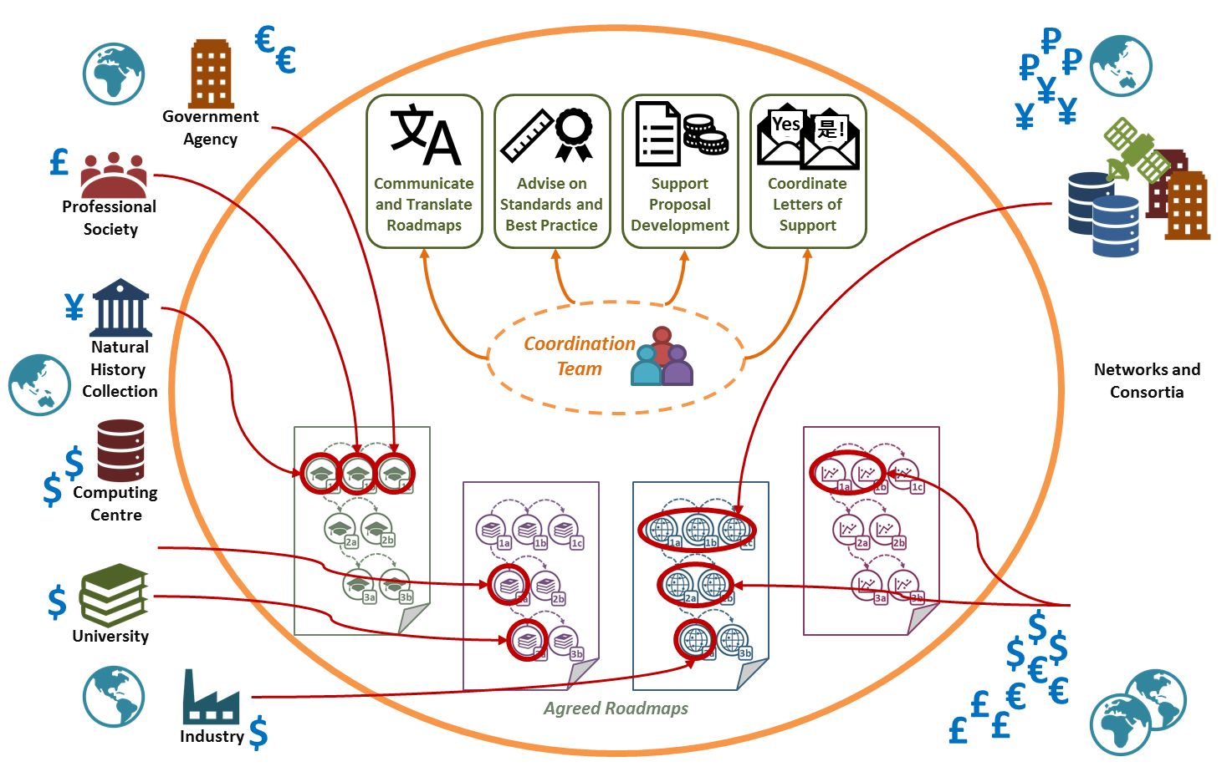
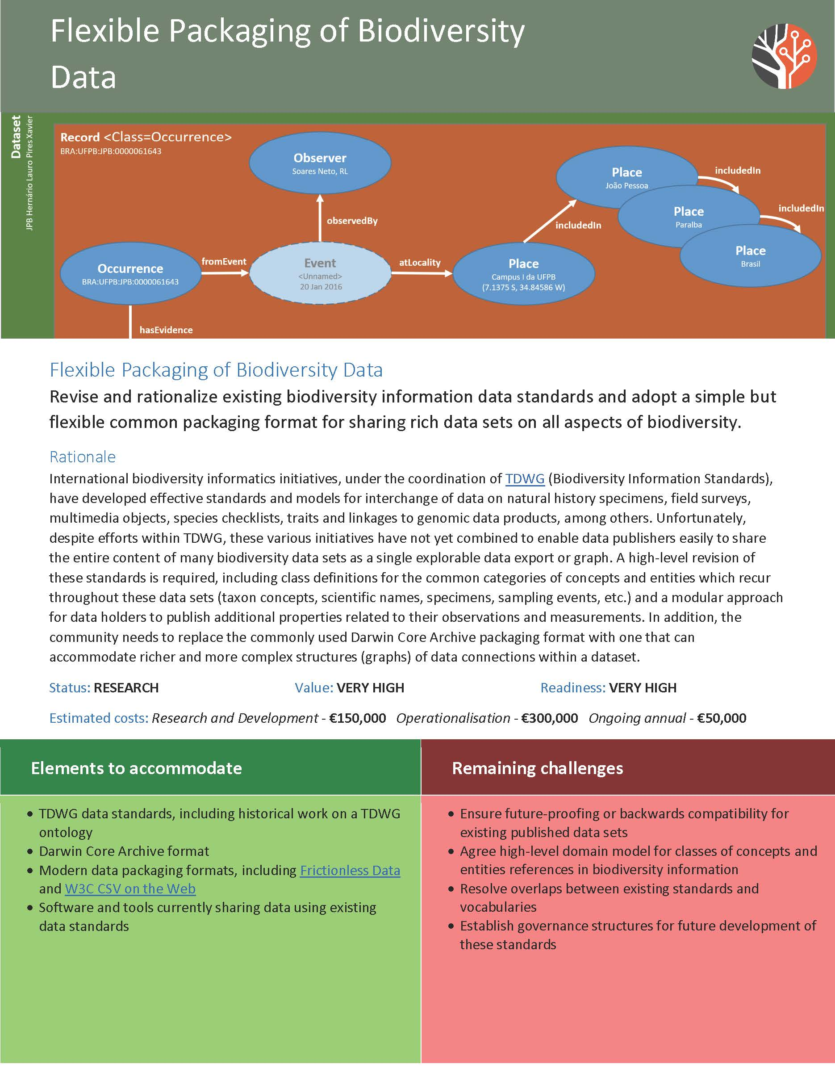
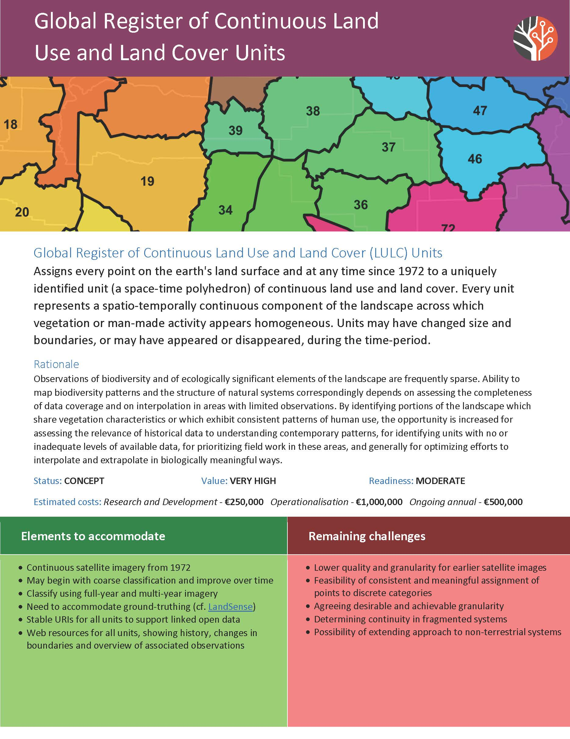
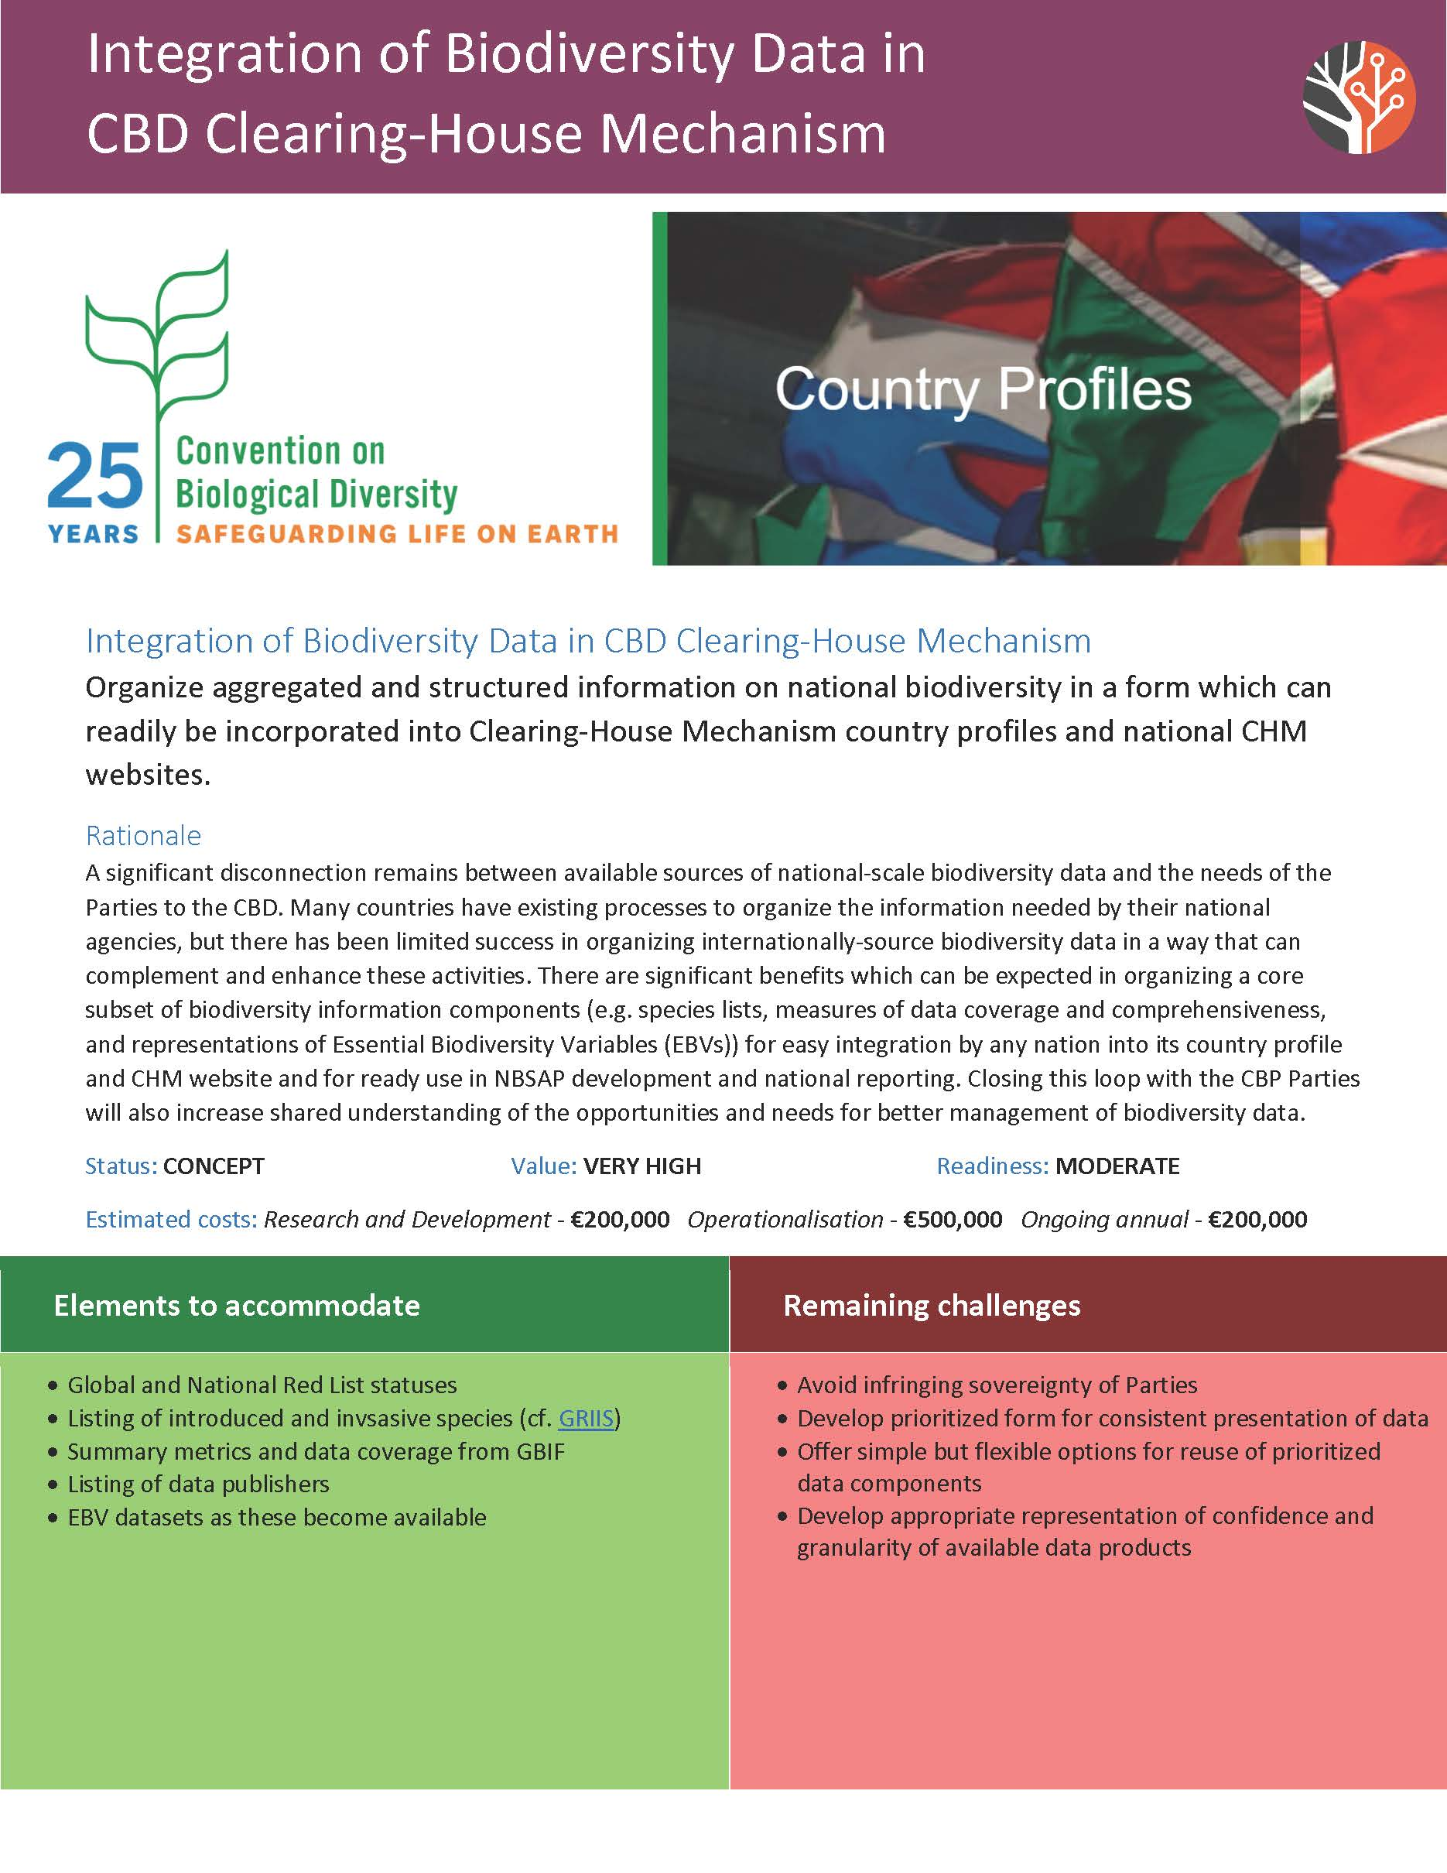
How MUCH COORDINATION IS POSSIBLE?
EASIER
HARDER
Shared vision
Shared language
Shared vision
Shared language
Shared priorities
Shared vision
Shared language
Shared priorities
Shared reporting
Shared vision
Shared language
Shared priorities
Shared reporting
Shared funding
Shared delivery
Shared sustainability

Slide 12
Precedents to explore
Apache Software Foundation (ASF)
The Apache Way: “Community, Merit, and Openness, backed up by Pragmatism and Charity” (http://theapacheway.com/about/)
ELIXIR
Unites European life science organizations to manage and safeguard the increasing volume of data being generated by publicly funded research (https://www.elixir-europe.org)
Global Alliance for Genomics and Health (GA4GH)
Policy-framing and technical standards-setting organization, seeking to enable responsible genomic data sharing within a human rights framework (https://www.ga4gh.org)
http://biodiversityinformatics.org/

Slide 13
Next stepS (1/2)
GBIF Secretariat leading first-phase coordination
Funding under SYNTHESIS+ project (integration of EU natural history collections)
Forthcoming paper to summarize recommendations
Plan to present in multiple languages
Publicity at international conferences and events
Web-based consultation
Developing concept of an alliance
What can we learn from other alliance models?
Who should be eligible to join such an alliance?
Consult with stakeholder groups to develop set of defining questions
http://biodiversityinformatics.org/

Slide 14
Next stepS (2/2)
Map stakeholder landscape
Relationships between major initiatives
Important tool for wider communication
Need assistance from social scientists, etc.
Identify candidate project areas
Important to multiple stakeholders
Likely to bring major benefits in increased interoperability
Sufficiently understood for progress to be feasible
Seek individuals & organizations signatories
https://www.biodiversityinformatics.org
http://biodiversityinformatics.org/

