Slide 1
Mayfield Stakeholder Map
Vital to Engage
Need to Engage
Good to engage
Courtesy to inform
Governance Segment
Provider Segment
Customer Segment
Influencer Segment

Slide 2
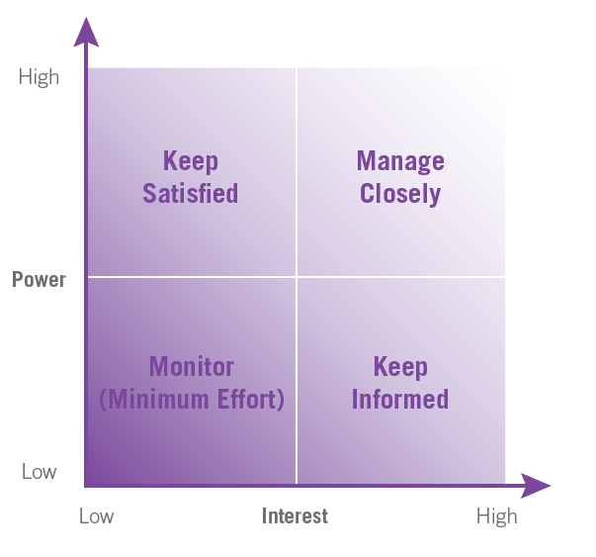
Mayfield Stakeholder Communication Map
Determine level of Power and Interest.
Place post-it with name in relevant quadrants.

