Slide 1

Introduction to Borderline Personality Disorder (BPD)
Module One
Apr 24

Slide 2
2
Welcome & house rules for this safe space
Use your personal judgement regarding the appropriateness of the skills in your situation
Confidentiality
  Anything said in the group stays in the group
  Do not mention BPD if you meet other group members by chance in a public place
Respect for others' opinions and ideas. Be polite. Do not use strong language
Mobile phones – Keep phones on silent. Step outside if you need to respond to a message or a call
Use the hand icon if you want to speak online.
We welcome your feedback!
Module One: Introduction to BPD

Slide 3
3
Who are we?
Christella and Philippa developed FACTS (Families & Carers Training & Support Programme for carers of people who have BPD), working with Professor Anthony Bateman from the Anna Freud Centre
Christella and Philippa also run the 'Harrow' Rethink BPD Carers Support Group, open to all, regardless of where people live
Our co-presenters: we welcome graduates of earlier FACTS courses who join us to share their experiences as carers and of using the skills learnt through the FACTS programme
Introduce participants
Module One: Introduction to BPD

Slide 4
4
Focus of the Course
To teach families skills to:
  aid communication with their loved one
  reduce conflict
Note: FACTS is a training course, not a support group
Support groups, open to all, regardless of where people live:
  'Harrow' Rethink BPD Carers Support Group
  'Harrow' Friends BPD Carers WhatsApp group
    To join these support groups, please email: bpdbooking@yahoo.co.uk
Module One: Introduction to BPD

Slide 5
5
Content
Module 1: Introduction to BPD
Module 2: Mindfulness and Emotion Management
Module 3: Mentalizing
Module 4: Validation
Module 5: Problem Solving between us and the person with BPD
Module One: Introduction to BPD

Slide 6

The principal difficulties in BPD
6
Emotional problems
Interpersonal problems
Interpersonal sensitivity
Impulsivity
Risk
Module One: Introduction to BPD

Slide 7

What is BPD?
7
1938
Adolph Stern gave the name 'borderline'
BPD was thought to be on a border between Psychosis and Neurosis
Now
We know they are not on a border!
Module One: Introduction to BPD

Slide 8
Why do we use BPD/EUPD in FACTS?
8
BPD: Borderline Personality Disorder - generally used in adults
EUPD: Often used in CAMHS (Child and Adolescent service)
  - Emotionally Unstable Personality Disorder
  - Emerging Emotionally Unstable Personality Disorder
Other terms you may hear:
- CEN - Complex Emotional Needs
- Emotional Dysregulation with Impulsivity
- BPD traits
As a shorthand in FACTS, we use the terms BPD/EUPD
Google 'Rethink BPD/EUPD' to read more
Module One: Introduction to BPD

Slide 9
BPD in the DSM (Diagnostic and Statistical Manual of Mental Disorders)
9
Criteria
Emotional instability
Feelings of emptiness
Inappropriate intense anger
Stress-related paranoid ideation or severe dissociative symptoms
Avoiding real or imagined abandonment
Unstable and intense interpersonal relationships
Identity disturbance
Impulsivity
Suicidal or self-harming behaviour
Module One: Introduction to BPD

Slide 10
Activity: Tick for BPD
10
Imagine asking your loved one these questions. What do you think your family member would answer ‘yes’ to?
Are you scared of rejection and abandonment, and being left all alone?
Are your relationships with your friends and us unstable?
Do you have trouble knowing who you are and what is important to you?
Do you impulsively do things which might damage yourself in some way?
Do you self-harm (cause intentional harm to your body, including taking overdoses) or behave in a suicidal manner?
Do you have mood swings that can change quickly?
Do you feel empty and feel you need others to fill you up and make you whole?
Do you get excessively angry in a manner that is to your own detriment?
Do you ‘numb out’ (dissociate) or sometimes feel overly suspicious or paranoid when stressed?
Do you see things as either all ‘good’ or all ‘bad’; 100% right or 100% wrong or in absolute terms – for example, do you tend to say things like; ‘Everybody is…’ or ‘All men are...’?
Module One: Introduction to BPD

Slide 11
How common is BPD?
11
US Prevalence
1.8 - 5.9%
BPD is as common as schizophrenia, but the public is less aware of it
UK Prevalence
0.7 - 1%
Module One: Introduction to BPD

Slide 12
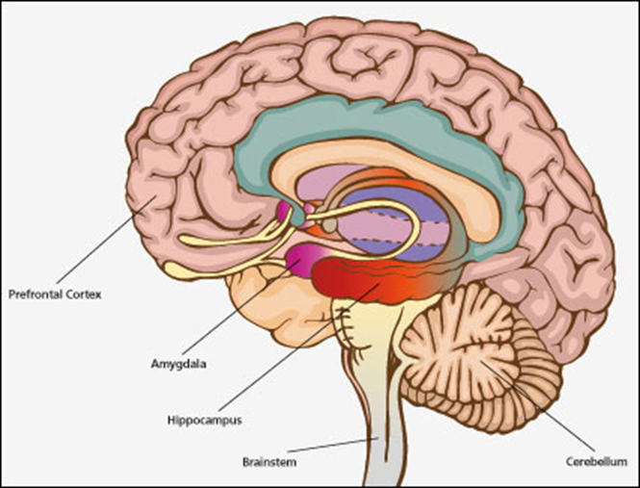
Why do people develop BPD?
12
Possible contributing factors
Biology:
Sensitivity to brain chemicals
Overactive amygdala (emotional brain)
Underactive prefrontal cortex (planning and reasoning brain)
Module One: Introduction to BPD

Slide 13

Why do people develop BPD?
13
Possible contributing factors continued
Genetics and environment:
Temperament has a genetic contribution
Stressful or traumatic life events
People with BPD tend to be emotionally sensitive
Tendency to have very intense, long-lasting emotional responses
‘Poorness of fit’: difficult to parent child with different temperament
Insecure/difficult relationships in early childhood
Module One: Introduction to BPD

Slide 14
How this ties together
14
Biology
Temperament
Environment
Module One: Introduction to BPD

Slide 15
Activity: Possible contributory factors
15
Personality
Social
Drugs
Shy
Early life experiences
Finances
Insecure relationships
Bullying
Biology
Medical
Genetic risks
Life events
Death of someone close
Module One: Introduction to BPD

Slide 16
Therapies and medication for BPD
16
Therapies, although limited NHS availability:
Dialectical behaviour therapy (DBT)
Mentalization-based treatment (MBT)
Schema-focused treatment (SFT)
Compassion-focused therapy (CFT)
Structured Clinical Management
Medication:
No single medication for BPD
Medication is used to help associated problems
For more information: www.choiceandmedication.org
Module One: Introduction to BPD

Slide 17
Activity: What do you hope to gain from the course?
17
Participants' thoughts:
For example, better communication skills
To be reviewed at the end of the course!
Module One: Introduction to BPD

Slide 18
Takeaway thoughts:
18
Some things to think about before the next session. We can discuss what you noticed next time.
How do you interact with your loved one?
What happens? How do you respond?
Emotional problems: fluctuating and unpredictable moods, anxiety, irritability
Impulsivity: sudden decisions, lack of planning
Risk: self-harm, suicide attempts, reckless behaviour
Interpersonal sensitivity: sensitivity to what’s said, inappropriate responses, certainty of negative motives of others
Interpersonal problems: difficult relationships, fearful of rejection
Module One: Introduction to BPD

Slide 19
19
Resources
Rethink Mental Illness website:
Diagnosis https://www.rethink.org/diagnosis-treatment/conditions/personality-disorders/types-diagnosis
Mind website:
What is borderline personality disorder (BPD)? https://www.mind.org.uk/information-support/types-of-mental-health-problems/borderline-personality-disorder-bpd/about-bpd/
Dialectical Behaviour Therapy DBT: https://www.mind.org.uk/information-support/drugs-and-treatments/talking-therapy-and-counselling/dialectical-behaviour-therapy-dbt/
TARA4BPD
(Treatment and Research Advancements National Association for Personality Disorder, based in New York) http://www.tara4bpd.org/
Overcoming Borderline Personality Disorder, A Family Guide to Healing and Change, book by Valerie Porr, founder of TARA4BPD
NEABPD
Family Connections https://www.borderlinepersonalitydisorder.org/family-connections/
The Sashbear Foundation
https://sashbear.org/
Module One: Introduction to BPD

Slide 20
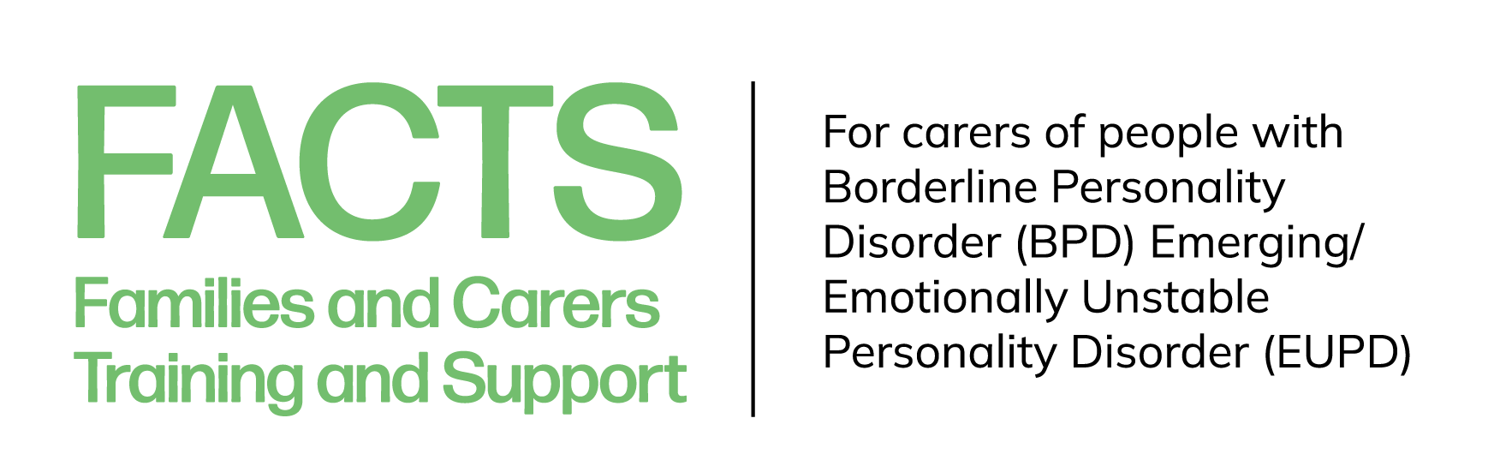
Thank you
End of Module One: Introduction to BPD

