Slide 1
Title Your Pitch!
Sample Pitch Deck
Notes:
This can be modified for any age group and since the pitches will be done virtually, it would be nice to have guide while speaking

Slide 2
How to do a pitch
A pitch is a short verbal and sometimes, visual presentation of an idea. In this case, you will be pitching the story of your villain character, inspired by The SpongeBob Movie: Sponge on the Run.
A strong pitch is done with a lot of confidence and a some photos to help you tell your story.

Slide 3
Components of a strong pitch
Strong Public Speaking Skills
Teaser
Setting (PLACE)
Characters
Plot (WHAT HAPPENED)
Area of Expertise (WHAT ARE YOU GOOD AT?)

Slide 4
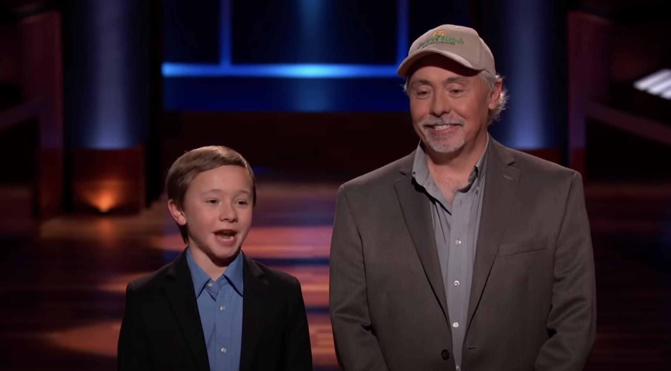
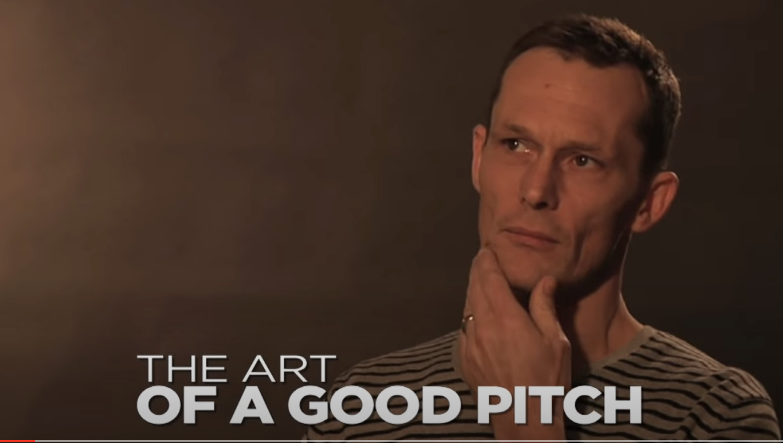
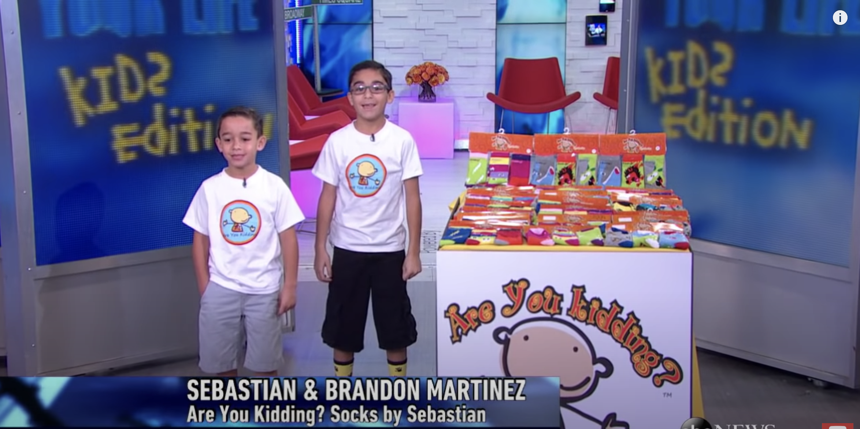
Sample Kid Pitches (click to watch)

Slide 5
Public Speaking

Slide 6
Speaking with confidence is very important during a pitch. You are selling your idea, so do it with heart!
Sit up straight
Make eye contact
Project your voice so
Speak slowly and clearly

Slide 7
The Teaser

Slide 8
Get your audience’s attention by sharing the tone and a few details from your story.
Be a great storyteller even if you are better at drawing. Something big and juicy is hard to ignore!
Here’s an example:
“It was a cold, wet night when a loud crash of thunder clapped against the window of Spongebob’s boat…”
Notes:
Examples can be modified depending on grade level

Slide 9
The Characters

Slide 10
What makes your character different?
Are they a hero or a villain? How do they look? What is the inspiration for your character? Who are their enemies? Who are their friends? Using specific details helps paint the perfect picture of who your character is.
Here’s an example:
“Octagon, an evil Octopus, joins the SpongeBob cast as a villain. He is dark red with purple, gooey tentacles. Octagon is followed by a dark cloud of smoke everywhere he goes. He doesn’t have a lot of friends or enemies - he is a loner because he is known to eat the other characters in Bikini Bottom.”

Slide 11
Character Sketch
Consider how you will use your character’s design to express her or his emotions, personality and story!
Body Shape (Silhouette)
Facial features
Clothing
Hair
Posture
Color scheme
Tips to keep in mind:
Exaggerate
Organic vs. Geometric shapes
Origin Story
Place Image Here
Notes:
Upload a picture in the box to the right. You can hand draw it or do it electronically with the scribble function.

Slide 12
The Setting

Slide 13
You’ve spent quite some time creating the perfect setting for your story to take place.
Is it hot or cold? Day or night? What are some details? What colors do we see? How does it feel for your characters to be there?
Here’s an example:
“Rattling coins. Big, loud laughter. Bright, blinding lights. SpongeBob arrives atthe Lost City of Atlantic City!”

Slide 14
Setting Sketch
Consider how the setting sets a mood
What time of day is it?
What season is it?
Is it hot or cold?
Wet or dry?
Add details
Keep your sketch simple
Place Image Here
Notes:
Upload a picture in the box to the right. You can hand draw it or do it electronically with the scribble function.

Slide 15
The Plot

Slide 16
Plot is a sequence of events in a story that force a character to make hard decisions. There is usually a drama (conflict) and then it is resolved.

Slide 17
5 Point Plot
Exposition - This establishes the setting.
Rising Action (Inciting Incident) - Here’s where you raise the stakes and start building to the conflict. Make it clear what the conflict is.
Climax - If you do it right, this is the worst (or best!) moment of tension that puts your readers on edge.
Falling Action - This is where you explore your character’s decisions and the consequences.
Resolution - This is the end where you introduce how all the previous steps changed your character. It’s THE END!
Notes:
Extracted from https://thewritepractice.com/plot/

Slide 18
5 Point Plot
Climax
Rising Action
(Inciting
incident)
Falling Action
Exposition
Resolution
Notes:
https://thewritepractice.com/plot/

Slide 19
Title: __________________________
Place Image Here
Place Image Here
Place Image Here
First,__________________________________________________________________________________________.
Next,__________________________________________________________________________________________.
Last,__________________________________________________________________________________________.

Slide 20
Your Expertise

Slide 21
Tell your audience what you are good at. Are you a master storyteller? Can you illustrate anything from memory? Share that! Do you hope to become an animator when you grow up? Now would be a perfect time to share that with someone in the animation industry.
Notes:
This a chance to show lots of visuals of the work you did!

Slide 22
Contact Information

Slide 23
>Put your information here<

