Slide 1
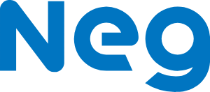
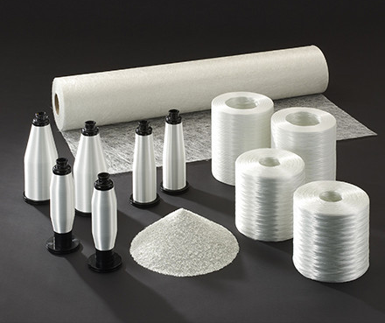
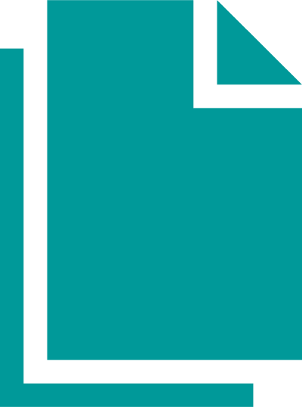
Nippon Electric Glass (NEG): Guaranteed Energy Savings for Electric Glass Fiber plant in the UK
“The benefit was all frontloaded for us. We were financially backed by SFS, and only when the verified savings came in did we start repaying the lease. We’ve actually managed to achieve more savings than those guaranteed so they’ve exceeded expectations”
Steve Keeton, Managing Director, NEG
Challenges
NEG is dedicated to practicing sustainable manufacturing and wanted to invest in its Wigan facility to become more energy efficient and improve operational efficiencies in incumbent processes and equipment. The company was also keen to reduce energy costs so that funds could be channelled into further environmentally-focused projects.
Solution
After a full assessment of the Wigan facility, Siemens identified elements where more energy and operationally efficient processes and equipment could be implemented. This included installing new Siemens motors and controllers, new water pumps, flow meters and replacement of nearly 3000 LED light fittings. Working with expert financier Siemens Financial Services (SFS), Siemens guaranteed the expected savings over the course of the 5 year contract. Under the energy performance contracting agreement, SFS was able to spread NEG’s payments over the term to align with the guaranteed savings, effectively making the investment net zero cost.
Benefits
With the installation of the technology, NEG is now seeing significant reductions in operating costs, totalling around 3 million EUR and carbon emissions of 2,000 tons across the financing period. Thanks to the smart solutions from Siemens and SFS, these savings reliably match repayments and ensure energy efficiency while increasing productivity. NEG have since embarked on additional sustainability projects with SFS, following the success of this project, including plans for digital transformation of the Bulk Packing Process.
Nippon Electric Glass (NEG)
NEG is the world’s leading manufacturer of speciality glass.
The key products within its glass fiber business are chopped strands and direct draw rovings for reinforcing high function composite solutions in fields such as automotive and renewable energy.
2,000 tons
Of carbon emissions saved over
5 years
€3million
In operating costs saved over
5 years

