Slide 1
Welcome to the guide on
Existing supplier modification in Lipton’s SAP Business Network

Slide 2
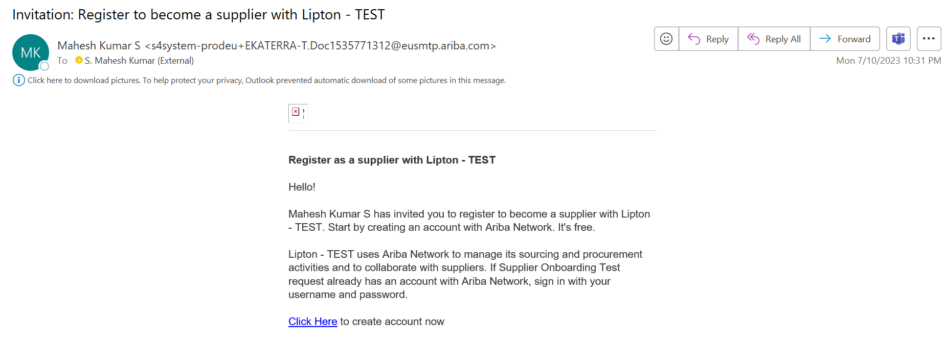
Supplier Data Modification using SAP Business Network
Supplier registration steps will be different for new suppliers and existing suppliers. This guide is for existing suppliers already registered with Lipton’s SAP Business Network Supplier Lifecyle Management Platform. If you have NOT registered, please view the document for new suppliers.
You will receive an invitation email to sign-in to your account from an email ID ending xxx@eusmtp.ariba.com Please check your inbox and junk mail, then “Click here” to sign-in to your account

Slide 3
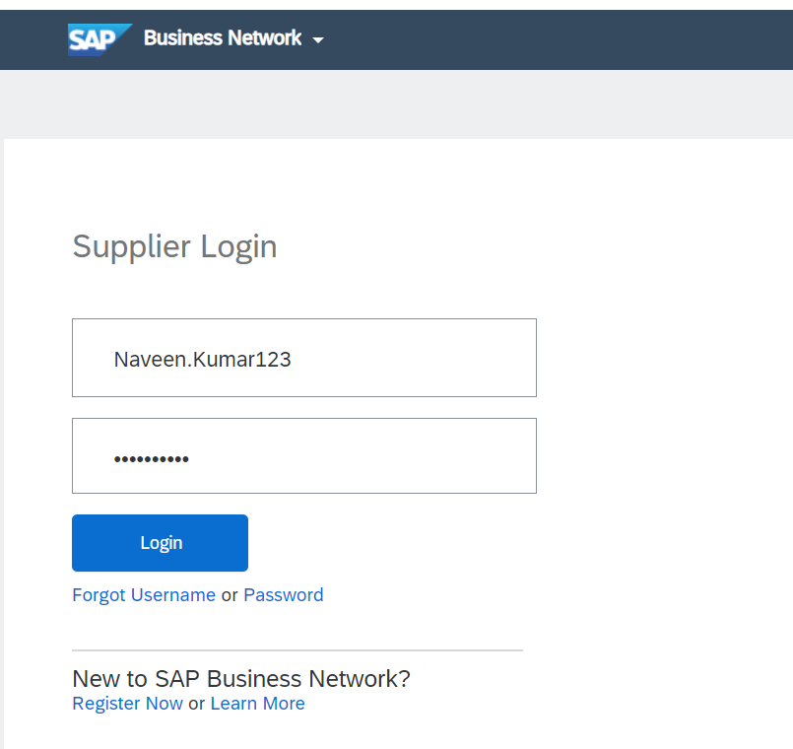
Supplier Data Modification using SAP Business Network
Now click “Log in” to begin the process
Enter existing user name and details

Slide 4
Supplier Data Modification using SAP Business Network
From here you can see the landing page or home page of Ariba.
The next stage is to complete/check the Lipton registration questionnaire to ensure that we hold all the necessary data we need for your business.
If you are not automatically directed to the questionnaire page, please click on the Business Network drop down, select Ariba proposals and questionnaire and Supplier registration questionnaire.

Slide 5
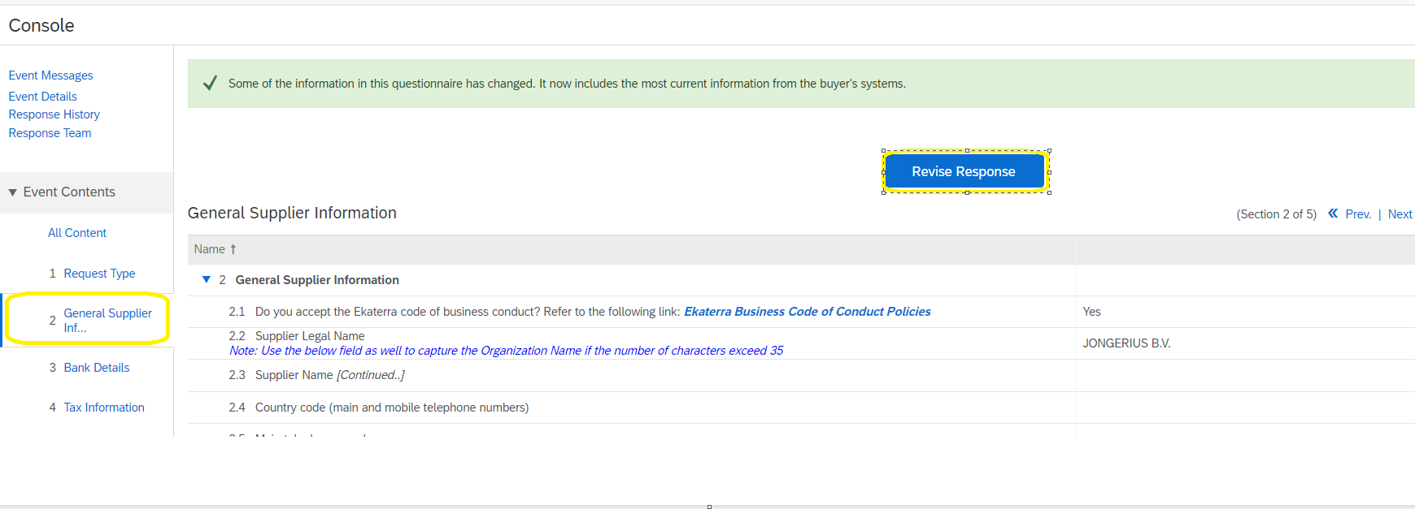
Supplier Data Modification using SAP Business Network
Now click on “Revise Response” (there may be a delay whilst the data loads).
Work through the questions and update your information as required. The following pages will provide advice on what details to enter if you are unsure, and there are contact details if you need help.

Slide 6
Supplier Data Modification using SAP Business Network
Ensure this the email address where orders will be sent to
Bank details all fields are mandatory (except for Region, Postal codes. IBAN, Swift, Bank Control Key are mandatory for only some countries)
Bank Type: If your business legal entity is in the same country as the Lipton entity you are supplying, select “Domestic”, if not please select “Foreign”
After completing the bank details, please click on “save” button.
To assist you with finding out these details, you can use the following links
To validate the IBAN: https://www.ibancalculator.com/
To validate the BIC/SWIF code: https://bank.codes/swift-code-checker/
To Validate ABA/ACH code: https://www.usbanklocations.com.
Attach supporting documentation as requested (non editable format e.g PDF) Business letterhead or bank letter are acceptable
If you have any issues please contact SRM@lipton.com for help

Slide 7
Supplier Data Modification using SAP Business Network
Important notes on the fields you will complete
Please select your country/region and the relevant fields for your country are displayed please complete.
Attach supporting documentation as requested (e.g Tax certificate, business letterhead, in non-editable format)
Attach any other supporting documentation in non-editable format.
1
Submit your response (or save as draft if you still have fields to complete)
Click on OK
Submission is confirmed
2
For more information you can visit:
Suppliers (liptonteas.com)
Welcome to your SAP Business Network Standard Account (ariba.com)
Please contact SRM@lipton.com for more help.
3

