Slide 1
QI PILOT PROGRAM Introduction to Concepts of Patient Safety and Quality Healthcare LECTURE 1
Notes:
This is the first presentation in a small series of presentations aimed at addressing the key concepts involved in patient safety and quality improvement practices within dermatology. These lectures

Slide 2
What is Quality Healthcare?
Institute for Healthcare Improvement definition:
Safe: Avoiding injuries to patients form the care that is intended to help them
Timely: Reducing waits and sometimes harmful delays for patients and providers
Effective: Providing the appropriate level of services based on scientific knowledge
Efficient: Avoiding waste, including waste of equipment, supplies, ideas and energy
Equitable: Providing care that does not vary in quality because of personal characteristics
Patient-Centered: Providing care that is respectful of and responsive to individual patients
http://www.ihi.org/education/IHIOpenSchool/resources/Pages/Activities/DefiningQualityAimingforaBetterHealthCareSystem.aspx
Notes:
Before discussing definitions of quality improvement and patient safety, we should examine the six core tenets of quality healthcare as defined by the Institute for Healthcare Improvement. The Institute for Healthcare Improvement (IHI) is a global collaborate learning group formed by over 500,000 interprofessional learners from universities, organizations, and health systems around the world who have a shared interest in building core skills in improvement, safety, system design, and leadership.
When defining quality healthcare, the IHI suggests care should be safe, timely, effective, efficient, equitable, and patient-centered. Patient safety and quality improvement work should be able to be related directly back to one of these key principles. The IHI does not define one of these components as being above the others and does not rank them, but rather argues they should all exist equally in the ideal model of healthcare delivery.
Potential audience interactive moment: Can anyone name an issue they have had in our healthcare system in the past week, and which tenet of quality healthcare it relates to?

Slide 3
Health Care System Performance Scores
Higher performing
Eleven-country average
Lower performing
Notes:
When we look at how our healthcare system in the United States compares to other developed nations, the US is often at the bottom in terms of overall performance. This study examined seventy-two indicators across five healthcare domains: care process, access, Administrative Efficiency, Equity, and Health Care Outcomes. The U.S. ranked last on performance overall, and ranked last or near last on the Access, Administrative Efficiency, Equity, and Health Care Outcomes domains.

Slide 4
Health Care Spending as a Percentage of GDP, 1980–2014
Percent
GDP refers to gross domestic product. Data in legend are for 2014.
Source: OECD Health Data 2016. Data are for current spending only, and exclude spending on capital formation of health care providers.
Notes:
Despite ranking the lowest among these countries in overall care quality, the United States spends the most money as defined by percent of the country’s gross domestic product. As you can see from this graph, health care spending is continuing to rise and the gap between the money spent on healthcare in the US and other countries is widening. Data such as this demonstrates the current need to deliver better quality care at a lower cost.

Slide 5
Quality Healthcare
Safe: Avoiding injuries to patients form the care that is intended to help them
Timely: Reducing waits and sometimes harmful delays for patients and providers
Effective: Providing the appropriate level of services based on scientific knowledge
Efficient: Avoiding waste, including waste of equipment, supplies, ideas and energy
Equitable: Providing care that does not vary in quality because of personal characteristics
Patient-Centered: Providing care that is respectful of and responsive to individual patients
http://www.ihi.org/education/IHIOpenSchool/resources/Pages/Activities/DefiningQualityAimingforaBetterHealthCareSystem.aspx
Notes:
Before discussing definitions of quality improvement and patient safety, we should examine the six core tenets of quality healthcare as defined by the Institute for Healthcare Improvement. The Institute for Healthcare Improvement (IHI) is a global collaborate learning group formed by over 500,000 interprofessional learners from universities, organizations, and health systems around the world who have a shared interest in building core skills in improvement, safety, system design, and leadership.
When defining quality healthcare, the IHI suggests care should be safe, timely, effective, efficient, equitable, and patient-centered. Patient safety and quality improvement work should be able to be related directly back to one of these key principles. The IHI does not define one of these components as being above the others and does not rank them, but rather argues they should all exist equally in the ideal model of healthcare delivery.
Potential audience interactive moment: Can anyone name an issue they have had in our healthcare system in the past week, and which tenet of quality healthcare it relates to?

Slide 6
What is patient safety?
“The prevention and mitigation of harm caused by errors of omission or commission that are associated with healthcare, and involving the establishment of operational systems and processes that minimize the likelihood of errors and maximize the likelihood of intercepting them when they occur.”
– The National Quality Forum, adapted from the Institute of Medicine’s report “To Err Is Human”
Notes:
Patient safety and quality improvement are often linked together, as many quality improvement movements are motivated by patient safety events. The definition of patient safety has two main components. The first is defining patient harm and types of errors that can occur within the healthcare system. Understanding the types of harm and errors is critical to patient safety and quality improvement. These will be discussed later. The second component of this definition is the actionable part of patient safety; that is the development of a system that minimizes opportunities for patient harm. When considering the system in which we deliver care, many people a quick to name human error as the main cause of safety events. While it is true that human error is one of the components of our system, there are many other components as well.
Potential audience interaction moment: Can anyone name another component of our modern healthcare system that may improve or detract from patient safety?
Examples include: electronic medical records, frequent patient handoffs, cultural barriers, malfunctioning equipment, cost of medications, patient volume.

Slide 7
Patient Safety: Background
According to Institute of Medicine’s 1999 report To Err Is Human, between 44,000 and 98,000 Americans die in hospitals each year due to errors in their care.
1,300 to 2,700 wrong-site procedures occur yearly, with about half occurring during outpatient procedures
Seiden SC ; Barach P. Wrong-side/wrong-site, wrong-procedure, and wrong-patient adverse events: are they preventable? Arch Surg. 2006; 141: 931-939
Notes:
Let’s talk a little more in depth about patient safety. We now know safety events in healthcare are common, thanks to a landmark article published in the Institute of Medicine’s report To Err is Human. In this report they suggest the numbers reported may actually under-represent the true number of medical errors due to lack of disclosure. Articles published after this study have further underscored the immense number of safety issues present in our current healthcare system. A study published in the surgical literature suggests procedural errors are occurring equally in the inpatient and outpatient care arenas. This is highly relevant to us in dermatology.

Slide 8
Wrong site surgeries in dermatology
Wrong site surgeries are one of the most common Sentinel Events reported to the Joint commission.
Wrong site surgery responsible for 14% of professional liability cases against Mohs surgeons
Multiple studies have demonstrated the difficulty in identifying correct biopsy site by both patient and providers
Alam. JAMA Derm. 2014 Mar;150(5):550-8.; Hansen. JAAD. 2015 Jul;73(1):1-13.; Hussain. Br J Dermatol. 2012 Nov; 167(5):1186.; Ke. Dermatol Surg. 2010 Feb; 36(2):198-202.; McGinness. Dermatol Surg. 2010 Feb;36(2):194-7.; Starling. JAAD. 2011 Oct;65(4):807-810.; Zhang. JAAD. 2016 Jun;74(6):1158-93

Slide 9
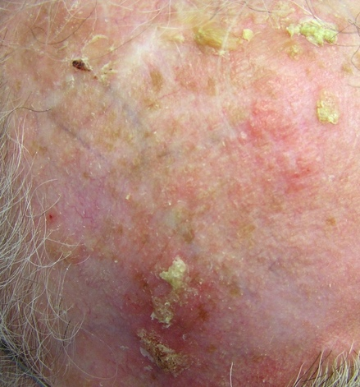
Case of Dermatology Safety Event
Mr. Thomas referred to Mohs surgeon for treatment of SCC on “Right anterior scalp.”
No biopsy site photograph accompanies the referral.
The patient and Mohs surgeon agree on the surgical site, and Mohs surgery is performed.
The patient’s daughter calls the next day livid because she said the SCC was located somewhere different from the surgical site.
Notes:
Let’s investigate an example case of how a wrong site surgery might happen in routine practice.
Potential interactive opportunity: Spend 2-3 minutes discussing contributing factors to this safety event. Have you ever experienced a similar situation?

Slide 10
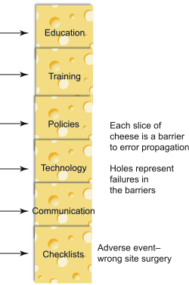
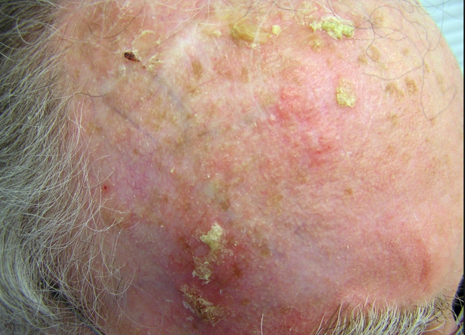
How did this mistake happen?
Swiss cheese model of adverse events
Site labeled incorrectly on biopsy form
MA’s first day in clinic – forgets to check physician’s site label.
Biopsy photo taken, but new MA not yet trained on photography upload and photo is stored in the wrong section in the chart.
Biopsy report faxed without photo for Mohs referral. No policy at referring physician’s office requiring review if biopsy photo is missing. No policy at Mohs office requiring biopsy site photo for referral.
Adapted from: Semin Pediatr Surg. 2015 Dec;24(6):278-82
Lack of interoperability between referring dermatologist’s and Mohs surgeon’s EHR → surgeon unable to review chart to find biopsy photo stored in EHR.
On day of surgery, Mohs surgeon is unable to reach referring dermatologist to confirm site. Patient’s daughter is at work and unable to attend surgery. Patient is anxious and does not admit to the Mohs surgeon that he’s not sure where the skin cancer is located.
Notes:
As we discuss this case, you should become familiar with the Swiss Cheese Model of Adverse Events. This model is commonly used by healthcare systems (and of companies outside of healthcare) to help identify all the contributing factors to the occurrence of a safety event. The principle which underlies the Swiss Cheese Model is that procedures and processes in healthcare should have multiple layers of “error protection” embedded within the process or procedure to protect against errors. When a safety event does occur, investigation into the event typically reveals multiple different levels of error protection breakdown, all of which aligned perfectly to allow the event to occur. The Swiss cheese model is used in patient safety to help us understand that most medical errors result from overlapping problems with our safety system, rather than the personal failures of individuals.
What were the process failures that allowed harm to come to our patient? Here, it is important to consider not only individual mistakes, but even more importantly how the checks in our system failed to prevent patient harm.

Slide 11
AAD’s Commitment to Patient Safety
The American Academy of Dermatology Patient Safety Initiative began in 2007
Ad Hoc Task Force (AHTF) on patient safety and quality formed in 2008
Replaced by a standing committee in 2009
Notes:
The AAD launched a formal patient safety program in 2007, and has a standing committee dedicated to patient safety and quality issues comprised of board-certified dermatologists and AAD staff. The purpose of the Safety and Quality Committee is to provide academy members with educational opportunities and resources related to safety and quality, as well as to advocate for dermatologists when it comes to policies regarding quality-based reimbursement regulations.
Currently there is a patient safety module available through the AAD for purchase which fulfill the ABD’s requirement for a patient safety course.

Slide 12
Why is patient safety important to me as a dermatologist?
Dermatology residencies are required to demonstrate competency in patient safety and quality improvement
Maintenance of certification
For board certification, the American Board of Dermatology (ABD) completion of a patient safety course prior within 2 years of beginning Maintenance of Certification (MOC)
Must also complete a performance improvement activity every 10 years
Reimbursement from Centers for Medicare and Medicaid now tied to demonstration of meeting certain quality metrics.
Notes:
Some dermatologists and dermatology residents may feel safety and quality improvement are issues more pertinent to places like the emergency department and the operating room, but in reality the vast majority of health care in the United States takes place outside of the hospital environment. Furthermore, our specialty is one in which providers see high volumes of patients quickly and perform numerous procedures, setting which have proven to be high-risk for patient safety issues.
The Accreditation College for Graduate Medical Education (ACGME) is the organization that is responsible for accrediting residency programs. The ACGME has developed milestones that residents must achieve to graduate from their training program, and one of the milestones relates to ability to perform quality improvement.
The Centers for Medicare and Medicaid (CMS) have shifted the way physicians are reimbursed for patient care away from the traditional fee-for-service model and towards quality-driven reimbursement. Now providers who want to participate in the Merit-based Incentive Payment System (MIPS) are required to submit documentation to CMS that they are meeting certain quality metrics which have been defined as improving patient care and patient safety in dermatology.

Slide 13
ACGME Requires Safety Training in Residency
ACGME Clinical Learning Environment Review (CLER) outlines responsibilities of residency programs to teach patient safety to trainees
Residents need to know how to report safety events at their institution and the responsibility to do so.
Residents should be involved in activities designed to improve their clinical site’s safety.
Trainee’s environment should be support a “culture of safety” where reporting of events is received positively.
Residency programs should provide emotional support for those involved in patient safety events (second victim).
Clinical site provides feedback to trainees on safety investigations.
Trainees should receive training on how to disclose safety events to patients and families.
Notes:
As we mentioned in the beginning of this talk, the ACGME considers patient safety and quality critical to the accreditation of a training program. This slide lists some of the main areas programs need to address with their trainees in order to maintain accreditation.
All member of the health care team, trainees included, need to know how their individual institution reports safety events. Institutions should have an anonymous reporting tool which is easily accessible from inpatient and outpatient care areas as a way to quickly document when a safety event or near-miss safety opportunity occurs.
Residents are required by ACGME to contribute to safety and quality improvement projects conducted at their clinic site. This does not mean residents necessarily have to conduct a project alone; residents could form teams to conduct projects, join an ongoing clinic QI project, or work with colleagues like nursing staff and faculty on addressing safety issues.
The residency training environment should be one where all healthcare team members feel comfortable voicing safety concerns and are treated with respect and encouragement when voicing such concerns. Retribution for speaking up or negative reactions are not conducive to a culture of safety. Sometimes residents, fellows, or medical students may not feel comfortable speaking up if they see something occurring which is unsafe. Using phrases such as “I have a safety concern” or “I need a pause/time-out for clarification” is a neutral way of introducing one’s concern in the team environment.
When a serious safety event occurs, it can have a profound impact on those involved in the event. Resident physicians involved in a safety event may have a strong emotional response and require counseling or other supportive services to help cope with event. Programs are required to offer support for residents either within the department or through their associated institution.
As clinic sites undergo safety and quality projects, they should provide regular and timely feedback to all healthcare team members on the status of the projects and the changes that will be implemented as a result. This ensures everyone is “on the same page” with regards to the process and promotes buy-in from the team members to incorporate proposed changes. This ultimately sets the project up for success.
Finally, error disclosure is an important component of a safety culture but a component that can be overlooked or neglected due to its uncomfortable nature. Residents should receive training on the proper way to disclose errors to patients and know when to consult with their attendings and institutional safety experts prior to disclosure.

Slide 14
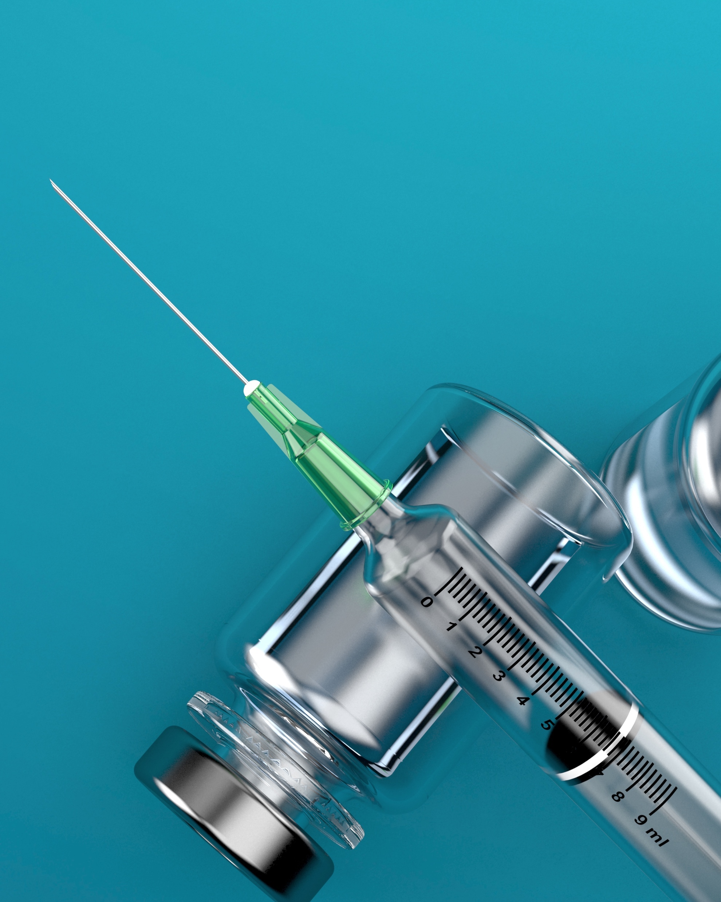
Need for patient safety efforts in dermatology training
2012 survey of all US dermatology residents
45% failed to report sharps injuries
83% reported cutting and pasting EMR notes without checking validity
97% reported left/right labelling errors
29% did not take a clinical photograph of biopsied lesions
80% do NOT always perform a time out
58% reported being intimidated by an attending
78% witnessed willful disregard of safety steps
Notes:
This survey completed in 2012 highlights some major issues within our specialty’s training environment. There are multiple responses that do not support a culture of safety, such as failing to report injuries, residents feeling intimidated by faculty and witnessing disregard for safety procedures. This survey also reveals multiple issues with procedural safety, such as a very high rate of mislabelling specimens and lack of routinely performing time out procedures. Studies such as these are not intended to point fingers at any one person, but rather are useful to highlight some of the areas within our practice of dermatology that could use improvement.
Potential interactive moment: What of these safety issues have you witnessed in training? Are there other safety events you have witnessed not listed here? What is the biggest hurdle to improving these safety issues?

Slide 15

Patient Safety: What can you do?
Follow the four pillars of safe behavior:
Follow written safety protocols. Example: Sanitize and wash your hands to reduce the spread of infection. Perform time-out prior to procedure.
Speak up when you have concerns. Example: Report unsafe conditions, close calls, and adverse events.
Listen to patients, colleagues, and mentors. Encourage patients and families to participate in decision-making.
Take care of yourself. Example: Get an appropriate amount of sleep and control your stress.
Notes:
We have talked a lot about patient safety so far. Sometimes thinking about all the problems with our healthcare system can feel overwhelming. If you can start implementing these four key behaviors, you will be off to a great start. Try to follow the existing safety protocols in place at your clinic site. By paying attention to existing protocols, you will not only increase the safety of the care you provide, but you will likely quickly notice areas where protocols may not be in place, or may need revision. Don’t be afraid to speak up any time you have a safety concern. Training environments are required to encourage safety reporting by all members of the care team, including students and residents. Reporting close calls and near miss events are vitally important, as these events allow the institution to analyze a process to avoid a potential serious safety event. Be sure you know how to access your institution’s safety event reporting system.
Embrace the team mentality when it comes to healthcare. By listening to your peers and patients, you will gain more insight into each situation in which you are involved, and will be better able to make informed decisions that benefit your patient.
And finally, providing care to patients is a demanding and stressful job. Taking care of yourself outside of work by maintaining your hobbies, getting regular sleep and exercise, and having a method for stress relief will help prevent burn out. Physicians suffering from burn out are more likely to make serious safety errors. If you are feeling overly stressed or burned out, please reach out to your chief resident or program director for help.

Slide 16
Patient Safety: CMS
For past decade Medicare has been moving towards a value-driven reimbursement model over a fee-for-service model
Merit-based incentive payment system (MIPS) began in 2017 as a way for physicians to earn increased payments for Medicare patients
Part of MIPS requires physicians to submit evidence they are meeting certain safety measures
Example: documenting yearly TB tests for biologic use
Example: biopsy anatomic location accuracy
Example: timely follow-up of biopsy reports
https://www.aad.org/practicecenter
Notes:
We mentioned CMS and the MIPS program earlier in this presentation. In 2015 Congress passed the Medicare Authorization and CHIP Reauthorization Act, also known as MACRA. This act laid out the new steps physicians would need to take in order to avoid penalties and maximize reimbursement from Medicare insurance payments. The new system for reimbursing physicians has two pathways, with the vast majority of dermatologists choosing the Merit-based incentive payment system, called MIPS. The safety measures listed in this slide are just some of the quality measures which can be used by dermatologists to document the type of care they are providing.

Slide 17
Patient Safety: MIPS
Quality | Improvement Activities | Advancing Care Information | Cost
Replaces PQRS. | New Category. | Replaces the Medicare HER Incentive Program also known as Meaningful Use | Replaces the Value-Based Modifier
Percentage of biopsies with a diagnosis of BCC and SCC in which the pathologist provides results to the clinician within 7 days of biopsy date | Implementation of a process that documents care coordination activities | Requires an EHR system certified to 2015 Meaningful Use standards | Algorithm used to determine actual payment to participating providers
Notes:
MIPS is a complicated algorithm that awards a physician or physician practice a score in each of four categories, including quality, use of technology like electronic health records, quality improvement activities, and cost. An example of a quality measure which can be recorded for dermatology is the time between a non-melanoma skin cancer biopsy being performed and its report given to the dermatologist. We listed three examples of improvement activities on the previous slide, but another example would be implementing a documented care coordination encounter that tracks all clinical staff involved and communications from date patient is scheduled for outpatient procedure through day of procedure. The Advancing Care Information category replaces the old Meaningful Use category. This incentivizes physicians to use a sophisticated electronic health record system which can e-prescribe medications, create a patient portal with two-way communication between patients and providers, and allow for electronic communication between physicians, among many other requirements. The final category is “cost”, which stands for a complicated algorithm used to determine the adjustment in Medicare reimbursement for a participating provider based on performance in the first three categories and performance against peers in a national registry. For more information on MIPS, you can visit the AAD’s Practice Management Center.

Slide 18
Patient Safety: Resources
Patient safety and quality reporting using DataDerm
https://www.aad.org/practicecenter/quality/dataderm
Institute for Healthcare Improvement
http://www.ihi.org/Pages/default.asp
Agency for Healthcare Research and Quality Patient Safety Network
https://psnet.ahrq.gov/primers
Principles of Patient Safety
http://accessmedicine.mhmedical.com/content.aspx?bookid=496&sectionid=41303962#56191339
Notes:
Here are some additional online resources to expand your knowledge regarding patient safety and specific safety issues. The IHI has many free safety and quality resources, and also offers a Basic Certificate program through their Open School website. The Patient Safety Network (PSNet) has excellent short primers on many different safety issues, all of which are about 2 pages in length and easy to read.

Slide 19
What defines Quality Healthcare?
Safe: Avoiding injuries to patients form the care that is intended to help them
Timely: Reducing waits and sometimes harmful delays for patients and providers
Effective: Providing the appropriate level of services based on scientific knowledge
Efficient: Avoiding waste, including waste of equipment, supplies, ideas and energy
Equitable: Providing care that does not vary in quality because of personal characteristics
Patient-Centered: Providing care that is respectful of and responsive to individual patients
http://www.ihi.org/education/IHIOpenSchool/resources/Pages/Activities/DefiningQualityAimingforaBetterHealthCareSystem.aspx
Notes:
We have spent a lot of time on patient safety. Let’s now briefly review the other key components of quality healthcare. After that, we will discuss the process of performing quality improvement.

Slide 20

Timeliness of Care
Delivering care in a timely manner can be challenging in our current healthcare system
Issues related to timely care
Access to healthcare system
Coordination of care between providers
Limited resources
Prior authorizations
https://www.aad.org/practicecenter/managing-a-practice/prior-authorization-assistance
Notes:
In an ideal world, all patients would be able to get the exact care they need without any delays. Unfortunately, our current healthcare system is fraught with barriers to providing timely care to our patients. Access to the healthcare system is a pervasive issue. The number of patients are growing, and the number of physicians providing care is not able to keep pace with the growing demand. Concentration of physicians in certain geographical areas puts rural and certain urban communities at risk for poor access. Lack of health insurance is also a major barrier to receiving timely care.
Scheduling procedures for patients or referrals to other specialists is another area that can contribute to delayed care. One of the quality metrics for dermatology under the MIPS program is looking at the time between diagnosis of melanoma and definitive treatment.
Many hospitals and clinics in the United States are fortunate to have access to a wide spectrum of equipment and healthcare services, but even in the United States certain resources are often limited. Have you ever seen a patient waiting in the hospital for placement into a rehabilitation facility, or a patient with mental health issues who cannot be placed into an inpatient psychiatric hospital? Have you ever witnessed a patient in the emergency department waiting hours for an MRI or CT scan?
In the outpatient healthcare settings, prior authorizations for medications and procedures are a huge barrier to providing timely care. The AAD has created helpful resources for providers who need prior authorization assistance. This includes an interactive online prior authorization letter generator.

Slide 21
Effective Care
Is what we are doing improving outcomes?
Where are there gaps in knowledge? How do we close those gaps?
AAD’s Clinical Guidelines: https://www.aad.org/practicecenter/quality/clinical-guidelines
AAD’s Choosing Wisely Program: https://www.aad.org/practicecenter/quality/choosing-wisely
AAD’s Appropriate Use Criteria: https://www.aad.org/practicecenter/quality/appropriate-use-criteria
Notes:
IHI defines effective care as “providing the appropriate level of services based on scientific knowledge”. How do we determine what care is appropriate and what care is not appropriate? Use of expert consensus groups is one way to help define appropriate care. Another is by referring to well-done studies that demonstrate the outcomes of a particular therapy or intervention. This is reflected in the IHI definition being “based on scientific knowledge”. The AAD has several resources available for clinicians to help provide more effective care. The AAD Clinical guidelines are evidenced-based guidelines rigorously written and reviewed by a large panel of content experts. There are guidelines on atopic dermatitis, melanoma, psoriasis, acne, and office-based surgery. The Choosing Wisely program focuses on encouraging physicians and patients to talk about tests and procedures that may be unnecessary or may cause harm. This program encompasses many different areas of medicine, but the AAD has developed ten statements to reflect current issues in dermatology. Finally, the AAD has published appropriate use criteria regarding the use of Mohs micrographic surgery for treatment of nonmelanoma skin cancers. This was a large effort in collaboration with the American College of Mohs Surgery, the American Society for Mohs Surgery, and the American Society for Dermatologic Surgery Association in which appropriateness of Mohs surgery in various instances was reviewed by >75 physicians. These are three examples of our specialty’s efforts to improve the care we provide.

Slide 22

Efficient Care
Use of electronic health record systems are designed to reduce waste and facilitate communication between healthcare providers
Delivering efficient patient care requires members to operate within a highly functional healthcare team which includes physicians, nurses, pharmacists, nursing assistants, lab technicians, etc.
Notes:
The IHI defines efficient healthcare as being care which avoids waste, including waste of equipment, supplies, ideas and energy. Lack of efficiency is a major problem in our current healthcare system. Duplication of tests, inappropriate use of medications or procedures, and lack of streamlined processes are contribute to inefficient care. Improving efficiency in medicine is vital to closing the gap between the amount of money the US spends on healthcare and the quality of the care provided.
Creating a successful healthcare team can improve efficiency in several ways. Doctors, advanced care providers, nurses, pharmacists, nursing assistants, and office staff should work together harmoniously so no one is duplicating each other’s work and everyone has a clear role in the care of the patient that maximizes each individuals time and talents. A bonus to engaging in an effective healthcare team is members of the team may view an encountered problem differently, thereby identifying multiple potential solutions to improve care.
Potential interactive audience moment: Can anyone describe a time when they experienced inefficient care, or when they experience exceptionally efficient care?

Slide 23
Efficient Care
Keys to an effective and efficient healthcare team:
People know their concerns will be received positively and treated with respect.
Leaders create an environment where all staff are comfortable expressing their concerns.
Team members have a high degree of confidence that the organization will learn from problems and use them to improve the system.
People know they will not be punished or blamed for system-based errors.

Slide 24

Equitable Care
Identifying at-risk populations:
Ethnic minorities
Homeless population
Prisoners
Immigrants
Patients who do not speak English
Patients who are illiterate
Patients who are deaf or blind
Infants and the elderly
Transgender and homosexual patients
Recognize your own biases https://implicit.harvard.edu/implicit/takeatest.html
See something, say something!
Notes:
Equitable care is defined as care that does not vary in quality because of personal characteristics: maintaining the principle that all people should be treated equally. There are numerous literature reports demonstrating that certain patient populations regularly receive inferior care due to issues like ethnicity, language, socioeconomic status, age, and sexual orientation.
Recognizing our own implicit biases is one of the first steps towards ensuring equitable care. One resource for determining your own implicit biases is to take a test that helps identify certain stereotypes you may hold. Harvard University has developed a series of short implicit bias tests called Project Implicit.
The second step towards ensuring equitable care is to speak up when you witness inequitable care being provided. Giving a voice to some of the more marginalized patients in our healthcare system will create a more robust culture of safety.

Slide 25
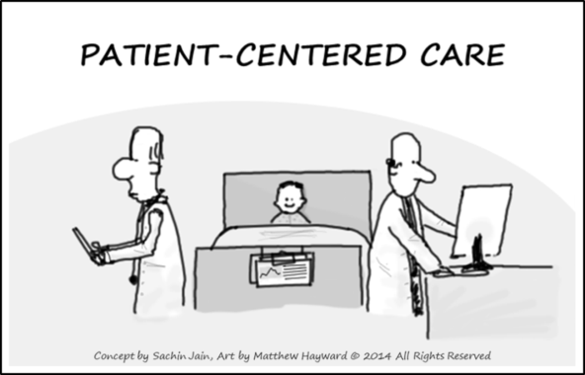
Patient-Centered Care
Core principles of patient-centered care
Establish a meaningful relationship
Listen to patient’s concerns, expectations, and ideas regarding their illness
Set mutual goals
Anticipate roadblocks to success
Notes:
Patient-centered care is care that respects patients and treats patients as individuals who are an equal part of the health-care team. Paternalistic medicine is no longer felt to be the best way to take care of patients; we should instead actively engage with our patients to mutually agree upon the best plan of care.
Establishing a relationship with your patient is one of the easiest ways to have you and the patient be on the same team, by showing you really care about them as a person. Actively listening to the patient’s concerns, expectations, and ideas regarding illness will give you unique insight into what the patient is thinking, and allow you to address misconceptions or misunderstandings if they arise. Setting goals that both you and the patient agree to gives the patient “buy-in” and makes them more involved in the decision-making process. Anticipating issues such as medication cost, scheduling conflicts, side effects, etc. can help you address these proactively so the patient is prepared rather than having to reactively address issues after they occur.

Slide 26
What is Quality Improvement?
US Department of Health and Human Services definition:
“Quality improvement (QI) consists of systematic and continuous actions that lead to measurable improvement in health care services and the health status of targeted patient groups.”
http://www.hrsa.gov/quality/toolbox/methodology/qualityimprovement/
Notes:
It’s important to look at the key words in this definition. The US Department of Health and Human services defines quality improvement as being “systematic”. What does that mean? It means being purposeful and thoughtful in developing ways to evaluate health care, that use widely accepted and standardized methods of assessment such as Root Cause Analysis and Plan-Do-Study-Act cycles. We will discuss these in more detail later. “Continuous” means constantly looking at the current system, or way of doing things, for opportunities to improve the “status quo”. “Measureable improvement” indicates that quality improvement projects need to identify a measurable outcome in order to determine if a change to the system is having a positive, negative, or neutral impact. A classic example of this measuring number of hospital-acquired central line infections during a specified time period, or number of mislabeled biopsy specimens. The last part of this definition indicates quality improvement should look at a specific and defined patient population. Who should be included in the quality improvement study, and why? Who should be excluded? All of these concepts are critical to successful quality healthcare improvement.

Slide 27
Now that we know the main components of quality health care, what are the steps for improving the quality of the care we provide?
Notes:
The next educational lesson in this series will discuss the steps vital to the quality improvement process.

Slide 28
For more information, please see part 2 in the lecture series.

