Slide 1
QI PILOT PROGRAM
Quality Improvement:
Project Design and Measuring Impact
LECTURE 3

Slide 2
TERMS AND CONDITIONS:
The persons using this course material acknowledges and agrees that the American Academy of Dermatology (AAD) owns all right, title, and interest in the materials and they are being given permission (a limited, royalty-free license) to use the materials solely for the educational purposes specified by AAD, and they agree not to use, modify, reproduce, or disseminate the materials for any other purpose, except that faculty may modify Lecture 4, for the limited purpose of including their institution-specific information, but will not make any other edits to such lecture. By using these materials, you agree to the above terms and conditions. AAD will enforce its intellectual property rights against anyone who violates these terms and conditions.

Slide 3
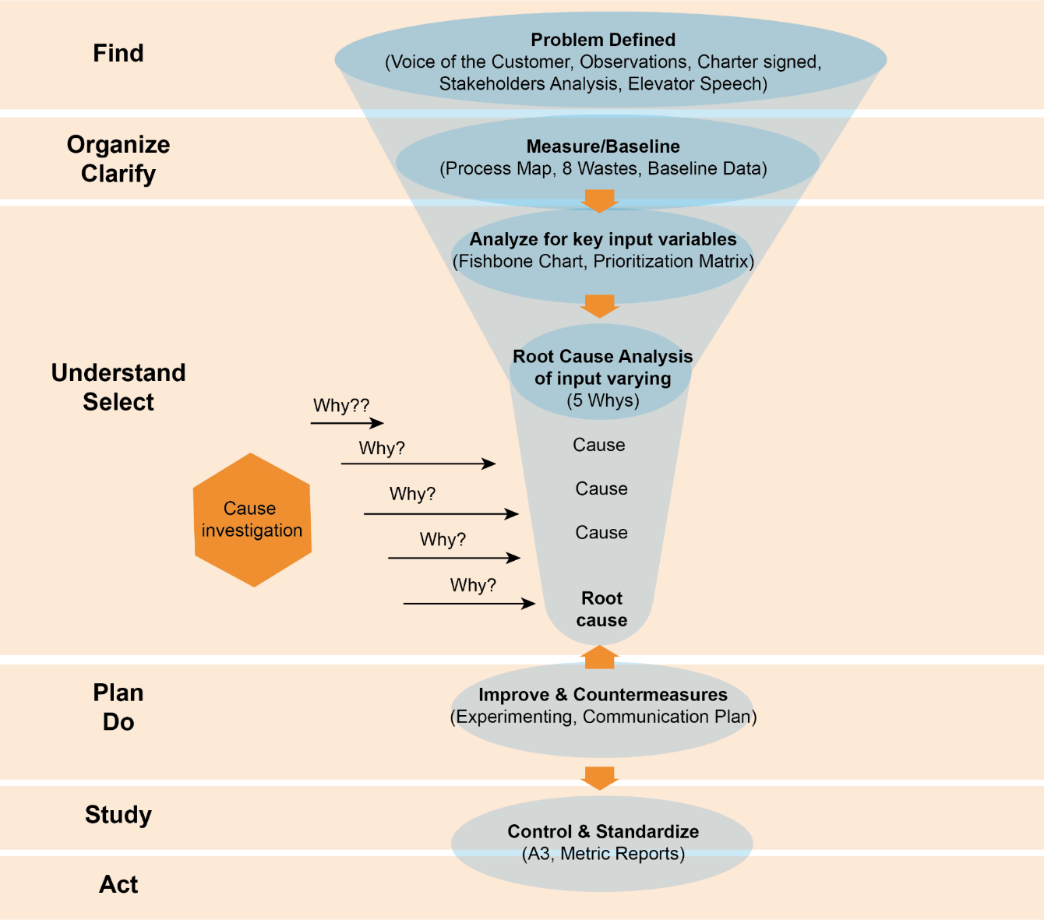
A3 Problem Solving
Performance Improvement
at Penn Medicine
Notes:
In our last lecture, we discussed how to select a problem for your QI intervention, collect preliminary data, and organize a team. This correlates to the Find, Organize/Clarify, and Understand/Select stages of the A3 problem solving framework.
In this lecture, we will discuss how to implement a solution and how to study its impact. We will focus on the Plan, Do Study, Act Cycle for project implementation.

Slide 4
Plan-Do-Study-Act (PDSA) Cycle
Plan
Do
Study
Act
Dr. William Edwards Deming
Notes:
The PDSA Cycle – which stands for Plan, Do, Study, and Act is an iterative process for making incremental changes, studying the impact of those changes, and continuing to improve over successive cycles. This PDSA cycle will be provide the framework for how we discuss project implementation and measurement throughout this lecture.

Slide 5
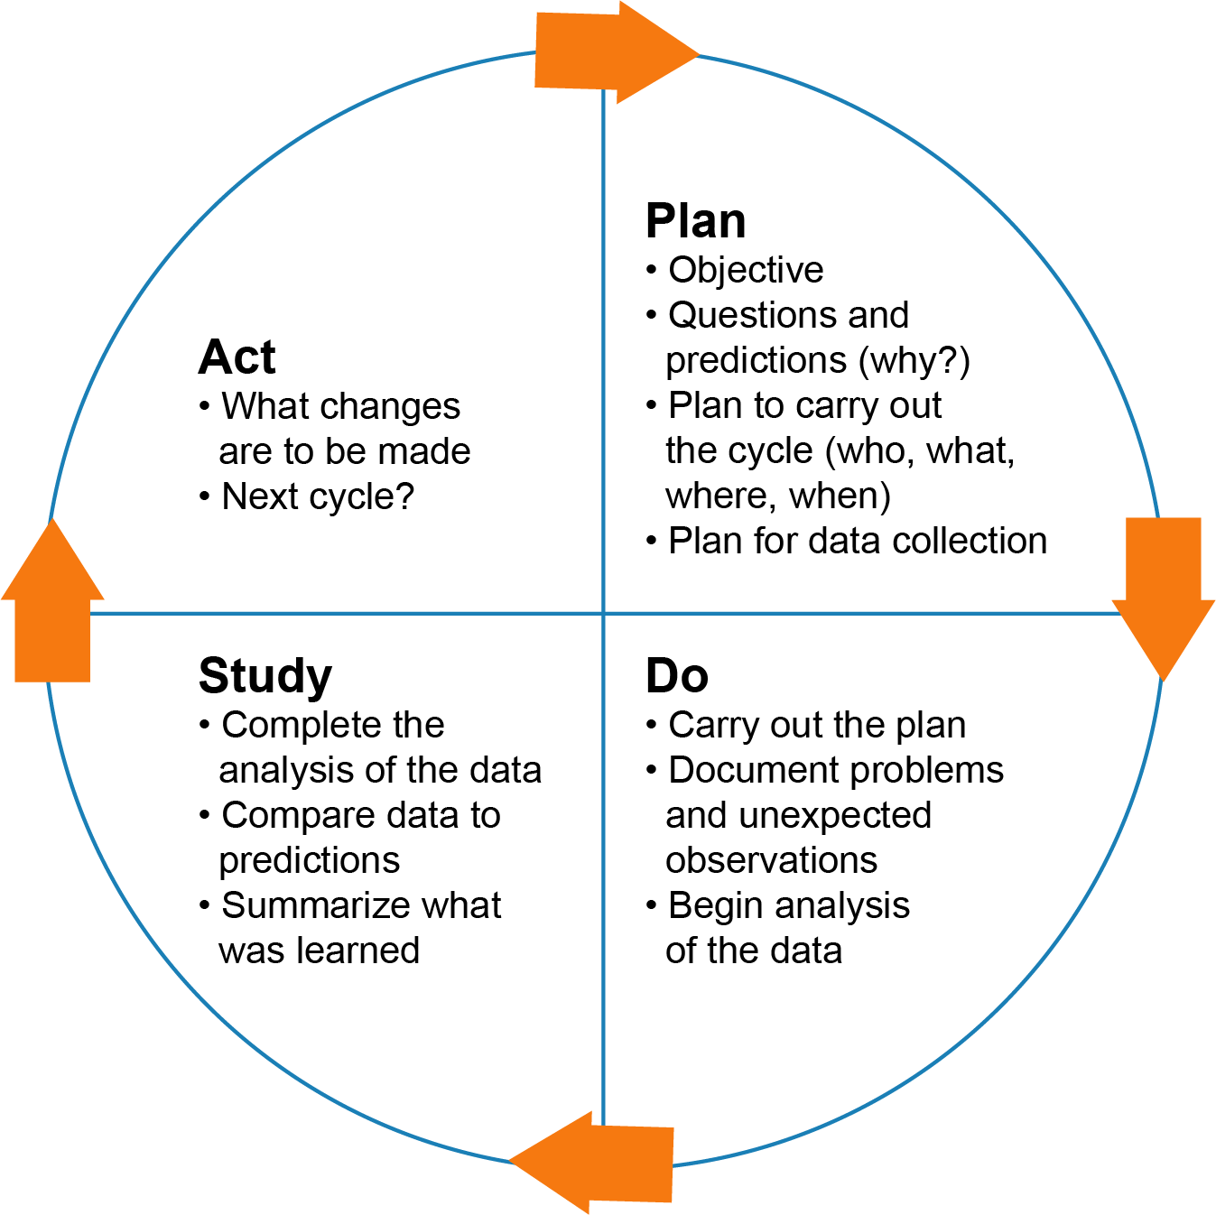
PLAN: Change Concepts for Effecting Improvement
Eliminate waste
Optimize process efficiency and workflow
Optimize inventory
Change work environment
Focus on variation and error proofing
Notes:
In the Plan/Do part of the PDSA cycle, we organize the information that has been learned thus far and begin to synthesize this information into ideas about how we would like to improve upon the current state.
There are a lot of different ways that you can go about making an improvement. A few key change concepts for making change include:
Elimination of waste/non-value added steps
Workflow optimization
Optimize inventory
Change the work environment
Decrease process variation and errors
Too often, QI interventions focus on educational interventions. While education is often necessary, it is almost never sufficient to effect sustainable change. Beware, educational interventions are one of the weakest types of improvement interventions and are less likely to lead to long term change.

Slide 6
Which intervention(s) should we start with?
Many factors go into decision…
Resources
Stakeholder preferences
Ability to measure
Potential for impact:
Low
High
High
High effort
Low impact
High effort
High impact
Amount of effort:
Low effort
Low impact
Low effort
High impact
Low
Notes:
When you finally have collected enough information about the problem and have assembled the right team, it will be time to sit down and brainstorm the best solution. Early on, it’s great to get as many ideas as possible. As you begin to narrow down on which intervention(s) you may want to pilot, I would encourage you to use the rubric above to weigh your options. Which ideas are likely to have the greatest impact and how much effort will each idea require?

Slide 7
PLAN: Donebedian Evaluation Framework
Structure
Process
Outcome
Healthcare organization:
Facilities, equipment
Staffing
Computer systems
Organizational charts
How care is delivered:
Preventive services
Guideline adherence
Number of patients served
Diagnoses
Impact on health
Death(s)
Number of adverse events
Satisfaction
Donebedian A. JAMA. 1988; 260(12): 1743-48.
Notes:
Before piloting your intervention, it’s important to plan how the success of the intervention will be measured. The Donebedian Framework from Quality Evaluation describes three categories of measures:
Outcome measures: Effects of healthcare on the health of a population
Process measures: Sum of actions in giving and receiving care
Structure measures: Physical facility, equipment, human resources, training, organizational structure, etc.
In addition to measuring success, it’s very important to measure any unintended consequences of your intervention. These types of measures - Balance measures – help answer the question : Are changes designed to improve on part of the system causing new problems in other parts of the system?

Slide 8
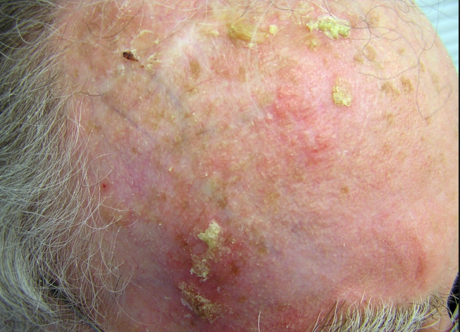
Measures for biopsy photo project
Outcome measures: # Wrong site surgeries
Process measures: Proportion of biopsies with photos
Structure measures: Nursing staff, # photo taking devices
Balance measures: Time per patient encounter
Courtesy of L. Orenstein, M.D.
Notes:
Let’s go back to the problem that we’ve discussed in prior lectures, that patients are experiencing wrong site surgeries due to lack of biopsy site photo. Here are some of the measures that we could consider using for our intervention.
An outcome measure would be the number of wrong site surgeries This is an outcome measure because it truly impacts the patient’s health.
A process for measure for this project might be the proportion of neoplasms with a biopsy site photo available at the time of surgery. Or the proportion of biopsy site photos in which it is possible to identify the anatomic site of the biopsy.
Some structure measures might include: the number of nurses who have been trained to take biopsy photos or the number of devices for taking and uploading patient photos
But what might be some unintended consequences when rolling out an intervention to improve biopsy site photography rates? Visits may take longer, more money will need to be spent on photography devices, and clinic staff may need to spend extra time outside of clinic to upload photos. Any of these could be considered good balance measures for this project.

Slide 9
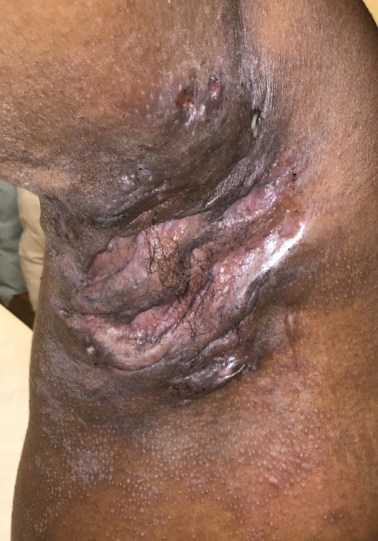
Help plan QI Metrics for Biologic Medication Access in HS clinic
Outcome measures?
Process measures?
Balance measures?
Courtesy of L. Orenstein, M.D.
Notes:
Now, let’s return to our prior example project in which there are substantial delays in access to biologic medications among patients with hidradenitis suppurativa.
In small groups, brainstorm about some different measures that could be used to measure the success of this project.
Ask volunteers to share their ideas for project measures. A few examples might include:
Outcome measures: Patient reported global assessment of disease, quality of life measures, time to first dose of biologic medication
Process measures: Number of patients with new biologic prescriptions, time to submitting prior authorization appeals, time from appeal to informing patient that their medication has been approved
Balance measures: Staff time spent on tracking patient access to biologics, time to access biologic medication for other dermatologic indications (perhaps because your staff is focusing so much on HS patients, less time will be spent on other conditions, leading to delay to care in those other conditions)

Slide 10
DO: PILOTING YOUR IDEA
Vapor testing
Fake front end
Fake back end
One night stand
N Engl J Med 2015; 373:592-594. DOI:10.1056/NEJMp1506311
Notes:
Once you’d decided on which intervention you’d like to try first, you will want to start developing pilot as a test of concept for your intervention. The purpose of a pilot is to “test the waters” with your intervention without committing the full resources necessary to fully implement the intervention.
There are many different strategies for piloting your intervention. A few concepts that we will review now include fake front end, fake back end, and one night stand.

Slide 11
DO: Vapor testing
Tests whether there is demand for your solution before investing resources to make that solution available.
Asks the question “Do customers/patients want it?”
I.e. “We may not be able to do it today, but if I could arrange it, would you like the IUD inserted before you leave the emergency department?”
N Engl J Med 2015; 373:592-594. DOI:10.1056/NEJMp1506311
Notes:
Vapor testing allows you to test whether there is a demand for a solution or product before investing resources to build the solution.
When you select a product from a website and get a message that the product is “out of stock,” the truth is often that the product never existed. The site’s goal is to find out if they offer a product whether anyone will buy it.
In a less deceptive manner, we can use vapor testing to help determine whether the demand for a service would be there before arranging all of the resources and materials to make it happen. For instance, before adding a service of IUD placement in the ED for emergency contraception, it might be reasonable to ask patients coming in for emergency contraception “We may not be able to do it today, but if I could…[read question from slide]”

Slide 12
DO: Intervention pilot - Fake front end
Uses a less technology heavy medium
Allows teams to iterate quickly on paper or another disposable medium.
Tests features with as few resources as possible
App for helping patients navigate process for obtaining biologic
N Engl J Med 2015; 373:592-594. DOI:10.1056/NEJMp1506311
Notes:
A fake front-end uses a less technology intensive model to iterate quickly on paper or another disposable medium. be able to test how users will be able to interact with the solution that you are proposing.
For the example of the biologic medication access problem among hidradenitis patients, imagine that you decided that a patient facing App to help them navigate the prior authorization and medication delivery process was the right solution. Instead of building the entire app and THEN testing it out on patients, you might decide to mock up different screen shots from the app using paper or PowerPoint. You could the test this “fake front end” on patients to learn which parts of the design make sense or do not make sense to them.

Slide 13
DO: Intervention pilot - Fake back end
Allows teams to answer question: “What happens if people actually use my intervention?”
Devises a temporary infrastructure that is not scalable but allows concept testing.
I.e. Biologic navigation texting app
Patient texting App
Notes:
Developing a fake back end allows teams to test what will happen if individuals actually use the solution that they are planning.
Imagine in the biologic medication access project for HS patients that you decide that the best intervention would be to develop an automated texting app that prompt patients to along different steps in the medication attainment process. Before developing the infrastructure for a fully automated texting reminder service, you could pilot an intervention in which an office staff member would type in the text responses according to the algorithm that you built for automated responses.

Slide 14
DO: Intervention pilot - One night stand
Implement the solution for a limited time and scope to understand impact
Ask users about impact on process and results yielded
I.e. biopsy project – one week pilot of photographing all neoplasms
Notes:
A “one night stand” is a term for a mini-pilot of an intervention that is limited in time and/or scope. The purpose of a “one night stand” is to being to understand the impact of an intervention on work flow and results.
Imagine for our wrong site surgeries/biopsy photo project, you decide that providing an electronic health record app that automatically uploads photos to the EHR would be the ideal solution for increasing biopsy site photos. To test this idea, you might convince the EHR vendor to provide one of your clinic sites with a two week free trial.

Slide 15
DO: Project Implementation
Implementation should be minimally disruptive
Change management: guides how we prepare, equip, and support individuals and institutions to successfully adopt change
Consider step-wedge design in which the change is implemented one unit/location at a time
Notes:
Once you have piloted your idea, you are ready to begin rolling out the full intervention.
Beware, people are generally loathe to change, so there is likely to be some resistance on the front end. Be sure to listen to all of the criticism and take note of constructive ideas for improving on the next version/iteration of your intervention.
Sometimes it can be helpful to roll out your intervention gradually in different clinic locations. This provides a natural “controlled experiment” for understanding how your intervention is meeting its targets.

Slide 16
STUDY
Track and analyze data
Must collect outcomes in real time
Build sustainable metrics
These data will inform the next phase of improvement
Notes:
During the study phase, data should be collected in real time on a regular basis. These data will help track your progress and will inform the next PDSA cycle for your QI project

Slide 17
Data Analysis in QI
Run Charts
Interrupted time series
Statistical process control (SPC) Charts
Notes:
Next, we will review several commonly used analytic tools in QI: run charts, interrupted time series, and statistical process control charts.
Simple before and after measures of an outcome should almost never be used in QI. We’ll demonstrate why that’s the case in the following slides.

Slide 18
Does the intervention work?
Data visualization matters
AIM: Within 2 months, we will decrease the number of biopsy processing errors in our dermatopathology lab from 8/day to 6/day
Courtesy of L. Orenstein, M.D.
Notes:
Imagine that in your dermatopathology lab, the specimens are frequently sectioned incorrectly, requiring the dermatopathologists to order and exceptionally high number of recuts. This delays the time to finalizing pathology results and increases the cost for the lab.
Your aim with this project is to decrease the number of processing errors from 8 per day to 6 per day.
Imagine that the number of errors is measured on week 4, and that follow up measurements are conducted nearly 2 months later, on week 11. If we analyze the before and after numbers, they are really impressive. It looks like our intervention has decreased the number of biopsy processing errors from 8 per day to 3 per day!
(Advance slide). Here is a run chart that supports your conclusion that your intervention has made a big difference. Run charts are used to track outcomes over time, but do not include any analytic statistics. From this run chart, we get a sense of the baseline error rate preceding the intervention (6-9 per day), and we can also see that the number of errors per day falls steadily from week 4 all the way to week 14.
(Advance slide). However, here is another run chart that would give the exact same before/after bar graph as is shown on the left. This run chart tells a very different story. In the weeks prior to intervention, the baseline number of errors per day was 6-9. Following the rollout of the intervention at week 4, the error rate appears approximately stable until weeks 11/12, where a sharp decline in the number of errors is noticed. Unfortunately, that error rate goes right back up on weeks 13-14. This run chart on the bottom right of the slide suggests that the QI intervention may not have had as big of an impact as is suggested by the bar chart. Perhaps weeks 11 and 12 were anomalies, caused by a drop in biopsy volume over the holidays or perhaps the histotech who makes most of the errors was out of work those weeks on vacation.
The lesson here is that how you choose to visualize your QI outcomes really matters. A simple before and after measure is NOT enough.

Slide 19
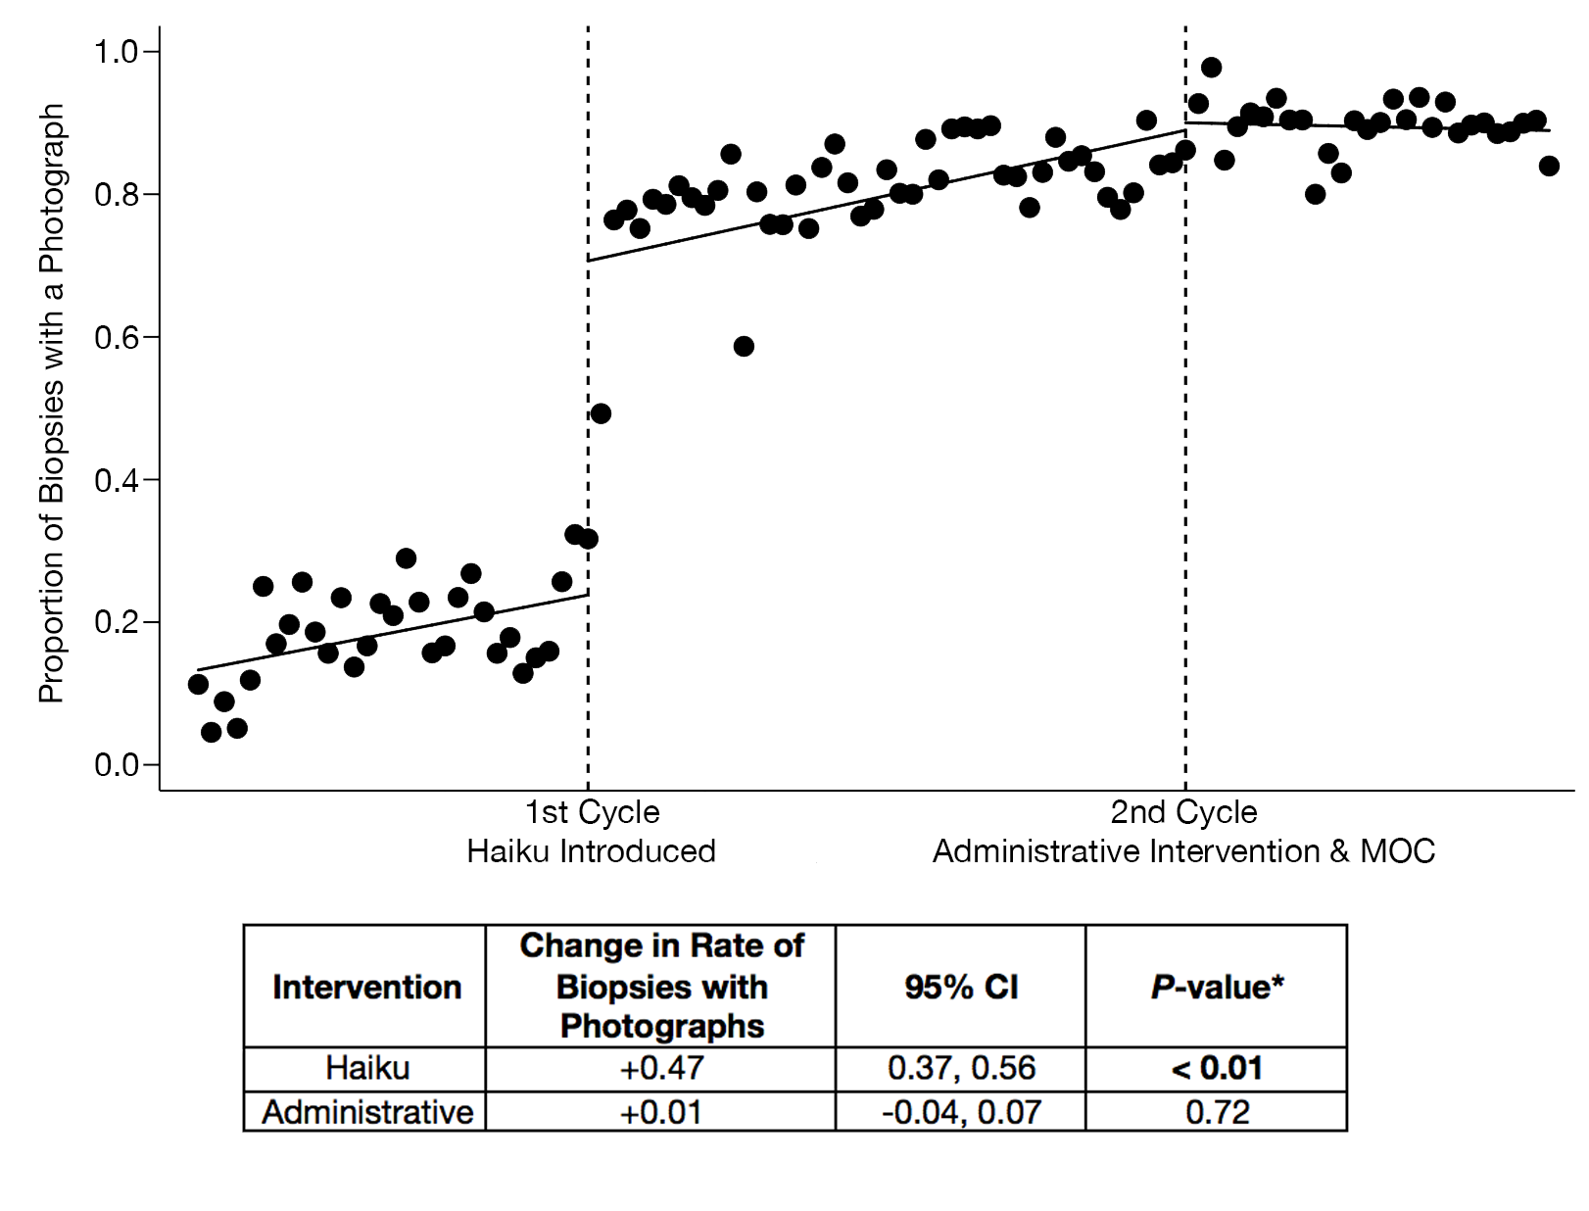
Phase 1: Application introduced to automatically upload photos to EHR
Phase 2: Biopsy photo protocol + education about application
 | Change in Photo rates | 95% CI | P-value
Phase 1 | +0.47 | 0.37, 0.56 | <0.01
Phase 2 | +0.01 | -0.04, 0.07 | 0.72
Phase 1
Courtesy of L. Orenstein, M.D. and J. Zhang, M.D.
Courtesy of L. Orenstein, M.D and J. Zhang M.D.
Notes:
Here is an example of an interrupted time series analysis. An interrupted time series analysis
is a quasi-experimental design that can evaluate an intervention’s effect using longitudinal data.
Going back to our example about missing biopsy site photos. The initial phase of this intervention consisted of introducing a new application into the clinic that connects automatically with the electronic health record and ports photos directly into the medical chart.
During the planning for phase 2 of this QI intervention, the biopsy site photography rate increased dramatically undenounced to the QI team. The QI team did not know because they did not have data collection available in real time. Initially, they only had the ability to collect data through manual chart review. Several months after phase one (and before planning phase two), the QI team manually analyzed a month’s worth of data, which suggested that only 50% of biopsies had an accompanying photo. Based on this information the QI team started planning a second phase of intervention.
The second phase of the intervention (denoted by the second vertical line) involved developing a protocol for biopsy site photography, education about the App, and provider incentives for photographing biopsy sites.
Had we only measured before and after data, we might have come to the conclusion that Phase 1 and Phase 2 played an equal role in increasing biopsy site rates. However, the data in this statistical process control chart tell a very different story. Here, it appears, that Phase 1 (the introduction of the app) was almost entirely responsible for the observed increase in biopsy site photo rate.
Two major take aways from this slide are that:
1.) It’s crucial to collect and evaluate outcomes data in real time.
2.) Outcomes simply measured before and after an intervention do NOT tell the whole story.

Slide 20
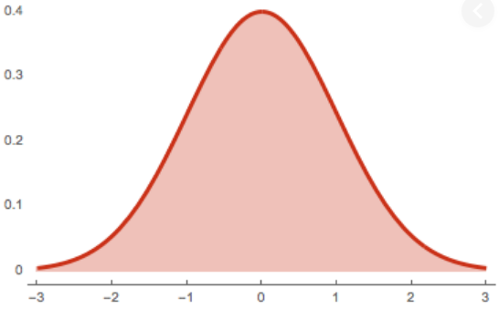
Statistical Process Control –
Understanding Variation
Variation is expected in any process.
Common-cause variation: Fluctuation caused by unknown factors → random distribution of output around an average
Special-cause variation: Caused by known factors → non-random distribution of output
Control limits can help distinguish special- and common-cause variation
Special-cause variation
Special-cause variation
Common-cause variation
Notes:
Thus far we have discussed two tools for visualizing and analyzing QI outcomes data – run charts and interrupted time series analysis. A third commonly used tool used in QI analysis is the statistical process control chart.
Variation occurs in any process. Statistical process control charts help distinguish between 2 types of variation:
Common cause variation: Fluctuation which is caused by random distribution of outputs around an average.
Special cause variation: Caused by specific events that lead to non-random distributions of an output around an average.

Slide 21
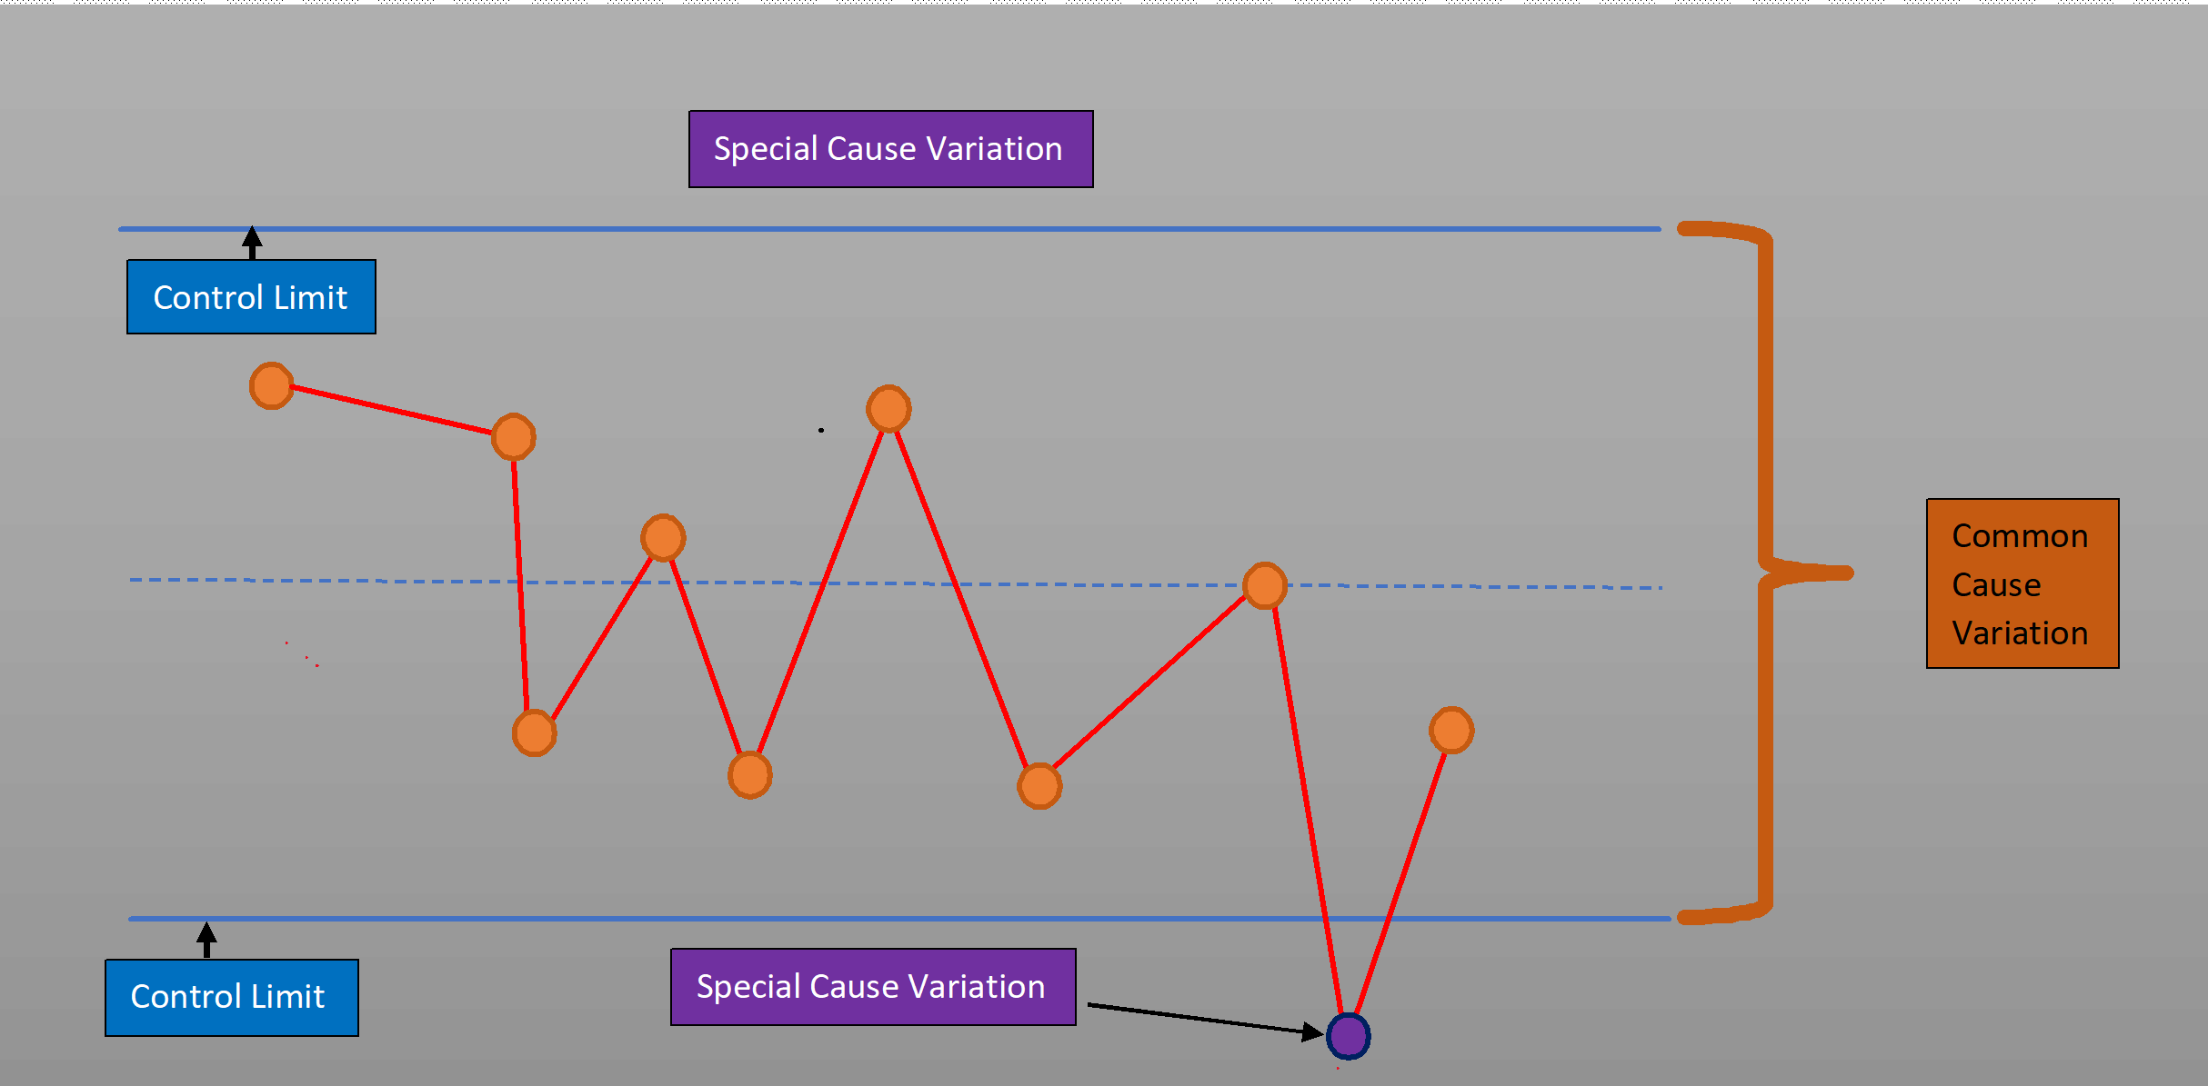
Statistical Process Control Chart
http://www.cqeacademy.com
Notes:
This slide depicts a statistical control chart. A control chart is statistical tool to distinguish between variation in a measure due to common cause vs special cause variation. There are established rules for setting control limits, which are depicted by the blue solid lines in this slide. Points outside of these control limits are considered to be the result of special cause variation, whereas points within the control limits are considered to be within the limits of common cause variation.
There are several different types of statistical process control charts. The correct type of statistical process control chart is determined by the type of data collected, however detailed review of these subtypes of SPCs are beyond the scope of this lecture

Slide 22
ACT
Synthesize data to begin planning next phases of intervention
Transition project to a process owner
Sponsor check-in
Notes:
In the act phase of the PDSA cycle, the team should synthesize the information that has been collected thus far and begin planning the next phase of intervention, if needed. PDSA is a method for continuous improvement, and it’s not uncommon to need to continue to make changes and improvements to your initial intervention to achieve the project’s goals.

Slide 23
“Without continual growth and progress, such words as improvement, achievement, and success have no meaning.”
–Benjamin Franklin

Slide 24
For more information,
please see
part 4 in the lecture series.
COPYRIGHT: ©American Academy of Dermatology/Association. All rights reserved.

