Slide 1
QI PILOT PROGRAM Performance/Process Improvement in Quality Improvement and Patient Safety LECTURE 2
Copyright American Academy of Dermatology | Association. All Rights Reserved. Proprietary materials for AAD/A use only. Reproduction or distribution of this material is strictly prohibited without prior permission.

Slide 2
“Without continual growth and progress, such words as improvement, achievement, and success have no meaning.” –Benjamin Franklin

Slide 3
Performance/Process Improvement

Slide 4
What is performance improvement?
A philosophy and process to identify and implement constructive, cost-effective opportunities to improve performance
Uses structured methodology
Establishes a continuous process with many cycles of improvement over time – requires upkeep!
Has measurable results – customer satisfaction, employee satisfaction, improved efficiency, increased productivity, increased profit and enhanced quality

Slide 5
Two Methodologies used in Process Improvement
Six Sigma (Focuses on precision)
Originated in car industry. Goal was to produce defect-free product 99.99966% of the time.
Seeks to improve process quality by minimizing variability and removing causes of defects.
Uses statistics to understand process variation.
DMAIC = Define, Measure, Analyze, Improve and Control
Lean (Focuses on efficiency)
Also originated in the car industry.
Systematic method for eliminating waste or non-value steps within a process
Examples of waste: over production, excess processing, and wait time
➔ Lean Six Sigma – combines efficiency with precision

Slide 6
A3 Problem Solving Report
A scientific method to execute performance improvements in an academic setting (aligned with Lean methodology)
Find
Organize/clarify
Understand/Select
Plan/Do
Study
Act
Notes:
A3 is a structured problem solving method first put in practice at Toyota. The goal is to use a structured plan that can be summarized on a sheet of paper, hence the name. This problem solving approach mirrors Deming’s Plan-Do-Check/Study-Act cycle.

Slide 7
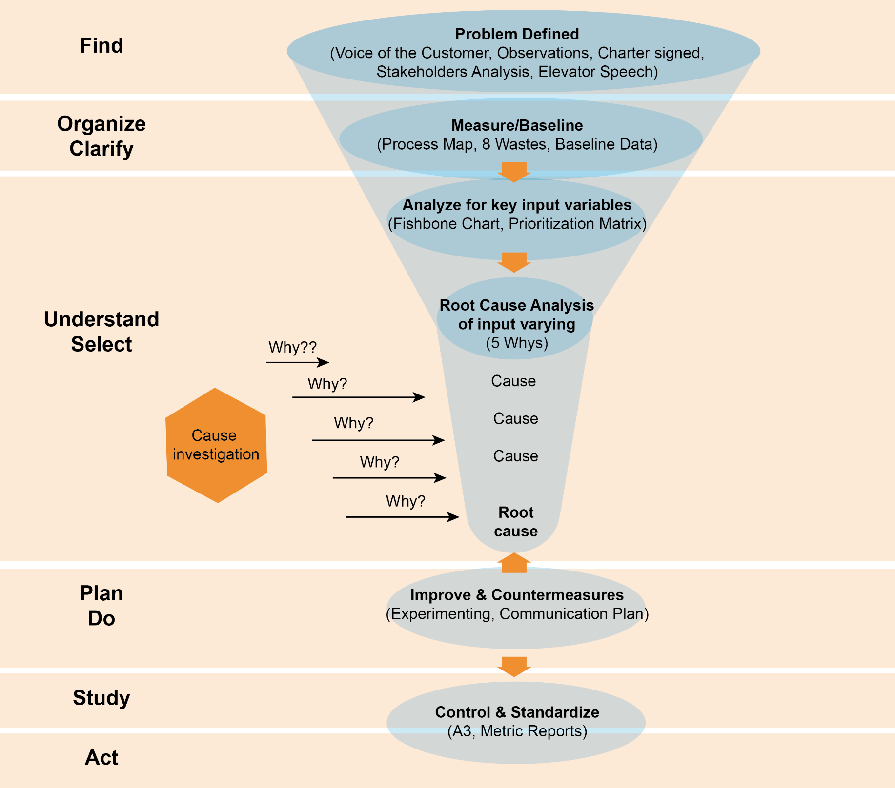
Performance Improvement at Penn Medicine
Notes:
Find – This is your starting point to better define the problem. In doing such, you need to get background information, identify those involved in the process or problem, set a goal and create your problem statement. The key components are the voice of the customer (VOC), observations of the process/current condition, development of a charter, identify stakeholders in your process improvement initiative and create an elevator speech.
Organize/clarify – This is aligns with the current condition in the A3 pathway. The goal is to observe the process and develop a process map.
Understand/Select – This aligns with the root cause analysis in the A3 pathway. RCA is a structured step by step process that focuses on finding the real cause of the problem.
Plan/Do – This aligns with the target condition in the A3 pathway. The goal is to identify ways to improve and propose countermeasures.
Study/Act – This aligns with the metrics and successful implementation of the intervention portion of the A3 pathway.

Slide 8
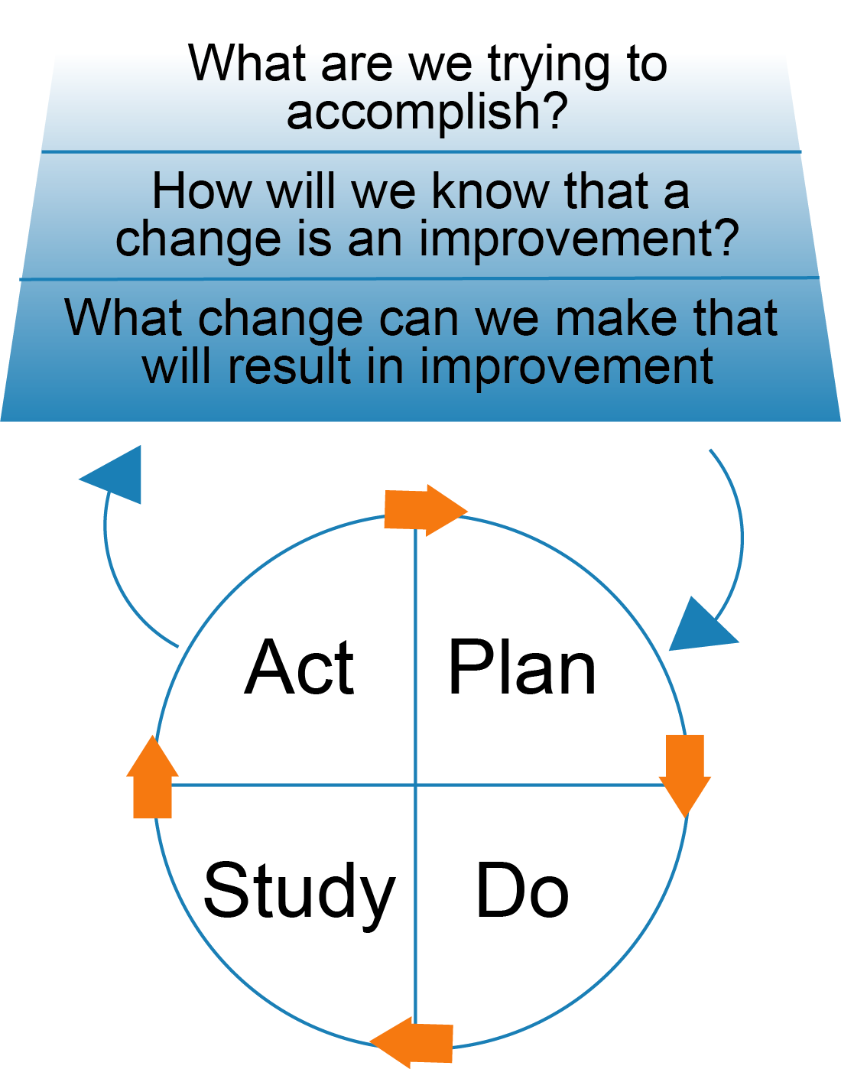
Model for Improvement
Institute for Healthcare Improvement
Notes:
Similar to the diagram on the prior slide, the goal is to answer the following questions which lead into a PDSA cycle:
What are we trying to accomplish? – Aligns with Define/Find
How will we know that a change is an improvement? – Aligns with organize/clarify
What change can we make that will result in improvement? – Aligns with Understand/select

Slide 9
Selecting a project
Project should address one of the most important/urgent needs in your practice
Sentinel safety events and the clinic’s error reporting system may signal problems that need to be addressed
Areas of underperformance in established quality measures
Notes:
What you select is one of the most critical parts of the performance improvement process. It can also be the most difficult.

Slide 10
FIND
Develop project charter
Problem statement
Voice of the customer
Team
Goal setting
Elevator Speech
Analyze stakeholders
Sponsor check-in

Slide 11
The Problem/Opportunity Statement
Problem/Opportunity statement is the most important stage of a project. It should answer these key questions:
A problem statement should not assign a cause or blame and should not include a solution.
“We are accidentally entering in the wrong dose for phototherapy leading to an increased risk of burns”
INSTEAD “The burn rate for patients getting phototherapy is 5%. The opportunity for improvement would be a 50% reduction in burn risk”.
What What is occurring or what are we missing?
When When did the problem start? How long has it been?
Where Where is the problem occurring?
Extent (Gap) What is the extent of the problem or gap?

Slide 12
Build an effective team
Effective teams include members representing 3 kinds of expertise: system leadership, technical expertise and day-to-day leadership
6-8 people is generally a good size
Clinical leader
Someone in the organization with enough authority to test and implement a change
Examples: Faculty mentor, department leader in QI, Vice chair of operations, nurse manager, chief resident
Technical expertise
Someone who knows the subject intimately and understands the process of care
Examples: nurses on the unit, medical assistants, social worker
Day-to-day leader
The driver of the project assuring tests are implemented and who oversees data collection
Examples: Project leader, nurse manager, director of operations
Project Sponsor
Someone with executive authority who can provide liaison with other areas of the organization
Examples: Residency Program Director, Chairman, Hospital Unit Medical Director
Notes:
Including the right people on an improvement team is critical to a successful improvement effort. Teams vary in size and composition. Each organization builds teams to suit its own needs.
First, review the aim.
Second, consider the system that relates to that aim: What system will be affected by the improvement efforts?
Third, be sure that the team includes members familiar with all the different parts of the process — managers and administrators as well as those who work in the process, including physicians, pharmacists, nurses, and front-line workers.
Finally, each team needs an executive sponsor who takes responsibility for the success of the project.
-- Institute for Healthcare Improvement

Slide 13
Project Charter Worksheet
Project Title
Problem Definition:
Scope:
Start point and end point
Who or what is included and excluded in the work?
Don’t include the solution
What would be better about that?
Will change after VOCs are completed
Role | Description | Name | Signature
Project Leader | Primary responsibility: to lead the team Serves as the primary communication link between the sponsor and the team Coordinates team logistics Schedules and plans monthly, biweekly, or weekly team meetings Keeps official records of team activities Oversees project and assigns tasks to team members for project completion
Executive Sponsor | Typically chair or chief of department or executive leader Assists team to remove barriers May need to provide resources Participates in report outs and approves the action plans or provides the team further direction
Mentor(s) | Assists the Project Leader in planning team activities and evaluating team meetings Coaches the team in use of the improvement model and appropriate analytical tools Meets with project leader weekly in person or via phone call
Champion | To provide guidance to the Project Leader Typically physician leader or nurse manager of project location
Team members | Completes tasks towards project completion Participates fully in team meetings Meets biweekly or monthly at minimum
Notes:
Above worksheet from Upenn GME
Make sure its multidisciplinary
Everyone should sign this
Look to Stakeholder Analysis
Pick team Members from Roles/Locations on Analysis
Make sure team has the “touches” of your process/problem
Involve a Facilitator
Include an Executive Sponsor/Champion

Slide 14
Voice of the Customer
Go to the where the problem is occurring and directly observe the process.
Ask people with different roles in the process:
What works well?
What doesn’t work well?
What would you change?
Why would you change it?
Allows for immediate feedback and perceptions
Notes:
The customer is someone who is involved in or affected by the problem. The voice of the customer allows you to directly capture feedback from those individuals. Feedback can be obtained via surveys, interviews, focus groups, suggestions and observations.

Slide 15
Voice of the Customer Worksheet
What works well?
[Role] | [What they said] | [What you think it means]
What does not work well?
If you could change one thing what would it be and why:
Notes:
Above worksheet from Upenn GME

Slide 16
Developing a Stakeholder Analysis
Customer: Role/person who receives an output to a process or process step
Process owner: Role/person responsible for design, continuous improvement, and sustaining the process
Decision maker: Role/person who has authority to give approval
Target of change: Role/person who is directly impacted by a proposed change.
Interested party: Has a recognizable stake but may not be directly involved in the process.
Supplier to the process: Role/person providing input to the system
Notes:
Stakeholders are those who have an interest or “stake” in the process and its outcome.

Slide 17
Stakeholder Analysis
1) Insert X for current support 2) Insert O where they need to be 3) Insert arrow for gap in-between
Name(s) or Group(s) | Strongly Against | Moderately Against | Neutral | Moderately Supportive | Strongly Supportive
Notes:
Above worksheet from Upenn GME

Slide 18
Goal Setting
Goals should be SMART
Specific
Look at a specific area for improvement
Measurable
Make sure your scope is measurable using input or output metrics
Attainable
Make sure your goal is realistic and guided by the original problem
Relevant
Fixes the what would be better about that from the problem statement
Time Bound
Can be done within a reasonable time frame
Notes:
In 2001, the institute of medicine issued a second report (following their 1999 report To err is human: building a safer health system), Crossing the quality chasm: a new health system for the 21st century. This report outlines 6 overarching “aims for improvement” for health care: Safe: Avoid injuries to patients from the care that is intended to help them.
Effective: Match care to science; avoid overuse of ineffective care and underuse of effective care.
Patient-Centered: Honor the individual and respect choice.
Timely: Reduce waiting for both patients and those who give care.
Efficient: Reduce waste.
Equitable: Close racial and ethnic gaps in health status.
Aim should be time specific and measurable
“Reduce MRSA infections.”
“Reduce MRSA infections by 30% within 12 months in patients admitted to University of Minnesota Medical Center.”

Slide 19
Elevator Speech
Purpose:
Clearly and simply state the need for change
Describe the future state
“Sell” the project to stakeholders
Express a unified vision for the team
Answer these four questions:
What is our project about?
Why is it important to do?
What does success look like?
Here’s what we need from you…
Combine the four answers into one fluid statement
In everyday language
Easy to repeat
Example:
"Dermatology residents are under-reporting sharps injuries leading to potential harm for patients and providers. We need your support to launch an anonymous sharps injury reporting hotline with the goal of increasing sharps reporting by 50% in three months time."
Notes:
An elevator speech is a clear brief message that theoretically can be delivered in the time it takes for someone to ride an elevator together, about 30 seconds.

Slide 20
ORGANIZE AND CLARIFY
Observe the process
Watch the process first hand from start to finish
Create current process map
Visual document of the process
Validate current process
Identify which parts of the process add value from the viewpoint of the customer
Collect baseline data

Slide 21
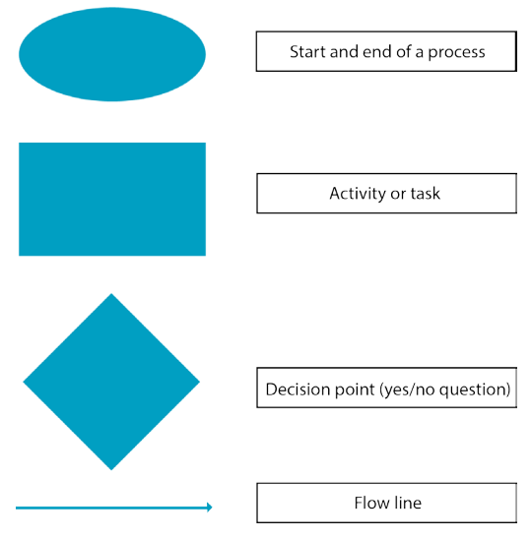
Flowchart
Flow charts are a pictorial illustration that map out a process so that it can be easily communicated.
Developing an accurate and complete flow chart requires direct observation of the process and asking the right people/engaging the customer
Performance Improvement at Penn Medicine

Slide 22
Example flowchart
Patient has labwork ordered for medication monitoring
YES
Nurse triage calls patient three separate times
YES
Labwork abnormal?
Patient Reached?
NO
NO
Letter sent to patient by nurse triage with normal labs
Certified letter sent in mail
Results communicated

Slide 23
UNDERSTAND/SELECT
Analyze baseline data
Do the data support that a problem exists?
How big/prevalent is the problem that you’re planning to address?
Identify root causes
Fish bone diagram
5 Whys

Slide 24
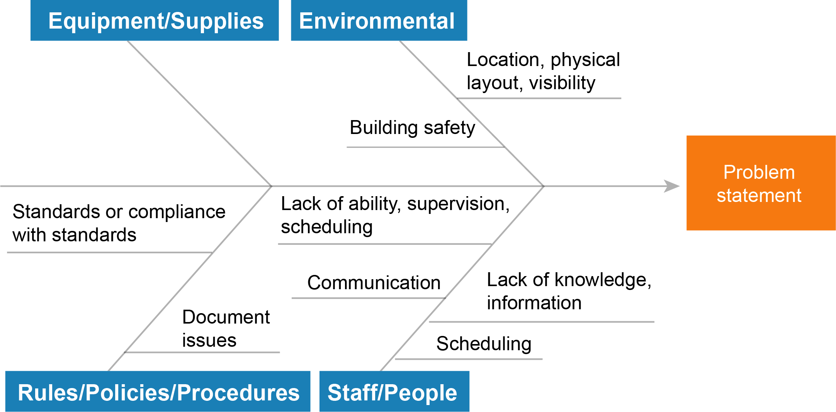
Fishbone Diagram
Here is an example of the start of a fishbone diagram that shows sample categories to consider, along with some sample causes.
Performance Improvement at Penn Medicine
Notes:
A fishbone diagram is essentially a cause and effect diagram with the problem at one end with all the variables contributing to it at the other. The actual fishbone allows for a visual demonstration of the potential causes of a specific problem.

Slide 25
5 Whys
The simple idea is to keep asking "Why" (usually five times) to ensure that the root cause of the problem is fully understood.
Notes:
The key to solving a problem is to truly understand it in the first place. We often shift to finding a solution before completely comprehending its cause. One way to identify a root cause is to ask “why” 5 times. The concept is that you do not stop after the first why and that deep questioning of the problem will lead you to its actual root cause.
Here is an example of how to ask "Why?" five times (per the institute for healthcare improvement):
Why is a patient's intravenous run rate wrong? The previous nurse didn't change the run rate.
Why didn't the previous nurse change the rate? The doctor's order had gone to the pharmacy and the medication administration record (MAR) was not updated.
Why wasn't the MAR updated? The MAR is updated only once per day.
Why is the MAR updated only once per day? The hospital has chosen to use oral instructions for updates that happen more frequently.
Why are oral instructions used? The process was constructed a decade ago, when medication orders changed less frequently due to longer lengths of stay. Upon further study, the hospital determines that 40 to 50 percent of its medications change every day.

Slide 26
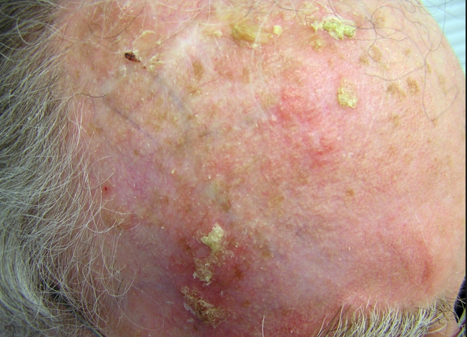
Let’s go back to our case from lecture 1 Case of Dermatology Safety Event
Mr. Thomas referred to Mohs surgeon for treatment of SCC on “Right anterior scalp.”
No biopsy site photograph accompanies the referral.
The patient and Mohs surgeon agree on the surgical site, and Mohs surgery is performed.
The patient’s daughter calls the next day livid because she said the SCC was located somewhere different from the surgical site.
Notes:
Let’s investigate an example case of how a wrong site surgery might happen in routine practice.
Potential interactive opportunity: Spend 2-3 minutes discussing contributing factors to this safety event. Have you ever experienced a similar situation?

Slide 27
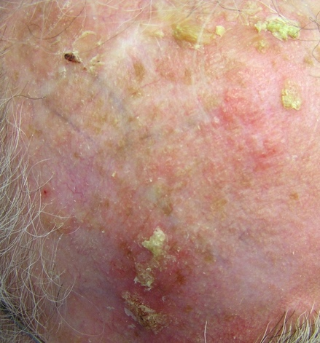
Case of Dermatology Safety Event
Mr. Thomas referred to Mohs surgeon for treatment of SCC on “Right anterior scalp.”
No biopsy site photograph accompanies the referral.
The patient and Mohs surgeon agree on the surgical site, and Mohs surgery is performed.
The patient’s daughter calls the next day livid because she said the SCC was located somewhere different from the surgical site.
Notes:
Let’s investigate an example case of how a wrong site surgery might happen in routine practice.
Potential interactive opportunity: Spend 2-3 minutes discussing contributing factors to this safety event. Have you ever experienced a similar situation?

Slide 28
5 Whys
The reasoning is that the result of each time the Why is asked gives a different answer finally getting to the issue at its core:
Problem: lack of adequate (notable anatomic site) biopsy site photograph in the patient chart
First Why—individual was rushed and quickly took the photograph and put it in the wrong place (Don’t stop here!) (Symptom)
Second Why—they didn’t realize they had to take a photo with the anatomic location evident (Excuse)
Third Why—they were never instructed how to use the device, take photographs, or upload (Blame)
Fourth Why—they do not receive training on the importance of biopsy site photograph and lesion identification (Cause)
Fifth Why—Biopsy site photography is not identified as an important issue with onboarding of new staff and therefore, staff do not receive education regarding what would be an anatomic landmark and hands on training using the photography device and uploading system (Root cause)
Notes:
Our case is the perfect example of how the 5 whys are critical to fully understanding the problem.

Slide 29
Notes:
Now we are ready for the PDSA portion of our process improvement pathway

Slide 30
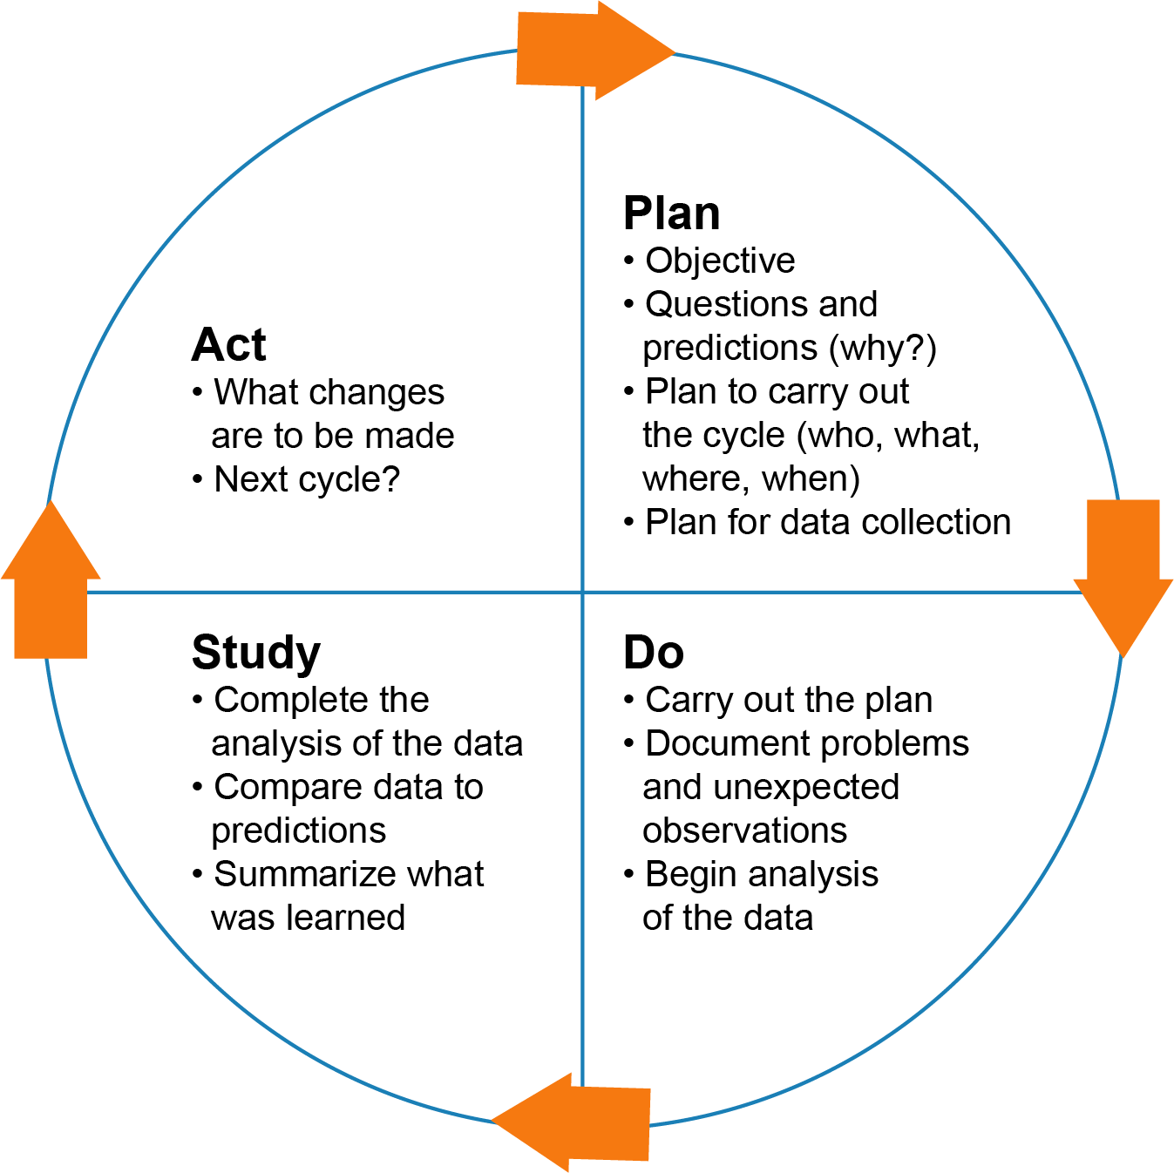
PLAN/DO
Create the future state process map
The ideal process with waste eliminated
Develop countermeasures
What tools will reduce or eliminate the root cause?
What does the customer really need?
What process improvements will be necessary to achieve the future state?
Develop pilot
When the scope of the change in large or costly
Communicate change
Identify your audience and the message
Sponsor check-in
Notes:
The real process map is always “messier” than one would envision. A future process map would be to clean up that mess and create a more streamlined or efficient future state.
Change concepts → change ideas
Eliminate waste
Improve work flow
Optimize inventory
Change the work environment
Producer/customer interface (aka provider/patient interface)
Manage time
Focus on variation
Error proofing
Focus on the product or service

Slide 31
Types of Metrics
Process
Measures performance at different steps along the care pathway
Are the parts/steps in the system performing as planned? Are we on track in our efforts to improve the system?
Ex. % of patients whose Hgb A1c level was measured twice in past year
Outcome
Measures the results of care
How does the system impact the values of patients, their health and wellbeing? What are impacts on other stakeholders?
Ex. Average Hgb A1c level for patients with diabetes
Balancing
Did your process improvement cause a new problem?
Are changes designed to improve one part of the system causing new problems in other parts of the system?
Ex. If you reduce patient’s length of stay in the hospital, make sure readmission rates are not increasing
Notes:
Measurement is a critical part of testing and implementing changes; measures tell a team whether the changes they are making actually lead to improvement.
Here are examples of the different types of metrics:
Outcome
For diabetes: Average hemoglobin A1c level for population of patients with diabetes
For access: Number of days to 3rd next available appointment
For critical care: Intensive Care Unit (ICU) percent unadjusted mortality
For medication systems: Adverse drug events per 1,000 doses
Process
For diabetes: Percentage of patients whose hemoglobin A1c level was measured twice in the past year
For access: Average daily clinician hours available for appointments
For critical care: Percent of patients with intentional rounding completed on schedule.
Balancing
For reducing time patients spend on a ventilator after surgery: Make sure reintubation rates are not increasing
For reducing patients' length of stay in the hospital: Make sure readmission rates are not increasing
Process – are we doing what we ought to be doing
Outcome – are we doing it well
Balancing – is what we are doing causing problems elsewhere

Slide 32
Biopsy site photography
Outcome Measure | Process Measure | Balancing Measure
Number of wrong site surgeries | Number of patients with biopsy site photo available at time of surgery | Time of visit Extra time loading photos Cost of camera/device

Slide 33
STUDY
Track data
Make decisions based on data

Slide 34
ACT
Build sustainable metrics
Establish control chart
tool that will help the process owner execute specific actions if critical control points fail
Transition project to process owner
Sponsor check-in

Slide 35
“We are what we repeatedly do. Excellence, then, is not an act, but a habit.”
- Aristotle

Slide 36
For more information, please see part 3 in the lecture series.

