Slide 1
Annual General Meeting
ABN AMRO Bank N.V.
22 April 2026

Slide 2
Opening and announcements
1

Slide 3
Agenda
Opening and announcements
Annual report and corporate governance (voting item)
Reservation- and dividend policy, dividend proposal (voting item)
Discharge (voting item)
Report on the functioning of the external auditor (discussion item)
Composition of the Supervisory Board (voting item)
Composition of the Executive Board (discussion item)
Cross-border merger ABN AMRO and Hauck Aufhäuser Lampe Privatbank AG (voting item)
Issuance of new shares by ABN AMRO and acquisition of (depositary receipts for) shares by ABN AMRO (voting item)
Cancellation of (depositary receipts for) shares in the issued share capital of ABN AMRO (voting item)
Any other business and closing

Slide 4
Annual report and corporate governance
2

Slide 5
Report of the Executive Board for 2025
2(a)

Slide 6
Key developments 2025
The world around us | Geopolitical tensions leading to increased uncertainties for global markets Dutch economy continues to perform well Rising focus on the broader impact of artificial intelligence
Results | Good financial results Growth in mortgage portfolio and customer deposits Significant fee growth from acquisition of HAL Strict cost discipline delivering on strategic ambitions Solid credit quality Strong capital position Delivering on profitable growth, right-sizing cost base and optimising capital allocation
Development key financials
EUR bn | 2025 | 2024
Net interest income | 6.3 | 6.5
Net fee and commission income | 2.1 | 1.9
Operating income | 8.7 | 8.9
Operating expenses ¹⁾ | 5.6 | 5.5
Profit | 2.3 | 2.4

Slide 7
Our longer-term vision
Committed to our purpose
Banking for better for generations to come
Guided by longer-term ambitions
Strengthen position in Dutch retail banking
Become a Top 5 European private bank
Support family-wealth
& -businesses
Drive growth by supporting European transitions
Grow Clearing to sustain global Top 3 position

Slide 8
2028 priorities and targets
Grow profitably
Right-size cost base
Optimise capital allocation
Strengthen position in Dutch retail
Grow the private bank
Grow in family-wealth & -businesses
Drive growth in European transitions
Maintain global top 3 Clearing position
Transform organisation
Simplify operations
Reduce complexity in IT
Leverage automation and AI to boost efficiency
900m cost savings, 5200 FTE reduction
Deploy capital at higher ROE
Release RWA through improving data quality
Apply strict criteria for growth
Exit underperforming exposures
Capital relief through SRTs
Attractive 7.5bn capital distribution
Return on equity ¹⁾
Cost/income ratio ¹⁾
Capital allocation Corporate Bank, excluding Clearing
>12%
60%
58%
c.50%
10%
<55%
2024
2028
2024
2028
2024
2028
1) Income statement adjusted for large incidentals

Slide 9
Grow Profitably - Good progress for all client units in 2025
Personal &
Business Banking
Mortgage growth of over 8bn in 2025 with 19% market share
Client deposits inflow of c.4bn, mainly in savings and current accounts
New10 reached 1bn in SME financing to >10,000 entrepreneurs
Mortgages, €bn, CAGR%
+5-6%
>190
NIBC
2024
2025
2028
Wealth Management
Strong increase in client assets Growth in Net New Assets, supported by addition of HAL assets and good market performance, led to
New Ghent (BE) branch targeting entrepreneurs and families
Client assets, €bn & CAGR %
+8-10%
>335
283
HAL
HAL
2024
2025
2028
Corporate
Banking
Ample capital headroom for profitable growth following SRT
Higher fees in Clearing and Global Markets
Growth in transition sectors including defence
RWA allocation CB ¹⁾
58%
c.51%
c.50%
2024
2025
2028
1) Excluding Clearing

Slide 10
c.30% of FTE reductions realised
Right-size cost base
Optimise capital allocation
Significant RWA reduction realised
Strong reduction in external FTEs from tighter controls on hiring
Internal FTEs broadly stable due to internalisation of externals and some business growth
Of the 900m cost savings to be realised by 2028, c.160m achieved by YE2025, mainly from commercial optimisation and streamlining IT landscape
Over 2025 credit risk RWA decreased by EUR 6.6bn
Significant decrease driven by optimisation, data quality improvements and risk transfers
Partly offset by portfolio transitions to the Standardised Approach and the acquisition of HAL
Operational risk RWA up EUR1.7bn, reflecting income growth and the inclusion of HAL

Slide 11
Attractive capital returns as we optimise capital allocation
Final dividend of 0.70 p.s. proposed, together with interim dividend of 0.54 p.s. equals 50% pay-out of net profit ¹⁾
Additional distributions of 500m, consisting of 250m cash dividend and a 250m share buyback programme (pending regulatory approval)
2025 pay-out ratio is 87%
Distribution ambition for ’26-’28 is to pay-out up to 100% of net profit ¹⁾
Distributions and pay-out ratio, €bn
94%
87%
78%
69%
50%
1.307
1.025
1.125
2021
2022
2023
2024
2025
Pay-out ratio
Additional dividend
Cash dividends
Share buyback
1) After deduction of AT1 coupon payments and minority interests

Slide 12
Move from broad ambition to impactful delivery
Building on past success, we focus our commercial sustainability strategy on climate
We commit to reduce the absolute emissions of our lending book in line with a Well-below 2°C pathway, serving as a backstop to our climate ambition.
To support this aim, we maintain our existing sectoral intensity targets, most of which are 1.5°C-aligned.
Develop a Transition Finance Framework to help support long-run achievement of net zero
Focused push on commercial climate opportunities
Energy label
upgrades across
real estate
portfolio
Expertise &
finance for deep
sea shipping
emission
reductions
Deliver €8B
renewable
energy fin.
by 2028

Slide 13
2028 financial targets
Capital allocation Corporate Bank ¹⁾
Return on equity
Cost/income ratio
Income
CET1 ratio
>12%
<55%
>€10bn
>13.75%
c.50%
Full year 2025 results
ROE
C/I
Income
CET1
CB%
8.7%
64.4%
8.7bn
15.4%
51%
1) Excluding Clearing

Slide 14
Closing remarks CEO

Slide 15
Report of the Supervisory Board for 2025
2(b)

Slide 16
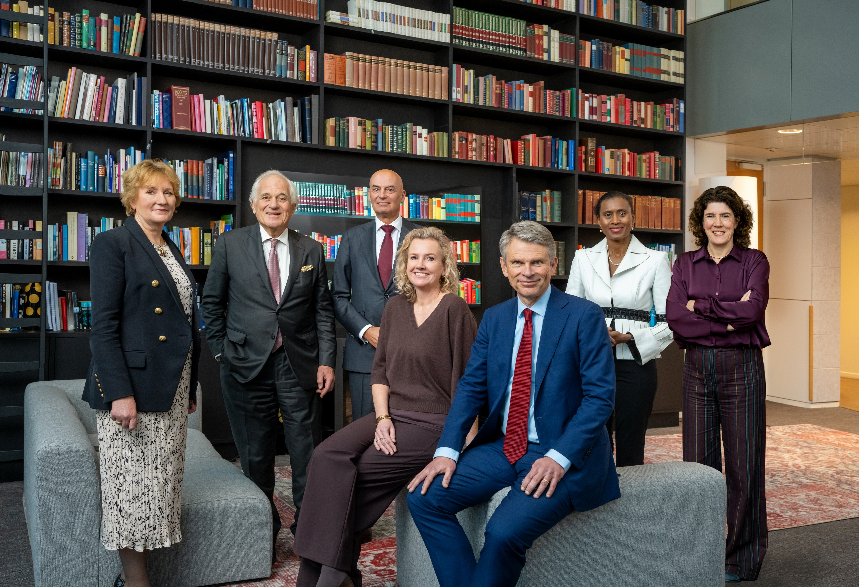
2b. Report of the Supervisory Board for 2025
Please refer to the report of the Supervisory Board included on pages 157 through 167 of the Annual Report 2025.

Slide 17
Presentation of the Employees Council
2(c)

Slide 18
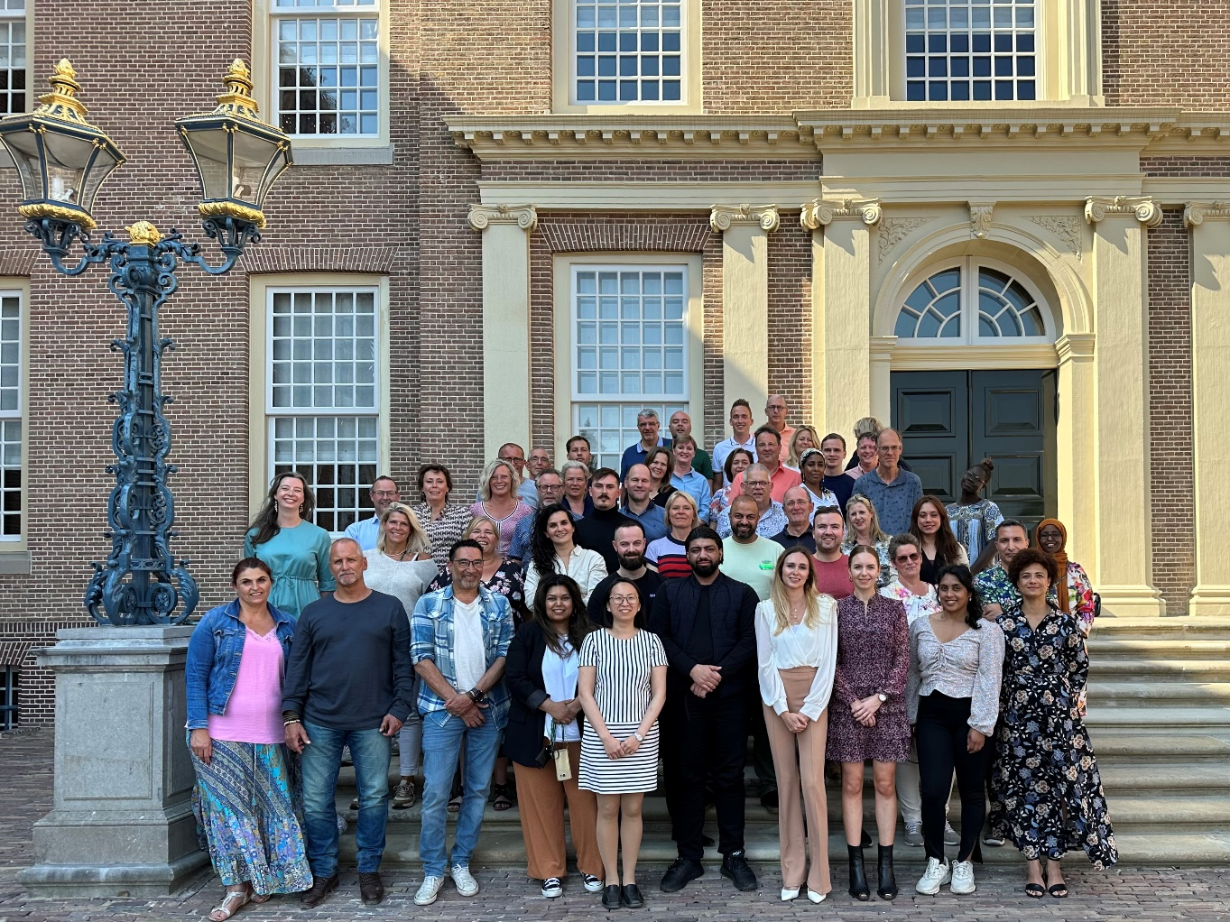
2c. Presentation of the Works Council
Ms Arlene Bosman
Chair Works Council
ABN AMRO Bank N.V.

Slide 19
Corporate Governance
2(d)

Slide 20
2d. Corporate Governance
Please refer to the Leadership & Governance section as included on pages 143 through 192 of the Annual Report 2025.

Slide 21

Remuneration Report for 2025
2(e)
voting item

Slide 22
2e. Remuneration Report for 2025
Participants can vote virtually throughout the meeting.
The result of the vote will be announced at the end of the meeting.
voting item

Slide 23
External auditor’s presentation and Q&A
2(f)

Slide 24
ABN AMRO Bank N.V. Audit Financial Statements 2025
Presentation for Annual General Meeting
22 April 2026

Slide 25
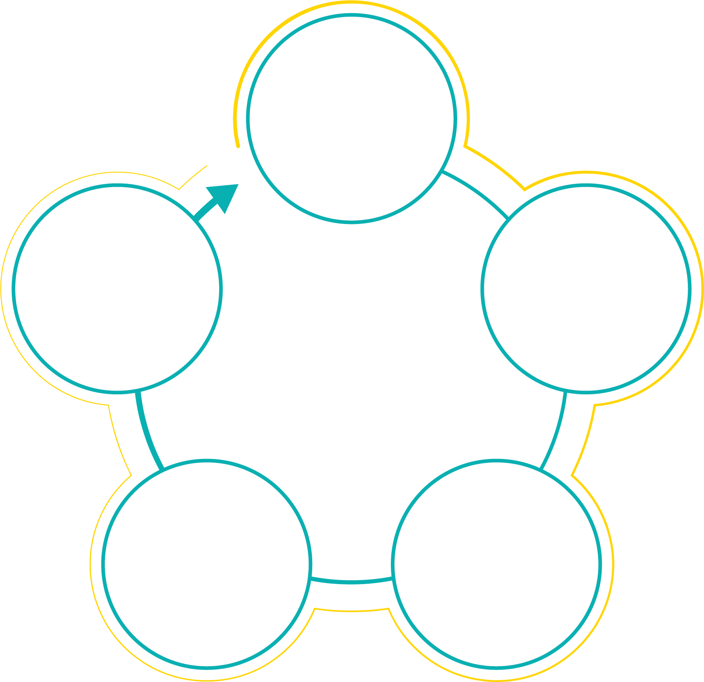
Financial Statements 2025 Scope and Timing
Annual Report:
Annual Financial Statements
Executive Board Report
Sustainability Statements
Other information
Quarterly reviews
Prudential reporting (COREP/FINREP)
Statutory audit subsidiaries
Other assurance (related) engagements
Apr –May ‘25
Audit Planning and Q1 review
Apr –Jun ‘26
Prudential Reporting Statutory audits
Other Assurance
Jun - Aug ‘25
Walkthroughs key
processes and
Q2 review
Dec 25 - Mar ‘26
YE procedures Annual Report
Sep –Nov ‘25
Key Controls testing and
Q3 review

Slide 26

Financial Statements 2025 Audit approach
Attention areas 2025
Strategy execution
Acquisitions and disposals
External developments
Regulatory remediation and legal developments
IT environment and cyber crime
Sustainability reporting
Materiality
Basis for banking industry is the level of equity
Benchmark is set at 0.7%, same as previous year
Tolerable error: EUR 90 million
Planning
materiality
180 million
Audit
difference
threshold
9 million
Key audit matters
Estimation uncertainty:
Impairment allowances for loans and advances to customers
Provisions and contingent liabilities related to legal claims and compliance matters
Reliability and continuity of IT environment

Slide 27
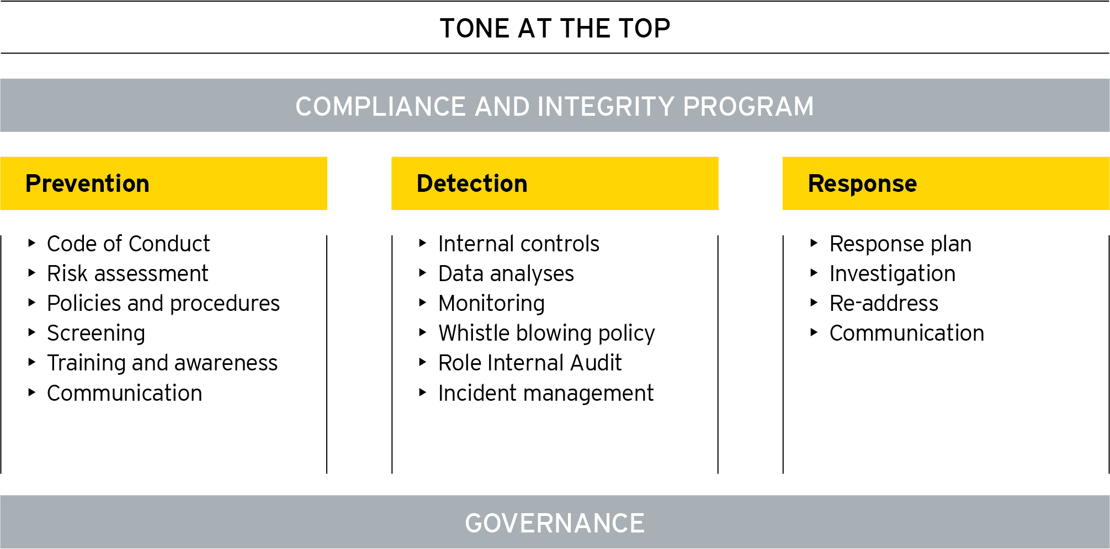
Financial Statements 2025 Risk of fraud and non-compliance
Risk of fraud
Assessment of ABN AMRO’s overall risk framework for fraud, bribery and corruption
Frequent meetings with compliance, legal, security affairs, operational risk and internal audit functions of ABN AMRO
Assessment of design of (fraud) incident identification and remediation procedures
Review accounting estimates for management bias/override and run data analytic procedures on manual journal entries and procurement process
Involvement from own forensic specialists
Risk of non-compliance with law and regulations
Review of ABN AMRO’s SIRA documents
Focus on regulatory inspections and investigations and follow up on remediation/recovery programs
Assessment of design on anti-money laundering (KYC, TM) and sanction processes
Review of whistle blower reports, reports from risk and compliance departments and correspondence with regulators
Involvement from own legal specialists

Slide 28
Financial Statements 2025 Sustainability Information
Two limited assurance reports:
Sustainability Statement (CSRD) in the Annual Report, prepared in accordance with the European Sustainability Reporting Standard as adopted by the European Commission (including EU Taxonomy)
Specific strategic sustainability KPI’s as included in the chapter ‘Strategy & performance’ in the Annual Report
Attention areas 2025
Impact of organizational developments
Double Materiality Assessment
Estimations & uncertainties in metrics & targets
Climate strategy update and transition plans
Climate & Environmental Risks
EU Taxonomy reporting
CSRD and KPI’s compliance incl. balanced reporting
Materiality – 2 levels:
Reporting materiality
Qualitative
including completeness
Element materiality
Quantitative
per KPI

Slide 29
Financial Statements 2025 Conclusion and other remarks
Conclusion
Unqualified audit opinion 2025 on the Annual Financial Statements
Limited assurance conclusions:
Sustainability Statement: unqualified conclusion with 4 inherent limitations associated with measurement or evaluation of sustainability information
Strategic sustainability KPI’s (SAS, NPS): unqualified conclusion
Other information included in the annual report
Complies with the law, corporate governance code including the statement of risk management (‘’VOR’’) and is consistent with the financial statements
Other remarks
Communication: Management letter on internal control observations; quarterly reporting and long form report; independence communication
Prudential reporting, statutory audit subsidiaries and other assurance (related) engagements
Transparent communication and good cooperation

Slide 30

Questions?

Slide 31
Adoption of the audited 2025 Annual Financial Statements
2(g)
voting item

Slide 32
Reservation- and dividend policy, dividend proposal
3

Slide 33
Reservation- and dividend policy
3(a)

Slide 34
Dividend proposal
3(b)
voting item

Slide 35
3b. Dividend proposal
It is proposed to adopt a final dividend of EUR 0.70 per share over the financial year 2025
voting item

Slide 36
Discharge
4

Slide 37
Discharge of each member of the Executive Board in office during the financial year 2025 for the performance of his or her duties during 2025
4(a)
voting item

Slide 38
Discharge of each member of the Supervisory Board in office during the financial year 2025 for the performance of his or her duties during 2025
4(b)
voting item

Slide 39
Report on the functioning of the external auditor
5

Slide 40
AGM 2026: Evaluation of the performance of the external auditor
Approach
On an annual basis the performance of the external auditor is evaluated by the Supervisory Board of ABN AMRO. The evaluation includes an internal survey. The survey had a good response rate of 41 participants, including various Supervisory Board and Executive Board members as well as relevant senior executives in Finance, Risk and Internal Audit and across the Business lines. The survey provides a good indication of management’s assessment.
Outcome 2025 evaluation
The overall score improved to last year’s evaluation and represents a Good score.
The survey resulted in a score of 3.9, compared to 3.7 in 2024 (on a 5-point scale).
• Compared to last year, EY improved their services in all areas except for a minor decrease in the area of non-financial information which includes aspects like strategic developments, culture and behaviour, governance and sustainability.
• As in previous years, strong results are noted amongst respondents around independence and objectivity, knowledge and competence. Also, financial reporting risks and awareness around risk developments score good.
• Compared to last year, most considerable improvements were perceived in professional scepticism, a more efficient structuring of work, an improved data driven audit approach and quality and readability of the management letter.
• Although on a satisfactory level, opportunity to improve in terms of effectiveness, efficiency and the relevance of information exchange is observed regarding:
o the timely discussion of findings, and the translation of observations into concrete actions;
o effective and efficient exchange of information, and
o visibility of innovation in the audit approach.

Slide 41
Composition of the Supervisory Board
6

Slide 42
Notification of vacancies on the Supervisory Board
6(a)

Slide 43
Opportunity for the General Meeting to make recommendations, with due regard to the profile
6(b)

Slide 44
Opportunity for the Employees Council to explain the position statement
6(c)

Slide 45
Re-appointment of Sarah Russell as a member of the Supervisory Board
6(d)
voting item

Slide 46
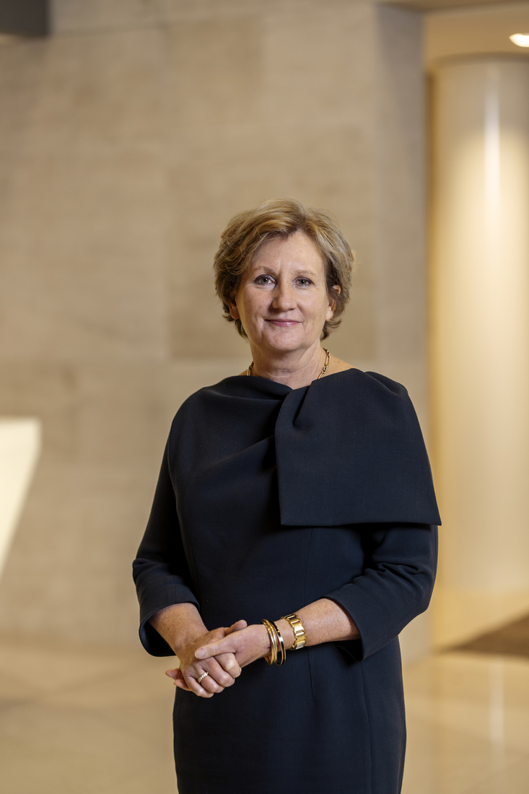
6(d) Re-appointment of Sarah Russell as a member of the Supervisory Board
The Supervisory Board has nominated Sarah Russell for re-appointment as a member of the Supervisory Board. Sarah Russell was first appointed to the Supervisory Board on 20 April 2022.
The Supervisory Board proposes to the General Meeting to re-appoint Sarah Russell as a member of the Supervisory Board, for a period of 4 years, effective as of the close of the General Meeting and ending at the close of ABN AMRO’s annual general meeting in 2030, in accordance with the Articles of Association.
voting item

Slide 47
Appointment of Jean-Pierre Mustier as member of the Supervisory Board
6(e)
voting item

Slide 48
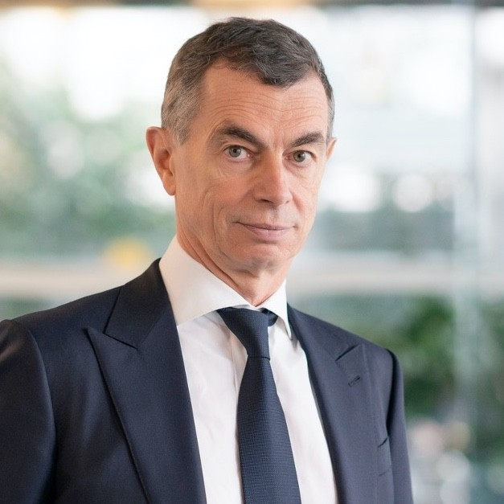
6(e) Appointment of Jean-Pierre Mustier as member of the Supervisory Board
The Supervisory Board proposes to appoint Jean-Pierre Mustier as a member of the Supervisory Board effective as of the close of the General Meeting.
The term of appointment will end at the closure of ABN AMRO's annual general meeting in 2030, in accordance with the Articles of Association.
For more information, reference is made to the resume of Jean-Pierre Mustier which is available as a meeting document via the website of ABN AMRO.
voting item

Slide 49
Composition of the Executive Board
7

Slide 50
Notification of the intended reappointment of Dan Dorner as member of the Executive Board with the title Chief Commercial Officer Corporate Banking
7(a)

Slide 51
Notification of the intended reappointment of Choy van der Hooft-Cheong as member of the Executive Board with the title Chief Commercial Officer Wealth Management
7(b)

Slide 52
Notification of the intended reappointment of Annerie Vreugdenhil as member of the Executive Board with the title Chief Commercial Officer Personal & Business Banking
7(c)

Slide 53


Cross-border merger ABN AMRO and Hauck Aufhäuser Lampe Privatbank AG
8
voting item

Slide 54
Issuance of new shares by ABN AMRO and acquisition of (depositary receipts for) shares by ABN AMRO
9

Slide 55
Authorisation to issue shares and/or grant rights to subscribe for shares
9(a)
voting item

Slide 56
Authorisation to limit or exclude pre-emptive rights
9(b)
voting item

Slide 57
Authorisation to acquire (depositary receipts for) shares in ABN AMRO’s own capital
9(c)
voting item

Slide 58
Cancellation of (depositary receipts for) shares in the issued share capital of ABN AMRO
10
voting item

Slide 59
Any other business and closing
11

Slide 60
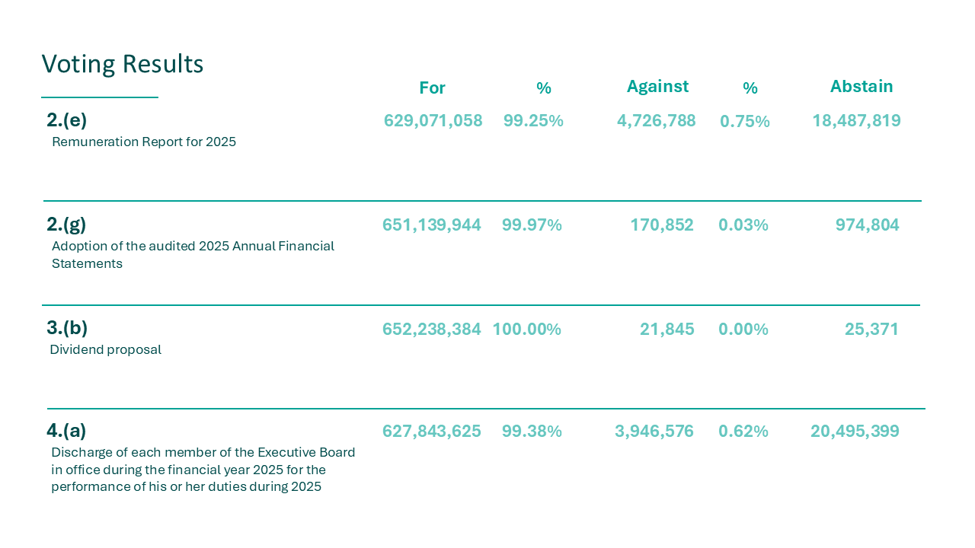

Slide 61
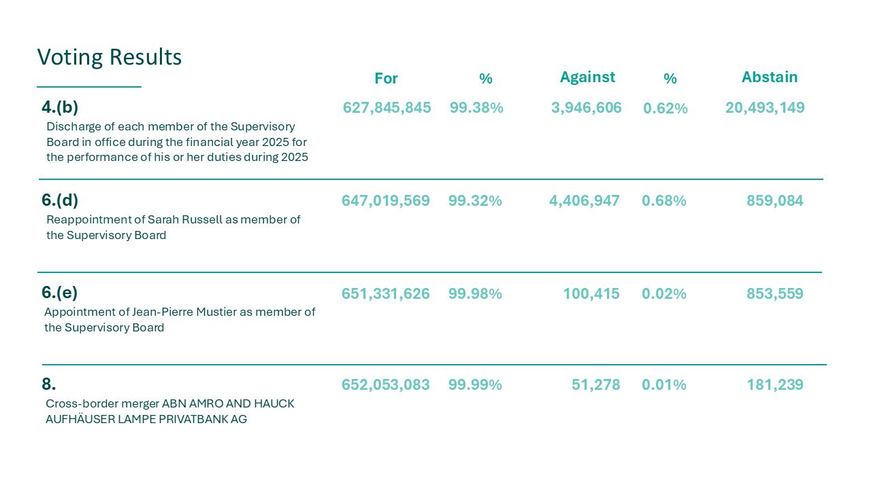

Slide 62
