Slide 1
Modern Slavery Report 2020
This statement relates to the financial year 1 January 2020 to 31 December 2020.

Slide 2
Modern Slavery Act Transparency Statement 2020
Safeguard Global is a global human resources and payroll solutions outsourcing company. Founded in 2008, it has expanded to cover more than 130 countries worldwide with capability of covering 170 + countries via its internal resources and third party partner relationships, delivering to its clients a range of flexible and tailored solutions be it a small medium or large business.
Safeguard Global serves over 250 clients worldwide from its regional service centres based in EMEA, America’s and APAC.
Safeguard Global believes that protecting the dignity and rights of all people is paramount to good business. It is a strong advocate for ensuring it maintains a strong sense of corporate social responsibility including compliance with the U.K Modern Slavery Act 2015, which includes but is not limited to, our network of payroll and human resources partnerships worldwide.
Safeguard Global’s dedicated supply chain department undertakes strict due diligence and regular partner reviews to ensure all partners operate a zero tolerance to a forced labour workforce or human trafficking. Furthermore Safeguard Global will not work with or will cease working with any partner that does not abide by its strict ethics in this regard.
Our legal and compliance team regularly works closely with all departments and specifically with supply chain to regularly check policies and procedures ensuring compliance at all times.
Safeguard’s HR team conducts thorough background checks on all joining team members and uses only reputable employment agencies to source labour, when required.
Additionally, as part of our ongoing overall approach to corporate social responsibility we also encourage localised fundraising events via the relevant social committees and via our ‘Time Off for Charitable Work Policy.’ This policy allows our employees to take up to two days per year to support a charity or community project of their choice.
Notes:
When employment within an occupation is heavily skewed towards either men or women, it is likely to introduce
occupational segregation – where some occupations become more attractive than others to either men or women.

Slide 3
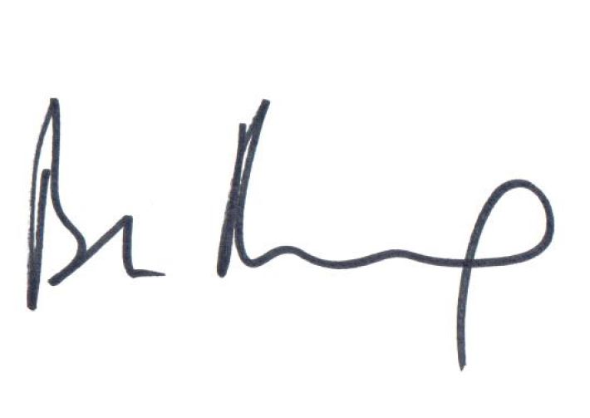
Statutory Approval and Signature
Chief Executive Officer Approval
This statement was approved on 15 February 2021 by Safeguard’s CEO, who reviews and updates it annually.
Bjorn Reynolds signature:
Bjorn Reynolds
CEO

