Slide 1
Getting Started - Understanding Contracting Options
MAY 2021

Slide 2
TOPICS
• Early Requirements Development
• Common Types of Contracting Approaches
• Selecting the Appropriate Contract Vehicle

Slide 3
Early Requirements Development
Notes:
FOR SCOTT: Who is responsible for this at NSIN. Which team or portfolio does the coordination with potential customers?

Slide 4
REQUIREMENTS DEVELOPMENT
Understanding Your Solution
Draft a Problem Statement
• Briefly explain the problem you’re trying to solve, and what the desired end-state/solution looks like.
Considerations:
• Does the solution exist already
• Is it commercially available
• Is it regularly used in the Government already
• Is it a Research and Development Effort
• Do you want to end up with Hardware, Software, Services or an as-a-Service platform
• What is long term goal, i.e. fielding or to advance TRL

Slide 5
REQUIREMENTS DEVELOPMENT
Market Research
• Should be taking place concurrently with the Problem Statement development.
• In accordance with FAR 10.002, must be current within the last 18 months
• Should be more recent than that if you’re looking at developmental projects, technology rapidly changes.
• Issue a Source Sought Notice on SAM.gov, also consider advertising the Notice through other electronic platforms (social media, PEO websites) concurrently.
Notes:
Make sure you’re not setting out to solve a problem that already has a solution. If there is already a solution, we don’t want to have an H4D semester (for example) on a solution that’s already available when it could focus on something else.

Slide 6
REQUIREMENTS DEVELOPMENT
How Much Should It Cost
• Create an initial Independent Government Estimate
• Be realistic. Accurate projection on project price/cost will inform scope of what the Government can ask the Contractor’s to perform
• Don’t just consider your available budget

Slide 7
REQUIREMENTS DEVELOPMENT
Identify Available Funding
The type of available funding will limit the types of contract vehicles you are allowed to use.
Appropriations Accounts | Time to Obligate (Years)
Operations and Maintenance (O&M) | 1
MILPERS | 1
Research and Development (R&D) | 2
Procurement | 3
SCN (Ships) | 5
Military Construction (MILCON) | 5
Useful Link: https://acqnotes.com/acqnote/acquisitions/ appropriation-categories

Slide 8
Common Types of Contracting Approaches

Slide 9
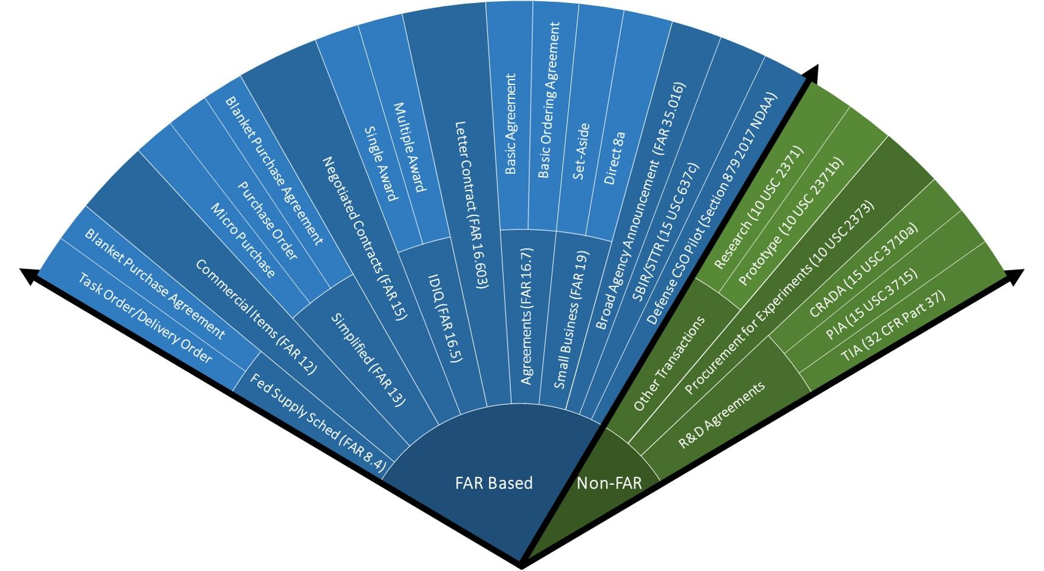
COMMON TYPES OF CONTRACTING APPROACHES
Non-traditional, unique/flexible approaches
Traditional, Federal Acquisition Regulations based approaches

Slide 10
COMMON TYPES OF CONTRACTING APPROACHES
Federal Acquisition Regulations (FAR)
• Federal Acquisition Regulations (FAR) based:
• Micro-purchase, $10k or less (FAR 13)
• Simplified Acquisition $250k or less (FAR 13)
• Commercial Item (FAR 12)
• Small Business Set-Aside (FAR 19)
• Broad Agency Announcements (FAR 35.016)
• Government Wide Acquisition Contracts (GWAC)/Required Sources
• Small Business Innovative Research (SBIR) / Small Busines Technology Transfer (STTR) Programs (https://www.sbir.gov/about)
• Commercial Solutions Opening

Slide 11
COMMON TYPES OF CONTRACTING APPROACHES
Non-FAR
• Other Transaction Agreement for Prototypes (10 USC §2371b)
• Other Transactions for Research Projects (10 USC §2371)
• Purchase for Experimental Purposes (10 USC §2373)
• Prize Authority (10 USC §2374a)
• Grants, Cooperative Agreements, or Technology Investment Agreement
• All three governed by the DoD Grants and Agreements Regulations (DoDGARS)
• Example, DPA Title III Funding Opportunity Announcements (FOA): https://www.businessdefense.gov/DPA-Title-III/Opportunities/
• Commercial Solutions Opening

Slide 12
COMMON TYPES OF CONTRACTING APPROACHES
Don’t Reinvent the Wheel
Look for existing contract vehicles
• Are there FAR based IDIQ’s available in your organization or agency, for example GSA, Army CHESS, etc.
• If a prototype OTA is appropriate, does an OTA Consortium already exist?
• List of Existing Consortia: (https://aida.mitre.org/ota/existing-ota-consortia/)
• Consider what the fees associated with using existing vehicles are.
• Some contracting offices, if you’re not part of their annual support agreement (i.e. 7600A), will charge FTEs or some sort of fee.
• Use of Consortiums may have a fee levied by the Government office that manages the consortium. Additionally, most Consortium Management Firms (CMFs) charge an administration fee per project awarded.

Slide 13
COMMON TYPES OF CONTRACTING APPROACHES
Know Your Contracting Office
Know what contracting authorities the procurement office that supports you have
• Each unique Government contracting method requires specific delegation of authority to use it from the Agency’s Senior Procurement Executive (SPE).
• For example, has your contracting office been delegated authority to award prototype OTAs, Prize Authority awards or 2373s for Experiments?
• Most procurement offices have at a minimum delegation of authority to execute contracts under the FAR.
• Some, but not all, have the additional authorities, such as prototype OTA authority

Slide 14
Selecting the Appropriate Contact Vehicle

Slide 15
SELECTING THE APPROPRIATE VEHICHLE
Federal Acquisition Regulations (FAR)
If the solution/requirement is a recurring requirement that is readily used in the USG, likely you should be exploring a FAR based approach. The following link is an interactive tool to help with FAR actions:
https://www.dau.edu/tools/Documents/Contracting%20Subway%20Map/index.html
• Full and Open Competition (F&OC) for a C-type contract
• F&OC on a GWAC (ex: GSA OASIS)
• Use of an existing local IDIQ

Slide 16
SELECTING THE APPROPRIATE VEHICHLE
Non-FAR
• If the solution/requirement is unique/new/novel, you can consider an alternative approach.
• Three common Non-FAR vehicles:
• Prototype Other Transactions
• 2373 for Experimental Purpose
• Prize Authority
• Visit this website for more information: https://www.dau.edu/tools/Documents/Contracting %20Subway%20Map/innovation-airport.html
*Be sure to select the ‘Resources’ buttons under the individual method described.

Slide 17
SELECTING THE APPROPRIATE VEHICHLE
Prototype Other Transaction Agreements
• A project that meets the statutory requirements of 10 USC 2371b(d): Can be defined as a prototype, Directly Enhances Mission Effectiveness and has Significant Nontraditional Defense Contractor participation, or resource-share by a Traditional Defense contractor.
• Allows for a possibility of non-competitive following production of successfully completed requirements IAW 10 USC 2371b(f)
• You can issue a standalone OTA (using F&OC), or go through a consortium.

Slide 18
SELECTING THE APPROPRIATE VEHICHLE
2373 for Experimental Purposes
• You can buy ordnance, signal, chemical activity, transportation, energy, medical, space-flight, telecommunications, and aeronautical supplies, including parts and accessories, and designs thereof, that the Secretary of Defense or the Secretary concerned considers necessary for experimental or test purposes in the development of the best supplies that are needed for the national defense.
• You can go direct to a Vendor, non-competitively.
• You can use this for a one-time buy that will not result in residual capabilities for the Government. Buy an item to test it out to see how it works.
• Vendor interaction should be low for these awards
• Little to no R&D effort, since you should be buying supplies or parts/accessories.
• The Government should be the party responsible for conducting the experiment vs. the contractor conducting the experiment on the Government’s behalf.
• No known limitations on value
• No guaranteed non-competitive follow-on activities without further justification (i.e. J&A or sole-source justification)

Slide 19
SELECTING THE APPROPRIATE VEHICHLE
Prize Authority
• A competitive process to award cash prizes and other types of prizes that are appropriate to recognize outstanding achievements in basic, advanced, and applied research, technology development, and prototype development that have the potential for application to the performance of the military missions of the Department of Defense
• Maximum prize value of $10M or less, but generally less than or equal to $1M due to required approval level. If a nonmonetary prize is contemplated, approval is required for prizes greater than $10k.
• A prize competition must be advertised as widely as possible.
• Examples include beta.SAM.gov, social media, PEO websites

Slide 20
IN SUMMARY ...
Questions to Ask
• What type of funding would they be using
● What is the overall project timeline (when do they need the contract to start and how long should it take before they have something delivered)
● Does the customer have an affiliated contracting office that they have an existing annual support agreement with; would that office be willing to write the contract/agreements. What authorities do they have.
● Is the customer opposed to any type of contracting approach (are they 'okay' if NSIN makes that decision, or do they need internal higher level/senior leader approval).
● Can the customer dedicate resources (other than funding) to participants in the programs or pilots that might take place. Will the right type of personnel be readily available and willing to participate
● If things go well, what is the ideal end state. What is the intended use. Does the customer want a solution that can be immediately utilized/fielded; is a smaller ‘prototype quantity’ acceptable, are they trying to advance the TRL. Do they just want to experiment with it.

Slide 21
Resources
• Guidebooks: https://acqnotes.com/dod-guides-handbooks
• Funding Type: https://acqnotes.com/acqnote/acquisitions/appropriation-categories
• Accounting Symbols: https://www.fiscal.treasury.gov/files/fast-book/fastbook-march-2021.pdf
• Existing Consortia: https://aida.mitre.org/ota/existing-ota-consortia/
• Non-FAR Options: https://www.dau.edu/tools/Documents/Contracting%20Subway%20Map/innovation-airport.html
• FAR Pathway Overview: https://www.dau.edu/tools/Documents/Contracting%20Subway%20Map/index.html
STATUTORY AUTHORITIES:
• Prototype OTAs: https://www.law.cornell.edu/uscode/text/10/2371b
• Prize Competitions: https://www.law.cornell.edu/uscode/text/10/2374a
• 2373: https://www.law.cornell.edu/uscode/text/10/2373
• General Procurement: https://www.law.cornell.edu/uscode/text/10/subtitle-A/part-IV/chapter-137

