Slide 1
Note to Bill.com Accounting Firm Partner
This deck is for introducing Bill.com to a partner/colleague
It can be used as a standalone presentation
To use as part of a longer presentation in your firm’s template, follow these instructions
  Drop in a PNG of your logo on the following slide in the white space provided
  Enter company name below logo space
  Add date of presentation
  Add presenter photo, name, and contact info to slide 9

Slide 2
Bill.com Overview for [PARTNER NAME]
Add Firm Logo
Bill management for our clients
Date

Slide 3
Bill Management – Why Bill.com
We partner with Bill.com, the leading business payments service, to manage the complexities of our client’s bill payment needs.
Together, we ensure the highest levels of security balanced with our clients preferred level of control and involvement in the bill pay process.

Slide 4
Bill.com benefits our clients and our firm
Outsourcing bill pay delivers benefits to both
Partner Benefits
Client Benefits
Delivering bill pay services benefits our clients and our firm
Bill pay is a profitable recurring revenue stream
Bill pay is the gateway to CAS, a business opportunity we do not want to miss
CAS accounted for 9% of client fees in 2016, up over 200% from 2014 – the hottest growth area in accounting.***
Clients want us to take away the headache of bill management
53% of business professionals appreciate CAS because it takes away the worry of making mistakes*
Clients value the transparency and freedom of the Bill.com process.
The most commonly named service that businesses want to outsource is accounts payable.**
Notes:
* Bill.com and CPA.com 2018 research
** Accounting Today Year Ahead survey 2017
*** 2016 AICPA National MAP survey

Slide 5
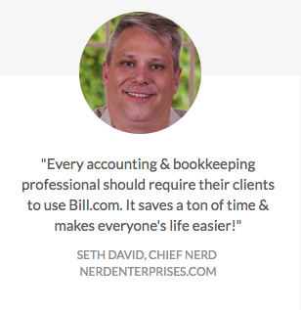
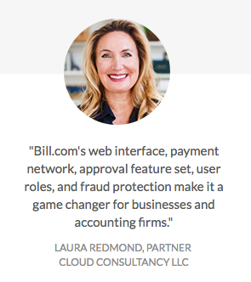
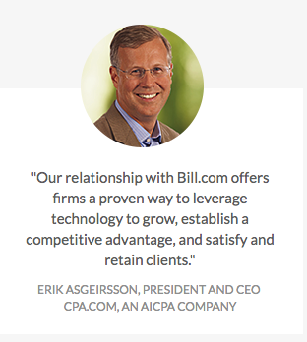
What our peers have to say about Bill.com

Slide 6
How to Prospect for the right client
Look for clients/companies that:
  Pays over 10 bills each month
  Are disorganized, but want more efficiency
  Are frequently missing papers and expense documentation
  Want better cash flow management
  Don’t have a dedicated employee looking after their billing
And suffer from these pain points:
  Have billing headaches and they spend WAY too much time dealing with bills
  They have a have dual bookkeeping processes. They’re probably doing things twice…or more
  They’re chained to their desks with accounting software; & don’t understand what online/cloud services can do for their business

Slide 7
Partner with the marketing department
Ready to go tools to send/share with clients
Nurture Campaigns
  Ads
    Include in company newsletter; use one in your email signature
  Social media
    Leverage your corporate and firm handles to share benefits of outsourcing bill pay
  Email campaigns to your client base
    Include client success stories, co-branded content, video links & short demo
Pitch Prospects
  Leverage Selling Tools
    Cheat sheets, videos, overview deck
  Webinars & Speaking Ops
    Host a webinar series to your industry markets and showcase how bill pay benefits this market
    Explore external speaking opportunities @ industry events; highlight recent successes
  Direct Mail
    Include a free evaluation with a targeted DM piece (printed cards, letter, creative).

Slide 8
Learn more: Bill.com

Slide 9






The Leading SaaS Platform for B2B Payments
55+
Top-100 Firms
4
Top-10 U.S. Banks
$50B
Moved
3M
Members
Customer Validation
Partner Success
Proven Scale
Strong Network
Partners
Notes:
Bill.com is the leading SaaS platform for B2B payments. They make it simple for thousands of businesses, banks, and accounting firms to connect and do business. Bill.com is used and trusted by the best for over 10 years.

Slide 10

The Benefits of Bill.com
All your important bills and history – just clicks away
Access and control on the go
Bank-level security
Notes:
Managing your clients’ bills is the best way to get started in the new world of client accounting.
You can offer it to all of your existing clients, so any takers immediately become a new source of incremental revenue without you having to find new clients and spend money on sales and marketing.
Paying bills for clients is only profitable if you leverage technology, and chances are you’ve got some younger staff who are digital natives who would love to work with modern technology in their roles.
And when you invest in new technology for bill pay, all those risky manual processes go away…
And finally, bill pay is the ideal first step for building a full CAS practice. It’s easy to get going with bill pay, which then leads to even more accounting services you can offer clients.

Slide 11
Bill Pay Is A Painful Process For Clients
ENTER
APPROVE
PAY
RECONCILE
Paper-intensive
Manual
Time-consuming
Fraught with Risk
Notes:
[This slide has a build.]
Paying bills is a real problem, which is why we are talking today.
Every business struggles with financial workflows. traditional payment processes are
Paper intensive
Time consuming, manual, and error prone due to entering the same data multiple times in multiple places
Involving collaboration with multiple people and systems – including spreadsheets
And throughout this process there are opportunities for fraud – systems don’t match up, information needs to be double checked for inconsistencies, and misplaced checks or deposits can be compromised.

Slide 12
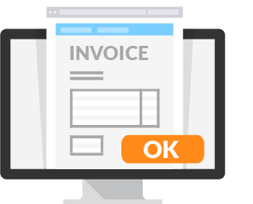
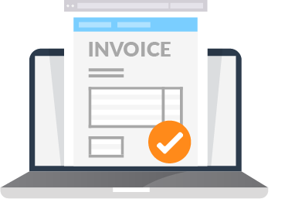
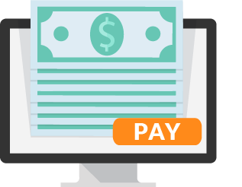
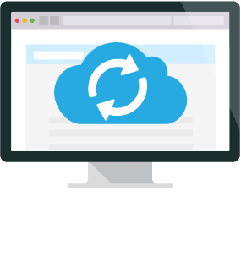
Bill.com Will Simplify and Secure Payments
4 Easy Steps – 2 for the client, 2 for the firm
SEND
APPROVE
PAY
ACCOUNT
Send bills to us via email or upload
View and approves bills online from any device
We pay for you
We add the details to your books
Paperless
Automated
Secure
Efficient
Notes:
[This slide has a build.]
With Bill.com, the end-to-end payables process is simplified and automated. Bill.com is built from the ground up as a solution to track documentation, incorporate collaboration, and keep up to date records of expenses and revenue in the accounting software.
Throughout the process there are built in fraud prevention features, resulting in an automated payables process that is protected and takes less time to manage.

Slide 13
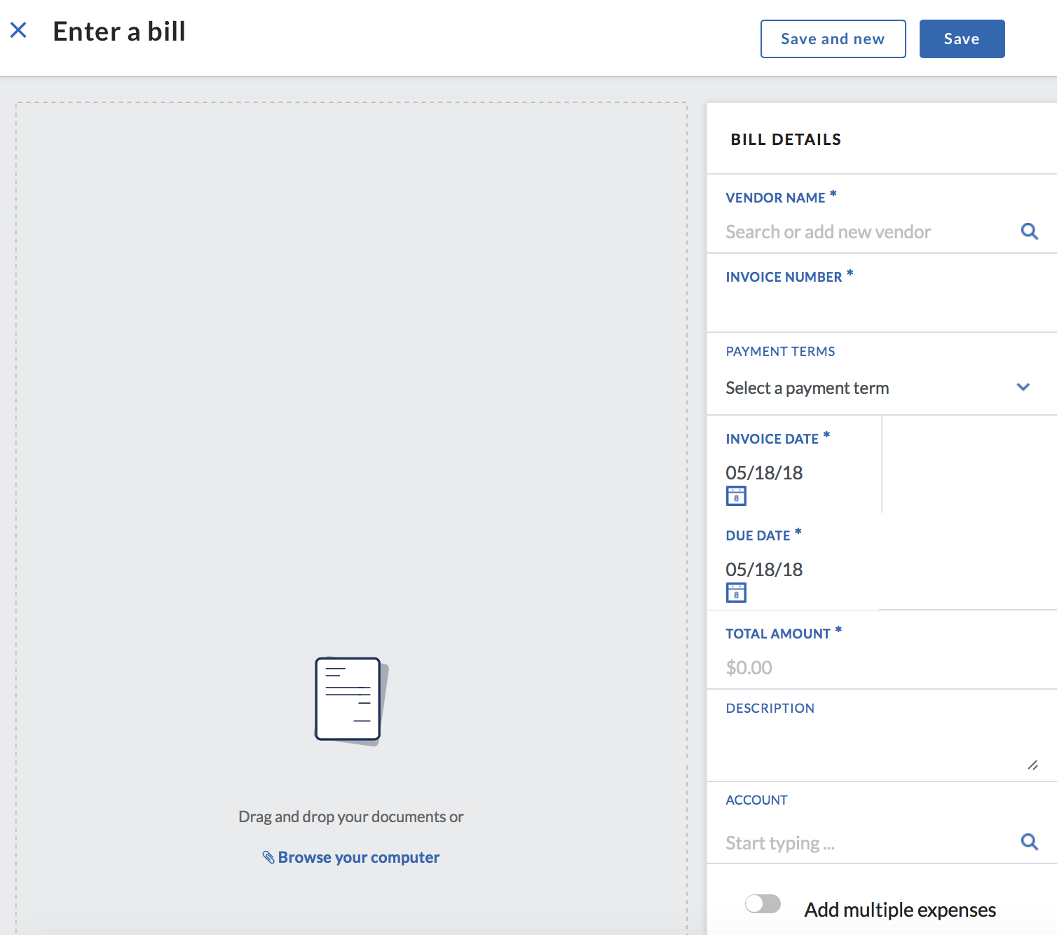
How Bill.com Works: Step 1
Upload your bills into Bill.com
Email to your Bill.com inbox
Fax
Direct upload
Drag and drop
Notes:
We’re excited to introduce the fastest, easiest way to digitally approve your bills, powered by Bill.com.
Here’s how it works.
Step 1: Uploading Documents to Bill.com
Bills and other documents can be uploaded to Bill.com in several ways
Email
Fax
Direct upload, drag and drop
Every Bill.com account has a unique inbox email address and optional fax number. Bills received from vendors can be sent to this email address or fax number and will then be uploaded to the Bill.com Inbox for our firm to process. Bills and other documents can also be directly uploaded or dragged & dropped into Bill.com through the Home or Inbox pages.

Slide 14
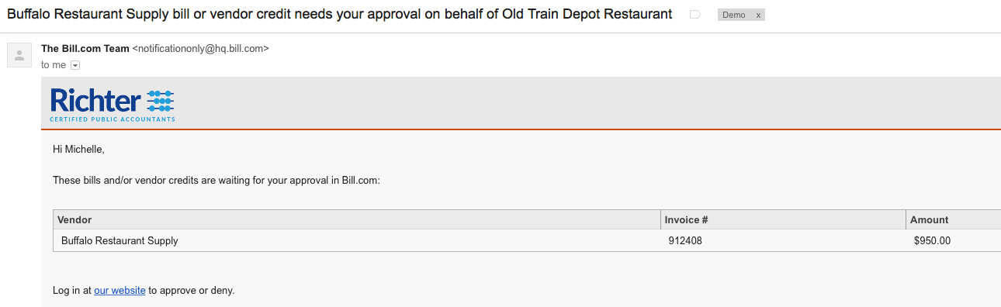
How Bill.com Works: Step 2
We’ll send an email letting you know a bill is ready for approval
Click the link to log in to your portal
Notes:
We’ll enter and code a bill for you, and then send an email letting you know it’s ready for approval.
Click the link to log in to your portal.

Slide 15
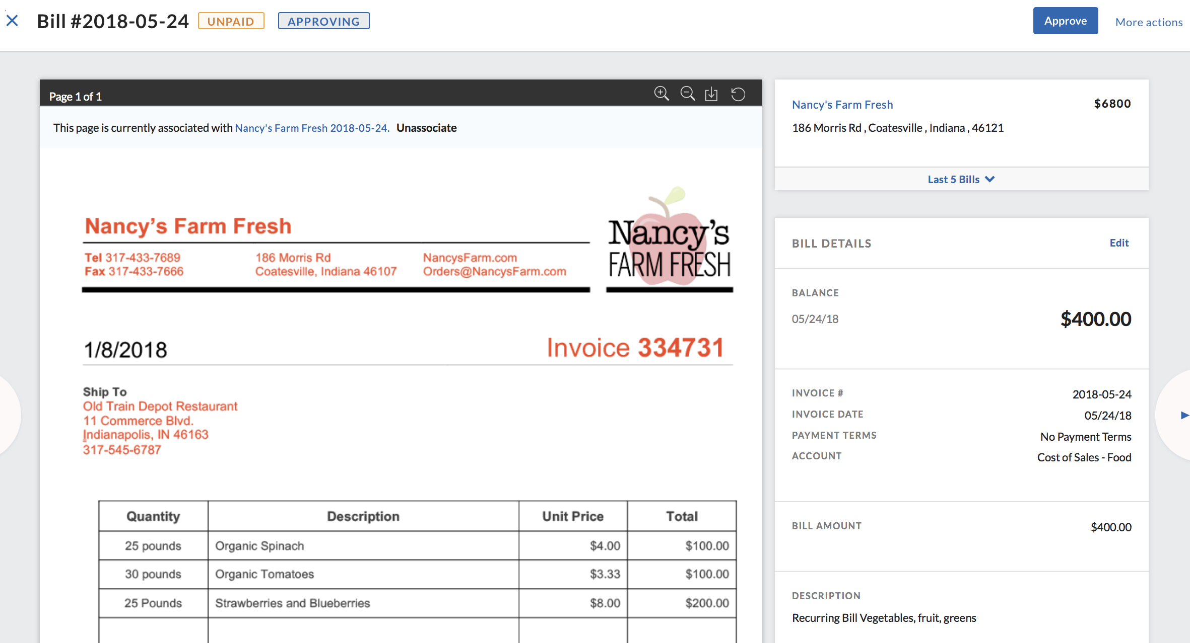
How Bill.com Works: Step 3
View your bill in the portal
Hit Approve
You’re finished!
We pay the bill for you
Notes:
Take a second to look over the bill. If everything looks good, click Approve.
Need more details before approving? Click Review to see the original invoice, due date, amount, and coding information.
If you need to approve multiple bills, simply select them all, and click Approve.
If denying the bill, leave us a note as to why.
Once you’re finished, we pay them for you. It’s that simple!

Slide 16
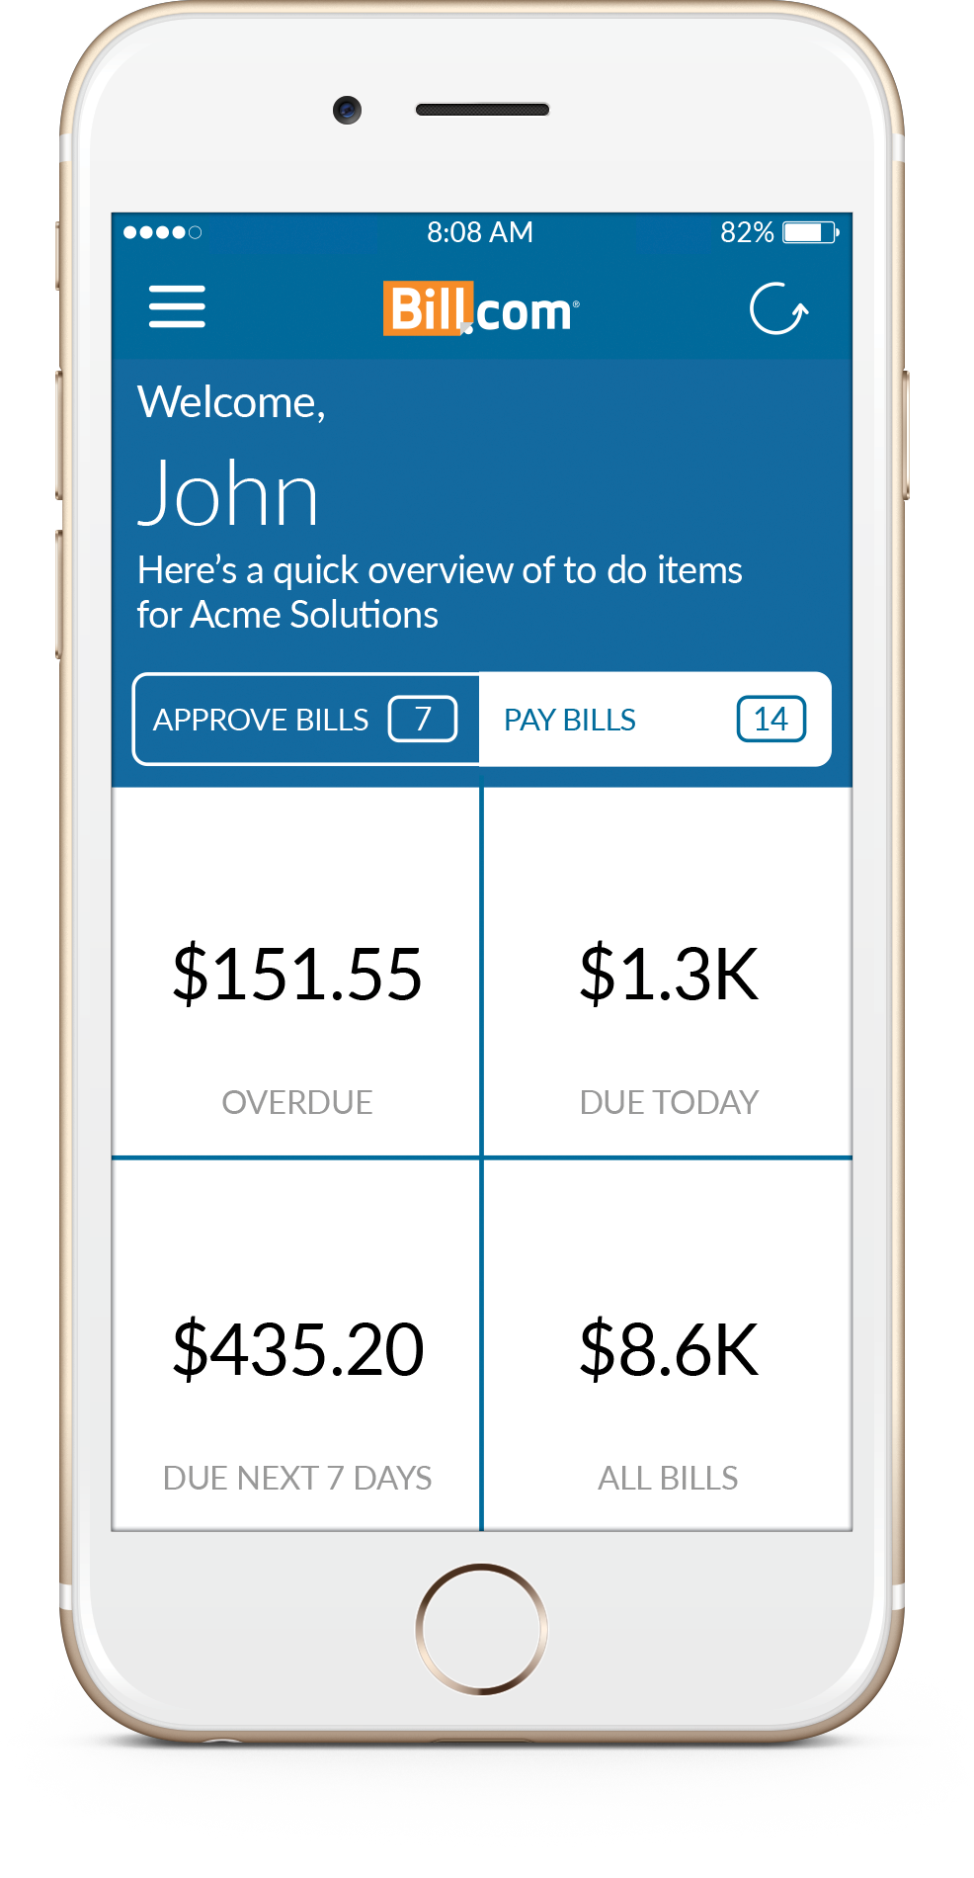
It’s just as easy from your smartphone with the Bill.com app
Get notifications
Approve bills
Track status
Watch the video
Notes:
Click on ‘live’ to see a vidoe

Slide 17

Let’s get started
Determine prospects
Decide on marketing tools
Determine timelines
Where to get help
Share out wins

Slide 18
Thank You!

Slide 19
Appendix

