Slide 1
Accounts Receivable Workflow
Notes:
How to use this presentation:
This presentation is designed for you to present to your client and their staff in a virtual or in-person workshop. You can add your logo and customize it for their unique needs.
Use these presenter notes as a guideline for what they need to know to get started.
To ensure the training goes smoothly, we recommend that you:
Set up their account beforehand so you can demo using their account.
Schedule about 60 minutes with staff and appropriate managers to show them the workflow and answer questions.
During the workshop:
Assign roles and train client staff to use the system.
Demonstrate Bill.com workflow using their account.

Slide 2
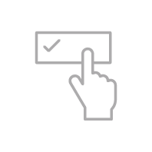
Bill.com accounts receivable
With Bill.com A/R you:
Create, send and manage invoices
Collaborate with your team and customers
Receive payments electronically, and set up auto-pay
Sync both invoice and payment activity with the most popular accounting software packages
Invoices are organized by customer so you can view outstanding invoices and a complete payment history
Create, send and track invoices to customers−(no more lost invoices!)
Collaborate with staff, accountants and customers−(complete audit trail!)
Custom portal to accept payments− (get paid faster)
Synchronize with accounting package− (no duplication!)
Notes:
In this workshop, we’ll look at the basic accounts receivable workflow with Bill.com.
Before using Bill.com with a manual receivables process, you could only see your General Ledger and Bank Account.
You were often missing answers to important questions such as:
When was the invoice sent?
Did they receive the invoice?
When did we send out the last reminder?
How do we send a mass reminder to all customers?
When will they pay?
Will they pay by ACH, PayPal or Credit Card?
Do they want to pay online, or have automatic payments withdrawn?
Bill.com not only automates your payments process, it gives you control and insight into this entire process.

Slide 3
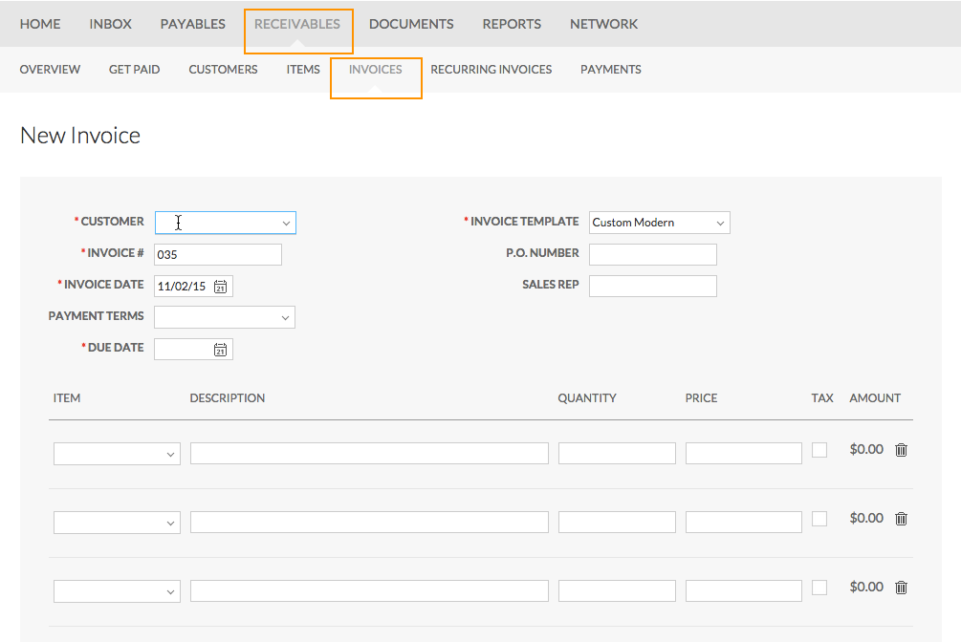
Creating invoices: manual
Notes:
To create a new invoice in Bill.com, go to Receivables and click Invoices. Click the New button.
The invoice entry screen looks like an actual invoice.
When you sync with your accounting system, Bill.com will bring in your customer items list.
The invoice number auto-enters, but you can change it if needed. The invoice date auto-populates as well.
You can set the payment terms and the due date will automatically populate.
You can also select an invoice template that is customizable.

Slide 4
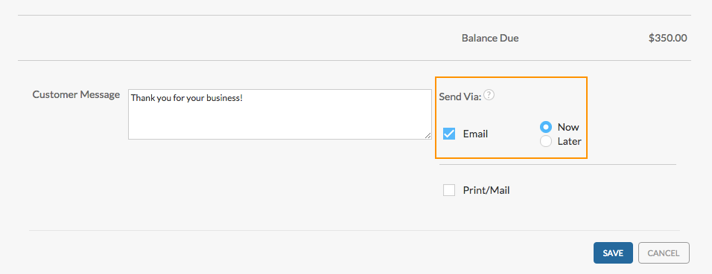
Sending invoices
Notes:
You can add a customer message and then decide to send the invoice via E-mail either Now or Later, or by Print/Mail (USPS).
The easiest and most efficient way to send invoices is via e-mail. The e-mail includes a PDF attachment of the invoice.
To complete the invoice, click the Save button.
If you choose to e-mail the invoice later, the invoice will be sent to the email queue and you can send the invoice when you’re ready.

Slide 5
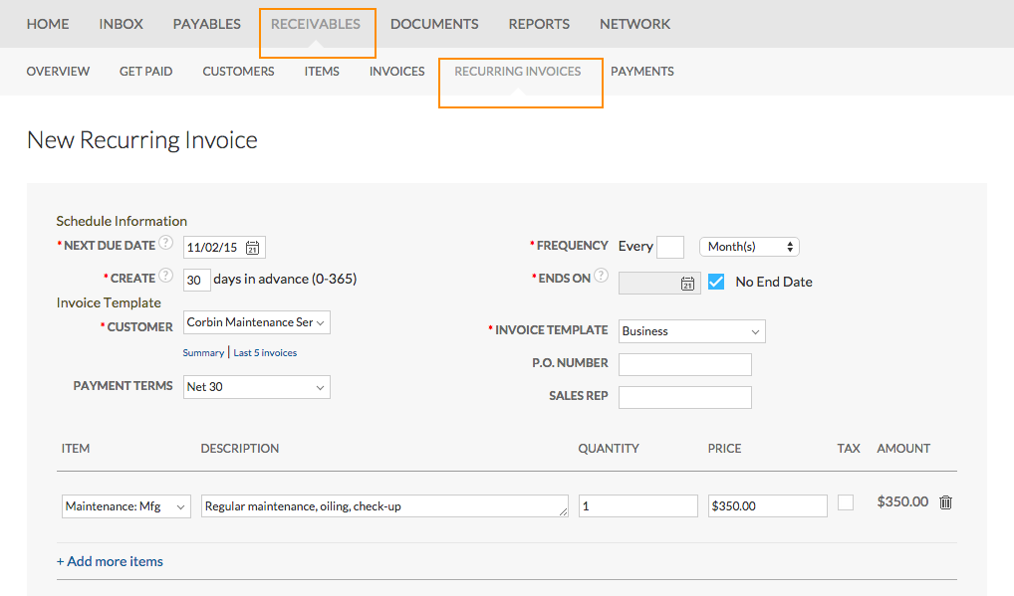
Creating invoices: recurring
Notes:
Instead of manually creating new invoices each billing period, you can set up recurring invoices for items such as rent or service contracts.
From Receivables, click Recurring Invoices. A list of your recurring invoices will display. Click the New button to create a new recurring invoice.
In the Schedule Information section, enter the next due date, enter how many days in advance of the due date that the invoice should be created, the frequency the invoice needs to be sent, and whether or not there will be an end date.
You’ll also enter the specific invoice information. Select the items, description, quantity and price. When done, click the Save button.
Let’s go take a look at the Email queue now.

Slide 6
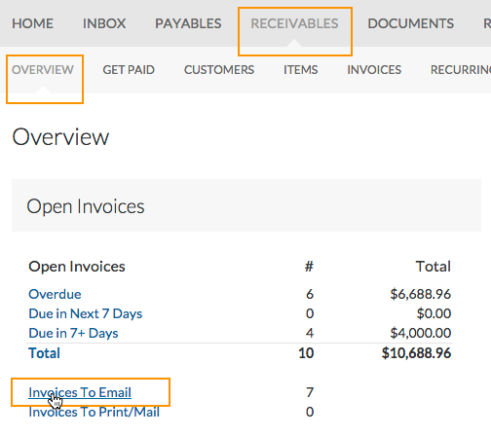
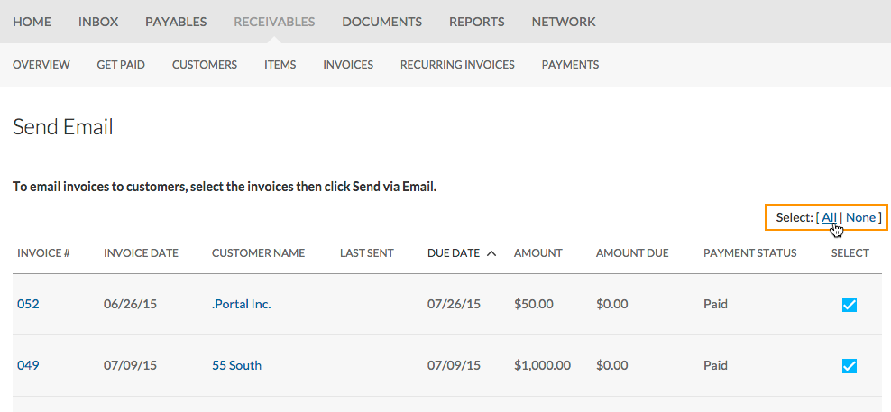
Sending invoices from the queue
Notes:
On the Overview page, you can see the Invoices to Email queue has items to send.
When you click the Invoice to Email link, the Send Email page displays with a list of all the invoices that need to be sent.
Select them individually or Select All to send the entire list at once.

Slide 7
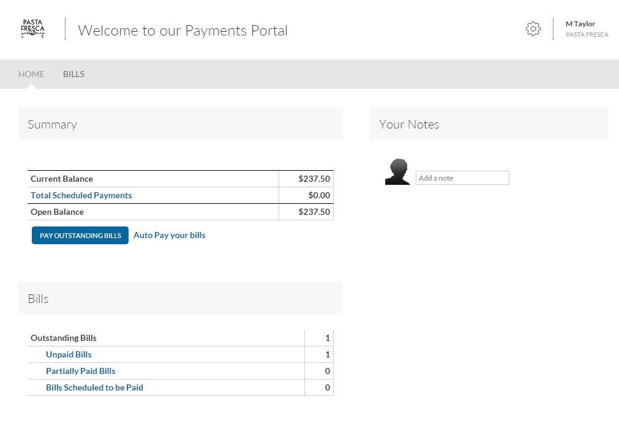
Customer portal
There are 3 ways for customers to pay:
ACH/ ePayment
PayPal
Credit card
Notes:
When the customer receives their email invoice, they can click the link to access the customer portal, or they can type the URL from a printed invoice.
They will be directed to their own custom online portal where they can pay bills, view transaction history, and enable auto-pay.

Slide 8
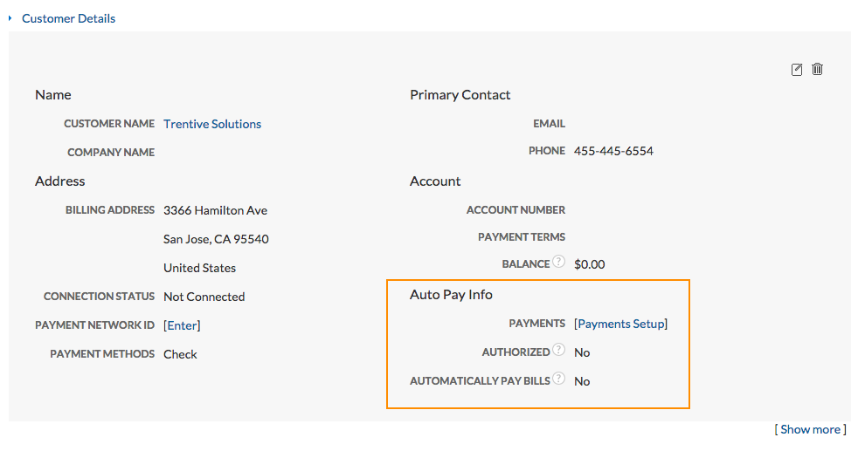
Accounts receivable workflow: automatic payments
Notes:
To help ensure on-time payment of customer invoices, you can set up your client’s customer with auto pay. We strongly encourage you to get authorization from your client’s customer to charge their bank account or credit card. (The customer can also do this themselves on their customer portal.)
Each time an invoice is generated the auto pay feature will activate, processing payment of the outstanding invoice on the due date using the customer’s payment information.
To set up customer auto pay, go to Receivables > Customers, then select the customer.
Click the [Payments Setup] link in the lower right corner of the customer detail screen.
Check Authorized. Click either the Save & Add Bank Account or Save & Add Credit Card button. Enter the customer’s bank or credit card details and Save.
Select Automatically Pay Bills. Enter a Maximum Payment amount.
When Automatic Payments are set up and paired with a recurring Invoice, both you and your customer can relax knowing the invoice will automatically recur each month and the auto payment will trigger to transfer the funds.

Slide 9
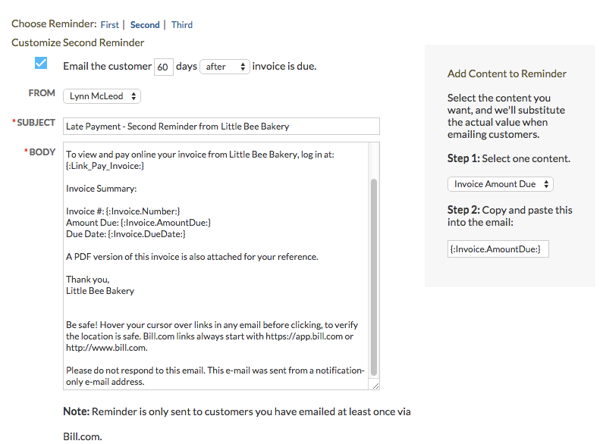
Accounts receivable workflow: collections
Notes:
To automate your collections reminders, you can customize Bill.com Auto Reminders to be scheduled and sent when needed automatically.
Go to Settings > Receivables: Auto Reminders and select the edit icon.
To enable auto reminders, check Email the customer and customize the reminder template.
You can customize first, second, and third reminders independently, including who will be the sender, the schedule, and the subject and message text. You can even use placeholders to further customize the content of your message.

Slide 10
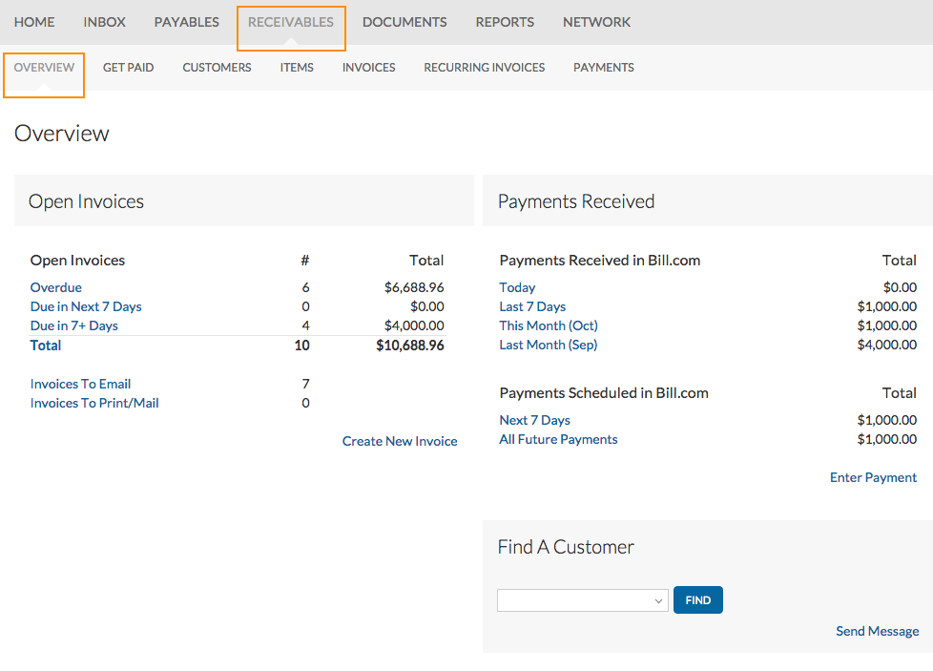
Accounts receivable workflow
Notes:
One of best things about Bill.com is how you get paid!
Bill.com Receivables saves both you and your customers time and money. When your customer selects the option to pay electronically via the customer portal, Bill.com automatically sends the payment – eliminating the need to print and mail a check. The payment is automatically applied to the invoices in your Bill.com account. Bill.com then deposits the money directly into your bank account.
The Receivables Overview page provides a summary of all the payments received or scheduled.
This completes a demonstration of the basic Accounts Receivable workflow in Bill.com. You learned how to create invoices, and get paid electronically.

