Slide 1
Accounts Payable Workflow
Notes:
How to use this presentation:
This presentation is designed for you to present to your client and their staff in a virtual or in-person workshop. You can add your logo and customize it for their unique needs.
Use these presenter notes as a guideline for what they need to know to get started.
To ensure the training goes smoothly, we recommend that you:
Set up their account beforehand so you can demo using their account.
Schedule about 60 minutes with staff and appropriate managers to show them the workflow and answer questions.
During the workshop:
Assign roles and train client staff to use the system.
Demonstrate Bill.com workflow using their account.

Slide 2
Bill.com accounts payable
With Bill.com A/P you:
Receive and manage bills online
Route bills for review and approval
Schedule bill payments, no more printing checks
Sync with accounting software, eliminating duplicate data entry
Bills are organized by vendor so you can view outstanding bills, paid bills, and a complete payment history
Simply fax, email, or scan documents into Bill.com−(we enter the data!)
Access and approve bills and documents−(it’s paperless!)
Pay by ACH or check with one click− (we process them for you!)
Synchronize with accounting software −(no data entry!)
Notes:
In this workshop, we’ll look at the basic accounts payable workflow with Bill.com.
Before using Bill.com with a manual payables process, you could only see your General Ledger and Bank Account.
You were often missing answers to important questions such as:
Did we receive the bill?
Does the bill match the contract?
Was this bill approved?
When was the bill approved?
Who approved the payment?
Who sent the payment?
Bill.com not only automates your payments process, it gives you control and insight into the process.
There are 3 roles within the payables workflow – clerk, approver, and payer. Let’s take a look at how the payables clerk will complete their activities.

Slide 3
Roles and responsibilities: clerk
From the Bill.com payables module you:
Receive, enter, and manage bills online
Go paperless – never lose or forget anything
Keep track of all your due dates
Responsibilities of the clerk:
Upload bills
Process documents
Enter bills
Route bills for approval
Correct denied bills
Notes:
Responsibilities of the clerk include:
Upload Bills
Process Documents
Enter Bills
Route Bills for Approval
Correct Denied Bills

Slide 4
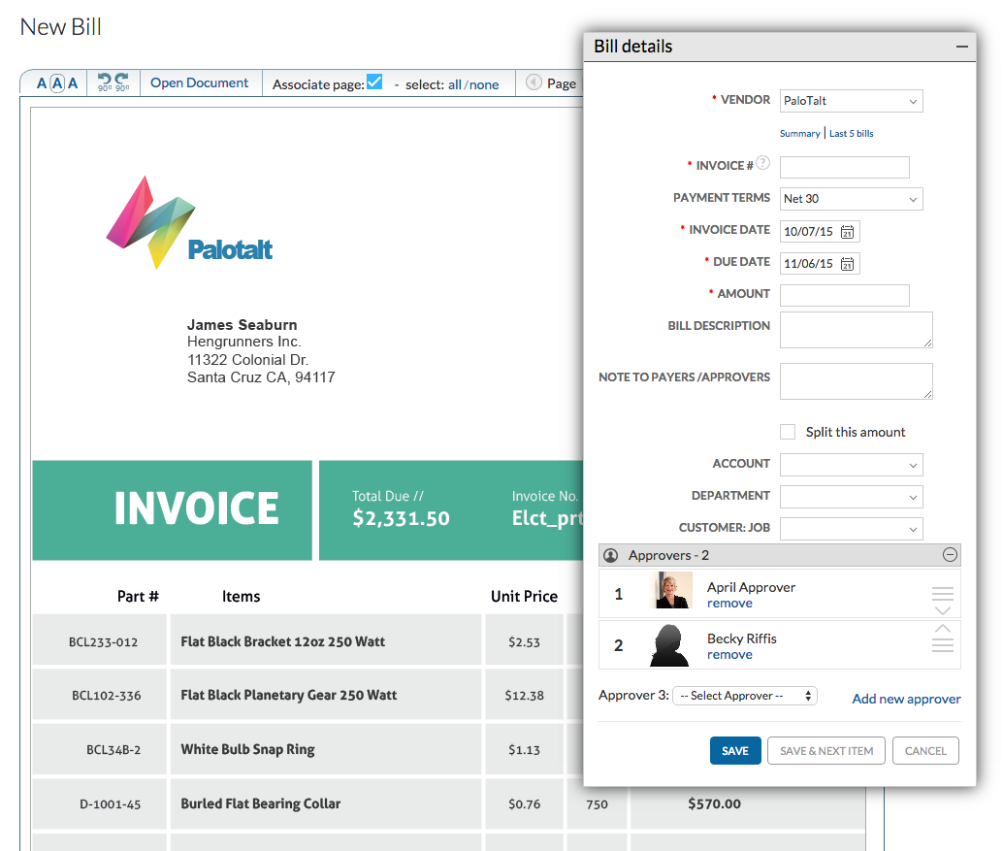
Accounts payable workflow: clerk
Notes:
From the Inbox you will click the document image and then select Create a new Bill
The Bill details box appears. All the fields marked with an asterisk are required. Start typing the vendor name to select from the list, or click Add New to create a new vendor. Then, enter the invoice number, invoice date, and due date. If you select a vendor that has a previous bill entered into Bill.com, Smart Data entry will fill in the Payment Terms, Bill Description, Coding, and approvers for you (Smart Data Entry uses the information from the previous bill).
Next, enter the total amount of the bill, and then enter the line item details, GL account, Department, etc. If you need to split the amounts between different accounts or departments select the split option. If you need to route for approval Choose an approver from the drop-down list, and then click the Save button. There is no limit to the number of approvers you can assign to a bill.
Now an email notification will be sent to the first approver based on their e-mail notification preferences.
Let’s look at how the approver will complete their activities.

Slide 5
Roles and responsibilities: approver
From the Bill.com payables module you:
Review and approve bills
Track and share every bill’s approval status
Access the audit trail when needed
Responsibilities of the approver:
Review bills
Edit bills
Deny bills and add notes
Approve bills
Notes:
Responsibilities of the approver include:
Review Bills
Edit Bills
Deny Bills and Add Notes
Approve Bills

Slide 6
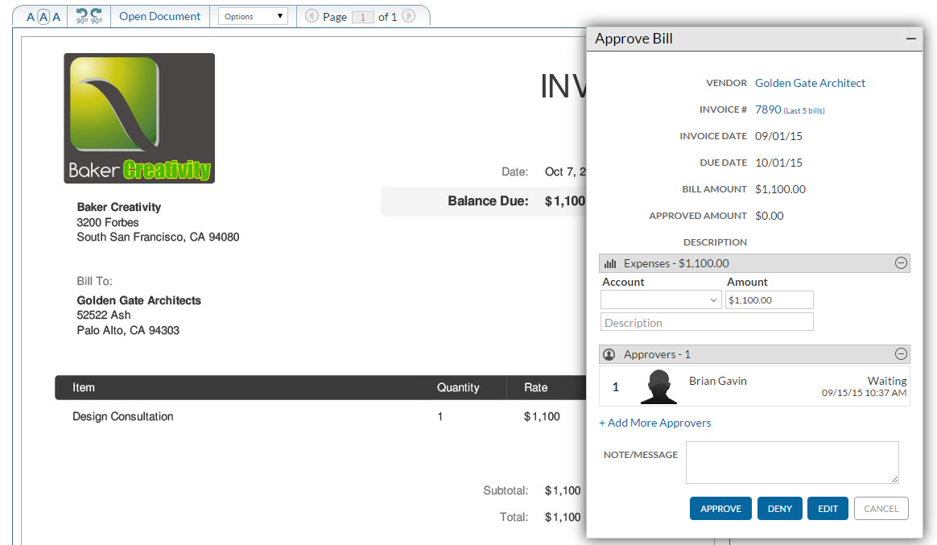
Accounts payable workflow: approver
Notes:
When bills are assigned to a user for approval, an item will appear on their To Do list. The approver will also be notified via e-mail based on their individual notification preferences.
The Payables > Approve page displays a summary of bills that have been assigned to you for approval. If you have multiple bills to approve, click the Slide Show approval link at the top of the list or click on the Review link next to a specific bill to review and approve just that specific bill.
You will then be presented with the document image and can view all the bill details. If you have been assigned permission to edit the bill, you’ll see an Edit button.
To approve the bill, click Approve. The bill will be routed to the next approver if there is more than one, or will complete the approval workflow and mark the bill as ready to be paid.
If you deny the bill, you are required to enter a Note detailing the reason, and it will be routed back to the user responsible for managing bills.
The approvers names, date, time stamp, and any notes that were added become a permanent part of the transaction.
Next, let’s look at how the payer will complete their activities.

Slide 7
Roles and responsibilities: payer
Responsibilities of the payer:
Manage cash flow
Pay bills on time
Schedule payments
Manage vendor payment notifications
There are 3 levels of payment permissions for payers:
Pay approved bills
Pay unapproved bills
Record payments outside of Bill.com
Notes:
Responsibilities of the Payer:
Manage Cash Flow
Pay Bills
Schedule Payments
Manage Vendor Payment Notifications
Only the assigned payers can make payments, and these individuals must be Bank Verified to pay via Bill.com.
There are three levels of payment permissions that can be assigned to a payer:
Pay approved bills – the user can only pay bills that have completed the approval workflow
Pay unapproved bills – the user can pay any bill regardless of the approval status. This eliminates the possibility of late payments due to a bill being hung up in the workflow
Record payments outside of Bill.com – the user will be able to record bills paid by different payment methods, like by Credit Card.

Slide 8
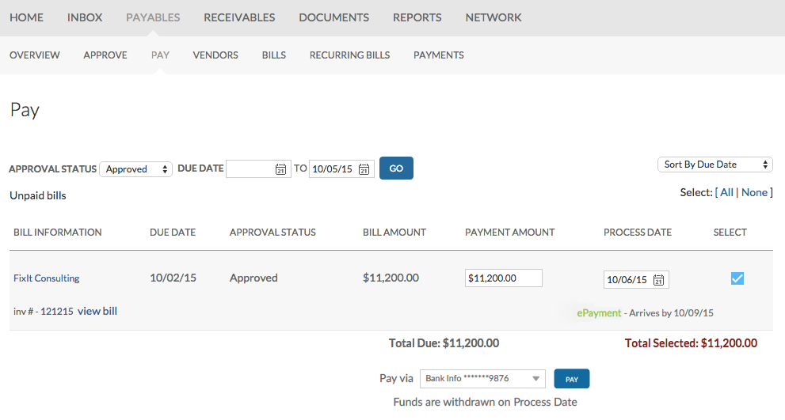
Accounts payable workflow: payer
Notes:
To pay bills, click on the bills to be paid link on the To Do list.
The Pay bills page displays bills based on the approval status. You can change the view via the Approval Status drop-down at the top of the list.
Review the bill information, due date, approval status, bill amount, payment amount, and the process date. If the bill contains a document image, a view bill link will be displayed.
You can also review notes if there are any, and see credit amounts if applicable.
You can edit the amount displayed in the Payment Amount field to make a partial payment.
Bill.com automatically displays the process date field with a recommended date based on the bill due date. By default this is six business days prior to the due date. You can edit the process date to control when the bill gets paid. Payments are only processed on banking business days, excluding holidays.
By default, all payments are sent by check, however, any vendor can receive electronic payments. The Arrives by date is displayed based on the process date. For checks, this is an estimate provided by the US Postal Service. For ePayments, this is the actual date the payment will be posted to the vendor’s bank account.
To schedule a bill payment, select the bill and then click Pay.

Slide 9
You learned how to:
Enter, approve and pay bills
Establish an efficient payables workflow
Accounts payable summary
Notes:
This completes a demonstration of the basic Accounts Payable workflow in Bill.com. You learned about Bill.com’s primary A/P functions: entering, approving and paying bills.

Slide 10
The Bill.com payment system:
Saves time and money
Eliminates the need to print checks and stuff envelopes
Eliminates double data entry
Helps prevent payment fraud
Centralizes data (no audit time headaches)
Notes:
Bill.com is going to save you time by eliminating the need to print checks and stuff envelopes.
With the accounting software sync it will eliminate the need to do double data entry.
It will help prevent check fraud by eliminating exposure of the company’s bank account details.
And because all of your documents, cashed checks, and audit trails will be centralized in one place, audit time will be a breeze.

