Slide 1
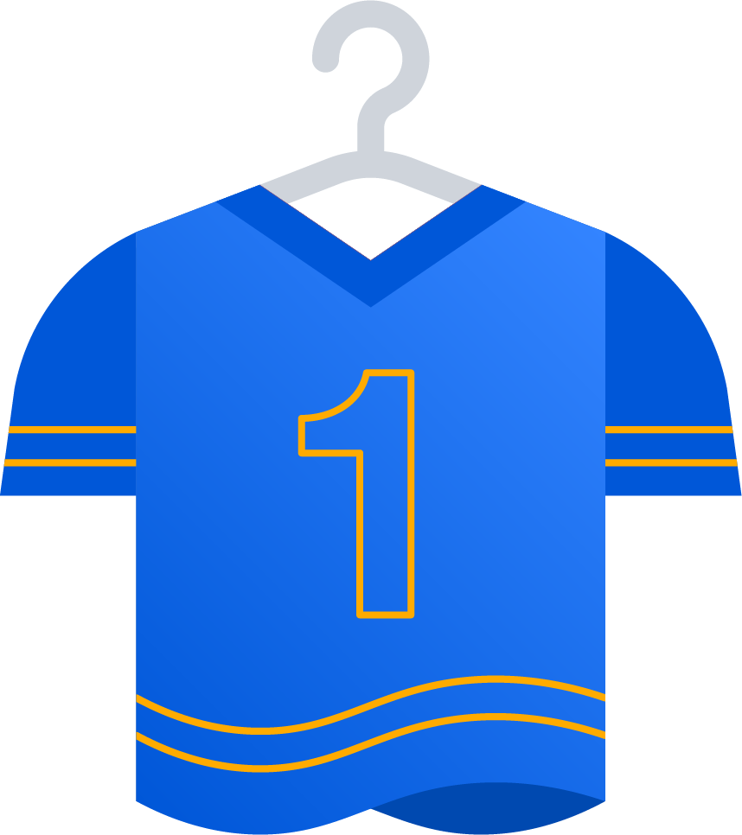
APD01 / Purpose (Business Capability-Centric Example)
Customer Journey
Corporate Goals
STEP #1
STEP #2
STEP #3
STEP #4
Operational Value Streams
OVS #1
OVS #2
Program Boundary
Business Capability
CAP #1
CAP #3
CAP #4
CAP #6
CAP #2
CAP #5
Teams
Solution A

Slide 2
APD01 / Purpose (Product-Centric Example)
Customer Journey
Corporate Goals
STEP #1
STEP #2
STEP #3
STEP #4
Operational Value Streams
OVS #1
OVS #2
Program Boundary
Products
prod #1
prod #3
prod #4
prod #6
prod #2
prod #5
Teams
Solution A

Slide 3
APD01 / Purpose (IT-Centric Example)
Customer Journey
Corporate Goals
STEP #1
STEP #2
STEP #3
STEP #4
Operational Value Streams
OVS #1
OVS #2
Program Boundary
IT Systems
SYS #1
SYS #3
SYS #4
SYS #6
SYS #2
SYS #5
Teams
Solution A

