Slide 1

Inspira Member Website
Create your profile & Login

Slide 2

Access your account from inspirafinancial.com

Slide 3

First Time User

Slide 4


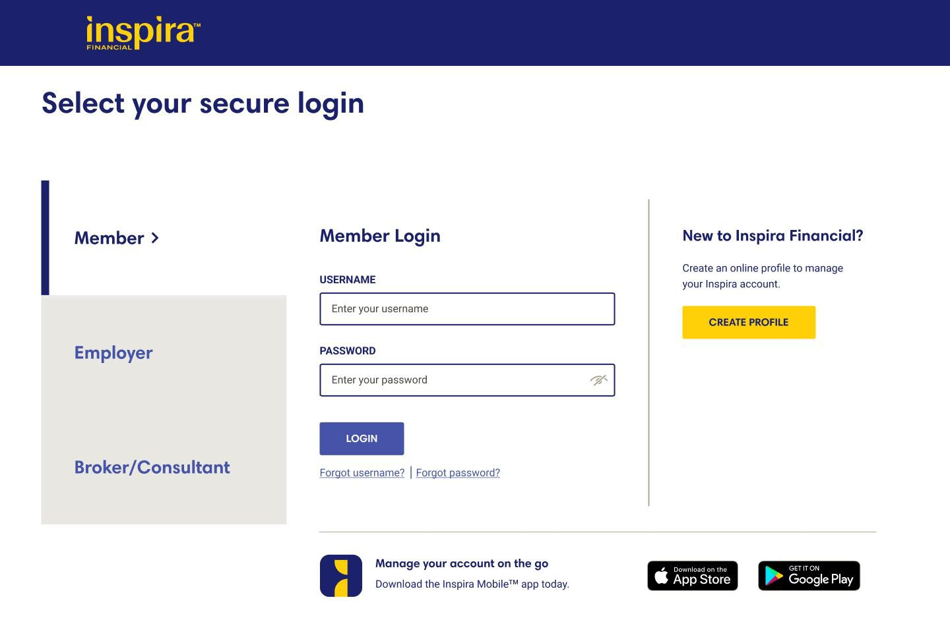
Go to inspirafinancial.com
MEMBER W EBSITE EXPERIENCE
Click, “Log in.”
If you’re a new user Click, “CREATE PROFILE” to get started.

Slide 5

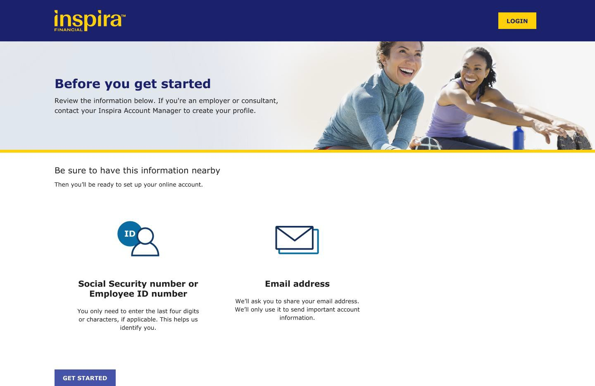
Be sure to have this information nearby
MEMBER WEBSITE EXPERIENCE

Slide 6
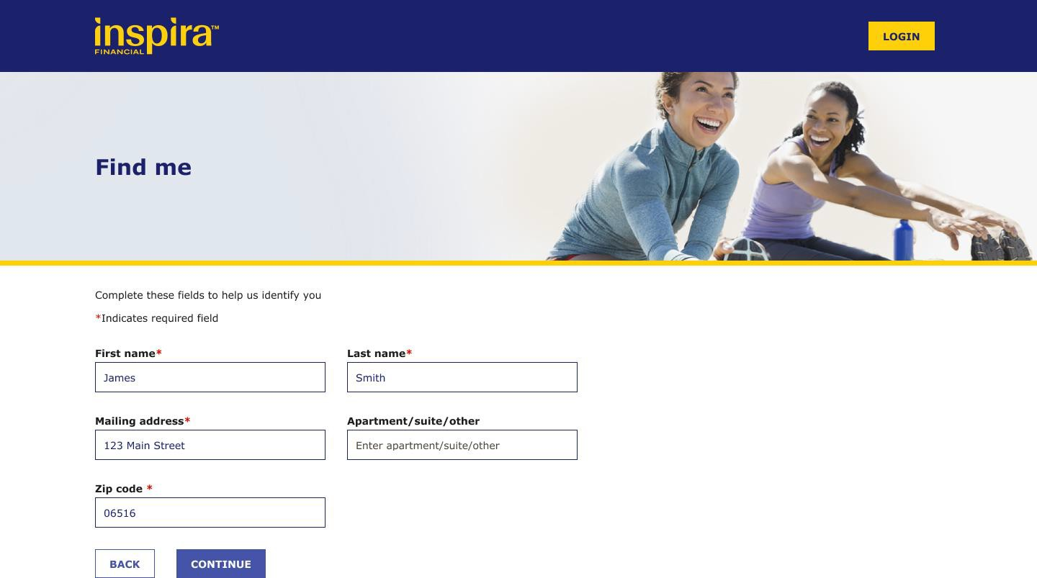
Complete this page to help us identify you
MEMBER WEBSITE EXPERIENCE

Slide 7
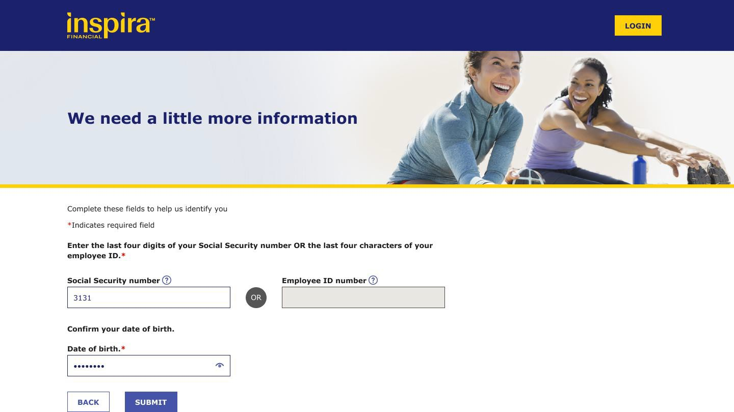
Complete this page to help us identify you
MEMBER WEBSITE EXPERIENCE

Slide 8
Enter the last 4 digits of your card number
If your account does NOT include a Inspira debit card, you won’t see this page
FOR CARDHOLDERS ONLY

Slide 9
Create your profile
MEMBER WEBSITE EXPERIENCE
After you verify your account, you’ll create your profile. We’ll ask you to:
Create a username and password
Set up security questions and answers
Review/accept the Online Services Agreement*
*When you agree to the terms and conditions,
we’ll turn on your paperless settings for certain notifications. You’ll simply get your documents online. This will be in place unless you make changes to your notifications in Account Settings
QUICK TIP: After you create a username and password, you can use it to log into the Inspira Mobile® app.

Slide 10
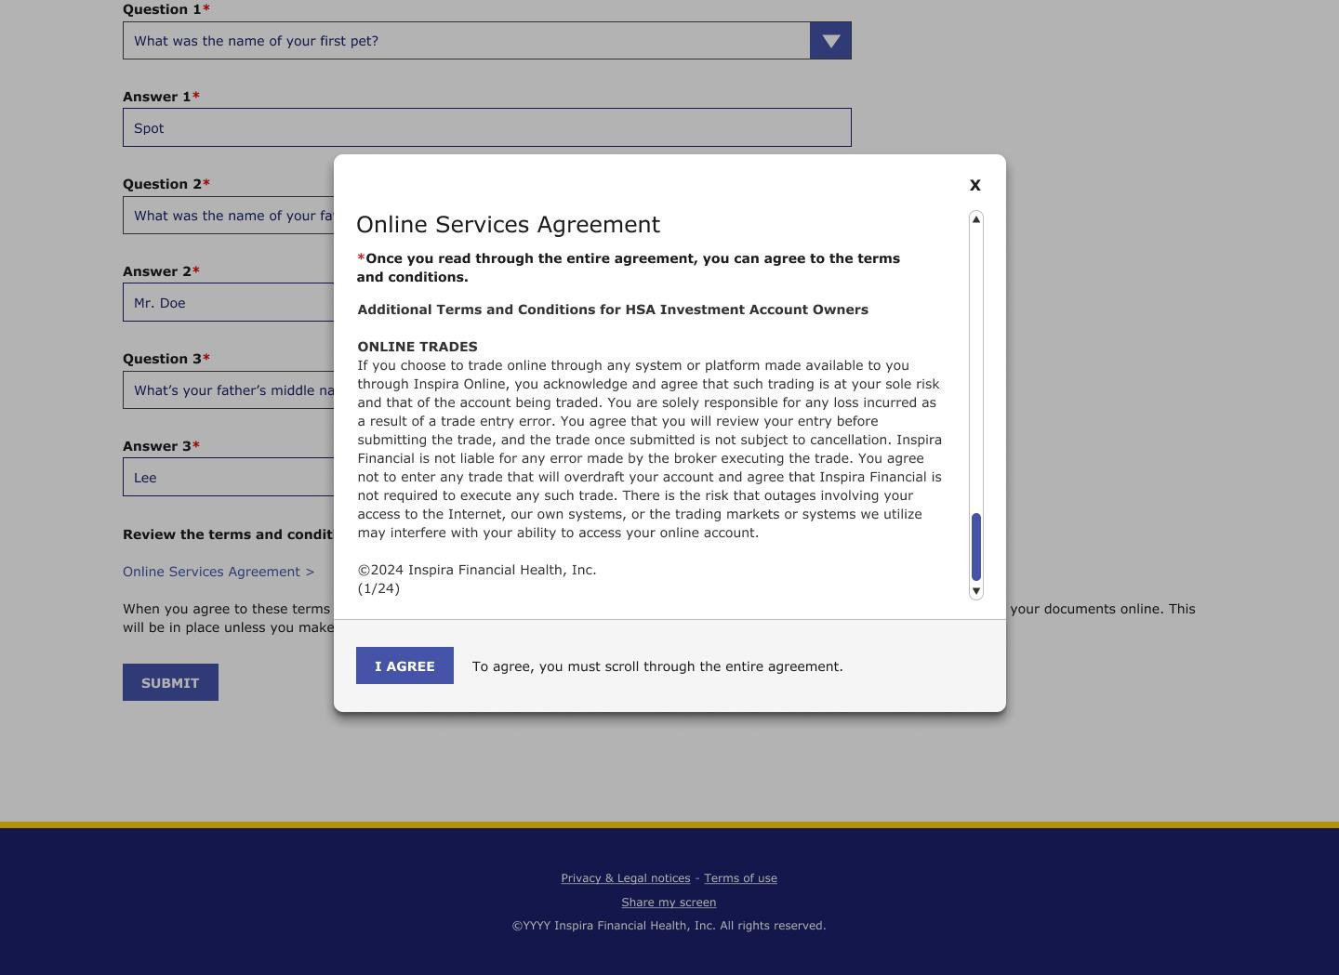
Review the terms and conditions of our Online Service Agreement
MEMBER WEBSITE EXPERIENCE

Slide 11
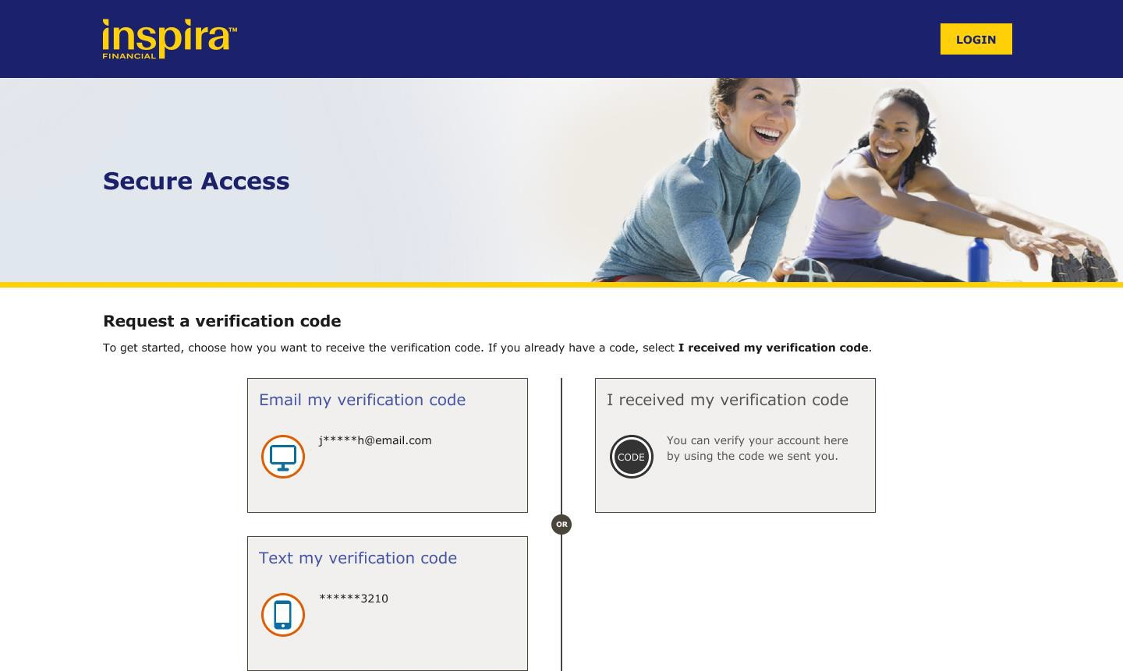
Request a verification code to be sent by email or text
This is how we verify your account.
MEMBER WEBSITE EXPERIENCE

Slide 12

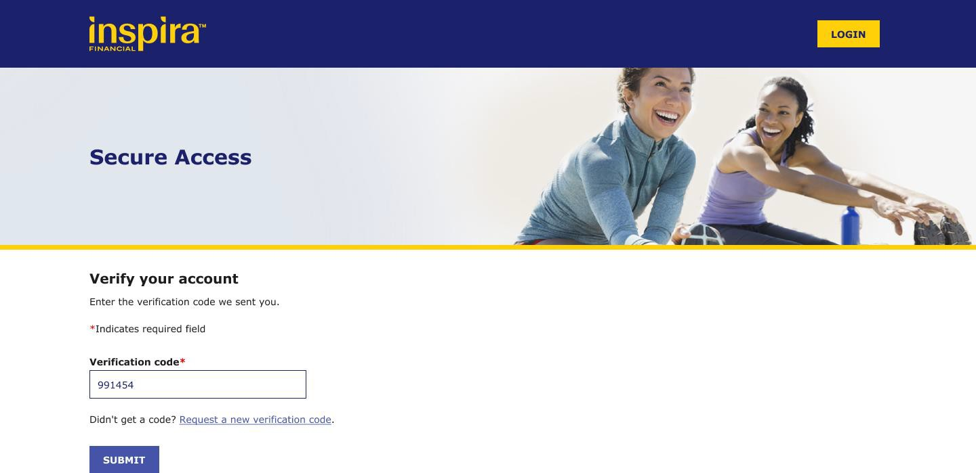
Enter your verification code
MEMBER WEBSITE EXPERIENCE

Slide 13
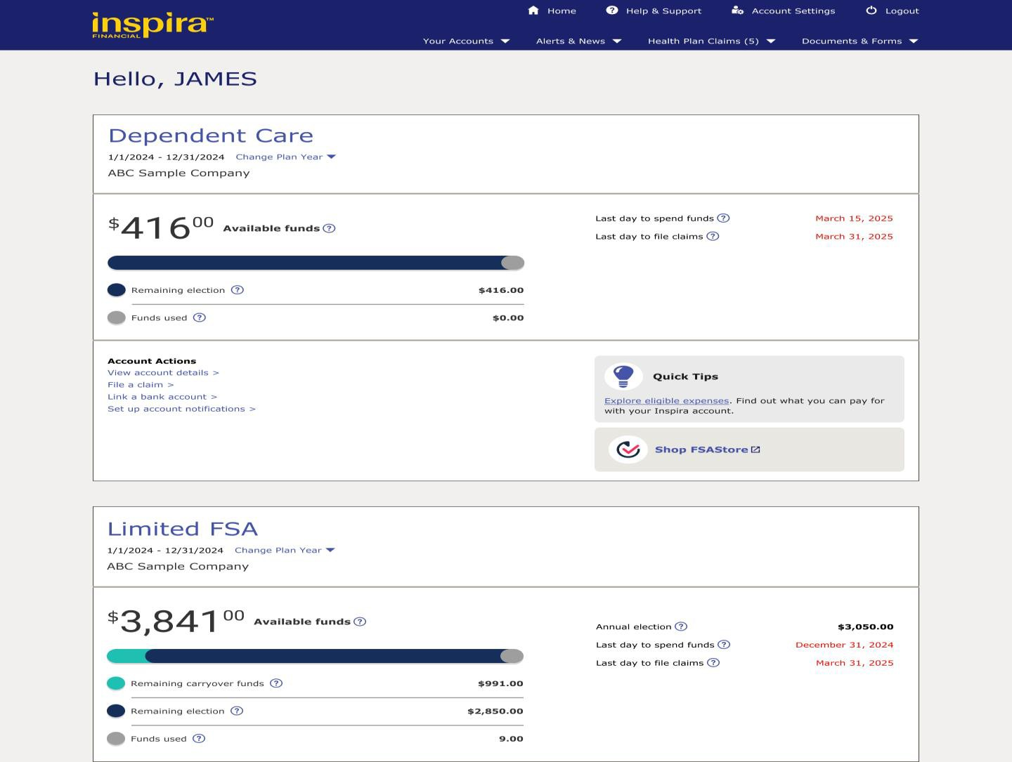
After you create your profile and set up your account, we’ll take
you to your account dashboard.
MEMBER WEBSITE EXPERIENCE

Slide 14

Go to mybenefits.inspirafinancial.com
MEMBER WEBSITE EXPERIENCE
Click, “CREATE PROFILE."

Slide 15
After you update your profile, we’ll take you to your account dashboard
MEMBER WEBSITE EXPERIENCE

