Slide 1
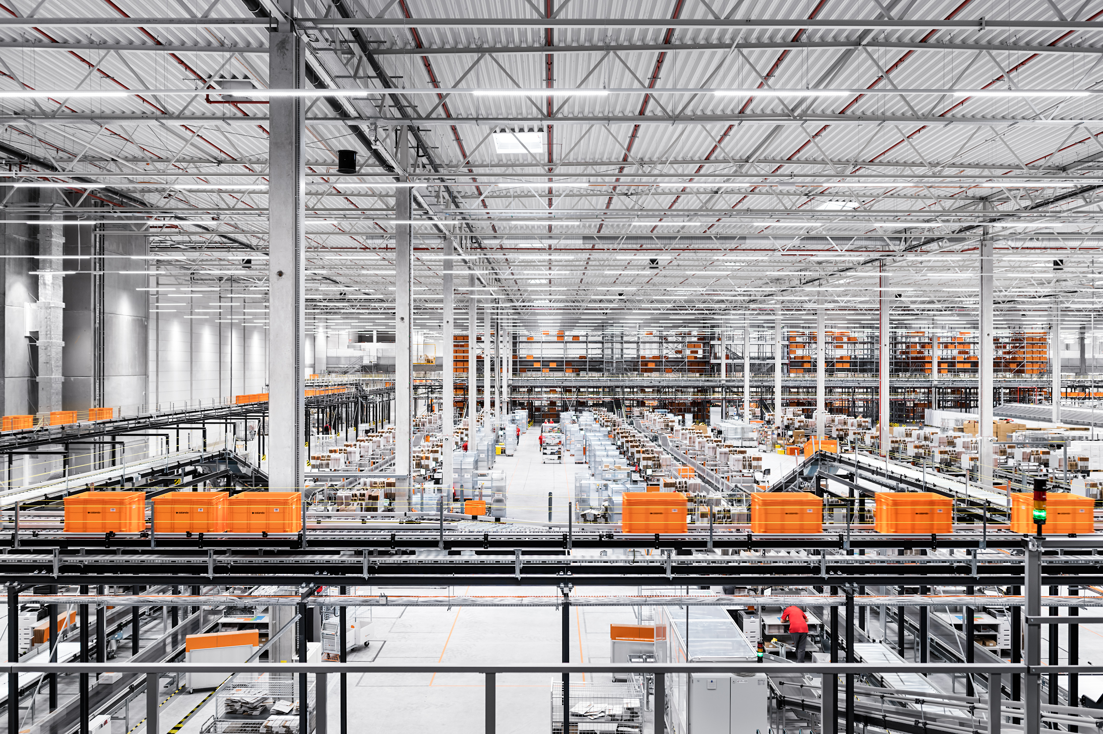
ZALANDO
SHIPPING
SOLUTIONS
2 0 2 1

Slide 2
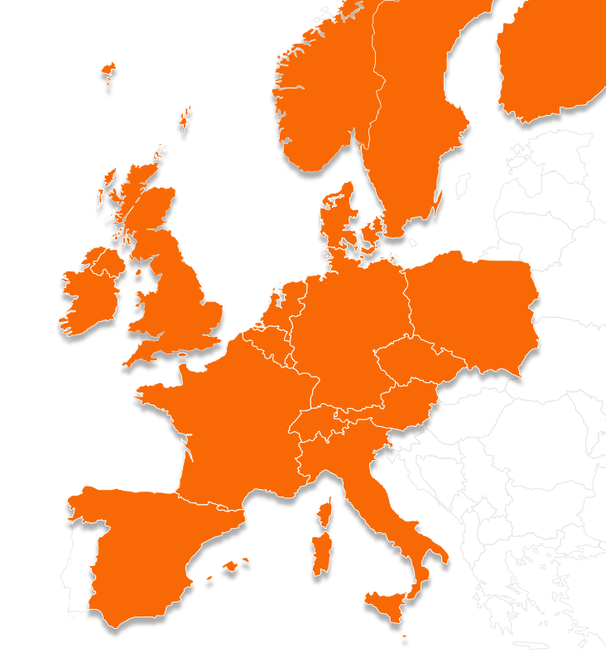
PURPOSE
SERVICE
BENEFITS
INTEGRATION
enable our Partners to grow internationally and deliver on customer promises by leveraging Zalando’s transport infrastructure

Slide 3
INTRODUCTION to Zalando Shipping Solutions (ZSS)
PURPOSE
SERVICE
BENEFITS
INTEGRATION
Partners consolidate customer orders and ship them to a Zalando Sorting Center
1
CARRIER
NETWORK
3
PARTNER
WAREHOUSE
CUSTOMER
2
(1) Once customer orders, the Partner fulfills and delivers labeled shipments to Zalando Hubs
(2) Zalando sorts partner parcels and forwards them to the carrier network Hub
(3) The entire outbound and return shipping is done by Zalando
The partner remains the owner of the goods along the entire process.

Slide 4
PURPOSE
SERVICE
BENEFITS
INTEGRATION
Tailored solution to help you with logistics requirements
MULTIPLE INJECTION SOURCES INTO THE ZSS HUB
Parcels can be injected into the Zalando network from several locations across Germany and other European countries from multiple partners, third-party logistics providers, and other Zalando warehouses
Combined Linehaul
Feed-in Linehaul
Last Mile Network
Feed-in via Int. Linehaul
Last Mile Carrier Feed-in Hub
Source of Goods
Injection Node
INTERNATIONAL AND DOMESTIC LINEHAUL SHARING
Volume aggregation on linehauls ensures cost efficient transport into foreign countries and optimised injection times into multiple carriers’ networks in various end-consumer markets
ZSS Markets
Expansion Wave I
PARTNER
PARTNER
PARTNER
PARTNER
ZALANDO
PARTNER
ZALANDO
FREIGHT RATE FORWARDING
Partners purchase shipping labels for Last Mile Carriers from Zalando, where stable and proven business relations with transport service providers enable highly attractive conditions for local hero-players, providing highest quality services
ILLUSTRATIVE

Slide 5
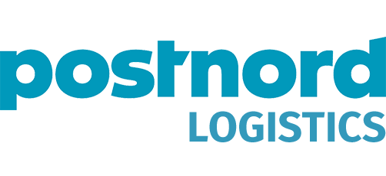
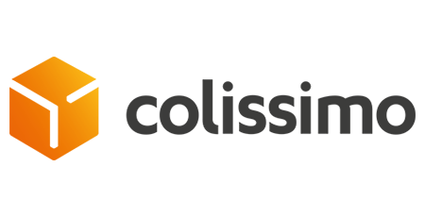
PURPOSE
SERVICE
BENEFITS
INTEGRATION
Resolving complexity of serving multiple markets
BENEFIT FROM ZALANDO’S NETWORK
ensuring high quality, flexibility and scalability for an unrivaled customer experience
SERVICE NETWORK
Live in SE, DK, FI, DE, BE, FR, NL, AT
Home Delivery & Pick-up Point Delivery
Express Carriers ¹
Premium Services ¹
...and constantly expanding
AVOID PROCEDURAL COMPLEXITIES
related to the setup of multiple service providers with just one integration into ZSS
BENEFIT FROM LOW COST STRUCTURES
and high service quality by sharing linehauls and last mile delivery services with Zalando, leveraging attractive conditions
OFFER THE BEST SERVICE
to end customers, utilising Zalandos market expertise and preferred providers in each market

Slide 6
PURPOSE
SERVICE
BENEFITS
INTEGRATION
Lean integration: ready to ship in just 5 weeks
Partner
Integrator & DI
Carrier
Zalando
Label data
Track & Trace data
Partner’s Warehouse Management System
ZSS Connect
ZSS account
Invoicing for Last Mile Delivery
ZSS product
Call label
Shipment announcement
Providing Track & Trace data
Invoicing for Total ZSS Service (Linehaul + Last Mile Delivery)
Automatically comply with Zalando’s requirements on carrier selection, even if they change
Only one integration
Invoicing for all services from one point of contact
Track and trace data is provided in standardised structure for all CEPs

Slide 7
ZALANDO
SHIPPING
SOLUTIONS
FOR MORE DETAILS REACH OUT TO
Connected Network Sales Team
logisticssolutions@zalando.de
2 0 2 1

Slide 8
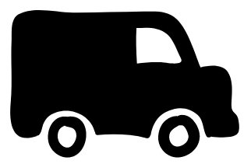
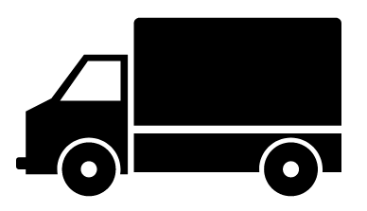
PURPOSE
APPENDIX A.2
SERVICE
BENEFITS
RATES
Recommended injection methods, determined by the total daily volume
Border
1
2
Outbound Linehaul
Domestic CEP Network
Customer
Zalando Sort Site
3
Use Case | Minimum Volume* | First Mile Solution from Partner WH into Zalando network
1 - large | ~250/day | dedicated linehaul (e.g. van for 3 to 8 pallets); injection depends mainly on drive time
2 - medium | ~70/day | LTL-solution; daily pick-up of 1-10 pallets; next day injection**
3 - small | 1/day | parcel-in-parcel-solution; daily volume of 1-5 “outer parcels”; parcel-in-parcel-factor depends on parcel sizes; next day injection**
* commercially sensible minimum volume depends on parcel size, NMV per parcel, time-criticality of total setup (e.g. when including cross-border First Mile) ** injection into Zalando network on next business day relies on timely departure (depending on location/distance and relevant delivery countries)

Slide 9
PURPOSE
APPENDIX A.1
SERVICE
BENEFITS
RATES
Connecting with multiple last mile carriers with single integration
Partner_{a}
Delivery Product_{x1}
Last Mile Carrier_{x}
Delivery Product_{x2}
Delivery Product_{y1}
Partner_{b}
Integrator & DI
Last Mile Carrier_{y}
Delivery Product_{y2}
Returns Product_{y3}
Partner_{c}
Delivery Product_{z1}
Last Mile Carrier_{z}
Delivery Product_{z2}
Returns Product_{z3}
Partner_{d}
Returns Product_{z1}

Slide 10
PURPOSE
APPENDIX A.3
SERVICE
BENEFITS
RATES
Simple steps to onboard ZSS
INTRODUCTION OF ZSS
CONCEPT DEEP DIVE
ONBOARDING
ZALANDO
PARTNER
EXPRESSION OF INTEREST
SIGN CONTRACT
The Partner needs to...
- be interested in internationalisation
- commit to / start commercial integration with the Partner Program
- consult with Merchant Operations and ZSS on the opportunities and decide for the best solution for its individual setup
- discuss the potential modes for linehaul transport and returns
- decide for ZSS and sign separate contract for Logistics Solution
- integration can be prepared in parallel to commercial integration process
- integrate into ZSS’ self-service API
- set up operational flow of goods
- conduct end-to-end test

Slide 11
PURPOSE
APPENDIX A.4
SERVICE
BENEFITS
RATES
FAQ
Q. Which markets are covered by ZSS?
A. DK, FI, SE, FR, BE, NL, AT, DE
Q. Which markets are planned for expansion?
A. In near future we plan to expand our reach to customs countries - PL, IT, ES, CZ.
Q. What is included in the price?
A. ZSS is fully flexible and is tailored to cater individual needs of the partner. The basic service offer includes logistics costs (Sort, International Linehaul, Last Mile) as well as Customer Care, label issue, account management. Ultimately the price is all inclusive for the partner.
Q. I have live operations in one or more markets. Is it possible to onboard for the ones I do not currently have in the portfolio but are covered by ZSS?
A. Yes. For example, you plan to expand your business to the Nordics and have Denmark already covered. In this case ZSS can facilitate market expansion to Finland and Sweden while you continue using the existing setup in Denmark as long as you comply with Zalando requirements. However, it is of course more efficient to utilise ZSS via accumulation of volumes across markets, driving down logistics costs due to the economy of scales.
Q. What are the options of bringing goods to Zalando?
A. We identified three sensible modes for the First Mile: a dedicated van, pallet solution, parcel-in-parcel solution (via Express service) - with total daily volume as the main criterion for the decision.
Q. What is the benefit of integration to ZSS on a technical level?
A. Using the ZSS service and connecting into it via trusted integrator & DI, will unlock the full potential of delivering goods to multiple markets with only one integration. The effort of this integration is estimated to equal the integration into one additional carrier but allows you to use all the carriers in the ZSS portfolio.
Q. Who should be contacted to settle Customer Care claims?
A. Generally, Zalando Customer Care will be the first point of contact for end consumer requests. In case Zalando Customer Care needs to investigate a logistics issue, this will in a first attempt be solved Zalando-internally and only truly Partner-caused issues will be addressed to the Partner. Requests from Partner side can always be addressed to ZSS.
Q. What service range is offered by ZSS, for example, how many delivery attempts are there?
A. The service range is generally dependent on the carrier and the market. ZSS offers at least one to two / three delivery attempts for Home Delivery as well as standard Pick up Point delivery options. A detailed overview of ZSS delivery options per market can be provided upon request.

