Slide 1



Launching the wellbeing campaign

Slide 2
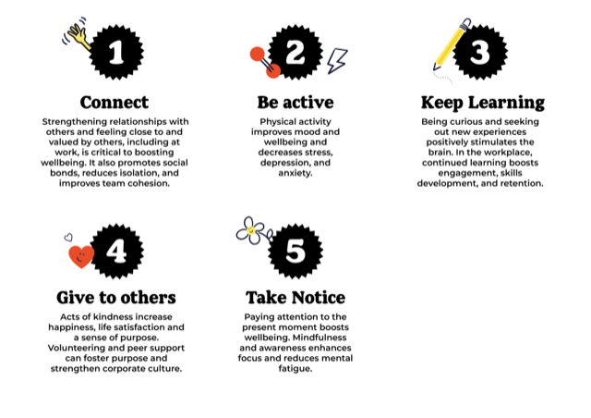
Business Case

Slide 3
Our aims and objectives
Aim
To increase the awareness and engagement of our staff in the 5 ways to Feel Good campaign
Objective
Enhance the mental and physical wellbeing of staff, by achieving a xx% participation in the 5WTFG campaign by the end of Q2

Slide 4

Action Plan
Who:
Where:
When
What:
How do we measure success?
The 5 ways to Feel Good is a proven method. It also takes a positive approach to mental health

Slide 5
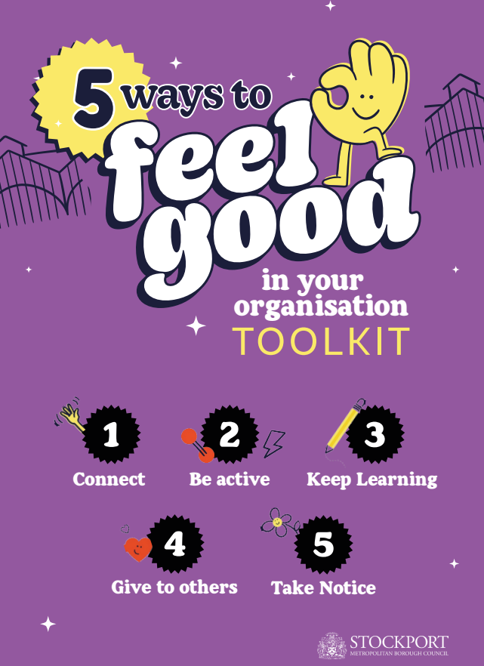
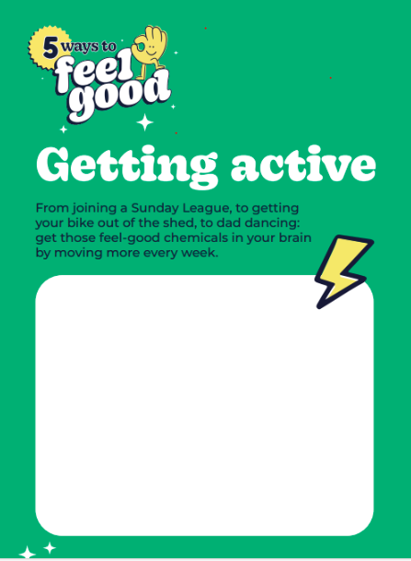

Online resources - Everything ready to deliver to staff
  Toolkit
  Templates
  Videos
  Digital assets
  Customisable posters, flyers and more
  Loan pop up stall for launch event
  Signposting to further resources for Mental Health Support

Slide 6
Ideas
Walking challenge/Walking meetings
Planned PR at key milestones
Staff spotlights
5 Ways to Feel Good launch, pop-up activities & events
Pledges
Internal promotion
Giveaways & competitions
Gratitude Wall
Staff surveys

Slide 7
Timeframes
START - Jan/ Week 1
Feb/Week 2
March/ Week 3
April/ Week 4

Slide 8
Questions

