Slide 1
Data Storytelling for Communities Contando historias con los datos de sus comunidades
CPHE Retreat October 2019 Retiro de CPHE – octubre 2019

Slide 2
Goals for today:
Objetivos para hoy:
UNDERSTAND why data storytelling is important & how to effectively communicate your story
HEAR & ENGAGE with evaluation data (Community Science)
….
Leave with a template for bringing you’re the story back to your community!
ENTENDER por qué contar historias con los datos es importante y cómo comunicar eficazmente su historia
ESCUCHAR E INTERACTUAR con los datos de la evaluación (Community Science)
….
¡Irnos con un modelo para llevar la historia a sus comunidades!

Slide 3
WHY is data storytelling important? ¿POR QUÉ es importante contar historias con datos?
“People will forget what you said, people will forget what you did, but people will never forget how you made them feel.” ~ Maya Angelou
“Las personas se olvidarán de lo que les dijiste, las personas se olvidarán de lo que hiciste, pero las personas nunca se olvidarán de cómo las hiciste sentir”.
~ Maya Angelou

Slide 4

Storytelling Science
La ciencia de contar historias
During intense moments, the stress hormone cortisol helps us focus
Durante momentos intensos, la hormona del estrés, cortisol, nos ayuda a enfocarnos
Sweet moments release the “feel good” chemical oxytocin which promotes empathy
Los momentos agradables liberan la hormona oxitocina que promueve la empatía
Happy endings stimulate the brain’s reward system, which releases dopamine, leaving us with the feeling of hope
Los finales felices estimulan el sistema cerebral de las recompensas, el cual libera dopamina y nos hace sentir esperanza
Notes:
(2 mins)
https://medium.com/@darmenab/in-2017-narrative-intelligence-will-be-your-edge-over-artificial-intelligence-d978e9427c35
For thousands of years, storytelling has been an integral part of our humanity. Even in our digital age, stories continue to appeal to us just as much as they did to our ancient ancestors. Stories play a vibrant role in our daily lives—from the entertainment we consume to the experiences we share with others to what we conjure up in our dreams.
Neuroeconomist Paul Zak has done extensive research on the types of hormones released during stories. During intense moments, the stress hormone cortisol helps us focus. Sweet moments of a story release the “feel good” chemical, Oxytocin, which promoted empathy. Oxytocin gives you that feeling of connection and empathy. Happy endings stimulate the brain’s reward system, the limbic system, which release dopamine, leaving us with the feeling of hope.
For some people, crafting a story around the data may seem like an unnecessary, time-consuming effort. They may feel the facts are enough to stand on their own, or they may believe facts alone should influence the right decisions and drive action. Unfortunately, this point of view is based on the assumption that decisions are based solely on logic and reason, which we know they are not.

Slide 5

Andy Goodman : Storytelling as a Best Practice
Contando historias como la práctica más eficaz
https://youtu.be/P_x6i2RTZes?t=83
Notes:
https://youtu.be/P_x6i2RTZes?t=83
Starts at 1:23

Slide 6
How to Effectively Communicate Your Story Cómo comunicar eficazmente tu historia

Slide 7

¿Cuál es su historia?
Notes:
So What Is a Good Story?
• A good story or movie involves characters
• Challenge is believable • There are hurdles to overcome • Outcome or prognosis is clear
Memorability: A study by Stanford professor Chip Heath (Made to Stick author) found 63% could remember stories, but only 5% could remember a single statistic.

Slide 8
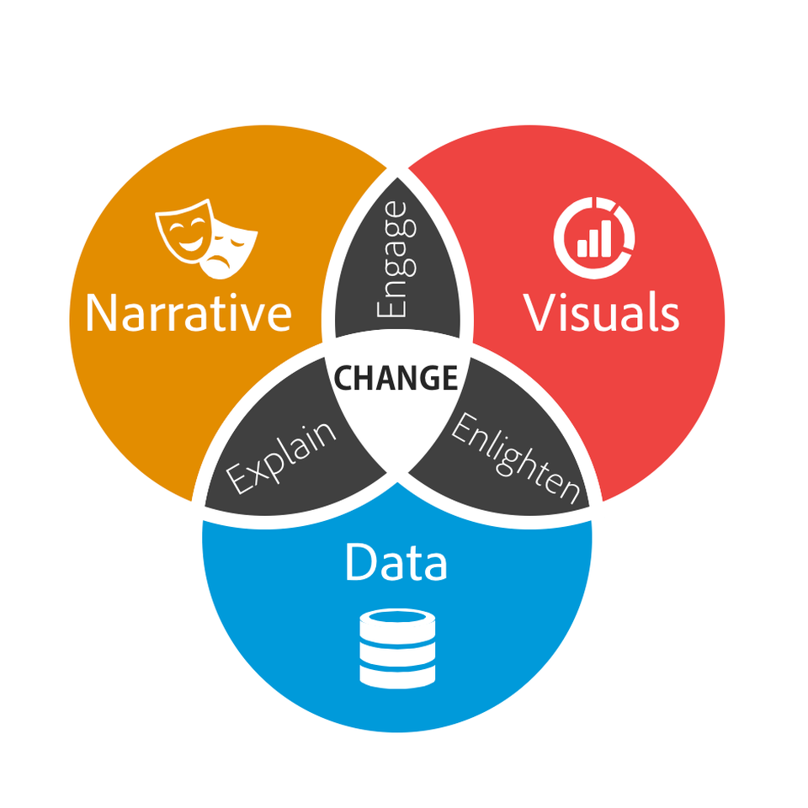
+
+
=
Datos
Narrativa
Imágenes
Data Storytelling
Contando historias con datos
Notes:
Data storytelling is defined as “a structured approach for communicating data insights, and it involves a combination of three key elements: data, visuals, and narrative.”
The key is combining data plus narrative to explain to your audience what’s happening in the numbers and why it’s important. Adding visuals only enlightens the insights, highlighting things that might be difficult to see otherwise.
Start engaging your executive team and explaining your strategies and results more powerfully by approaching your assignment as a story. You will need the “what” of your story (the facts and data) but you also need the “who?”, the “how?”, the “why?” and the often missed “so what?”. It’s these story elements that will make your data relevant and tangible for your audience. Creating a good story can aid you and senior management in focusing on what is important.
Make sense and order • See the whole where there disparate parts • Give vision to what the future can look like • Interactive—people put themselves into stories • Make your job easier
It’s important to understand how these different pieces work together in data storytelling…

Slide 9

Datos
Narrativa
When narrative is coupled with data, it helps explain to your audience what’s happening in the data and why a particular insight is important.
Cuando se usa la narrativa junto con los datos, eso ayuda a explicarle a su audiencia lo que está pasando en los datos y por qué un conocimiento en particular es importante.
Notes:
It’s important to understand how these different pieces work together in data storytelling…
When narrative is coupled with data, it helps explain to your audience what’s happening in the data and why a particular insight is important.

Slide 10
Datos
Imágenes
When visuals are applied to data, they can enlighten the audience to insights that they wouldn’t see without charts or graphs, and help to build out context, help the audience see themselves or specific characters within the data.
Cuando las imágenes se aplican a los datos, pueden aclararle a la audiencia aquellos conocimientos que no podría ver sin las gráficas y ayudarla a aumentar el contexto; ayudan a la audiencia a ver por sí misma o a ver ciertos caracteres dentro de los datos.
Notes:
It’s important to understand how these different pieces work together in data storytelling…
When visuals are applied to data, they can enlighten the audience to insights that they wouldn’t see without charts or graphs, and help to build out context, help the audience see themselves or specific characters within the data

Slide 11
Narrativa
Imágenes
When narrative and visuals are merged together, they can engage or even entertain an audience.
Cuando la narrativa y las imágenes se combinan, pueden generar interés o hasta entretener a una audiencia.
Notes:
It’s important to understand how these different pieces work together in data storytelling…
When narrative and visuals are merged together, they can engage or even entertain an audience. It’s no surprise we collectively spend billions of dollars each year at the movies to immerse ourselves in different lives, worlds, and adventures.

Slide 12
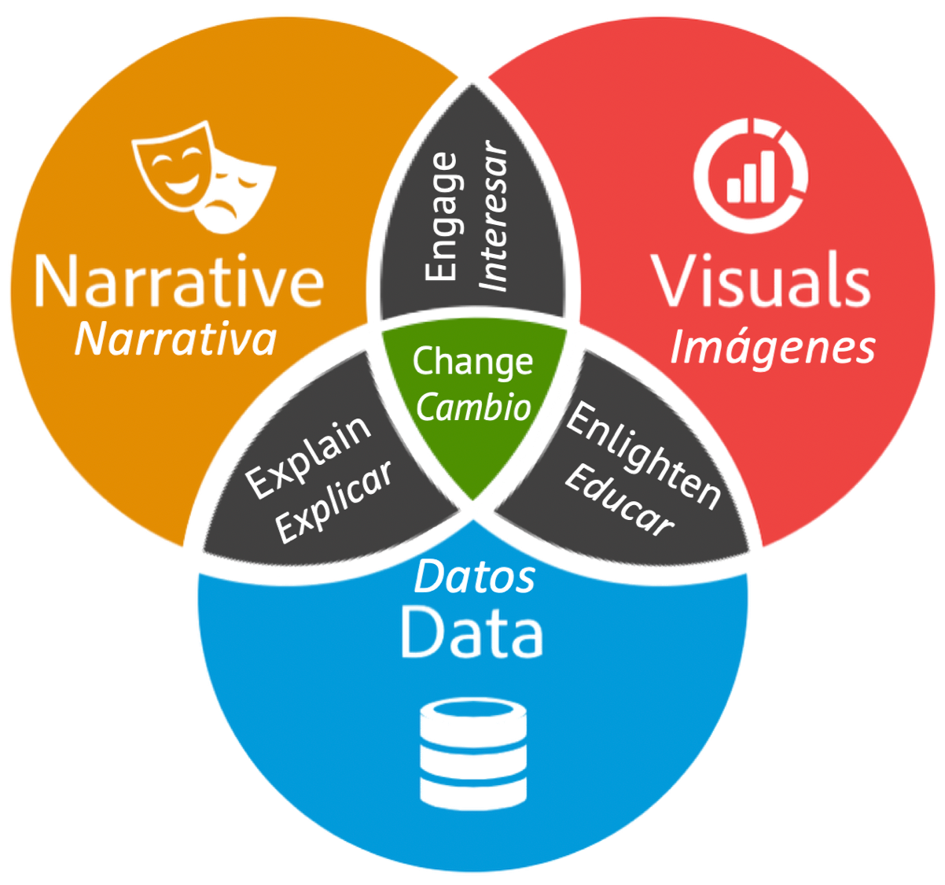
When you combine the right visuals and narrative with the right data, you have a data story that can influence and drive change.
Cuando combinas las imágenes correctas y la narrativa con los datos correctos, tienes una historia con datos que pueden influir y promover cambios.
Notes:
And altogether, when you combine the right visuals and narrative with the right data, you have a data story that can influence and drive change.
The key is combining data plus narrative to explain to your audience what’s happening in the numbers and why it’s important.

Slide 13
BREAK – MACRO EVALUATION PRESENTATION DESCANSO – PRESENTACIÓN DE LA MACROEVALUACIÓN

Slide 14
Five Beat Story Structure
Estructura de la historia en 5 pasos
1.
2.
3.
4.
5.
Introduction / Introducción
STORY
HISTORIA
Incident / Evento
Rising Action / Inspiracion para actuar
Climax / Punto culminante
Transformation /Transformación
Notes:
Set-Up: What is the main character’s situation or perspective with regard to this story. Set a story with important details that place the main character in a time, place and emotional state. Use sensory and emotional details to bring the audience into that emotional and physical space as much as possible.
Inciting Incident: something happens that impacts the main character’s situation or perspective, and he/she must respond. A game-changing moment, an upset to the status quo, an unexpected turn of events. Bring immediacy — using imagery and sensory details to this part of the story as much as possible.
Rising Action: as a result of the inciting incident, the main character makes some choices, which have consequences, and impact the main character.
Climax: The rising action leads to a turning point — the emotional tension rises to a heightened intensity, possibly a breakthrough moment, a low point that forces a redirection or a high point that lights the way.
Transformation: Where this emotional journey takes the main character. What is changed as a result of having gone through this process? A shift in perspective, a letting go of an old role or belief, taking up a new approach or behavior.
https://99u.adobe.com/articles/17652/the-five-beats-of-successful-storytelling-how-it-can-help-you-land-your-next-job

Slide 15
Using Data Storytelling Tools to Communicate Your Story to the Community Usando herramientas para contar historias con datos y comunicar su historia en la comunidad

Slide 16
Notes:
Today we received a lot of great data from Community Science about each of your communities. Our hope is that you can use that data as the foundation for your Data Storytelling, and bring this great news back to your community and partners. The more thoroughly you can explore your data, the more likely you’ll find the dramatic insights that make for a great story.
Then, we’ll give you some tools to think about how you add in the narrative and visuals, and give you time to work on that today so that you walk away with a fairly fleshed out data storytelling plan to bring back to your community.

Slide 17
Some Best Practices in Data Storytelling Algunas prácticas más eficaces para contar historias con datos

Slide 18
Be authentic… Your story will flow Sean auténticos... La historia sonará más natural
Make it personal, make it emotional
Personalícensela, transmitan emoción/sentimiento
Make it easy for your audience and you
Hagan que sea fácil tanto para su audiencia como para ustedes
Be simple and direct. Stick to 2-3 key issues, which makes it easier for your audience to take action.
Hablen con sencillas y sean directos. Enfóquense en 2 o 3 asuntos, lo cual facilita que su audiencia pueda actuar.
Source / Fuente: https://www.tableau.com/sites/default/files/whitepapers/whitepaper_best-practices_telling_great_stories.pdf
Notes:
Your audience wants to connect with you, they want you to be memorable and real. Remember, they have probably heard or read too many lengthy, boring and downright fabricated presentations and documents. So be yourself and be true to your story.
To best capture your audience’s attention, consider how you can take a data fact and make it personal, relatable and—if you’re lucky—emotional. Is there a metaphor or anecdote to make the data more memorable and specific? This will help them take notice. Does your audience like competitive sports? Then try use a sailing analogy. Again, this will help your audience connect to your message.
Take your story and develop it with data. Authenticity is rooted in facts. Facts are rooted in data. Since you’ve already reached them personally and captured their attention with a metaphor, now is the time to selectively present core facts and data that prove your point.
Story-telling makes the process of communication easier. Your audience will recall the key message and can act on it. Of course, this means that you haven’t buried them in too many issues and stories. Multiple stories within one overall presentation or document are fine but realize that the human brain typically cannot hold more than three to five major facts or concepts. If you’re also asking people to analyze information on the fly and draw their own conclusions, you are likely requiring your audience to jump through too many hoops. In the end, you risk losing them. Being simple and direct will take you much further.

Slide 19
Think of your evaluation data as a story – Use a story structure Piensen sobre los datos de su evaluación como una historia. Usen una estructura.
Find the story first: explore the data
Primero encuentren la historia: exploren los datos
Determine what you want people to do as a result
Determinen lo que quieren que las personas hagan como resultado
Invite and direct discussion
Inviten a y guíen la plática
Extend the story into questions
Extiendan la historia para que surjan preguntas
Invite them to continue the discussion
Inviten a su audiencia a continuar la plática
Notes:
Using the data and your key dramatic insights as the core story, you can then craft other story elements around this - define your characters, understand the challenge, identify the hurdles.
Make sure you are clear with what you want people to do as a result. This will shape how your audience will recall your story. In the case of many of your communities – it may be that you want your community to reinvigorate their momentum and motivation for this work; it may be that you want a community partner to see the early results of your work and join as a funder or more involved partner. It may be that you want your Mayor or another key decision-maker to see the results of your early work and join in with resources and engagement. Think about this ahead of time and frame your story accordingly.
Once all these elements are in place, write out the storyboard - we’ll be giving you a handout that provides a structure for you on this. Although it’s tempting to skip to this step, it is better first to understand the story you are telling and then to focus on the presentation structure and form.
Give your audience the tools they need to talk about and advance your story. This includes reminding them and directing them to your key points. Extend the story into questions. Be sure and suggest means of continuing communication after you’ve left your audience or once the presentation is finished. Technology makes this easy with blogs, discussion groups, intranets and many other choices. F

Slide 20
Resources: Creating Data Visualizations
Recursos: Creando visualizaciones con datos
Excel, Google Charts or Google Sheets
Infogr.am - https://infogram.com
Timeline JS - https://timeline.knightlab.com
Storymap – https://storymap.knightlab.com
Piktochart – https://piktochart.com
Hubspot – https://hubspot.com
STORYTELLING: A Tool for Health Advocacy (The Colorado Trust)
https://www.coloradotrust.org/sites/default/files/PHC_IssueBrief_070214_FINAL.pdf
Notes:
Infogr.am
Price: Free for Basic. Paid packages fall into three categories: Pro $19/month, Business $67/month, and Team $119/month.
Infographics are a great way to interpret your data by turning it into something that tells a visual, memorable story.
If you have little to no design experience, Infogr.am is a great tool for you. It offers different infographic templates and tools for customizing your infographic. You can use charts, graphs, maps, images, and icons to really spice up your data and make it visually appealing.
Timeline JS
Price: Free
One type of data visual that often gets overlooked: timelines. They're a great way to display your data by looking at changes or events over time.
While you could design a timeline on various graphic design platforms such as Illustrator, this free tool makes it easy to create slideshow-based timelines to embed on your website or blog.
Piktochart
Price: Free lifetime account. Paid options are offered at two levels: Lite $15/month & Pro $29/month.
A similar tool to Infogr.am, Piktochart makes it easy for you to create and customize infographics within its templates. This tool is meant for users with little design experience who want to create awesome infographics.
Note: If you’re going to be using one of these two tools often, try using them in combination with one another. That will give you access to more templates, which you can use to vary your content.

Slide 21





Change Matrix
Alina Taniuchi
Kazzandra Medellin
Kristin Lacy
Rachele Espiritu
Sandra Silva
Contact Information/ Información de contacto: klacy@changematrix.org or/o https://public.3.basecamp.com/p/D6L49ou5xCtou3tb4pcnTeuX

